Slide 1

SCAM
Scam Call Analysis Monitoring System
Hackathon 2024
Presented by:
Team Capybara Pay2Win

Slide 2



Problem Statement
Proposed Solution
Financial scams and fraud cost consumers and institutions millions annually.
Current measures lack real-time, coordinated fraud detection.
Integration across banks, telcos, and governments is insufficient.
Introduces an Open Finance Framework for collaborative fraud prevention.
Connects banks, telcos, governments to share scam information.
Detect Incoming Calls
Real time Call Transcription & Scam Classification
Alert User and Hold Suspicious Transactions
Self Learning Machine using NLP

Slide 3
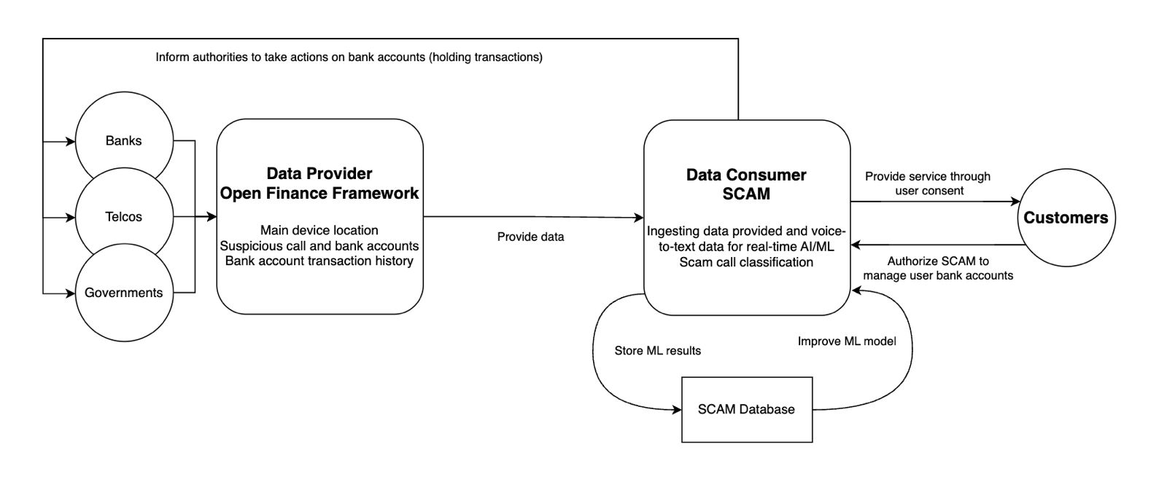
Open Finance
Notes:
Follows Open Finance Principles:
Data Sharing: It allows banks, telcos, and governments to share data securely.
Customer-Centric: It involves customers authorizing services to take action on their behalf.
Unification: It connects multiple stakeholders in a unified framework.

Slide 4

Demo of Proposed Solution:
{SCAM} Python

Slide 5

Business Value
Reduce Fraud Loss
The service help banks save money that would be lost due to fraud transaction.
E.g., prevents RM1mil in fraud monthly for a bank, then RM20k they spend on API is a highly cost-effective investment.
Data Insights & Analytics
Delivers actionable insights on fraud trends and tactics as added value.
Helps businesses stay ahead of threats.
User Trust
Proactive fraud prevention builds trust with customers, enhance the credibility in the Open Finance ecosystem.

Slide 6
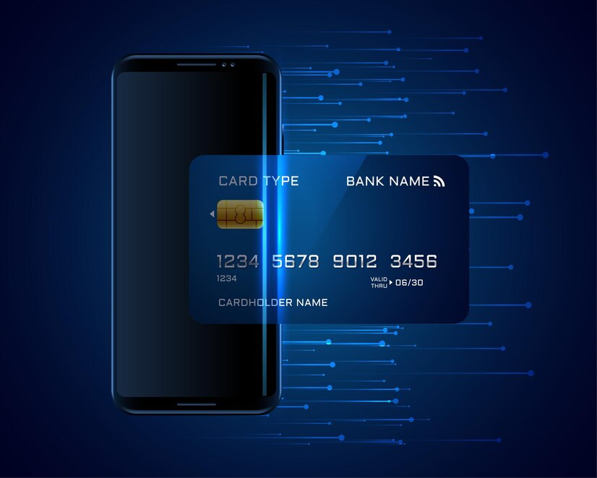
Thank
You
Prepared by: Capybara Pay2Win

Slide 7




Project Features
Autodetection
Auto detect and alert for potential fraud activities
Auto Data Collection
Auto voice, text, data collection without violating user privacy
User Privacy Agreement
Ensuring user aware of data collected
B2B Business Partnerships
Working with banks, platforms for scam transactions

Slide 8
Pricing Strategy
Tier 1 Revenue:
Total Requests: 50,000
Price per Request: RM0.10
Revenue: 50,000 × RM0.10
= RM5,000
Tier 2 Revenue:
Total Requests: 250,000
Price per Request: RM0.08
Revenue: 250,000 × RM0.08 = RM20,000
Tier 3 Revenue:
Total Requests: 200,000
Price per Request: RM0.05
Revenue: 200,000 × RM0.05 = RM10,000
Total Monthly Revenue
= RM35,000 ~ RM50,000
Offer multiple tiers with decreasing costs as volume increases.
It can be adjusted based on the amount of phone numbers monitored.
Tiered Pricing Model
Tier | Volume Range (Requests) | Price per Request | Cost
1 | 0–1,000 | RM0.10 | RM20
2 | 1,001–10,000 | RM0.08 | RM64 for 1,000 requests
3 | 10,001+ | RM0.05 | RM500 for 10,000 requests

Slide 9
Privacy Concerns
User Consent and PDPA Compliance:
Incorporate user consents into your system to ensure compliance with PDPA:
Explicit Consent for Data Collection:
- Specify the types of data collected (e.g., call metadata, voice transcripts).
Purpose Limitation:
Clearly state that the collected data will only be used for fraud detection and scam prevention.
Right to Withdraw Consent
Granular Permissions :
(User-Controlled Privacy Settings)
Offer options that empower users to control their privacy preferences:
Monitor All Calls (Full Coverage)
Monitor Only Calls from Unknown Numbers (Privacy-Focused)
Consent to Voice-to-Text Analysis:
Explicit consent for converting call content into text for scam classification.

