Slide 1

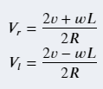
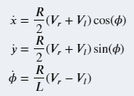
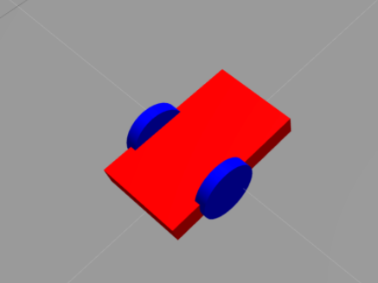
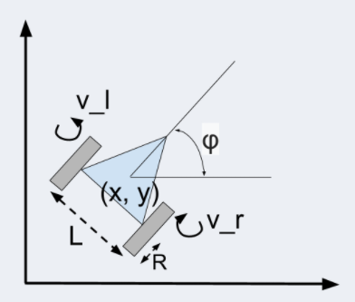

Slide 2
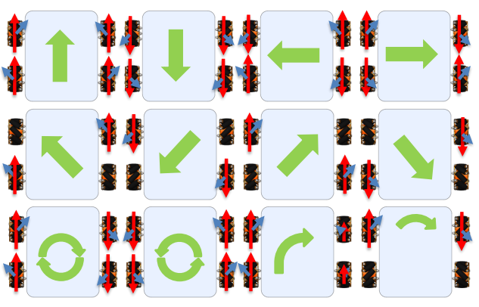
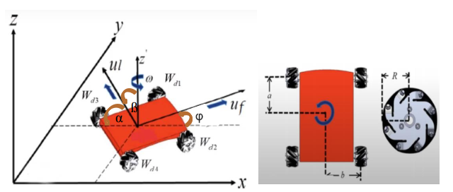

Slide 3
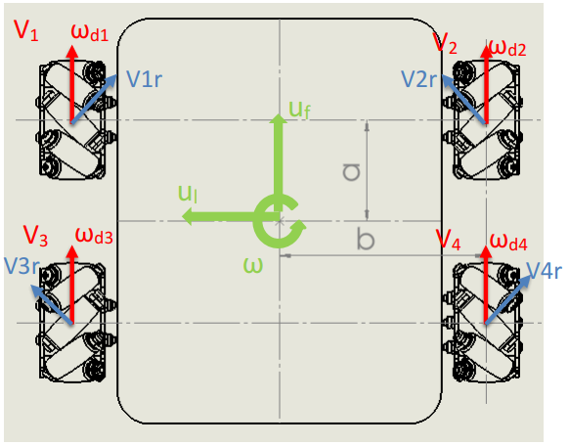
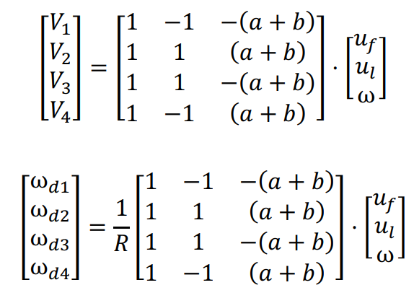
M1-A
M2-B
M3-C
M4-D

Slide 4

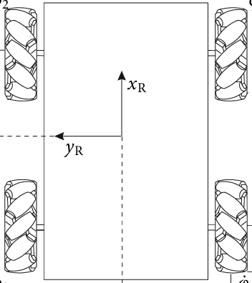
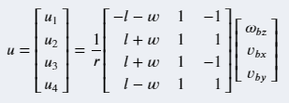
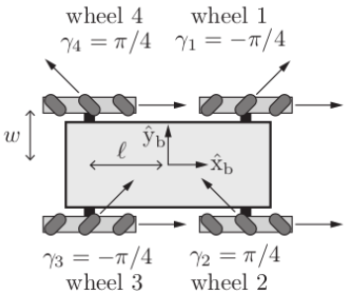
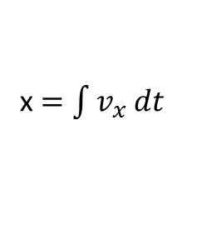
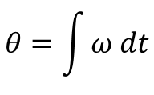
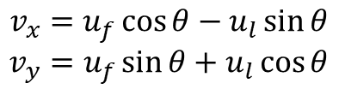
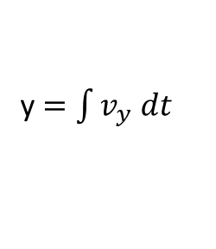
u_{f}
y
$$θ=\int{ω dt}$$
θ
u_{l}
θ
$$v_{x}=u_{f}\cos{θ−u_{l}\sin{θ}}$$
$$v_{y}=u_{f}\sin{θ+u_{l}\cos{θ}}$$
x $=\int{v_{x} dt}$
y $=\int{v_{y} dt}$
x

Slide 5
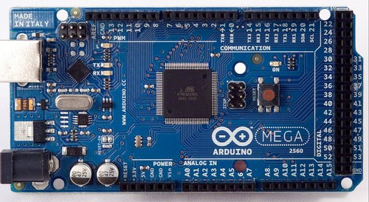
/pen_ orientation
/serial_node
std_msgs/Float32MultiArray
/pen_position
std_msgs/Bool
/pen_ open
std_msgs/Bool

Slide 6
/scan
/raspicam_node
Node
sensor_msgs/Image
/scan
/ydlidar_node
Node
sensor_msgs/LaserScan
Node
/cmd_vel
/rUBot_nav
/serial_node
geometry_msgs/Twist
/odom
nav_msgs/Odometry

