Slide 1
Master Pages
Notes:
MIS 324 -- Professor Sandvig

Slide 2
Outline
Why Master Pages?
Syntax
Example
Notes:
MIS 324 -- Professor Sandvig

Slide 3
Benefits of Master Pages
Create a template for site layout
  Defined in one place, rather than each page
Include “Placeholders” for page-specific content
Individual pages inherit layout from master
Eliminates last place where code was duplicated
Notes:
MIS 324 -- Professor Sandvig

Slide 4
Syntax
Create master page
  .master extension
  Directive: <%@ master %>
  Include common content
    headers, footers, menus, layout, etc.
  Include placeholder controls for page content
Notes:
MIS 324 -- Professor Sandvig

Slide 5
Syntax
.aspx pages
  Reference master page in page directive
  Include “content” controls
    Provides content
    Map to placeholders in .master page
Notes:
MIS 324 -- Professor Sandvig

Slide 6
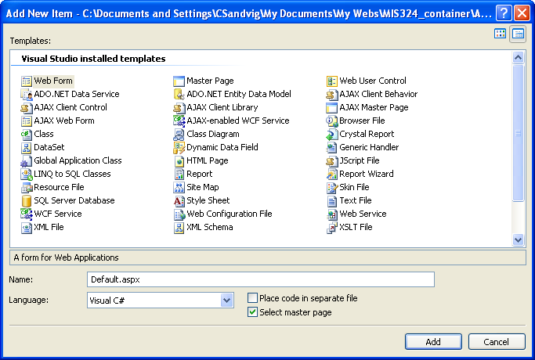
VS Support
Notes:
MIS 324 -- Professor Sandvig

Slide 7
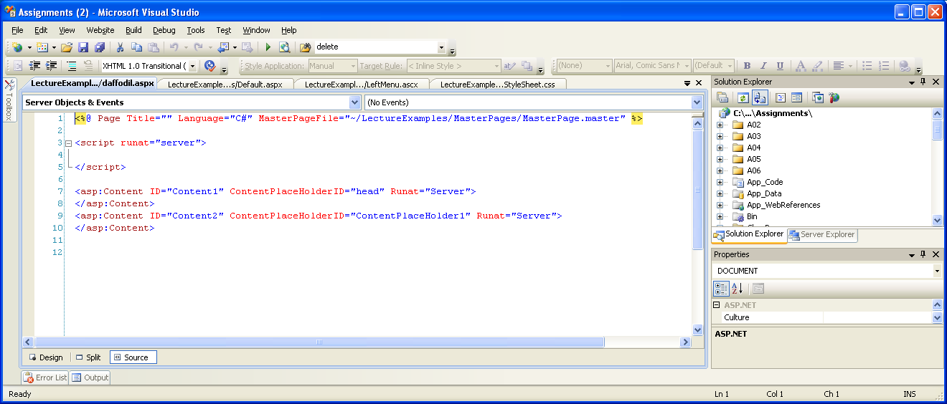
VS Support
Notes:
MIS 324 -- Professor Sandvig

Slide 8
Syntax
Default Content
  Include in master page
  Used when .aspx page does not provide content.
  Example:
    Florist: default.aspx
    Source: masterPage.master.txt, daisy.aspx.txt
Notes:
MIS 324 -- Professor Sandvig

Slide 9
MasterPages: Other Features
Nesting
  Sub-masters inherit from .master
  Add more placeholders
Programmatic access to master page
  Change items from .aspx page
    meta tags
    style sheet …
Navigation Controls
  Extensive integration with MasterPages
    Page titles, formatting, etc.
Example: ISC web site
Notes:
MIS 324 -- Professor Sandvig

Slide 10
Summary
Master Pages
  Easy to use
  Reduce site maintenance
  Use on all new sites
Notes:
MIS 324 -- Professor Sandvig

