Slide 1
Claims Email Triage POC: Results and Next Steps
Fabrikam Insurance · Contoso Consulting
October 22, 2026

Slide 2
AI triage met 4 of 5 success criteria and cut handling time from 6 minutes to 41 seconds per email
We recommend an 8-week pilot on the Motor inbox, with a fix for scanned claim forms.
92.5%
41 s
88.2%
of emails routed to the right team, against a 90% target
to handle an email with a handler checking, down from 6 min 10 s
of claimed amounts read correctly, short of the 95% target because of scanned forms
Source: POC test on 600 anonymized emails from January to June 2026. Time study with 3 handlers, 150 emails.
Contoso Consulting · Confidential
2
Notes:
Start with the answer. It routes emails and reads policy numbers well enough, and handlers get through an email in well under a minute. Say the miss on claimed amounts out loud now, so nobody finds it on slide 5 and wonders what else we left out.

Slide 3
Your intake team spends about 30 hours a day reading and routing claim emails
300 claim emails a day, each read by one of the 4 people on Maria's team
6 min 10 s per email to find the claim type, policy number, and amount, type them in, and forward it
Up to 2 days of backlog in storm weeks, when customers call to ask if their claim arrived
The question for the POC: can AI do the first read well enough that a handler only has to check it?
Source: Fabrikam time study, March 2026.
Contoso Consulting · Confidential
3
Notes:
These are Fabrikam's own numbers, from their March time study, not ours. Let Maria add to this if she wants.

Slide 4
The AI reads each email and suggests where it goes; a handler checks every suggestion
Email arrives in the claims inbox
AI reads the email and its attachments
Suggests team, policy number, and amount, and says why
Handler accepts or changes it
Tested on 600 past emails from January to June 2026, anonymized by Fabrikam IT: 540 in English, 60 in Spanish
Customer data stayed in Fabrikam's Azure tenant. Azure OpenAI in East US 2, signed off by Raj on September 30, before any emails were loaded
Not connected to live email or ClaimsHub yet. That was out of scope for the POC
Contoso Consulting · Confidential
4
Notes:
Keep this one short. The point for Dana is that nothing goes out without a handler checking it. The point for Raj is the data line: he reviewed the setup himself, so hand it to him if there are questions.

Slide 5
Four of five criteria met; claimed amounts fell short at 88.2%
Criterion | Target | Result | Status
Routed to the right team | ≥ 90% | 92.5% (555 of 600) | Met
Policy number read correctly | ≥ 95% | 97.8% (587 of 600) | Met
Claimed amount read correctly | ≥ 95% | 88.2% (300 of 340) | Not met
Handling time, with a handler checking | < 1 min | 41 s on average, from 6 min 10 s | Met
Customer data stays in Fabrikam's tenant | Required | Signed off by Raj, September 30 | Met
Source: POC test on 600 anonymized emails labeled by Fabrikam's intake team. Claimed amount: the 340 emails that state one.
Contoso Consulting · Confidential
5
Notes:
These are the five criteria we agreed with Dana and Raj at kickoff, unchanged. For claimed amounts, the count is out of 340 because only 340 emails state an amount. If asked about routing by claim type, it's in the appendix.

Slide 6
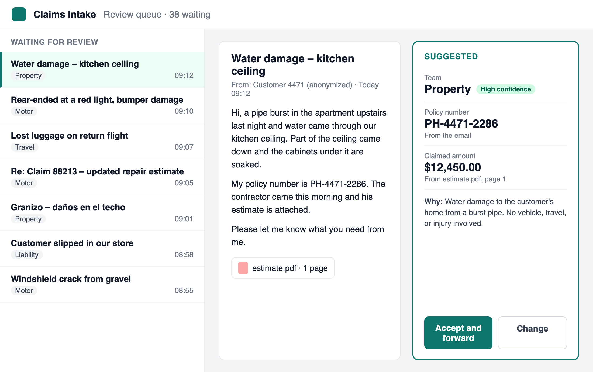
With the suggestion and its reason next to the email, handlers took 41 seconds instead of 6 minutes
41 s per email on average across 150 emails, median 33 s
Handlers changed the suggested team on 11 of 150
The "Why" line is what two handlers said made them trust the suggestions
The review screen from the time study
Contoso Consulting · Confidential
6
Notes:
This is the screen Maria's team used in the time study. Point at the Why line: Maria worried at kickoff that handlers would stop trusting a tool that's confidently wrong, and this is the answer to that.

Slide 7
Two gaps to fix before going live: scanned claim forms and Spanish emails
Scanned claim forms
Spanish emails
29 of the 40 claimed-amount misses were scanned or handwritten forms
The other 11 had more than one amount, or a range
Fix: add OCR (Azure AI Document Intelligence) before the AI reads them, then retest
75.0% routed to the right team, against 94.4% for English
Only 60 Spanish emails in the test set
Fix: label 200 more Spanish emails, then retest
Contoso Consulting · Confidential
7
Notes:
Both fixes are in the pilot plan, and both get retested before anything goes live. Don't promise a number for the retest: we'll know after the pilot.

Slide 8
An 8-week pilot on the Motor inbox, then rollout to all claim types
Phase 1: Pilot, 8 weeks
Phase 2: Rollout, 10–12 weeks
What Fabrikam provides
Motor inbox only, about 43% of claim emails
Handlers check every suggestion
Add the OCR and Spanish fixes, then retest
Done when all five criteria hold on live email for 4 weeks in a row
$85,000 fixed fee
All claim types
Confirmed fields go straight into ClaimsHub, so nobody types them in
A dashboard for accuracy and volume
$140,000–180,000, firmed up after the pilot
IT: about 2 days a week from Raj's team, for mailbox access and Azure
Claims: 2 handlers, about 3 hours a week each, for feedback
Running cost: about $900 a year in Azure OpenAI usage at today's volume, plus OCR
Contoso Consulting · Confidential
8
Notes:
Phase 2 is an estimate, and we'll firm it up after the pilot. Say that plainly. Running cost: 300 emails a day, 250 working days, $0.012 each. OCR adds about a cent per scanned page, and we'll know the yearly total after the pilot.

Slide 9
We need a go on the pilot by November 13 to start December 1 with the same team
Dana: approve the 8-week pilot ($85,000) by November 13
Raj: set up mailbox access through Microsoft Graph before December 1
Maria: name 2 handlers for the pilot before December 1
Contoso: start the pilot on December 1
Contoso Consulting · Confidential
9
Notes:
End on the ask and stop talking. If they need more time, say why the date matters: Wei, who built the POC, moves to another project on December 15 if the pilot hasn't started.

Slide 10
Appendix

Slide 11
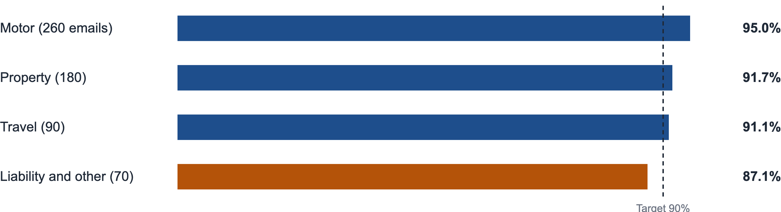
Routing held above 90% for every claim type except Liability, at 87.1%
Most Liability misses were injury emails that mention a car, which went to Motor.
Source: POC test on 600 anonymized emails from January to June 2026. Bars run from 0 to 100%.
Contoso Consulting · Confidential
11
Notes:
Only if asked. Motor, where the pilot starts, has the best routing of the four.

