Slide 1




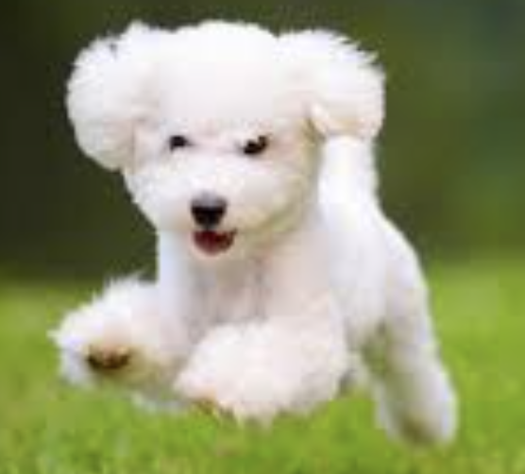


Federated Learning Algorithms
Evaluation Protocols
FedAvg
FedProx
FedOTP
…
Global model performance
Personalized model performance
Base-to-novel class generalization
Few-shot learning
Cross domain generalization
…
Server
Predefined Models
...
...
CLIP
Client 1
Client i
Client N
Image encoder: RN50, RN101, ViT-B/16, ViT-B/32…
Text encoder: Transformer-63M
Predefined Datasets
Prompt Learning Algorithms
Generic Image Recognition
CoOp
CoCoOp
ProDA
ProGrad
PLOT
SRC
KgCoOp
…
Text
Encoder
Text feature
Caltech101
ImageNet
…
🔥
$$v_{1}$$ | $$v_{2}$$ | $$…$$ | $$v_{m}$$
class
❄️
prompt
Fine-grained Image Recognition
Image
Encoder
Food-101
FGVC Aircraft
…
Client Data
❄️
Predictions
Image feature
Cross Domain Generalization
DomainNet
ImageNet-A(dvarsarial)
…
🔥
Learnable
❄️
Frozen
$$v_{i}$$
Context vectors
class
Class embeddings
Similarity
Transmitted

