Slide 1




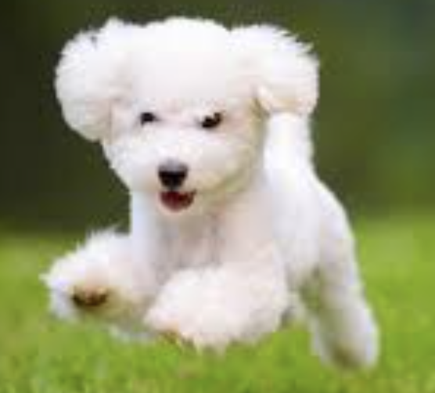


Server
...
...
Client 1
Client i
Client N
Text
Encoder
Text feature
🔥
$$v_{1}$$ | $$v_{2}$$ | $$…$$ | $$v_{m}$$
class
❄️
prompt
Image
Encoder
❄️
Predictions
Image feature
🔥
Learnable
❄️
Frozen
$$v_{i}$$
Context vectors
class
Class embeddings
Similarity
Transmitted

