Slide 1
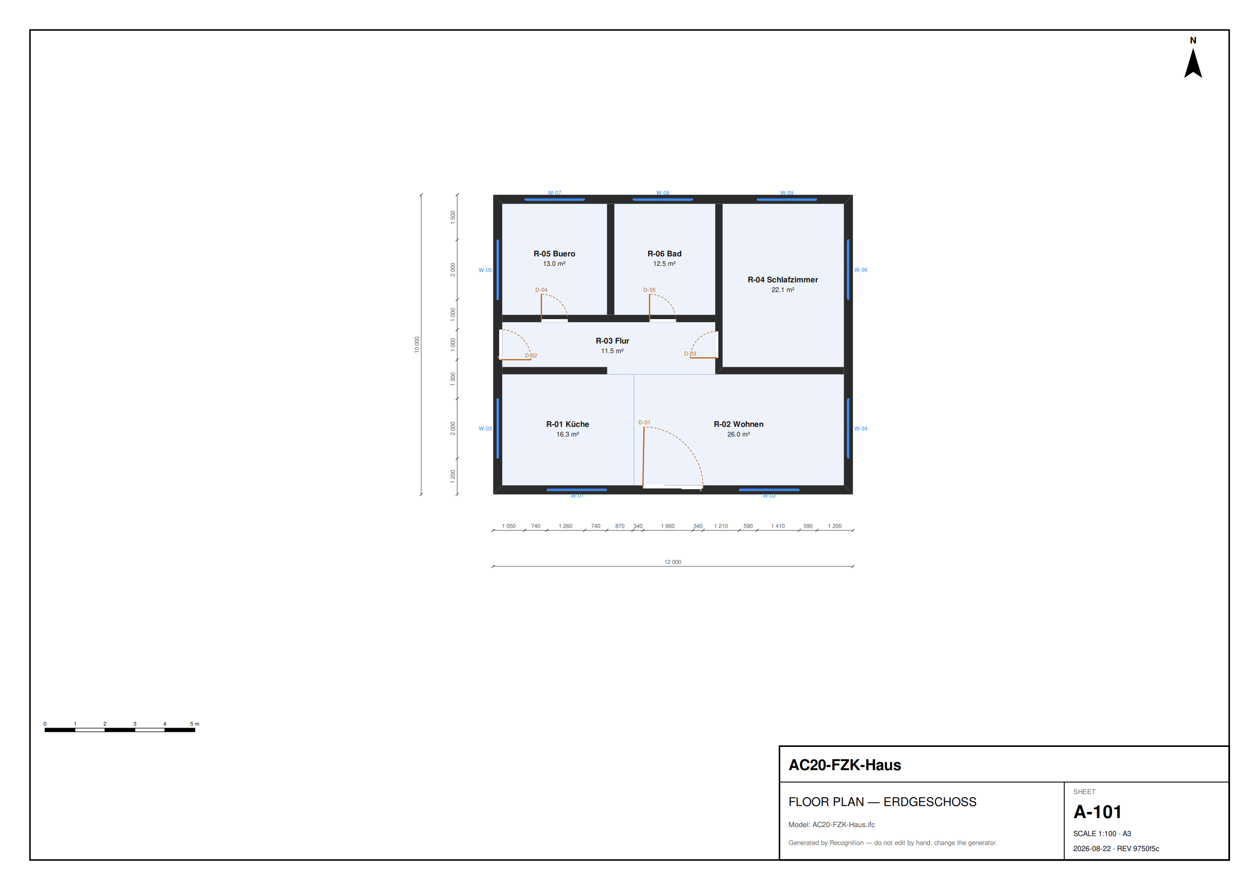
Recognition
your AI architect
Describe a building in plain words. Get four verified blueprints, a 3D model, and files a builder can open — with nobody in the loop between your sentence and the artifacts.
Devin plans it · deterministic code draws it · a cited rule engine verifies it
A-101 · generated by the pipeline, no hand edits
0-uddeshya-0.github.io/Recognition
Notes:
Recognition is an AI architect. You describe a building in plain words; it returns four verified blueprints, a 3D model, and builder-grade files — no human in the loop.

Slide 2
THE PROBLEM
Every industry has an engineering problem
SOFTWARE
ARCHITECTURE
has the loop
had none
write → run → test → fix
draw → submit → wait → find out
Every attempt gets a verdict in seconds, so a wrong answer announces itself — which is exactly why an agent can work unsupervised.
A layout that breaks building code surfaces at permit review or on site — months later. Small practices and their clients wait weeks for a first compliant answer, and every change restarts the wait.
Pick a domain with no way to check the work, and an agent is only guessing.
Notes:
Software improves fast because every attempt gets a verdict. Architecture's work goes out and someone finds out months later whether it was right.

Slide 3
THE INSIGHT
Building code is machine-checkable
Clear heights. Daylight ratios. Door widths. Corridor clearances. Which rooms a dwelling must contain. Every one of them is decidable from a model — an executable predicate, not an opinion.
THE RULEPACK IN FORCE
BayBO Art. 45 (1)
law
clear height ≥ 2.40 m
BayBO Art. 45 (2)
law
glazing ≥ 1/8 of floor
The verdict already existed.
Nothing was sitting inside the loop.
BayBO Art. 46
law
kitchen + bathroom required
BayBO Art. 48 (1)
law
> 2 homes → barrier-free
Recognition is the layer that puts an agent inside it.
DIN 18040-2
standard
1.20 m clear corridor
Richtwerte
guidance
typical room areas
Notes:
Building code is machine-checkable: heights, daylight, door widths, corridor clearance. The feedback loop already exists — nothing was inside it.

Slide 4
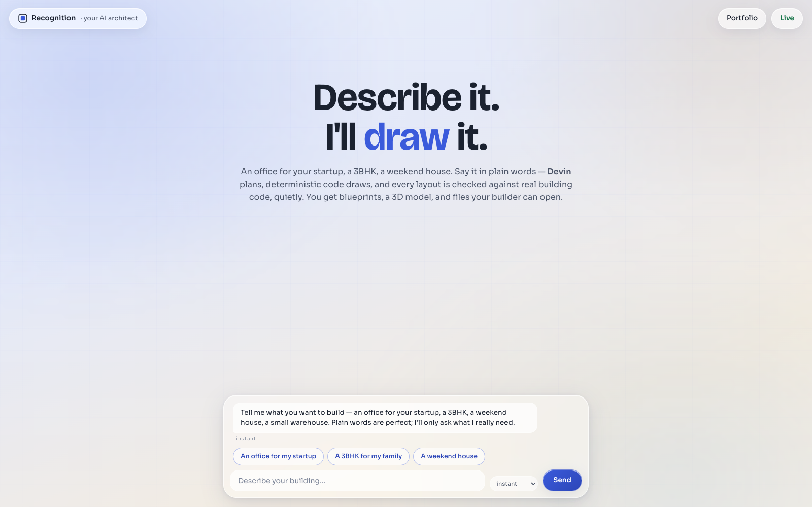
THE PRODUCT
Say it. Choose. Build.
1
Say it
“An office for my startup — 8 of us, an open studio, a meeting room, a small kitchen.” It asks only what it genuinely can't infer.
2
Choose
Four structurally different blueprints come back, dimensioned and already checked. Keep talking and it redrafts.
3
Build
Pick one: the 3D model appears with the plan below it. Archive it and the pipeline verifies, merges itself, and files it.
Live, in the browser — nothing to install, no account, no key.
Notes:
Three moves: say it in plain words, choose from four checked blueprints, build the one you like in 3D. Regulations run underneath, not in your face.

Slide 5
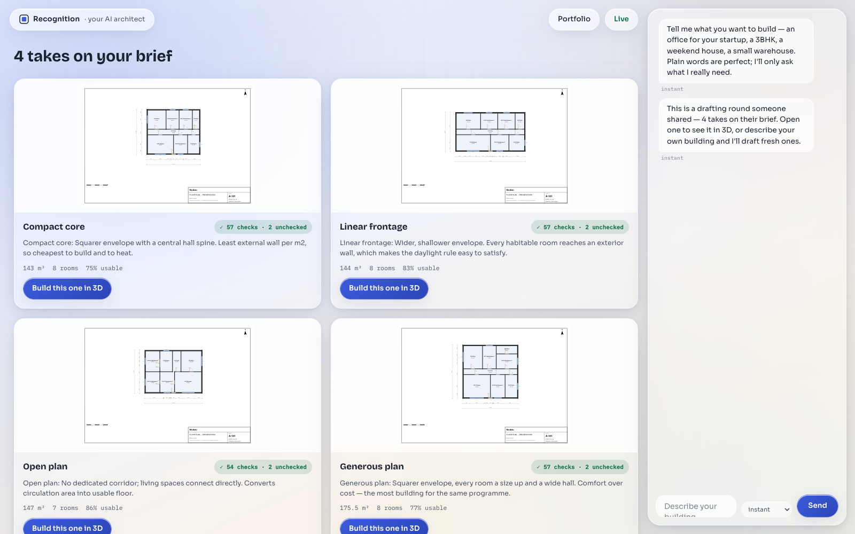
THE DRAFTING ROUND
Four takes — every one already checked
Structurally different
Compact core, linear frontage, open plan, generous — different topologies, not the same plan ±10%.
Quietly verified
Each card carries its own check count. Regulations stay underneath; the citations are one tap away.
Never a bare PASS
What the model can't see is counted and shown, never silently passed.
Notes:
One brief, four structurally different layouts, each verified before you ever see it. Every card shows its own check coverage.

Slide 6
THE THESIS
The model plans. The code draws.
→
→
→
→
Brief
Devin
Translate
Build
Verify
sealed intent
areas + adjacencies
no coordinates
plan → code
0 tokens
IFC4 · sheets · 3D
the only gate
A session cannot fake a pass.
Devin never emits a coordinate and never states a regulation — it returns a typed plan. The IFC model, the drawings and the verdict are produced afterwards by deterministic code it never ran, and judged against a cited ruleset it cannot edit. “I fixed it” is not a claim the system can accept from a model.
Notes:
The whole design is this split: the model plans in relationships and areas; deterministic code turns that into geometry and judges it. That is why the agent can run unsupervised.

Slide 7
WHERE DEVIN DOES THE WORK
Four roles, one autonomous loop
Interviewer
Architect ×4
Reads the client's own words and returns a typed brief — questions only where a rule genuinely needs one, every inferred value registered as an assumption.
Four sessions in parallel, each handed a structurally different strategy. Each returns an ArchitectPlan: rooms, areas, adjacencies. No coordinates.
Critic
Repairer
Reviews the winner for what a checker cannot see — a room you can't furnish, a route that doesn't work. Advisory by construction; it can annotate, never overturn.
A contract error goes back verbatim as the repair prompt. Observed live: one rejection, one repair, clean pass — no human saw it.
Taught by the repo itself: four Agent Skills Devin discovers natively, playbooks per role, structured output enforced at the API, and Fusion-shaped delegation — judgement in the main agent, mechanical verification to the sidekick.
Notes:
Devin is the intelligence in four places: interviewer, four parallel architects, critic, repairer. The repo teaches it with Agent Skills and playbooks.

Slide 8
AUTONOMY — PROVEN, NOT CLAIMED
Trigger to merged artifact, nobody in between
3
2
1
0
Devin sessions
planned in parallel
rejected by the gate
— not by a person
pull request opened and
merged by github-actions
humans in the loop
after the trigger
THE RECORDED RUN · engine=devin · run 32600313272
One workflow_dispatch started three Devin sessions. Each returned a plan; deterministic code built and verified all three; the scorer picked the winner; the workflow opened a pull request and merged it — then deployed the result to the live site.
There is no Approve button anywhere in the product.
Notes:
A real run: four parallel Devin sessions, the gate rejected two, and the workflow opened and merged the winning design itself. No approve step exists.

Slide 9
VERIFICATION
It knows good from bad — and what it cannot know
EVERY RULE CARRIES A TIER AND A CITATION
NO RUN EVER SHOWS A BARE PASS
law
a cited statute article
57 checked · 2 not evaluated · 0 failed
blocks a merge
Smoke detectors and thresholds cannot be judged from a model, so they are reported — never counted as passes. The coverage travels with every verdict.
standard
a DIN norm, once triggered
blocks when in force
guidance
published Richtwerte
never blocks
THE RULES CONFIGURE THEMSELVES
A brief with three homes auto-triggers BayBO Art. 48: DIN 18040-2 becomes mandatory, and the same 1.15 m corridor finding flips from advisory to blocking. Nobody configured that — the rule declares its own trigger.
house
our own convention
never blocks
A rule without a citation fails to load. No model may author one.
Notes:
Tiers and citations decide what may block. Blind spots are declared, never counted as passes. And rules trigger each other: three dwellings make barrier-free mandatory automatically.

Slide 10
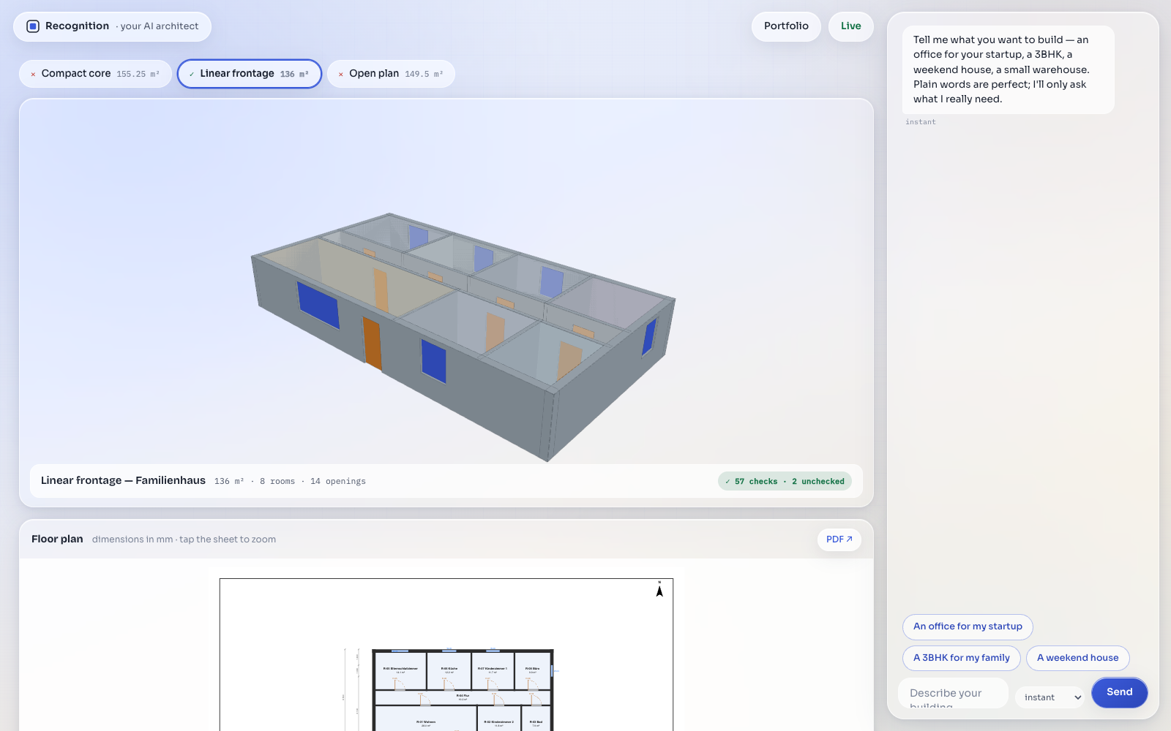
ARTIFACTS
Output an architect can actually use
model.ifc
IFC4 with real IfcSpace / IfcWall / IfcDoor — opens in Revit or ArchiCAD
sheets .dxf
AIA-named layers, millimetres — straight into AutoCAD
sheets .pdf .svg
dimensioned plans with a title block
schedules .csv
room, door and window schedules
verdict.json
every finding with its tier and statute citation
design.py
the building as readable, diffable code
Notes:
Real deliverables: IFC4 that opens in Revit, DXF for AutoCAD, dimensioned PDFs, CSV schedules, and a verdict citing the statute behind every finding.

Slide 11
Find an industry.
Give it an engineer.
TRY IT
0-uddeshya-0.github.io
/Recognition
THE CODE
Architecture had the loop all along — a machine-checkable verdict nobody had put an agent inside. Recognition is that layer, and it runs today: a sentence in, a verified building out.
github.com/0-uddeshya-0
/Recognition
BUILT WITH
Honest limits: v1 designs a single storey, and the cited rulepack is Bayern residential — a workplace is designed gladly and the report says exactly what it could and could not check. A design aid, not a Prüfstatiker.
Devin · IfcOpenShell · Python
Three.js · GitHub Actions
Notes:
Architecture had the loop all along. Recognition is the layer that puts an agent inside it — live today, and honest about what it cannot yet do.

