Slide 1

libPC – DESIGN
PC
Montreal Code Sprint
mpg
Flaxen Geo
15 March 2011

Slide 2
Contents
libPC Goals
Design
Pipeline Architecture
The Classes
Open Issues

Slide 3
libPC Goals (1-3)
libPC is a library which provides APIs for reading, writing, and processing point cloud data of various formats. Additionally, some command line tools are provided. As GDAL is to 2D pixels, libPC is to multidimensional points.
From a market perspective, libPC is "version 2" of libLAS. The actual code base will be different, however, and the APIs will not be compatible.
The libPC implementation has high performance, yet the API remains flexible. We recognize that these two goals will conflict at times and will weigh the tradeoffs pragmatically.

Slide 4
libPC Goals (4-6)
The architecture of a libPC-based workflow will be a pipeline of connected stages, each stage being either a data source (such as a file reader), a filter (such as a point thinner), or data sink (such as a file writer).
The libPC library will be in C++, but will also include a C API and will have SWIG bindings for languages like Python and C#. libPC will support multiple platforms, specifically Windows, Linux, and Mac.
libPC is open source and is released under a BSD license.

Slide 5
Pipeline Design
1. readPoints()
2. readPoints()
0. writePoints()
LAS writer
Crop
filter
LAS reader
6. points
5. points
3. disk read
7. disk write
4. bytes
8. bytes
output
stream
input
stream

Slide 6
Pipeline Design Goals
Aimed at:
command line apps for data processing
secondarily, viewing
“Readers” and “Writers”
Producers/Consumers, Sources/Sinks, …
Composition of stages
Pipeline is static
Setup once at run time
Then use (read from) repeatedly

Slide 7
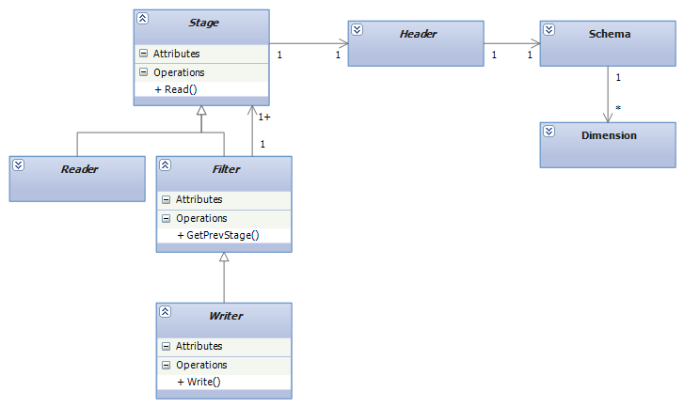
Key Classes (1)

Slide 8
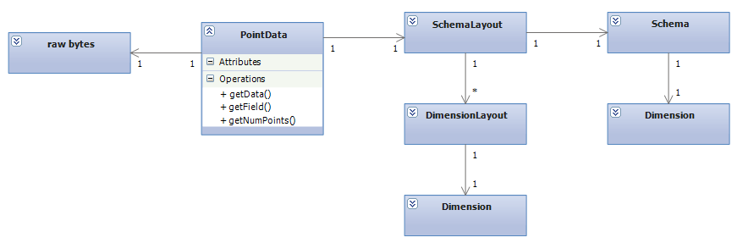
Key Classes (2)

Slide 9
Groups of Classes
Math
Range, Vector, Bounds
Schemata
Dimension, DimensionLayout, Schema, SchemaLayout, PointData
Pipeline
Header, Stage, Reader, Writer, Filter
Other
Utils, Signaller, exceptions, Color, Metadata, SpatialReference

Slide 10
Math Range<T>
A minimum/maximum pair
Features
get/set min/max
predicates: equality, overlaps, contains, …
clip, grow, scale, …

Slide 11
Math Vector<T>
A vector of values, in the mathematical sense
Features
length fixed at ctor
element accessors
equality testing

Slide 12
Math Bounds<T>
A list of Ranges
such as an (x,y,z) bounding box
Features:
get/set min/max
predicates: equality, empty, contains, overlaps, …
grow, clip, ...

Slide 13
Schemata Dimension
Strongly typed data field
such as “X Position” or “GPS Time”
Features:
field name enum
XPosition, GPSTime, ReturnNumber
data type enum
Int8, …, Uint64, …, double
getNumBytes, isSigned, isNumeric, …
supports “scale/offset” uint32/float concept

Slide 14
Schemata Schema
A set of Dimensions
conceptually like a database schema
unordered; no associated physical layout
Features:
void addDimension(const Dimension&)
const Dimension& getDimension(size_t index)
size_t getDimensionIndex(Field field)

Slide 15
Schemata DimensionLayout
Represents a Dimension, as physically stored
conceptually, an array of raw bytes
the schema is overlaid/union’d over that
Features:
getByteOffset() // starting byte in raw bytes array
getPosition() // index into Dimensions array

Slide 16
Schemata SchemaLayout
An ordered list of DimensionLayouts, to represent the physical layout on disk
Features
getSchema
getByteSize() // sum of all dimensions
getDimensionLayout(size_t index)

Slide 17
Pipeline Header
Basic data associated with all stages
Number of points, bounds, …
Features
get/set Schema, NumPoints, Bounds, …
get/set Metadata, SpatialReference

Slide 18
Pipeline Stage
Stage is abstract base class for a pipeline unit
for Readers, Writers, Filters
Features:
uint32_t read(PointData&)
virtual void readBegin(uint32 numPointsToRead)
virtual uint32 readBuffer(PointData&)
virtual void readEnd(uint32 numPointsRead)
seekToPoint(), getCurrentPosition(), bool atEnd()
getHeader()

Slide 19
The read() protocol
user calls Stage::read(PointData&)
user supplies the PointData object
this is not virtual, do not override
read() does this for you:
readBegin
readBuffer()
readEnd
you override these in your derived classes

Slide 20
Pipeline Reader
Derives from Stage
only difference is it supplies code to manage the current point number for you
Features
adds m_currentPointNumber

Slide 21
Pipeline Filter
Derives from Stage
ctor takes a Stage& (the “previous” stage)
only difference is it supplies default implementations of read functions, etc.
Features
readBegin(): m_prevStage.readBegin()
…

Slide 22
Pipeline Writer
Derived from Filter, designed for file-based writers
Features:
write(size_t numPoints)
protected writeBegin, writeBuffer, writeEnd
get/set ChunkSize

Slide 23
The write() protocol
User calls write(numPointsToWrite)
not virtual
writeBegin/Buffer/End are virtual
Derived classes provide these
write() does this:
writeBegin()
numChunks = numPoints / chunkSize
for each chunk do
PointData data(chunkSize)
prevStage.readBuffer(data)
writeBuffer()
writeEnd()

Slide 24
Other Utils
Provides a dumping ground for static helper functions
Features:
random()
compare_epsilon
iostream helpers: open/create/close file
file helpers: rename, getSize, delete
read/writeField<T>(uint8*)

Slide 25
Other Signaller
Provides callbacks for progress reporting and requesting interrupts during long-running pipeline operations
class done, but not yet implemented anywhere
Features
virtual void setPercentComplete(double)
virtual bool isInterruptRequested() const

Slide 26
Other exceptions
Provides some libPC-named exceptions for specific error situations
Features
libpc_error // base class
invalid_point_data
invalid_format
configuration_error
not_yet_implemented

Slide 27
Other Color
Provides a simple holder for an R,G,B triplet
Features
get/set Red/Green/Blue
interpolate(value, rangeMin, rangeMax)
// provides a mapping into a color ramp

Slide 28
Other Metadata
Provides a holder for an arbitrary array of bytes
class not yet implemented

Slide 29
Other SpatialReference
Provides a holder for some sort of SRS representation
class not yet implemented
will provide WKT, EPSG code, reprojection, etc.
likely heavily dependent on LIBPC_HAVE_GDAL

Slide 30
Concrete pipeline classes
Things derived from Stage
Readers/Writer (Drivers)
LasReader, LasWriter
LiblasReader, LiblasWriter
OCI
FauxReader, FauxWriter
Filters
CacheFilter, ColorFilter, DecimationFilter, CropFilter, MosaicFilter

Slide 31
Issues
Some things are still open and need resolution
like, this week

Slide 32
Issue Capabilities
It would be a Good Thing if some readers could advertise certain features
I_Support_Spatial_Indexing
I_Don’t_Like_Doing_Random_Seeks
…?
Knowing this information would help a pipeline-creator be able to omit a filter, for example
Questions
What is the set of capabilities offered?
Should they be exposed from Stage?
How should they be expressed?
Boost-style traits?

Slide 33
Issue PointData Templating
The Dimension class uses an enum for the data type
It is not Dimension<T>, because then there is no base class to allow for std::vector<Dimension>
plus, virtual function overhead?
But PCL does templates, sayeth Hobu
Task: give a 5-10 min talk on PCL
how/why it is different from libPC
what ideas can we adopt?

Slide 34
Issue Sequential or Random?
Two worlds
LAS (files) present a sequential list of points
OCI (queries) present a spatially indexed set of points
But:
Stage::read() is really a sequential/file model
What can/should we do about this?

Slide 35
Issue Stage Class Hierarchy
The naming of classes is a difficult matter It isn't just one of your holiday games
Reader, Writer, Filter, Producer, Consumer, Source, Sink, …
What is a Writer?
The Chipper ain’t one.
Should it really be it’s own class?

Slide 36
Issue IsValid?
It seemed like a good idea at the time
But doesn’t seem useful at all now.
Just one more thing for developers to need to remember to do
The default action goes the wrong way

Slide 37
Issue Miscellany
Get rid of header class? (fits into stage)
Boost equivalents for Range, Vector, etc.?
(where are we actually using these?)
Bit fields in dimensions?
Needed for direct mapping to disk only

