Slide 1
COMP2322 Computer Networking Tutorial One

Slide 2

Question 1:
Consider the circuit-switched network in Figure.
Recall that there are 4 circuits on each link.
Label the four switches A, B, C and D.
What is the maximum number of simultaneous connections that can be in progress at any one time in this network?
Suppose that all connections are between switches A and C. What is the maximum number of simultaneous connections that can be in progress?
Suppose we want to make four connections between switches A and C, and another four connections between switches B and D. Can we route these calls through the four links to accommodate all eight connections?
A
B
D
C

Slide 3
Suggested solution for Q1:
What is the maximum number of simultaneous connections that can be in progress at any one time in this network?
For each pair of two adjacent switches, there will be one connection for each circuit, thus totally 4 connections for two adjacent switches. The whole network can support up to 16 connections.
Suppose that all connections are between switches A and C. What is the maximum number of simultaneous connections that can be in progress?
We can 4 connections passing through the switch in the upper-right-hand corner and another 4 connections passing through the switch in the lower-left-hand corner, thus, the network can have a total of 8 connections.
Suppose we want to make four connections between switches A and C, and another four connections between switches B and D. Can we route these calls through the four links to accommodate all eight connections?
Yes. For the connections between A and C, we route two connections through B and two connections through D. For the connections between B and D, we route two connections through A and two connections through C. In this manner, there are at most 4 connections passing through any link.

Slide 4
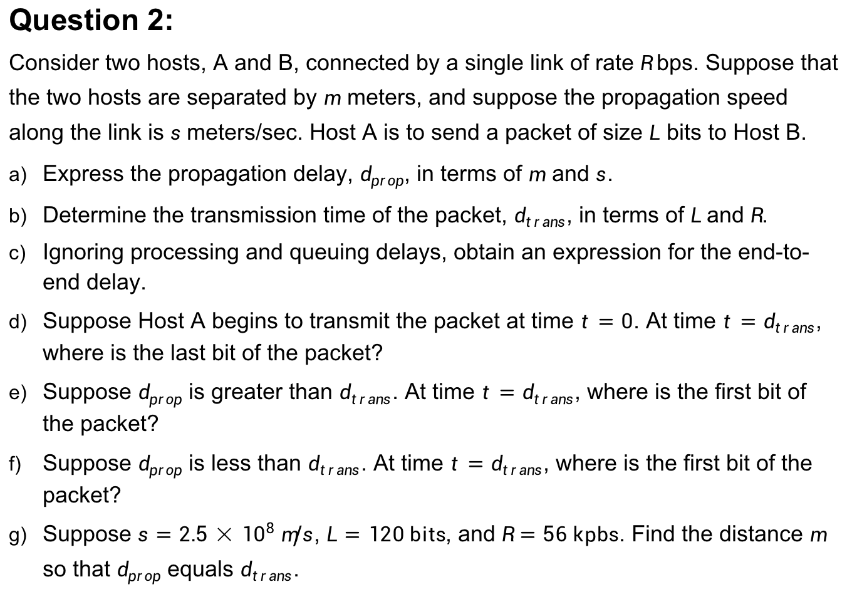
Question 2:
Consider two hosts, A and B, connected by a single link of rate $R$bps. Suppose that the two hosts are separated by $m$ meters, and suppose the propagation speed along the link is $s$meters/sec. Host A is to send a packet of size $L$ bits to Host B.
Express the propagation delay, $d_{prop}$, in terms of $m$ and $s$.
Determine the transmission time of the packet, $d_{trans}$, in terms of $L$and $R$.
Ignoring processing and queuing delays, obtain an expression for the end-to-end delay.
Suppose Host A begins to transmit the packet at time $t=0$. At time $t=d_{trans}$, where is the last bit of the packet?
Suppose $d_{prop}$ is greater than $d_{trans}$. At time $t=d_{trans}$, where is the first bit of the packet?
Suppose $d_{prop}$ is less than $d_{trans}$. At time $t=d_{trans}$, where is the first bit of the packet?
Suppose $s=2.5×{10}^{8} m/s$, $L=120 bits$, and $R=56 kpbs$. Find the distance $m$ so that $d_{prop}$ equals $d_{trans}$.

Slide 5
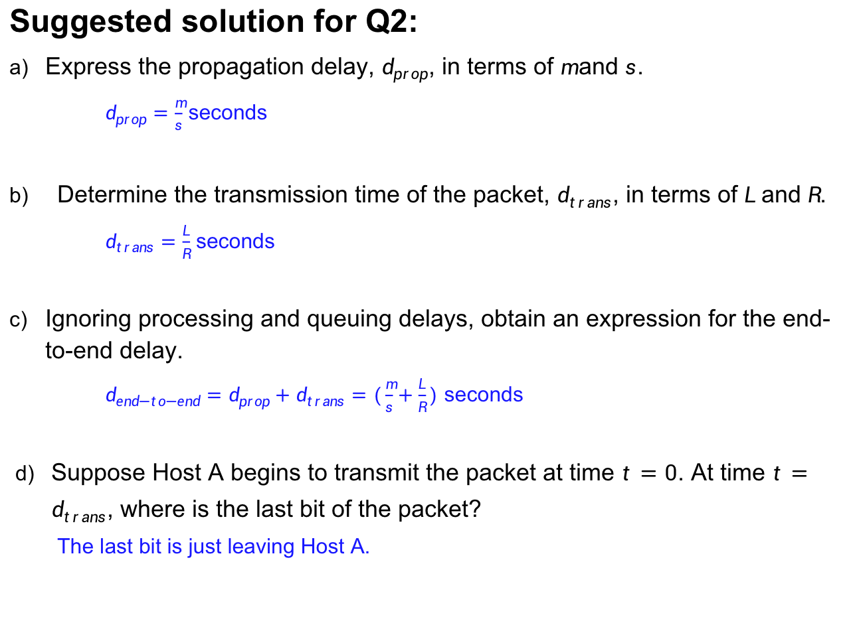
Suggested solution for Q2:
Express the propagation delay, $d_{prop}$, in terms of $m$ and $s$.
$d_{prop}=\frac{m}{s}$ seconds
Determine the transmission time of the packet, $d_{trans}$, in terms of $L$and $R$.
$d_{trans}=\frac{L}{R}$ seconds
Ignoring processing and queuing delays, obtain an expression for the end-to-end delay.
$d_{end−to−end}=d_{prop}+d_{trans}=(\frac{m}{s}+\frac{L}{R})$ seconds
Suppose Host A begins to transmit the packet at time $t=0$. At time $t=d_{trans}$, where is the last bit of the packet?
The last bit is just leaving Host A.
Jan 26 (Wed), 10:30 am - 11:20 am

Slide 6
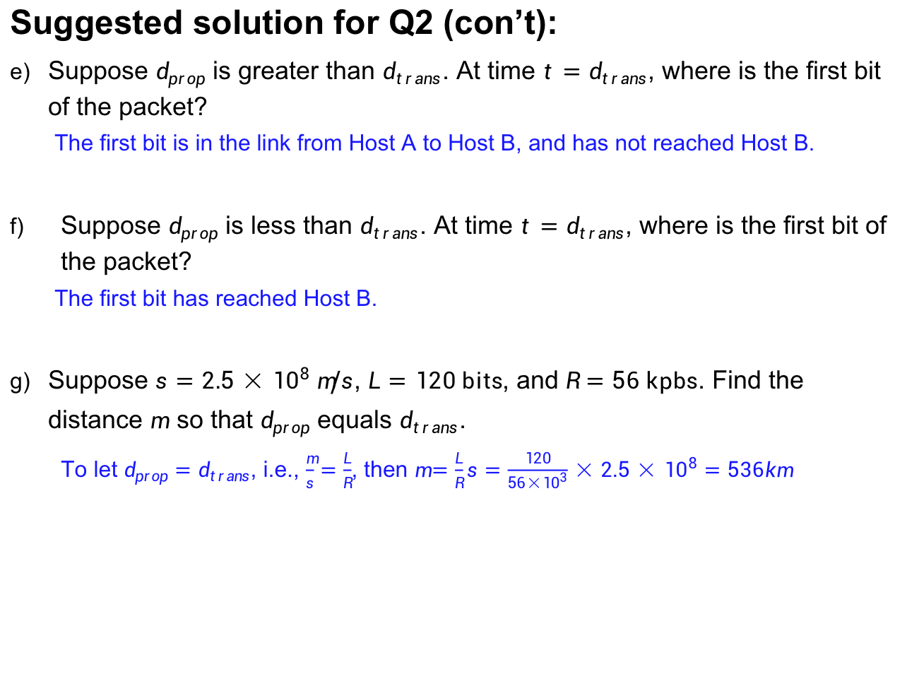
Suggested solution for Q2 (con’t):
Suppose $d_{prop}$ is greater than $d_{trans}$. At time $t=d_{trans}$, where is the first bit of the packet?
The first bit is in the link from Host A to Host B, and has not reached Host B.
Suppose $d_{prop}$ is less than $d_{trans}$. At time $t=d_{trans}$, where is the first bit of the packet?
The first bit has reached Host B.
Suppose $s=2.5×{10}^{8} m/s$, $L=120 bits$, and $R=56 kpbs$. Find the distance $m$ so that $d_{prop}$ equals $d_{trans}$.
To let $d_{prop}=d_{trans}$, i.e., $\frac{m}{s}=\frac{L}{R}$, then $m=\frac{L}{R}s=\frac{120}{56×{10}^{3}}×2.5×{10}^{8}=536km$

Slide 7
Question 3:
Consider a VoIP system that sends real-time voice from Host A to Host B over a packet-switched network. There is one link between Hosts A and B; its transmission rate is 2Mbps and its propagation delay is 10 msec. Host A converts analog voice to a digital 64 kbps bit stream on the fly. Host A then groups the bits into 56-byte packets. As soon as Host A gathers a packet, it sends it to Host B. As soon as Host B receives an entire packet, it converts the packet’s bits to an analog signal. How much time elapses from the time a bit is created (from the original analog signal at Host A) until the bit is sent (as part of the analog signal at Host B)?

Slide 8
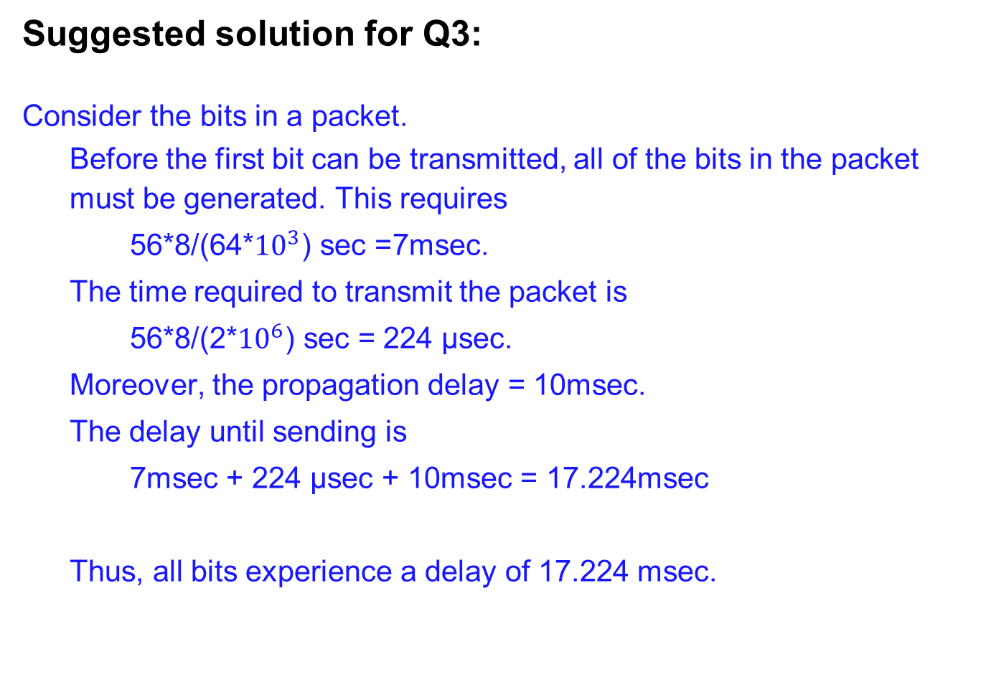
Suggested solution for Q3:
Consider the bits in a packet.
Before the first bit can be transmitted, all of the bits in the packet must be generated. This requires
56*8/(64*${10}^{3}$) sec =7msec.
The time required to transmit the packet is
56*8/(2*${10}^{6}$) sec = 224 μsec.
Moreover, the propagation delay = 10msec.
The delay until sending is
7msec + 224 μsec + 10msec = 17.224msec
Thus, all bits experience a delay of 17.224 msec.

Slide 9
Question 4:
Suppose an end to end path from a server to a client contains N links. Each link has a packet loss probability p, and the packet loss probabilities for these links are independent.
What is the probability that a packet (sent by the server) is successfully received by the client?
If a packet is lost in the path from the server to the client, then the server will re-transmit the packet. On average, how many times will the server re-transmit the packet in order for the client to successfully receive the packet?

Slide 10
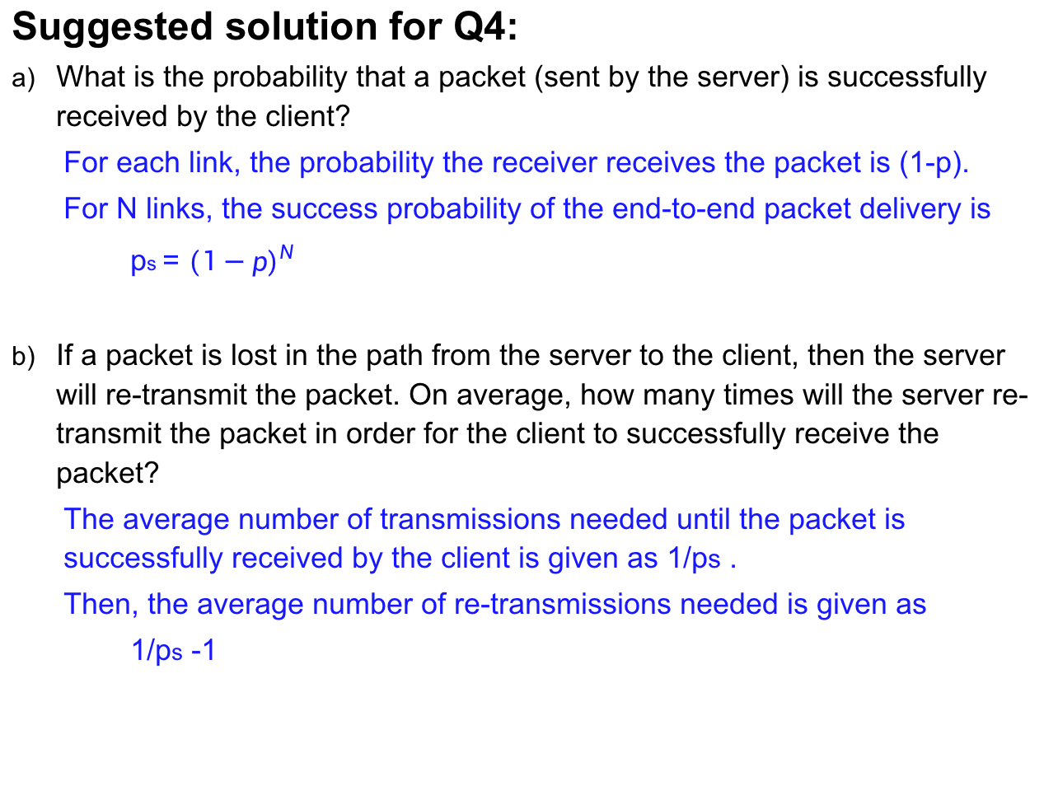
Suggested solution for Q4:
What is the probability that a packet (sent by the server) is successfully received by the client?
For each link, the probability the receiver receives the packet is (1-p).
For N links, the success probability of the end-to-end packet delivery is
ps = ${(1−p)}^{N}$
If a packet is lost in the path from the server to the client, then the server will re-transmit the packet. On average, how many times will the server re-transmit the packet in order for the client to successfully receive the packet?
The average number of transmissions needed until the packet is successfully received by the client is given as 1/ps .
Then, the average number of re-transmissions needed is given as
1/ps -1

Slide 11
Question 5:
Suppose users share a 3 Mbps link. Also suppose each user requires 150 kbps when transmitting, but each user transmits only 10 percent of the time.
When circuit switching is used, how many users can be supported?
Suppose there are 120 users. Find the formula that describes the probability that at any given time, exactly n users are transmitting simultaneously.
Under the above condition (b), find the probability that there are 21 or more users transmitting simultaneously.

Slide 12
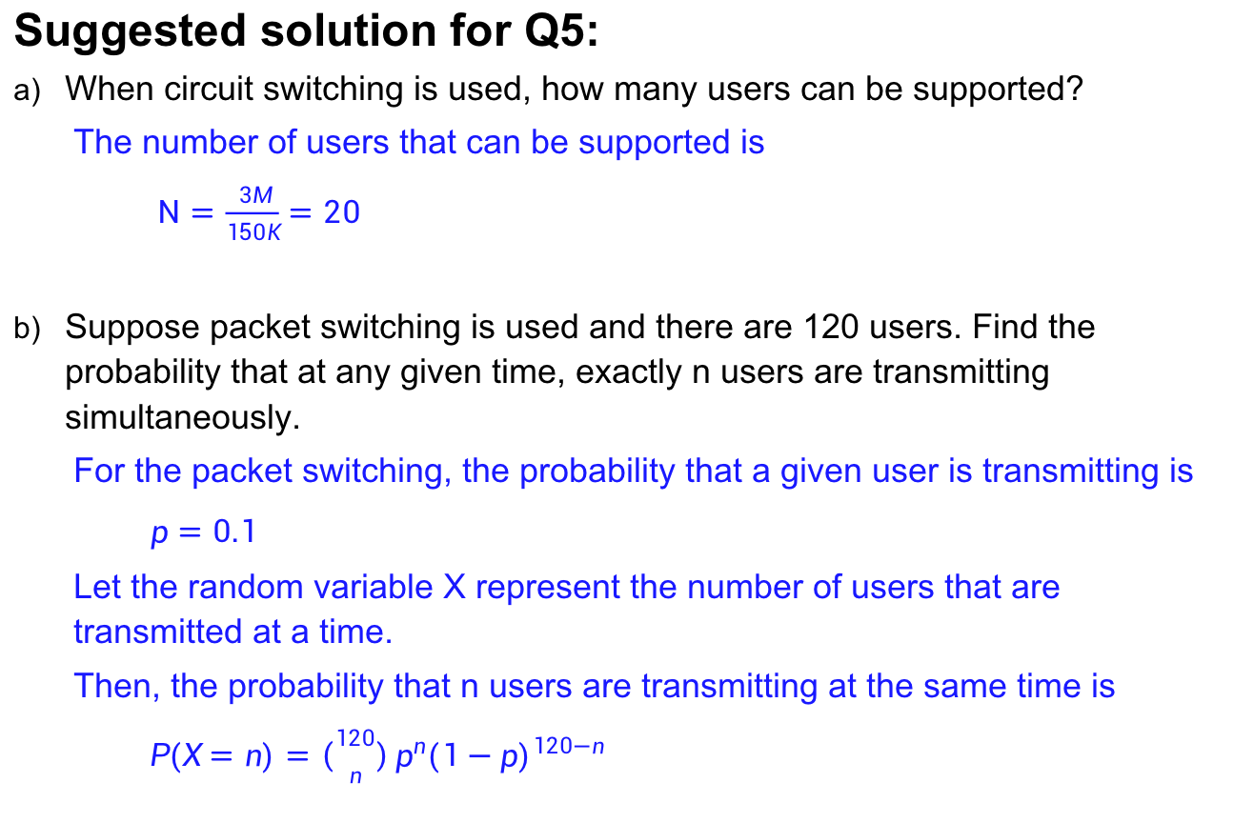
Suggested solution for Q5:
When circuit switching is used, how many users can be supported?
The number of users that can be supported is
$N=\frac{3M}{150K}=20$
Suppose packet switching is used and there are 120 users. Find the probability that at any given time, exactly n users are transmitting simultaneously.
For the packet switching, the probability that a given user is transmitting is
$p=0.1$
Let the random variable X represent the number of users that are transmitted at a time.
Then, the probability that n users are transmitting at the same time is
$P(X=n)=\left({120 \atop n}\right)p^{n}{(1−p)}^{120−n}$

Slide 13
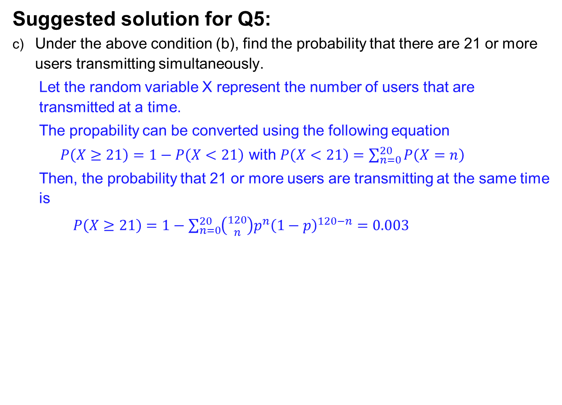
Suggested solution for Q5:
Under the above condition (b), find the probability that there are 21 or more users transmitting simultaneously.
Let the random variable X represent the number of users that are transmitted at a time.
The propability can be converted using the following equation
$P\left(X≥21\right)=1−P\left(X<21\right)$ with $P\left(X<21\right)=\sum_{n=0}^{20}{P\left(X=n\right)}$
Then, the probability that 21 or more users are transmitting at the same time is
$P\left(X≥21\right)=1−\sum_{n=0}^{20}{\left({120 \atop n}\right)p^{n}{\left(1−p\right)}^{120−n}}=0.003$

