Slide 1
COMP2322 Computer Networking Tutorial Two

Slide 2
Question 1:
Consider an HTTP client that wants to retrieve a Web document at a given URL. The IP address of the HTTP server is initially unknown. What transport and application-layer protocols besides HTTP are needed in this scenario?

Slide 3
Suggested solution for Q1:
Application layer protocols:
DNS
Transport layer protocols:
UDP for DNS;
TCP for HTTP

Slide 4
Question 2:
Suppose within your Web browser you click on a link to obtain a Web page. The IP address for the link’s URL is not cached in your local host, so a DNS lookup is necessary to obtain the IP address.
Suppose that n DNS servers are visited before your host receives the IP address from DNS; the successive visits incur an RTT of RTT₁, RTT₂, ..., RTT_{n}.
Further suppose that the Web page associated with the link contains exactly one object, consisting of a small amount of HTML text. Let RTT₀ denote the RTT between the local host and the server containing the object.
Assuming zero transmission time of the object, how much time elapses from when the client clicks on the link until the client receives the object?

Slide 5
Suggested solution for Q2:
The total amount of time to get the IP address is
RTT₁ + RTT₂ + ··· + RTT_{n}
Once the IP address is known, the local host and server needs a RTT₀ to set up the TCP connection and another RTT₀ to request and receive the small object.
The total response time is
RTT₁ + RTT₂ + ··· + RTT_{n} + 2 × RTT₀

Slide 6
Question 3:
Referring to Question 2, suppose the HTML file references eight very small objects on the same server. Neglecting transmission times, how much time elapses with
Non-persistent HTTP with no parallel TCP connections?
Non-persistent HTTP with the browser configured for 5 parallel connections?
Persistent HTTP?

Slide 7
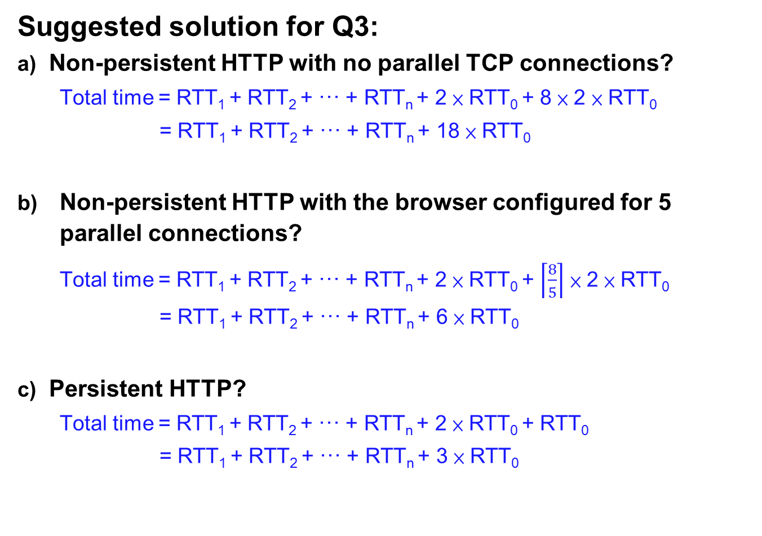
Suggested solution for Q3:
Non-persistent HTTP with no parallel TCP connections?
Total time = RTT₁ + RTT₂ + ··· + RTT_{n} + 2 × RTT₀ + 8 × 2 × RTT₀
= RTT₁ + RTT₂ + ··· + RTT_{n} + 18 × RTT₀
Non-persistent HTTP with the browser configured for 5 parallel connections?
Total time = RTT₁ + RTT₂ + ··· + RTT_{n} + 2 × RTT₀ + $\left\lceil \frac{8}{5}\right\rceil$ × 2 × RTT₀
= RTT₁ + RTT₂ + ··· + RTT_{n} + 6 × RTT₀
Persistent HTTP?
Total time = RTT₁ + RTT₂ + ··· + RTT_{n} + 2 × RTT₀ + RTT₀
= RTT₁ + RTT₂ + ··· + RTT_{n} + 3 × RTT₀

Slide 8
Question 4:
Consider a short, 10-meter link, over which a sender can transmit at a rate of 150 bits/sec in both directions. Suppose that packets containing data are 100,000 bits long, and packets containing only control (e.g., ACK or handshaking) are 200 bits long. Assume that N parallel connections each get 1/N of the link bandwidth. Now consider the HTTP protocol, and suppose that each downloaded object is 100 Kbits long, and that the initial downloaded object contains 10 referenced objects from the same sender. Would parallel downloads via parallel instances of non-persistent HTTP make sense in this case? How about persistent HTTP? Do you expect significant gains over the non-persistent case? Justify and explain your answer.

Slide 9
Suggested solution for Q4:
Assume that each downloaded object can be completely put into one data packet.
Let Tp denote the one-way propagation delay between the client and the server.
First consider parallel downloads using non-persistent connections. As parallel downloads would allow 10 connections to share the 150 bits/sec bandwidth, so each download just has 15 bits/sec.
Thus, the total time needed to receive all objects is given by:
Total = (200/150+Tp+200/150+Tp+200/150+Tp+100,000/150+Tp)
+[200/(150/10)+Tp+200/(150/10)+Tp+200/(150/10)
+Tp+100,000/(150/10)+Tp]
= 7377 + 8*Tp (seconds)

Slide 10
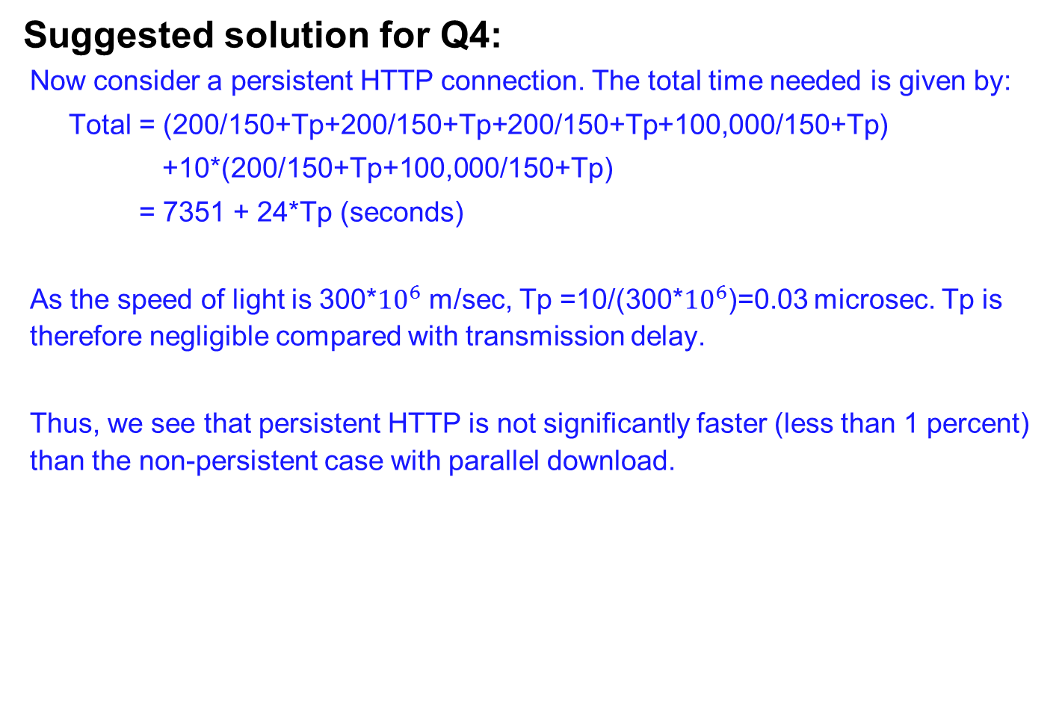
Suggested solution for Q4:
Now consider a persistent HTTP connection. The total time needed is given by:
Total = (200/150+Tp+200/150+Tp+200/150+Tp+100,000/150+Tp)
+10*(200/150+Tp+100,000/150+Tp)
= 7351 + 24*Tp (seconds)
As the speed of light is 300*${10}^{6}$ m/sec, Tp =10/(300*${10}^{6}$)=0.03 microsec. Tp is therefore negligible compared with transmission delay.
Thus, we see that persistent HTTP is not significantly faster (less than 1 percent) than the non-persistent case with parallel download.

Slide 11
Question 5:
Consider the scenario introduced in Question 4. Now suppose that the link is shared by Bob with four other users. Bob uses parallel instances of non-persistent HTTP, and the other four users use non-persistent HTTP without parallel downloads.
Do Bob’s parallel connections help him get Web pages more quickly? Why or why not?
If all five users open five parallel instances of non-persistent HTTP, then would Bob’s parallel connections still be beneficial? Why or why not?

Slide 12
Suggested solution for Q5:
Do Bob’s parallel connections help him get Web pages more quickly? Justify your answer.
Yes, because Bob has more connections, he can get a larger share of the link bandwidth.
If all five users open five parallel instances of non-persistent HTTP, then would Bob’s parallel connections still be beneficial? Justify your answer.
Yes, Bob still needs to perform parallel downloads; otherwise he will get less bandwidth than the other four users.

