Slide 1
COMP2322 Computer Networking Tutorial Four

Slide 2
Question 1:
Consider sending a large file from a host to another over a TCP connection that has no loss.
Suppose TCP uses AIMD for its congestion control without slow start. Assuming cwnd increases by 1 MSS (maximum segment size) every time an ACK is received and assuming approximately constant RTT (round-trip time), how long does it take for cwnd increase from 6 MSS to 12 MSS (assuming no loss events)?
What is the average throughput (in terms of MSS and RTT) for this connection up to time = 6 RTT?

Slide 3
Suggested solution for Q1:
Suppose TCP uses AIMD for its congestion control without slow start. Assuming cwnd increases by 1 MSS (maximum segment size) every time an ACK is received and assuming approximately constant RTT (round-trip time), how long does it take for cwnd increase from 6 MSS to 12 MSS (assuming no loss events)?
What is the average throughput (in terms of MSS and RTT) for this connection up to time = 6 RTT?
It takes 1 RTT to increase cwnd to 7 MSS; 2 RTTs to increase to 8 MSS; 3 RTTs to increase to 9 MSS; 4 RTTs to increase to 10 MSS; 5 RTTs to increase to 11 MSS; and 6 RTTs to increase to 12 MSS.
In the first RTT, 6 MSS was sent; in the second RTT, 7 MSS was sent; in the third RTT, 8 MSS was sent; in the fourth RTT, 9 MSS was sent; in the fifth RTT, 10 MSS was sent; and in the sixth RTT, 11 MSS was sent.
Thus, up to time 6 RTT, 6+7+8+9+10+11 = 51 MSS were sent and ACKed. The average throughput up to time 6 RTT was (51 MSS)/(6 RTT) = 8.5 MSS/RTT.

Slide 4
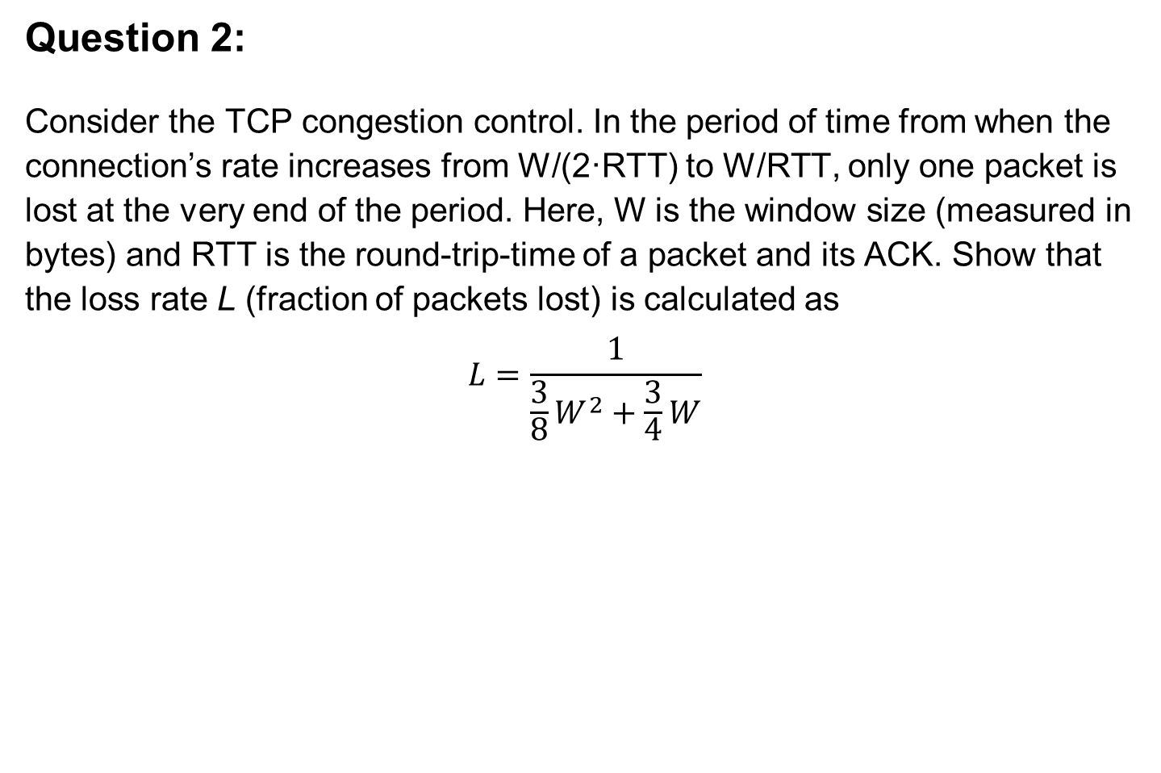
Question 2:
Consider the TCP congestion control. In the period of time from when the connection’s rate increases from W/(2·RTT) to W/RTT, only one packet is lost at the very end of the period. Here, W is the window size (measured in bytes) and RTT is the round-trip-time of a packet and its ACK. Show that the loss rate L (fraction of packets lost) is calculated as
$$L=\frac{1}{\frac{3}{8}W^{2}+\frac{3}{4}W}$$

Slide 5

Suggested solution for Q2:
The loss rate L is the ratio of the number of packets lost over the number of packets sent. In the period of time, 1 packet is lost. The total number of packets sent in this period is$L=\frac{1}{\frac{3}{8}W^{2}+\frac{3}{4}W}$
$$\frac{W}{2}+\left(\frac{W}{2}+1\right)+⋯+W=\frac{3}{8}W^{2}+\frac{3}{4}W$$
Thus, the loss rate is
$$L=\frac{1}{\frac{3}{8}W^{2}+\frac{3}{4}W}$$

Slide 6
Question 3:
According to TCP’s AIMD algorithm, the convergence of two competing sessions is shown as the figure.
Suppose that instead of a multiplicative decrease, TCP decreases the window size by a constant amount. Would the resulting AIAD algorithm converge to an equal share point? Justify your answer.
R
equal bandwidth share
congestion avoidance: additive increase
Connection 2 throughput
loss: decrease window by factor of 2
Connection 1 throughput
R

Slide 7
Suggested solution for Q3:
The top figure shows the case that the ratio of the linear decrease on loss between connection 1 and connection 2 is the same as the ratio of the linear increases. In this case, the throughputs never move off of the AB line segment.
The bottom figure shows the ratio of the linear decrease on loss between connection 1 and connection 2 is 2:1. That is, whenever there is a loss, connection 1 decreases its window size by twice the amount of connection 2. We see that eventually, after enough losses, and subsequent increases, connection 1's throughput will go to 0, and the full link bandwidth will be allocated to connection 2.
linear increase with equal linear decrease
linear increase while connection 1’s decrease is twice of connection 2’s decrease

Slide 8
Question 4:
We consider the delay introduced by the TCP slow-start phase. Consider a client and a Web server directly connected by one link of rate R. Suppose the client wants to retrieve an object whose size is exactly equal to 15S, where S is the maximum segment size (MSS). Denote the round-trip time between client and server as RTT (assumed to be constant). Ignoring protocol headers, determine the time to retrieve the object (including TCP connection establishment) when
2S/R < S/R + RTT < 4S/R
4S/R < S/R + RTT
RTT < S/R

Slide 9

Suggested solution for Q4:
a) 2S/R < S/R + RTT < 4S/R
client
server
initiate TCP
connection
request
object
1st window
= S/R
The figure shows the procedure,
total delay
=RTT+RTT+S/R+RTT+S/R+RTT+12S/R
= 4RTT+14 S/R
2nd window
= 2S/R
RTT
3rd window
= 4S/R
4th window
= 8S/R
complete
transmission
object
delivered
time
time

Slide 10
Suggested solution for Q4:
b) 4S/R < S/R + RTT
client
server
initiate TCP
connection
request
object
The delay in this case:
total delay
= RTT+RTT+S/R+RTT+S/R
+RTT+S/R+RTT+8S/R
= 5RTT+11S/R
1st window
= S/R
RTT
2nd window
= 2S/R
3rd window
= 4S/R
4th window
= 8S/R
object
delivered
complete
transmission
time
time

Slide 11
Suggested solution for Q4:
c) RTT < S/R
client
server
initiate TCP
connection
request
object
1st window
= S/R
RTT
2nd window
= 2S/R
The delay in this case:
total delay
= RTT+RTT+S/R+RTT+14S/R
= 3RTT+15S/R
3rd window
= 4S/R
4th window
= 8S/R
object
delivered
complete
transmission
time
time

