Slide 1
COMP2322 Computer Networking Tutorial Five

Slide 2
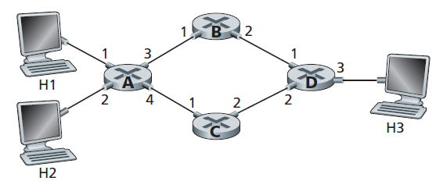
Question 1:
Consider the network below.
Show the forwarding table in router A, such that all traffic destined to host H3 is forwarded through interface 3.
Can you write down a forwarding table in router A, such that all traffic from H1 destined to host H3 is forwarded through interface 3, while all traffic from H2 destined to host H3 is forwarded through interface 4?

Slide 3
Suggested solution for Q1:
Show the forwarding table in router A, such that all traffic destined to host H3 is forwarded through interface 3.
Can you write down a forwarding table in router A, such that all traffic from H1 destined to host H3 is forwarded through interface 3, while all traffic from H2 destined to host H3 is forwarded through interface 4?
No, because forwarding rule is only based on destination address.
Destination Address | Link Interface
H3 | 3

Slide 4
Question 2:
Consider a datagram network using 32-bit host addresses. Suppose a router has four links, numbered 0 through 3, and packets are to be forwarded to the link interfaces as follows:
Destination Address Range | Link Interface
From 11100000 00000000 00000000 00000000 To 11100000 00111111 11111111 11111111 | 0
From 11100000 01000000 00000000 00000000 To 11100000 01000000 11111111 11111111 | 1
From 11100000 01000001 00000000 00000000 To 11100001 01111111 11111111 11111111 | 2
Otherwise | 3

Slide 5
Question 2:
Provide a forwarding table that has five entries, uses longest prefix matching, and forwards packets to the correct link interfaces.
Describe how your forwarding table determines the appropriate link interface for datagrams with destination addresses:
11001000 10010001 01010001 01010101
11100001 01000000 11000011 00111100
11100001 10000000 00010001 01110111
Rewrite this forwarding table using the a.b.c.d/x notation instead of the binary string notation.

Slide 6
Suggested solution for Q2:
Provide a forwarding table that has five entries, uses longest prefix matching, and forwards packets to the correct link interfaces.
Prefix Match | Link Interface
11100000 00 | 0
11100000 01000000 | 1
1110000 | 2
11100001 1 | 3
Otherwise | 3

Slide 7
Suggested solution for Q2:
Describe how your forwarding table determines the appropriate link interface for datagrams with destination addresses:
11001000 10010001 01010001 01010101
Prefix match for this address is 5th entry => link interface 3
11100001 01000000 11000011 00111100
Prefix match for this address is 3nd entry => link interface 2
11100001 10000000 00010001 01110111
Prefix match for this address is 4th entry => link interface 3

Slide 8
Suggested solution for Q2:
Rewrite this forwarding table using the a.b.c.d/x notation instead of the binary string notation.
Prefix Match | a.b.c.d/x Notation | Link Interface
11100000 00 | 224.0.0.0/10 | 0
11100000 01000000 | 224.64.0.0/16 | 1
1110000 | 224.0.0.0/8 | 2
11100001 1 | 225.128.0.0/9 | 3
Otherwise | - | 3

Slide 9
Question 3:
Consider sending a 2400-byte datagram into a link that has an MTU of 700 bytes. Suppose the original datagram is filled with the identification number 422. How many fragments are generated? What are the values in the various fields in the IP datagram(s) generated related to fragmentation?

Slide 10
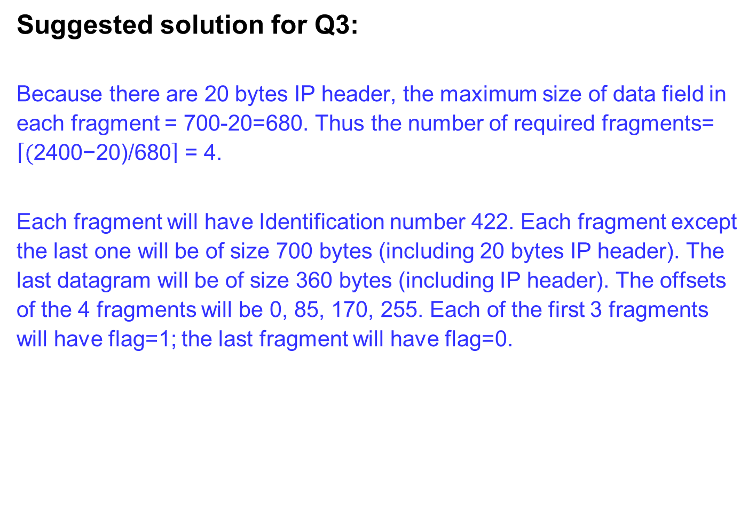
Suggested solution for Q3:
Because there are 20 bytes IP header, the maximum size of data field in each fragment = 700-20=680. Thus the number of required fragments= $\left\lceil \text{(}\text{2400}\text{−20)}\text{/680}\right\rceil$ = 4.
Each fragment will have Identification number 422. Each fragment except the last one will be of size 700 bytes (including 20 bytes IP header). The last datagram will be of size 360 bytes (including IP header). The offsets of the 4 fragments will be 0, 85, 170, 255. Each of the first 3 fragments will have flag=1; the last fragment will have flag=0.
length
ID
fragflag
offset
700
422
1
0
700
422
1
85
700
422
1
170
360
422
0
255

Slide 11
Question 4:
Consider the seven-node network (with nodes labeled t to z) below. With the indicated link cost, use Dijkstra’s shortest-path algorithm to compute the shortest path from node z to all network nodes. Show the routing table for node z.

Slide 12
Suggested solution for Q4:
Using Dijkstra’s algorithm to build the shortest path tree from z to all other nodes.
The shortest path tree rooted at z is
Step
0
1
2
3
4
5
6
N'
z
zx
zxv
zxvy
zxvyu
zxvyuw
zxvyuwt
D(x),p(x)
8,z
8,z
8,z
8,z
8,z
8,z
8,z
D(u),p(u)
∞
∞
14,v
14,v
14,v
14,v
14,v
D(v),p(v)
∞
11,x
11,x
11,x
11,x
11,x
11,x
D(w),p(w)
∞
14,x
14,x
14,x
14,x
14,x
14,x
D(y),p(y)
12,z
12,z
12,z
12,z
12,z
12,z
12,z
D(t),p(t)
∞
∞
15,v
15,v
15,v
15,v
15,v
4
12
y
v
t
z
3
3
u
8
x
w
6

Slide 13
Suggested solution for Q4:
The routing table from z to all other nodes:
Destination | Next Hop | Cost
t | x | 15
u | x | 14
v | x | 11
w | x | 14
x | x | 8
y | y | 12

