Slide 1

Security
www.switchfully.com
Notes:
Disclaimer: I am not an expert, neither should you be. You should have a basic understanding of the security principles and be able to secure your code.
Slides won’t have much info, most things I say will be explained in the comments of the slides

Slide 3
Overview

Slide 4
Overview
Hackers
Passwords
Securing sessions
Https
Notes:
No one likes to have a 3 hour long session with only theory. That’s why the exercises will be sprinkled throughout the day. This means, however that some concepts in the exercises will be talked about after you’ve completed an exercise about it.

Slide 5
Overview
Hackers
Why hackers hack
Getting hacked
Passwords
Securing sessions
Https

Slide 6
Overview
Hackers
Passwords
Three types of authentication
Password policies
Securing sessions
Https

Slide 7
Overview
Hackers
Passwords
Securing sessions
Securing client-side sessions
Https

Slide 8
Overview
Hackers
Passwords
Securing sessions
Https
Why Https?
Why is Https secure?
Secure connections with TLS
Certificates

Slide 9
Hackers
Chapter 1

Slide 10
Overview
Hackers
Why hackers hack
Getting hacked
Passwords
Securing sessions
Https

Slide 11
Why hackers hack
Hackers

Slide 12
Why hackers hack
Hackers
Notes:
There are three types of hackers (illustrated using ‘hats’):
White hat (e.g. penetration testers. Will try to find the holes in your system, but will not damage it).
Black hat (the ‘evil’ hackers that are out to get you and your code. Breaks the law)
Grey hat (similar to bounty hunters. Look for exploits and will offer to fix them (for a price), but will not exploit the exploits. Also see big site’s ‘bounty programs’.
NOTE EXTRA INFO SYMBOL
Extra info:
black hat: https://en.wikipedia.org/wiki/Black_hat
grey hat: https://en.wikipedia.org/wiki/Grey_hat
White hat: https://en.wikipedia.org/wiki/White_hat_(computer_security)

Slide 13
Why hackers hack
Black hat
‘Evil’ hackers
Damage your systems/steal your data for own profit
Breaks the law
Hackers
Notes:
There are three types of hackers (illustrated using ‘hats’):
White hat (e.g. penetration testers. Will try to find the holes in your system, but will not damage it).
Black hat (the ‘evil’ hackers that are out to get you and your code. Breaks the law)
Grey hat (similar to bounty hunters. Look for exploits and will offer to fix them (for a price), but will not exploit the exploits. Also see big site’s ‘bounty programs’.
NOTE EXTRA INFO SYMBOL
Extra info:
black hat: https://en.wikipedia.org/wiki/Black_hat
grey hat: https://en.wikipedia.org/wiki/Grey_hat
White hat: https://en.wikipedia.org/wiki/White_hat_(computer_security)

Slide 14
Why hackers hack
White hat
Penetration testers
Hired by companies to find security holes and help fix them
Will not exploit security holes
‘Legal hackers’
Hackers
Notes:
There are three types of hackers (illustrated using ‘hats’):
White hat (e.g. penetration testers. Will try to find the holes in your system, but will not damage it).
Black hat (the ‘evil’ hackers that are out to get you and your code. Breaks the law)
Grey hat (similar to bounty hunters. Look for exploits and will offer to fix them (for a price), but will not exploit the exploits. Also see big site’s ‘bounty programs’.
NOTE EXTRA INFO SYMBOL
Extra info:
black hat: https://en.wikipedia.org/wiki/Black_hat
grey hat: https://en.wikipedia.org/wiki/Grey_hat
White hat: https://en.wikipedia.org/wiki/White_hat_(computer_security)

Slide 15
Why hackers hack
Grey hat
‘Hacker bounty hunter’
Looks for security holes and informs companies when he finds any
Will only share the details/help fix them for a price
Will not exploit security holes
Participates in ‘Bug bounty programs’
Hackers
Notes:
There are three types of hackers (illustrated using ‘hats’):
White hat (e.g. penetration testers. Will try to find the holes in your system, but will not damage it).
Black hat (the ‘evil’ hackers that are out to get you and your code. Breaks the law)
Grey hat (similar to bounty hunters. Look for exploits and will offer to fix them (for a price), but will not exploit the exploits. Also see big site’s ‘bounty programs’.
NOTE EXTRA INFO SYMBOL
Extra info:
black hat: https://en.wikipedia.org/wiki/Black_hat
grey hat: https://en.wikipedia.org/wiki/Grey_hat
White hat: https://en.wikipedia.org/wiki/White_hat_(computer_security)

Slide 16
Why hackers hack
Because you hired them
Data/Extortion == $$$
They don’t like you
Warfare
Prestige
For the lulz
Recruit you to their zombie army
Hackers
Notes:
Data can be sold or used to break into your other accounts (eg: https://krebsonsecurity.com/2013/06/the-value-of-a-hacked-email-account/ )
Threatening with releasing sensitive data can give them money
They don’t like you because of clashing political views (eg: the left vs the right, nazis, ISIS, etc)
They don’t like you because you ruined their favorite movie/tv show
Hacked by hackers hired by other nations/terror groups (eg: stuxnet. Worm created by USA & Israel to destabilize Iranian power plants https://en.wikipedia.org/wiki/Stuxnet)
Prestige: your site has been ‘unhackable’ for x years. If someone manages to hack you, they become famous in the hacker community
For the lulz: the hacker is bored and hacks a random site to pass the time
Zombie army: Botnet/DDOS (https://en.wikipedia.org/wiki/Botnet)

Slide 17
The consequences of a hack
The consequences of a hack
Data stolen (but still intact)
Data stolen and destroyed
Hacker left a ‘presence’ on infected machines
Keyloggers
Backdoor for easy re-entrance later
Chaos inducing scripts
Application(s) down
Reputation damage (especially if you’re an IT company)
Hackers

Slide 18
Getting hacked
Hackers

Slide 19
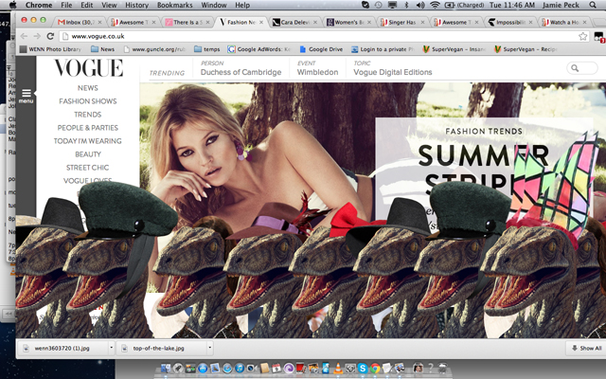
Getting hacked
Sometimes it’s obvious you’ve been hacked…
Hackers
Notes:
Sometimes it’s obvious
Eg: when the hacker did it ‘For the lulz’ or for prestige
Example image isn’t actually a hacked site. More like an easter egg when using the Konami Code on VOGUE’s site,

Slide 20
Getting hacked
Most hackers won’t leave a (obvious) trace that they’ve entered your system, so you need
Sufficient logging
But don’t expose logs to outside world!
Log both successful and failed attempts to access ‘sensitive’ code
Use tools such as ELK-stack to make searching through logs easier for humans AND machines
Automated warning systems
EG: warning when the number of requests is suddenly x10
Application blocks and/or escalates ‘suspicious’ behavior
EG: Allow max 3 failed login attempts/hour
Hackers

Slide 21
Getting hacked
So you’ve been hacked…
Perform a post-mortem
Find and close the hole in your security
Find and fix the damage (if possible)
Make sure the hacker didn’t leave behind any ‘presents’
Notify the affected parties (ASAP!)
Users
Clients
Government (GDPR)
Hackers

Slide 22
References
Hackers

Slide 23
References
Three types of hackers
https://en.wikipedia.org/wiki/Black_hat
https://en.wikipedia.org/wiki/Grey_hat
https://en.wikipedia.org/wiki/White_hat_(computer_security)
What hackers do with hacked e-mail accounts: https://krebsonsecurity.com/2013/06/the-value-of-a-hacked-email-account/
Hacking and warfare: https://en.wikipedia.org/wiki/Stuxnet
Zombie army: https://en.wikipedia.org/wiki/Botnet
Hackers

Slide 24
Passwords
Chapter 2

Slide 25
Overview
√ Hackers
Passwords
Three types of authentication
Password policies
Securing sessions
Https

Slide 26
Three types of authentication
Passwords

Slide 27
Three types of authentication
A user can be identified using three methods:
Something they know
Password, security question, PIN code
Something they have
ID card, Bank card, cell phone
Something they are
Voice, retinal scan, fingerprint, DNA
Passwords
Notes:
Know: password, security question (even though those are usually easy to guess), PIN code
Have: ID/Bank card, cell phone
Are: voice, retinal scan, fingerprint, DNA
https://en.wikipedia.org/wiki/Authentication#Factors_and_identity
https://hackaday.com/2015/11/10/your-unhashable-fingerprints-secure-nothing/

Slide 28

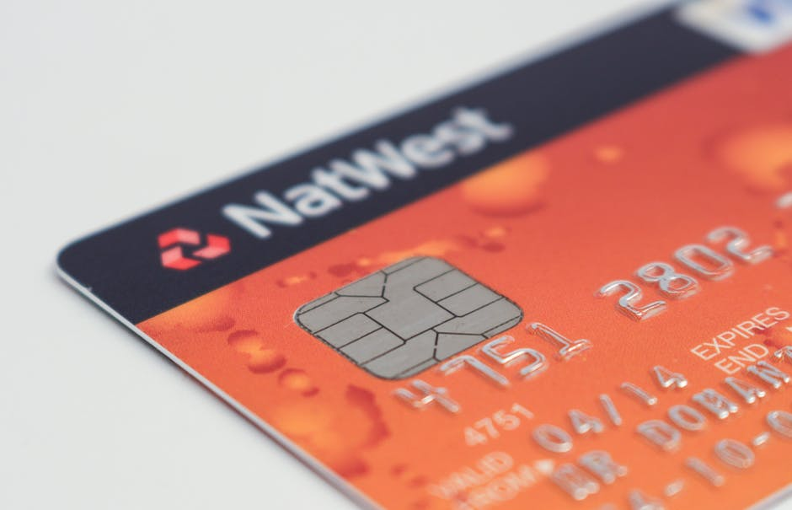
Three types of authentication
Single-factor vs Multi-factor authentication
Passwords
Notes:
Single factor: user needs to provide only 1 piece of evidence that he is who he claims to be.
Eg: Phones: can unlock using either pincode (KNOWS) or using fingerprint (IS) or using facial recognition (IS)
Eg: Most websites only ask for the right username/password combination (KNOWS)
Mult-factor: user needs to provide multiple (usually 2 or 3) pieces of evidence that is who he claims to be.
Eg: Banking transactions: you need both the card (HAS) and the correct pin for that card (KNOWS)
Eg: Google login: You need both the correct password (KNOWS) and access to the phone number coupled to the account (HAS)

Slide 29
Three types of authentication
Only use 1 of 3 ways to check if user claims who he is
EG: Phones: Can be unlocked using either Fingerprint scan (IS), Facial Recognition (IS) or password (KNOWS)
Single-factor vs Multi-factor authentication
Passwords
Notes:
Single factor: user needs to provide only 1 piece of evidence that he is who he claims to be.
Eg: Phones: can unlock using either pincode (KNOWS) or using fingerprint (IS) or using facial recognition (IS)
Eg: Most websites only ask for the right username/password combination (KNOWS)
Mult-factor: user needs to provide multiple (usually 2 or 3) pieces of evidence that is who he claims to be.
Eg: Banking transactions: you need both the card (HAS) and the correct pin for that card (KNOWS)
Eg: Google login: You need both the correct password (KNOWS) and access to the phone number coupled to the account (HAS)

Slide 30
Three types of authentication
Use 2 or more ways to check if user claims who he is
EG: Online banking: Requires the card (HAS) and the correct pin (KNOWS)
Single-factor vs Multi-factor authentication
Passwords
Notes:
Single factor: user needs to provide only 1 piece of evidence that he is who he claims to be.
Eg: Phones: can unlock using either pincode (KNOWS) or using fingerprint (IS) or using facial recognition (IS)
Eg: Most websites only ask for the right username/password combination (KNOWS)
Mult-factor: user needs to provide multiple (usually 2 or 3) pieces of evidence that is who he claims to be.
Eg: Banking transactions: you need both the card (HAS) and the correct pin for that card (KNOWS)
Eg: Google login: You need both the correct password (KNOWS) and access to the phone number coupled to the account (HAS)

Slide 31
Password policies
Paswords

Slide 32
Password policies
What are the properties of a good (= hard to hack) password?
aka
What makes it hard for a hacker to crack your password?
Passwords

Slide 33
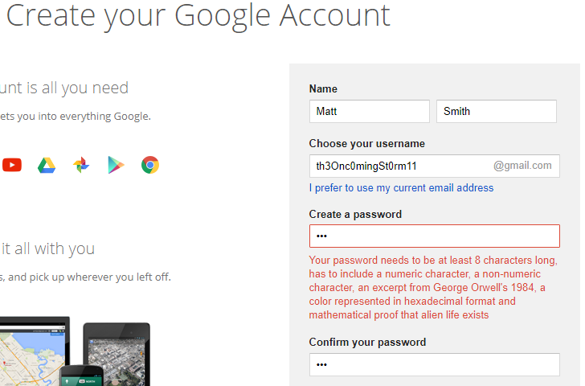
Password policies
Insane password requirements don’t really help against hackers and scares off customers
Passwords
Notes:
There seem to be two extremes on the web currently.
Either the password requirements are so absurd that you’ll have a hard time remembering the password you chose.
This causes users to either flee your site or write down their password somewhere to be able to remember it later (which is really unsecure).

Slide 34
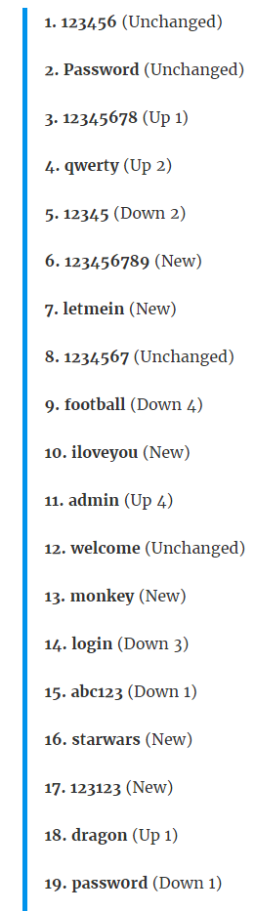
Password policies
Having no password requirements has users default to really easy to guess passwords
2017’s most used passwords
Passwords

Slide 35
Three types of authentication
Recap of hacker’s toolbox
Brute force
Hates long passwords
Dictionary attack
Hates made up words and long combinations of real words
Rainbow table
Can only reverse hash words it already knows
Passwords

Slide 36
Storing passwords
What are the properties of a good (= hard to hack) password?
Long (12 – 20 characters)
Contains lowercase, uppercase, non-numeric and special characters
Don’t be predictable
Don’t include your favorite superhero, name of your mom, etc
Never reused on other sites
Passwords
Notes:
Dont be predictable: dont use your favorite soccer club/movie/book/superhero in your password

Slide 37
Storing passwords
How to think of a good (= hard to hack) password?
Passphrase: combine 12 or more random words. Eg:
ProtectCucumberBricksThatInhaleTwentyAngularSticksDroolElephantMyMind
And then add numbers and special characters
Generate a random password
Passwords
Notes:
https://fossbytes.com/how-to-set-an-easy-password-thats-hard-to-crack/

Slide 38
Storing passwords
How to remember all those good (= hard to hack) password?
Use a 3 level password system
Level 1: ‘throwaway passwords’. Easy to remember, reused on multiple sites where you don’t mind losing it or all data those site have about you.
Level 2: harder to remember. Used on sites you would mind if they were hacked. You can use the same password on each level 2 site, but every time use a slight variation so you don’t lose all your passwords if one of the level 2 sites is hacked
Level 3: Used for the most important sites. Use for very important accounts, like financial or health. None of these passwords should be similar to each other.
Use a password manager
Passwords
Notes:
Level 1: ‘throwaway passwords’. Easy to remember, reused on multiple sites where you don’t mind losing it or all data those site have about you.
Level 2: harder to remember. Used on sites you would mind if they were hacked. You can use the same password on each level 2 site, but every time use a slight variation so you don’t lose all your passwords if one of the level 2 sites is hacked
Level 3: Used for the most important sites. Use for very important accounts, like financial or health. None of these passwords should be similar to each other.

Slide 39
References
Authentication

Slide 40
References
N-Factor authentication: https://en.wikipedia.org/wiki/Authentication#Factors_and_identity
Fingerprints are not suitable to use as passwords: https://hackaday.com/2015/11/10/your-unhashable-fingerprints-secure-nothing/
Hard to crack password strategies: https://fossbytes.com/how-to-set-an-easy-password-thats-hard-to-crack/
Passwords

Slide 41
Securing sessions
Chapter 3

Slide 42
Overview
√ Hackers
√ Passwords
Securing sessions
Securing client-side sessions
Https

Slide 43
Securing client-side sessions
Securing sessions

Slide 44
Securing client-side sessions
The basics of client-side sessions
Stateless backend
Backend has no knowledge about the active sessions
Securing sessions

Slide 45
Securing client-side sessions
What is a session?
A dialogue
Between two or more devices
Set up at a certain point in time (logging in)
Torn down at a certain point in time (logging out, or after a certain period of inactivity)
Securing sessions
Notes:
https://en.wikipedia.org/wiki/Session_(computer_science)

Slide 46
Securing client-side sessions
The basics of client-side sessions
Stateless backend
Backend has no knowledge about the active sessions
Session data stored on the client (browser)
Client sends session data to server with every request
To prevent tampering of data, 3 things need to be guaranteed:
Confidentiality: Nothing apart from the server should be able to interpret session data.
Data integrity: Nothing apart from the server should manipulate session data (accidentally or maliciously).
Authenticity: Nothing apart from the server should be able to initiate valid sessions.
Securing sessions
Notes:
https://en.wikipedia.org/wiki/Session_(computer_science)#Client-side_web_sessions

Slide 47
Securing client-side sessions
The Authorization header (recap)
Sent with every request
Contains session data (eg: username + password)
Data usually encoded using Base64
Encoded =/= Encypted!
Securing sessions

Slide 48


Securing client-side sessions
Securely communicating session data using JSON Web Tokens
Comprised of three parts
Header
Payload
Signature
Base64 encoding all parts:
Added to every request the client does
Securing sessions
Notes:
JWT generated by server after user logs in succesfully
Header: type of token + algorithm to use to generate signature
Payload: iat: issued at (time)
https://jwt.io/
https://en.wikipedia.org/wiki/JSON_Web_Token
https://en.wikipedia.org/wiki/HMAC
https://security.stackexchange.com/questions/108662/why-is-bearer-required-before-the-token-in-authorization-header-in-a-http-re
https://dev.to/neilmadden/7-best-practices-for-json-web-tokens

Slide 49
Securing client-side sessions
Securely communicating session data using JSON Web Tokens
Confidentiality
Tokens can be encrypted by the server so only he knows the content
Data integrity
Tokens are signed by server, so both client and server can verify if the token hasn’t been tampered with
Authenticity
Can be verified using the server’s key
Securing sessions

Slide 50
References
Securing sessions

Slide 51
References
Session: https://en.wikipedia.org/wiki/Session_(computer_science)
JSON Web tokens
https://jwt.io/
https://en.wikipedia.org/wiki/JSON_Web_Token
https://en.wikipedia.org/wiki/HMAC
https://security.stackexchange.com/questions/108662/why-is-bearer-required-before-the-token-in-authorization-header-in-a-http-re
https://dev.to/neilmadden/7-best-practices-for-json-web-tokens
Securing sessions

Slide 52
Https
Chapter 4

Slide 53
Overview
√ Hackers
√ Passwords
√ Securing sessions
Https
Why Https?
Why is Https secure?
Secure connections with TLS
Certificates

Slide 54
Why HTTPS?
Https

Slide 55
Why HTTPS?
With regular HTTP, all traffic between client and server is communicated using plain-text. This makes man in the middle attacks possible
Hacker on the same network as you can
Read traffic
Change traffic client sends to server
Change traffic server sends to client
Act as the server
How you doin’?
Feeling quite insecure lately
StupidQuestions,org’s server
Client (Bob)
Https

Slide 56
Why HTTPS?
With HTTPS(ecure), a hacker cannot
Inspect data sent between client and server, because all data is encrypted
Alter the data sent between client and server, because either party will find out if the data is still intact at decryption time
Act as if he is the server, because the client will find out when he is trying to decrypt the fake server’s responses
Secure HTTPS connection between client and server
How you doin’?
Feeling quite insecure lately
StupidQuestions,org’s server
Client (Bob)
Https

Slide 57
Why HTTPS?
HTTPS hides the following from hackers listening in:
URL
Query parameters
Headers
Cookies
Data sent between client and server
HTTPS does not hide
IP address
The base url of the site
Amount of data transferred and how long it took to transfer between client and server
Https

Slide 58
Why is HTTPS secure?
Https

Slide 59
Why is HTTPS secure?
Https uses Transport Layer Security (TLS) to encrypt communication between parties
Certificates backed by Certificate Authorities help browsers trust real HTTPS connections (and blacklist fakes)
Https

Slide 60
Secure connections with TLS
Https

Slide 61
Secure connections with TLS
TLS is a cryptographic protocol and the successor to Secure Sockests Layer, a protocol that you’re no longer allowed to use due to security holes.
TLS uses asymmetric to create a session between client and server
TLS uses symmetric cryptography to encrypt data sent during a session
Https

Slide 62
Secure connections with TLS
Asymmetric encryption
Using Asymmetric encryption, a session between client and server is initialized
A session key is generated and shared between both parties
As soon as the session key is shared, symmetric encryption is used
The server has two keys (long, random strings)
Public key, shared with the whole world
Private key, only known to the server
Data can be encrypted using one of the keys, but can only be decrypted by the other one
EG: Encrypted data by the public key can then only be decrypted by the private key
Https

Slide 63
Secure connections with TLS
Asymmetric encryption: prelude
Hey, I want to start a session with you! I support up to SSL version XXX and cryptographic algorithms A,B and C
server
Client
Hey man, let’s use version XXX-2 and algorithm B
Can I see your certificate?
There you go
Looks legit!
Https

Slide 64
Secure connections with TLS
Asymmetric encryption in 4 easy steps
Let’s get this secure party started!
server
Client
Here’s my public key
Generates random ‘session key’ and encrypts it using the server’s public key
Decrypts session key using it’s private key. Both parties now know the session key. Communication now switches to symmetric encryption
Https

Slide 65
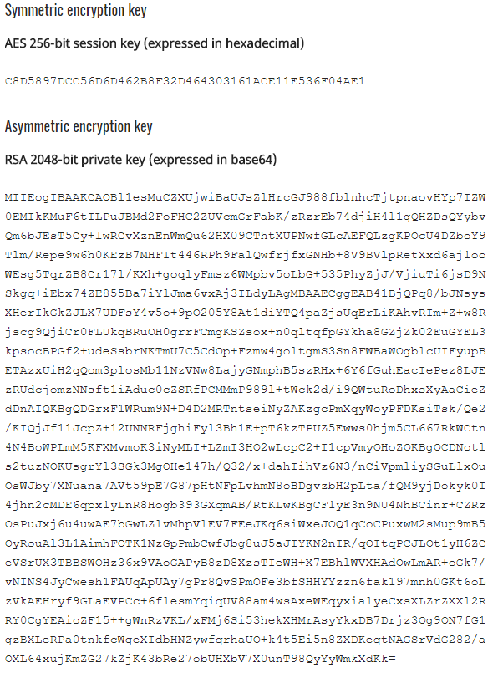
Secure connections with TLS
Why don’t we use Asymmetric encryption for all communication?
Computational overhead for asymmetric encryption is far greater than for symmetrical
EG: Symmetric key size vs Asymmetric key size:
Https

Slide 66
Secure connections with TLS
Why don’t we use Asymmetric encryption for all communication?
Encrypted communication only goes one way
Client can send encoded data to the server (using the server’s public key) but server wouldn’t be able to send encoded data back to the client
Https

Slide 67
Secure connections with TLS
Symmetric encryption
Encodes request using shared session key, server decodes request using shared session key
server
Client
Encodes response using shared session key, client decodes request using shared session key
Https

Slide 68
Secure connections with TLS
Why don’t we use Symmetric encryption for all communication?
You need a way to share a secret key between two parties
If the server just sends the session key to the client, anyone listening in on the network could steal the key and hijack the session
Https

Slide 69
Certificates
Https

Slide 70
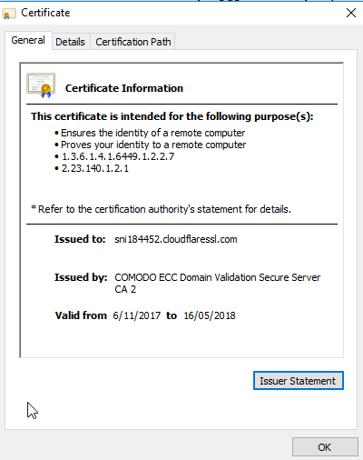
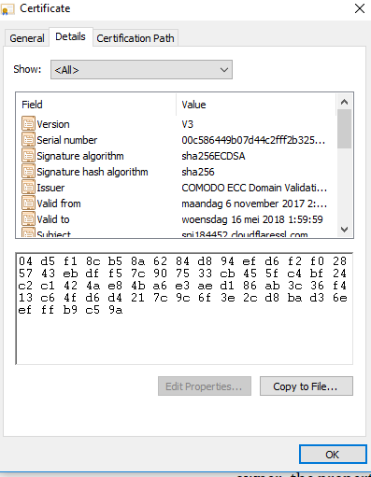
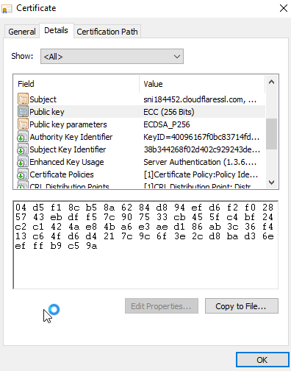
Certificates
Certificates
Https

Slide 71
Certificates
Why should I trust your certificate?
Certificates are issued by Certificate Authorities (CA’s).
CA’s are a ‘trusted third party’
Your browser has a list of CA’s it knows to trust
If a CA gets hacked (EG: DigiNotar), all of its certificates become garbage, because a hacker could create certificates under the CA’s name and use them for malicious practices.
Faking certificates is very hard. A hacker could create a certificate himself, but it would show up as ‘self-signed’ to the browser and will be flagged as ‘not trusted’. To successfully create a certificate trusted by the browser, you would need the CA’s private key.
Https

Slide 72
References
Https

Slide 73
References
HTTPS
https://en.wikipedia.org/wiki/HTTPS
https://robertheaton.com/2014/03/27/how-does-https-actually-work/
https://tiptopsecurity.com/how-does-https-work-ssl-tls-explained/
https://stackoverflow.com/questions/11047103/how-can-i-get-the-public-key-of-a-webpage
https://security.stackexchange.com/questions/8145/does-https-prevent-man-in-the-middle-attacks-by-proxy-server
Https

Slide 74
References
TLS and Encryption
https://en.wikipedia.org/wiki/Transport_Layer_Security
https://en.wikipedia.org/wiki/Public-key_cryptography
https://www.reddit.com/r/explainlikeimfive/comments/1jvduu/eli5_how_does_publicprivate_key_encryption_work/
Https

Slide 75
References
Certificates
https://en.wikipedia.org/wiki/Certificate_authority
https://security.stackexchange.com/questions/11832/why-is-faking-ssl-certificate-difficult
Free CA: https://letsencrypt.org/
DigiNotar (hacked CA): https://en.wikipedia.org/wiki/DigiNotar
Https

Slide 76
Security | Extra topics
www.switchfully.com

