Slide 1

Security
www.switchfully.com
Notes:
Disclaimer: I am not an expert, neither should you be. You should have a basic understanding of the security principles and be able to secure your code.
Slides won’t have much info, most things I say will be explained in the comments of the slides

Slide 3
Overview

Slide 4
Overview
Common attacks
Authentication
Authorization
Features
Additional access checks

Slide 5
Overview
Common attacks
Authentication
Authorization
Features
Additional access checks
Theory
Codelabs!

Slide 6
Overview
Common attacks
OWASP
Password stealing
Cross-site request forgery
Man in the middle attack
Code injection
Insecure direct object reference
Broken access controls
Third-party security vulnerabilities
Authentication
Authorization
Features
Additonal access checks

Slide 7
Overview
Common attacks
Authentication
What is authentication?
Authentication in modern client-side web apps
Realms
Spring security
Authorization
Features
Additional access checks

Slide 8
Overview
Common attacks
Authentication
Authorization
Authentication vs Authorization
Roles
Features
Additional access checks

Slide 9
Overview
Common attacks
Authentication
Authorization
Features
Feature based security aka Permission based security
Additional access checks

Slide 10
Overview
Common attacks
Authentication
Authorization
Features
Additional access checks
Introducing more complex authorization checks

Slide 11
Common attacks
Chapter 1

Slide 12
Overview
Common attacks
OWASP
Password stealing
Cross-site request forgery
Man in the middle attack
Code injection
Insecure direct object reference
Broken access controls
Third-party security vulnerabilities
Authentication
Authorization
Features
Additonal access checks

Slide 13
OWASP
Common attacks
Notes:
OWASP = Open Web Application Security Project
Publishes top 10 of possible security vulnerabilities of websites globally. They rank based on the number sites that are vulnerable, how easy it is to perform the attack and the severity of the consequences if the attack should happen.
Most recent top 10 is from 2017
PDF can be found here: https://www.owasp.org/images/7/72/OWASP_Top_10-2017_%28en%29.pdf.pdf

Slide 14
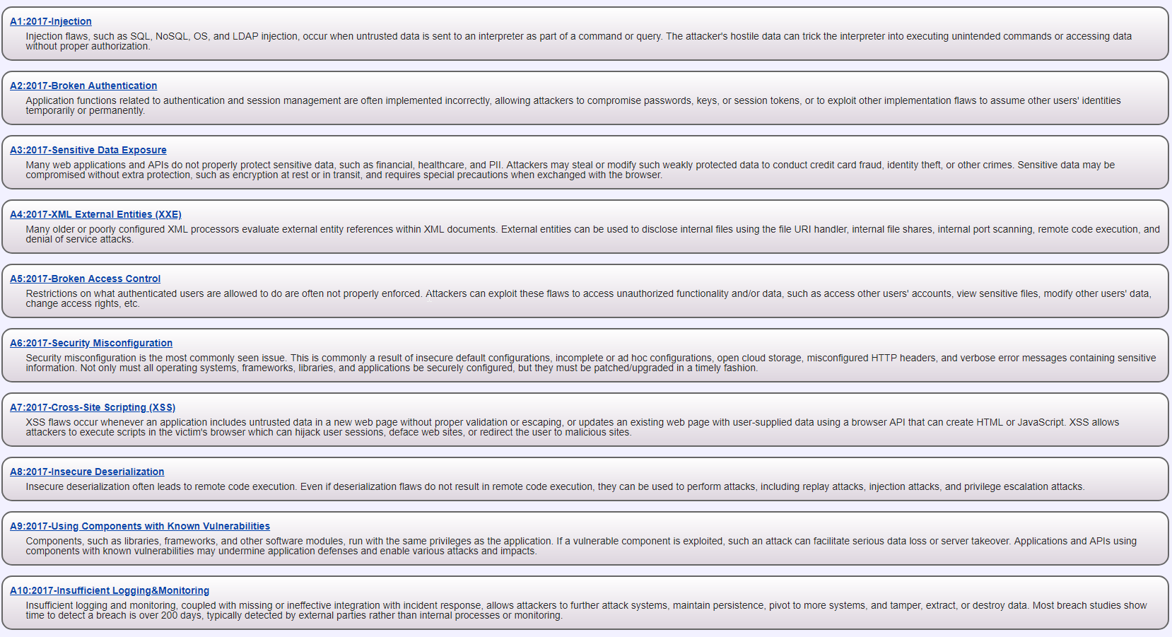
OWASP
Common attacks
Notes:
We will be talking about each of the indicated risks during the course.
Final topic can be found in the ‘extra topics’ powerpoint.

Slide 15
Password stealing
Common attacks

Slide 16


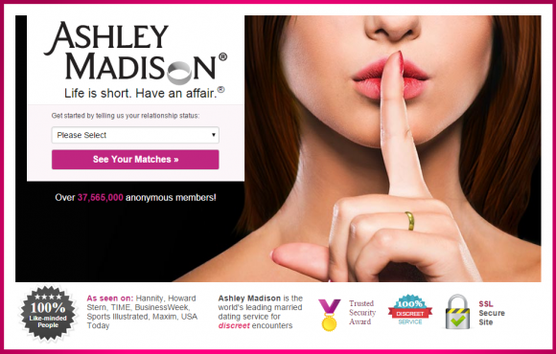





Password stealing
Keeping passwords safe, even after your database gets hacked
Common attacks
Notes:
Often when big companies get hacked, it turns out they saved the user’s passwords as plain tekst.
https://arstechnica.com/tech-policy/2011/06/sony-hacked-yet-again-plaintext-passwords-posted/

Slide 17
Password stealing
Storing passwords in the database as plaintext is never a good idea
Once a hacker gains access to your database, their job is done
Any employee with database access can steal all the customer’s account info
Common attacks

Slide 18
Password stealing
Alternatives to plain-text storage
Since the hacker already has access to all the data, the goal is to really slow him down when he’s trying to get hold of your users’ passwords.
Common attacks

Slide 19
Password stealing
Hashes
‘switchfully’ -> SHA512 -> ‘A8C42DD0635A5755E994AA735E3B94F6E0124FB7378FCBCFFA776AF7301CFF818ACC1379BB723D2B8B7AD5A01286BDDA2448394D9DA41E45E5314AB04060F629’
‘sw1tchfully’ -> SHA512 ->
‘7F900592A0BED8DF4E3A3193F6C809BF45D45E71C0227FDB71D6C4E887F2C3CC5685E0777047577B0777DB0702DDB65ACAFD3D7F4DA2FBB570B2F5E6C97C1991’
Common attacks
Notes:
https://passwordsgenerator.net/sha512-hash-generator/
http://md5decrypt.net/en/Sha512
https://en.wikipedia.org/wiki/SHA-2

Slide 20
Password stealing
Hashes
Deterministic
A given input will always result in the same output
Quick to calculate
No clashing outputs
Unfeasible to guess input based on output
Estimated time to brute-force a salted SHA-512 hash: 3,17 * 10^64 years
A small change at the input side results in a big change at the output side
Common attacks
Notes:
Deterministic -> A given input always results in the same output
https://en.wikipedia.org/wiki/Cryptographic_hash_function
https://stackoverflow.com/questions/6776050/how-long-to-brute-force-a-salted-sha-512-hash-salt-provided

Slide 21
Password stealing
The hacker’s toolbox to steal passwords
Brute-force attack
Credential recycling
Dictionary attack
Rainbow table
Common attacks

Slide 22
Password stealing
Brute-force attack
aka
“Let’s try every possibility”
-> Longer passwords/hashes take a longer time to find
-> Mostly interesting when trying to break into a system via a login form
-> Don’t allow users to perform more than a few incorrect login attempts/minute
Common attacks
Notes:
https://en.wikipedia.org/wiki/Brute-force_attack

Slide 23
Password policies
Credential recycling
Hacker reuses your username/password combination obtained from earlier hacks
Not much an application can do about it
‘Suspicious login attempt’ notifications
Force user to come up with an uncommon password
Common attacks
Notes:
Once you’ve found a victim’s username/password combination on one site, the odds are great that they’ve used that same combination on other sites.
As soon as your credentials are hacked on one site, they’re pretty much hacked on all sites you’ve ever created an account on.
Thus, it only takes 1 insecure site to give a hacker the keys to all your accounts.
https://en.wikipedia.org/wiki/Wikipedia:10,000_most_common_passwords
https://xkcd.com/792/

Slide 24
Password stealing
Dictionary attack
Loop over a dictionary or it’s hashed values and try every result to see if there’s a match
Modern tools can combine multiple words and use L33T5p34K
Won’t work against made up words, slowed down by long words or long combinations of words (10-12)
Common attacks
Notes:
Use words from the dictionary to guess the victim’s password
Modern dictionary attacks also implement leetspeak, so changing your password from ‘LovePuppies’ to ‘L0v3Pupp135’ won’t help that much
If hackers target a specific person, they also add words related to the person to the dictionary (eg name of their pet/friend/family/street, favorite author/movie, words regarding to their hobbies, idols, etc)
https://en.wikipedia.org/wiki/Dictionary_attack

Slide 25
Password stealing
Rainbow table
Contains huge list of mapping hash to plaintext password mappings
Eg: Hash: ‘a336f671080fbf4f2a230f313560ddf0d0c12dfcf1741e49e8722a234673037dc493caa8d291d8025f71089d63cea809cc8ae53e5b17054806837dbe4099c4ca’ is equal to the password ‘mypassword’
Common attacks
Notes:
https://en.wikipedia.org/wiki/Rainbow_table

Slide 26
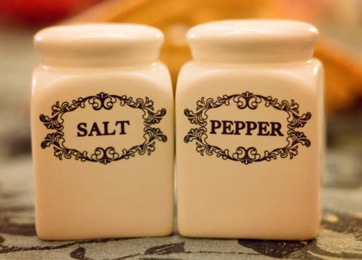
Password stealing
Seasoning your passwords to severely slow down rainbow tables
Common attacks

Slide 27

Password stealing
Salt
Generate a random string (the ‘salt’)
At least 256 bits long
Concatenate salt and password
Hash Password
Save Hashed password and the used salt in DB
The generated hash will not be in a rainbow table
Common attacks
Notes:
https://en.wikipedia.org/wiki/Salt_(cryptography)
Salt has to be ‘long enough’. 256 bits should be long enough.
https://stackoverflow.com/questions/9619727/how-long-should-a-salt-be-to-make-it-infeasible-to-attempt-dictionary-attacks
Don’t use the same salt for all records. Then hackers can generate a new rainbow table using that salt. With a different salt per record, he has to generate a new rainbow table per record, which increases the calculation times exponentially,
Also it is not obvious when two users share the same password,

Slide 28
Password stealing
Salt
Generate a random string (the ‘salt’)
At least 256 bits long
Concatenate salt and password
Hash Password
Save Hashed password and the used salt in DB
The generated hash will not be in a rainbow table
Hides the fact that 2 users share the same password
If you reuse the salt every time, the hacker just creates a new rainbow table using your salt!
Common attacks
Notes:
https://en.wikipedia.org/wiki/Salt_(cryptography)
Salt has to be ‘long enough’. 256 bits should be long enough.
https://stackoverflow.com/questions/9619727/how-long-should-a-salt-be-to-make-it-infeasible-to-attempt-dictionary-attacks
Don’t use the same salt for all records. Then hackers can generate a new rainbow table using that salt. With a different salt per record, he has to generate a new rainbow table per record, which increases the calculation times exponentially,
Also it is not obvious when two users share the same password,

Slide 29
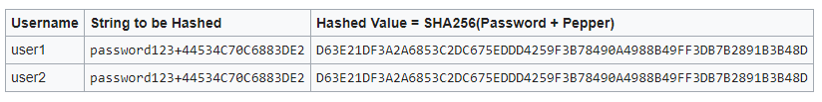
Password stealing
Pepper
Fixed random string per application
Add fixed string to password
Hash string and password
Save password in database
By itself less secure than a salt, but…
Slows hackers down if they hack multiple databases from the same company
Common attacks
Notes:
https://en.wikipedia.org/wiki/Pepper_(cryptography)
Peppers protect against rainbow tables, because all hashes have been randomized. Also slows down hackers if they gain access to multiple databases from the same company, because they all have their own unique salts.
If two passwords are the same, their hashes will still be the same after peppering

Slide 30

Password stealing
To really slow down hackers, add some salt and pepper
Common attacks

Slide 31
Password stealing
Do not use ‘security questions’ for password recovery
Answers to these questions are by definition not safe
Very easy to guess
“What’s your mother’s maidens name?” begs to be Dictionary attacked
Common attacks

Slide 32
Cross-site request forgery
Common attacks

Slide 33
CSRF
Logs in: session data is saved in cookie
Has a great time using the site’s features
VulnerableBankingapp.com
John
Without John’s knowledge, performs request to VulnerableBankingapp to transfer John’s money to hacker’s account
John’s session cookie is still active, so request is accepted
Accidently stumbles upon site
Fills in a form to see some cute puppy pictures
John
GonnaStealYourMoney.com
Common attacks

Slide 34
CSRF
Why does this happen?
Cookies remain valid for a long time
All cookies are automatically sent with every request
Backend has no way of knowing the origin of the request
Common attacks

Slide 35
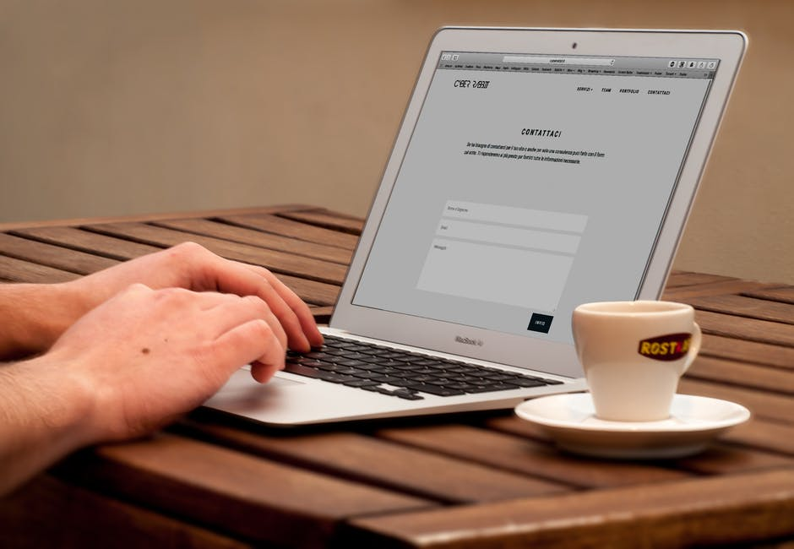
CSRF
Dangerous elements: forms
<form action=”https://www,bank,com/transfer” method=“post”>
Common attacks

Slide 36

CSRF
Dangerous elements: images
Common attacks

Slide 37

CSRF
Dangerous elements: transparent images
Common attacks

Slide 38
CSRF
Dangerous elements: fully automated on page load
Common attacks

Slide 39
CSRF
Protecting against CSRF: Synchroniser Token
JavaScript code can only read cookies from its own domain, so JS code on www.evilwebapp.com can’t read cookies from www.totallysecurebankingapp.com
Create a second cookie we use to check if a request originates from our own site and not some attackers’.
Common attacks
Notes:
https://docs.spring.io/spring-security/site/docs/current/reference/html/csrf.html

Slide 40
CSRF
1. POST /login (Header: Authorization: Basic xyz123)
server
Client
3. Correct username/password combination! Awesome!
Token: lkdsqjfknvzoefizujkqlsjgsqmglkjh3254sdgfqsg
2. Server creates session data for user and Synchroniser token
4. Client saves value as XSRF-TOKEN cookie
and authentication header as AUTHORIZATION cookie
Common attacks
Notes:
https://docs.spring.io/spring-security/site/docs/current/reference/html/csrf.html

Slide 41
CSRF
5. POST /sendMoney (Header: Authorization: Basic xyz123,
X-XSRF-TOKEN: lkdsqjfknvzoefizujkqlsjgsqmglkjh3254sdgfqsg)
server
Client
6. Token and user combination are correct!
Common attacks
Notes:
https://docs.spring.io/spring-security/site/docs/current/reference/html/csrf.html

Slide 42
Man in the middle attack
Common attacks

Slide 43
MITM
Hey John
Hey Paul
Paul
John
Common attacks

Slide 44
MITM
Paul
John
Hey John
Hey John
Hey Paul
Hey Paul
Ringo
Eavesdropping on communication
Common attacks

Slide 45
MITM
Paul
John
I’ve got this great idea for a new song called Yellow submarine
Hey John
We think you should leave the singing to Ringo
What? That sounds stupid!
Ringo
Alters communication, without sender or receiver realizing it
Common attacks

Slide 46
MITM
Man in the middle attacks
Easy to perform on a public network (wi-fi)
All data travels over the network
Eavesdropping also done by government agencies like NSA
Can also be used to fake a server
Common attacks

Slide 47
MITM
Stopping man in the middle attacks
Upgrade to HTTPS
Establishes safe tunnel between two parties
All traffic in the tunnel is encrypted and can only be decrypted by sender or receiver
All traffic is signed, so tampering is immediately detected
Moving from HTTP to HTTPS has been simplified and become less costly in recent years
Common attacks
Notes:
More info on https in extra topics

Slide 48
Code injection
Common attacks

Slide 49

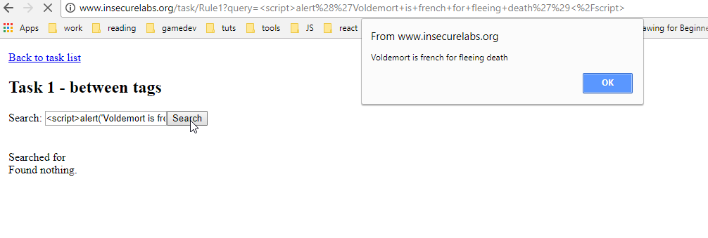
Code injection
Injecting code using input fields
Common attacks

Slide 50
Code injection
Injecting code using url parameters
Common attacks

Slide 51
Code injection
The cause of code injection
Application naively trusts any data it receives
Any type of code can be injected
HTML
JavaScript
SQL
…
Common attacks

Slide 52
Code injection
Two types of code injection
Part of the request, outputted in the response
Content is saved in a datastore and inserted in the ui later
Common attacks

Slide 53

Code injection
SQL injection
‘ OR ‘1’=‘1
Lennon’); DROP TABLE USERS;--
Lennon’); UPDATE TABLE USERS SET PASSWORD=‘gimmeaccess’ where 1<2;--
In the backend…
Query=“SELECT * FROM USERS WHERE USERNAME =‘”+login+”’”
Common attacks

Slide 54
Code injection
Avoiding sql injection
Separate code from data
== Don’t user string literal escape characters
Use parametrized statements instead
Select * from user where username = “’”+login+”’”
becomes
Select * from user where username=:login
{“login”: login}
ORM’s use this by default
Common attacks

Slide 55
Code injection
Avoiding code injection
Escape code-specific characters
<script>alert(‘gotcha’)</script>
Becomes
&lt;script&gt;alert(‘gotcha’)&lt;/script&gt;
Common attacks

Slide 56
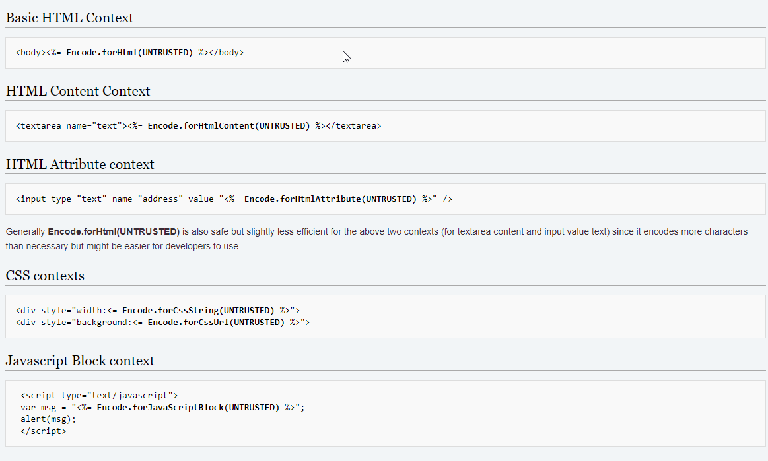
Code injection
OWASP Java Encoder Project
Common attacks

Slide 57
Insecure direct object reference
Common attacks

Slide 58
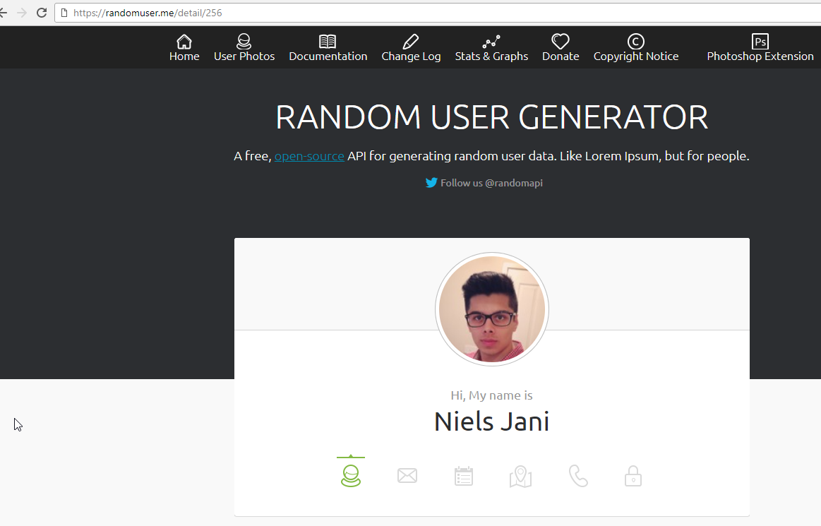
Insecure direct object reference
Common attacks

Slide 59
Insecure direct object reference
Can you guess what other users exist?
Common attacks

Slide 60
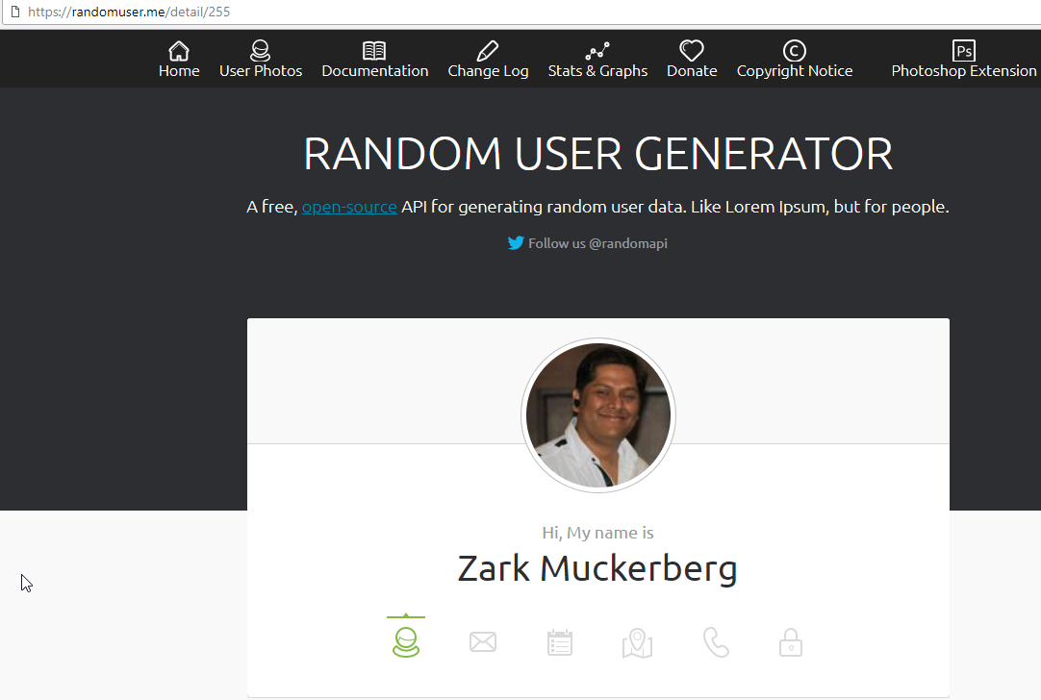
Insecure direct object reference
Common attacks

Slide 61
Insecure direct object reference
Insecure direct object reference
Identifiers are easily guessable (even without hacker’s tools)
Auto-incrementing database keys
First name + Last name
Passport number
Common attacks

Slide 62
Insecure direct object reference
Preventing insecure direct object reference
Use long, random ID’s to identify data
UUID’s
…but someone(‘s tools) might still guess an ID
Add explicit authorization checks when handling data
Add a ‘CreatedUser’ to an object when persisting the first time
When someone tries to read/update/delete object, check if he is the ‘CreatedUser’
Common attacks

Slide 63
Broken access control
Common attacks
Notes:
https://www.owasp.org/index.php/Top_10-2017_A5-Broken_Access_Control

Slide 64
Broken access control
Common attacks

Slide 65
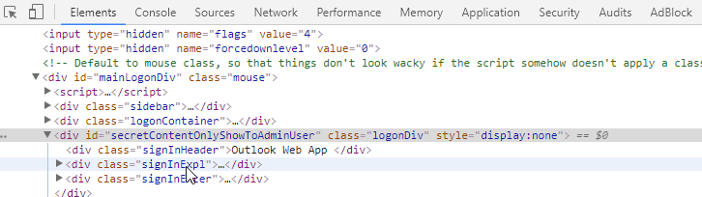
Broken access control
Common attacks

Slide 66
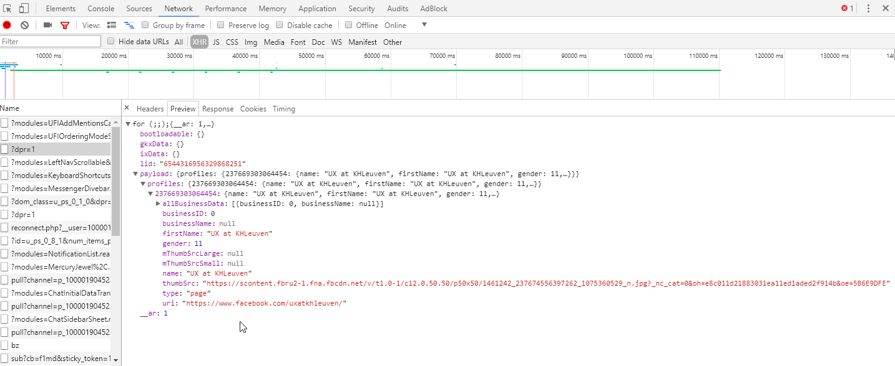
Broken access control
Common attacks
Notes:
Facebook does 309 requests when loading homepage

Slide 67
Broken access control
Broken access control
Everything in the user interface can be manipulated by user
URL’s
HTML content
Scripts
All traffic between user and server can be inspected
Simply hiding parts of the data with css is not enough if that data is still sent over the wire
UI can be bypassed completely
User can find out the backend urls and call it directly
Common attacks

Slide 68
Broken access control
No more broken access control
Block off most resources from unauthorized users
Functionalities like registering and logging in still need to be publicly available
Implement authorization checks
Only send content to the ui that the user is allowed to see
Check if a user can perform a certain action, can see a certain piece of data, etc…
Common attacks

Slide 69
Third-party security vulnerabilities
Common attacks
Notes:
https://www.owasp.org/index.php/Top_10-2017_A5-Broken_Access_Control

Slide 70
Third-party security vulnerabilities
Today’s development stack relies heavily on other people’s code
Java: third-party libraries such as Spring, Hibernate, Guava, …
JavaScript: Node modules (‘downloading the internet’), Angular/React/Vue, …
Styling: Bootstrap, Foundation, …
Build tools: Jenkins, TeamCity, …
Servers & Deployment tools: Tomcat, Puppet, Hiera, …
Common attacks

Slide 71
Third-party security vulnerabilities
Everything you use might have security holes and might be an opportunity for a hacker to enter your system
Don’t leave any services accessible without authorization
Change the default username and password combination
Replace components that are no longer supported by supplier
Try to upgrade to the latest stable version asap, especially when release notes mention security fixes
Monitor specialized sites for up-to-date info on discovered security holes
Common attacks
Notes:
https://cve.mitre.org/

Slide 72
References
Common attacks

Slide 73
References
OWASP
Top 10: https://www.owasp.org/index.php/Top_10-2017_Top_10
Top 10 pdf: https://www.owasp.org/images/7/72/OWASP_Top_10-2017_%28en%29.pdf.pdf
Common attacks

Slide 74
References
Password stealing
Hacked company stored passwords unencrypted: https://arstechnica.com/tech-policy/2011/06/sony-hacked-yet-again-plaintext-passwords-posted/
SHA-2: https://en.wikipedia.org/wiki/SHA-2
Hash function: https://en.wikipedia.org/wiki/Cryptographic_hash_function
Encrypt text online: https://passwordsgenerator.net/sha512-hash-generator/
Try to decypt: http://md5decrypt.net/en/Sha512
Common attacks

Slide 75
References
Password stealing
Salt: https://en.wikipedia.org/wiki/Salt_(cryptography)
How long should a salt be? https://stackoverflow.com/questions/9619727/how-long-should-a-salt-be-to-make-it-infeasible-to-attempt-dictionary-attacks
Time needed to crack a salted hash: https://stackoverflow.com/questions/6776050/how-long-to-brute-force-a-salted-sha-512-hash-salt-provided
Pepper: https://en.wikipedia.org/wiki/Pepper_(cryptography)
Common attacks

Slide 76
References
Password stealing
10,000 most common passwords: https://en.wikipedia.org/wiki/Wikipedia:10,000_most_common_passwords
Brute-force attack: https://en.wikipedia.org/wiki/Brute-force_attack
Dictionary attack: https://en.wikipedia.org/wiki/Dictionary_attack
Rainbow table: https://en.wikipedia.org/wiki/Rainbow_table
Owasp risk: https://www.owasp.org/index.php/Top_10-2017_A3-Sensitive_Data_Exposure
Common attacks

Slide 77
References
CSRF
OWASP: https://www.owasp.org/index.php/Cross-Site_Request_Forgery_(CSRF)
In-depth explanation: https://www.troyhunt.com/owasp-top-10-for-net-developers-part-5/
CSRF risk with headers: https://security.stackexchange.com/questions/62080/is-csrf-possible-if-i-dont-even-use-cookies
Synchronizer token & Spring: https://docs.spring.io/spring-security/site/docs/current/reference/html/csrf.html
CSRF and Angular: https://stormpath.com/blog/angular-xsrf
Common attacks

Slide 78
References
Man in the middle
Wikipedia: https://en.wikipedia.org/wiki/Man-in-the-middle_attack
HTTPS: https://en.wikipedia.org/wiki/HTTPS
How HTTPS prevents MITM: https://security.stackexchange.com/questions/8145/does-https-prevent-man-in-the-middle-attacks-by-proxy-server
Common attacks

Slide 79
References
Code injection
SQL injection: https://en.wikipedia.org/wiki/SQL_injection
OWASP XSS: https://www.owasp.org/index.php/Top_10-2017_A7-Cross-Site_Scripting_(XSS)
OWASP Injection: https://www.owasp.org/index.php/Top_10-2017_A1-Injection
OWASP Encoder project: https://www.owasp.org/index.php/OWASP_Java_Encoder_Project
Common attacks

Slide 80
References
Insecure direct object reference
OWASP: https://www.owasp.org/index.php/Top_10_2013-A4-Insecure_Direct_Object_References
https://affinity-it-security.com/what-is-an-insecure-direct-object-reference/
Common attacks

Slide 81
References
Broken access control
OWASP: https://www.owasp.org/index.php/Top_10-2017_A5-Broken_Access_Control
OWASP: https://www.owasp.org/index.php/Top_10-2017_A2-Broken_Authentication
Common attacks

Slide 82
References
Vulnerabilities in third-party libraries
OWASP: https://www.owasp.org/index.php/Top_10-2017_A9-Using_Components_with_Known_Vulnerabilities
OWASP: https://www.owasp.org/index.php/Top_10-2017_A6-Security_Misconfiguration
Recently discovered vulnerabilities: https://cve.mitre.org/
Common attacks

Slide 83
Authentication
Chapter 2

Slide 84
Overview
√ Common attacks
Authentication
What is authentication?
Authentication in modern client-side web apps
Realms
Spring security
Authorization
Features
Additional access checks

Slide 85
What is authentication?
Authentication

Slide 86
What is authentication?
Authentication
= the act of confirming the truth of an attribute of a single piece of data claimed true by an entity.
AKA
Proving you are who you claim to be
Authentication

Slide 87
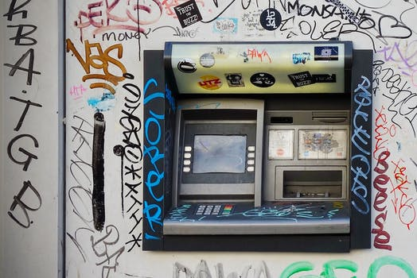
What is authentication?
Authentication in the physical world
Bank card + pincode
ID card + code
Authentication

Slide 88
What is authentication?
Authentication in the digital world
Username + password are the most used
Fingerprints
Facial recognition
…
Authentication

Slide 89
What is authentication?
Authentication in the digital world
Username + password are the most used
Fingerprints
Facial recognition
…
Today’s focus in the exercices
Also just data, so not that different
Authentication

Slide 90
Authentication in modern client-side web apps
Authentication

Slide 91
Authentication in modern client-side web apps
Enter the authorization header
Sent with every request to the server
Payload => Basic username:password
Payload encoded using Base64
Eg: Aladdin:OpenSesame becomes
Encoding =/= Encrypting!
Anyone can easily decode the contents. Use HTTPS and JSON Web Tokens for encrypting this data
Authentication

Slide 92
Authentication in modern client-side web apps
Why Base64?
Computers talk to eachother in binary (0’s and 1’s)
Computers use different configurations to transform from binary back to ‘readable’ text
EG: line ending encoding might modify ASCII character 10 (line feed) and 13 (carriage return)
Base64 was one of the mechanisms built to bypass these dangers
Authentication
Notes:
https://stackoverflow.com/questions/3538021/why-do-we-use-base64

Slide 93
Realms
Authentication

Slide 94
Realms
Realms
Divide the resources into a set of protection spaces, each with their own authentication scheme and/or authorization database
Authentication

Slide 95
Realms
Realms
/api/v1/apples/*
/api/v1/pears/*
/api/v1/bananas/*
/api/v1/oranges/*
Realm A
Authorisation: Basic
“John”/”Azerty123”
“Mike”/”Azerty456”
…
Realm B
Authorisation: JSON Web Tokens
“Chris”/”Qwerty123”
“Mike”/”Qwerty123”
…
Authentication
Notes:
https://stackoverflow.com/questions/12701085/what-is-the-realm-in-basic-authentication

Slide 96
Spring security
Authentication

Slide 97
Spring security
Spring security features
Authentication
Authorization
Protection against CSRF
Integration with Spring Web
Support for number of popular security frameworks
OAuth2
LDAP
…
Authentication
Notes:
https://projects.spring.io/spring-security/

Slide 98
Codelabs
Codelab 1: Operation Avocado
GOTO https://github.com/nielsjani/switchfully-security
FORK
READ STORIES.MD (YOU’RE IN THE ARMY NOW + SOME TACTICAL NOTES + OPERATION AVOCADO)
COMPLETE OPERATION AVOCADO
HAVE FUN
Authentication
Notes:
After done, debug in BasicAuthenticationFilter to show what happens

Slide 99
Codelabs
Codelab 1: Operation Avocado: Debriefing
GET /armies/Cuba
BasicAuthenticationFilter
Fetch Authorisation header
Decode
Is username/password in InMemory user store?
YES
NO
ArmyResource
HTTP 403
Authentication

Slide 100
Codelabs
Codelab 1: Operation Avocado: Debriefing
Enabling Spring security
Add dependency
@EnableWebSecurity
SecurityConfig should extend from WebSecurityConfigurerAdapter
Override configure() method to start configuring security in general
SessionCreationPolicy should be stateless. Client needs to send header for every request and server should authenticate it every time
Use BasicAuthenticationEntryPoint for Basic authentication
Authentication

Slide 101
Codelabs
Codelab 1: Operation Avocado: Debriefing
PasswordEncoderFactories creates a DelegatingPasswordEncoder
DelegatingPasswordEncoder has a list of encoders , each for a different algorithm (MD4, scrypt, SHA, etc…)
Your encoded passwords in the inMemoryAuthentication need to be prefixed with the algorithm you wish to use. E.g. {noop}myencryptedpassword
You can also pick a single Encoder to use, like MessageDigestPasswordEncoder
No need to prefix your passwords with the algorithm. Encoder will automatically use the algorithm it was made for
When using a salt, it has to be put between the algorithm and the encoded password. E.g. {brypt}{saltNpepper}myencryptedpassword
Spring will add the salt AFTER the password when encoding!
Authentication

Slide 102
References
Authentication

Slide 103
References
Authentication
Wikipedia: https://en.wikipedia.org/wiki/Authentication
Basic authentication: https://en.wikipedia.org/wiki/Basic_access_authentication
Base64: https://en.wikipedia.org/wiki/Base64
Base64 encode/decode online: https://www.base64decode.org/
Why Base64: https://stackoverflow.com/questions/3538021/why-do-we-use-base64
Realm: https://stackoverflow.com/questions/12701085/what-is-the-realm-in-basic-authentication
Spring security: https://projects.spring.io/spring-security/
Authentication

Slide 104
Authorization
Chapter 3

Slide 105
Overview
√ Common attacks
√ Authentication
Authorization
Authentication vs Authorization
Roles
Features
Additional access checks

Slide 106
Authentication vs Authorization
Authorization

Slide 107
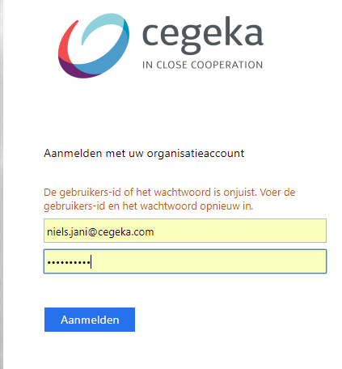
Authentication vs Authorization
Authentication: is this user who is claims to be?
Authorization
Notes:
Does the provide a username/password combination that is known to the system?

Slide 108
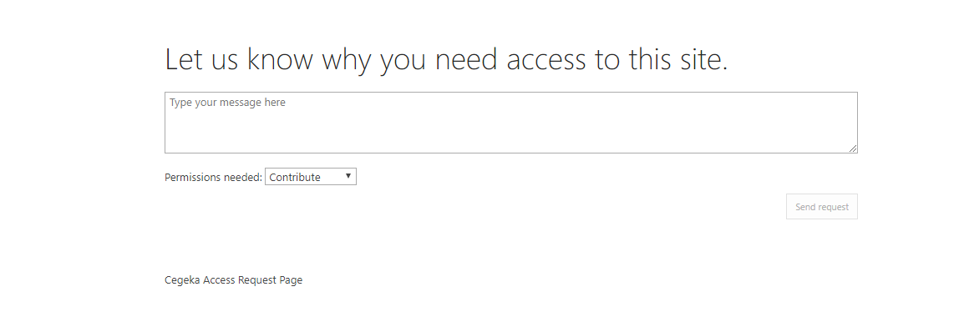
Authentication vs Authorization
Authorization: can this user perform this action?
Authorization
Notes:
Does the user’s account have sufficient permissions to access this feature (eg: web page, REST-call)?

Slide 109
Authentication vs Authorization
Authentication: Identity
Authorization: Permissions
Authorization

Slide 110
Authentication vs Authorization
Authentication: Identity
Authorization: Permissions
Unlock phone using fingerprint
Log in form
Online banking using card + pin
Authorization

Slide 111
Authentication vs Authorization
Authentication: Identity
Authorization: Permissions
Show completely different page based on role
Blocking off admin-only pages for regular users
Hiding patient records in search form for non treating doctors
Authorization

Slide 112
Roles
Authorization

Slide 113
Roles
Roles
Every user has username / password (authentication)
Most applications have the need to serve content to subset of users
EG: Facebook groups: regular members can create posts, group admins can change group name, invite members, etc…
Every user also has one or more roles
EG: Sales person needs to see both financial info (‘FINANCE’ role) and info on potential customers (‘CUSTOMERS’ role)
Authorization

Slide 114
Roles
Rewind to Chapter 1: Insecure direct object reference
All your front-end content can be altered by users
Hidden elements in HTML and CSS can be made visible
Data sent over the network can be inspected before it hits the screen
Rest endpoints can be called directly to retrieve data
Only adding authorization checks to UI is not enough
Authorization

Slide 115
Codelabs
Codelab 2: Operation Baobab
BRANCH BAOBAB-START
READ OPERATION BAOBAB
COMPLETE OPERATION BAOBAB
HAVE FUN
Authorization
Notes:
Debug in BasicAuthenticationFilter + SecurityExpressionRoot (this is called with both PreAuthorise and with the antmatchers solution)

Slide 116
Codelabs
Codelab 2: Operation Baobab: Debriefing
GET /armies/Cuba
HTTP 403
NO
BasicAuthenticationFilter
Fetch Authorisation header
Decode
Is username/password in InMemory user store?
NO
SecurityExpressionRoot
Get Allowed roles for URL
Get Roles for user
Does role have needed role(s)?
YES
YES
ArmyResource
Authorization

Slide 117
Codelabs
Codelab 2: Operation Baobab: Debriefing
Two ways to tackle problem
Both offer same functionalities
Using Antmatchers in SecurityConfig
Possible to group multiple URL’s under one regex
Go from specific to less specific with regexes
Possible to add HttpMethod. EG: antMatcher(GET, “some/url/**”)
Using PreAuthorize
@EnableGlobalMethodSecurity(prePostEnabled = true)
Annotate every RestEndpoint (method or class)
Don’t mix the approaches in one application
Might confuse your fellow developers (and future you)
Authorization

Slide 118
Features
Chapter 4

Slide 119
Overview
√ Common attacks
√ Authentication
√ Authorization
Features
Feature based security aka Permission based security
Additional access checks

Slide 120

Features
Time for another codelab!
Features

Slide 121
Codelabs
Codelab 3: Operation Cedar
BRANCH CEDAR-START
READ OPERATION CEDAR
COMPLETE OPERATION CEDAR
HAVE FUN
Features

Slide 122
Codelabs
Codelab 3: Operation Cedar: Debriefing
Create class that extends AuthenticationProvider
Supports: determines which type of token it will handle
Authenticate
Calls the service that hosts the user data (usually reached by doing a REST-call)
Throws some kind of AuthenticationException if anything goes wrong
Returns Authentication objects. These have a collection of GrantedAuthorities. To use our authority logic from Lab 2 on these, we have to change our ‘hasRole’ checks to ‘has Authority’
Use the AuthenticationProvider by adding it to the AuthenticationManagerBuilder in SecurityConfig
Builder also supports common authentication solutions like LDAP or JDBC
Features

Slide 123
Feature based security aka Permission based security
Features

Slide 124
Feature based security
Systems can be become quite complex over time
Manager
Janitor
GET /documents
POST /camis
Features

Slide 125
Feature based security
Systems can be become quite complex over time: more roles
Manager
Janitor
Clerk
Driver
Admin
Intern
Company cat
GET /documents
POST /camis
Features

Slide 126
Feature based security
Systems can be become quite complex over time: and more features
Manager
Janitor
Clerk
Driver
Admin
Intern
Company cat
GET /documents
POST /camis
DELETE /comment
GET /lunch
POST /promotion
……………………………..
Features

Slide 127
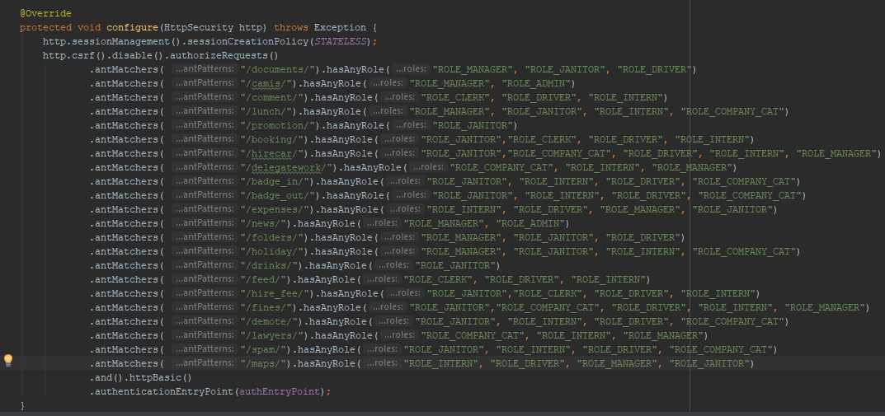
Feature based security
This also increases the complexity of your security config
Features

Slide 128
Feature based security
Feature requests
Janitors should also be able to perform all financial related activities
We made a mistake: interns shouldn’t be able to use any of the cafeteria’s services
There’s this now role: accountant. He’s like a regular employee, but he also gets access to financial data. He can’t use our dental plan, however.
Features

Slide 129

Feature based security
You, a poor developer
SHIIIIIIIIIT. WTF!?
Let me take a look.
Features

Slide 130
Feature based security
Problem
Security rules tend to change over the course of a project
Non-developers don’t think in terms of REST URL’s when talking about what someone should or shouldn’t be able to do
Non-developers often group a number of REST-calls together (an ‘epic’ of related actions), E.G.: create, view, delete and update a request for an absence
Current mechanisms don’t allow us to input these rules in a way that corresponds with non-technical thinking
Features

Slide 131
Feature based security
We need a new concept…
As a manager I want to see the hours worked of my employees, so I can see how much story points have already been used up.
Features

Slide 132
Feature based security
We need a new concept…: As Is
As a manager I want to see the hours worked of my employees, so I can see how much story points have already been used up.
Has 1 or more
Has 1 or more
User
Role
/rest/url
Features

Slide 133
Feature based security
We need a new concept…: To Be with Features!
As a manager I want to see the hours worked of my employees, so I can see how much story points have already been used up.
Has 1 or more
Has 1
Has 1 or more
User
Role
Feature
/rest/url
Features

Slide 134
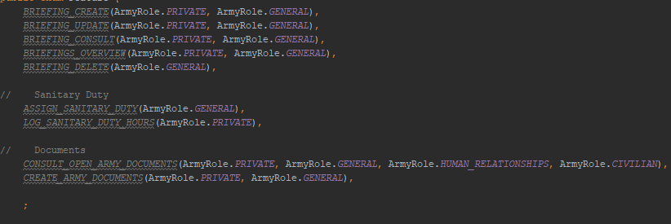
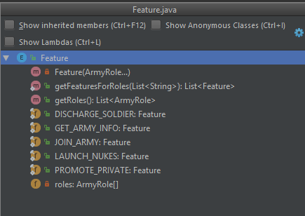
Feature based security
What a feature list might look like
Features

Slide 135
Feature based security
Features recap
A user’s role is a set of actions he is allowed to perform
Features make these actions explicit
EG: Feature ‘PUBLISH_NOVEL’ can be performed by anyone with any of the roles ‘INDEPENDANT_AUTHOR’ or ‘PUBLISHER’
Dividing code based on functional properties > Dividing code based on technical properties
Easier for human beings to find their way around
Great tool if you have a lot of different roles, still possible to use if you only have a few
Decouples relationship between roles and permissions
Calling code only cares about ‘can user x perform action y’
Features

Slide 136
Codelabs
Codelab 4: Operation Dogwood
BRANCH DOGWOOD-START
READ OPERATION DOGWOOD
COMPLETE OPERATION DOGWOOD
HAVE FUN
Features

Slide 137
Codelabs
Codelab 4: Operation Dogwood: Debriefing
No ‘official’ mechanisms to handle Features
Using Enums to handle the role -> feature mapping is a good idea
Mapping role(s) -> feature(s) needs to happen in AuthenticationProvider
Some handy Lambda-ing should do the trick
Features

Slide 138
Additional access checks
Chapter 5

Slide 139
Overview
√ Common attacks
√ Authentication
√ Authorization
√ Features
Additional access checks
Introducing more complex authorization checks

Slide 140
Introducing more complex authorization checks
Additional access checks

Slide 141
Introducing more complex access checks
Authorization checks beyond roles
Some REST endpoints require some extra checks to see if a user can access them
EG: ‘GET patient/record/detail/{patientid}’
Only accessible by accounts with role ‘DOCTOR’ AND if their userId is in the ‘treatingDoctors’ array on the PatientRecord Object
EG: ‘POST teams/{teamId}/invite/{athleteId}’
Only accessible by people with role ‘ATHLETE’ who are part of the team that has ‘teamId’
EG: ‘DELETE store/{storeId}/inventory/{itemId}’
Only accessible by people with role ‘STORE_MANAGER’ if they are the manager of the store with ‘storeId’
Additional access check

Slide 142
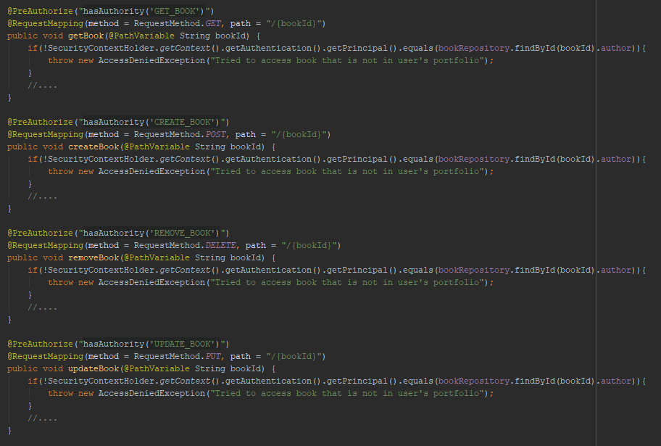
Introducing more complex access checks
How WriteABook-GetRich.com’s API fixed these extra checks
Additional access checks

Slide 143
Introducing more complex access checks
How WriteABook-GetRich.com’s API fixed these extra checks
CODE DUPLICATION
Additional access checks

Slide 144
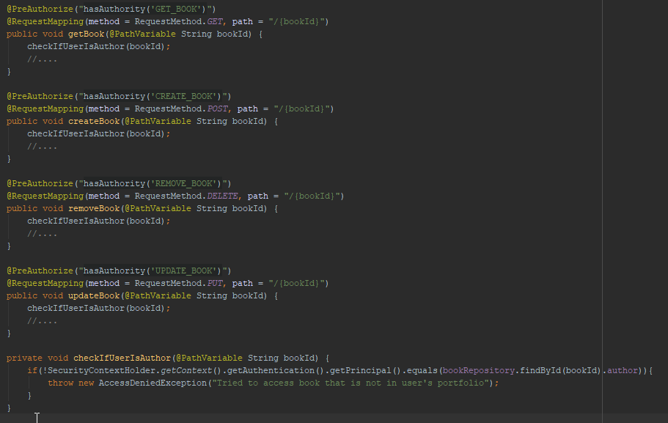
Introducing more complex access checks
How WriteABook-GetRich.com’s API fixed these extra checks
- Mental clutter
- Not controller’s responsibility
Additional access checks

Slide 145
Codelabs
Codelab 5: Operation Elm
BRANCH ELM-START
READ OPERATION ELM
COMPLETE OPERATION ELM
HAVE FUN
Additional access checks

Slide 146
Codelabs
Codelab 5: Operation ELM: Debriefing
GET /armies/Cuba
HTTP 403
NO
BasicAuthenticationFilter
Fetch Authorisation header
Decode
Is username/password in InMemory user store?
NO
SecurityExpressionRoot
Get Allowed roles for URL
Get Roles for user
Does role have needed role(s)?
false
YES
YES
access-check (criminal record)
true
ArmyResource
Additional access checks

Slide 147
Codelabs
Codelab 5: Operation ELM: Debriefing
GET /armies/Cuba
Authentication check (user + password ok?)
access-check
Authorization check (role ok?)
Resource
Additional access checks

Slide 148
Codelabs
Codelab 5: Operation Elm: Debriefing
Add access checks to configure-method of SecurityConfig
Centralize all extra security checks in one place ☺
Can’t combine hasRole/has Authority and access ☹
Branch EXTRACTION-POINT has final solution
Additional access checks

Slide 149
Codelabs
Codelab 6: Operation Fir
BRANCH FIR-START
READ OPERATION FIR
COMPLETE OPERATION FIR
HAVE FUN
Additional access checks

Slide 150
Codelabs
Codelab 6: Operation Fir: Debriefing
SpringSecurityLdapTemplate is your friend
Difference between using the FakeAuthenticationService and the LDAP is minimal
Only code changes are in the AuthenticationProvider itself.
Features

Slide 151
Security
www.switchfully.com

