Slide 1

RANDOM FOREST
Nikesh DC(075BCt052)
Ravi Pandey(075BCT065)
Rohan Chhetry(075BCT066)

Slide 2

03.
04.
05.
06.
07.
08.
What is random forest?
Algorithm diagram
Algorithm
Application of Random Forest
CONTENTS
The pros and cons
Overview

Slide 3
WHAT IS
RANDOM FOREST?
A supervised machine learning algorithm which utilizes many decision trees
Can be used for classification as well as regression problems
Accurate and variable important information is provided with results

Slide 4
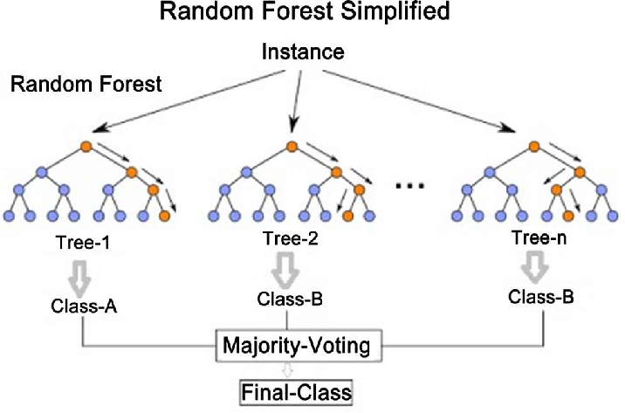
RANDOM FOREST ALGORITHM

Slide 5

RANDOM FOREST ALGORITHM
Step-1: Select random K data points from the training set
Step-2: Build the decision trees associated with the selected data points(subsets)
Step-3: Choose the number N for decision trees that you want to build
Step-4: Repeat step1 and 2
Step-5: For new data points, find the predictions of each decision tree and assign the new data points to the category that wins the majority votes.

Slide 6
APPLICATION
In banking sector mostly used for identification of
Loan risk
Credit card Fraud Detection
Customer Segmentation
Use of this algorithm in to predict best mix for drugs and predict risk of diseases such as diabetes, heart diseases and many more
Banking
Medicine
Can be used to predict stock market price fluctuations and study stock market. Also applicable to crypto market.
Random forest can be used for product recommendation and price optimization based on user data
Stock Market
E-commerce

Slide 7
THE PROS
AND CONS
PROS
CONS
Ease of use
Efficiency
Accuracy
Versatility - can be used for classification or regression
More beginner friendly than similarly accurate algorithms like neural networks
Better immunity to noise in data
Use of many decision trees may require more memory
Overfitting may be an issue, normally random forest prevents this by default as it uses random subsets and builds smaller trees

Slide 8
KEY TAKEAWAYS
Random forest is a supervised machine learning algorithm made up of decision trees
Random forest is used for both classification and regression
Random forest is used across many different industries, like banking ,retail ,healthcare etc.
Random forest is accurate, efficient and relatively quick to develop, making it an extremely handy tool

Slide 9
PREDICTING THE FUTURE ISN'T MAGIC,ITS ARTIFICIAL INTELLIGENCE
Dave Waters

Slide 10

THANK YOU!

