Slide 1


向量的外积
张 赐
Mail: educourse@163.com
讲师的CSDN博客地址
http://blog.csdn.net/zhangci226

Slide 2
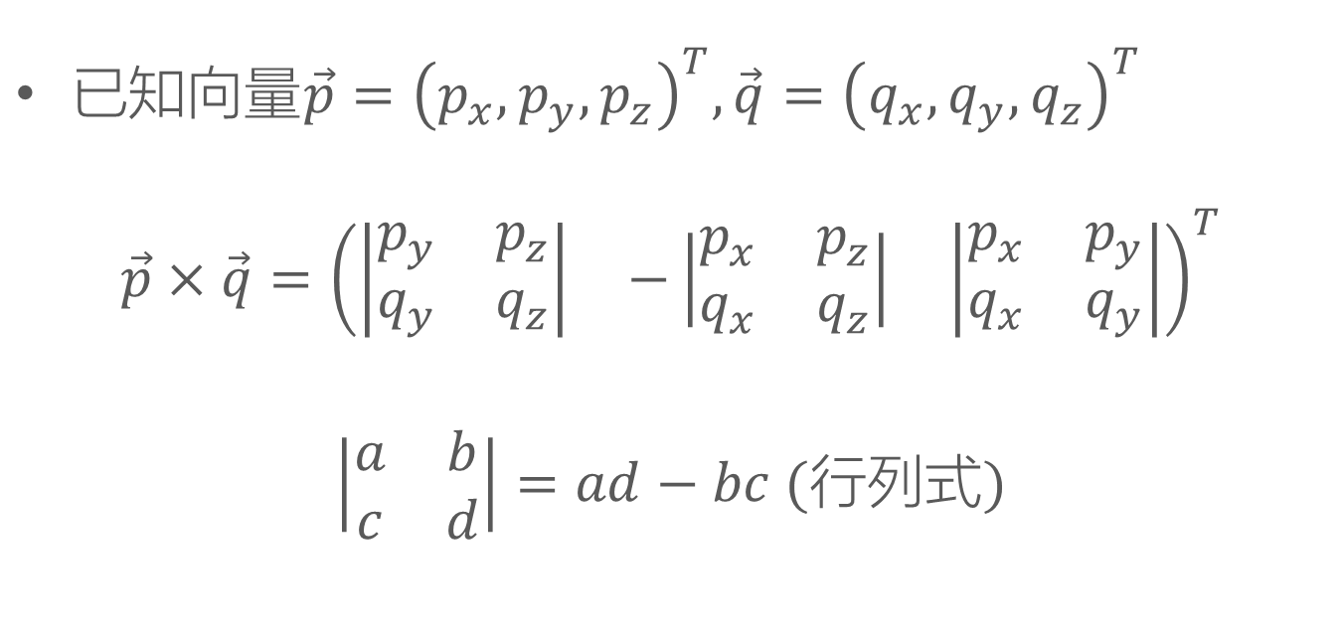
定义
$已知向量\vec{p}={\left(p_{x},p_{y},p_{z}\right)}^{T},\vec{q}={\left(q_{x},q_{y},q_{z}\right)}^{T}$
$$\vec{p}×\vec{q}={\left(\begin{matrix}\left|\begin{matrix}p_{y} & p_{z} \\ q_{y} & q_{z}\end{matrix}\right| & −\left|\begin{matrix}p_{x} & p_{z} \\ q_{x} & q_{z}\end{matrix}\right| & \left|\begin{matrix}p_{x} & p_{y} \\ q_{x} & q_{y}\end{matrix}\right|\end{matrix}\right)}^{T}$$
$\left|\begin{matrix}a & b \\ c & d\end{matrix}\right|=ad−bc$ $(行列式)$

Slide 3
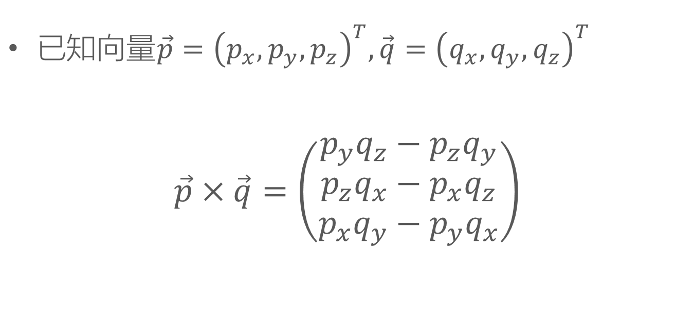
定义
$已知向量\vec{p}={\left(p_{x},p_{y},p_{z}\right)}^{T},\vec{q}={\left(q_{x},q_{y},q_{z}\right)}^{T}$
$$\vec{p}×\vec{q}=\left(\begin{matrix}p_{y}q_{z}−p_{z}q_{y} \\ p_{z}q_{x}−p_{x}q_{z} \\ p_{x}q_{y}−p_{y}q_{x}\end{matrix}\right)$$

Slide 4

向量的外积
例：$\vec{p}={\left(1，2，1\right)}^{T},\vec{q}={\left(2，1，0\right)}^{T}$

Slide 5
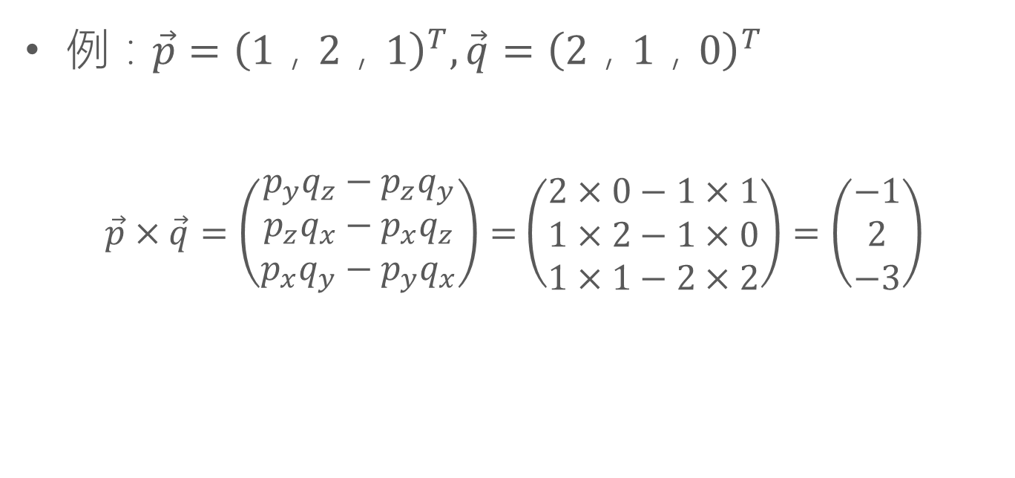
向量的外积
例：$\vec{p}={\left(1，2，1\right)}^{T},\vec{q}={\left(2，1，0\right)}^{T}$
$\vec{p}×\vec{q}=\left(\begin{matrix}p_{y}q_{z}−p_{z}q_{y} \\ p_{z}q_{x}−p_{x}q_{z} \\ p_{x}q_{y}−p_{y}q_{x}\end{matrix}\right)=$ $\left(\begin{matrix}2×0−1×1 \\ 1×2−1×0 \\ 1×1−2×2\end{matrix}\right)=\left(\begin{matrix}−1 \\ 2 \\ −3\end{matrix}\right)$

Slide 6

定理1
$\vec{p},\vec{q}$：已知向量
$$\left(\vec{p}×\vec{q}\right)⋅\vec{p}=\vec{0}$$
$$\left(\vec{p}×\vec{q}\right)⋅\vec{q}=\vec{0}$$

Slide 7

定理1:证明
$\left(\vec{p}×\vec{q}\right)⋅\vec{p}=$ $\left(\begin{matrix}p_{y}q_{z}−p_{z}q_{y} \\ p_{z}q_{x}−p_{x}q_{z} \\ p_{x}q_{y}−p_{y}q_{x}\end{matrix}\right)$ $⋅\left(\begin{matrix}p_{x} \\ p_{y} \\ p_{z}\end{matrix}\right)$

Slide 8

定理1:证明
$\left(\vec{p}×\vec{q}\right)⋅\vec{p}=$ $\left(\begin{matrix}p_{y}q_{z}−p_{z}q_{y} \\ p_{z}q_{x}−p_{x}q_{z} \\ p_{x}q_{y}−p_{y}q_{x}\end{matrix}\right)$ $⋅\left(\begin{matrix}p_{x} \\ p_{y} \\ p_{z}\end{matrix}\right)$
$$=p_{x}p_{y}q_{z}−p_{x}p_{z}q_{y}+p_{y}p_{z}q_{x}−p_{x}p_{y}q_{z}+p_{x}p_{z}q_{y}−p_{y}p_{z}q_{x}$$

Slide 9
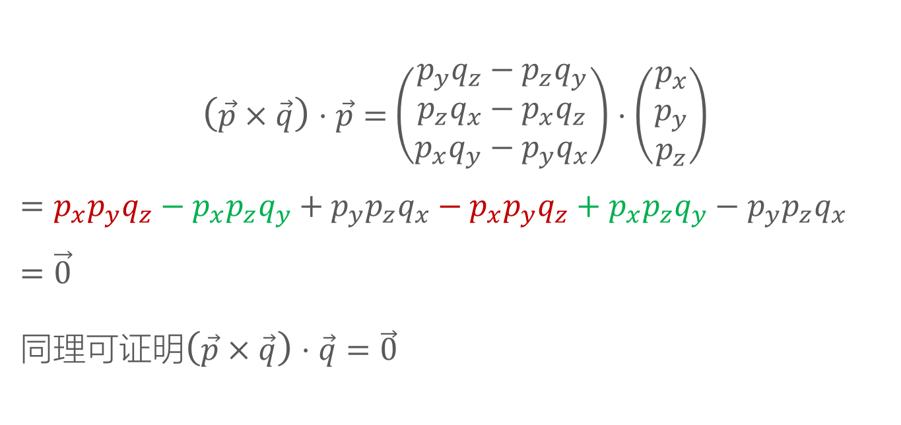
定理1:证明
$\left(\vec{p}×\vec{q}\right)⋅\vec{p}=$ $\left(\begin{matrix}p_{y}q_{z}−p_{z}q_{y} \\ p_{z}q_{x}−p_{x}q_{z} \\ p_{x}q_{y}−p_{y}q_{x}\end{matrix}\right)$ $⋅\left(\begin{matrix}p_{x} \\ p_{y} \\ p_{z}\end{matrix}\right)$
$$=p_{x}p_{y}q_{z}−p_{x}p_{z}q_{y}+p_{y}p_{z}q_{x}−p_{x}p_{y}q_{z}+p_{x}p_{z}q_{y}−p_{y}p_{z}q_{x}$$
$$=\vec{0}$$
同理可证明$\left(\vec{p}×\vec{q}\right)⋅\vec{q}=\vec{0}$

Slide 10

定理2
$\vec{p},\vec{q}$：已知向量
$$\left\|\vec{p}×\vec{q}\right\|=\left\|\vec{p}\right\|\left\|\vec{q}\right\|sinθ$$
$θ为\vec{p}和\vec{q}$之间的夹角

Slide 11

定理2:证明
$${\left\|\vec{p}×\vec{q}\right\|}^{2}={(p_{y}q_{z}−p_{z}q_{y})}^{2}+{(p_{z}q_{x}−p_{x}q_{z})}^{2}+{(p_{x}q_{y}−p_{y}q_{x})}^{2}$$

Slide 12

定理2:证明
$${\left\|\vec{p}×\vec{q}\right\|}^{2}={(p_{y}q_{z}−p_{z}q_{y})}^{2}+{(p_{z}q_{x}−p_{x}q_{z})}^{2}+{(p_{x}q_{y}−p_{y}q_{x})}^{2}={{p_{y}^{2}q}_{z}^{2}−2p_{y}p_{z}q_{y}q_{z}+{p_{z}^{2}q}_{y}^{2}+{p_{z}^{2}q}_{x}^{2}−2p_{x}p_{z}q_{x}q_{z}+{p_{x}^{2}q}_{z}^{2}+{p_{x}^{2}q}_{y}^{2}−2p_{x}p_{y}q_{x}q_{y}+p_{y}^{2}q}_{x}^{2}$$

Slide 13

定理2:证明
$${\left\|\vec{p}×\vec{q}\right\|}^{2}={(p_{y}q_{z}−p_{z}q_{y})}^{2}+{(p_{z}q_{x}−p_{x}q_{z})}^{2}+{(p_{x}q_{y}−p_{y}q_{x})}^{2}={{p_{y}^{2}q}_{z}^{2}−2p_{y}p_{z}q_{y}q_{z}+{p_{z}^{2}q}_{y}^{2}+{p_{z}^{2}q}_{x}^{2}−2p_{x}p_{z}q_{x}q_{z}+{p_{x}^{2}q}_{z}^{2}+{p_{x}^{2}q}_{y}^{2}−2p_{x}p_{y}q_{x}q_{y}+p_{y}^{2}q}_{x}^{2}$$
= $\left(p_{y}^{2}+p_{z}^{2}\right)q_{x}^{2}+\left(p_{x}^{2}+p_{z}^{2}\right)q_{y}^{2}+\left(p_{x}^{2}+p_{y}^{2}\right)q_{z}^{2}−2p_{x}p_{y}q_{x}q_{y}−2p_{y}p_{z}q_{y}q_{z}−2p_{x}p_{z}q_{x}q_{z}$

Slide 14
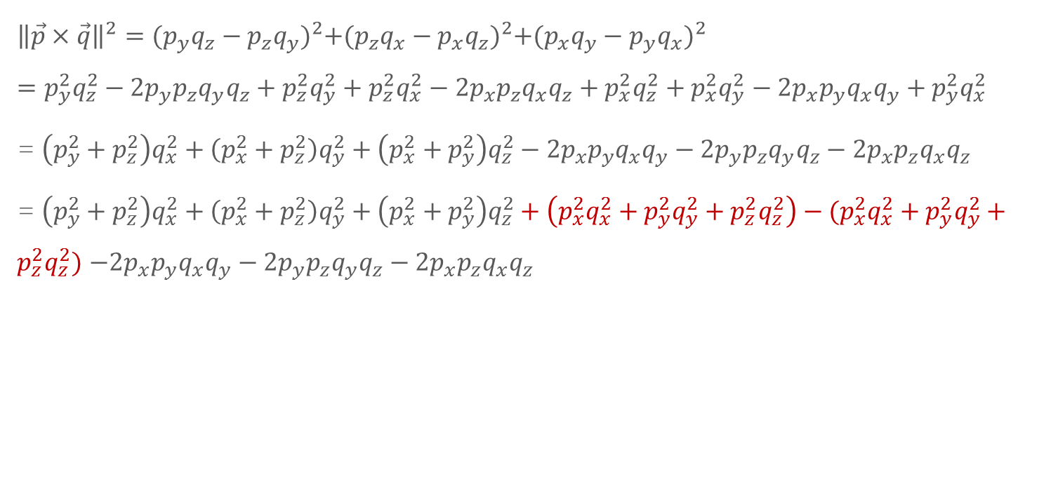
定理2:证明
$${\left\|\vec{p}×\vec{q}\right\|}^{2}={(p_{y}q_{z}−p_{z}q_{y})}^{2}+{(p_{z}q_{x}−p_{x}q_{z})}^{2}+{(p_{x}q_{y}−p_{y}q_{x})}^{2}={{p_{y}^{2}q}_{z}^{2}−2p_{y}p_{z}q_{y}q_{z}+{p_{z}^{2}q}_{y}^{2}+{p_{z}^{2}q}_{x}^{2}−2p_{x}p_{z}q_{x}q_{z}+{p_{x}^{2}q}_{z}^{2}+{p_{x}^{2}q}_{y}^{2}−2p_{x}p_{y}q_{x}q_{y}+p_{y}^{2}q}_{x}^{2}$$
= $\left(p_{y}^{2}+p_{z}^{2}\right)q_{x}^{2}+\left(p_{x}^{2}+p_{z}^{2}\right)q_{y}^{2}+\left(p_{x}^{2}+p_{y}^{2}\right)q_{z}^{2}−2p_{x}p_{y}q_{x}q_{y}−2p_{y}p_{z}q_{y}q_{z}−2p_{x}p_{z}q_{x}q_{z}$
= $\left(p_{y}^{2}+p_{z}^{2}\right)q_{x}^{2}+\left(p_{x}^{2}+p_{z}^{2}\right)q_{y}^{2}+\left(p_{x}^{2}+p_{y}^{2}\right)q_{z}^{2}+\left(p_{x}^{2}q_{x}^{2}+p_{y}^{2}q_{y}^{2}+p_{z}^{2}q_{z}^{2}\right)−(p_{x}^{2}q_{x}^{2}+p_{y}^{2}q_{y}^{2}+p_{z}^{2}q_{z}^{2})$ $−2p_{x}p_{y}q_{x}q_{y}−2p_{y}p_{z}q_{y}q_{z}−2p_{x}p_{z}q_{x}q_{z}$

Slide 15
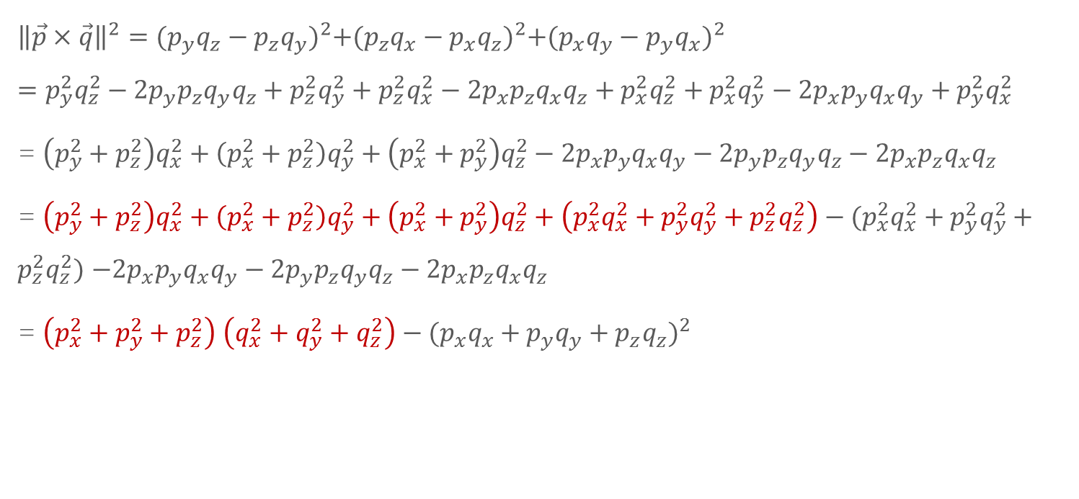
定理2:证明
$${\left\|\vec{p}×\vec{q}\right\|}^{2}={(p_{y}q_{z}−p_{z}q_{y})}^{2}+{(p_{z}q_{x}−p_{x}q_{z})}^{2}+{(p_{x}q_{y}−p_{y}q_{x})}^{2}={{p_{y}^{2}q}_{z}^{2}−2p_{y}p_{z}q_{y}q_{z}+{p_{z}^{2}q}_{y}^{2}+{p_{z}^{2}q}_{x}^{2}−2p_{x}p_{z}q_{x}q_{z}+{p_{x}^{2}q}_{z}^{2}+{p_{x}^{2}q}_{y}^{2}−2p_{x}p_{y}q_{x}q_{y}+p_{y}^{2}q}_{x}^{2}$$
= $\left(p_{y}^{2}+p_{z}^{2}\right)q_{x}^{2}+\left(p_{x}^{2}+p_{z}^{2}\right)q_{y}^{2}+\left(p_{x}^{2}+p_{y}^{2}\right)q_{z}^{2}−2p_{x}p_{y}q_{x}q_{y}−2p_{y}p_{z}q_{y}q_{z}−2p_{x}p_{z}q_{x}q_{z}$
= $\left(p_{y}^{2}+p_{z}^{2}\right)q_{x}^{2}+\left(p_{x}^{2}+p_{z}^{2}\right)q_{y}^{2}+\left(p_{x}^{2}+p_{y}^{2}\right)q_{z}^{2}+\left(p_{x}^{2}q_{x}^{2}+p_{y}^{2}q_{y}^{2}+p_{z}^{2}q_{z}^{2}\right)−(p_{x}^{2}q_{x}^{2}+p_{y}^{2}q_{y}^{2}+p_{z}^{2}q_{z}^{2})$ $−2p_{x}p_{y}q_{x}q_{y}−2p_{y}p_{z}q_{y}q_{z}−2p_{x}p_{z}q_{x}q_{z}$
= $\left(p_{x}^{2}+p_{y}^{2}+p_{z}^{2}\right)$ $\left(q_{x}^{2}+q_{y}^{2}+q_{z}^{2}\right)−{(p_{x}q_{x}+p_{y}q_{y}+p_{z}q_{z})}^{2}$

Slide 16
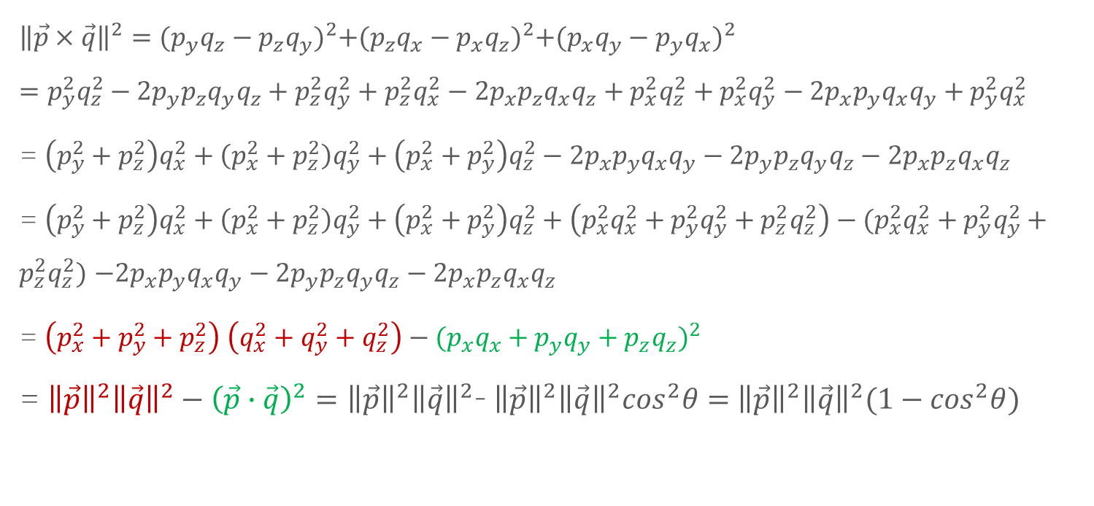
定理2:证明
$${\left\|\vec{p}×\vec{q}\right\|}^{2}={(p_{y}q_{z}−p_{z}q_{y})}^{2}+{(p_{z}q_{x}−p_{x}q_{z})}^{2}+{(p_{x}q_{y}−p_{y}q_{x})}^{2}={{p_{y}^{2}q}_{z}^{2}−2p_{y}p_{z}q_{y}q_{z}+{p_{z}^{2}q}_{y}^{2}+{p_{z}^{2}q}_{x}^{2}−2p_{x}p_{z}q_{x}q_{z}+{p_{x}^{2}q}_{z}^{2}+{p_{x}^{2}q}_{y}^{2}−2p_{x}p_{y}q_{x}q_{y}+p_{y}^{2}q}_{x}^{2}$$
= $\left(p_{y}^{2}+p_{z}^{2}\right)q_{x}^{2}+\left(p_{x}^{2}+p_{z}^{2}\right)q_{y}^{2}+\left(p_{x}^{2}+p_{y}^{2}\right)q_{z}^{2}−2p_{x}p_{y}q_{x}q_{y}−2p_{y}p_{z}q_{y}q_{z}−2p_{x}p_{z}q_{x}q_{z}$
= $\left(p_{y}^{2}+p_{z}^{2}\right)q_{x}^{2}+\left(p_{x}^{2}+p_{z}^{2}\right)q_{y}^{2}+\left(p_{x}^{2}+p_{y}^{2}\right)q_{z}^{2}+\left(p_{x}^{2}q_{x}^{2}+p_{y}^{2}q_{y}^{2}+p_{z}^{2}q_{z}^{2}\right)−(p_{x}^{2}q_{x}^{2}+p_{y}^{2}q_{y}^{2}+p_{z}^{2}q_{z}^{2})$ $−2p_{x}p_{y}q_{x}q_{y}−2p_{y}p_{z}q_{y}q_{z}−2p_{x}p_{z}q_{x}q_{z}$
= $\left(p_{x}^{2}+p_{y}^{2}+p_{z}^{2}\right)$ $\left(q_{x}^{2}+q_{y}^{2}+q_{z}^{2}\right)−{(p_{x}q_{x}+p_{y}q_{y}+p_{z}q_{z})}^{2}$
= ${\left\|\vec{p}\right\|}^{2}{\left\|\vec{q}\right\|}^{2}−{\left(\vec{p}∙\vec{q}\right)}^{2}={\left\|\vec{p}\right\|}^{2}{\left\|\vec{q}\right\|}^{2}$- ${\left\|\vec{p}\right\|}^{2}{\left\|\vec{q}\right\|}^{2}\cos^{2}θ=$ ${\left\|\vec{p}\right\|}^{2}{\left\|\vec{q}\right\|}^{2}(1−\cos^{2}θ)$

Slide 17
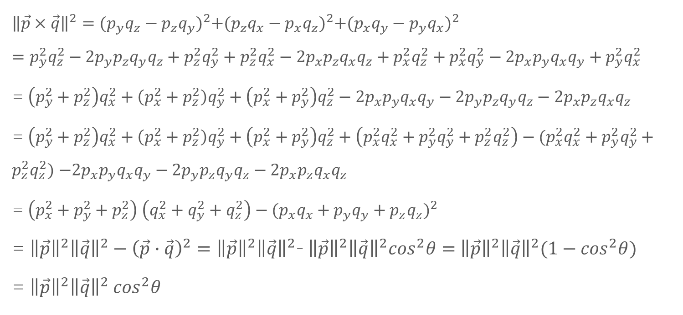
定理2:证明
$${\left\|\vec{p}×\vec{q}\right\|}^{2}={(p_{y}q_{z}−p_{z}q_{y})}^{2}+{(p_{z}q_{x}−p_{x}q_{z})}^{2}+{(p_{x}q_{y}−p_{y}q_{x})}^{2}={{p_{y}^{2}q}_{z}^{2}−2p_{y}p_{z}q_{y}q_{z}+{p_{z}^{2}q}_{y}^{2}+{p_{z}^{2}q}_{x}^{2}−2p_{x}p_{z}q_{x}q_{z}+{p_{x}^{2}q}_{z}^{2}+{p_{x}^{2}q}_{y}^{2}−2p_{x}p_{y}q_{x}q_{y}+p_{y}^{2}q}_{x}^{2}$$
= $\left(p_{y}^{2}+p_{z}^{2}\right)q_{x}^{2}+\left(p_{x}^{2}+p_{z}^{2}\right)q_{y}^{2}+\left(p_{x}^{2}+p_{y}^{2}\right)q_{z}^{2}−2p_{x}p_{y}q_{x}q_{y}−2p_{y}p_{z}q_{y}q_{z}−2p_{x}p_{z}q_{x}q_{z}$
= $\left(p_{y}^{2}+p_{z}^{2}\right)q_{x}^{2}+\left(p_{x}^{2}+p_{z}^{2}\right)q_{y}^{2}+\left(p_{x}^{2}+p_{y}^{2}\right)q_{z}^{2}+\left(p_{x}^{2}q_{x}^{2}+p_{y}^{2}q_{y}^{2}+p_{z}^{2}q_{z}^{2}\right)−(p_{x}^{2}q_{x}^{2}+p_{y}^{2}q_{y}^{2}+p_{z}^{2}q_{z}^{2})$ $−2p_{x}p_{y}q_{x}q_{y}−2p_{y}p_{z}q_{y}q_{z}−2p_{x}p_{z}q_{x}q_{z}$
= $\left(p_{x}^{2}+p_{y}^{2}+p_{z}^{2}\right)$ $\left(q_{x}^{2}+q_{y}^{2}+q_{z}^{2}\right)−{(p_{x}q_{x}+p_{y}q_{y}+p_{z}q_{z})}^{2}$
= ${\left\|\vec{p}\right\|}^{2}{\left\|\vec{q}\right\|}^{2}−{\left(\vec{p}∙\vec{q}\right)}^{2}={\left\|\vec{p}\right\|}^{2}{\left\|\vec{q}\right\|}^{2}$- ${\left\|\vec{p}\right\|}^{2}{\left\|\vec{q}\right\|}^{2}\cos^{2}θ=$ ${\left\|\vec{p}\right\|}^{2}{\left\|\vec{q}\right\|}^{2}(1−\cos^{2}θ)$
= ${\left\|\vec{p}\right\|}^{2}{\left\|\vec{q}\right\|}^{2}$ $\cos^{2}θ$

Slide 18
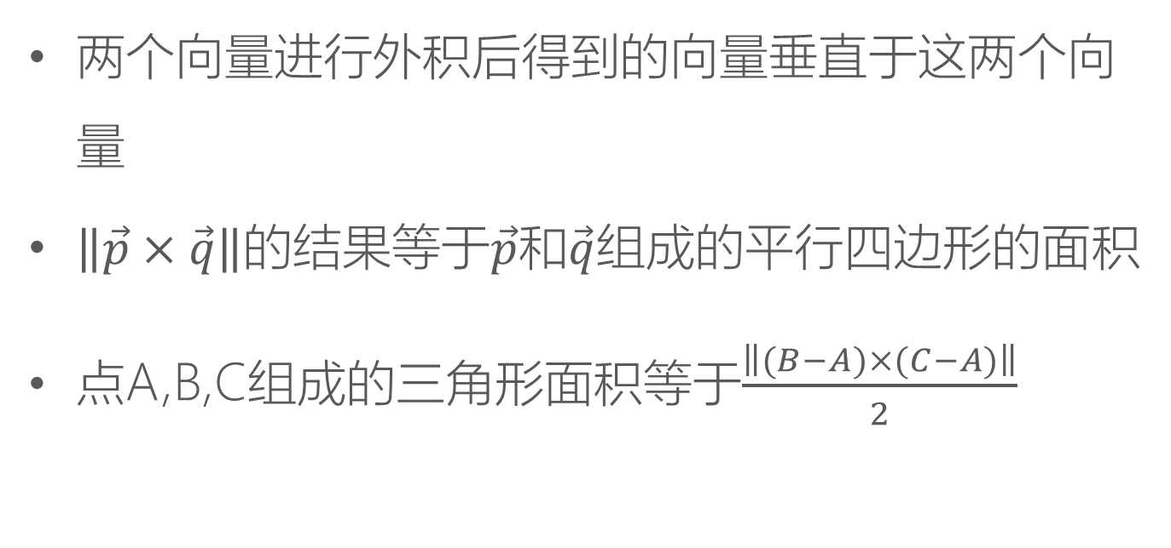
注意
两个向量进行外积后得到的向量垂直于这两个向量
$\left\|\vec{p}×\vec{q}\right\|$的结果等于$\vec{p}$和$\vec{q}$组成的平行四边形的面积
点A,B,C组成的三角形面积等于$\frac{\left\|(B−A)×(C−A)\right\|}{2}$

Slide 19
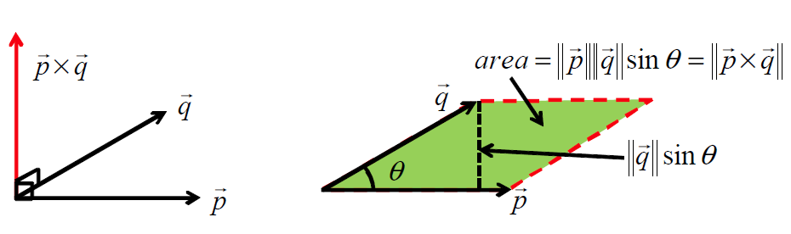

注意
两个向量进行外积后得到的向量垂直于这两个向量。
$\left\|\vec{p}×\vec{q}\right\|$的结果等于$\vec{p}$和$\vec{q}$组成的平行四边形的面积。
点A,B,C组成的三角形面积等于$\frac{\left\|(B−A)×(C−A)\right\|}{2}$

Slide 20





外积的右手法则
$\vec{p}×\vec{q}时$，右手大拇指以外的四根手指表示从$\vec{p}$逆时针旋转到$\vec{q}$，大拇指的指向就是$\vec{p}×\vec{q}$的方向。
$$\vec{p}×\vec{q}$$
$$\vec{q}$$
$$\vec{p}$$
$$\vec{q}×\vec{p}=−\vec{p}×\vec{q}$$

Slide 21
外积的右手法则
$\vec{p}×\vec{q}时$，右手大拇指以外的四根手指表示从$\vec{p}$逆时针旋转到$\vec{q}$，大拇指的指向就是$\vec{p}×\vec{q}$的方向。
$$\vec{p}×\vec{q}$$
$$\vec{q}$$
$$\vec{p}$$
$$\vec{q}×\vec{p}=−\vec{p}×\vec{q}$$

Slide 22

向量外积的性质
$a:标量;\vec{p},\vec{q},\vec{r}:$向量
$$\vec{p}×\vec{q}=−\vec{q}×\vec{p}$$

Slide 23

向量外积的性质
$a:标量;\vec{p},\vec{q},\vec{r}:$向量
$$\vec{p}×\vec{q}=−\vec{q}×\vec{p}$$
$$\left(a\vec{p}\right)×\vec{q}=a\left(\vec{p}×\vec{q}\right)$$

Slide 24

向量外积的性质
$a:标量;\vec{p},\vec{q},\vec{r}:$向量
$$\vec{p}×\vec{q}=−\vec{q}×\vec{p}$$
$$\left(a\vec{p}\right)×\vec{q}=a\left(\vec{p}×\vec{q}\right)$$
$\vec{p}×(\vec{q}+$ $\vec{r})=\vec{p}×\vec{q}$+ $\vec{p}×\vec{r}$

Slide 25

向量外积的性质
$a:标量;\vec{p},\vec{q},\vec{r}:$向量
$$\vec{p}×\vec{q}=−\vec{q}×\vec{p}$$
$$\left(a\vec{p}\right)×\vec{q}=a\left(\vec{p}×\vec{q}\right)$$
$\vec{p}×(\vec{q}+$ $\vec{r})=\vec{p}×\vec{q}$+ $\vec{p}×\vec{r}$
$$\vec{p}×\vec{p}=\vec{0}$$

Slide 26
THANKS
本课程由 张赐 提供
CSDN网站：www.csdn.net
企业服务：http://ems.csdn.net/
人才服务：http://job.csdn.net/
CTO俱乐部：http://cto.csdn.net/
高校俱乐部：http://student.csdn.net/
程序员杂志：http://programmer.csdn.net/
CODE平台：https://code.csdn.net/
项目外包：http://www.csto.com/
CSDN博客：http://blog.csdn.net/
CSDN论坛：http://bbs.csdn.net/
CSDN下载：http://download.csdn.net/

