Slide 1


高斯消元法
张 赐
Mail: educourse@163.com
CSDN博客地址
http://blog.csdn.net/zhangci226

Slide 2

高斯消元法
Gauss-Jordan Elimination
利用矩阵基本行变换，将$m×n$的矩阵变换为最小行阶梯形式

Slide 3


算法
输入： $m×n$的矩阵$A，$输出：矩阵$A$的最小行阶梯形式
$$l=\min\left(m,n\right)$$
$$shift=0$$
$$for\left(i=0;i<l;i++\right)$$
$$\{$$
$find the row vector {\vec{r}}_{k}\left(i<k<m\right)such that A\left[k\right]\left[i+shift\right] has maximum absolute value$
$if\left(A\left[k\right]\left[i+shift\right]!=0\right)$
$\{$
$exchange {\vec{r}}_{i} and {\vec{r}}_{k}$
${\vec{r}}_{i}={\vec{r}}_{i}/A\left[i\right]\left[i+shift\right]$
$for\left(j=0;j<r;j++\right)$
$if\left(i≠j\right)$
$${\vec{r}}_{j}={\vec{r}}_{j}−A\left[j\right]\left[i+shift\right]∗{\vec{r}}_{i}$$
$\}$
$else$
$\{$
$shift+,i−−$
$\}$
$\}$
/* leading 1 */
/* kill $\left(i+shift\right)th$ column */

Slide 4

高斯消元法
例：
$$A=\left[\begin{matrix}3 & 2 & −3 & | & −13 \\ 4 & −3 & 6 & | & 7 \\ 1 & 0 & −1 & | & −5\end{matrix}\right]$$

Slide 5

$$\left[\begin{matrix}3 & 2 & −3 & | & −13 \\ 4 & −3 & 6 & | & 7 \\ 1 & 0 & −1 & | & −5\end{matrix}\right]\underset{⇒}{r_{1}↔r_{2}}$$

Slide 6

$$\left[\begin{matrix}3 & 2 & −3 & | & −13 \\ 4 & −3 & 6 & | & 7 \\ 1 & 0 & −1 & | & −5\end{matrix}\right]\underset{⇒}{r_{1}↔r_{2}}\left[\begin{matrix}4 & −3 & 6 & | & 7 \\ 3 & 2 & −3 & | & −13 \\ 1 & 0 & −1 & | & −5\end{matrix}\right]$$

Slide 7

$$\left[\begin{matrix}3 & 2 & −3 & | & −13 \\ 4 & −3 & 6 & | & 7 \\ 1 & 0 & −1 & | & −5\end{matrix}\right]\underset{⇒}{r_{1}↔r_{2}}\left[\begin{matrix}4 & −3 & 6 & | & 7 \\ 3 & 2 & −3 & | & −13 \\ 1 & 0 & −1 & | & −5\end{matrix}\right]\underset{⇒}{r_{1}=\frac{r_{1}}{4}}\left[\begin{matrix}1 & −\frac{3}{4} & \frac{3}{2} & | & \frac{7}{4} \\ 3 & 2 & −3 & | & −13 \\ 1 & 0 & −1 & | & −5\end{matrix}\right]$$

Slide 8

$$\left[\begin{matrix}3 & 2 & −3 & | & −13 \\ 4 & −3 & 6 & | & 7 \\ 1 & 0 & −1 & | & −5\end{matrix}\right]\underset{⇒}{r_{1}↔r_{2}}\left[\begin{matrix}4 & −3 & 6 & | & 7 \\ 3 & 2 & −3 & | & −13 \\ 1 & 0 & −1 & | & −5\end{matrix}\right]\underset{⇒}{r_{1}=\frac{r_{1}}{4}}\left[\begin{matrix}1 & −\frac{3}{4} & \frac{3}{2} & | & \frac{7}{4} \\ 3 & 2 & −3 & | & −13 \\ 1 & 0 & −1 & | & −5\end{matrix}\right]\underset{⇒}{r_{2}=−3r_{1}+r_{2}}$$
$$\left[\begin{matrix}1 & −\frac{3}{4} & \frac{3}{2} & | & \frac{7}{4} \\ 0 & \frac{17}{4} & −\frac{15}{2} & | & −\frac{73}{4} \\ 1 & 0 & −1 & | & −5\end{matrix}\right]$$

Slide 9

$$\left[\begin{matrix}3 & 2 & −3 & | & −13 \\ 4 & −3 & 6 & | & 7 \\ 1 & 0 & −1 & | & −5\end{matrix}\right]\underset{⇒}{r_{1}↔r_{2}}\left[\begin{matrix}4 & −3 & 6 & | & 7 \\ 3 & 2 & −3 & | & −13 \\ 1 & 0 & −1 & | & −5\end{matrix}\right]\underset{⇒}{r_{1}=\frac{r_{1}}{4}}\left[\begin{matrix}1 & −\frac{3}{4} & \frac{3}{2} & | & \frac{7}{4} \\ 3 & 2 & −3 & | & −13 \\ 1 & 0 & −1 & | & −5\end{matrix}\right]\underset{⇒}{r_{2}=−3r_{1}+r_{2}}$$
$$\left[\begin{matrix}1 & −\frac{3}{4} & \frac{3}{2} & | & \frac{7}{4} \\ 0 & \frac{17}{4} & −\frac{15}{2} & | & −\frac{73}{4} \\ 1 & 0 & −1 & | & −5\end{matrix}\right]\underset{⇒}{r_{3}=−1r_{1}+r_{3}}\left[\begin{matrix}1 & −\frac{3}{4} & \frac{3}{2} & | & \frac{7}{4} \\ 0 & \frac{17}{4} & −\frac{15}{2} & | & −\frac{73}{4} \\ 0 & \frac{3}{4} & −\frac{5}{2} & | & −\frac{27}{4}\end{matrix}\right]$$

Slide 10

$$\left[\begin{matrix}3 & 2 & −3 & | & −13 \\ 4 & −3 & 6 & | & 7 \\ 1 & 0 & −1 & | & −5\end{matrix}\right]\underset{⇒}{r_{1}↔r_{2}}\left[\begin{matrix}4 & −3 & 6 & | & 7 \\ 3 & 2 & −3 & | & −13 \\ 1 & 0 & −1 & | & −5\end{matrix}\right]\underset{⇒}{r_{1}=\frac{r_{1}}{4}}\left[\begin{matrix}1 & −\frac{3}{4} & \frac{3}{2} & | & \frac{7}{4} \\ 3 & 2 & −3 & | & −13 \\ 1 & 0 & −1 & | & −5\end{matrix}\right]\underset{⇒}{r_{2}=−3r_{1}+r_{2}}$$
$$\left[\begin{matrix}1 & −\frac{3}{4} & \frac{3}{2} & | & \frac{7}{4} \\ 0 & \frac{17}{4} & −\frac{15}{2} & | & −\frac{73}{4} \\ 1 & 0 & −1 & | & −5\end{matrix}\right]\underset{⇒}{r_{3}=−1r_{1}+r_{3}}\left[\begin{matrix}1 & −\frac{3}{4} & \frac{3}{2} & | & \frac{7}{4} \\ 0 & \frac{17}{4} & −\frac{15}{2} & | & −\frac{73}{4} \\ 0 & \frac{3}{4} & −\frac{5}{2} & | & −\frac{27}{4}\end{matrix}\right]\underset{⇒}{r_{2}=\frac{4}{17}r_{2}}$$
$$\left[\begin{matrix}1 & −\frac{3}{4} & \frac{3}{2} & | & \frac{7}{4} \\ 0 & 1 & −\frac{30}{17} & | & −\frac{73}{17} \\ 0 & \frac{3}{4} & −\frac{5}{2} & | & −\frac{27}{4}\end{matrix}\right]$$

Slide 11
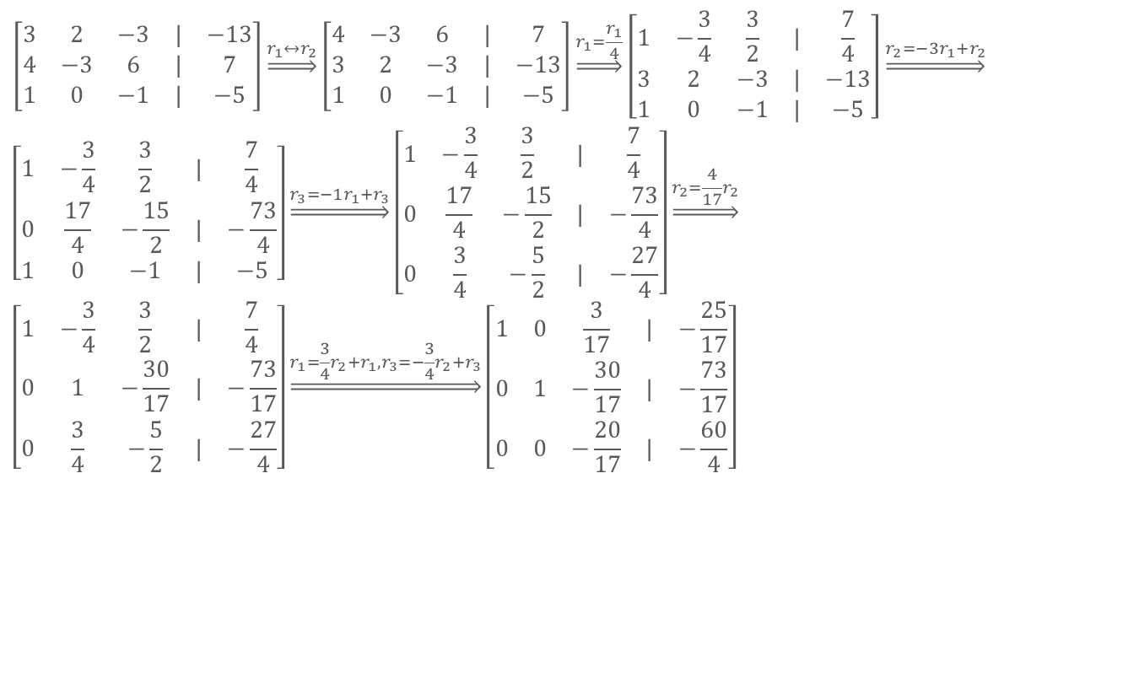
$$\left[\begin{matrix}3 & 2 & −3 & | & −13 \\ 4 & −3 & 6 & | & 7 \\ 1 & 0 & −1 & | & −5\end{matrix}\right]\underset{⇒}{r_{1}↔r_{2}}\left[\begin{matrix}4 & −3 & 6 & | & 7 \\ 3 & 2 & −3 & | & −13 \\ 1 & 0 & −1 & | & −5\end{matrix}\right]\underset{⇒}{r_{1}=\frac{r_{1}}{4}}\left[\begin{matrix}1 & −\frac{3}{4} & \frac{3}{2} & | & \frac{7}{4} \\ 3 & 2 & −3 & | & −13 \\ 1 & 0 & −1 & | & −5\end{matrix}\right]\underset{⇒}{r_{2}=−3r_{1}+r_{2}}$$
$$\left[\begin{matrix}1 & −\frac{3}{4} & \frac{3}{2} & | & \frac{7}{4} \\ 0 & \frac{17}{4} & −\frac{15}{2} & | & −\frac{73}{4} \\ 1 & 0 & −1 & | & −5\end{matrix}\right]\underset{⇒}{r_{3}=−1r_{1}+r_{3}}\left[\begin{matrix}1 & −\frac{3}{4} & \frac{3}{2} & | & \frac{7}{4} \\ 0 & \frac{17}{4} & −\frac{15}{2} & | & −\frac{73}{4} \\ 0 & \frac{3}{4} & −\frac{5}{2} & | & −\frac{27}{4}\end{matrix}\right]\underset{⇒}{r_{2}=\frac{4}{17}r_{2}}$$
$$\left[\begin{matrix}1 & −\frac{3}{4} & \frac{3}{2} & | & \frac{7}{4} \\ 0 & 1 & −\frac{30}{17} & | & −\frac{73}{17} \\ 0 & \frac{3}{4} & −\frac{5}{2} & | & −\frac{27}{4}\end{matrix}\right]\underset{⇒}{r_{1}=\frac{3}{4}r_{2}+r_{1},r_{3}=−\frac{3}{4}r_{2}+r_{3}}\left[\begin{matrix}1 & 0 & \frac{3}{17} & | & −\frac{25}{17} \\ 0 & 1 & −\frac{30}{17} & | & −\frac{73}{17} \\ 0 & 0 & −\frac{20}{17} & | & −\frac{60}{4}\end{matrix}\right]$$

Slide 12
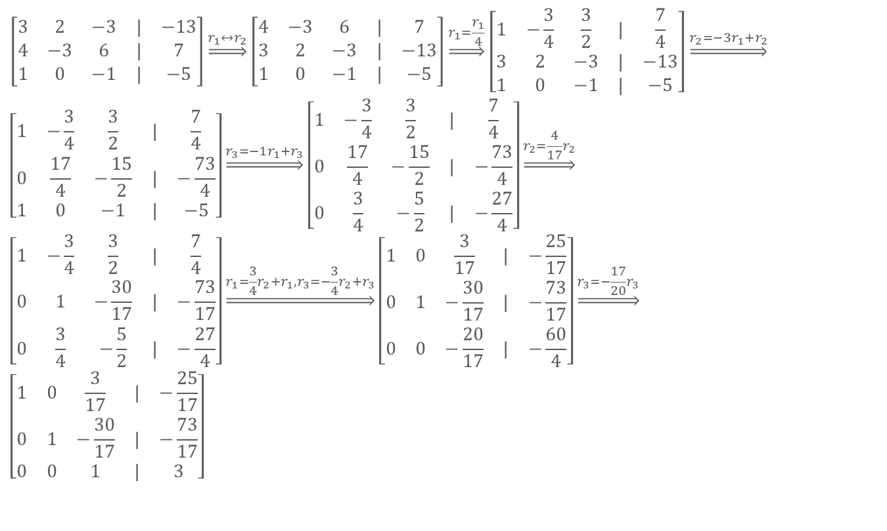
$$\left[\begin{matrix}3 & 2 & −3 & | & −13 \\ 4 & −3 & 6 & | & 7 \\ 1 & 0 & −1 & | & −5\end{matrix}\right]\underset{⇒}{r_{1}↔r_{2}}\left[\begin{matrix}4 & −3 & 6 & | & 7 \\ 3 & 2 & −3 & | & −13 \\ 1 & 0 & −1 & | & −5\end{matrix}\right]\underset{⇒}{r_{1}=\frac{r_{1}}{4}}\left[\begin{matrix}1 & −\frac{3}{4} & \frac{3}{2} & | & \frac{7}{4} \\ 3 & 2 & −3 & | & −13 \\ 1 & 0 & −1 & | & −5\end{matrix}\right]\underset{⇒}{r_{2}=−3r_{1}+r_{2}}$$
$$\left[\begin{matrix}1 & −\frac{3}{4} & \frac{3}{2} & | & \frac{7}{4} \\ 0 & \frac{17}{4} & −\frac{15}{2} & | & −\frac{73}{4} \\ 1 & 0 & −1 & | & −5\end{matrix}\right]\underset{⇒}{r_{3}=−1r_{1}+r_{3}}\left[\begin{matrix}1 & −\frac{3}{4} & \frac{3}{2} & | & \frac{7}{4} \\ 0 & \frac{17}{4} & −\frac{15}{2} & | & −\frac{73}{4} \\ 0 & \frac{3}{4} & −\frac{5}{2} & | & −\frac{27}{4}\end{matrix}\right]\underset{⇒}{r_{2}=\frac{4}{17}r_{2}}$$
$$\left[\begin{matrix}1 & −\frac{3}{4} & \frac{3}{2} & | & \frac{7}{4} \\ 0 & 1 & −\frac{30}{17} & | & −\frac{73}{17} \\ 0 & \frac{3}{4} & −\frac{5}{2} & | & −\frac{27}{4}\end{matrix}\right]\underset{⇒}{r_{1}=\frac{3}{4}r_{2}+r_{1},r_{3}=−\frac{3}{4}r_{2}+r_{3}}\left[\begin{matrix}1 & 0 & \frac{3}{17} & | & −\frac{25}{17} \\ 0 & 1 & −\frac{30}{17} & | & −\frac{73}{17} \\ 0 & 0 & −\frac{20}{17} & | & −\frac{60}{4}\end{matrix}\right]\underset{⇒}{r_{3}=−\frac{17}{20}r_{3}}$$
$$\left[\begin{matrix}1 & 0 & \frac{3}{17} & | & −\frac{25}{17} \\ 0 & 1 & −\frac{30}{17} & | & −\frac{73}{17} \\ 0 & 0 & 1 & | & 3\end{matrix}\right]$$

Slide 13
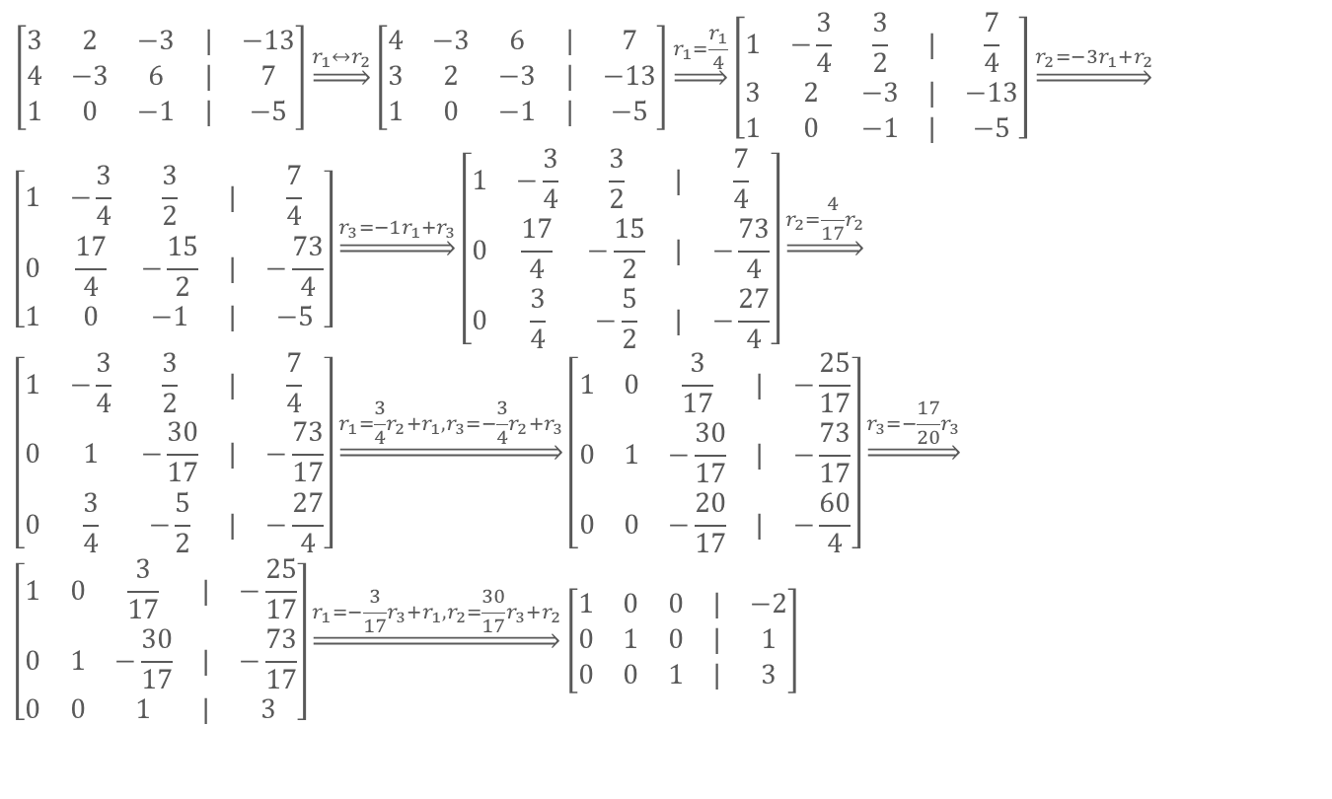
$$\left[\begin{matrix}3 & 2 & −3 & | & −13 \\ 4 & −3 & 6 & | & 7 \\ 1 & 0 & −1 & | & −5\end{matrix}\right]\underset{⇒}{r_{1}↔r_{2}}\left[\begin{matrix}4 & −3 & 6 & | & 7 \\ 3 & 2 & −3 & | & −13 \\ 1 & 0 & −1 & | & −5\end{matrix}\right]\underset{⇒}{r_{1}=\frac{r_{1}}{4}}\left[\begin{matrix}1 & −\frac{3}{4} & \frac{3}{2} & | & \frac{7}{4} \\ 3 & 2 & −3 & | & −13 \\ 1 & 0 & −1 & | & −5\end{matrix}\right]\underset{⇒}{r_{2}=−3r_{1}+r_{2}}$$
$$\left[\begin{matrix}1 & −\frac{3}{4} & \frac{3}{2} & | & \frac{7}{4} \\ 0 & \frac{17}{4} & −\frac{15}{2} & | & −\frac{73}{4} \\ 1 & 0 & −1 & | & −5\end{matrix}\right]\underset{⇒}{r_{3}=−1r_{1}+r_{3}}\left[\begin{matrix}1 & −\frac{3}{4} & \frac{3}{2} & | & \frac{7}{4} \\ 0 & \frac{17}{4} & −\frac{15}{2} & | & −\frac{73}{4} \\ 0 & \frac{3}{4} & −\frac{5}{2} & | & −\frac{27}{4}\end{matrix}\right]\underset{⇒}{r_{2}=\frac{4}{17}r_{2}}$$
$$\left[\begin{matrix}1 & −\frac{3}{4} & \frac{3}{2} & | & \frac{7}{4} \\ 0 & 1 & −\frac{30}{17} & | & −\frac{73}{17} \\ 0 & \frac{3}{4} & −\frac{5}{2} & | & −\frac{27}{4}\end{matrix}\right]\underset{⇒}{r_{1}=\frac{3}{4}r_{2}+r_{1},r_{3}=−\frac{3}{4}r_{2}+r_{3}}\left[\begin{matrix}1 & 0 & \frac{3}{17} & | & −\frac{25}{17} \\ 0 & 1 & −\frac{30}{17} & | & −\frac{73}{17} \\ 0 & 0 & −\frac{20}{17} & | & −\frac{60}{4}\end{matrix}\right]\underset{⇒}{r_{3}=−\frac{17}{20}r_{3}}$$
$$\left[\begin{matrix}1 & 0 & \frac{3}{17} & | & −\frac{25}{17} \\ 0 & 1 & −\frac{30}{17} & | & −\frac{73}{17} \\ 0 & 0 & 1 & | & 3\end{matrix}\right]\underset{⇒}{r_{1}=−\frac{3}{17}r_{3}+r_{1},r_{2}=\frac{30}{17}r_{3}+r_{2}}\left[\begin{matrix}1 & 0 & 0 & | & −2 \\ 0 & 1 & 0 & | & 1 \\ 0 & 0 & 1 & | & 3\end{matrix}\right]$$

Slide 14
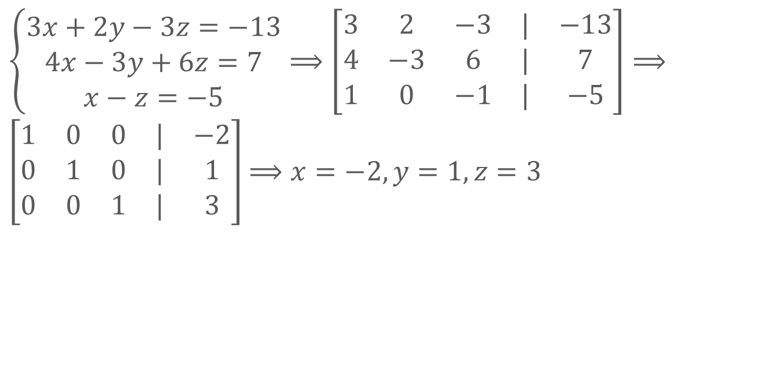
利用高斯消元法求解线性方程组
$\left\{\begin{matrix}3x+2y−3z=−13 \\ 4x−3y+6z=7 \\ x−z=−5\end{matrix}\right.⟹\left[\begin{matrix}3 & 2 & −3 & | & −13 \\ 4 & −3 & 6 & | & 7 \\ 1 & 0 & −1 & | & −5\end{matrix}\right]⟹$ $\left[\begin{matrix}1 & 0 & 0 & | & −2 \\ 0 & 1 & 0 & | & 1 \\ 0 & 0 & 1 & | & 3\end{matrix}\right]$ $⟹x=−2,y=1,z=3$

Slide 15
THANKS
本课程由 张赐 提供
CSDN网站：www.csdn.net
企业服务：http://ems.csdn.net/
人才服务：http://job.csdn.net/
CTO俱乐部：http://cto.csdn.net/
高校俱乐部：http://student.csdn.net/
程序员杂志：http://programmer.csdn.net/
CODE平台：https://code.csdn.net/
项目外包：http://www.csto.com/
CSDN博客：http://blog.csdn.net/
CSDN论坛：http://bbs.csdn.net/
CSDN下载：http://download.csdn.net/

