Slide 1
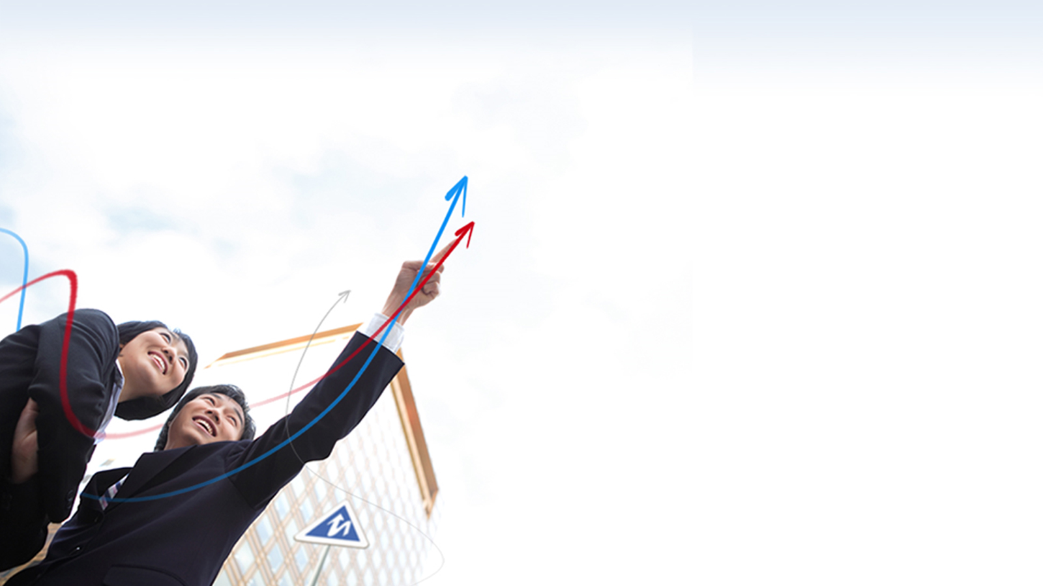

向量空间
张 赐
Mail: educourse@163.com
CSDN博客地址
http://blog.csdn.net/zhangci226

Slide 2
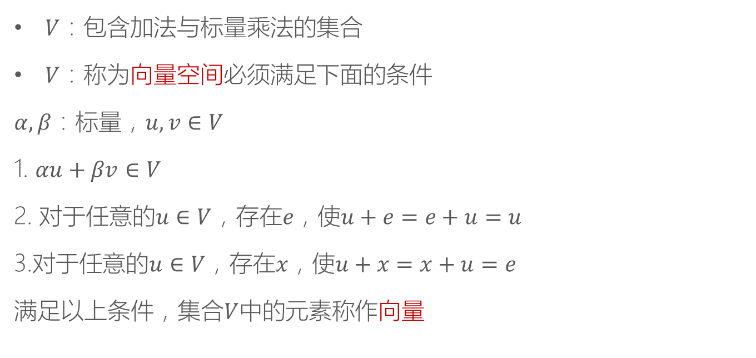
定义1
$V$：包含加法与标量乘法的集合
$V$：称为向量空间必须满足下面的条件
$α,β$：标量，$u,v∈V$
1. $αu+βv$ $∈V$
2. 对于任意的$u∈V$，存在$e$，使$u+e=e+u=u$
3.对于任意的$u∈V$，存在$x$，使$u+x=x+u=e$
满足以上条件，集合$V$中的元素称作向量

Slide 3

定义2
$a_{i}$：标量， ${\vec{v}}_{i}$：向量，那么
$${a_{1}\vec{v}}_{1}+{a_{2}\vec{v}}_{2}+…+{a_{n}\vec{v}}_{n}$$
称为${\vec{v}}_{1},{\vec{v}}_{2},…,{\vec{v}}_{n}$的线性组合

Slide 4
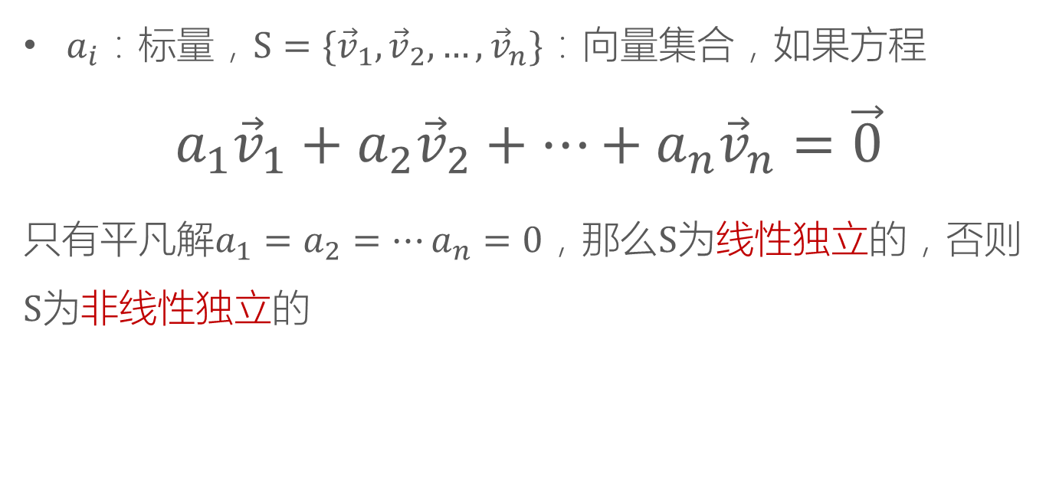
定义3
$a_{i}$：标量，$S=\{{\vec{v}}_{1},{\vec{v}}_{2},…,{\vec{v}}_{n}\}$：向量集合，如果方程
$${a_{1}\vec{v}}_{1}+{a_{2}\vec{v}}_{2}+…+{a_{n}\vec{v}}_{n}=\vec{0}$$
只有平凡解$a_{1}=a_{2}=…a_{n}=0$，那么$S$为线性独立的，否则$S$为非线性独立的

Slide 5

向量空间
例：
$$S=\{\vec{p}={\left(1,0,1\right)}^{T},\vec{q}={\left(0,1,0\right)}^{T}\}$$
$$S=\{\vec{p}={\left(1,0,1\right)}^{T},\vec{q}={\left(0,1,0\right)}^{T},\vec{r}={\left(2,1,2\right)}^{T}\}$$

Slide 6

向量空间
$$S=\{\vec{p}={\left(1,0,1\right)}^{T},\vec{q}={\left(0,1,0\right)}^{T}\}$$

Slide 7

向量空间
$$S=\{\vec{p}={\left(1,0,1\right)}^{T},\vec{q}={\left(0,1,0\right)}^{T}\}$$
$$a\vec{p}+b\vec{q}={\left(a,0,a\right)}^{T}+{\left(0,b,0\right)}^{T}={\left(a,b,a\right)}^{T}$$

Slide 8

向量空间
$$S=\{\vec{p}={\left(1,0,1\right)}^{T},\vec{q}={\left(0,1,0\right)}^{T}\}$$
$$a\vec{p}+b\vec{q}={\left(a,0,a\right)}^{T}+{\left(0,b,0\right)}^{T}={\left(a,b,a\right)}^{T}$$
$${\left(a,b,a\right)}^{T}=\vec{0}⟹a=b=0$$

Slide 9
向量空间
$$S=\{\vec{p}={\left(1,0,1\right)}^{T},\vec{q}={\left(0,1,0\right)}^{T}\}$$
$$a\vec{p}+b\vec{q}={\left(a,0,a\right)}^{T}+{\left(0,b,0\right)}^{T}={\left(a,b,a\right)}^{T}$$
$${\left(a,b,a\right)}^{T}=\vec{0}⟹a=b=0$$
线性独立

Slide 10

向量空间
$$S=\{\vec{p}={\left(1,0,1\right)}^{T},\vec{q}={\left(0,1,0\right)}^{T},\vec{r}={\left(2,1,2\right)}^{T}\}$$

Slide 11

向量空间
$$S=\{\vec{p}={\left(1,0,1\right)}^{T},\vec{q}={\left(0,1,0\right)}^{T},\vec{r}={\left(2,1,2\right)}^{T}\}$$
$$a\vec{p}+b\vec{q}+c\vec{r}={\left(a,0,a\right)}^{T}+{\left(0,b,0\right)}^{T}+{\left(2c,c,2c\right)}^{T}$$

Slide 12

向量空间
$$S=\{\vec{p}={\left(1,0,1\right)}^{T},\vec{q}={\left(0,1,0\right)}^{T},\vec{r}={\left(2,1,2\right)}^{T}\}$$
$$a\vec{p}+b\vec{q}+c\vec{r}={\left(a,0,a\right)}^{T}+{\left(0,b,0\right)}^{T}+{\left(2c,c,2c\right)}^{T}$$
$$={\left(a+2c,b+c,a+2c\right)}^{T}$$

Slide 13
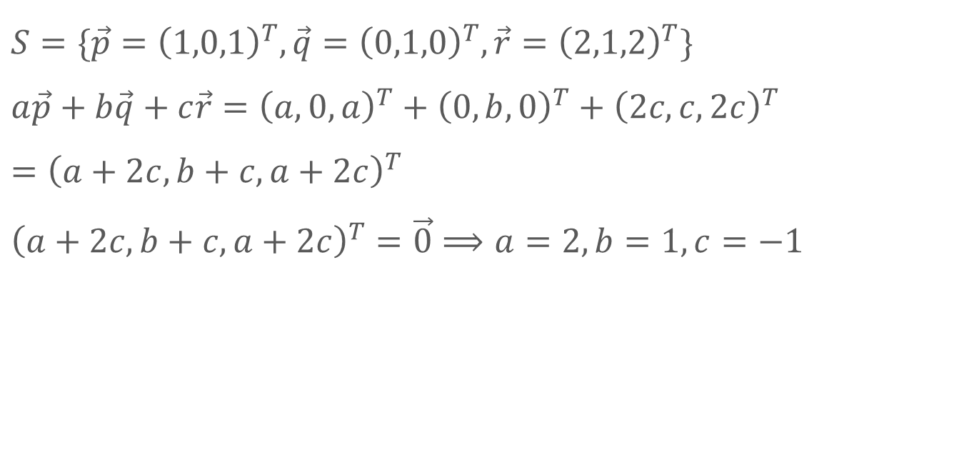
向量空间
$$S=\{\vec{p}={\left(1,0,1\right)}^{T},\vec{q}={\left(0,1,0\right)}^{T},\vec{r}={\left(2,1,2\right)}^{T}\}$$
$$a\vec{p}+b\vec{q}+c\vec{r}={\left(a,0,a\right)}^{T}+{\left(0,b,0\right)}^{T}+{\left(2c,c,2c\right)}^{T}$$
$$={\left(a+2c,b+c,a+2c\right)}^{T}$$
$${\left(a+2c,b+c,a+2c\right)}^{T}=\vec{0}⟹a=2,b=1,c=−1$$

Slide 14
向量空间
$$S=\{\vec{p}={\left(1,0,1\right)}^{T},\vec{q}={\left(0,1,0\right)}^{T},\vec{r}={\left(2,1,2\right)}^{T}\}$$
$$a\vec{p}+b\vec{q}+c\vec{r}={\left(a,0,a\right)}^{T}+{\left(0,b,0\right)}^{T}+{\left(2c,c,2c\right)}^{T}$$
$$={\left(a+2c,b+c,a+2c\right)}^{T}$$
$${\left(a+2c,b+c,a+2c\right)}^{T}=\vec{0}⟹a=2,b=1,c=−1$$
非线性独立

Slide 15

定理1
$S=\{{\vec{v}}_{1},{\vec{v}}_{2},…,{\vec{v}}_{n}\}$：线性独立向量集合，对于任意${\vec{v}}_{k}∈S，$
$${\vec{v}}_{k}=\sum_{i≠k}{a_{i}}{\vec{v}}_{i}$$
即${\vec{v}}_{k}$是${\vec{v}}_{i}$的线性组合

Slide 16
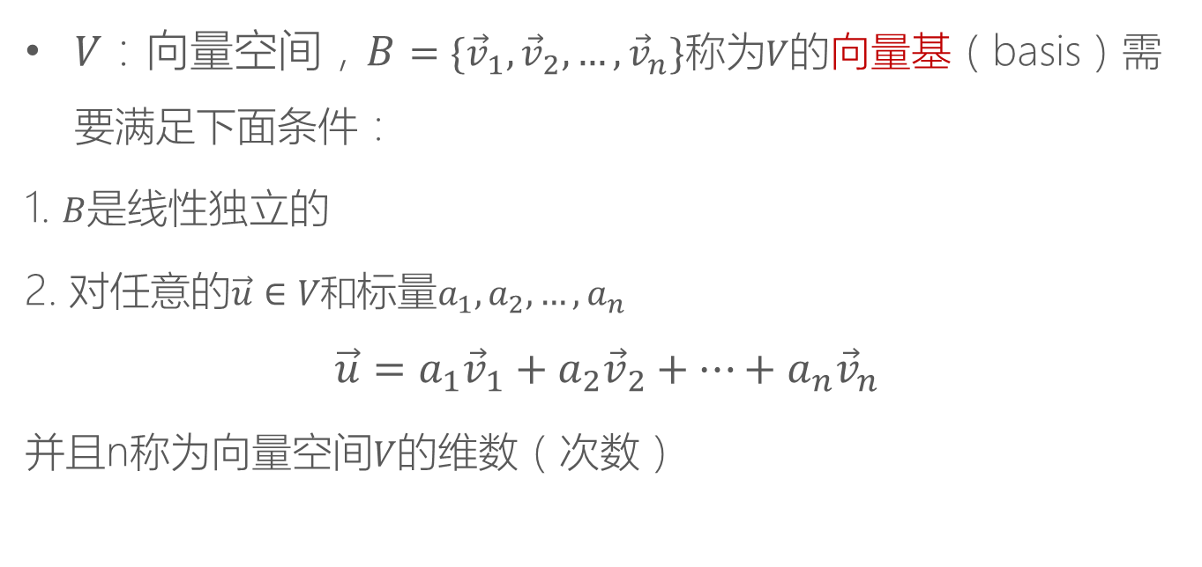
定义4
$V：向量空间，B=\{{\vec{v}}_{1},{\vec{v}}_{2},…,{\vec{v}}_{n}\}称为V$的向量基（basis）需要满足下面条件：
1. $B$是线性独立的
2. 对任意的$\vec{u}∈V和$标量$a_{1},a_{2},…,a_{n}$
$$\vec{u}={a_{1}\vec{v}}_{1}+{a_{2}\vec{v}}_{2}+…+{a_{n}\vec{v}}_{n}$$
并且n称为向量空间$V$的维数（次数）

Slide 17

向量空间
例：找出$R^{3}=\left\{\vec{u} | \vec{u}={\left(u_{1},u_{2},u_{3}\right)}^{T},u_{1}∈R\right\}$的向量基

Slide 18

向量空间
例：找出$R^{3}=\left\{\vec{u} | \vec{u}={\left(u_{1},u_{2},u_{3}\right)}^{T},u_{1}∈R\right\}$的向量基
$$B=\left\{{\vec{e}}_{1}={\left(1,0,0\right)}^{T},{\vec{e}}_{2}={\left(0,1,0\right)}^{T},{\vec{e}}_{3}={\left(0,0,1\right)}^{T}\right\}$$

Slide 19
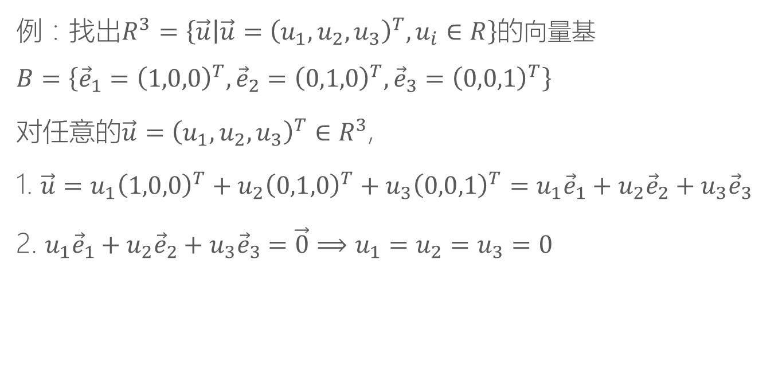
向量空间
例：找出$R^{3}=\left\{\vec{u} | \vec{u}={\left(u_{1},u_{2},u_{3}\right)}^{T},u_{i}∈R\right\}$的向量基
$$B=\left\{{\vec{e}}_{1}={\left(1,0,0\right)}^{T},{\vec{e}}_{2}={\left(0,1,0\right)}^{T},{\vec{e}}_{3}={\left(0,0,1\right)}^{T}\right\}$$
对任意的$\vec{u}={\left(u_{1},u_{2},u_{3}\right)}^{T}∈R^{3}$,
1. $\vec{u}=u_{1}{\left(1,0,0\right)}^{T}+u_{2}{\left(0,1,0\right)}^{T}+u_{3}{\left(0,0,1\right)}^{T}=u_{1}{\vec{e}}_{1}+u_{2}{\vec{e}}_{2}+u_{3}{\vec{e}}_{3}$
2. $u_{1}{\vec{e}}_{1}+u_{2}{\vec{e}}_{2}+u_{3}{\vec{e}}_{3}=\vec{0}⟹u_{1}=u_{2}=u_{3}=0$

Slide 20
THANKS
本课程由 张赐 提供
CSDN网站：www.csdn.net
企业服务：http://ems.csdn.net/
人才服务：http://job.csdn.net/
CTO俱乐部：http://cto.csdn.net/
高校俱乐部：http://student.csdn.net/
程序员杂志：http://programmer.csdn.net/
CODE平台：https://code.csdn.net/
项目外包：http://www.csto.com/
CSDN博客：http://blog.csdn.net/
CSDN论坛：http://bbs.csdn.net/
CSDN下载：http://download.csdn.net/

