Slide 1
Lecture 11: Greedy Algorithms
A greedy algorithm always makes the choice that looks best at the moment and adds it to the current partial solution.
Greedy algorithms don’t always yield optimal solutions but, when they do, they’re usually the simplest and most efficient algorithms available.

Slide 2

Interval Scheduling
Interval scheduling.
Job $j$ starts at $sj$ and finishes at $fj$.
Two jobs are compatible if they don't overlap.
Goal: find maximum subset of mutually compatible jobs.
a
b
c
d
e
f
g
h
Time
0
1
2
3
4
5
6
7
8
9
10
11

Slide 3
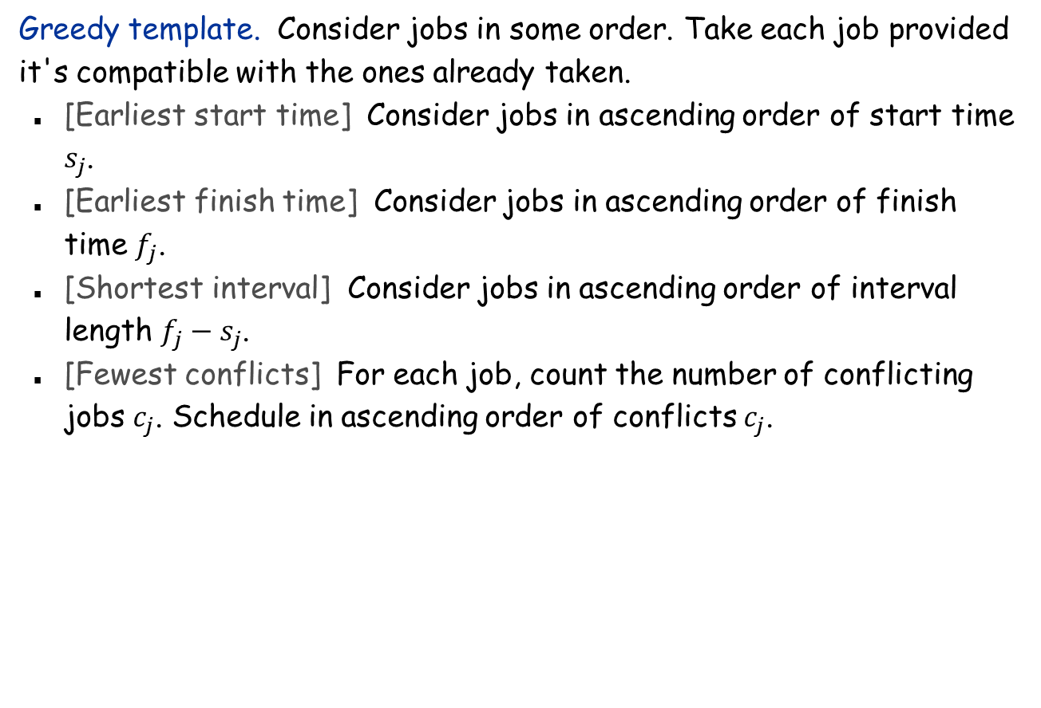
Interval Scheduling: Greedy Algorithms
Greedy template. Consider jobs in some order. Take each job provided it's compatible with the ones already taken.
[Earliest start time] Consider jobs in ascending order of start time $s_{j}$.
[Earliest finish time] Consider jobs in ascending order of finish time $f_{j}$.
[Shortest interval] Consider jobs in ascending order of interval length $f_{j}−s_{j}$.
[Fewest conflicts] For each job, count the number of conflicting jobs $c_{j}$. Schedule in ascending order of conflicts $c_{j}$.

Slide 4
Interval Scheduling: Greedy Algorithms
Greedy template. Consider jobs in some order. Take each job provided it's compatible with the ones already taken.
breaks earliest start time
breaks shortest interval
breaks fewest conflicts

Slide 5
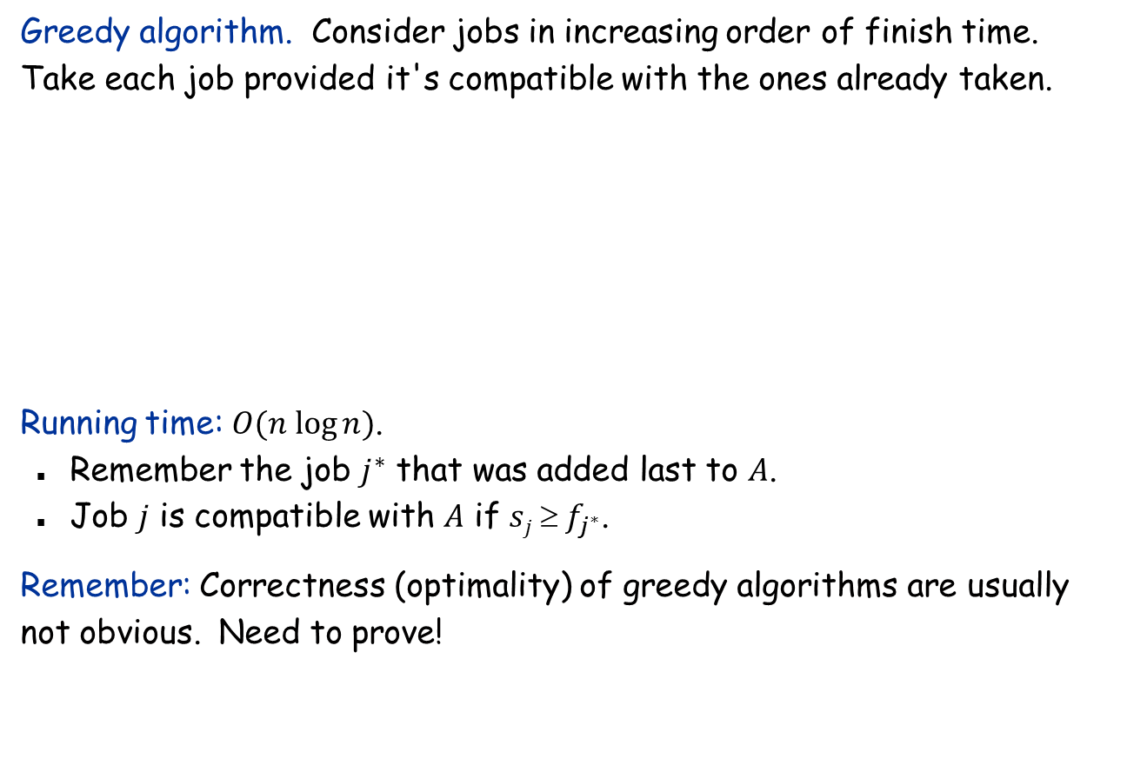
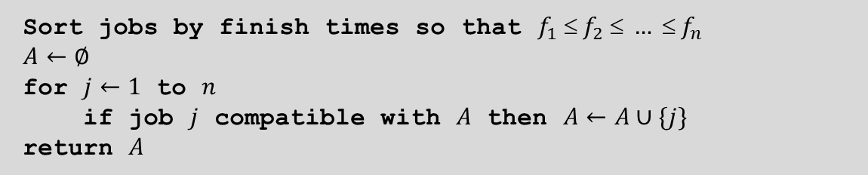
Interval Scheduling: Greedy Algorithm
Greedy algorithm. Consider jobs in increasing order of finish time. Take each job provided it's compatible with the ones already taken.
Running time: $O(n log⁡n)$.
Remember the job $j^{∗}$ that was added last to $A$.
Job $j$ is compatible with $A$ if $sj  f_{j^{∗}}$.
Remember: Correctness (optimality) of greedy algorithms are usually not obvious. Need to prove!
Sort jobs by finish times so that $f_{1}  f_{2}  …  f_{n}$
$$A←∅$$
for $j←1$ to $n$
if job $j$ compatible with $A$ then $A←A∪\{j\}$
return $A$

Slide 6




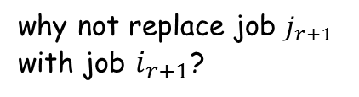






Interval Scheduling: Correctness
Theorem. Greedy algorithm is optimal.
Pf.
Assume greedy is different from OPT. Let's see what’s different.
Let $i1, i2, … ik$ denote the set of jobs selected by greedy.
Let $j1, j2, … jm$ denote set of jobs in the optimal solution with $i1=j1, i2=j2, …, ir=jr$ for the largest possible value of $r$.
job $i_{r+1}$ finishes before $j_{r+1}$
Greedy:
$$i1$$
$$i1$$
$$ir$$
$$i_{r+1}$$
OPT:
$$j1$$
$$j2$$
$$jr$$
$$j_{r+1}$$
. . .
why not replace job $j_{r+1}$ with job $i_{r+1}$?

Slide 7
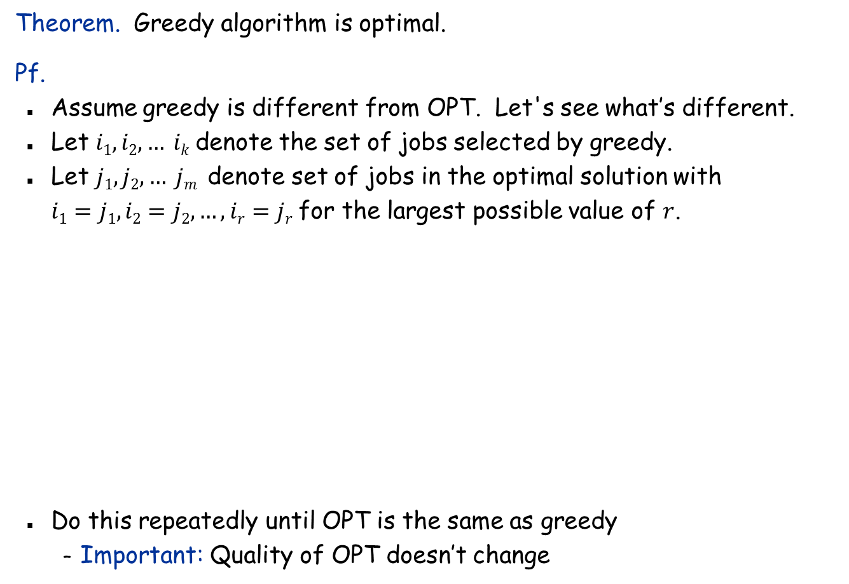
Interval Scheduling: Correctness
Theorem. Greedy algorithm is optimal.
Pf.
Assume greedy is different from OPT. Let's see what’s different.
Let $i1, i2, … ik$ denote the set of jobs selected by greedy.
Let $j1, j2, … jm$ denote set of jobs in the optimal solution with $i1=j1, i2=j2, …, ir=jr$ for the largest possible value of $r$.
Do this repeatedly until OPT is the same as greedy
Important: Quality of OPT doesn’t change
job $i_{r+1}$ finishes before $j_{r+1}$
Greedy:
$$i1$$
$$i1$$
$$ir$$
$$i_{r+1}$$
OPT:
$$j1$$
$$j2$$
$$jr$$
$$i_{r+1}$$
. . .
must still be compatible

Slide 8
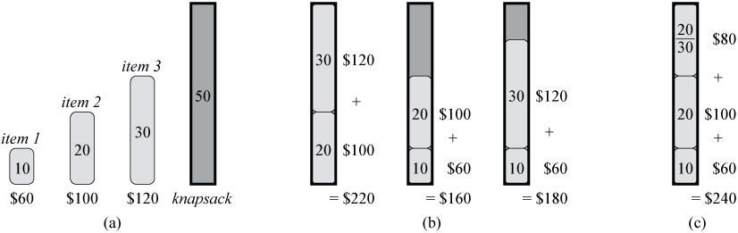
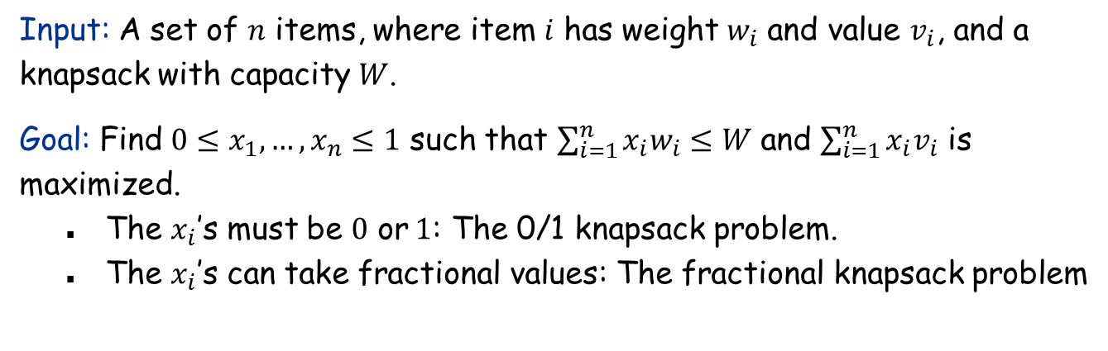
The Fractional Knapsack Problem
Input: A set of $n$ items, where item $i$ has weight $w_{i}$ and value $v_{i}$, and a knapsack with capacity $W$.
Goal: Find $0≤x_{1},…,x_{n}≤1$ such that $\sum_{i=1}^{n}{x_{i}w_{i}≤W}$ and $\sum_{i=1}^{n}{x_{i}v_{i}}$ is maximized.
The $x_{i}$’s must be $0$ or$1$: The 0/1 knapsack problem.
The $x_{i}$’s can take fractional values: The fractional knapsack problem

Slide 9
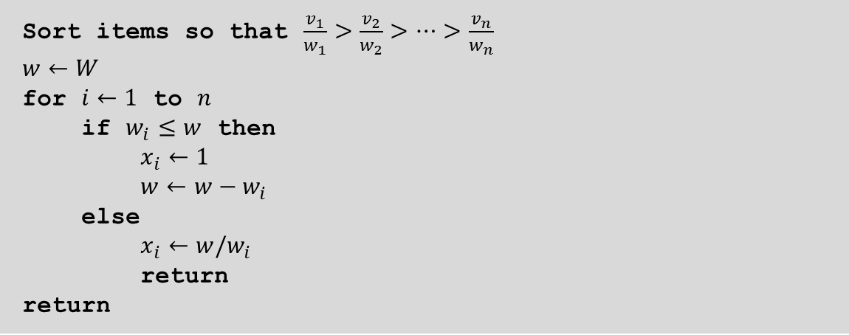
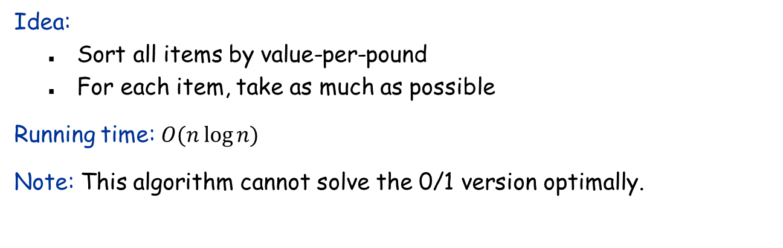
The Greedy Algorithm for Fractional Knapsack
Sort items so that $\frac{v_{1}}{w_{1}}>\frac{v_{2}}{w_{2}}>…>\frac{v_{n}}{w_{n}}$
$$w←W$$
for $i←1$ to $n$
if $w_{i}≤w$ then
$x_{i}←1$
$w←w−w_{i}$
else
$x_{i}←w/w_{i}$
return
return
Idea:
Sort all items by value-per-pound
For each item, take as much as possible
Running time: $O(n\log{n)}$
Note: This algorithm cannot solve the 0/1 version optimally.

Slide 10
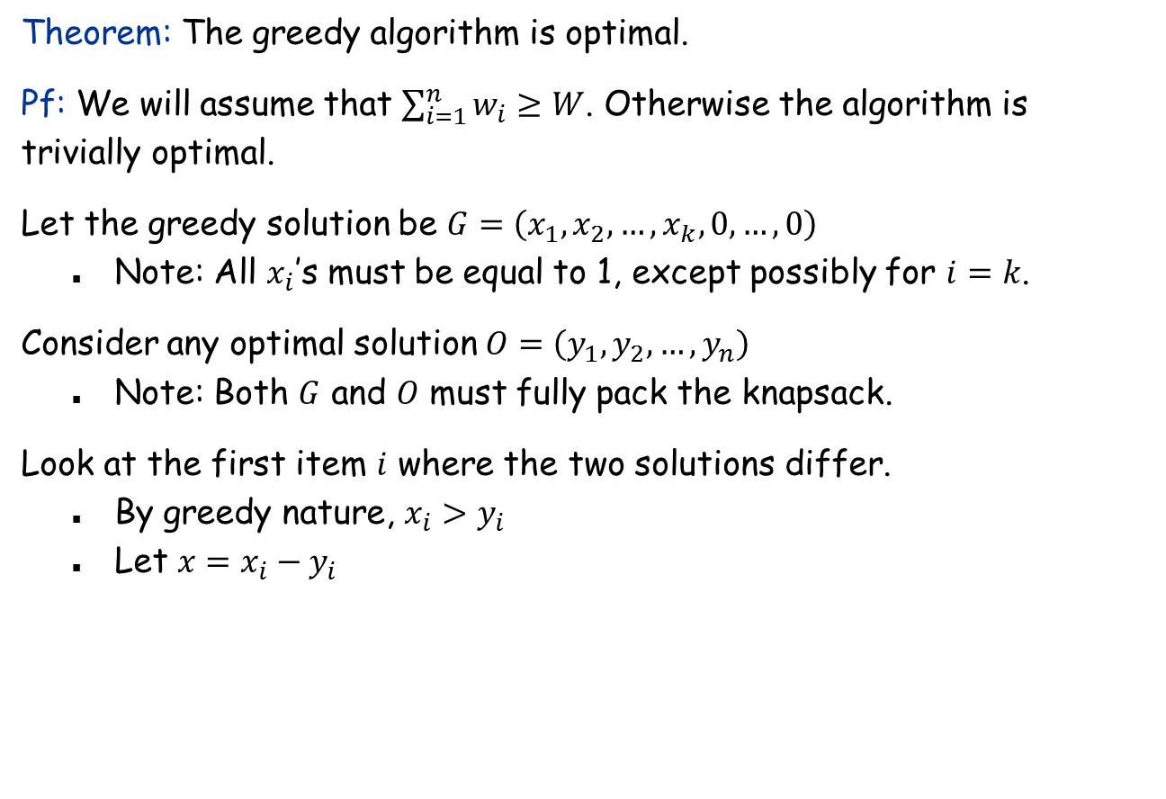
Greedy Algorithm: Correctness
Theorem: The greedy algorithm is optimal.
Pf: We will assume that $\sum_{i=1}^{n}{w_{i}}≥W$. Otherwise the algorithm is trivially optimal.
Let the greedy solution be $G=\left(x_{1}, x_{2}, …, x_{k},0, …,0\right)$
Note: All $x_{i}$’s must be equal to 1, except possibly for $i=k$.
Consider any optimal solution $O=\left(y_{1}, y_{2}, …, y_{n}\right)$
Note: Both $G$ and $O$ must fully pack the knapsack.
Look at the first item $i$ where the two solutions differ.
By greedy nature, $x_{i}>y_{i}$
Let $x=x_{i}−y_{i}$

Slide 11
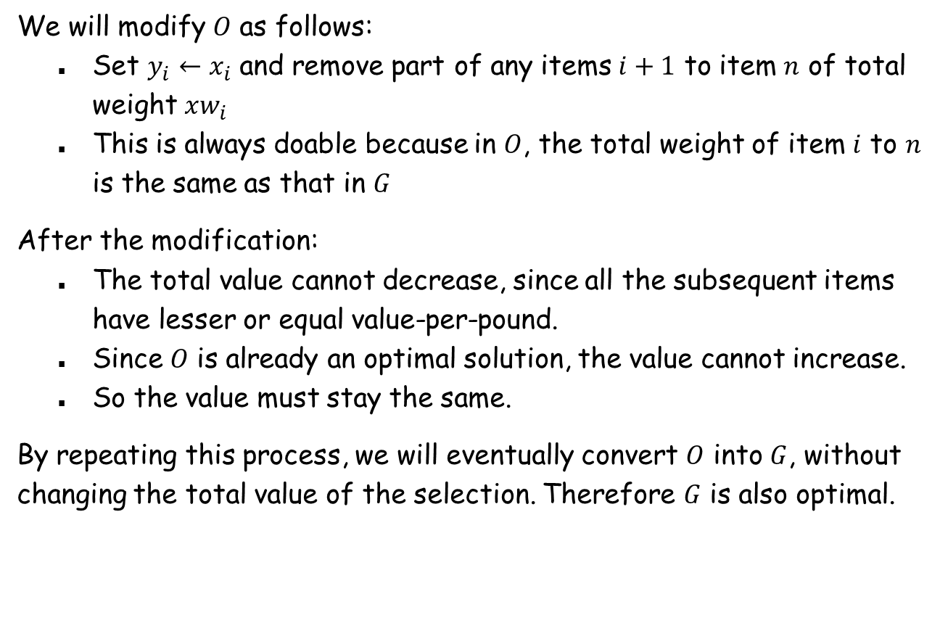
Greedy Algorithm: Correctness (continued)
We will modify $O$ as follows:
Set $y_{i}←x_{i}$ and remove part of any items $i+1$ to item $n$ of total weight $xw_{i}$
This is always doable because in $O$, the total weight of item $i$ to $n$ is the same as that in $G$
After the modification:
The total value cannot decrease, since all the subsequent items have lesser or equal value-per-pound.
Since $O$ is already an optimal solution, the value cannot increase.
So the value must stay the same.
By repeating this process, we will eventually convert $O$ into $G$, without changing the total value of the selection. Therefore $G$ is also optimal.

Slide 12

Interval Partitioning
Interval partitioning.
Lecture $j$ starts at $s_{j}$ and finishes at $f_{j}$.
Goal: find the minimum number of classrooms to schedule all lectures so that no two occur at the same time in the same room.
Ex: This schedule uses 4 classrooms to schedule 10 lectures.
e
j
c
d
g
b
h
a
f
i
9
9:30
10
10:30
11
11:30
12
12:30
1
1:30
2
2:30
3
3:30
4
4:30
Time

Slide 13

Interval Partitioning
Interval partitioning.
Lecture $j$ starts at $s_{j}$ and finishes at $f_{j}$.
Goal: find the minimum number of classrooms to schedule all lectures so that no two occur at the same time in the same room.
Ex: This schedule uses only 3.
c
d
f
j
b
g
i
a
e
h
9
9:30
10
10:30
11
11:30
12
12:30
1
1:30
2
2:30
3
3:30
4
4:30
Time

Slide 14
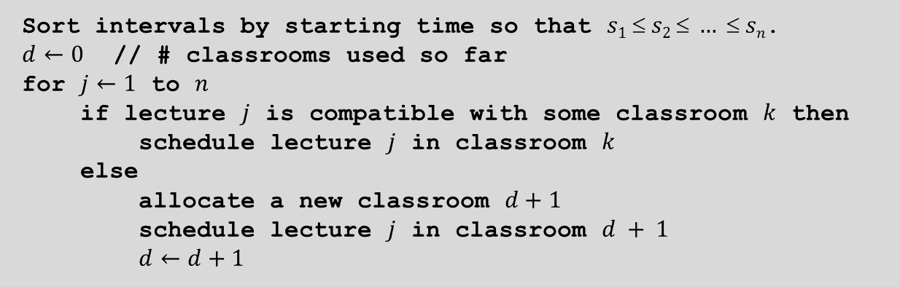
Interval Partitioning: Greedy Algorithm
Greedy algorithm. Consider lectures in increasing order of start time: assign lecture to any compatible classroom.
Sort intervals by starting time so that $s1  s2  …  sn$.
$d←0$ // # classrooms used so far
for $j←1$ to $n$
if lecture $j$ is compatible with some classroom $k$ then
schedule lecture $j$ in classroom $k$
else
allocate a new classroom $d+1$
schedule lecture $j$ in classroom $d + 1$
$d←d+1$

Slide 15
Interval Partitioning: Lower Bound on Optimal Solution
Def. The depth of a set of open intervals is the maximum number that contain any time instance.
Key observation. Number of classrooms needed ≥ depth.
Ex: Depth of schedule below = 3 ⇒ this schedule is optimal.
We will show: The # classrooms used by the greedy algorithm = depth.
c
d
f
j
b
g
i
a
e
h
9
9:30
10
10:30
11
11:30
12
12:30
1
1:30
2
2:30
3
3:30
4
4:30
Time

Slide 16
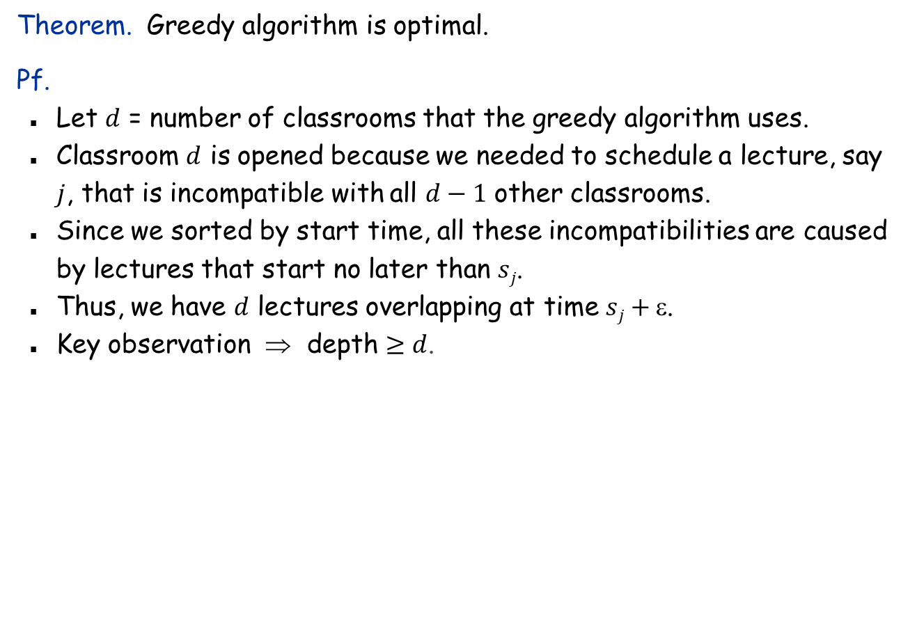
Interval Partitioning: Correctness
Theorem. Greedy algorithm is optimal.
Pf.
Let $d$ = number of classrooms that the greedy algorithm uses.
Classroom $d$ is opened because we needed to schedule a lecture, say $j$, that is incompatible with all $d−1$ other classrooms.
Since we sorted by start time, all these incompatibilities are caused by lectures that start no later than $sj$.
Thus, we have $d$ lectures overlapping at time $sj+$.
Key observation ⇒ depth $≥d$.

Slide 17
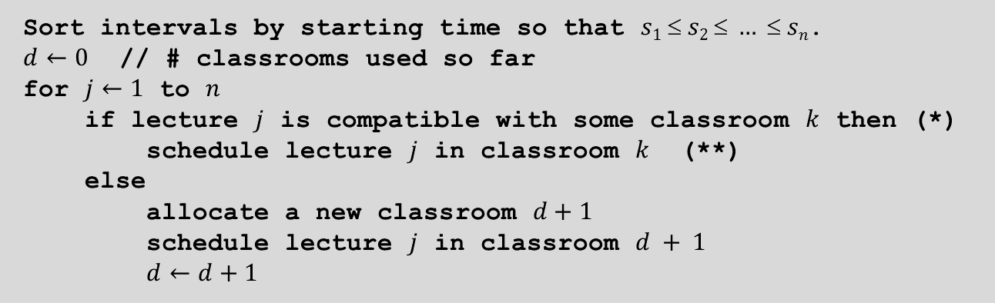
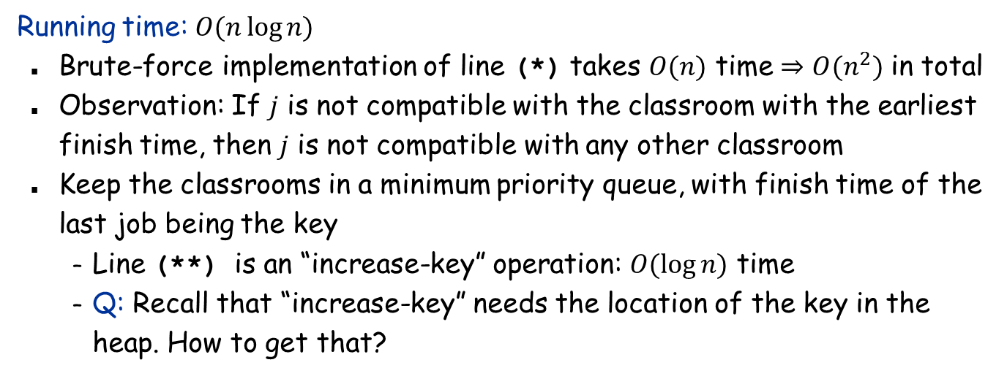
Interval Partitioning: Running Time
Sort intervals by starting time so that $s1  s2  …  sn$.
$d←0$ // # classrooms used so far
for $j←1$ to $n$
if lecture $j$ is compatible with some classroom $k$ then (*)
schedule lecture $j$ in classroom $k$ (**)
else
allocate a new classroom $d+1$
schedule lecture $j$ in classroom $d + 1$
$d←d+1$
Running time: $O(n\log{n)}$
Brute-force implementation of line (*) takes $O(n)$ time $⇒O(n^{2})$ in total
Observation: If $j$ is not compatible with the classroom with the earliest finish time, then $j$ is not compatible with any other classroom
Keep the classrooms in a minimum priority queue, with finish time of the last job being the key
Line (**) is an “increase-key” operation: $O(\log{n)}$ time
Q: Recall that “increase-key” needs the location of the key in the heap. How to get that?

