Slide 1
Lecture 12: Huffman Coding

Slide 2
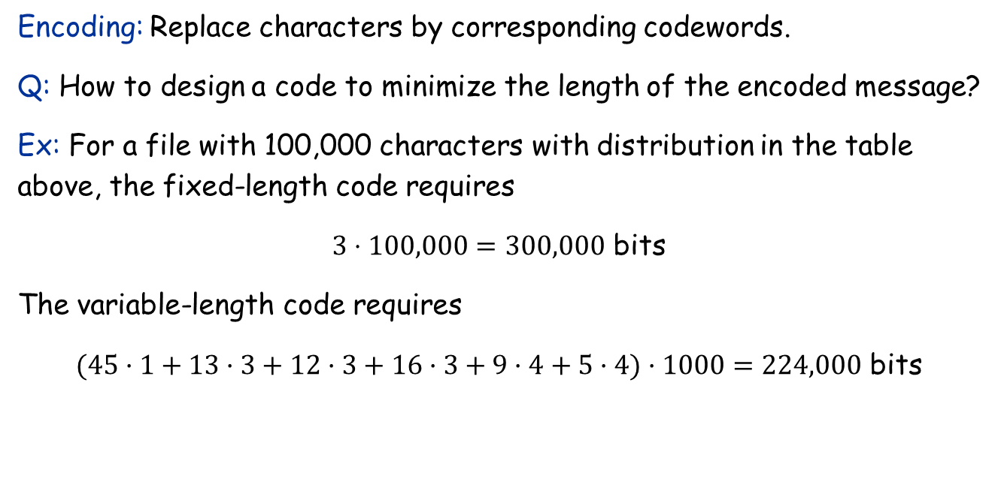
Encoding
 | a | b | c | d | e | f
Frequency (in thousands) | 45 | 13 | 12 | 16 | 9 | 5
Fixed-length codeword | 000 | 001 | 010 | 011 | 100 | 101
Variable-length codeword | 0 | 101 | 100 | 111 | 1101 | 1100
Encoding: Replace characters by corresponding codewords.
Q: How to design a code to minimize the length of the encoded message?
Ex: For a file with 100,000 characters with distribution in the table above, the fixed-length code requires
$3⋅100,000=300,000$ bits
The variable-length code requires
$(45·1+13·3+12·3+16·3+9·4+5·4)·1000=224,000$ bits

Slide 3
Decoding
Decoding: Replace codewords by corresponding characters.
C₁ = {a = 00, b = 01, c = 10, d = 11}. C₂ = {a = 0, b = 110, c = 10, d = 111}. C₃ = {a = 1, b = 110, c = 10, d = 111}
A message is uniquely decodable if it can only be decoded in one way.
Ex:
Relative to C₁, 010011 is uniquely decodable to bad.
Relative to C₂, 1100111 is uniquely decodable to bad.
But, relative to C 3 , 1101111 is not uniquely decipherable since it could have encoded to either bad or acad.
In fact, one can show that every message encoded using C₁ or C₂ is uniquely decodable.
C₁: Because it is a fixed-length code.
C₁: Because it is a prefix-free code.

Slide 4
Prefix Codes
Def: A code is called a prefix (free) code if no codeword is a prefix of another one.
Theorem: Every message encoded by a prefix free code is uniquely decodable.
Pf: Since no codeword is a prefix of any other, we can always find the first codeword in a message, peel it off, and continue decoding.
Ex: code: {a = 0, b = 110, c = 10, d = 111}.
01101100 = 01101100 = abba
Note: There are other kinds of codes that are also uniquely decocable.
Theorem (proof omitted): The best prefix code can achieve the optimal data compression among any code that is uniquely decodable.
Q: How to find the prefix code that results in the smallest encoded message for a given file?

Slide 5
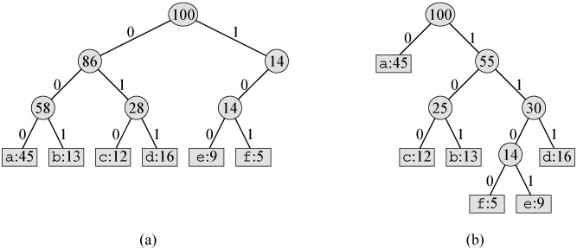
Correspondence between Binary Trees and Prefix Codes
Left edge is labeled 0; right edge is labeled 1.
The binary string on a path from the root to a leaf is the codeword associated with the character at the leaf.
The depth of a leaf is equal to the length of the codeword.

Slide 6
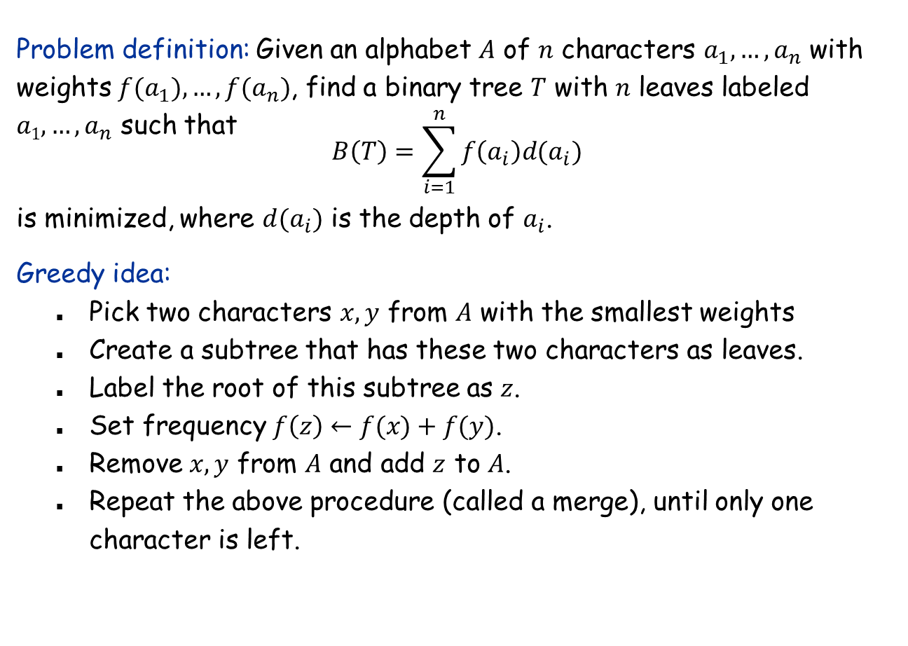
Problem Restated
Problem definition: Given an alphabet $A$ of $n$ characters $a_{1},…,a_{n}$ with weights $f(a_{1}),…, f(a_{n})$, find a binary tree $T$ with $n$ leaves labeled $a1,…,a_{n}$ such that
$$B\left(T\right)=\sum_{i=1}^{n}{f\left(a_{i}\right)d(a_{i})}$$
is minimized, where $d(a_{i})$ is the depth of $a_{i}$.
Greedy idea:
Pick two characters $x,y$ from $A$ with the smallest weights
Create a subtree that has these two characters as leaves.
Label the root of this subtree as $z$.
Set frequency $f\left(z\right)←f(x)+f(y)$.
Remove $x,y$ from $A$ and add $z$ to $A$.
Repeat the above procedure (called a merge), until only one character is left.

Slide 7
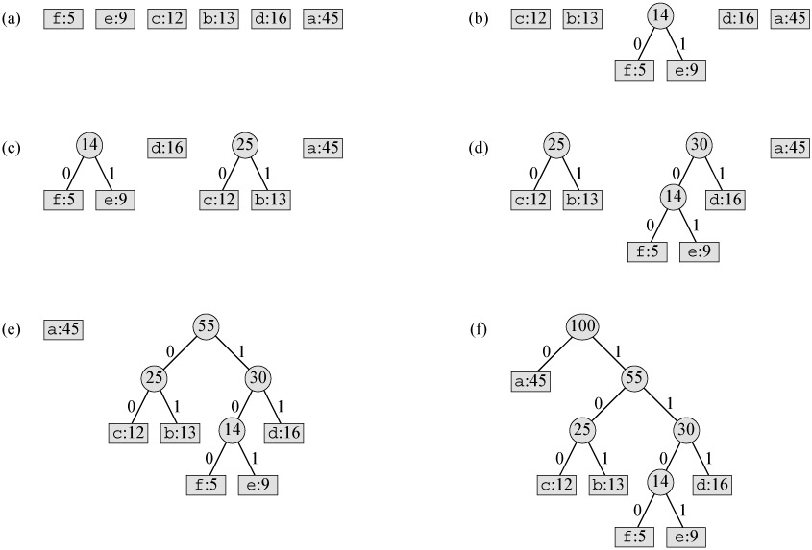
Example

Slide 8
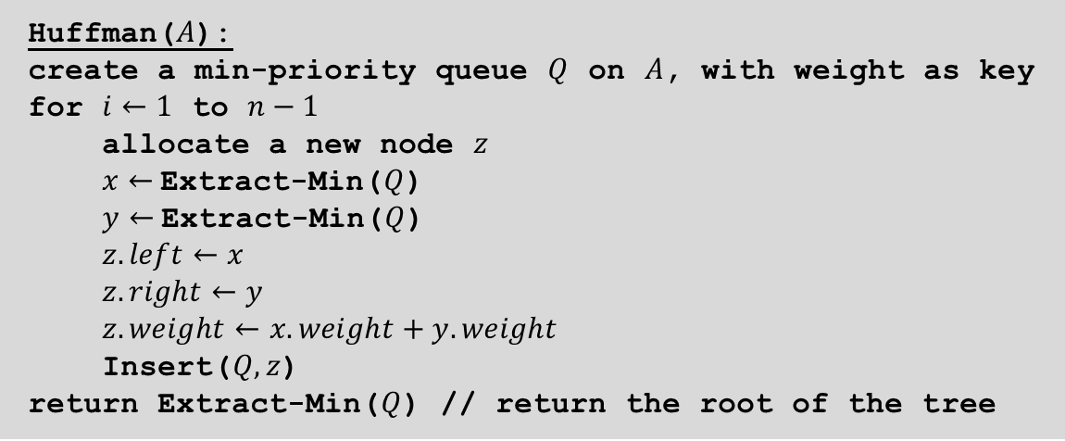
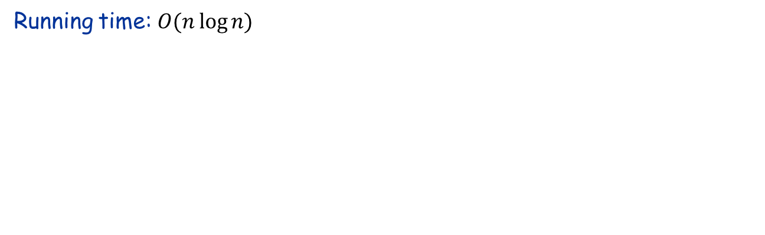
The Algorithm
Huffman($A$):
create a min-priority queue $Q$ on $A$, with weight as key
for $i←1$ to $n−1$
allocate a new node $z$
$x←$Extract-Min($Q$)
$y←$Extract-Min($Q$)
$z.left←x$
$z.right←y$
$z.weight←x.weight+y.weight$
Insert($Q, z$)
return Extract-Min($Q$) // return the root of the tree
Running time: $O(n\log{n)}$

Slide 9
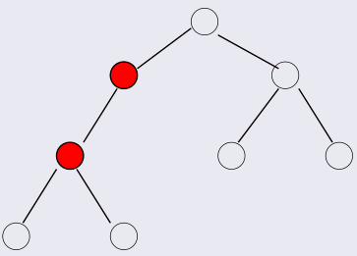
Huffman Coding: Correctness
Lemma 1: An optimal prefix code tree must be “full”, i.e., every internal node has exactly two children.
Pf: If some internal node had only one child,
then we could simply get rid of this node and replace it with its child. This would decrease the total cost of the encoding.

Slide 10
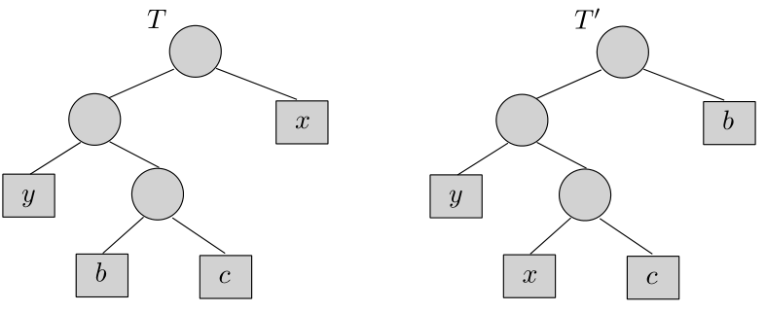

Huffman Coding: Correctness
Observation: Moving a small-frequency character downward in $T$ doesn’t make it worse.
Lemma 2: Let $T$ be prefix code tree and $T′$ be another obtained from $T$ by swapping two leaf nodes $x$ and $b$. If,
$$f(x)≤f(b),d(x)≤d(b)$$
then,
$$B(T′)≤B(T).$$

Slide 11
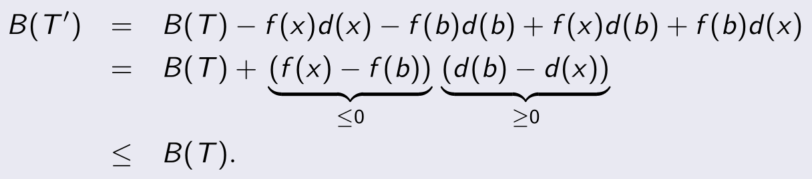
Huffman Coding: Correctness
Pf:

Slide 12
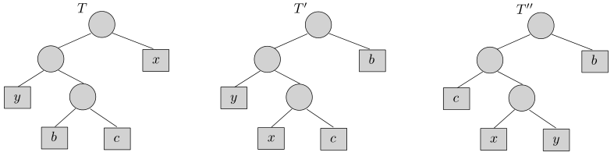
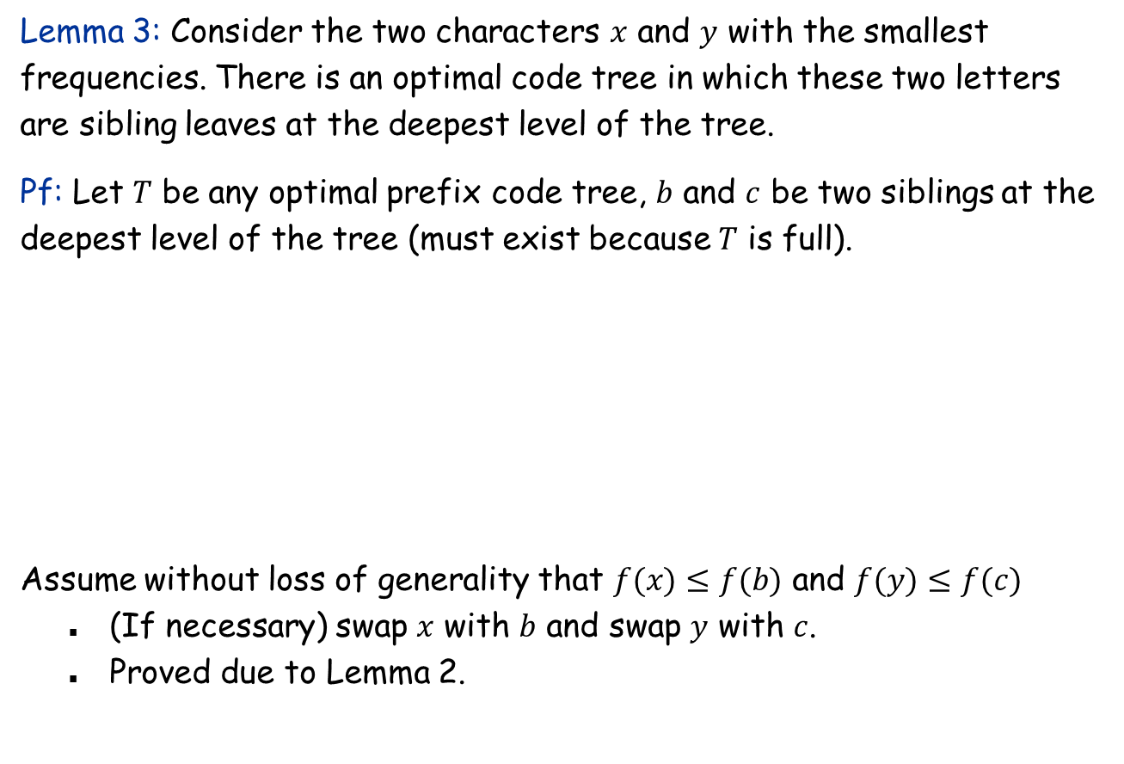
Huffman Coding: Correctness
Lemma 3: Consider the two characters $x$ and $y$ with the smallest frequencies. There is an optimal code tree in which these two letters are sibling leaves at the deepest level of the tree.
Pf: Let $T$ be any optimal prefix code tree, $b$ and $c$ be two siblings at the deepest level of the tree (must exist because $T$ is full).
Assume without loss of generality that $f(x)≤f(b)$ and $f(y)≤f(c)$
(If necessary) swap $x$ with $b$ and swap $y$ with $c$.
Proved due to Lemma 2.

Slide 13

Huffman Coding: Correctness
Lemma 4: Let $T$ be a prefix code tree and $x$ and $y$ are two sibling leaves. Let $T′$ be obtained from $T$ by removing $x$ and $y$, naming the parent $z$, and setting $f(z)=f(x)+f(y)$. Then
$$B(T) = B(T′)+f(x)+f(y).$$
Pf: $B(T)=B(T′)−f(z)d(z)+f(x)(d(z)+1)+f(y)(d(z)+1)$
$=B\left(T^{′}\right)−\left(f\left(x\right)+f\left(y\right)\right)d\left(z\right)+\left(f\left(x\right)+f\left(y\right)\right)\left(d\left(z\right)+1\right)$ $=B(T′)+f(x)+f (y).$

Slide 14
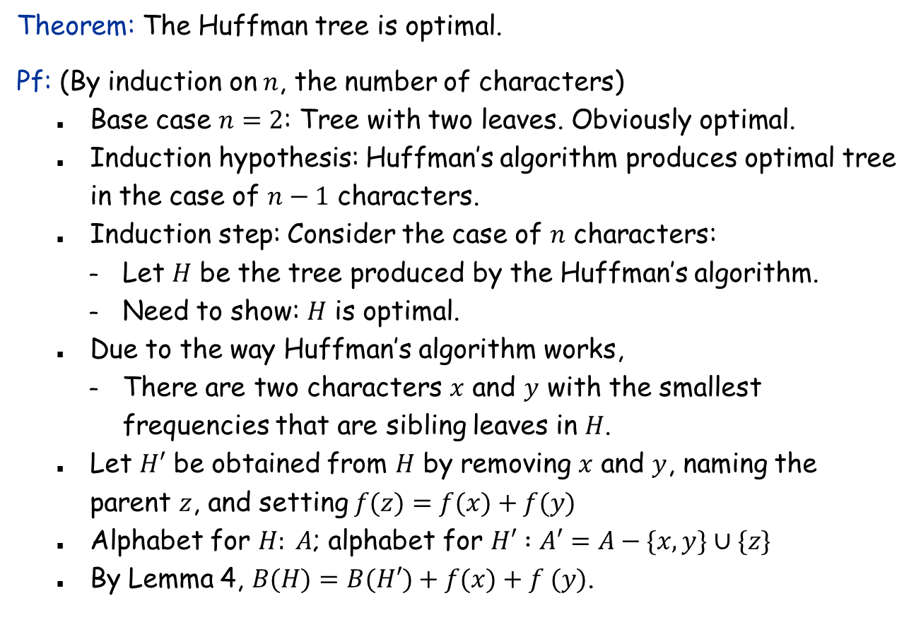
Huffman Coding: Correctness
Theorem: The Huffman tree is optimal.
Pf: (By induction on $n$, the number of characters)
Base case $n=2$: Tree with two leaves. Obviously optimal.
Induction hypothesis: Huffman’s algorithm produces optimal tree in the case of $n−1$ characters.
Induction step: Consider the case of $n$ characters:
Let $H$ be the tree produced by the Huffman’s algorithm.
Need to show: $H$ is optimal.
Due to the way Huffman’s algorithm works,
There are two characters $x$ and $y$ with the smallest frequencies that are sibling leaves in $H$.
Let $H′$ be obtained from $H$ by removing $x$ and $y$, naming the parent $z$, and setting $f(z)=f(x)+f(y)$
Alphabet for $H: A$; alphabet for $H′ :A′=A−\{x,y\}∪\{z\}$
By Lemma 4, $B(H)=B(H′)+f(x)+f (y)$.

Slide 15
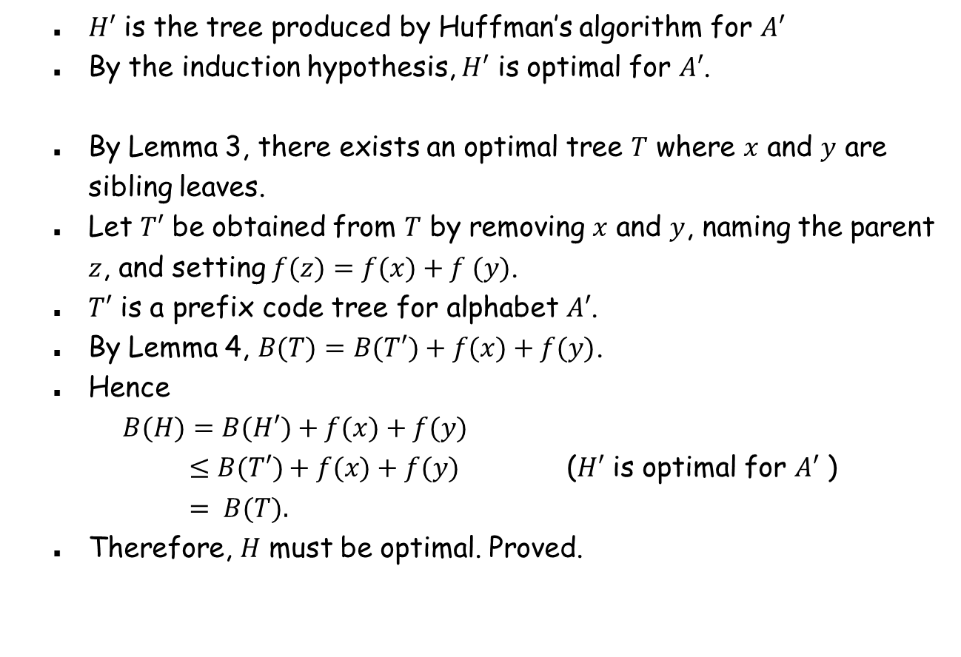
Huffman Coding: Correctness
$H′$ is the tree produced by Huffman’s algorithm for $A′$
By the induction hypothesis, $H′$ is optimal for $A′$.
By Lemma 3, there exists an optimal tree $T$ where $x$ and $y$ are sibling leaves.
Let $T′$ be obtained from $T$ by removing $x$ and $y$, naming the parent $z$, and setting $f(z)=f(x)+f (y)$.
$T′$ is a prefix code tree for alphabet $A′$.
By Lemma 4, $B(T)=B(T′)+f(x)+f(y)$.
Hence
$B(H)=B(H′)+f(x)+f(y)$
$≤B(T′)+f(x)+f(y)$ ($H′$ is optimal for $A′$ )
$= B(T).$
Therefore, $H$ must be optimal. Proved.

