Slide 1
Tecnomatix Plant Simulation
Compact Student Training
Accompanying Simulation Model: Compact_Student_Training_PS13.spp
Release 03
Release Date 11/08/2016

Slide 2
Preparation
Required: A working installation of Plant Simulation, with a Student license, on your computer.
The current version of the free Student edition is 13.0.2
A download link to the free Student edition was provided through your university.
Plant Simulation 13.0.2 is supported on the following 64 bit Operating Systems:
Windows Vista®
Windows 7®
Windows 8®
Windows 8.1®
Windows 10®
Installation and software support is provided by your university.
Note
The free Student addition is limited to 80 simulation objects. This limitation will be considered in developing our models.

Slide 3
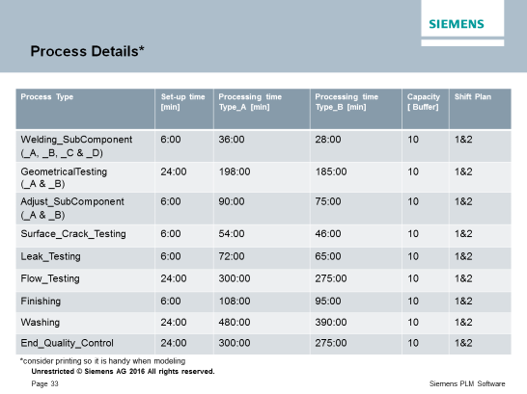
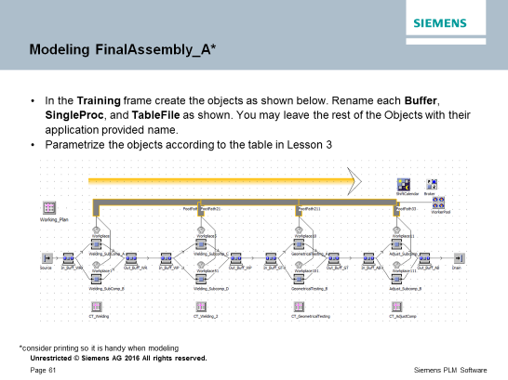
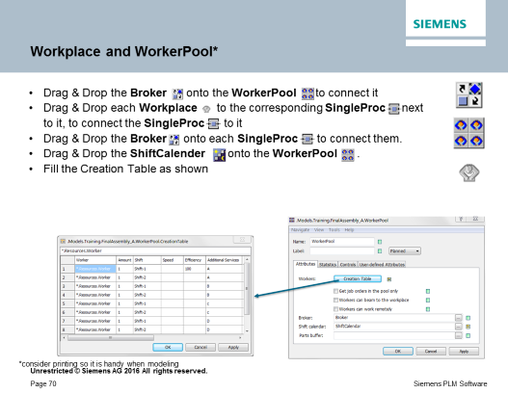
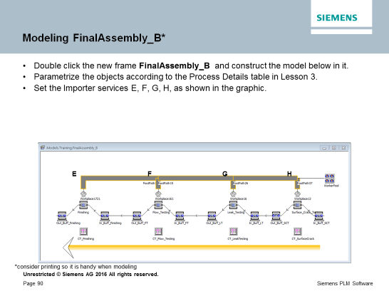
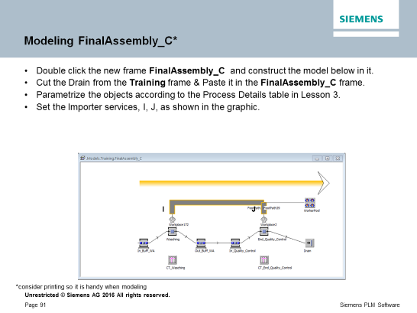
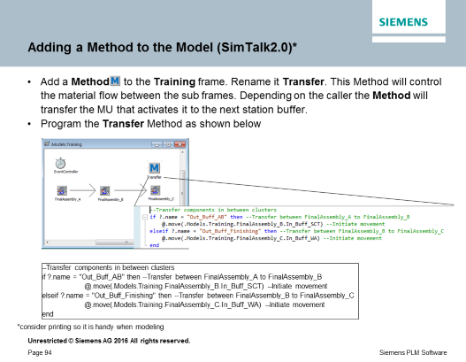
Preparation – for your Consideration
Some of the exercises you will perform will require reference to information detailed in specific slides, such as object names, or parameters. Titles of these slide are marked with an asterisk (*), referencing the following note:
For your convenience: You may want to consider presenting these slides, if possible, on an additional device, or using a second screen. If you will be using one screen to review the slides as well as develop the models, you may want to consider printing these specific 6 slides as handouts, for ease of reference. Titles of the slides below.
*consider printing so it is handy when modeling

Slide 4
Global University Challenge
Plant Simulation Basic Modeling
Student Guide
Plant Simulation 13.0.2
Collateral Student Model: Global_University_Challenge_PS12.spp

Slide 5
Lesson 1 Course Introduction

Slide 6
Course Introduction
Purpose
This lesson introduces the basic concepts and student guide structure.
Objectives
After you complete this lesson, you should be able to:
Understand the intent and goal of this Course
Conduct
Your are encouraged to ask questions and share thoughts

Slide 7
Course Overview
Intent
Provide an insight on the usage of Tecnomatix Plant Simulation @ Siemens AG for modeling of Key Processes inside the Production Facility in Berlin
Expected Key Learnings for students
Organization of Work Centers in the Production Facility
Modeling a Process Flow in Manufacturing of Support Housings for Gas Turbines
Usage of Buffers and Worker Pools
Use of visualization, in support of Decision Making, through display of charts, for understanding impact of change to Process Parameters

Slide 8
Course Description
The Plant Simulation GUC Compact Modeling course is intended for individuals who would like to become Plant Simulation users.
This is a one day course expected to run between 6 to 8 hours with a lunch break
Students will learn how to build, run, and evaluate simulation models
Course topics
Basic Modeling Techniques
Experiment Manager (Multi-Level, Random, Two-Level, etc.)
Analysis of Simulation Experiments
Basic Visualization Techniques
Random Numbers (Distributions, Confidence Intervals, etc.)
For more information:
Refer to Siemens Learning Advantage. (Learning Advantage online training is available for FREE to students and educators )

Slide 9
Student Guide Typographical Conventions
The following typographical conventions are followed in this student guide:
The training manual is subdivided into lessons. Each lesson has two sections: Instructor lecture and Student activity.
The Student activity contains all button clicks required to produce the result of the concept being taught in the lesson. The following syntax is used in the activities:
Informational Sidebar Conventions Note
Notes are used to show notes of special importance. This icon type is used most often.

Slide 10
Student Guide Typographical Conventions
Tip
Tips are used to show tips that may be helpful after class. The manual will only have a sparingly few number of these.
Caution
Warning and Cautions show areas where students might need special attention to proceed with their model.
Activity Button Click Conventions
In the activity the titles of views/dialog boxes, pop-ups, toolbars, or viewers are shown in italic.
Items that should be clicked with the mouse (such as action items), are shown in bold. For example: objects, buttons, icons, menu selections.
Keys from the keyboard are shown in brackets. For example: [Enter], [Alt], [Ctrl], [Delete], etc..

Slide 11
Student Guide Typographical Conventions
When an action item from the top menu bar is found in an activity it is shown with an arrow between the top menu and the action item. For example: File
→ Exit.
When an icon is referenced in an activity of the training manual, the name of the icon appears in bold in the step followed by the icon. For example: Open .

Slide 12
Student Guide Typographical Conventions
Example Usage of Activity Conventions
To refer to a top menu command such as Save:
Choose File → Save . The current file is saved.
Here is how an icon from a toolbar is referred to in an activity:
Click Save from the Standard toolbar.
Here is how a button on the keyboard is referred to in an activity:
Press the [Enter] key.
Press the [Esc] key.
Press the [Ctrl] or [Alt] key.
Press the [F1] key.

Slide 13
Lesson 2
Overview of Plant Simulation Basics

Slide 14
Overview of Plant Simulation Basics
Purpose
In this lesson, you gain an overview of Plant Simulation basics.
Objectives
After you complete this lesson, you should be able to:
Know the definition of Discrete Event Simulation
Know the uses of simulation
Describe the typographical conventions used in this student guide
Start Plant Simulation
Help topics
Additional information for this lesson can be found in:
Step-by-Step Help > Getting to Know Tecnomatix Plant Simulation > Simulation and Modeling Concepts

Slide 15
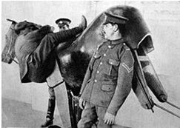
What is Simulation?
Simulation is a general term that means different things to different people, depending on your background
a wooden mechanical horse simulator used during World War I
For example:
Simulation is the imitation of a physical thing or process.
It represents key characteristics and behavior of a system.

Slide 16
Computer Simulations
A computer simulation is an attempt to model a real-life or hypothetical situation using a computer so that you can study it and see how it works.
Many times, the reason to invest in computer simulation is to answer a question or verify a result that are otherwise costlier or impossible to achieve
Plant Simulation performs a specific type of simulation: Discrete Event Simulations. Discrete Even Simulation will be reviewed later here in Lesson 2.
Examples of simulations not performed by Plant Simulation: Physical phenomena, such as force, heat, corrosion, and similar behavior

Slide 17
Definition of Simulation
Simulation is the imitation of a dynamic process within a model to arrive at results that may be transferred to real systems.
Or
"Simulation is the emulation of a system including its dynamic processes in a model you can experiment with. It aims at achieving results that can be transferred to reality." (VDI 3633, Blatt 1, 1993).

Slide 18
Discrete-Event Simulation
Discrete-event simulation tracks the state changes in the model components at the time the changes occur. Unlike continuous simulation where the clock runs
in a continuous manner, the clock in discrete-event simulation jumps from one event to the next scheduled event. Events can schedule other events such as a part entering a machine, which schedules an event for the same part to leave the machine.
Note
Discrete-event simulation only shows the state changes of the model components at certain points in time, not continually over time. When certain events take place, certain model components change their state and thus control the simulation. Plant Simulation considers these events in a discrete way, step-by-step. The main advantage of this approach is, that Plant Simulation skips the time between the events
In addition, Plant Simulation is an object-oriented application, that allows child objects to inherit properties from a parent object.

Slide 19
Simulation Uses
To plan a new facility:
Determine and optimize the times and the throughput
Determine the dimensioning
Determine the limits of performance
Investigate the influence of failures
Determine manpower requirements
Gain knowledge about the behavior of the facility
Determine suitable control strategies
Evaluate different alternatives
To optimize an existing facility:
Optimize control strategies
Optimize the sequence of orders
Test the daily proceedings

Slide 20
Simulation Uses
Simulation can:
Increase the profitability of the facility:
Increase
Throughput
Resource utilization
Utilization of the facility
Determine
Optimal buffer sizes
Number of transporters and AGVs
Number of the workpiece carriers
Production schedules and sequences

Slide 21
Simulation Uses
Decrease
Throughput times
Required resources
Storage requirements
Other
Validate the process design in the planning process
Identify bottlenecks
Reduce WIP (work-in-progress)
Evaluate capital investments or changes in processes
Optimize control strategies
Avoid planning errors
Protect investments

Slide 22


Starting Plant Simulation
Method 1:
Double-click the Plant Simulation 13 icon on the desktop. The Plant Simulation software starts.
Method 2:
Choose Start → Programs → Tecnomatix → Plant Simulation 13
The Plant Simulation software starts.
Plant Simulation Interface Overview
Starting Plant Simulation opens the program window that provides menus and toolbars, the Toolbox, Class Library, and Console windows, and the Start Page.
The Start Page offers links to access previously opened models and information about a variety of topics including the Tutorial.

Slide 23
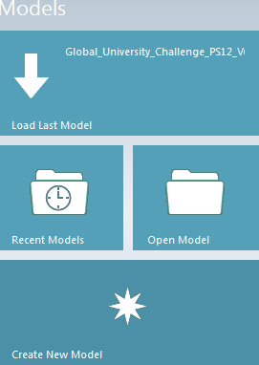
Start a new Model
Choose File → New to open a new model file. This file contains the Class Library with the selected built-in Plant Simulation objects.
Choose the Create New Model tile

Slide 24

Ways to Open a Plant Simulation Model File
Method 1:
Choose File → Open .
Browse to the folder that contains the model file and either double-click the model file or choose it and then click Open.
Method 2:
Drag and drop a model file (*.spp) into the Class Library.
Method 3:
Choose File → Recent Files. The list of recent files shows the last eight model files you worked with.

Slide 25
Method 4:
Choose a tile from the Models sections of the Start Page window. Recent Models lists the last eight models you worked on.

Slide 26
Ways to Close a Plant Simulation Model File
Method 1:
Choose File → Close .
Plant Simulation asks if the file is to be saved.
Method 2:
Choose the Close
icon on the Quick Access toolbar.
Method 3:
Click Close
in the upper right-hand corner of the Class Library window.

Slide 27
Exiting Plant Simulation
Method 1:
Choose File → Exit.
If there is a model file open Plant Simulation asks if the file is to be saved.
Method 2:
Click Close
window.
in the upper right-hand corner of the main Plant Simulation

Slide 28
Lesson 3
Overview of Topics in this Course

Slide 29
Overview of Topics in this Course
Purpose
In this lesson, you gain an overview of topics covered in this course.
Objectives
After you complete this lesson, you should be able to:
Know what topics are covered in this course
Lessons 13 through 15 are marked (Additional Content) and will be covered time permitting.
Lessons 16 through 21 are marked (Optional) and are included for awareness and self study.

Slide 30
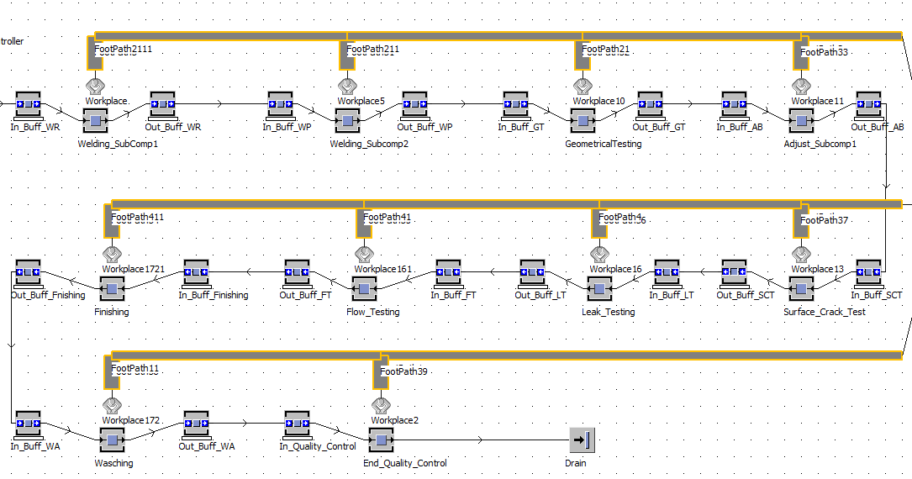
Topic Overview
This is the simulation model that is provided by Siemens P&G.
It shows the material flow of a production line, and contains data and settings reflecting the actual situation.
By constructing this simulation model in the training you will learn basic skills in Plant Simulation.
As you work on your own project, you are encouraged to visualize and analyze your ideas by modifying and enhancing the simulation model, and using it for presentations.

Slide 31
Process Flow (Final Assembly)
Final Assembly A
Welding Sub-Component 1
Welding Sub-Component 2
Geometrical Testing
Adjusting Sub-Component 1
Final Assembly B
Finishing
Flow Testing
Leak Testing
Surface Crack Testing
Final Assembly C
Storage
Final Quality Control
Washing

Slide 32
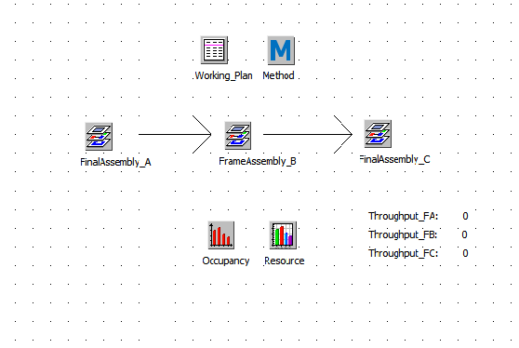
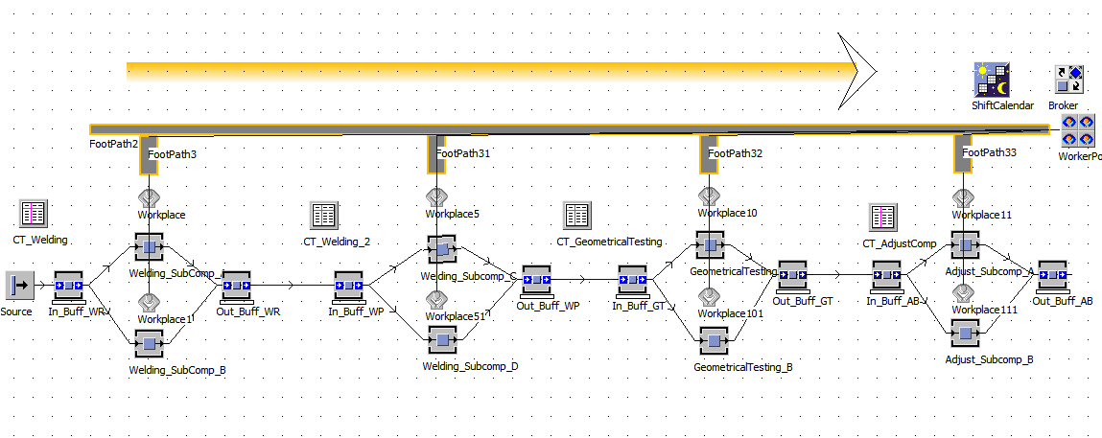
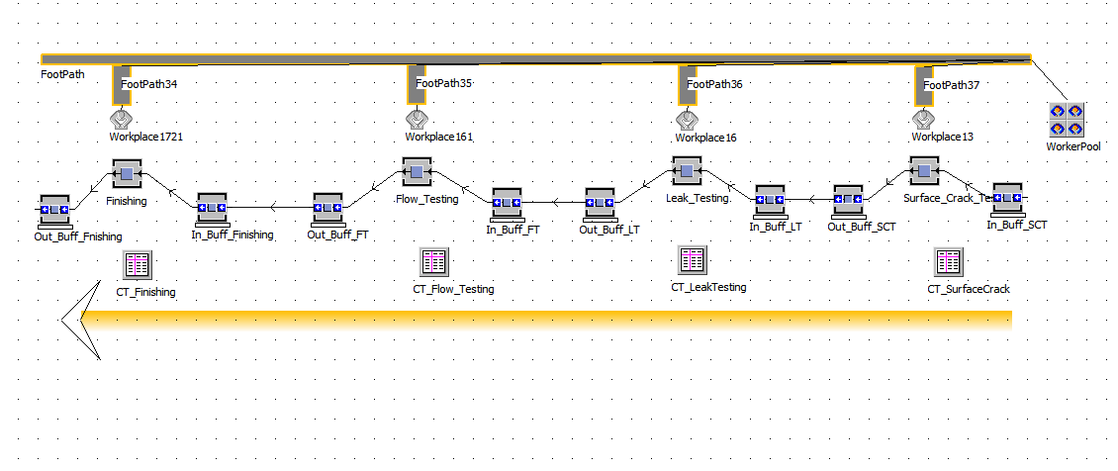
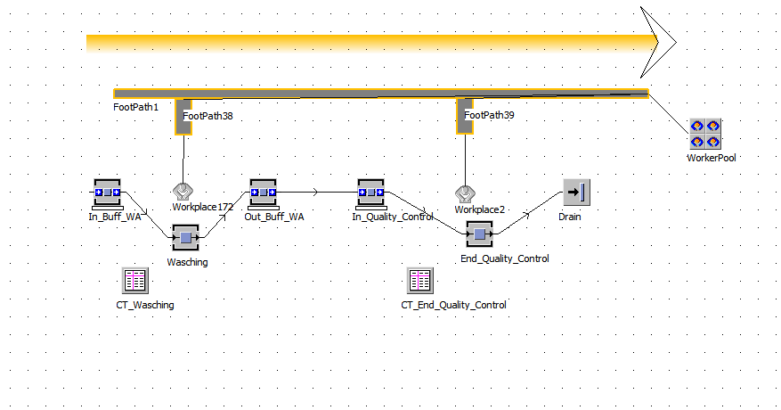
Simulation Model
Final Assembly
Final Assembly A
Final Assembly B
Final Assembly C

Slide 33
Process Details*
Process Type | Set-up time [min] | Processing time Type_A [min] | Processing time Type_B [min] | Capacity [ Buffer] | Shift Plan
Welding_SubComponent (_A, _B, _C & _D) | 6:00 | 36:00 | 28:00 | 10 | 1&2
GeometricalTesting (_A & _B) | 24:00 | 198:00 | 185:00 | 10 | 1&2
Adjust_SubComponent (_A & _B) | 6:00 | 90:00 | 75:00 | 10 | 1&2
Surface_Crack_Testing | 6:00 | 54:00 | 46:00 | 10 | 1&2
Leak_Testing | 6:00 | 72:00 | 65:00 | 10 | 1&2
Flow_Testing | 24:00 | 300:00 | 275:00 | 10 | 1&2
Finishing | 6:00 | 108:00 | 95:00 | 10 | 1&2
Washing | 24:00 | 480:00 | 390:00 | 10 | 1&2
End_Quality_Control | 24:00 | 300:00 | 275:00 | 10 | 1&2
*consider printing so it is handy when modeling

Slide 34
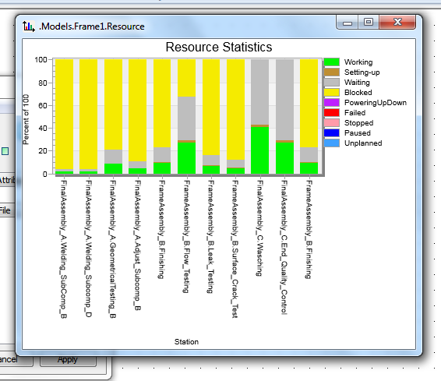
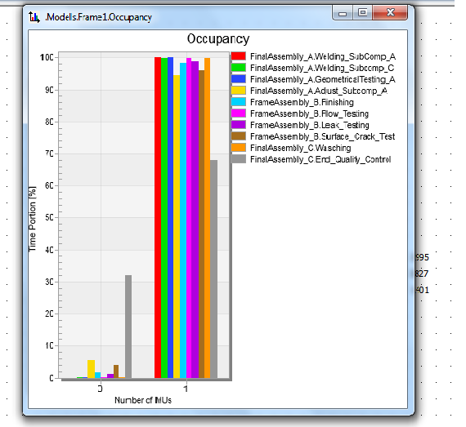

Results

Slide 35
Lesson 4
Modeling in Plant Simulation

Slide 36
Modeling in Plant Simulation
Purpose
This lesson describes how to create a model using objects from the library.
Objectives
After you complete this lesson, you should be able to:
Insert objects into a model
Connect objects to create a material flow
Help topics
Additional information for this lesson can be found in:
•
Step-by-Step Help > Modeling in Tecnomatix Plant Simulation 2D

Slide 37
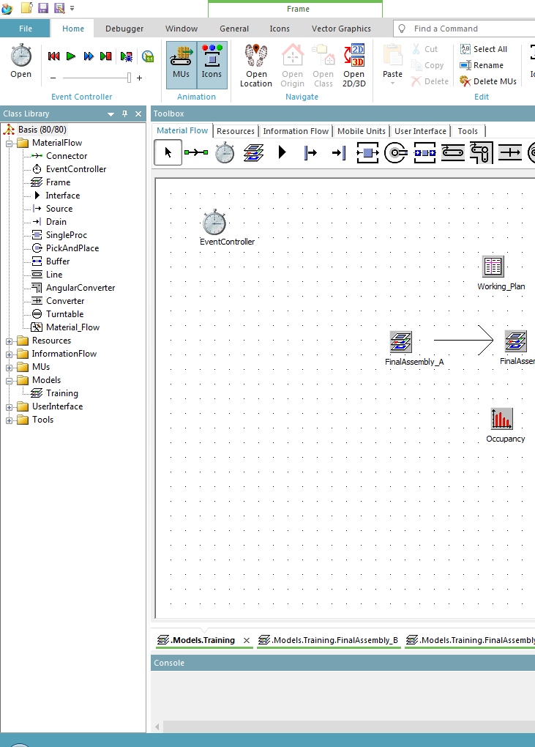
The class library
A model file contains the generic class library with a hierarchical structure.
It looks a little bit like the Windows file explorer.
Note
The used/maximum possible object are shown here
Note
All Object classes are organized in folders.
The structure can be modified as required

Slide 38
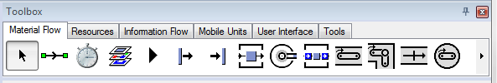
The Toolbox
The toolbox is used for easy and fast access to Objects while modelling.
A selected object can be inserted into the model at a user defined position.

Slide 39

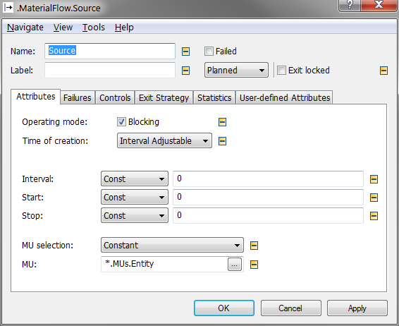
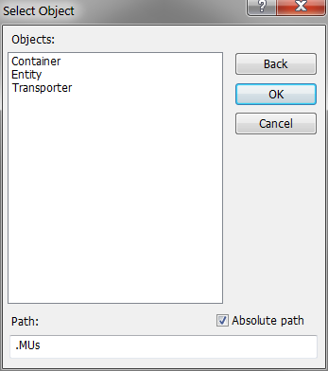
Objects in the Class Library The Source
In the Source is where the parts (referred to as MU‘s = Movable Units) are created.
Important settings for this Object:
MU type
Time of Creation
Creation Interval

Slide 40
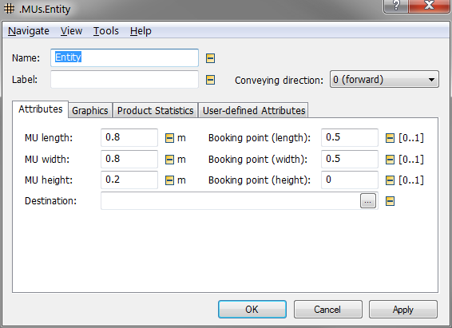


Objects in the Class Library The MU (Movable Unit)
MU‘s represent the Movable Units that can be produced, processed and transported.
Different types of MU‘s:
Entity
Capacity = 0
Container
Capacity > 0

Slide 41

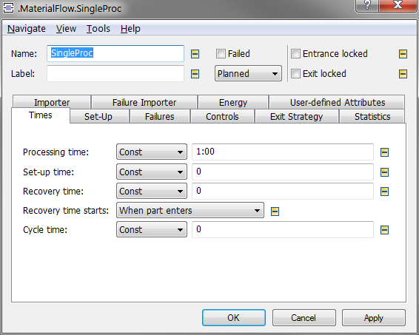
Objects in the Class Library The SingleProc
The SingleProc is an object with capacity = 1.
It takes one MU and releases it at the end of the Set-up and Process Times to the succeeding object.
Important settings for this Object:
Process Time
Set-up Time
Failures

Slide 42

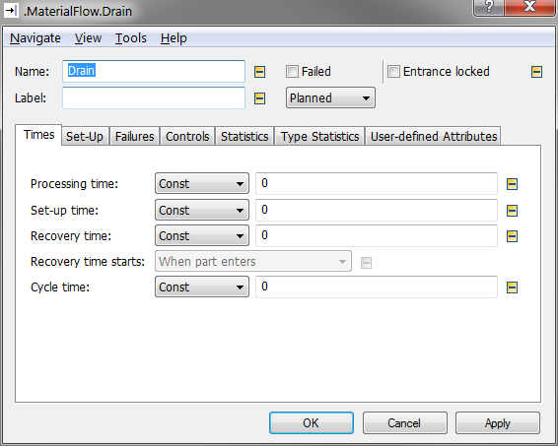
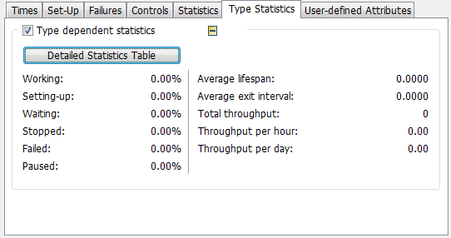
Objects in the Class Library The Sink
The Sink deletes the MUs transferred to it one at a time.
It collects statistics about all deleted MUs.
It is typically used to remove parts (MUs) from the plant (the Model)
Important settings for this object:
none

Slide 43
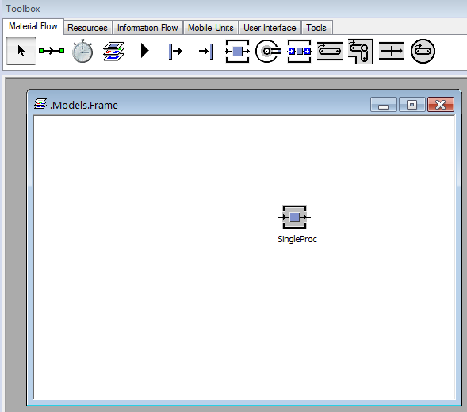
Inserting objects from the Toolbox
Select an object in the Toolbox
Move the cursor to the desired position
A left mouse click inserts the object into the model frame
Alternatively you can use Drag & Drop
Note
Holding down the CTRL key with the left mouse click allows for multiple insert of the object.

Slide 44

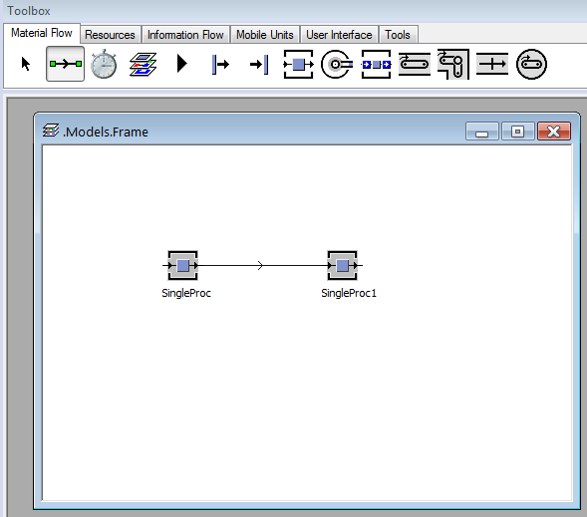
Connecting objects
Select the Connector in the Toolbox
Left click on the first object you want to connect
Left click on the second object you want to connect
Note
Holding down the CTRL key with the left mouse click allows for multiple connections.

Slide 45
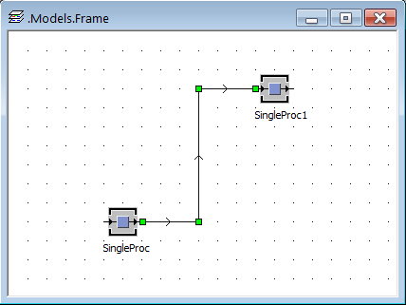
Connecting objects
You can set intermediate points by clicking onto a free space in the frame after clicking the first object you want to connect. This is useful when connectors would overlap each other.
The points can be selected and moved.

Slide 46

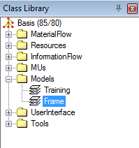
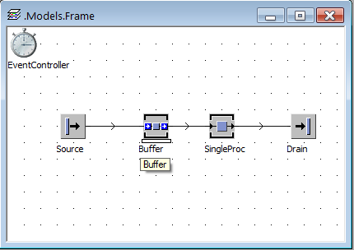
Frames
In the Class Library you can create unlimited Frames at any hierarchical level.
In these frames simulation models or sub models can be created using basic objects or other frames.
Frames can be inserted into other frames to create hierarchical model structures.

Slide 47
Lesson 5
Hierarchy and Inheritance

Slide 48
Hierarchy and Inheritance
Purpose
This lesson describes how to create a hierarchical model.
Objectives
After you complete this lesson, you should be able to:
Use hierarchy in a model.
Generate and insert user defined objects.
Help topics
Additional information for this lesson can be found in:
•
Step-by-Step Help > Modeling in Tecnomatix Plant Simulation 2D

Slide 49
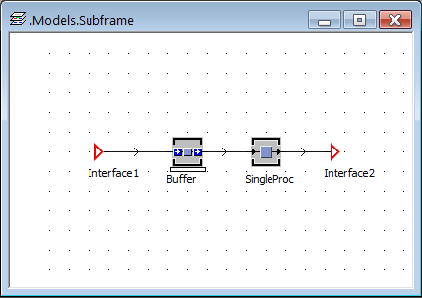
Model Hierarchy Motivation
Model hierarchy means inserting frames into other frames.
One reason for this is to model and test parts of a larger simulation model independently. Multiple users can create different parts of a simulation model.
One or more sections of a model can be inserted into a main model. These sections can also be inserted more than once.
The sections are used for modelling basic objects. These objects can be reused in other models.
A large simulation model will be easier to understand and follow when it is organized in a structure reflecting the hierarchy in which it was constructed.

Slide 50
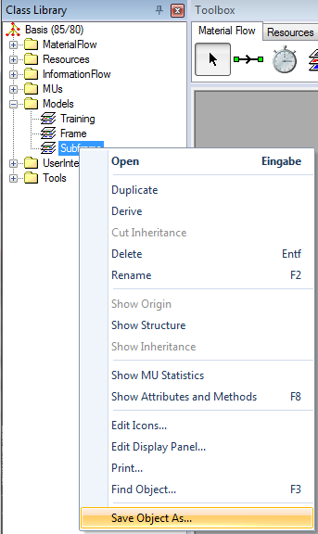

The Section Model
The object Interface connects the material flow into and out of the frame.
To reuse the section model save it as an object file.

Slide 51
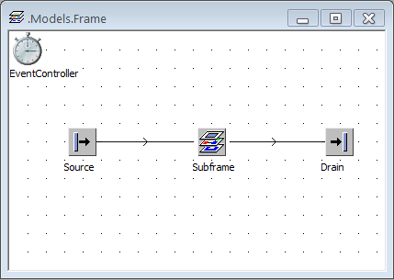
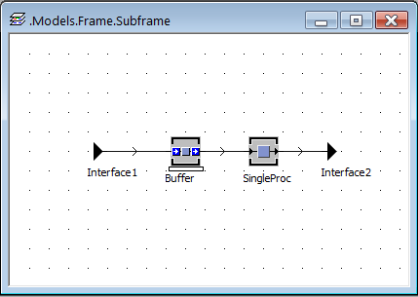
Using the Section Model
Insert the new user defined object into a frame “the main model”, and connect it to predecessors and successors.
Note
It is good practice to test the new object (section model) in a small test environment before using it in a large model.

Slide 52
Lesson 6
Running Simulations

Slide 53
Running Simulations
Purpose
This lesson shows how to configure and start simulation runs.
Objectives
After you complete this lesson, you should be able to:
Run simulation studies.
Help topics
Additional information for this lesson can be found in:
•
Step-by-Step Help > Modeling in Tecnomatix Plant Simulation 2D > Creating a Simulation Model > Controlling the Simulation with the EventController

Slide 54

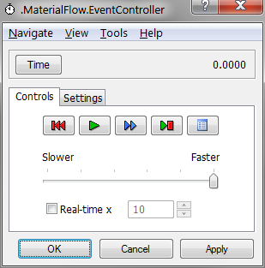
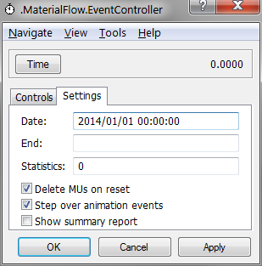
The EventController
The EventController coordinates the events during the simulation run.
On the Tab Settings you can set a Start Time and an End Time for the simulation run.
The EventController must be present in the root frame of a model to enable simulation runs. Trying to reset or start a model without an EventController will automatically insert one.
Important settings for this object:
Simulation Start Time
Simulation End Time
Simulation / Animation Speed

Slide 55
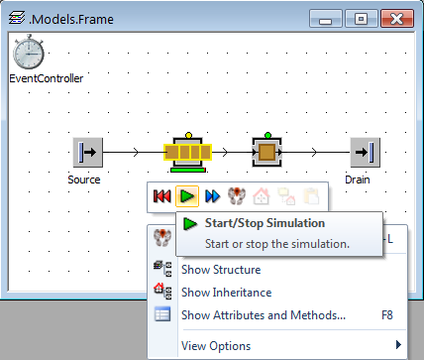
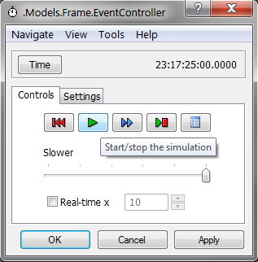
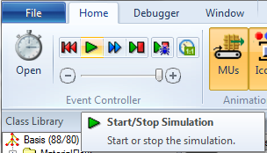
Starting a Simulation Run
There are 3 ways to start a simulation run:
1. A right click into a open space in the model frame opens a context menu. On top of this menu is a toolbar with the most important control elements of the EventController. Click on the green symbol to start the simulation. Click on the red symbol to reset the model.
2. Open the EventController in the model frame.
3. Use the controls in the Home ribbon.

Slide 56

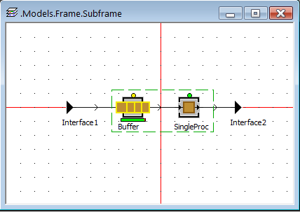
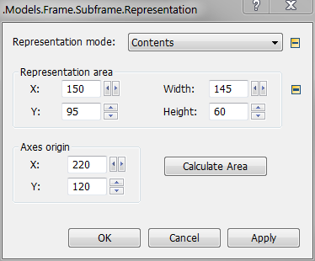
Animation of Sub Frames
To see the animation of the MU‘s and object states inside of a sub frame during a simulation run, you have to open this frame by double clicking it.
Using the Representation setting in the General ribbon, the sub frame can be set to show its content in the frame where it is inserted. The area that is shown “outside” is set in the dialog and marked with green lines in the sub frame.
Note
The shown area must include the axes origin. This is marked with red lines in the sub frame.

Slide 57

The State LED
The material flow objects have a LED at the top of the symbol to show their state in different colors. The LED can show more than one state at a time.
The colors represent the following states (the most important states):
red: object is failed
blue: object is paused
green: object is working
yellow: object is blocked
brown: object is in setUp
Light blue: object is in Recovery time (no entry)
The standard state, operational, shows no LED.
Notes:
Die Teilnehmer lassen ihre Modelle laufen und beobachten. Muss nicht live gezeigt werden.

Slide 58
Lesson 7
Creating the GUC Model
Part 1

Slide 59
Creating the GUC Model Part 1
Purpose
In this lesson you build up the first part of the reference model.
Objectives
After you complete this lesson, you should be able to:
Build up and change basic models.
Help topics
Additional information for this lesson can be found in:
•
Step-by-Step Help > Modeling in Tecnomatix Plant Simulation 2D

Slide 60
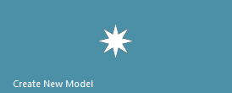
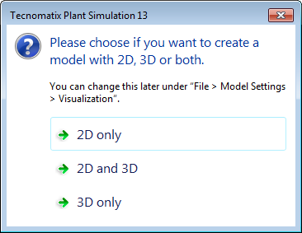
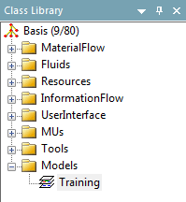
Preparation
Due to the 80 simulation Object limitation, you will want to start a new model with the Out of the Box (OOTB) ClassLibrary, and no Objects in the frame.
Close and Save or discard your models created to this point.
Create New Model, select 2D only at the prompt
Rename the Frame frame under the Models folder in the ClassLibrary window Training
Save your model in a location with a name of your preference. For example save it as MyModel to your Desktop.

Slide 61
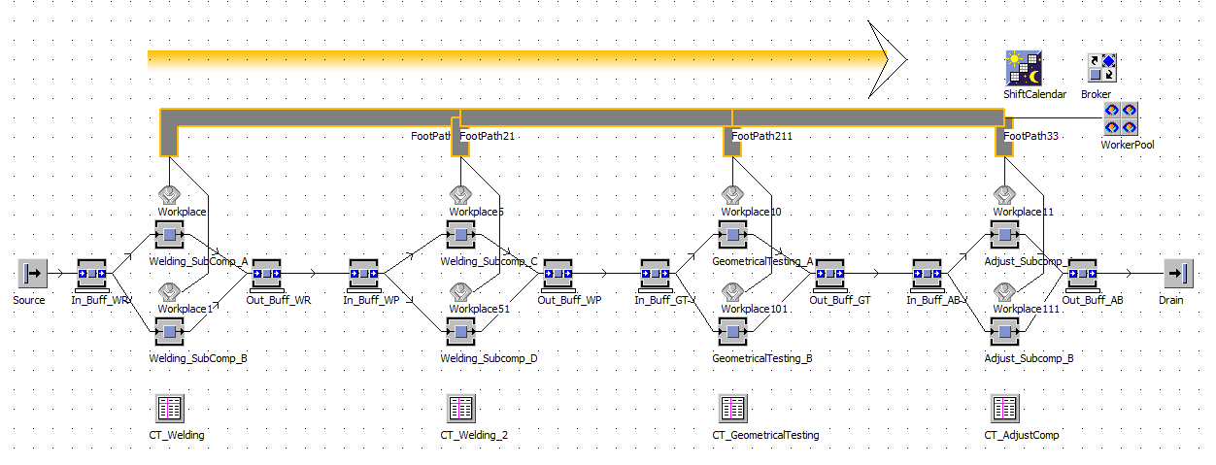

Modeling FinalAssembly_A*
In the Training frame create the objects as shown below. Rename each Buffer, SingleProc, and TableFile as shown. You may leave the rest of the Objects with their application provided name.
Parametrize the objects according to the table in Lesson 3
*consider printing so it is handy when modeling

Slide 62


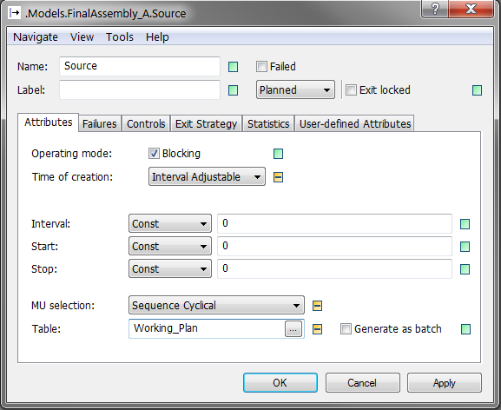
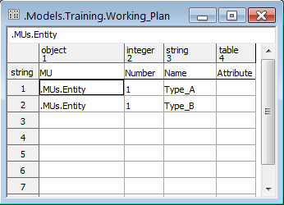
Production program in a TableFile
Set the Source MU Selection to Sequence Cyclical.
Drag & Drop the TableFile Working_Plan onto the Source icon or into the Table: field in the Dialog window. It will be formatted according to the settings in the Source.
Double Click to open the Working_Plan TableFile
Fill the production program as shown on the right

Slide 63

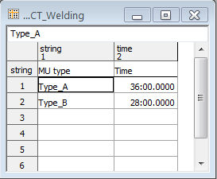
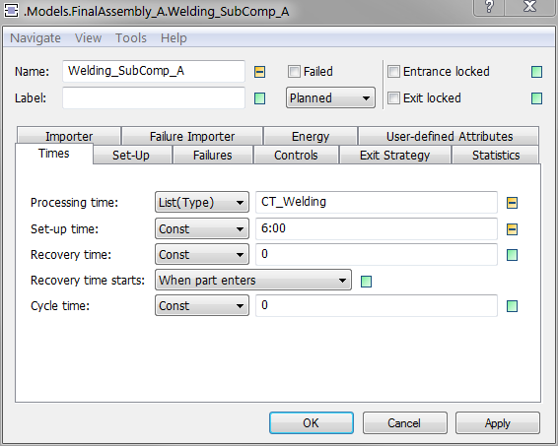
Processing and Setup Times: 1
For Welding_SubComp_A and Welding_SubComp_B:
Set the Processing time of the corresponding SingleProcs to List(type)
Drag & Drop the CT_Welding TableFile into the Processing time field, select Yes to the prompt ‘Would you like to format the TableFile now?’
Fill the Processing time as indicated below and as typed: minutes:seconds.tenths
Fill in the Processing time for Type_A and Type_B, and Setup time from the corresponding columns of the Welding_Subcomponent (_A, _B, _C, & _D) row from the Process Details table in Lesson 3
Note1
Drag & Drop will format the TableFile automatically.
Note2
If the name of the TableFile is changed, the setting in the SingleProcs has to be changed accordingly.

Slide 64
Processing and Setup Times: 2
Perform the same actions for Welding_SubComp_C and Welding_SubComp_D according to the Type_A and Type_B columns of the Welding_Subcomponent (_A, _B, _C, & _D) row from the Process Details table in Lesson 3. Use the CT_Welding_2 TableFile
Fill in Setup time from the Set-up time column of the Welding_Subcomponent (_A, _B, _C, & _D) row from the Process Details table in Lesson 3
Note1
Drag & Drop will format the TableFile automatically.
Note2
If the name of the TableFile is changed, the setting in the SingleProcs has to be changed accordingly.

Slide 65
Processing and Setup Times: 3
Perform the same actions for GeometricalTesting_A and GeometricalTesting_B and their corresponding CT_GeometricalTesting TableFile. Use Processing Time values from the GeometricalTesting (_A & _B) row of the Process Details table in Lesson 3
Fill in Setup time from the Set-up time column of the GeometricalTesting (_A & _B) row from the Process Details table in Lesson 3
Note1
Drag & Drop will format the TableFile automatically.
Note2
If the name of the TableFile is changed, the setting in the SingleProcs has to be changed accordingly.

Slide 66
Processing and Setup Times: 4
Perform the same actions for Adjust_SubComp_A and Adjust_SubComp_B and their corresponding CT_AdjustComp TableFile. Use values from the Adjust_SubComponent (_A & _B) row of the Process Details table in Lesson 3
Fill in Setup time from the Set-up time column of the Adjust_SubComp (_A & _B) row from the Process Details table in Lesson 3
Note1
Drag & Drop will format the TableFile automatically.
Note2
If the name of the TableFile is changed, the setting in the SingleProcs has to be changed accordingly.

Slide 67
Buffer Capacity
Fill in the Capacity of the corresponding In_Buff_ and Out_Buff_ Buffer pairs of each process from the Capacity [Buffer] column of the corresponding process row from the Process Details table in Lesson 3

Slide 68

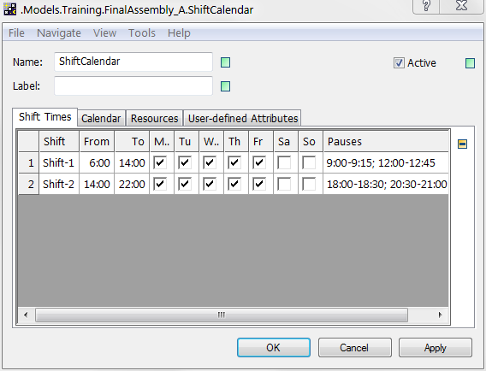
ShiftCalendar
Double click the ShiftCalendar
If not already so, configure the shifts as shown below
Note
The spelling of the shift names must be exactly the same as in the objects using these shifts (see next slide).

Slide 69



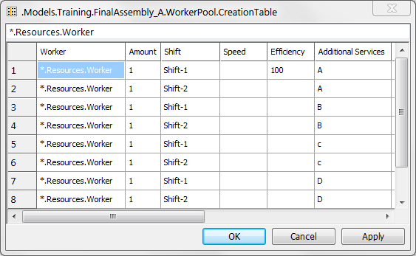
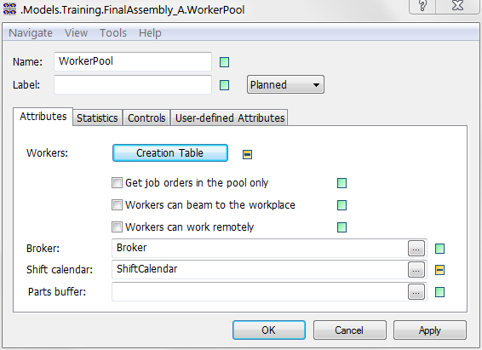
Workplace and WorkerPool*
Drag & Drop the Broker onto the WorkerPool to connect it
Drag & Drop each Workplace to the corresponding SingleProc next to it, to connect the SingleProc to it
Drag & Drop the Broker onto each SingleProc to connect them.
Drag & Drop the ShiftCalender onto the WorkerPool .
Fill the Creation Table as shown
*consider printing so it is handy when modeling

Slide 70
Workplace and WorkerPool
Note
If the Creation table does not allow entries, uncheck the inheritance button next to the Creation Table as indicated by the red box below
Fill the Creation Table as shown

Slide 71


Worker Services
Uncheck the inheritance button next to the Services button and the Active checkbox as indicated by the red box below
Check the Active checkbox
Set the services in the SingleProcs - according to the service entries of the WorkerPool Creation Table - as shown here.
A
B
C
D
A
B
C
D

Slide 72
Lesson 8
Analyzing Results

Slide 73
Analyzing Results
Purpose
This lesson introduces the Chart objects.
Objectives
After you complete this lesson, you should be able to:
Analyze model results using the different chart objects.
Help topics
Additional information for this lesson can be found in:
•
Reference Help > Display and User Interface Objects > Chart
Reference Help > Tools > WorkerChart

Slide 74




Chart Resource Utilization
Insert a Chart into the model.
Configure the Chart in one of the following ways:
Right Mouse click Chart and select Statistics Wizard... Leave only the Resource type Production checked. Select Statistics type: Resource. Press OK.
Drag & Drop one or more selected SingleProcs onto the Chart symbol. Select Statistics type: Resource Statistics.
Open the Chart with context menu Show. Drag & Drop one or more selected SingleProc into the Chart window. Select Statistics type: Resource Statistics.
If not already shown, Show the Chart
Run the simulation.

Slide 75




Chart Buffer Occupancy
Insert a Chart into the model.
Configure the Chart in one of the following ways:
Right Mouse click Chart and select Statistics Wizard... Leave only the Resource type Storage checked. Select Statistics type: Occupancy. Press OK.
Drag & Drop one or more selected Buffers onto the Chart symbol. Select Statistics type Occupancy.
Open the Chart with context menu Show. Drag & Drop one or more selected Buffers into the Chart window. Select Statistics type Occupancy.
If not already shown, Show the Chart
Run the simulation.

Slide 76



WorkerChart
Insert a WorkerChart into the model.
If it is not present in the Toolbox → Tools, you can add it through Home tab → Manage Class Libraries, Libraries tab, Tools libraries.
Drag & Drop the WorkerPool onto the WorkerChart icon.
Configure the WorkerChart as indicated below by the red boxes.

Slide 77
Lesson 9
Building Scenarios

Slide 78
Building Scenarios
Purpose
This lesson shows how to copy or derive model frames to generate scenarios.
Objectives
After you complete this lesson, you should be able to:
Make copies of a model, implement changes and analyze the changed behavior.

Slide 79



Copy / Derive
The context menu of objects in the class library allows to copy or derive the object. To create a scenario of an existing Frame containing your model copy or derive it.
Note
Copying an object creates a new independent class object.
Deriving an object keeps an inheritance relation between the original class and the new class. This means that changes to the original class object are reflected in the new class object.

Slide 80
Activities (1)
Duplicate the frame containing the original simulation model. Open the new frame and add simulation objects. Change settings, i.e. process times. Run the simulation and compare the results to the original model.

Slide 81





Activities (2)
Derive the frame containing the original simulation model. Open the new frame and add simulation objects. You will receive a message: This is to tell you that the structure is inherited from the original model frame. Unlock the structure to allow changes: → To change data in a derived TableFile open it and switch of Inherit Contents: → If you change parameters in a material flow object, the inheritance button is switched of automatically :

Slide 82
Lesson 10
Managing and Configuring Objects

Slide 83

Managing and Searching Objects
Purpose
This lesson describes how to manage and search for objects using the
AttributeExplorer .
Objectives
After you complete this lesson, you should be able to:
Setup an AttributeExplorer.
View and edit object attributes using the AttributeExplorer. Help topics
Additional information for this lesson can be found in:
•
Tecnomatix Plant Simulation Reference>Information Flow Objects>AttributeExplorer

Slide 84
The Attribute Explorer
The AttributeExplorer object is designed to parameterize several objects of the simulation model in one table view. You can define the set of attributes for parameterizing the simulation model which are selectable using drag and drop or using a rule mechanism. Finally, you can use as many attribute explorers as you want.
Accessing the Attribute Explorer:
In an open model, click the Information Flow tab of the Toolbox window. If the AttributeExplorer is not present, you can add it through Home tab → Manage Class Libraries, Basic objects tab, Information flow libraries.
Drag and drop an AttributeExplorer into the desired frame.

Slide 85
Defining the View (1)
Setup the Attribute Explorer:
Double-click on an AttributeExplorer
in a frame.
Data Tab Setup
In the AttributeExplorer window, click the Data tab.
Define if you want to Edit the data or only Watch the data.
Show objects with: Define if the absolute path of the objects, only the Name of the objects, or their Label is shown.
Show attributes with: Define if the attributes Name or by an alias you enter is shown.
Objects Tab Setup
In the AttributeExplorer window, click the Objects tab.
Switch off the Inheritance checkbox.
Drag & Drop the objects you want to parameterize.

Slide 86
Defining the View (2)
Attributes Tab Setup
In the AttributeExplorer window, click the Attributes tab.
Define the attributes of the objects you want to set in you simulation model.
You can also define an alias name for the attributes.
In case you do not know the name of attributes the AttributeExplorer shows all attributes of an object by clicking Attribute Viewer
The Attributes:
In the AttributeExplorer window, click Show Explorer.
See and modify the attribute values of the selected objects.
Assign the changes you made to the listed objects by clicking Apply.
Use Tools/Export to export the data to a Tab Separated Value text file.
You can also display simulation results using the AttributeExplorer.

Slide 87

Activities
Add the AttributeExplorer into FinalAssembly_A from the Information Flow tab in the Toolbox, or the Information Flow folder in the ClassLibrary window.
If it is not available from the Information Flow Object list:
Select Manage Class Library from the Home ribbon
Check AttributeExplorer from the InformationFlow group in the Basic Objects tab
Select OK in the Manage Class Library window
Add the AttributeExplorer to the Training frame
Practice the various options described in the previous slides with your Model
Note
When completing this Activity, remove the AttributeExplorer from the Frames to reduce the number of Objects added to your Model.
Delete the AttributeExplorer from the Training frame and anywhere else in your Model

Slide 88
Lesson 11
Creating the GUC Model
Part 2

Slide 89
Creating the GUC Model Part 2
Purpose
In this lesson you build up a hierarchy in the reference model.
Objectives
After you complete this lesson, you should be able to:
Build hierarchical models, and change and enhance the structure of existing models.
Use methods
Use charts and displays
Help topics
Additional information for this lesson can be found in:
Step-by-Step Help > Modeling in Tecnomatix Plant Simulation 2D > Creating a Simulation Model > Modeling Hierarchically

Slide 90



Building the structure
Insert a new Frame into your Training frame.
Rename the new frame FinalAssembly_A.
Cut & Paste all objects except the EventController and the Drain from the Training frame into the newly created FinalAssembly_A frame.

Slide 91

Building the structure
Add 2 more frames to the model and rename them FinalAssembly_B and FinalAssembly_C.

Slide 92

Modeling FinalAssembly_B*
Double click the new frame FinalAssembly_B and construct the model below in it.
Parametrize the objects according to the Process Details table in Lesson 3.
Set the Importer services E, F, G, H, as shown in the graphic.
E
F
G
H
*consider printing so it is handy when modeling

Slide 93

Modeling FinalAssembly_C*
Double click the new frame FinalAssembly_C and construct the model below in it.
Cut the Drain from the Training frame & Paste it in the FinalAssembly_C frame.
Parametrize the objects according to the Process Details table in Lesson 3.
Set the Importer services, I, J, as shown in the graphic.
I
J
*consider printing so it is handy when modeling

Slide 94




Adding a Control Method to the Model (SimTalk2.0)*
Add a Method to the Training frame. Rename it Transfer. This Method will control the material flow between the sub frames. Depending on the caller ‘?’ the Method will transfer the MU that activates it to the next station buffer.
Program the Transfer Method as shown below
--Transfer components in between clusters
if ?.name = "Out_Buff_AB" then --Transfer between FinalAssembly_A to FinalAssembly_B
@.move(.Models.Training.FinalAssembly_B.In_Buff_SCT) --Initiate movement
elseif ?.name = "Out_Buff_Finishing" then --Transfer between FinalAssembly_B to FinalAssembly_C
@.move(.Models.Training.FinalAssembly_C.In_Buff_WA) --Initiate movement
end
*consider printing so it is handy when modeling

Slide 95


Adding a Control Method to the Model
Double click on FinalAssembly_A in the Training frame
Update the path of the Exit Control of FinalAssembly_A.Out_Buff_AB to point to the Transfer Method
Double click on and FinalAssembly_B in the Training frame
Update the path of the Exit Control of FinalAssembly_B.Out_Buff_Finishing to point to the Transfer Method

Slide 96


Updating the Complete Model
Double click on FinalAssembly_B and FinalAssembly_C in the Training frame
Update the path to the Broker: and Shift calendar: fields on the Attributes tab of the corresponding WorkerPool in the newly opened frames
Update the path to the Broker: field on the Importer tab of each SingleProc in the newly opened frames

Slide 97

Updating the Complete Model
Double click on FinalAssembly_A in the Training frame
Update the path to each SingleProc Processing time: TableFile. It can be done by Dragging & Dropping the corresponding TableFile to the Processing time: field.

Slide 98




Chart and Display
Add 2 Charts and 3 Displays to the Training frame.
Configure one Chart to show the Occupancy of all Buffers and the other to show the Resource statistics of all SingleProcs.
The displays will show the throughput of the different sub frames.
Set each to the output of the last buffer/drain in the associated sub frame and the .statNumOut attribute as shown to the left.
Update the Comment: field accordingly.
Set the Display to Active

Slide 99

Run the Model, Show the Charts, and Observe

Slide 100

Save your Model
You have reached the maximum simulation objects permitted with the free Student license. Additional simulation objects are allowed, but the Model can no longer be saved.
If you exit without saving, only the work saved last will be preserved.
We will continue with a few additional Objects. You will not be able to save the Model after adding them, but it will be simple to add them every time you require to do so.

Slide 101
Lesson 12
The Method Debugger

Slide 102
The Method Debugger
Purpose
In this lesson, the method debugger is discussed.
Objectives
After you complete this lesson, you should be able to:
Debug methods using the watch window and debugger window.
Help topics
Additional information for this lesson can be found in:
•
Reference Help > Information Flow Objects > Method > The Method Window
> Method Debugger

Slide 103
The Method Debugger
The Debugger enables you to:
Follow the course of execution of the Method.
Step through the source code from instruction to instruction.
Watch local variables and parameters.
Watch the call chains.
Watch currently scheduled methods.

Slide 104
Opening the Debugger
Open the Debugger by:
Pressing the [F11] key in an active Method window.
Select Tools -> Debug from the ribbon bar.
Setting a breakpoint in a method and starting the simulation (or method).
Pressing the [Ctrl]-[Shift]-[Alt] keys (when a method is running: important action when a method is in an endless loop!).
Getting a run time error.

Slide 105
The Debugger Ribbon
Switch to Debugger — Opens the Debugger window.
Stop on controls — Opens the Debugger whenever a control is triggered.
Stop on Formulas — Opens the Debugger whenever a formula is calculated.
Stop on Subroutines — Opens the Debugger whenever a method is called by a method.
Ignore Breakpoints - Ignores all user defined breakpoints.
Ignore Errors — Ignores errors in methods, simulation continues.
Ignore Errors in Formulas — Ignores errors within formulas.
Remove Breakpoints in All Methods

Slide 106

The Debugger Window
The Debugger window is almost identical with the Method window. It is extended by the Watch Window area at the bottom. Access its functions on the toolbar or on the menus. You can also open a separate watch Window pressing the [F12] key or the corresponding button.

Slide 107
Activities
In the The Method Debugger section, do the following activities:
Using the Debugger

Slide 108
Lesson 13
Experiment Manager Basics
(Additional Content)

Slide 109
Experiment Manager Basics
Purpose
In this lesson, the Experiment Manager is discussed. The Experiment Manager
allows you to run several simulation experiments automatically.
Objectives
After you complete this lesson, you should be able to carry out simulation studies to:
Arrive at statistically safe results.
Investigate different variants of the model parameters (i.e. optimize the results).
Help topics
Additional information for this lesson can be found in:
Reference Help > Tools > ExperimentManager

Slide 110

Experiment Manager Overview
To insert an Experiment Manager into your model: drag the ExperimentManager
object from the Tools tab of the Toolbox, into the top most (root) frame of your model.
Usage
A simulation study contains several experiments. Each experiment executes several simulation runs, each of which leads to an observation.
The first three steps shown below are mandatory. The other steps are optional.
Create a simple simulation study.
Execute the simulation study.
Evaluate the results.
Refine the settings (several optional steps.)

Slide 111


Mandatory Steps to Create and Execute a Simulation Study
1. Define the Experiments
Manual creation of input and output values.
This can be done using the Definition tab of the ExperimentManager.
Control the Experiment Runs
Perform the experiment.
This is done using top half of the ExperimentManager.
View the Evaluations
View the HTML report of the results.
This is done using the Evaluation tab the ExperimentManager.

Slide 112


Optional steps to Refine Simulation Study Settings
Automatically Creating Experiments
Automatic creation of input values.
This is done using the Tools menu (i.e. Experimental Design) of the ExperimentManager.
Running a Distributed Simulation
Run a large experiment using several computers at once.
This is done by choosing Tools → Advanced Settings and then clicking the Distribution tab of the Advanced Settings window.
Defining Rule-based Settings
Dynamic creation of input values.
This is done by choosing Tools → Advanced Settings and then clicking the Rules tab of the Advanced Settings window.

Slide 113

Performing an Analysis of Factors and Analysis of Variance
Other ExperimentManager Features
Using antithetic random numbers.
Outputting models for the various experiments.
Setting up the HTML report.
And more.
This is done by choosing Tools → Advanced Settings and then clicking the Settings, Validation, and Report of the Advanced Settings window.
Working with the Neural Network
A way to run a large experiment quickly by using what the experiment manager has “learned” about the relationship between the given input and output values. The Neural Network can quickly get output values for other input values using what it has “learned”.
This is done using the NeuralNet
More on this later.
object of the Toolbox.

Slide 114
Activities
In the Experiment Manager Basics section, do the following activities:
Setting Up a Basic Model
Experiment Manager Basics (Define, Run, and Evaluate)

Slide 115
Lesson 14
HTML Report
(Additional Content)

Slide 116

HTML Report
Purpose
In this lesson, you learn about the HTMLReport object.
Objectives
After you complete this lesson, you should be able to:
See how the HTML Wizard works.
Help topics
Additional information for this lesson can be found by doing the following:
Insert the HTMLReport into your model, double-click it, and choose Help → Help on Object.

Slide 117

Record simulation runs using a HTML report
Note
If not present in the User Interface tab, the HTMLReport can be added to the Class Library , choose Home → Manage Class Library .
The HTMLReport, when added to a model, is shown in the User Interface tab of the Toolbox.

Slide 118

Activities
In the HTML report (Optional Topic) section, do the following activities:
Insert the HTMLReport into the Training frame
Run the simulation
Open the HTMLReport with its context menu → Show
Demos

Slide 119
Lesson 15
Creating and Using Custom Objects
Exchanging Objects with other Users/Models
(Additional Content)

Slide 120
Creating and Using Custom Objects
Purpose
In this lesson, you create an .OBJ file of our custom object.
Objectives
After you complete this lesson, you should be able to:
Create a custom object file.
Help topics
Additional information for this lesson can be found in:
•
Step-by-Step Help > Modeling in Tecnomatix Plant Simulation 2D > Creating a Simulation Model > Working with Classes in the Class Library > Saving a Folder or an Object and Loading it into Another Model > Save an Object or a Folder as an Object

Slide 121
Custom Object Introduction
It is possible to export our custom object as an .OBJ file from one .SPP file and import it into another.
Problems with using .OBJ files:
Typically when you import the .OBJ you use the Class Library objects of the new .SPP file (using Save / Load → Load Object). This may change the behavior of our custom object.
When changes are made to the “original” objects, there is no mechanism to notify the users of the new model file that they should import the latest
.OBJ file again.
Note
Both of these problems are addressed using .LIB files are be discussed in the next lesson.

Slide 122
Activities
In the Creating and Using Custom Objects section, do the following activities:
Working with .OBJ files
Demos

Slide 123
Lesson 16 Important Distributions
(Optional)

Slide 124
Important Distributions
Purpose
In this lesson, three important distributions are discussed: Erlang, Negative exponential, and Weibull.
Objectives
After you complete this lesson, you should be able to:
Understand more about various distributions used in Plant Simulation.
Have a better idea when to use a specific distribution to model a certain system behavior.
Help topics
Additional information for this lesson can be found in:
•
Reference Help > Material Flow Objects > Shared Properties of the Material Flow Objects > Times and Distributions > Probability Distributions

Slide 125
Negative Exponential Distribution
Note
Negative exponential distribution- The negative exponential distribution is called negative because of the negative prefix of the exponent. Use it to visualize times between independent events, and to model in-between
arrival times of customers in a service system, the duration of a repair job or the absence of employees from their job site. The exponential distribution plays an important role in reliability theory. The random life times of systems that fail during a certain time interval regardless of their life time is distributed in an exponential way.

Slide 126

Parameters:
Beta (the mean)
Lower Bound and Upper Bound are optional.
0,50
-- Negexp (2)
0,45
0,40
0,35
0,30
0,25
0,20
0,15
0,10
0,05
0
Density function of the negexp distribution with a mean value of 2

Slide 127

Erlang Distribution
Note
Erlang distribution - It was developed by A. K. Erlang to examine the number of telephone calls which might be made at the same time to the operators of switching stations. This work on telephone traffic engineering has been expanded to consider waiting times in queuing systems in general (according to wikipedia.com).
The Erlang distribution is the sum of k independent, exponentially distributed random numbers with the same argument beta.
-
- Erlang (10,7.07)
Parameters
Mu (the mean)
Sigma (the standard deviation)
Lower Bound and Upper Bound are optional.
0,07
0,06
0,05
0,04
0,03
0,02
0,01
Density funct on of the Erlang-distribution

Slide 128
Weibull Distribution
Note
Weibull distribution - It was named after Waloddi Weibull (pronounced as either va lod ih 'vay bul or wye bull). It can mimic the behavior of other statistical distributions such as the normal and the exponential for the
analysis of failure rates (i.e. failure typically occur early, occur randomly, or occur after heavy wear (according to wikipedia.com).
Use the Weibull distribution to model the reliability of your installation:
Use Alpha ( ) < 1 to model the random life time of an installation with a decreasing failure rate. The probability of a failure to occur within a certain time interval decreases as time goes on. Burn-in failures become more improbable the longer the machines work.
Use Alpha ( ) = 1 to model the exponential distribution. A random exponential life time describes an installation that does not change. The probability of a failure to occur is independent of the life time up to then.

Slide 129

Use Alpha ( ) > 1 to model the random life time of an installation with an increasing failure rate. After running machines for a long time, wear-out failures occur, so that the probability of a failure within a time interval increases as the system ages. The life times that accrue most of the time are determined by the maximum of the density function (for > 1) and are roughly defined by the values.
Parameters
Alpha
Beta (the mean)

Slide 130

Selecting Distribution Parameters in Plant Simulation
Plant Simulation offers a number of distributions to define object attribute values such as failure interval and the failure duration. Select one of the distributions.
Plant Simulation shows which parameters you have to enter above the text box for the Start time. Enter the parameters the selected distribution requires.
Note
Distributions can also be specified in Plant Simulation methods using functions such as z_weibull, z_negexp, or z_erlang. For example:
local R : real := z_erlang(1, 15, 5); where the first parameter is the
stream, the second the Mu, and the third the Sigma.

Slide 131
Other distribution functions
These lists are provided for your reference. In general they work the same as the previously discussed three distributions. See the help for more information.
Probability Distributions:
Beta (z_beta)
Binomial (z_binomial)
Cauchy (z_cauchy)
Erlang (z_erlang)
Frechet (z_frechet)
Gamma (z_gamma)
Geometric (z_geom)
Gumbel (z_gumbel)
Hypergeometric (z_hypgeom)
Laplace (z_laplace)
Log Logistic (z_loglogistic)
Log Normal (z_lognorm)
Negative Exponential (z_negexp)
Normal (z_normal)
Para Logistic (z_paralogistic)
Pareto (z_pareto)
Poisson (z_poisson)
Triangular (z_triangle)
Uniform (z_uniform)
Weibull (z_weibull)

Slide 132
Empirical Distributions:
You can use the empirical distributions when your data cannot be represented properly by a mathematical distribution.
Primitive Empirical (z_Emp)
Continuous Empirical (z_cEmp)
Discrete Empirical (z_dEmp)
User-defined Distributions:
You can use the basic arithmetic operations and all functions, which Plant Simulation supports. You can also define the formula in a Method.

Slide 133
Lesson 17 Random Numbers
(Optional)

Slide 134
Random Numbers
Purpose
In this lesson, random numbers and failures are discussed.
Objectives
After you complete this lesson, you should be able to:
Make the machine fail according to periodic distribution.
Use common and antithetic random numbers.
Increment the random number variant on reset.

Slide 135
Help topics
Additional information for this lesson can be found in:
•
Step-by-Step Help > Modeling in Tecnomatix Plant Simulation 2D > Modeling the Flow of Materials, Basics > Modeling Failures
•
Reference Help > Material Flow Objects > EventController > Dialog Window of the EventController > The Tools Menu
•
Reference Help > Material Flow Objects > Shared Properties of the Material Flow Objects > Simulating Random Processes

Slide 136

Failures Review
To closely model real-life situations where machines fail at times, (which affects the technical or organizational availability of the individual stations) you can define failures.
This sets the state of the component from operational to failed. Plant Simulation adds the duration of the failure to the processing time or the dwelling time.
You can define failures for all material flow objects.
The object shows a red dot in the LED display area along the top border of the icon.

Slide 137
Defining Failures
Multiple failure profiles can be defined for a single object:
Each with its own distribution function
With individual start/stop times
Note
On the Failures tab, click New to create a new failure profile. Each can simulate a different reason for failure of the object.
Note
Failures can be defined on individual objects (such as SingleProcs) or at the class level and inherited to all stations by default.
Two modes for entering failures
(Toggled by selecting or deselecting the Availability checkbox):

Slide 138
With Availability deselected, use the Interval (mean time between failures: MTBF) and the Duration (mean time to repair: MTTR) to calculate the times of a failure. In this case you select your own distribution.
With Availability selected, type the percentage of the availability and the MTTR. Plant Simulation uses the Negative Exponential distribution for the Interval and the Erlang distribution for the Duration.
Failure mode relates to
Simulation Time – Relative to the entire simulation time (Starting with the start of the simulation and the stop/reset of the simulation).
Processing Time – Relative to the time an MU is actively being processed.
Operating Time – Relative to the total simulation time minus the pause time of the machine (The machine is on but may or may not be processing a part).

Slide 139
Random Number Introduction
It is not possible for a computer to generate a series of truly random numbers. With a computer there is always a pattern to the random numbers generated. It is a point when the random numbers repeat, known as the period.
In order to introduce randomness into our computer simulations, pseudo random numbers are used. A mathematical function (sometimes called a pseudorandom number generator: PRNG) is used to generate the sequence. Where you start in this sequence is determined by the function’s independent variable known as a seed. This technique for creating random numbers is both fast and reproducible.

Slide 140
Random Number Streams-Seed Values
Seed Values for Object Dialogs
Plant Simulation automatically uses a dedicated random number stream for each material flow object. For this reason you don’t specify the random number stream from the text boxes of the object dialogs (such as the SingleProc window).
Using a dedicated random number stream for each material flow object has a number of advantages:
When you insert an object it is guaranteed that all random components of this object are different and stochastically independent from all other objects. Inserting an object with random behavior does, for example, not influence any other objects.
As the number of the random number stream is no longer part of the parameterization of a statistical distribution, you can now inherit the parameterization although different random numbers are used.

Slide 141
Stochastic (Random) Simulation Study
Simulation studies where all components have a predictable behavior are called deterministic.
Simulation studies which have at least one random component are called stochastic. The model uses random numbers. A statistical analysis of the simulation results is necessary.
What are the effects of random processing times in a line of machines? Consider the throughput in an hour, the waiting, and the blocking time of both machines.

Slide 142
Availability of machines
The interval between failures (MTBF Mean Time Between Failures) and the duration (MTTR: Mean Time To Repair) of failures are random numbers which are distributed according to a certain statistical distribution.
The availability is measured in %:
AV = (100 * MTBF)/ (MTBF + MTTR) = 80%
Occasionally (not in Plant Simulation) the value MTTF (Mean Time To Failure) is used:
MTTF = MTBF + MTTR

Slide 143
How are Random Number Streams Accessed
Plant Simulation now automatically uses a dedicated random number stream for each material flow object.
The first request to the stream is given the first number in the stream; the second request gets the second number in the stream, etc. Using a dedicated random number stream for each material flow object has a number of advantages:
When you insert an object it is guaranteed that all random components of this object are different and stochastically independent from all other objects. Inserting an object with random behavior does, for example, not influence any other objects.
To control whether successive runs using random number streams are identical, use Tools → Reset Random Number Streams on Reset from the Event Controller object’s menu:

Slide 144
Checking it resets the internal random number generator of Plant Simulation during a Reset This means that it generates the random number stream anew beginning with the seed values you set.
When it is deselected, a Reset does not initialize the random number stream anew. This means that a new simulation run does not use the same random numbers. For this reason the simulation runs no longer produce identical results.
Note
Plant Simulation uses the MRG63k3a random number generator to populate the random number streams (which is shown to have a period of approximately 2³⁷⁷).

Slide 145
Activities
In the Random Numbers section, do the following activities:
Stochastic Introduction
Failures, Randomization, and the Event Controller

Slide 146
Lesson 18 Confidence Intervals
(Optional)

Slide 147
Confidence Intervals
Purpose
In this lesson, confidence intervals are discussed as a way to measure the reliability of simulation results.
Objectives
After you complete this lesson, you should be able to:
Use the confidence interval object.
Help topics
Additional information for this lesson can be found in:
Add-Ins Reference Help > Statistical Tools > Confidence Intervals

Slide 148

Statistical Analysis
Random behavior of model parameters lead to variations of the result values.
The results are realizations x of random numbers X with unknown mean value and standard deviation.
You can consider the statistical distribution of X using a finite set of observations x.
All statements are uncertain and have a probability of error.
Determining the Quality of Simulation results:
The quality (exactness) of the mean value can be described by the
confidence interval.
This interval is determined by the sample which contains a finite number of observations of a random number.

Slide 149
Confidence Interval
When your model contains random components and processes, you have to execute several simulation runs with different seed values to arrive at reliable and “statistically safe” simulation results. It does not suffice to calculate the mean value from the simulation results. A strong scattering of the values of the simulation runs suggest that the calculated mean value is far off the true
mean value. Be aware that one cannot draw conclusions with absolute certainty. One can only make statements about a system with random components with a confidence level (level of significance) you define.
A confidence interval shows how well the calculated mean value fits the given confidence level.
The confidence level tells with which probability the true mean value is located within the calculated confidence interval.

Slide 150
Probability Distributions
Most of the time, only few watched data is available about random processes, such as the interval between two failures of a machine. To model random processes in your simulation, you have to select a probability distribution. Plant Simulation provides all important distributions.
Distribution Parameters
Once you have selected a distribution, you have to determine the parameters of the distribution using the numbers you received, and enter those into the dialogs in Plant Simulation. When you click the mouse in one of the text boxes for a random number, Plant Simulation shows which parameters you have to enter.
Note that the upper bound and the lower bound are optional parameters.

Slide 151
Activities
In the Confidence Intervals section, do the following activities:
Using Confidence Intervals

Slide 152
Lesson 19 Custom State of Objects
(Optional)

Slide 153
Custom State of Objects
Purpose
In this lesson, custom object states are discussed.
Objectives
After you complete this lesson, you should be able to:
Setup and use custom object states.

Slide 154

Custom State of Objects
Sometimes only a rough statistical value is needed for a group of objects. This can be done with a custom status of objects, i.e. with a variable string type.

Slide 155

Custom State of Objects
Insert variable
Write a value to it
Open variable
Activate statistics
Run simulation
Now the frequency of changes and the duration of each value assigned to the variable is monitored and can be used to form a statistic for a custom object.

Slide 156


Custom State of Objects
Note
Value – Value that was assigned
Frequency – How often is was changed to this value
Duration – How long this value was assigned
% Frequency – Used for the “Top 5 frequencies”
% Duration – Used for the “Top 5 durations”
Mean Duration – of the mean value
Standard Deviation – of the mean value

Slide 157
Activities
In the Custom State of Objects section, do the following activities:
Custom States

Slide 158
Lesson 20
Using Multi-Level Experimental Design to Setup the Experiments
(Optional)

Slide 159
Using Multi-Level Experimental Design to Setup the Experiments
Purpose
In this lesson, you learn about using multi-level experimental design to setup the experiments.
Objectives
After you complete this lesson, you should be able to:
Use multi-level experimental design to setup the experiments.
Help topics
Additional information for this lesson can be found in:
•
Reference Help > Tools > ExperimentManager > Controlling the Experiment Runs > Automatically Generating Experiments > Use a Multi-level Experimental Design

Slide 160
Multi-Level Experimental Design Introduction
In order to use this technique you still have to define the input and output values. However, you do not need to manually define each experiment. Instead setup a minimum, maximum, and increment value for each input value.
Note
This lesson is meant as a quick introduction to multi-level experimental design to enable you to roughly compare it to setting up the experiments with rules (discussed in a later lesson). You learn more about random experimental design in a later lesson as well.

Slide 161
Activities
In the Using Multi-Level Experimental Design to Setup the Experiments section, do the following activities:
Using Multi-Level Experimental Design

Slide 162
Lesson 21
Using Two-Level Experimental Design, Analysis of Factors, and Factorial Regression
(Optional)

Slide 163
Using Two-Level Experimental Design, Analysis of Factors, and Factorial Regression
Purpose
In this lesson, you learn more about experimental design.
Objectives
After you complete this lesson, you should be able to:
Use two-level experimental design.
Use regression analysis.
Help topics
Additional information for this lesson can be found in:
•
Reference Help > Tools > ExperimentManager > Controlling the Experiment Runs > Automatically Generating Experiments > Use a Two-level Experimental Design and Use Factorial Analysis
•
Add-Ins Reference Help > Statistical Tools > Regression Analysis

Slide 164

Introduction
The ExperimentManager systematically assigns values to all input values; this is called experimental design. It automatically fills the ExpTable experiment table.
Note that any experiments and their evaluations are deleted when you employ an experiment design. There are two tools to do this:
Multi-level Experiment Design
Two level Experimental Design and Factorial Analysis

Slide 165

Experimental Design
Think about the ideas of changes to the dynamic system which can be evaluated by simulation.
It considers your conjectures about the system.
Consider the statistical influence of random components.
Consider your knowledge and experience based on:
Interpretation of results of a previous simulation run and
Implication for the next simulation run.

Slide 166

Use ExperimentManager to perform experimental design and analysis of factors.
Check the statistical reliability of the results.
Experimental design and Factorial analysis
By a 2-level experimental design you determine the model parameters which affect the results significantly.

Slide 167

After 2-level experimental design you can continue with a multi-level experimental design in order to consider the (statistical) influence of essential parameters.
Experimental Design and Analysis of Factors
After modeling the system under consideration, begin planning the simulation study. A simulation study considers how model parameters, so-called factors, affect target values. A typical factor is the safety stock of a product stored in a warehouse. Experimental Design is an easy way to perform a simulation study. In a systematic way, you assign all factors values and observe a selected target value like the profit of a company.
The consideration of which factors substantially affect the target value is called the
Analysis of Factors.

Slide 168
The typical steps are explained using a model of an internet company that sells a single product. This product must be periodically ordered by one of two suppliers. Most of the typical factors of inventory systems are considered.
The results are expressed as income, inventory holding cost and expenditure.
Income is the sum of the prices of all sold products.
Expenditure is the selling cost consisting of fixed costs (order setup cost) and variable costs (incremental cost).
Customer arrives with a mean arrival time of 40 minutes, which is exponentially distributed. They order a random number of products. The size of the demand has a mean value of 2.5 and is described by an empirical distribution. The sale price is 60 €. If the product is not available, the customer gets a coupon worth 10 € (cost compensation ). The lost revenue is important for the evaluation of the control of the warehouse and is therefore stored in such cases.
Inventory Settings:
Inventory Settings: An operator of the warehouse periodically inspects the stock.

Slide 169

If the stock is smaller than the safety stock, the warehouse is filled to the maximal capacity, the so-called maximal stock.
inspection interval, the safety stock, the initial stock and the maximal stock
are factors of the simulation study.
There are two Suppliers which distinguish between:
Order setup cost of 2000 € to 1000 € fixed cost per order.
Incremental cost of 30 € to 40 € per product.
Lead time of 1-3 days to 3-5 days between the earliest and latest delivery.

Slide 170


Note
To avoid very small orders the ordered amount must be greater than the safety stock.
Experimental Design with 2 levels:
All input values are assigned with two values: lower level and upper level..
The Analysis of Factors is performed for one selected output value.

Slide 171

There are many parameter configurations which lead to a deficit (negative profit). Note that a profit greater 10,000 € seem to be a satisfied result.

Slide 172

Analysis of Factors:
Results:
See large differences of the target value.
Enlarging the safety stock results in an essentially greater profit.
The express delivery and daily inspection options should be used.
The initial stock does not affect the profit, as expected.
If the lost revenue which comes from unsatisfied customers is considered, you find out that the lost revenue is not the reason for the observed variations of profit.

Slide 173

Regression Analysis
Using a Regression analysis you can describe the correlation between the input values and a single output value of a simulation study with a mathematical formula. This way you can predict an output value for a large number of parameter combinations of input values. If you want to study how a single input value determines an output value, start with several observations of value pairs of input and output values. You can perform a linear, a polynomial or multiple regression analysis. The icon of the object shows a different icon after each calculation if you last ran a linear, a polynomial or a multiple regression.

Slide 174
Activities
In the Using Two-Level Experimental Design, Analysis of Factors, and Factorial
section, do the following activities:
Look at a Two Level Example
Factorial Regression

Slide 175
Where Do You Go From Here?

Slide 176
Additional Sources of Information
Siemens PLM Software Academic Resource Center
Tecnomatix Plant Simulation Public Community
Siemens PLM Software services personnel
Online help
Online demo models - Look at demo models to learn more about Plant Simulation is a good idea.

Slide 177

Have Fun with Tecnomatix Plant Simulation!

