Slide 1














Slide 2
Added ROS Version Dependency via Github
Package Version Dependencies
Bash Script
!/bin/bash
# Sorted Package Version Information in simple HTML Table Format
# Usage ./versioninfo.bash pkgname
# Assume ROS installed and pkg compiles
pkgs=`rospack depends $1 |sort `
echo "<HTML><BODY>"
echo "<h1> " $1 " Package Version Dependencies </h1>"
echo "<TABLE>"
echo "<TR><TH>Package</TH><TH>Version</TH></TR>"
for pkg in $pkgs
do
ver=`rosversion $pkg `
echo "<TR><TD> $pkg </TD><TD> $ver </TD></TR>"
done
echo "</TABLE></BODY></HTML>"
Package | Version
actionlibmsgs | 1.11.8
catkin | 0.6.16
classloader | 0.3.1
cppcommon | 0.5.6
eigenconversions | 1.11.7
eigenstlcontainers | 0.1.4
fcl | 0.3.2
gencpp | 0.5.3
genlisp | 0.4.15
genmsg | 0.5.6
genpy | 0.5.7
geometricshapes | 0.4.3
geometrymsgs | 1.11.8
kdlparser | 1.11.8
libccd | 1.5.0
messagegeneration | 0.2.10
messageruntime | 0.4.12

Slide 3
Added ROS Message Definitions via Github
nistcrcl/CrclCommandMsg
Python Program
Type | Name | Comment
uint8 | initCanon=1
uint8 | endCanon=2
uint8 | actuatejoints=3
uint8 | moveto=4
uint8 | dwell=5
uint8 | message=6
uint8 | moveThroughTo=7
uint8 | setCoordinatedMotion=8
uint8 | stopMotion=9
nistcrcl/CrclStatusMsg
Type | Name | Comment
uint8 | done=0
uint8 | error=1
uint8 | working=2
stdmsgs/Header | header
uint32 | seq

Slide 4
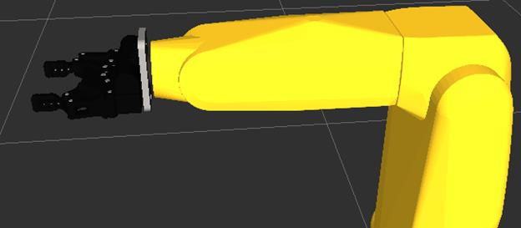
Added Gripper to Fanuc Robot in URDF – and Rviz display as byproduct

Slide 5
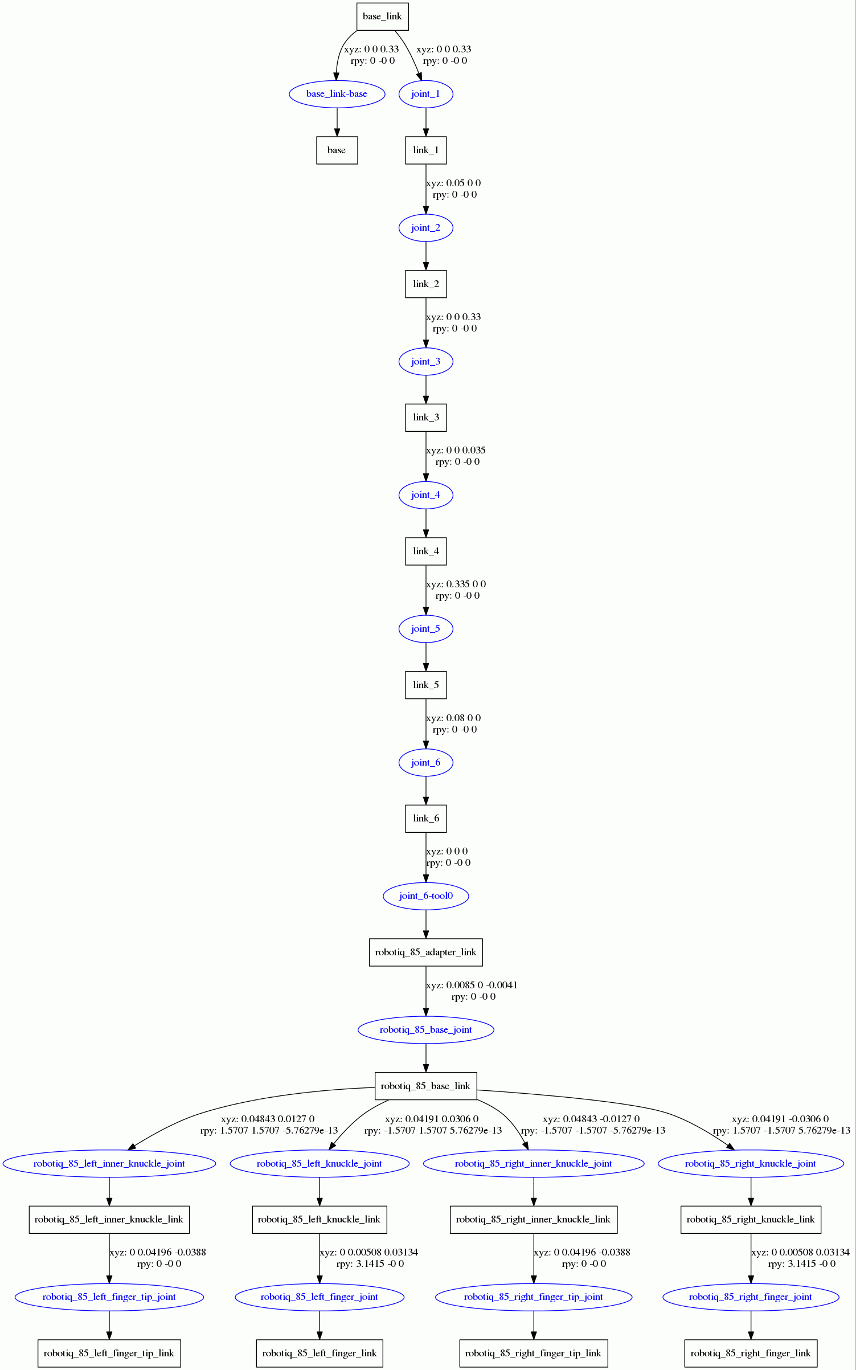
Fanuc and Robotiq URDF

Slide 6
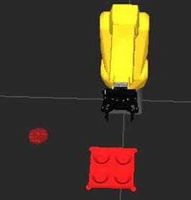
Added Bolt and Boltholder as STL to ROS Rviz

Slide 7
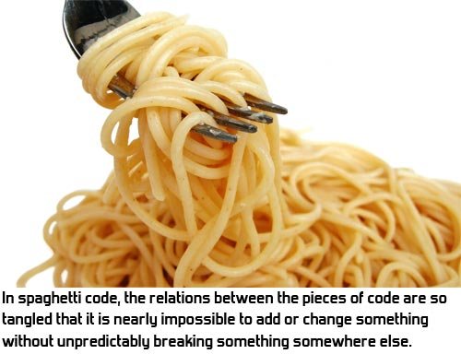
ROS as Spaghetti

Slide 8
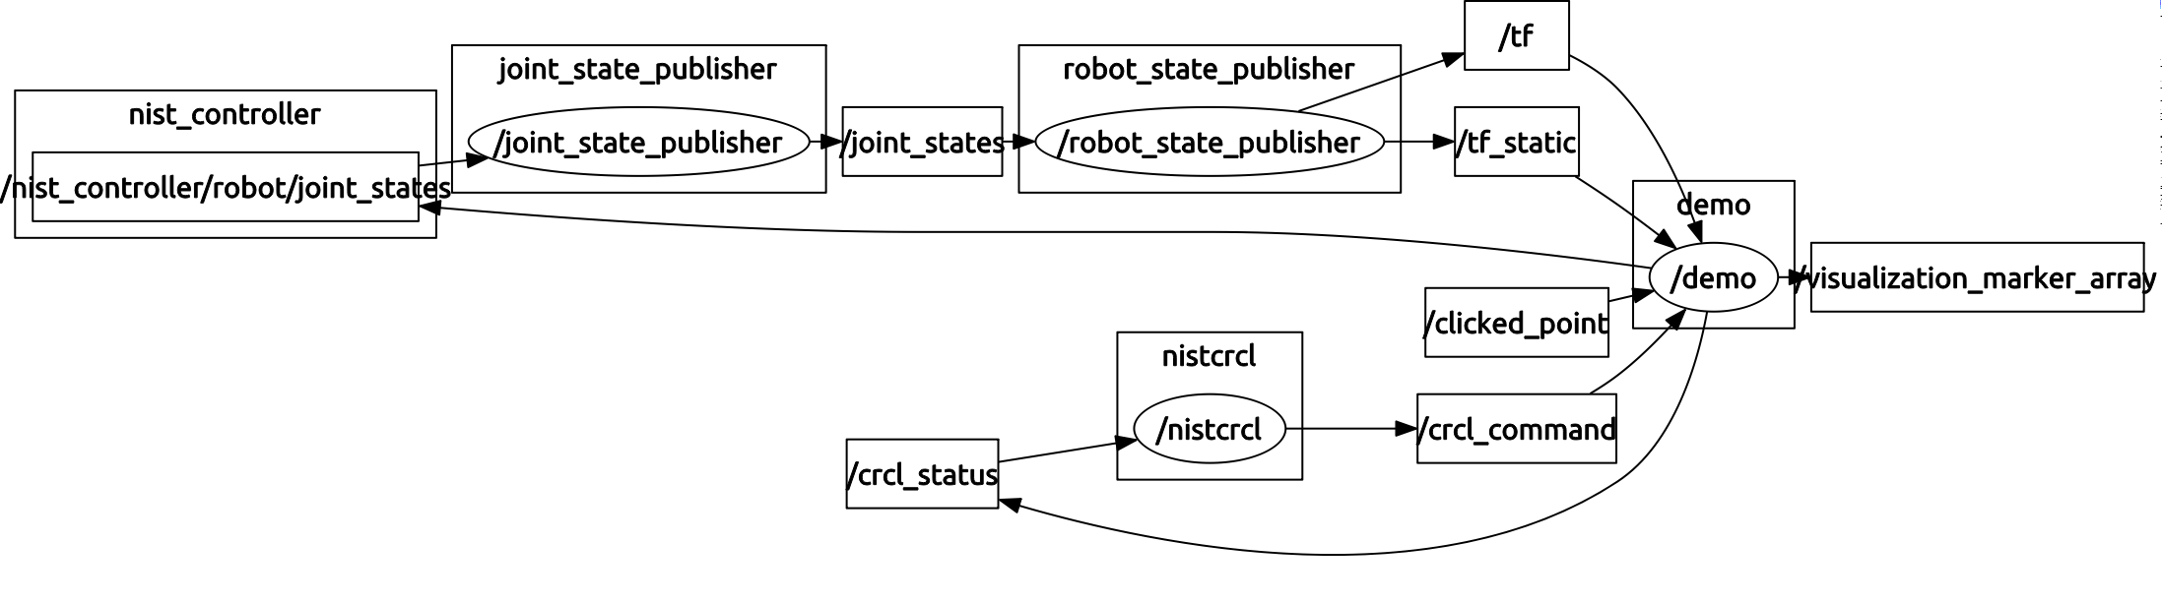
Simpler Real-time Control Architecture –
Displayed with ROS rqt_graph
Robot with gripper
Bolt Rviz Simulation
ROS CRCL Package
Simpler - no ROS moveit, joint_state_publisher does arm and gripper joint updates

Slide 9
Block diagram

Slide 10
Pose Data Type Spaghetti

Slide 11
Rviz Bang-bang Simulation of Bolt placement

