Slide 1
Real time end to end DevOps project
AWS (public API Gateway, s3, swagger, logs, kms), ROSA Openshift,
HELM, Kubernetes, Docker file, GitLab CI, Quay, AWS ECR.
CI pipeline, CD pipelines to DEV, SI, PROD.
Infra pipeline to AWS.

Slide 2
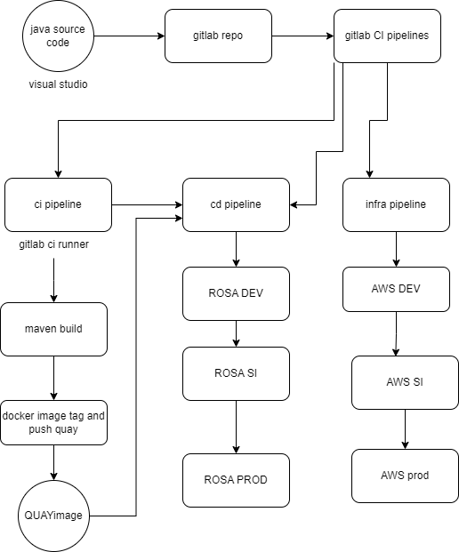

Slide 3
Agenda
Traditional architecture and challenges.
How to overcome, Why Devops ??
Strategies to adopt modern architecture.
Devops implementation strategies.
Devops Implementation plan
Implementation demo
review

Slide 4
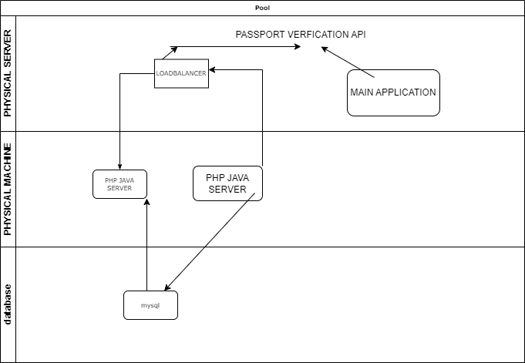
1. Traditional architecture

Slide 5
challenges
Limited Resource Utilization.
High Maintenance Overhead.
Data Center Costs
Disaster Recovery Complexity
Limited Geographic Reach
Hight availability.
Scalability.
Technology stack challenges.

Slide 6
How to overcome and why devops ?
Cloud Adoption: migrating to cloud infrastructure i.e AWS(IaaS, PaaS, or SaaS).
Virtualization: Implement server virtualization to consolidate physical servers into virtual machines. i.e ec2.
Containerization: Adopt containerization technologies (Docker, kubernetes) for packaging and deploying applications.
Infrastructure as Code (IaC):Implement IaC practices to manage and provision infrastructure using code.
DevOps Practices: Adopt DevOps practices for collaboration, automation, and continuous improvement.
Automation: Invest in automation tools for provisioning, configuration management, and routine tasks i.e deployment automation (ci/cd tools gitlab ci), infrastructure automation (cloudformation).

Slide 7
Strategies to adopt modern architecture-devops tools
Cloud adoption (AWS), migrate application/database.
Microservices Adoption. Split the application into micro services like api.
Containerization and Orchestration.
Infrastructure as Code
Continuous Evaluation and Improvement
Collaboration and Communication
Agile Project Management.
Security priority.
Cost Savings

Slide 8
Devops implementation strategies/selection of process/ selection of tools.
Aws (cloud adoption).
Aws infra services for microservices api i.e Public API etc.
ROSA redhat openshifton AWS (Containerization orchestration).
Gitlab ci (repo, project management, ci/cd, agile, security SAST,DAST).
Development tools jdk17, maven, visual studio, tomcat etc.
Helm- package management, Kubernetes.
Quay image repo.
Devops strategy name.

Slide 9
Selection of devops tools
Category | Tool name
Cloud technology | AWS, azure, gcp, ibm.
Ci/cd tools | Gitlab ci, rosa- tekton(custom gitops), azure pipeline, Jenkins, aws code pipeline.
Repo | Github, aws code commit, azure repo, gitlab etc
Container Build tools | Docker, podman, buildah, rosa –build(s2i/custom build).
Container repo registry | Aws ecr, dockerhub, quay, redhat. Nexus.
App build tools | Maven, ant, pip, nodejs etc
Agile track | Gitlab ci, azure, jira
Code SAST/DAST | Gitlab ci, Veracode, sonar scan.
Container security | Gitlab ci, Veracode etc.
Package management | Helm, redhat etc.

Slide 10
Case study cover in this tutorial
Based on selection on tools and workflow, we can name our pattern and process.
Pattern: ROSA-publicAPI-javaapp
Process: gitlab-dockerfile-quay-rosa-aws.

Slide 11
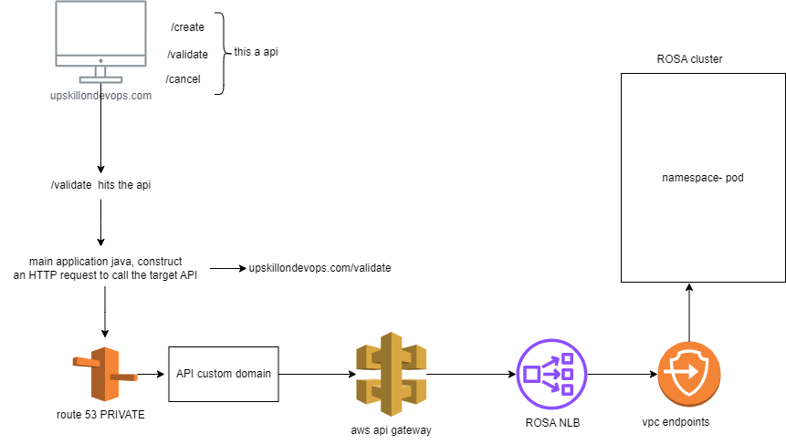
ROSA-publicAPI-javaapp.

Slide 12
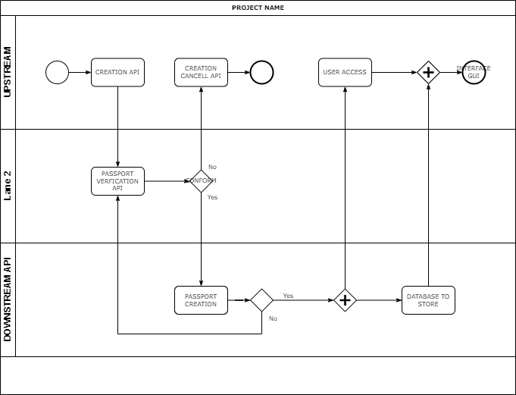

Slide 13
Devops Implementation plan
Review the current blueprint and understand the current scenario.
Under-stood the application architecture.
Understood the targeted architecture.
Understood the devops architecture.
Understood the aws architecture.
Actual workflow architecture.
implementation demo.

Slide 14
1. Review the current blueprint and understand the current scenario.
Go to blueprint and review the current scenario.

Slide 15
2. Under-stood the application architecture.

Slide 16
3.Understood the targeted architecture.

Slide 17
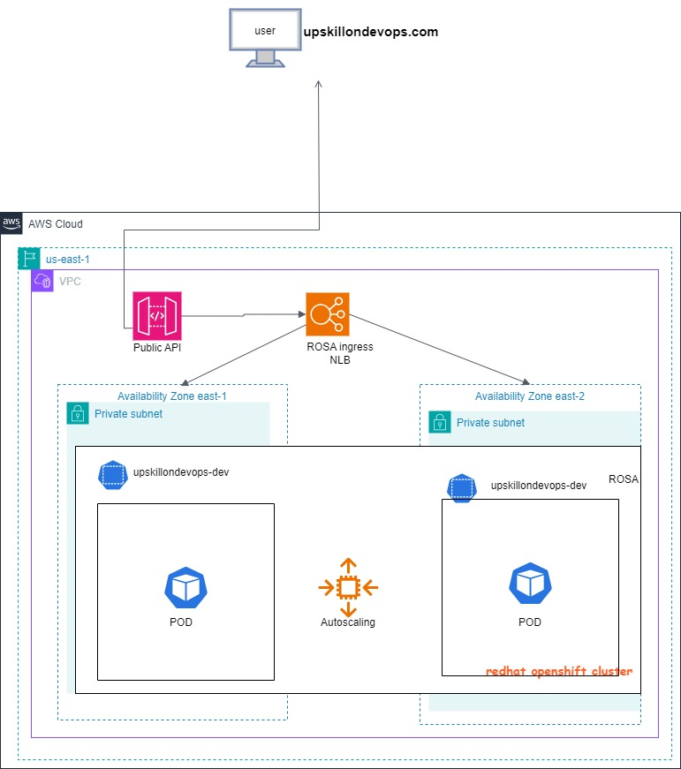

Slide 18
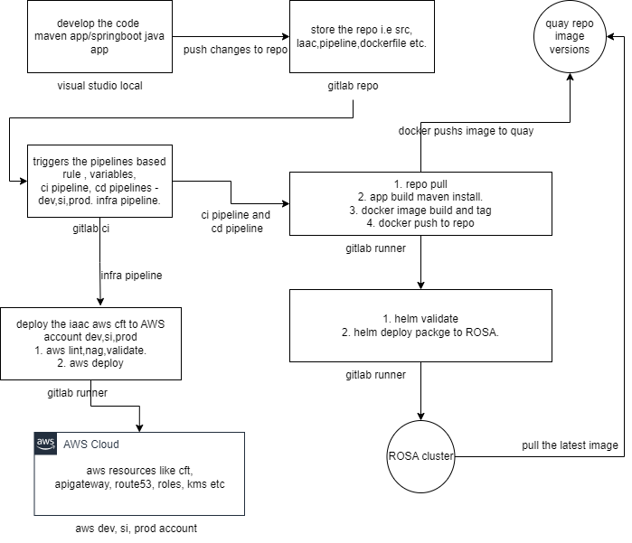
4.Understood the devops architecture.

Slide 20
Ci pipeline- git clone, maven build, docker build, docker push to quay.
Cd pipeline for dev, si, prod. – helm valid, helm deploy to rosa dev.
Once dev is successfully done, we need to review to grp team for feasibility. We need to submit the SAST, DAST scan results for code, image, aws infra.
Once they approve, we can deploy to SI and same vice-versa for prod also
Infra pipeline- aws lint, aws nag, aws validate, aws deploy to aws dev, si, prod.
Same we need to get the approvals from grp team.

Slide 21
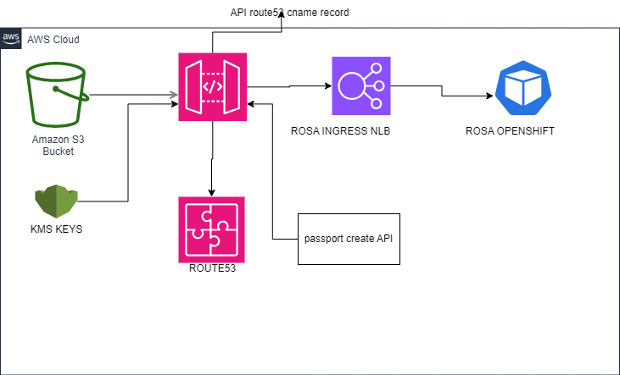
5. Understood the aws architecture

Slide 22
First we need to create s3 bucket and kms keys.
Then we can create a swagger file for creation of apigateway.
Once swagger is create we can copy to s3 bucket.
Once copied, we need to create apigateway using cft and swagger file.
kms keys for access the s3 bucket by apigateway.
Not in this tutorial : Once api is created , we can custom the api and create a cname in route53 hostedzone and also create domain name for main application.
Once main application hit the api, it route the traffic to cname to api then rosa NLB to rosa pod.

Slide 23
6.implementation demo.
Create the gitlab repo, project, and clone in visual studio.
create java app in visual studio and install extension like jdk, maven, tomcat etc.
Test the application in locally. Push changes to repo.
Create ci, cd, infra pipelines, dockerfile, helm.
Create rosa, aws accounts, quay and get the credentials and add in gitlab.
Trigger the ci& cd pipelines, build and deploy in rosa dev.
Trigger the infra pipeline, deploy the aws infra in aws dev.
Once it is successful then we can move to SI, PROD.

Slide 24
ROSA-publicAPI-javaapp.

Slide 25
FINAL overview.
once we open the application gui, then we click the create buttton, then /create or /validate api triggers.
in main application, construct an HTTP request to call the target API. You can use libraries like HttpURLConnection
this targeted api is created in the aws and create a custom domain name.
this custome domain name is added cnam record in hosted zone, and adds public domain.
This api will receive the request from the client and send the request to backend integration.
This backend service is having rosa NLB, this NLB having endpoints of rosa.
NLB routes the traffic to rosa enpoint to pod.
Then we can get the responds from pod and send the reponds to api, then reaches to main application.

Slide 26
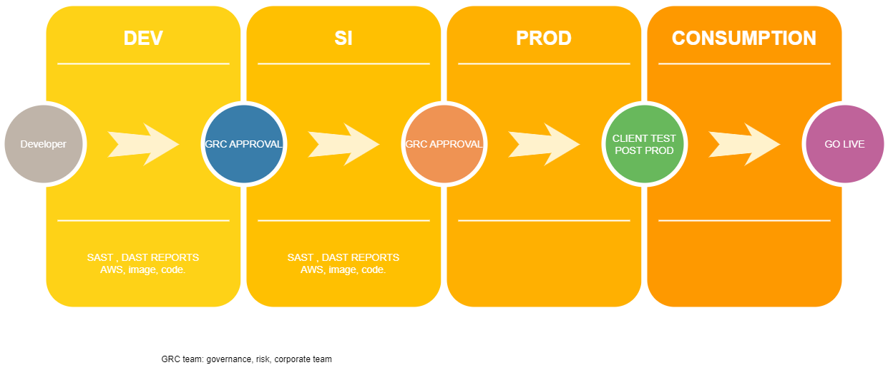
Work flow

Slide 27
review
Blueprint.
APP architecture.
Aws arch.
Devops arch.
Conclusion.
Troubleshoot and debugging skills to fix the issues.

Slide 28

Thank you

