Slide 1

Ex-template
A desktop application for organizing multiple excel sheets with validated excel templates.

Slide 2
Key features
Login credentials (analyst, reviewer, controller, approver & admin)
Organize excel templates (Validated or non-validated)
Desktop application only
Cloud server or home server
User friendly
Reduce risk of excel deletion and over write
Audit trials and version enabled

Slide 3
1st page of APP
Ex-TEMPLATE
Sign in Forget Password
Login ID
Password
If forgotten password, to reset click “forget password” to send password reset link to email id provided during login creation.

Slide 4
2nd page: Template access
Template name
Template sub type
Project code / Material name
Batch number
A.R. Number
Press enter or click here

Slide 5
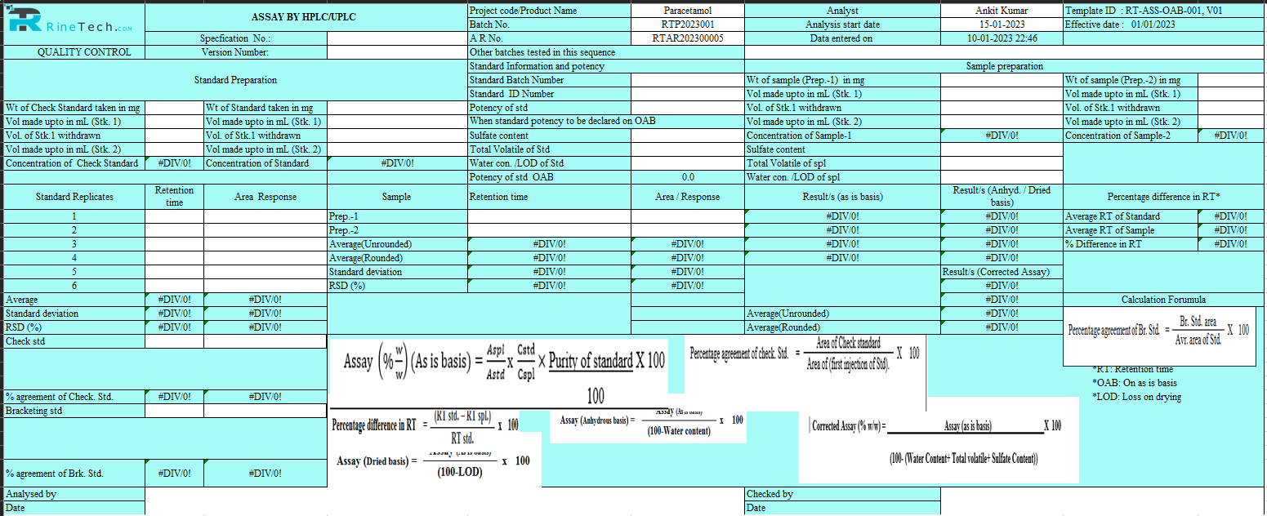
3rd page : Empty template will open
Save
Print
Edit
Sign / Approve
Export as link / PDF

Slide 6
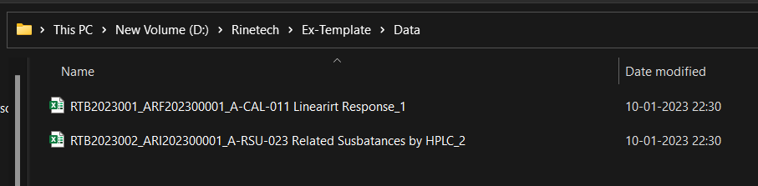
Template page
If the template name is “Linearity Response_ A-CAL-011 ”, batch number is RTB2023001 and AR number is ARF202300001 then data will be saved as mention in the below image first data file.
New template to add, create, edit and save. If data is edited after saving it will create next version (_2 and so on).

Slide 7
4th page: Authorization with credentials
Login ID
Password
Authorize Cancel Back
Approve Edit Cancel Back
This page will pop-up to authorize / approve the changes or save the files.

Slide 8
5th page: adding new template by admin
Template name
Template sub category / type
Template number
Browse template
Create / Edit Template

Slide 9
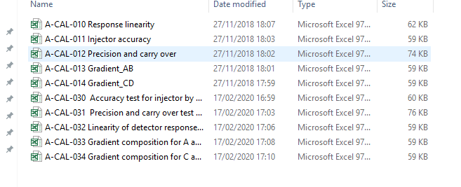
Template page
Available templates with name, type and template number
New template to add, create, edit and save

Slide 10
Analyst / Chemist
The analyst / chemist can create excel files and save with appropriate file name using his credentials.
File name will be batch number and AR number entered initially by analyst.
Analyst can retrieve his created file and can only print the saved files.
Analyst can also export the excel file as link or pdf to local server.
Analyst can perform correction in the excel file if Reviewer has rejected or reverted with comments.

Slide 11
template controller
A template controller can sign files created by analysts and edit the results in template files
A template can view audit trials.
A controller cannot upload new templates only admin or manager can do so.
A controller can retrieve the excel files saved file the analysts and can edit using his credentials. Controller can also view, save, print or export the files and audit trials.
Controller can view files but cannot edit file name or delete files.
Controller can Sign as reviewer using his credentials or he/ she can revert back for analyst to perform correction with his comments.
Controller once sign, the files will pop up for second level of review by Template manager.

Slide 12
manager
A template manager can view, add and edit the templates available
A manager can approve files created by analysts and edit the results in template files. Once manager approves the file, the file gets locked.
A template manager can view, save, print or export the files and audit trials.
Manager can upload new templates, edit and correct file names if required.
A manager can retrieve the excel files saved by the analysts using his credentials. Manager can view files but cannot delete any files.
Manager can Sign as reviewer using his credentials or he/ she can revert back for analyst to perform correction with his comments.
Manager once sign, the files will pop up for lock and to unlock IT admin approval required.

Slide 13
Admin access
The Admin can view all the excel files created and can edit the files.
Admin can add, remove and update credentials of all and others.
Admin can backup the data files and audit trials. Edit or delete templates.
Admin can perform trouble shooting.
Admin can perform self testing of the software (Minimum tests as prescribed by manufacturer).
Admin must check health of the data files and software once in a month or schedule.
Admin must take care of IQ/OQ/PQ.

Slide 14
Template editing by admin / controller
Template name
Template number
Browse Data base / Local server
Create
Edit template
This template will be access by template controller or Admin to add and/or edit existing templates. Templates can be browsed from its local data base or local computer. But templates once added or edited will be saved in data base only with new version number after every click of save button.
Template name and number can be customized. Upside format is type of display for addition or edit of templates.

Slide 15
Admin login and activities
Name of user
Department (To choose folder path of data base)
Employee code
User Role (To scroll down for role of Analyst / Controller / Manager / Admin)
Default password (To be changed upon 1st login)
Create Login / Modify login (for password reset / role change)
Additional information if any

Slide 16
Admin login and activities
User detail list
Name Role Department Remarks
Kundan Baranwal Analyst QC Ticket no.
Ishika Controller QC Last modified
Ankit Kumar Manager QC Ticket no.
Ajay Malhotra Admin IT NA
Add new login or edit login

Slide 17
Audit trail page
User details
Choose from date and time
Choose upto date and time
Name Role Department Activity Date/time Alert
Kundan Baranwal Analyst QC Login and entered data 26/01/2023 10:10:10
Ishika Controller QC Entered wrong password 26/01/2023 13:01:51
Ankit Kumar Manager QC Print failed, connection failure 27/01/2023 14:10:23 !
Sign and print using login credentials

Slide 18
Admin page
File and templates
Access credentials (creation / modification)
Data backup
Data health check
Data transfer and backup
IQ /OQ /PQ
Guidelines
Help and support (F1 key)

Slide 19
Thank you
Rinetech Internet Pvt Ltd thanks to it supporters, promoters and customers for building trust in us.

