Slide 1
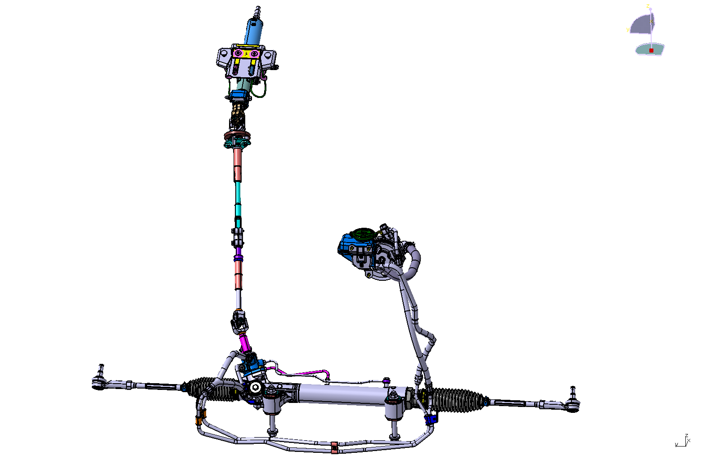
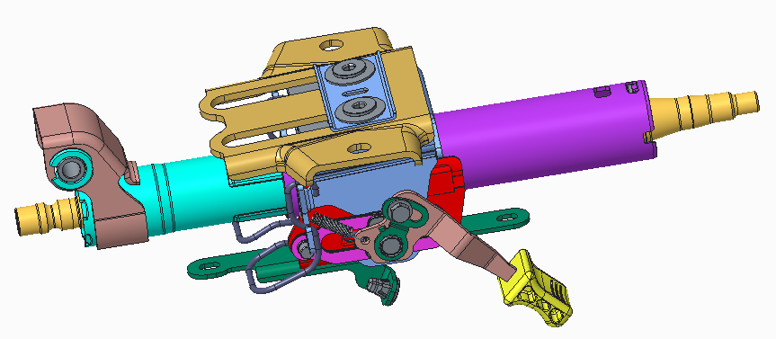
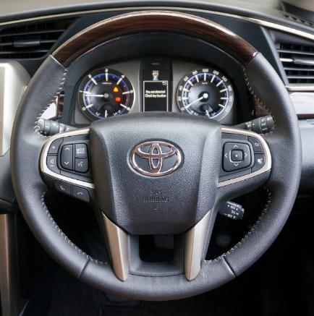
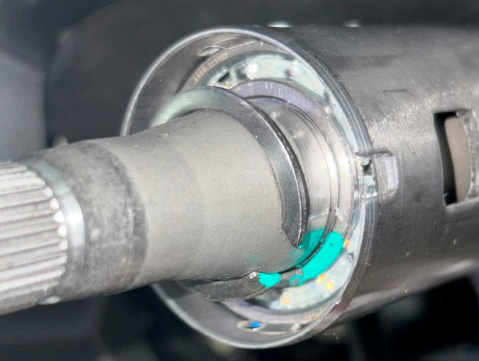
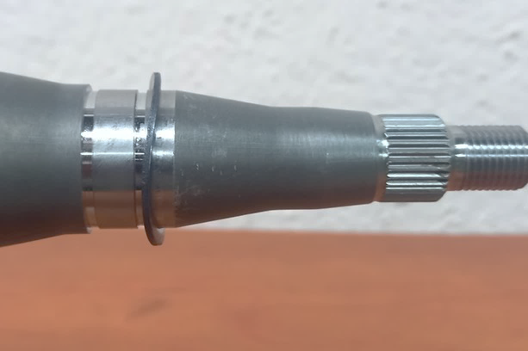
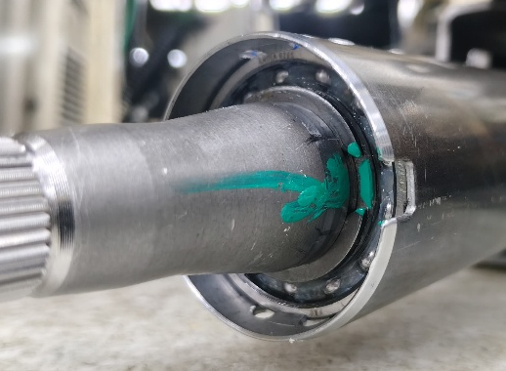
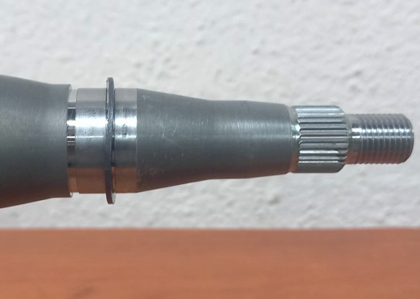
Problem Statement :
Customer : XXXXX
Concern : Steering Wheel Sliding Play more reported at Customer Line
[ Noticed at Vehicle while Tilt & Telesco Inspection ]
Report Date : 31-07-2026
Part Name : Steering Column Assembly
Model : New IMV 188D [ Fortuner ]
Part No : 45250 - 0K120
Quantity : 1 No.
Batch Code : 26.07.2026 [ A shift, S.No 164 ]
STEERING SYSTEM
Manual Steering Column
Upper IMS
Lower IMS
Up & Down
Steering Wheel Play
observed while Tilt &
Telescopic Inspection
HPS Gear
NG Condition
OK Condition
Concern Part
OK Part
C Ring Condition :
Came away from Groove
Picture : C – Ring Wrong fitment
C Ring Condition :
Properly fitted at Groove
Picture : C – Ring correct fitment

Slide 2
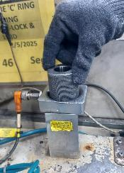
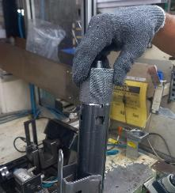
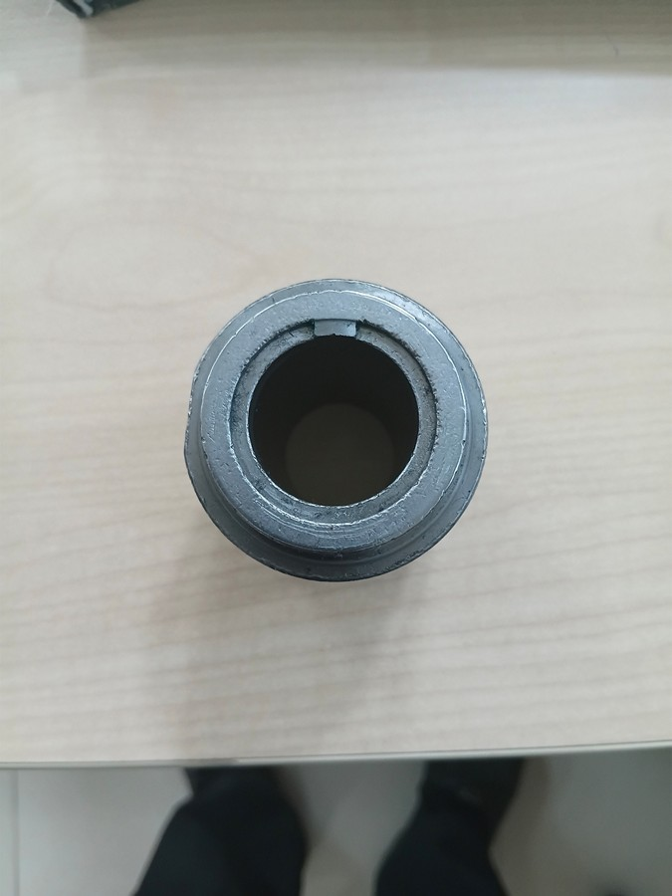
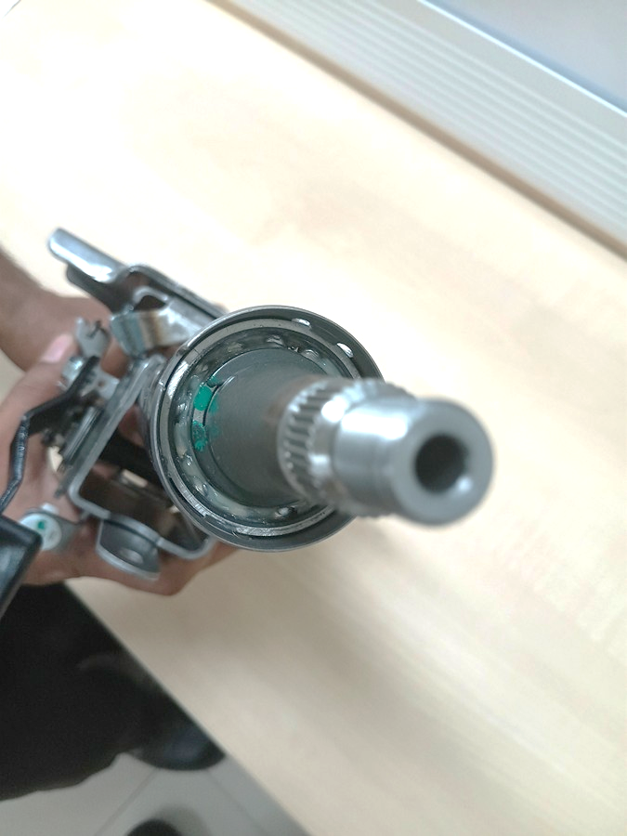
C- Ring Inspection Gauge Working Principle
Gauge
C-Ring assembled condition
C- Ring Gauge Pickup
from location
- Pike up sensor interlink
Gauge locate over Top side
Rotate the Gauge
Feel Locking at Groove
Slot width = 6.13 mm (Spec 6.1 ~ 6.15)
Height = 1.62 (Spec 1.6~1.65)
C-Ring end Gap = 7.12 mm (Spec 8.50 max)
Height = Actual asper C-Ring height
OK - Condition
C-Ring
Inspection Gauge
After C-Ring pressed : Gap = 7.12 mm ( Spec : 8.50 Max )
Here C-Ring height from datum 1.33 mm < Gauge height 1.62 mm
Hence SEATED & LOCKED
LOCKED
After C-Ring pressed : Base to Top height = 1.33 mm ( No Spec )
NG - Condition
After C-Ring Partial pressed : Gap = 10.32 mm ( Spec : 8.50 Max )
Here C-Ring height from datum 2.44 mm (Inclined due to not seating into groove) > Gauge height 1.62 mm
Hence NOT SEATED & NOT LOCKED
After C-Ring partial pressed : Base to Top height = 2.44 mm ( No Spec )
NOT LOCKED

Slide 3



Illustration of Gauge Inspection : Right & Wrong method
Right Method of Gauge Inspection
Incorrect Method of Gauge Inspection
Gauge Inspection
[ Judgement by Man ]
Must to Rotate one time
Failed to Rotate
Upper Shaft
C-Ring
C-Ring Gauge
Ball Bearing
Outer Tube
C-Ring Position checking Gauge
C-Ring Position checking Gauge
Column Assy.
S.N | RIGHT method of Gauge Inspection | WRONG method of Gauge Inspection
01 | Pick up the gauge from the PLC-interlocked sensor stand | Pick up the gauge from the PLC-interlocked sensor stand
02 | Insert the gauge through the upper shaft and rest it on the top of the C-ring. | Insert the gauge through the upper shaft and rest it on the top of the C-ring.
03 | Rotate the gauge until the C-ring gap locks into the gauge slot. | Without Rotate and lock - Judgement

Slide 4
Simulation study to recreate the Concern
Outer Jacket
Fixed plate
Movable plate
Cylinder
OK Condition
Threaded ring budding on Plate – No Gap
Fixed plate
Threaded Ring Gap with Plate
Cylinder
While cycle start first the movable plate touching on Thread ring and then pull start hence , partially done
NG Condition

Slide 5
Gap in Yokoten :
Group Plants
LVDT Standard
Selected Lines
Implemented
Current State
100% Deployment
Other Lines
Not Implemented
Customer Complaint
Reflection : Standard existed, but Yokoten was not completed across all applicable Lines

Slide 6
Reflection : Plant and CQA side
Since the LVDT standard already existed and only selected lines implemented it, causes for Gap are :
Incomplete applicability review – all applicable lines were not included.
No ownership and follow-up – implementation was not tracked to 100% completion.
Verification gap – audits did not detect that some lines were still using the conventional gauge.
Week 3G verification from CQA side for remote plant [JIN CHN].
Week linkage with QA network of Yokoten items.
Action | Purpose
Identify all applicable lines using conventional gauges. | Find remaining gaps.
Complete 100% deployment of the LVDT gauge on all applicable lines. | Standardize inspection.
Update Control Plan, SOP, Inspection Standards and QA network. | Make the new method mandatory.
Verify implementation through Layered Process Audit (LPA). | Ensure compliance
Maintain a Yokoten deployment tracking list with completion responsibility and target dates. | Prevent missed deployment
Review all group-plant countermeasures for pending horizontal deployment by 3G | Prevent recurrence of similar issues.

