Slide 1
In House Quality Concern
Crack in Worm Shaft
Reni Cherian | Naresh Gauba | Yogesh
Approved By | Reviewed By | Prepared By

Slide 2
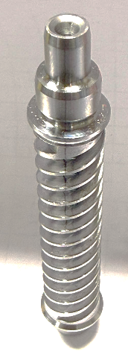
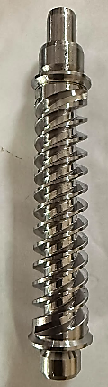
1
PROBLEM DETAIL
Defect Detail
Part Name | Worm Shaft
Model effected | Y17, YHB 25MC, YXA 26MC & YTA (part is common)
Qty | N=6 part
Defect | Crack observed
Detected at | After Whirling process (100% visual inspection)
Detected by | Line Operator
Occurrence Date | 08.09.26
Material grade | SCM 435
NG Part
OK Part
SUPPLY CHAIN
XXXX
(RM Supplier)
XXXX
(Heat Treatment )
XXXX
(Machining)
XXX
(Machining)
XXXX
(CEPS ASSY)

Slide 3
2
Current Status, Key Findings & Open Issues
Item | Summary
Problem | Worm shaft crack detected during visual inspection at JIN Bawal . Total 6 NG parts identified (2 machining level + 4 child parts).
Containment | 100% magnifying glass inspection at JIN receiving & machining. 200% MPI implemented at Dynamic. Suspected stock segregated and under control.
Customer Impact | No performance difference observed between OK & NG parts in C-EPS evaluation. Reliability impact under validation.
Traceability | Suspected heat identified as M215871. Complete supply chain traced: Mukand → Omega → Dynamic → JIN.
XXXX Findings | SEM, microstructure and joint analysis did not confirm RM abnormality. Current evidence points towards heat-treatment related crack generation.
Supplier Position | Mukand /Omega have not confirmed raw material responsibility. Investigation and FTA validation are continuing.
XXXX Concern | Actual crack generation mechanism remains unproven. Occurrence root cause and permanent countermeasure not yet validated.
Outflow Root Cause | MPI visual inspection weakness identified. WI non-adherence, operator fatigue, inspection guideline gaps and inadequate monitoring suspected.
Current Status | Containment completed. Traceability completed. Joint supplier analysis completed. SEM review completed. Durability test and FTA validation in progress.
Open Points | Final occurrence root cause pending. Heat-treatment mechanism not validated. Durability test not completed. Supplier final report pending. Permanent countermeasure pending.
Supplier Commitment | Final investigation report from Mukand /Omega. FTA validation and technical conclusion submission.
Management Support Required | Continue escalation with Mukand /Omega management. Obtain technically validated root cause, countermeasure and closure evidence before concern closure.

Slide 4

3
Containment Action
Temporary Action:- Segregation at JIN BWL & Dynamic
Location | Model | Part level | Total Qty | OK | NG | Pending | Segg. Method | Picture
BWL Line | Y17 | Machining | 192 | 190 | 02 | 0 | 100% parts checking with Magnifying Glass -at Receipt stage - after whirling process - 08.09.26 200% MPI started at Dynamic - 08.09.26
BWL (Receipt.) | Y17 | Child part | 4908 | 4904 | 04 | 0
Dynamic (Child Parts) |  | Child part | 1105 | 1102 | 0 | 0
Total |  |  | 6205 | 6199 | 6 | 0
Confirmation Marking on Worm Shaft
(Receiving Stage-JIN)
Refer next slide for Segregation Detail and Method

Slide 5
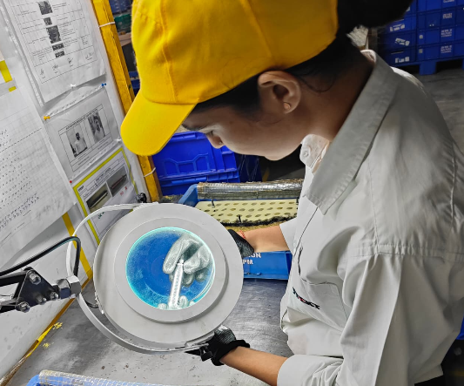
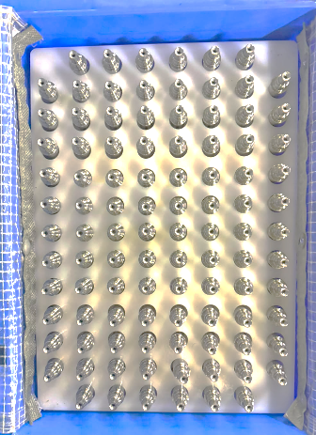
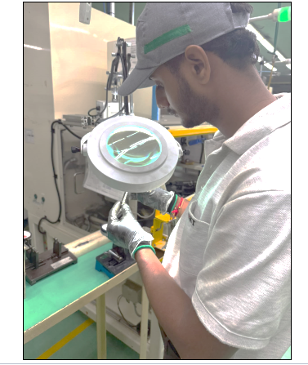
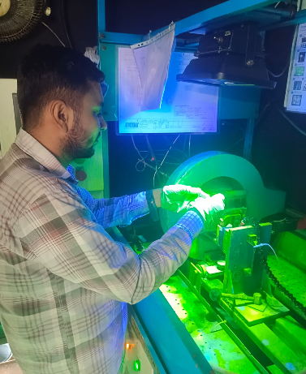
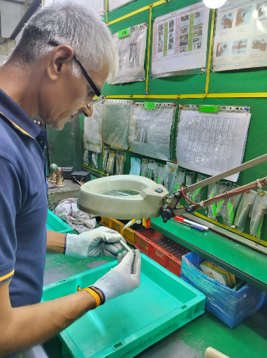
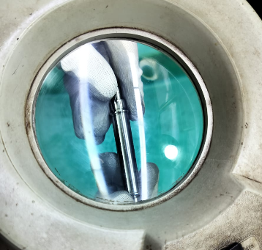
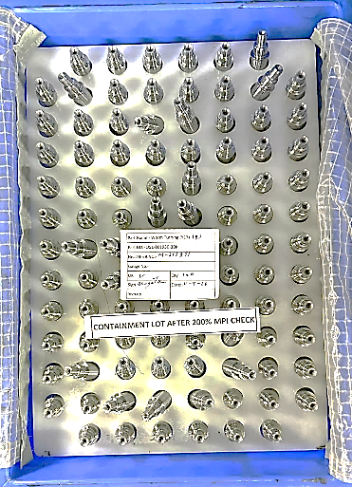
3.1
Containment Action
Black Line Marking
100% parts checking by Magnifying Glass (JIN RECEIVING STAGE)
IDENTIFICATION AFTER CONTAINMENT ACTIONS
AFTER WHIRLING-INSPECTION -JIN PRODUCTION LINE
Dynamic
Zoom View
200% parts inspection by MPI
100% parts checking by Magnifying Glass
Identification of containment-Identification Tag

Slide 6
4
4M CHANGE
MUKAND
4M | Observation | Result
Man | Skilled | OK
Machine | No Change | OK
Material | No change | OK
Method | As per work Instruction | OK
OMEGA
4M | Observation | Result
Man | Skilled | OK
Machine | No change | OK
Material | No change | OK
Method | As per work Instruction | OK
DYNAMIC
4M | Observation | Result
Man | Skilled | OK
Machine | No change | OK
Material | No change | OK
Method | As per work Instruction | OK
Inference:-
- As per 4M change record
no abnormality observed

Slide 7
5
PROCESS FLOW WITH DEFECTIVE PROCESS
Supplier Chain
Supplier → | Mukand |  | Omega |  | Dynamic |  | JIN BWL
Process → | Raw Material |  | Heat Treatment |  | Machining |  | Whirling | CEPS Assembly
Mini Blast Furnace
Energy Optimizing Furnace
Ladle Refining Furnace
Vacuum Degassing
Continues Casting
Billet Dressing
Mukand Process Flow
Dispatch
Bar Inspection
Hot Rolling to Desired Size & Shape
Occurrence
Outflow
Receiving inspection of RM
Straightening @ Ø19 mm
Peeling @ Ø18mm
Straightening @ Ø18mm
Hardening & Tempering
Pickling / Pointing / Cold Draw/ Pointing cutting @ Ø17.30mm
Omega Process Flow
Inspection, Packing & Dispatch
Centre Less grinding 2 (Final Size Ø17.00-0.04mm)
Centre Less grinding 1
Straightening
Dynamic Process Flow
RM Receiving & Inspection
Turning & Cantering at Sliding Head
Dia. Turning
Crack Detection at MPI
Visual Inspection & Gauging
Packing & Dispatch

Slide 8
5.1
BAWAL PROCESS FLOW
BAWAL-MACHINING PROCESS FLOW
RM Receiving & Inspection
Thread Cutting
Thread Grinding
Thread Grinding
OD Grinding
Washing
Detected at Process
100% Visual inspection with Magnifying glass
Space Runout
Bawal Worm Housing Process Flow
LOWER SHAFT WASHING
R/G ANNEALING
DMC MARKING(WORM HOUSING)
W/H BEARING & C- RING PRESS IN
WS BEARING & FLANGE BOSS PRESS-IN
ABLS ASSY
REDUCTION GEAR DEBURRING
RED.GEAR TEETH CUTTING
R/G PRESS
DMC MARKING(LOWER SHAFT)
SQUARE RING ASSEMBLY & END COVER PRESS
ASSY MEASUREMENT
L/S BUSH AND BEARING PRESS
RED.GEAR SPACE RUNOUT
'LOWER SHAFT ASSY INSTALLATION & C-RING PRESS
TOOTH SURFACE FORMING
Bawal Column Process Flow
DMC CODING (M/S)
DMC CODING (M/S)
TORSION BAR AND MIDDLE SHAFT PRESS
MAGNETIZING
NEEDLE BEARING PRESS & MCR ATTACHMENT
MAGNETIC YOKE PRESS
OUTER JACKET PRESS
JACKET/LOWER TUBE PRESS
BUSH & COLLAR PRESS
GAP REGULATION, BALANCING & DEBURRING
N-MIN TORQUE INSPECTION
GENERAL ASSEMBLY
GAIN OFFSET WRITING & FIXED LOAD INSPECTION
MCU INSTALLATION
PROPORTIONAL LOAD INSPECTION
MID POINT CURRENT & ROTATIONAL TORQUE INSPECTION
PEDAL BRACEKET ATTACHMENT
HARNESS BRACKET ATTACHMENT
FINAL INSPECTION
CABLE TIE ATTACHMENT
DIAG INSPECTION
IMS ATTACHEMENT
TILT & TELESCOPICE INSPECTION
FEELING INSPECTION

Slide 9

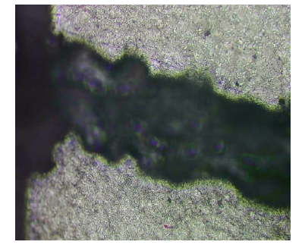
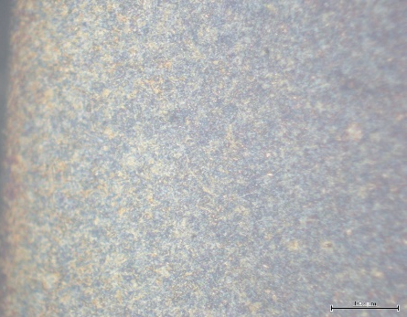
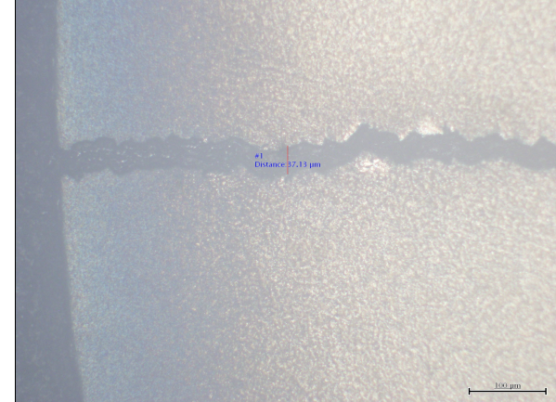
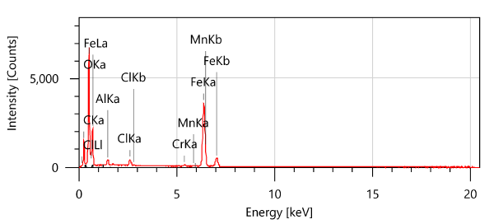
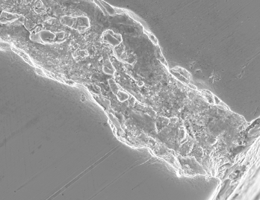
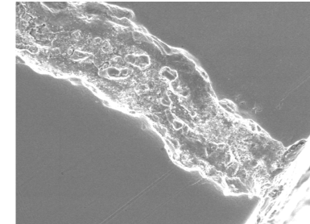
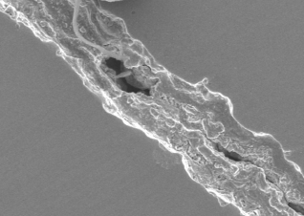
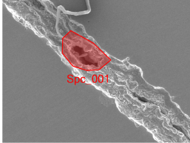
6
ANALYSIS
1. OK & NG PART COMPARISON DONE FOR MICROSTRUCTURE AT OMEGA
Inference:-
- No Decarb observed at Crack Portion.
- Tempered Martensite structure observed
OK PART MICROSTRCTURE
NG PART MICROSTRCTURE
2. OK & NG PART COMPARISON DONE FOR MICROSTRUCTURE AT JBIN
Inference:-
- Tempered Martensite structure observed
- RM Level issue not suspected
3. SEM TESTING PROCEED AT NG PART LEVEL
Inference:- As per SEM Testing Conclusion, No abnormality Observed at RM Level

Slide 10
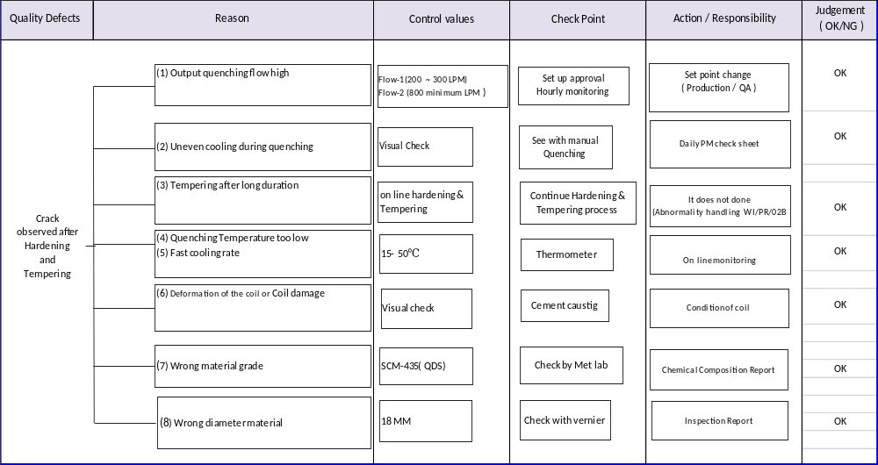
6.1
ANALYSIS
FTA SHARED BY THE OMEGA CONSIDERING THE POSSIBLE CAUSES
Inference:- Current Controls Verified by the Omega & Dynamic jointly And No Abnormality Observed.
JIN CQA & Plant QA will plan for the Validation Activities at Omega by 24rd Sep’26

Slide 11
Process verification of MPI
- Why out flow from Dynamic
6.2
ANALYSIS
S.N. | Ideal Condition | Actual Condition | Factors
1 | Start of Machine | Follow as per the Work Instruction | Non-Significant
2 | Machine parameter setting | Follow as per the Work Instruction and PCS | Non-Significant
3 | Part Loading | Follow as per the Work Instruction | Non-Significant
4 | Start the process | Follow as per the Work Instruction | Non-Significant
5 | Part Unloading | Follow as per the Work Instruction | Non-Significant
6 | Visual Inspection at MPI | During inspection, hold the part at an angle of approximately 45 degrees and rotate it twice in both the forward and backward directions. | Non-Significant
7 | Demagnetization and sent to 100% Gauging | Follow as per the Work Instruction and PCS | Non-Significant
8 | Operator Concentration and Attention | ❶ Operator fatigue observed due to continues inspection under UV light for complete shift (shift is of 11 working hours) | Significant
9 | Visual Inspection at Final Stage | ❷ Only general guidelines for inspection available. Part specific guidelines considering sequential check points for inspection at Final inspection stage. | Significant
Action Planned.
❶ MPI operator to be changed / rotated every 04 hours - 10.09.26 (Started)
❷ Final inspection guidelines to be changed for specific crack identification - 12.09.26 (Started)

Slide 12
6.3
ACTIVITY PLAN & STATUS
ACTIVITY PLAN
S.No | Activity Defined | Resp | T.Date | Status | Remarks
1 | Dynamic is doing 200% MPI for crack detection | Ravi Bajwa | 08.09.26 | Started | Still no no NG observed
2 | AT JIN Bawal Receiving stage, 100% confirmation visually with magnifying glass | Naresh Gauba | 08.09.26 | Started | Still no no NG observed
3 | After Whirling process, 100% visual confirmation with magnifying glass | Rakesh Nain | 08.09.26 | Started | Still no no NG observed
4 | Assemble NG worm shaft in C-EPS and performance results to be confirmed(Comparison of Ok & NG Assy) | Rakesh Nain | 09.09.26 | Done | Performance results observed OK on production line
5 | Comparison of Micro-structure And Hardness Inspection of Ok & NG Part at JIN | Naresh Gauba & Yogesh San | 12.09.26 | Done | Structure Observed-Tempered Martensite . - RM Level issue not suspected*
6 | Comparison of Micro-structure And Hardness Inspection of Ok & NG Part at Omega | Omega+Dynamic | 12.09.26 | Done
7 | CEPS assembly with one crack worm shaft send to JIN TC for reducer durability testing | Kamal San/Praveen San-JIN GGN LAB | Oct’26 (4th Week) | Started
8 | Investigation Report to be Received from Mukand of the NG Part. (As per Action plan, Mukand is proceeding for the testing) | Omega/Dynamic | 24.09.26
09 | Simulation activities to be done based on FTA at Omega | Yogesh-CQA/Naresh Gauba-QA | 24.09.26
10 | Outflow Root Cause and Permanent Actions to be Shared | Dynamic | 25.09.26

Slide 13
7
Challenges being faced during analysis
1. Both Raw material supplier XXXX & Heat treatment supplier XXX
not ready to accept the defect occurrence at their end
(as per expert – this defect can be occurred during heat treatment (at XXX)
Facing difficulty in coordinating with all the 03 suppliers for analysis.

Slide 14
Thank You

Slide 15
Suspected Quantity
WORM SHAFT CRACK PART TRACEABILITY DETAIL (SUSPECTED HEAT CODE-M215871)
Mukund to Omega |  | OMEGA Process |  |  |  |  |  |  |  | DYNAMIC |  |  |  |  |  | JIN BAWAL |  |  | Remarks
 |  | IMT Faridabad Plant |  |  | Sector 24 Plant
Date | A Qty | Heat Treatment & Peeling Date (HT) | B Peeling + HT Qty (KG) | C Scrap Qty (KG) | Pickling + Drawing + Grinding Date | Pickling + Drawing + Grinding Qty | D Scrap Qty | E OK Qty | Remaining A-(B+C+D+E) | Received Date | Recd Qty | Dynamic Production Data | Dynamic Rej Data | Dynamic Despatch to JIN | Opening Qty for next month | JIN Receiving Month/Date | CEPS Despatch Date | C-EPS Despatch QTY
 | In KG |  | In KG | In KG |  | In KG | In KG | In KG | In KG |  | In KG | In Nos | In Nos | In Nos | In Nos |  |  | In Nos
Heat-M215871-First Receiving 14.05.2026 | 12600 | 23.05.2026 | 3820 | 1380 | 25.05.2026 | 1820 | 146 | 1674 | 0 | 28.05.26 | 920 | 31908 | 154 | 25700 | 6054 | Jun'26 | -- | --
 |  |  |  |  | 26.05.2026 | 2000 | 160 | 1840 |  | 02.06.26 | 2680
 |  | 27.05.2026 | 7400 |  | 27.05.2026 | 3000 | 240 | 2760 |  | 04.06.26 | 2550
 |  |  |  |  | 29.05.2026 | 1400 | 112 | 1288 |  | 17.06.26 | 4130
 |  |  |  |  | 30.05.2026 | 3000 | 240 | 2760 |  | 02.07.26 | 1010 | 42811 | 167 | 45700 | 2998 | Jul'26 | -- | --
20.06.2026 | 3140 | 27.06.2026 | 2810 | 330 | 29.06.2026 | 1200 | 96 | 1104 | 0 | 08.07.26 | 1460
 |  |  |  |  | 30.06.2026 | 1610 | 129 | 1481 |  | 18.07.26 | 1270
01.07.2026 | 6280 | 08.07.2026 | 5580 | 700 | 13.07.2026 | 1200 | 96 | 1104 | 0 | 28.07.26 | 4050
 |  |  |  |  | 14.07.2026 | 800 | 64 | 736
 |  |  |  |  | 15.07.2026 | 1500 | 120 | 1380
 |  |  |  |  | 16.07.2026 | 1000 | 80 | 920 |  | 13.08.26 | 900 | 46464 | 189 | 46800 | 2473 | Aug'26 | -- | --
 |  |  |  |  | 17.07.2026 | 1080 | 86 | 994
31.07.2026 | 8970 | 08.08.2026 | 2690 | 870 | 09.08.2026 | 800 | 64 | 736 | 0 | 18.08.26 | 1420
 |  |  |  |  | 10.08.2026 | 1500 | 120 | 1380
 |  |  |  |  | 11.08.2026 | 390 | 31 | 359
 |  | 17.08.2026 | 2730 |  | 20.08.2026 | 1300 | 104 | 1196 | 0 | 27.08.26 | 2110 | 8461 | 29 | 2000 | 1005 | 01-Sep-26 | 05.09.2026 | 1740 | > From 05th to 08th of Sep, Suspected lot despach to customer. - Total dispatch to customer - 4800 (out of 5649 nos, 849 is with other heat material)
 |  |  |  |  |  |  |  |  |  |  |  |  |  | 300 |  | 01-Sep-26 | 06.09.2026 | 750
 |  |  |  |  |  |  |  |  |  |  |  |  |  | 1700 |  | 02-Sep-26 | 07.09.2026 | 1414
 |  |  |  |  |  |  |  |  |  |  |  |  |  | 700 |  | 03-Sep-26 | 08.09.26 | 1745
 |  |  |  |  |  |  |  |  |  |  |  |  |  | 300 |  | 03-Sep-26
 |  |  |  |  | 21.08.2026 | 1430 | 114 | 1316 |  |  |  |  |  | 1300 |  | 06-Sep-26 | -- | --
 |  |  |  |  |  |  |  |  |  |  |  |  |  | 1200 |  | 06-Sep-26
 |  |  |  |  |  |  |  |  |  |  |  |  |  | 700 |  | 08-Sep-26
 |  |  |  |  |  |  |  |  |  |  |  |  |  | 1700 |  | 08-Sep-26
 |  | 20.08.2026 | 2680 |  | 22.08.2026 | 1800 | 144 | 1656 |  | 01.09.26 | 1250 | -- | -- | -- |  | -- |  |  | Not Consumed
 |  |  |  |  | 24.08.2026 | 880 | 70 | 810
Total | 30990 |  | 27710 | 3280 |  | 27710 | 2216 | 25494 |  |  | 23750 | 129644 | 539 | 128100 |  |  |  | 4800
 |  |  |  |  |  |  |  |  |  |  | Pending at Dynamic-FG Qty |  |  |  |  | 1005 Nos | Till 08th of Sep'26
 |  |  |  |  |  |  |  |  |  |  | Pending Material at RM Stage(Dynamic) |  |  |  |  | 1250 KG
 |  |  |  |  |  |  |  |  |  |  | Pending at Omega End (Ok Qty at Omega-Total Received at Dynamic) |  |  |  |  | 1744 KG
 |  |  |  |  |  |  |  |  |  |  |  |  |  |  | Receiving of Last Suspected lot at Omega |  |  |  |  | 31.07.26
 |  |  |  |  |  |  |  |  |  |  |  |  |  |  | Received at Dynamic End |  |  |  |  | 27.08.26
 |  |  |  |  |  |  |  |  |  |  |  |  |  |  | Received at JTEKT |  |  |  |  | 03.09.26
 |  |  |  |  |  |  |  |  |  |  |  |  |  |  | Dispatch to Customer |  |  |  |  | 05.09.26 to 08.09.26

