Slide 1
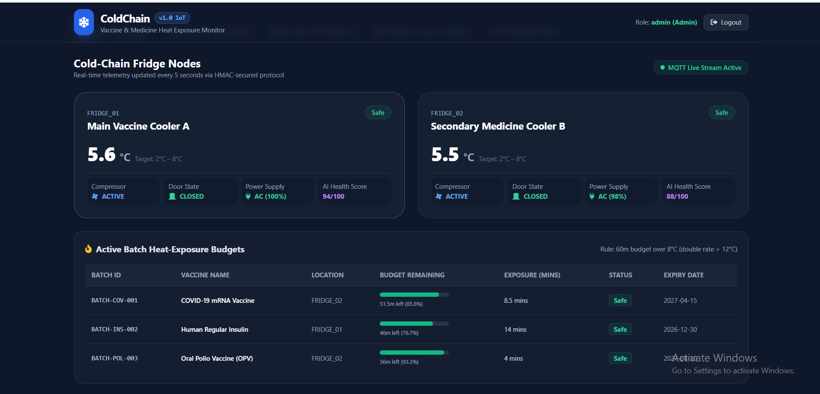
ColdChain
BUBT TECHATHON
Vaccine & Medicine Storage Monitor
An IoT, machine-learning and cryptographic cold-chain management system
Nova_Odyssey | Md. Shahriar Kabir, Noor-E-Khadiza Nuha
Notes:
Introduce the team and the problem we solved: monitoring vaccine and medicine storage end to end.

Slide 2



Why cold chain matters
Ineffective vaccination campaigns
Patients look protected but are not
2-8 °C
Wasted pharmaceutical inventory
Spoiled stock costs millions of dollars
The safe storage window for vaccines and insulin
Outside it, vaccines and biologics degrade irreversibly.
Undetected heat exposure
Compromised doses can reach patients
Our answer: a resilient, intelligent and tamper-evident cold-chain platform, from the sensor to the patient.
Notes:
Vaccines and insulin lose effectiveness outside 2-8 C. Failures are invisible until a patient is affected, which is why we built an end-to-end platform.

Slide 3
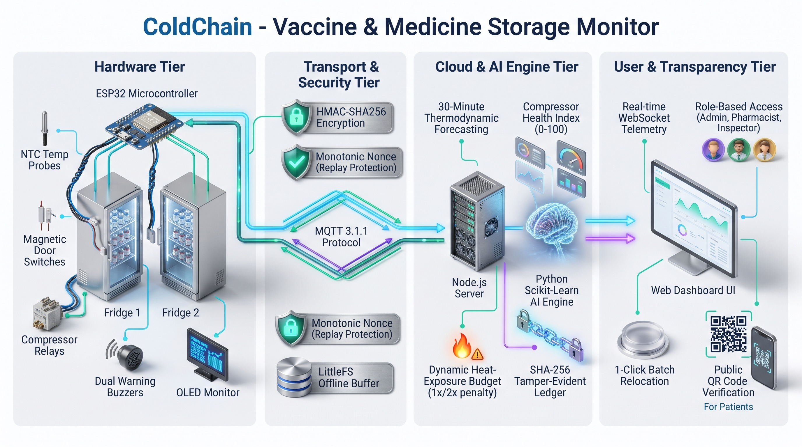
System architecture
Notes:
Four tiers: ESP32 hardware, MQTT transport with HMAC signing and offline buffering, Node.js plus Python AI, and the web dashboard with public QR verification.

Slide 4
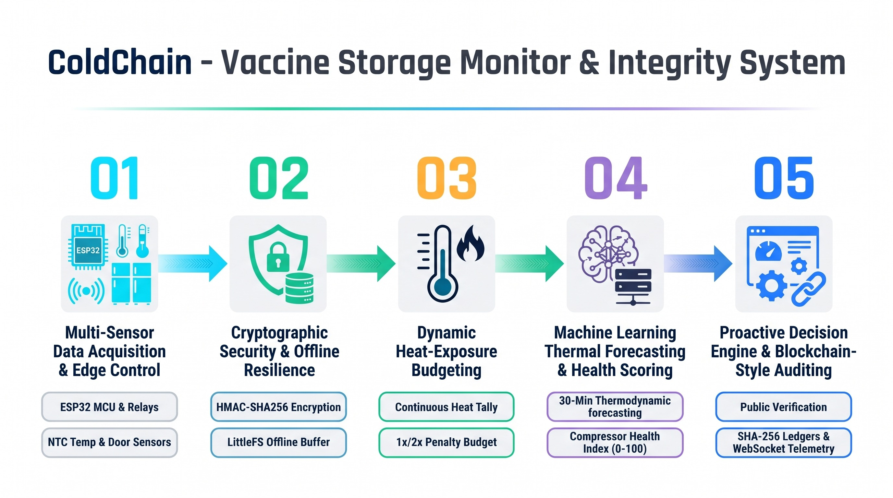
Methodology: five stages
Notes:
Acquire, secure, budget, forecast, decide and audit. Each stage feeds the next.

Slide 5
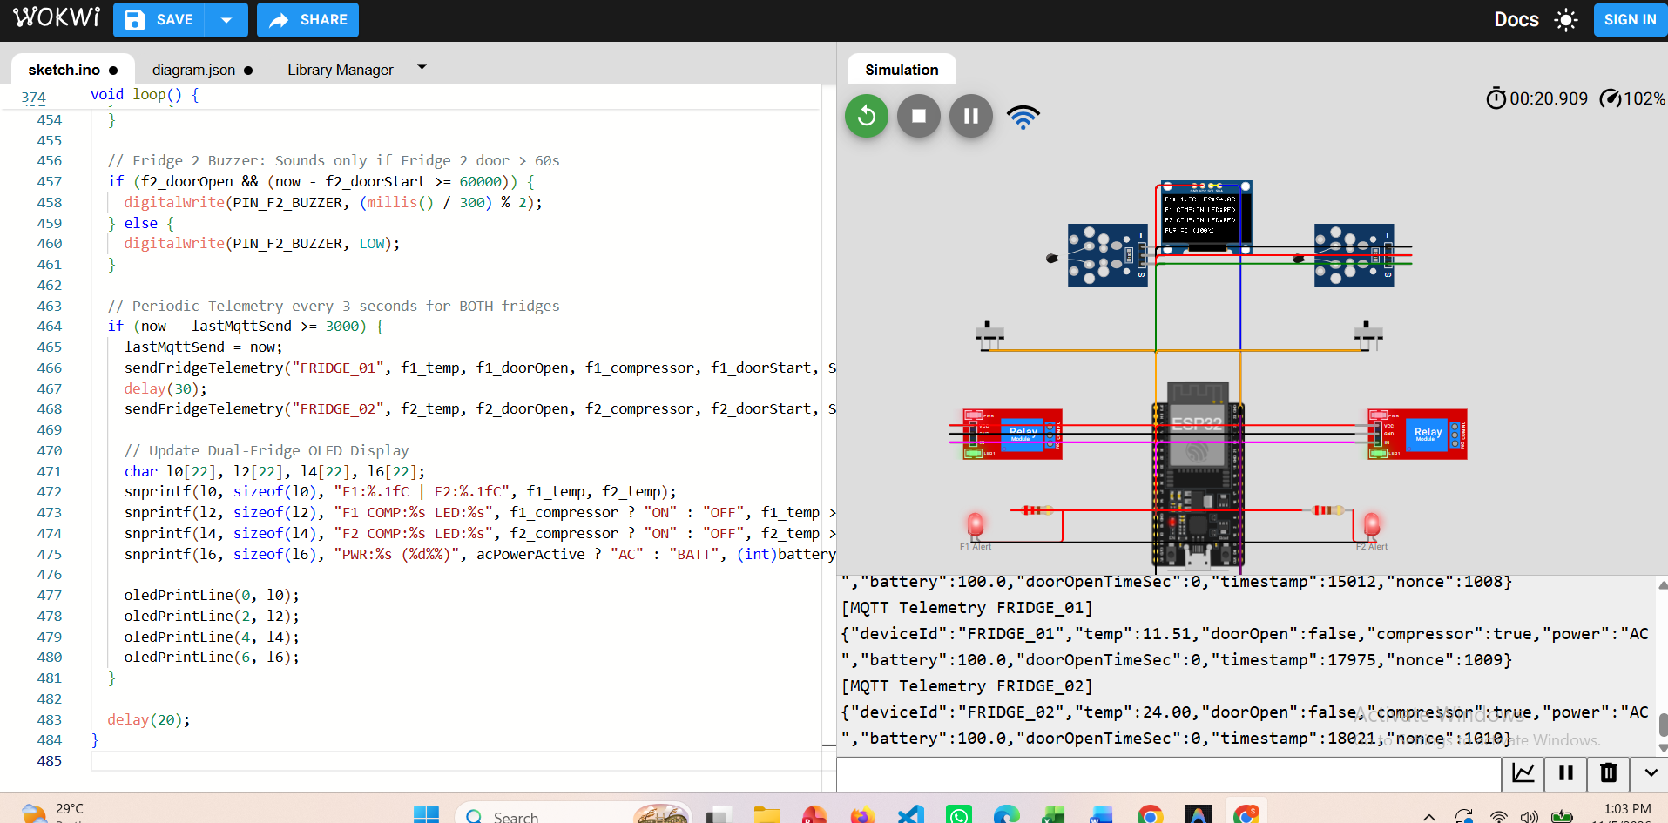
Fridge node: one ESP32, two chambers
NTC temperature probe, door switch, compressor relay and alert LED for each fridge
Compressor ON at 7 °C or above, OFF at 3 °C or below, with a 60 s minimum off-time
Door open longer than 60 s sounds that fridge's own buzzer and raises an incident alert
OLED shows live temperatures, compressor and power state, plus Safe, Warning or Breach for each fridge
Power-fail button switches to battery mode and reports the level
Signed telemetry over MQTT every 5 s and instantly on door change
Red LED latches on a breach and stays on until an admin clears it
Offline buffer: 30+ min of readings are buffered on the device and synced in order when MQTT returns
Wokwi simulation: two relays, OLED and signed MQTT telemetry in the serial log
Notes:
One ESP32 controls both coolers independently, which keeps hardware cost down. Each fridge has its own buzzer.

Slide 6
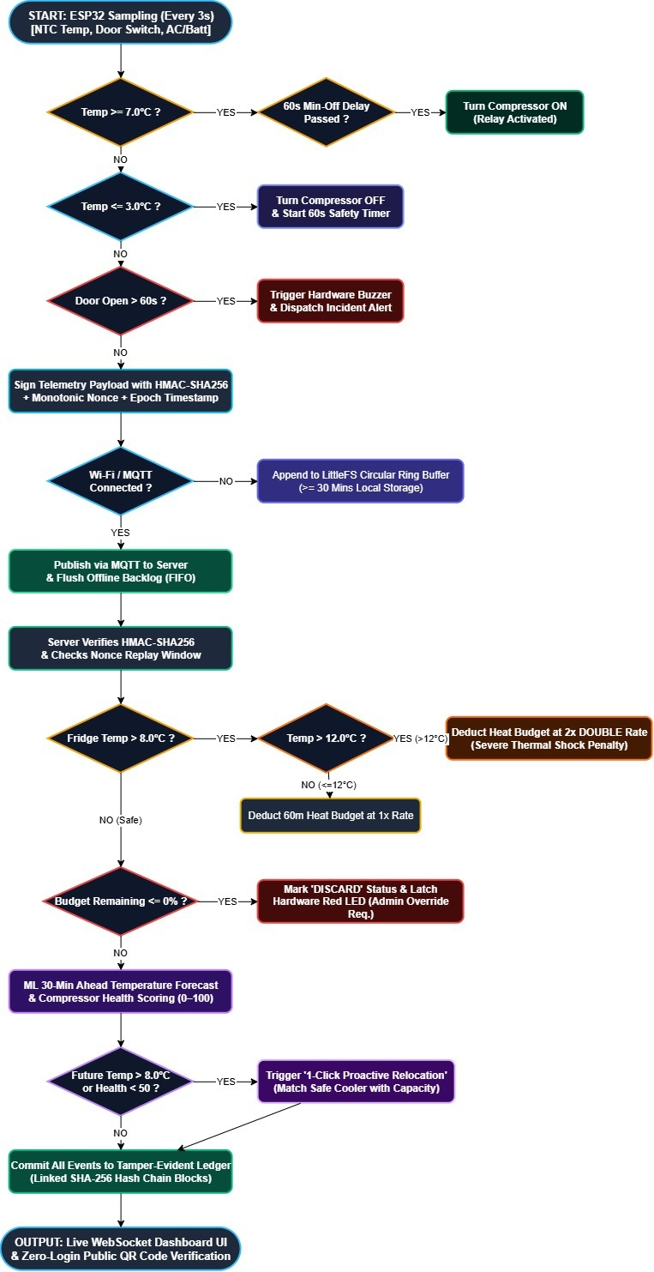
How a reading becomes a decision
1
Sense and control
Sample every 5 s. Start or stop the compressor and watch the door timer.
2
Sign and publish
HMAC-SHA256, nonce and timestamp on every payload, then MQTT to the server. If offline, readings are buffered and synced later.
3
Verify and decide
Server checks the signature and replay window, updates the heat budget, forecasts and logs to the ledger.
Notes:
Walk the flowchart top to bottom: control logic on the device, then trust and decisions on the server.

Slide 7
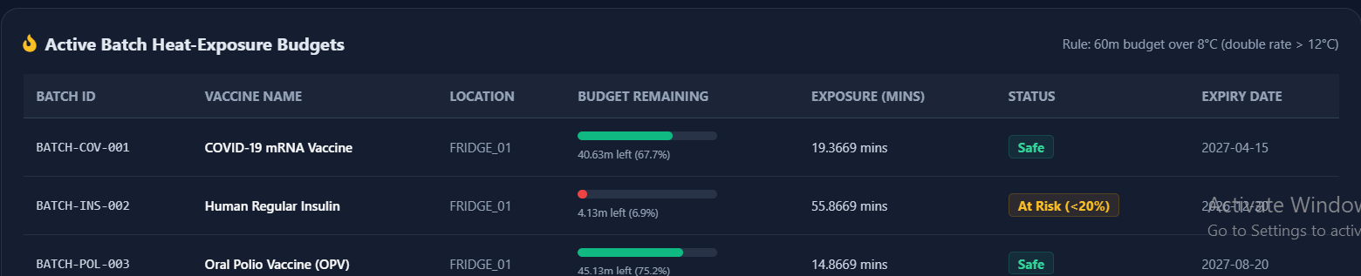
Heat-exposure budget
60 min
1x
2x
20% / 0%
budget per batch above 8 °C
rate between 8 and 12 °C
double penalty above 12 °C
At Risk below 20%, Discard at 0 with admin reset
Live batch budgets: remaining time, exposure and status per batch
Notes:
Every batch tracks its own allowance. Time above 12 C burns the budget twice as fast.

Slide 8

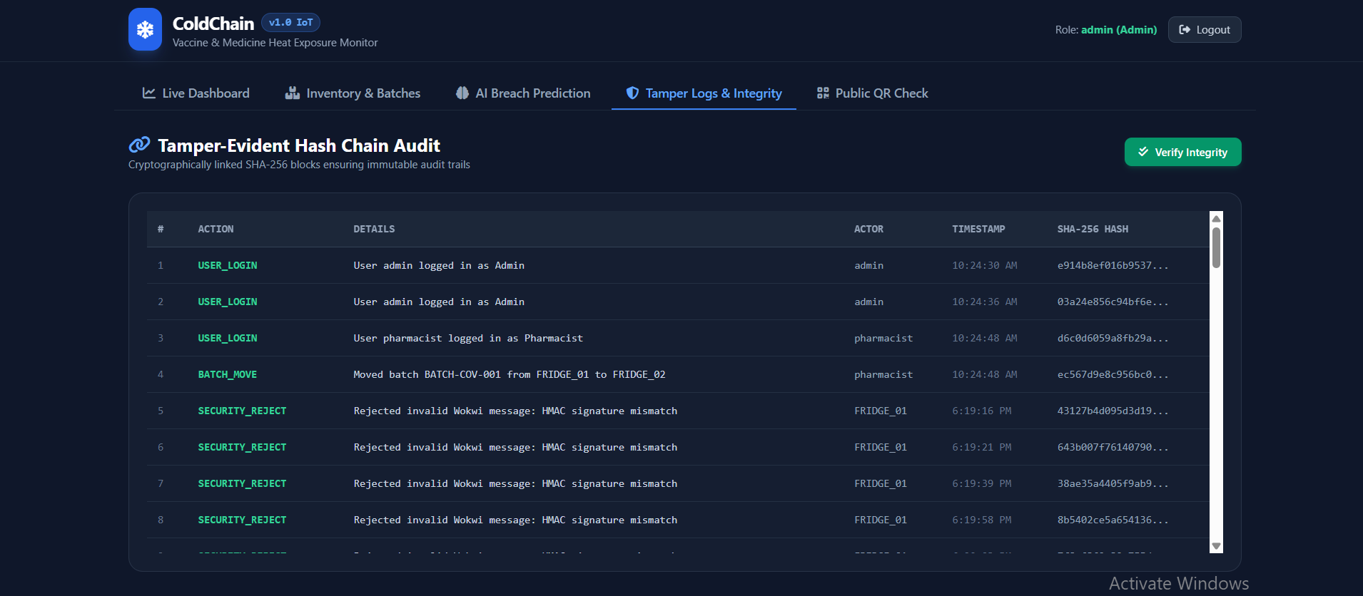



Device security
HMAC-SHA256 signatures
Each device signs every payload with its own key
Nonce replay protection
Repeated nonces are rejected inside a 10-minute window
Timestamp freshness
Messages older than 5 minutes are refused
Rejected messages appear as SECURITY_REJECT events in the audit chain
Reject and log
Invalid or replayed messages return 403 and enter the ledger
Notes:
Signed, fresh and unique: three checks before any reading is trusted. Rejections are visible to auditors.

Slide 9
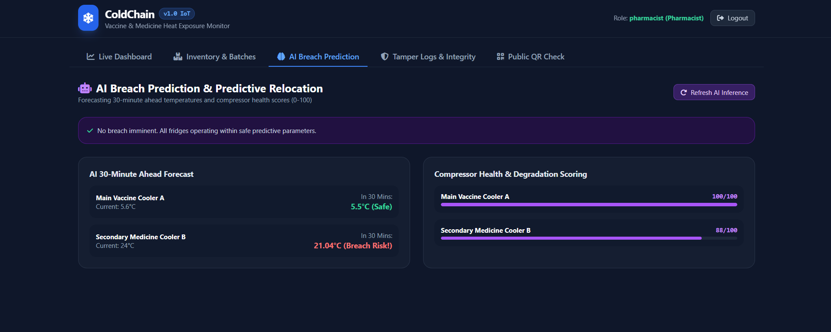
AI breach prediction
0.607 °C
0.75
MAE, 30-minute horizon
R² on held-out data
8,640
93.4%
samples: 24 h at 10 s
breach precision (73.9% recall)
30-minute forecast and compressor health for each fridge
Model features
Temperature, door state, compressor state, ambient temperature, 1-minute and 5-minute temperature change, 5-minute door-open ratio and 15-minute compressor duty.
Simulated 24-hour dataset, gradient boosting regressor, 80/20 chronological split.
Compressor health 0-100: scored from how fast the fridge cools while the compressor runs.
Notes:
Metrics come from a simulated 24-hour dataset with random door use, ambient swings and compressor wear. Say so openly if asked.

Slide 10
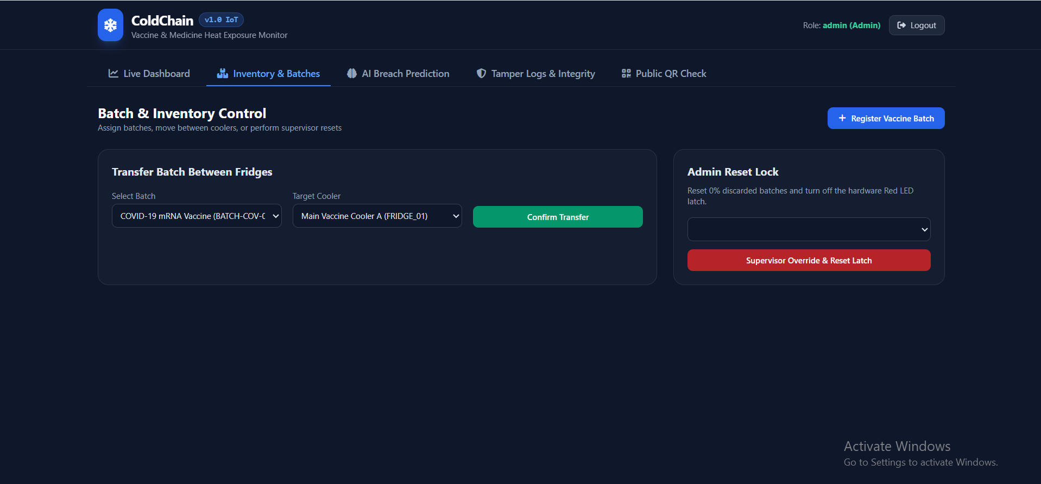
Proactive relocation
1
Forecast
A fridge is predicted above 8 °C in 30 minutes, or its health score is below 50.
2
Match
Target forecast at 6 °C or below, health 70 or above, with free capacity.
3
Prioritise
Batches with the least remaining budget move first.
Inventory: move batches between fridges, with an admin-only reset lock
4
Confirm
The pharmacist approves in one click and the move is written to the ledger.
Notes:
The engine suggests which batches to move and where. The pharmacist stays in control with a single confirmation.

Slide 11
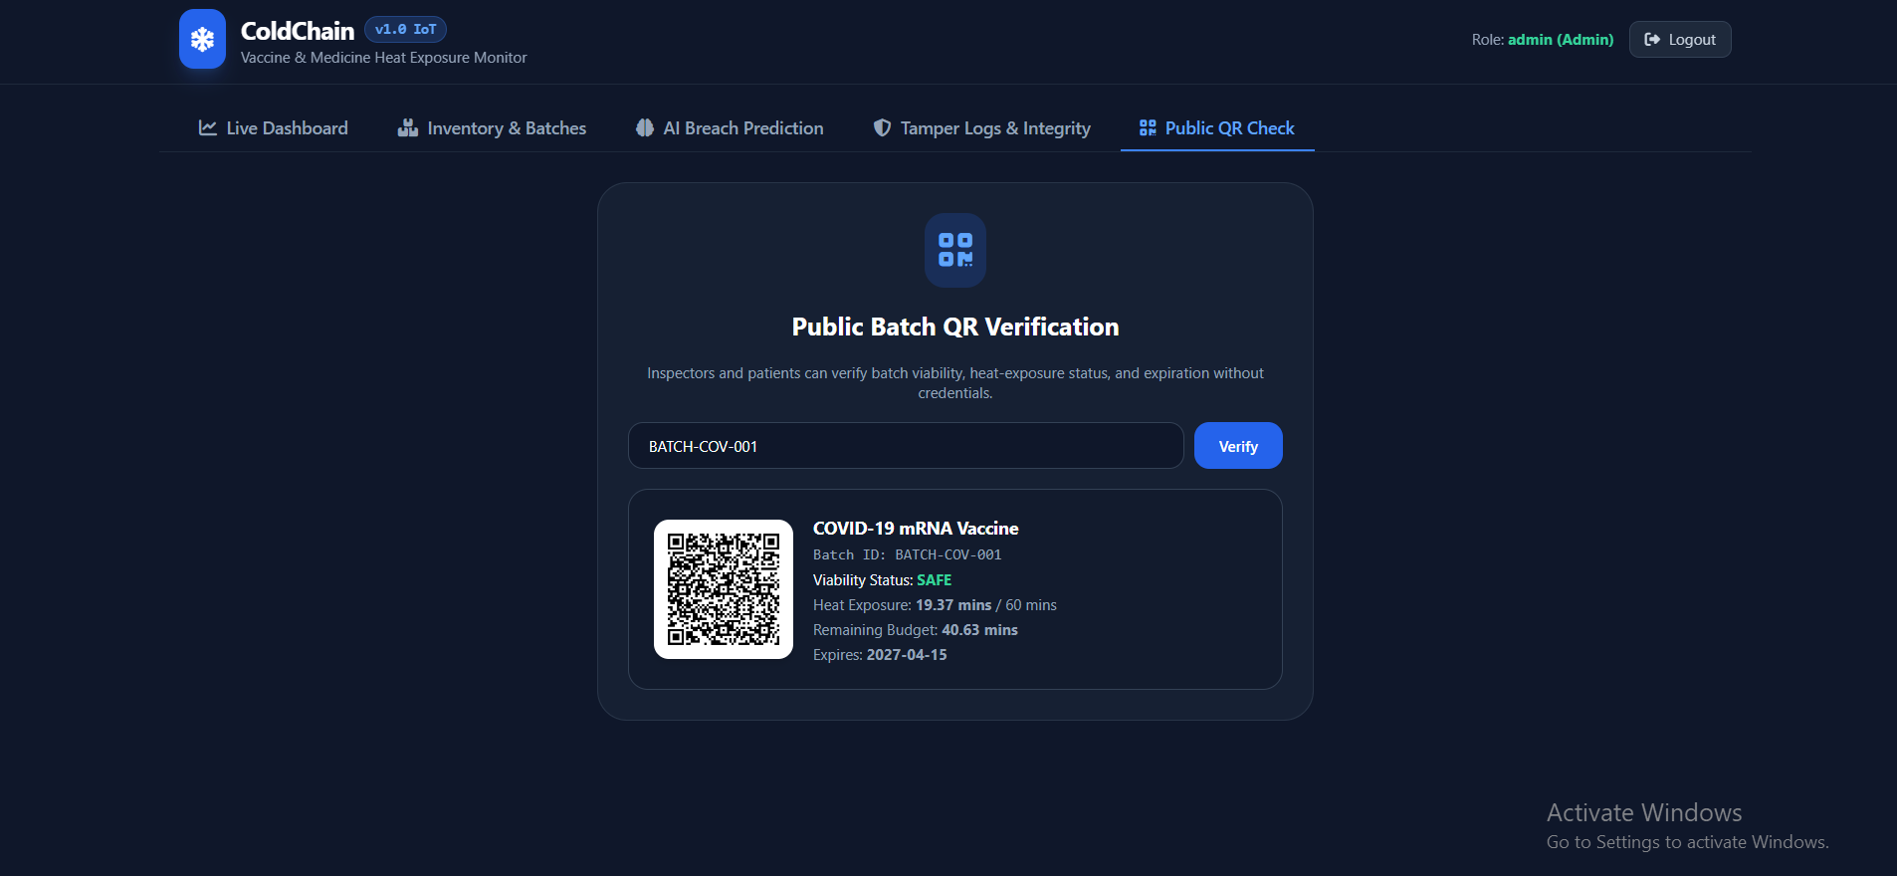
Transparency and auditability
Tamper-evident hash chain
Public QR verification
Each event links the previous hash and its own record with SHA-256
Verify Integrity recomputes the chain and reports the first altered block
No login: patients, clinics and inspectors can check any batch
Shows Safe, At Risk or Discard, heat exposure, remaining budget and expiry
Notes:
Two kinds of trust: auditors can prove the log was not edited, and patients can verify a batch without an account.

Slide 12

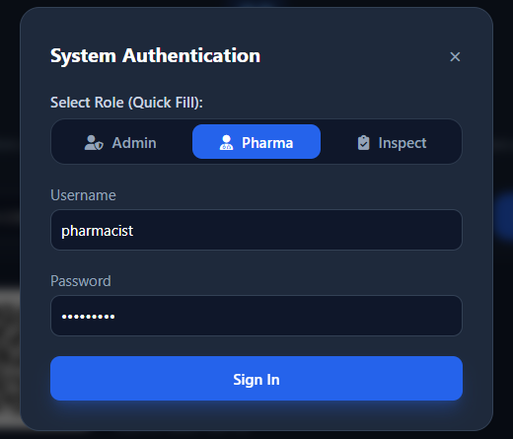
Role-based access
Admin
Full access, plus supervisor override to reset a discard latch
Pharmacist
Registers batches, moves them between fridges, confirms relocation
Inspector
Reviews the dashboard, AI results and audit logs
JWT sessions and bcrypt password hashes. Permissions are enforced on the server.
Notes:
Three roles with server-side enforcement. Anyone can use the public QR page without signing in.

Slide 13




What sets ColdChain apart
Two fridges, one controller
Predict, do not just react
A single ESP32 runs both coolers, cutting hardware cost.
Forecasts breaches 30 minutes ahead and proposes the move.
Tamper-evident by design
Open to every patient
A SHA-256 hash chain makes edited records detectable.
Public QR check needs no account.
Notes:
Four points to leave the judges with: cost, prediction, trust and transparency.

Slide 14
Thank you
Questions from the judges
Live demo: web app at localhost:5000 and the Wokwi ESP32 node
Nova_Odyssey | Md. Shahriar Kabir, Noor-E-Khadiza Nuha
Notes:
Summarise: sense, secure, budget, forecast, audit. Open the floor for questions.

