Slide 1
PL/0 - compiler
第八组: 朱河勤, 张世聪, 徐瑞, 詹慧悠

Slide 2
Content
Overview
Grammar
Key Points
Design
Usage

Slide 3
Overview
implementation: python
c-like grammar
dynamic, strong typing
compile, repl

Slide 4
Content
Overview
Grammar
Key Points
Design
Usage

Slide 5
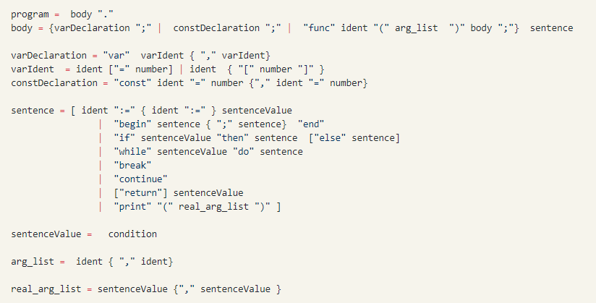
Grammar

Slide 6
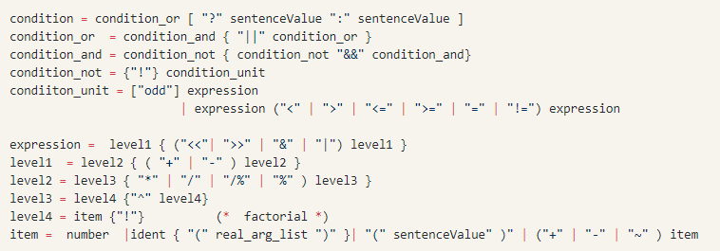
Grammar

Slide 7
Content
Overview
Grammar
Key Points
Design
Usage

Slide 8
Key Points
relation
<, >,
=, !=
&
control
if elif else
for,while
arithmetic
>>,<<
+, -
%, /%
^, !
>=,>=
break
continue
return
|
~
*, /
other
?:
print
random
bit
odd

Slide 9
Content
Overview
Grammar
Key Points
Design
Usage

Slide 10
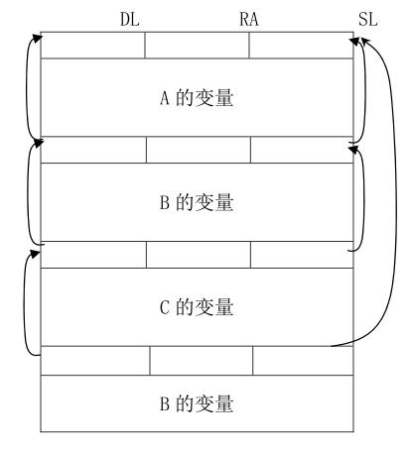
Design--stack
Dynamic Link
Static Link
Return Address
local variable
level

Slide 11
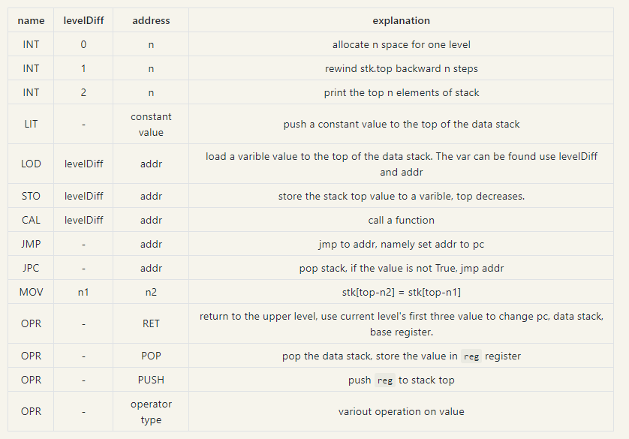
Design--instruction

Slide 12
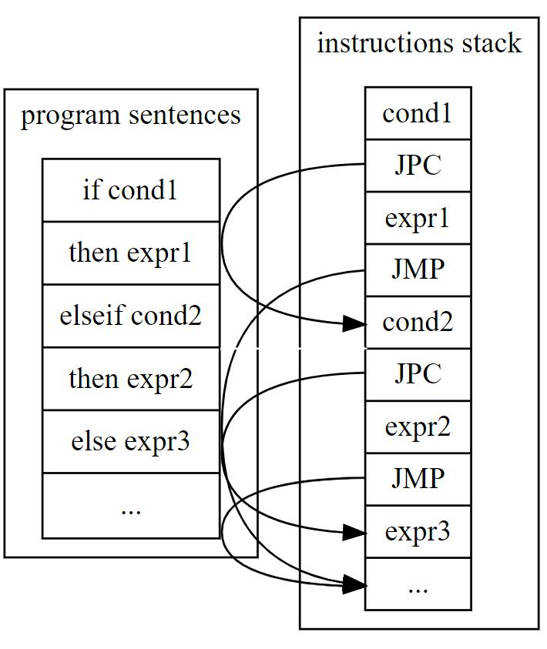
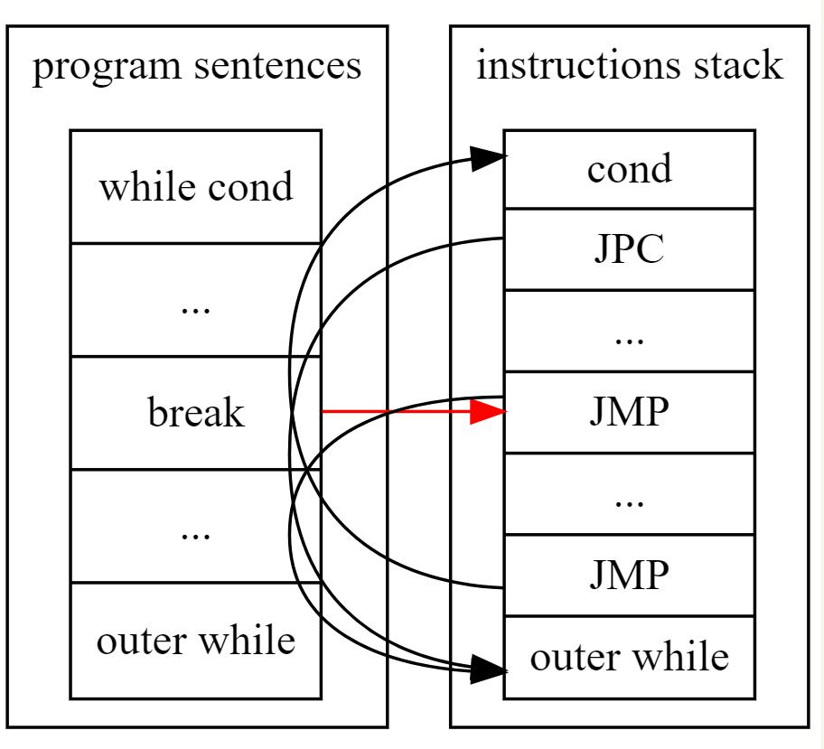



Design--control structure
if elif else
while break

Slide 13
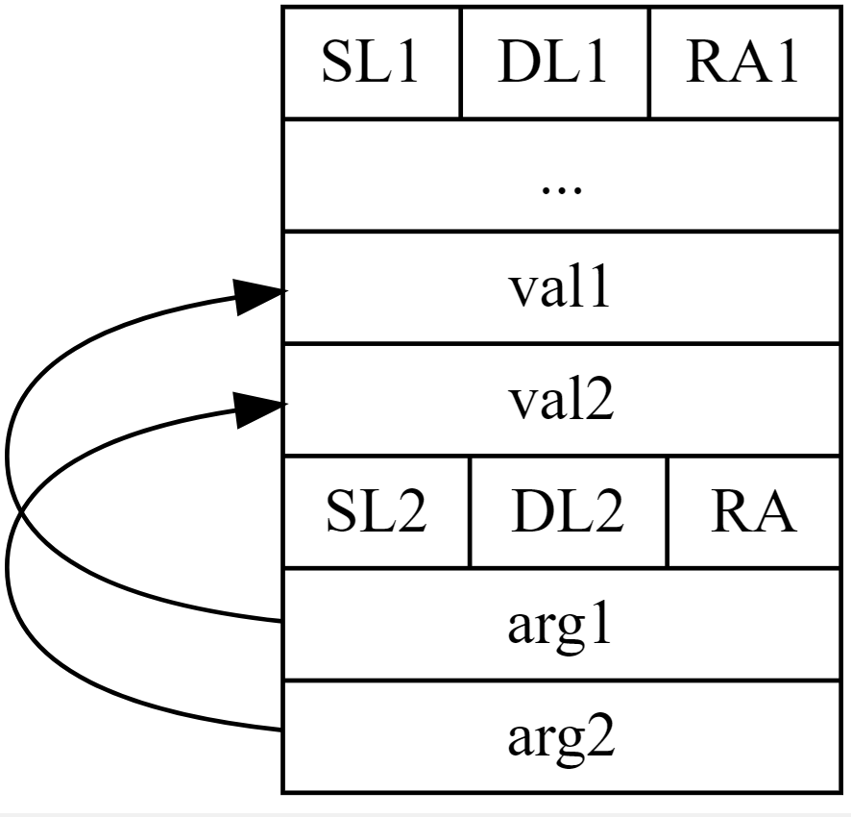
Desig--arg pass
argument calculation
mov n1,n2
opt n back

Slide 14
Design—return value
register
pop
push

Slide 15
Design—symbol table
saved: a,b,d
curClosure: a,b,c
saved = curClosure
curClosure = function.closure
call function
curClosure = saved

Slide 16
Content
Overview
Grammar
Key Points
Design
Usage

Slide 17
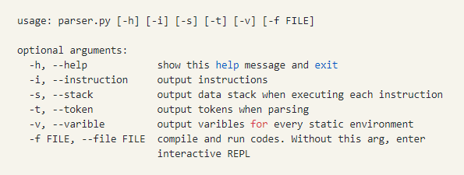
Usage

Slide 18
THANKS
github: https://github.com/mbinary/PL0-compiler

