Slide 1
Introduction into Basic of Data Science Tools
GIT

Slide 2

Version Control System (VCS)
Version control systems are software tools that help software teams manage changes to source code, Documents, websites and designs over time.

Slide 3
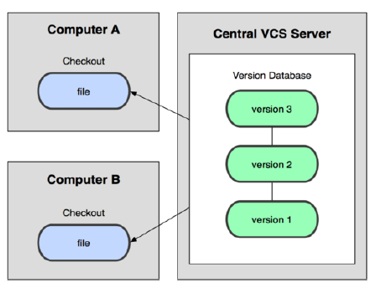
Centralized VCS
A central repository (repo) holds the "official copy" of the files in a server
the server’s copy is the sole version history of the repo
You make copies "checkouts" of it to your computer
you make changes on your copy only
your changes are not considered a version

Slide 4
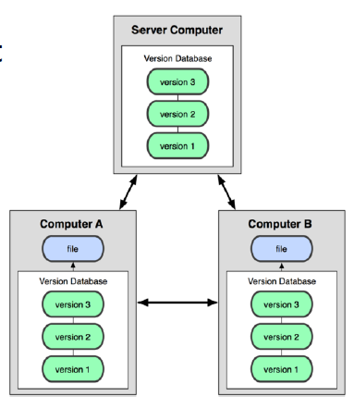
Distributed VCS
Your local repo is a complete copy of everything on the remote server
yours is the same as theirs
• Many operations are done locally:
check in/out from local repo
commit changes to local repo
local repo keeps version history
• When you're ready, you can "push" changes back to remote server

Slide 5
Centralized VS distributed
Centralized keeps track of changes on individual files
Distributed keeps snapshots of the entire project

Slide 6
GIT
Git is a free and open-source distributed VCS designed to handle everything from small to very large projects with speed and efficiency. Git allows group of people to work on the same project at the same time

Slide 7

GIT
Created by Linus Torvalds, in 2005
Goals of Git:
Speed
Support for non-linear development (parallel branches)
Fully distributed
Able to handle large projects efficiently

Slide 8
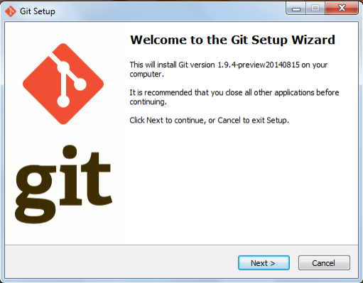
GIT for windows
http://git-scm.com/download/win

Slide 9
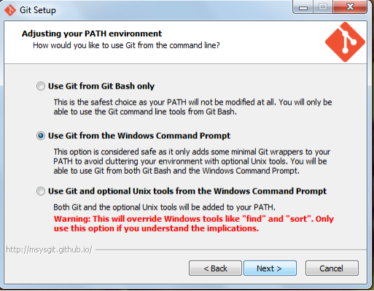
GIT for windows

Slide 10
How GIT works
In your local copy on git, files can be:
In your local repo (committed)
Checked out and modified, but not yet committed (working copy)
Or, in-between, in a "staging" area
Staged files are ready to be committed.
A commit saves a snapshot of all staged state.

Slide 11
How GIT works
Modify files in your working directory.
Stage files, adding snapshots of them to your staging area.
Commit, which takes the files in the staging area and stores that snapshot permanently to your Git directory.

Slide 12
Config
Set the name and email for Git to use when you commit:
git config --global user.name “chai"
git config --global user.email amir@example.com
You can call git config --list to verify these are set.
• Set the editor that is used for writing commit messages:
git config --global core.editor code

Slide 13
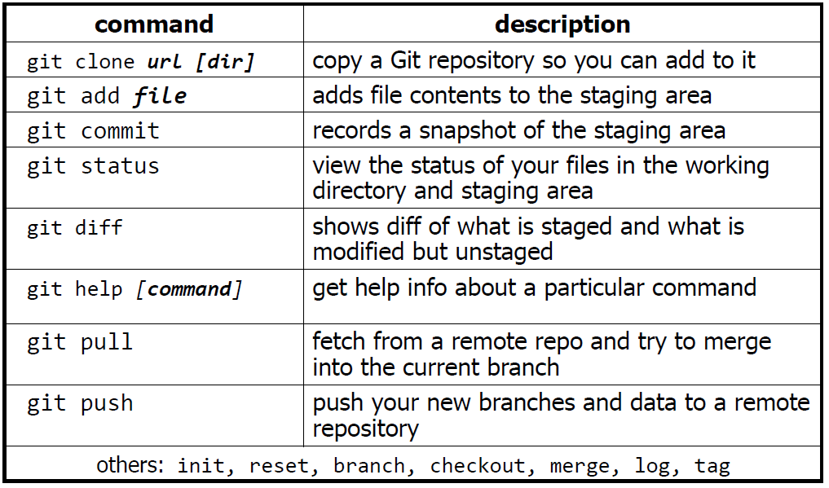
Commands

Slide 14
Commands
The first time we ask a file to be tracked, and every time before we commit a file, we must add it to the staging area:
git add Hello.txt amir.py
Takes a snapshot of these files, adds them to the staging area.
To move staged changes into the repo, we commit:
git commit –m “my first commit"

Slide 15
Commands
To view status of files in working directory and staging area:
git status or git status –s (short version)
To see what is modified but unstaged:
git diff

Slide 16
Commands
Git’s branching helps a lot in multitasking.
To create a new local branch:
git branch name
To list all local branches: (* = current branch)
git branch
To switch to a given local branch:
git checkout branchname
To merge changes from a branch into the local master:
git checkout master
git merge branchname

Slide 17
Remote repo
GitHub https://github.com/
Is probably the most famous public GIT hosting website.

Slide 18
Remote repo
Push your local changes to the remote repo.
Pull from remote repo to get most recent changes.
To fetch the most recent updates from the remote repo into
your local repo, and put them into your working directory:
git pull origin master
To put your changes from your local repo in the remote repo:
git push origin master

Slide 19

Attendance and Evaluation
https://malayanbanking.typeform.com/to/mIHbEP5K

