Slide 1
CSX 450.1 Project report:
Drug Possession charges Los Angeles 2010 – Present by
Nwokolo Daniel Tochukwu
June 14, 2020

Slide 2
Introduction
I used the data provided by the LAPD in the Los Angeles open data repository to calculate features like the age grouo and sex of the offenders charged with drug possession. To do so, I used various EDA techniques to explore and visualize the data and supervised Machine Learning to make predictions.
According to the LAPD
Southern California account for 40 to 45 percent of the methamphetamine produced in the United States.
Nearly one-third of the labs interdicted by the LAPD’s Lab Squad posed such significant environmental hazards that they were considered to be toxic waste dumps.
Approximately 80 percent of the labs seized were in residential areas.
Approximately 5 percent of those clandestine labs had children present.

Slide 3
Dataset
The dataset is provided by the LAPD through https://data.lacity.org.
It is a subset of a much larger dataset containing all the arrest made by the LAPD from 2010 – present.
The dataset contains 84,577 drug possession arrests but is updated frequently.
The data is transcribed from arrests notes so some degree of error is assumed.
The dataset is in a CSV format and there was no conversions.

Slide 4
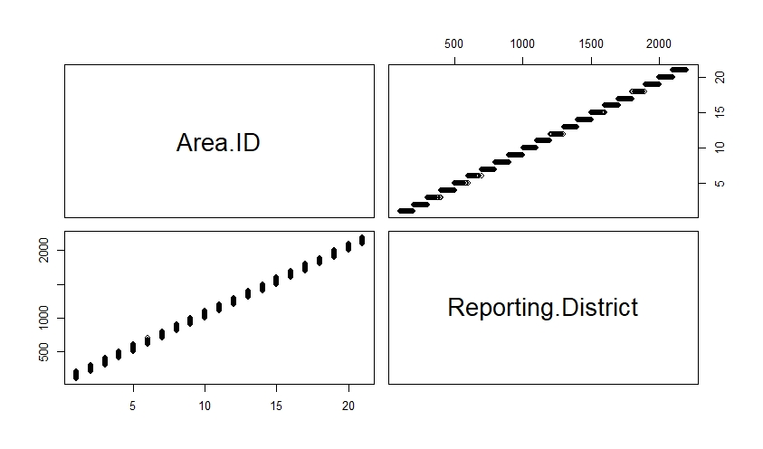
Features and Preprocessing
Focus was mainly on the age and sex of the offenders.
The idea was to get a better picture of the distributions between the two.
There features like the areas where the arrests were made and descent were also studied.
Nonetheless, a correlations test showed that area id and reporting districts had a 0.99921518 positive score.
That is positive because say district 1 cannot have more arrests in district 5 than they have in district 1 and vice versa.

Slide 5
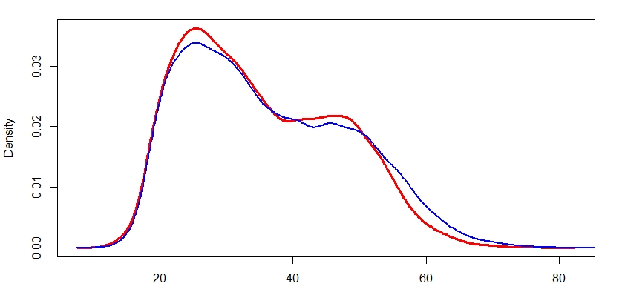
Features and Preprocessing
Since my key motivations are the age groups and sex of the offenders, this is an age density plot filtered by sex. And as predicted men have a much spread out density over the age ranges.

Slide 6
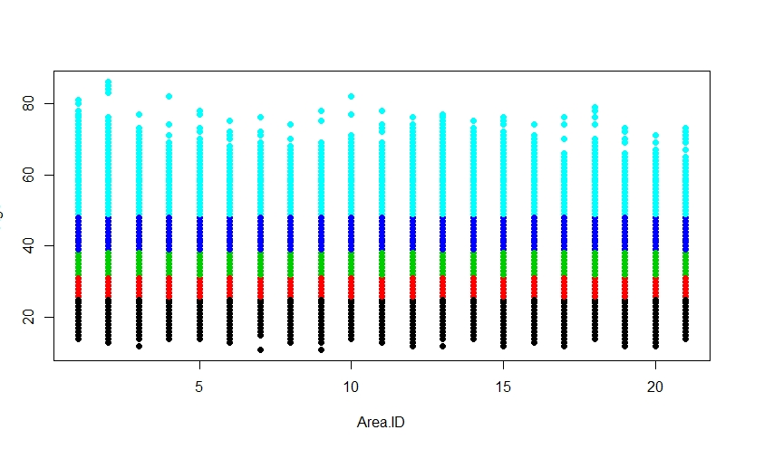
Features and Preprocessing
While taking a look at age to get a better picture of the age groups I found that tables to be a lot more straight forward that the charts, a levels chart in this case.
 | 10-20 | 20-30 | 30-40 | 40-50 | 50-60 | 60-70 | 70-80 | 80-90
F | 1333 | 6061 | 4408 | 3813 | 1875 | 231 | 12 | 0
M | 4752 | 21655 | 16477 | 13458 | 8522 | 1804 | 169 | 7

Slide 7
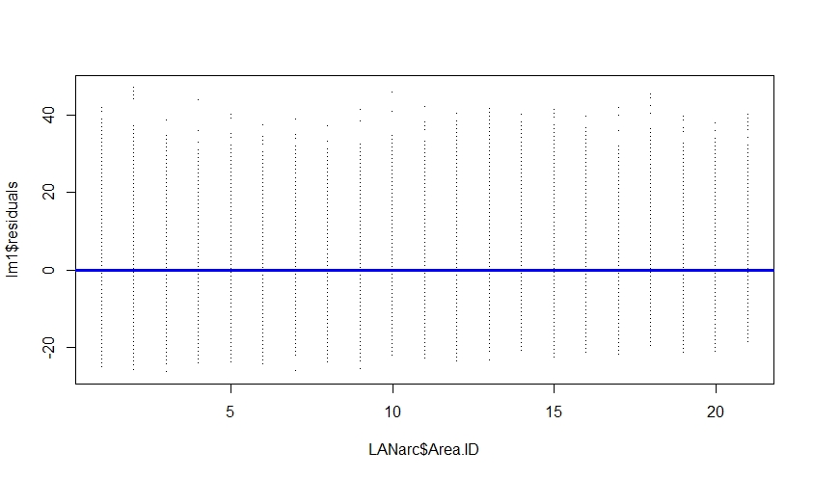
Models
I made linear model using basic least squares where age is the response variable and area id the predictor. There was a weak but positive relationship between the age and area id because while the coef was strong the p-value was too low. And that is the regression plot.

Slide 8
Models
Machine learning:
I reduced the dataset to 60 percent for created an index and split the data into train and test sets. Created a new binary categorical variable to predict a crime is by a male "M". Used logistic regression to predict that an arrested person is a 30 year old male. I got a 78 percent chance result which is within expected range

Slide 9
A lot of the results from my experiments were as expected. Perhaps the only thing I found slightly higher than expected was the ratio of men to women arrested (70+ - 20) that is more than triple.
Furthermore, unfortunate I also found that about 600 kids and young adults between the ages of 10 and 20 are arrest for possession each year.
Nonetheless, Hispanics have the highest possession arrest averages per year at 3544 per year, blacks 2270 and whites at 22402.
Central has the highest number of arrest in ten years at nearly twice that of Hollywood in second with 100700 and 6158 respectively. Foothill is third at 5042
Results and Discussion

