Slide 1

DATA WAREHOUSING ASSIGNMENT
Prepared by – Rehaan
Submitted to – Maryam Erfanian

Slide 2
OVERVIEW
Project Objectives
Design a Hospital OLTP database
Create an OLAP Star Schema
Implement ETL processes
Apply Data Quality rules
Validate warehouse data
Outcomes
OLTP Database
OLAP Star Schema
ETL Implementation
Data Quality Management
Validation Results

Slide 3
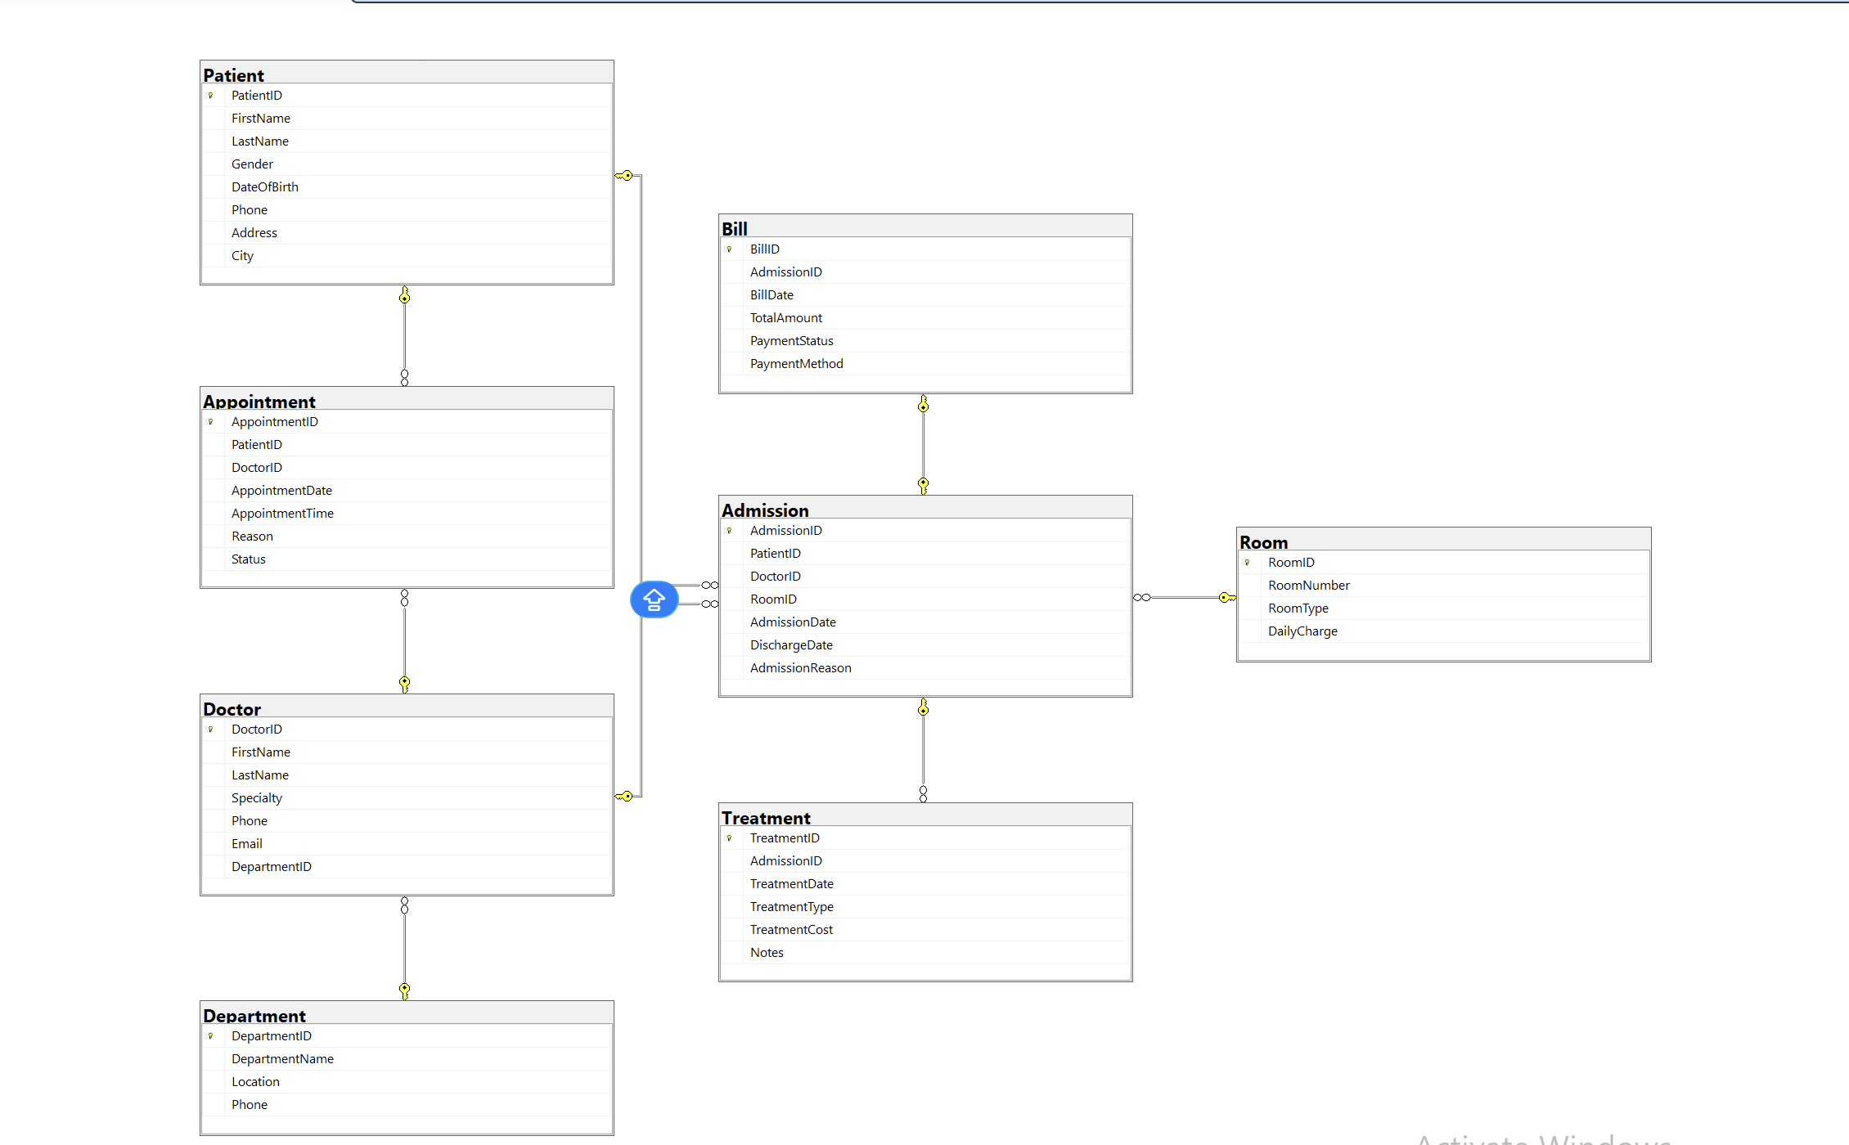
OLTP DATABASE DESIGN
OLTP stands for Online Transaction Processing.
Purpose: Store daily hospital transactions.
It stores operational hospital data used in day-to-day activities. We designed eight related tables with primary and foreign key relationships
Tables: • Department • Doctor • Patient • Room • Appointment • Admission • Treatment • Bill

Slide 4
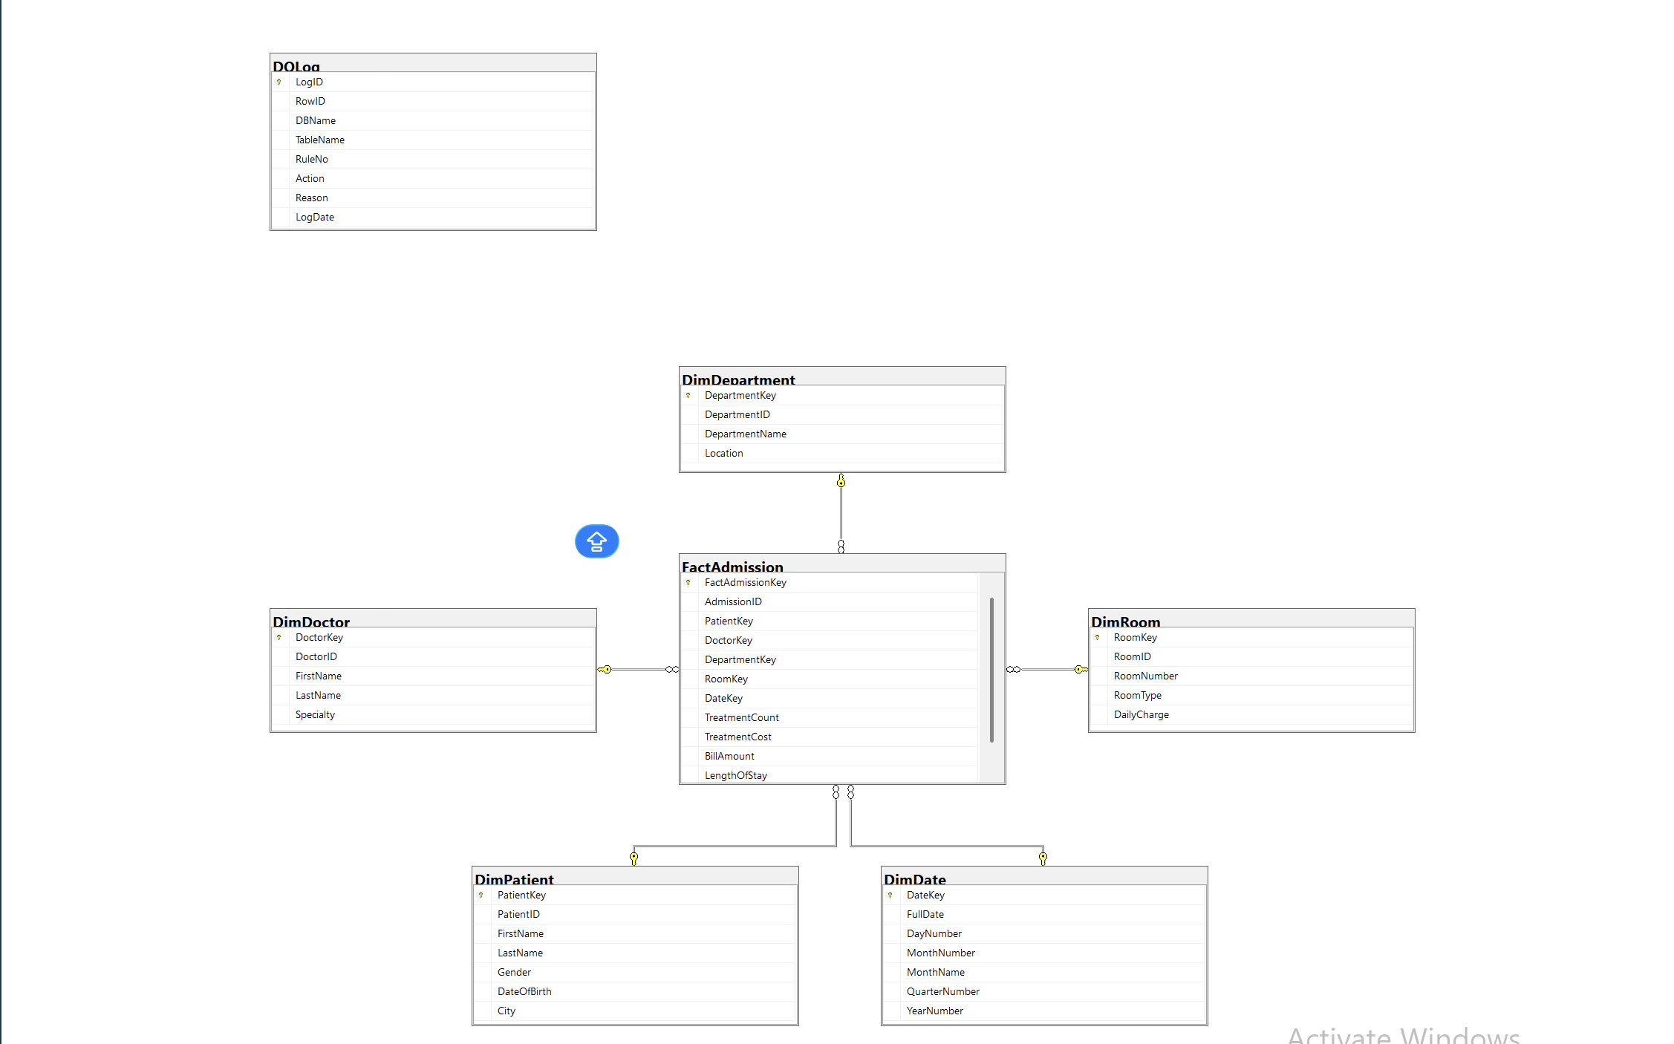
OLAP STAR SCHEMA
OLAP stands for Online Analytical Processing.
Purpose: Support reporting and analytics.
We created a star schema where FactAdmission is the central fact table and the dimension tables provide descriptive information.
Fact Table: • FactAdmission
Measures – TreatmentCount, TreatmentCost, BillAmount, LengthOfStay
Dimension Tables: • DimPatient • DimDoctor • DimDepartment • DimRoom • DimDate

Slide 5
ETL PROCESS
OLTP Database ↓ Data Quality Rules ↓ Dimension Tables ↓ Fact Table ↓ Reporting & Analysis
Techniques Used: • MERGE • Data Transformation • Data Cleaning
ETL stands for Extract, Transform, and Load. Data was extracted from the OLTP database, transformed using data quality rules, and loaded into dimension tables and Fact tables

Slide 6
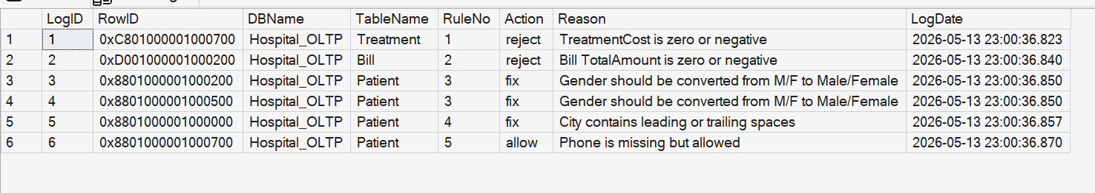
DATA QUALITY RULES
We implemented five data quality rules. Two rules reject invalid data, two rules automatically fix inconsistent data, and one rule allows missing but acceptable data.
Rule 1
Rule 2
Rule 3
Rule 4
Rule 5
TreatmentCost <= 0 | Reject
TotalAmount <= 0 | Reject
Gender M/F | Fix
Extra Spaces in City | Fix
Missing Phone | Allow

Slide 7
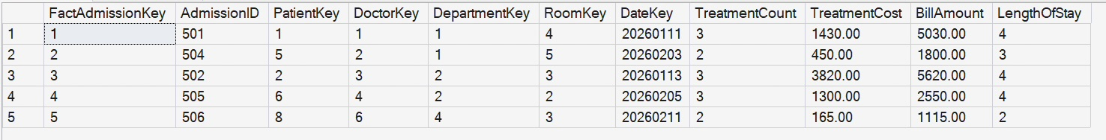
VALIDATION RESULTS
Data loaded successfully
AdmissionID 503 excluded due to rejected billing record
Gender values corrected
City values cleaned
FactAdmission populated correctly

Slide 8
THANK YOU

