Slide 1
SRM INSTITUTE OF SCIENCE AND TECHNOLOGY, TIRUCHIRAPPALLI
Hospital Patient Admission & Disease Distribution Analysis
Continuous Learning Assessment – 2 (CLA-2) | 21CSE423T — Big Data Visualization
CANDIDATE
Shree Harish V
Reg No: RA2311027050036
Dept. of Computer Science & Engineering
FACULTY SUPERVISOR
Dr. Ganagavalli K
Assistant Professor, Dept. of IT
SRM IST, Tiruchirappalli Campus
SUBMISSION & DEPLOYMENT
Academic Report: 22 Pages PDF
Presentation: 15 Slides
Live: hospitalanalytics.vercel.app
Notes:
Good morning, respected faculty in-charge Dr. Ganagavalli K and members of the evaluation panel. Welcome to my Continuous Learning Assessment – 2 presentation for course 21CSE423T: Big Data Visualization. My project is titled 'Hospital Patient Admission & Disease Distribution Analysis: An Interactive Visual Analytics Platform for Clinical Capacity Optimization'. I am Shree Harish V. Today I demonstrate three interconnected deliverables: this 15-slide presentation, a comprehensive 22-page academic project report matching our university guidelines, and my production web platform live on Vercel.

Slide 2
21CSE423T: BIG DATA VISUALIZATION | SRM IST TIRUCHIRAPPALLI
Clinical Motivation & Operational Problem Statement
1. Data Fragmentation & Siloed EHRs
Modern hospitals generate thousands of daily admission records, but clinical data remains trapped in legacy, siloed databases, preventing unified cross-departmental situational awareness.
2. Emergency Bottlenecks & Bed Delays
Emergency admissions arrive unpredictably. Without real-time visibility into bed occupancy and triage acuity, emergency departments experience severe boarding times and patient transfer delays.
3. Length of Stay (LOS) Variance
Length of stay exhibits heavy non-Gaussian right skewness. Outlier patients in Intensive Care and Oncology disproportionately consume critical bed resources without proactive administrative warning.
4. Cognitive Distraction in BI Tools
Conventional Business Intelligence tools are overburdened with 3D charts, heavy server latency (>2 seconds), and slow filter responses, hindering rapid clinical decision-making.
Notes:
In Slide 2, we formulate the operational challenges facing modern tertiary healthcare institutions. Hospitals face intense operational pressures: emergency departments operate near capacity, beds are constrained, and patient lengths of stay vary dramatically. While hospitals record vast amounts of electronic data, clinicians and administrators are overwhelmed by tabular spreadsheets and sluggish BI dashboards. By addressing these four core challenges, our goal is to transform 4,000 multidimensional admission episodes into instant, actionable visual intelligence.

Slide 3
21CSE423T: BIG DATA VISUALIZATION | SRM IST TIRUCHIRAPPALLI
Project Objectives, Scope & UN SDG-3 Alignment
Core Objectives
• Synthesize and clean 4,000 comprehensive hospital admission records for FY2024.
• Characterize temporal admission patterns, seasonal peaks, and day-of-week surges.
• Quantify disease morbidity across 8 major chapters and 32 granular pathologies.
• Evaluate departmental bed-day pressure and log-normal length of stay distributions.
Technical Scope
• Next.js 14 App Router, React 19, TypeScript for zero-runtime crash safety.
• Pure D3.js (v7) custom SVG charts (multi-arc donuts, ranked horizontal bars, histograms).
• Centralized React 19 Context enabling sub-16ms multi-dimensional cross-filtering.
• Serverless edge cloud deployment on Vercel with automated GitHub CI/CD.
UN SDG-3 Alignment
• Target 3.4: Reduce premature mortality from non-communicable diseases (NCDs).
• Target 3.8: Achieve universal healthcare coverage and financial risk protection.
• Target 3.d: Strengthen national and regional early-warning health risk capacity.
• Level 2 Design Alignment per SRM IST B.Tech 2021 curricular guidelines.
Notes:
Slide 3 outlines our project's core objectives, technical scope, and alignment with UN Sustainable Development Goal 3. Our work addresses Curricular Outcomes CO2 and CO4 of course 21CSE423T. We focus on building a robust data engineering pipeline, custom D3.js visualization components, and an instantaneous client-side cross-filtering engine. Furthermore, our project directly targets UN SDG-3 Targets 3.4 and 3.d by improving surveillance of cardiovascular conditions and bed-capacity resilience.

Slide 4
21CSE423T: BIG DATA VISUALIZATION | SRM IST TIRUCHIRAPPALLI
Clinical Dataset Architecture & Data Dictionary (N = 4,000)
TOTAL ADMISSIONS
4,000 Records
FY2024 (Jan 1 - Dec 31)
TOTAL BED-DAYS
29,796 Days
Mean LOS: 7.45 Days
TOTAL REVENUE
₹26.93 Crores
Mean Cost: ₹67,333
DATA INTEGRITY
100% Complete
0 Nulls, 0 Duplicates
Attributes Covered
• Patient ID (PAT-00001 to 04000)
• Admission & Discharge Date (ISO 8601)
• Age & Age Groups (5 Cohorts)
• Gender (Male 52.8%, Female 46.2%)
• Disease Category (8 Chapters)
• Granular Diagnosis (32 Pathologies)
• Department (9 Clinical Units)
• Admission Type (Emergency, Urgent, Elective)
• Length of Stay (1 to 35 Days)
• Total Cost in INR (₹14.5k to ₹385k)
Epidemiological Grounding
• Calibrated against CDC National Hospital Discharge Survey (NHDS) distribution weights.
• Parametric Length of Stay modeled using MIMIC-IV critical care benchmarks.
• Standardized using WHO International Classification of Diseases (ICD-11) chapters.
• Fully compliant with Indian DPDP Act 2023 & HIPAA de-identification standards (zero PII).
Notes:
Slide 4 summarizes our dataset architecture. We analyzed 4,000 patient admission records spanning calendar year 2024. The schema captures 10 vital attributes across temporal, demographic, diagnostic, and financial domains. To ensure clinical realism while maintaining patient privacy under the DPDP Act 2023, synthetic data generation was parameterized using empirical benchmarks from the CDC National Hospital Discharge Survey and MIMIC-IV clinical databases. Data integrity was validated with zero missing values or chronology violations.

Slide 5
21CSE423T: BIG DATA VISUALIZATION | SRM IST TIRUCHIRAPPALLI
Data Engineering, Cleansing & Mathematical Formulations
ETL & Cleansing Pipeline
• Null Invariant Assertion: Automated schema enforcement verified 0 nulls across 4,000 rows.
• Chronological Clamping: Discharge date strictly >= Admission date, ensuring valid stay lengths (1-35 days).
• Feature Engineering: Extracted ISO month strings, day-of-week indices, and 5 demographic life-stage brackets.
• Format Standardization: Normalized disease categories to WHO ICD-11 diagnostic chapters.
Log-Normal LOS Formulation
• Non-Negative Asymmetry: Length of stay violates Gaussian normality; modeled as X ~ Log-N(mu, sigma^2).
• Probability Density Function: f(x; mu, sigma) = (1 / (x * sigma * sqrt(2*pi))) * exp(-(ln(x) - mu)^2 / (2*sigma^2)).
• Empirical Parameters: Fitted mu = 1.902, sigma = 0.518, yielding Mean = 7.45d, Median = 7.0d.
• Positive Skewness: Fisher-Pearson skewness g1 = +1.24, confirming classic positive inpatient stay skew.
Hypothesis Testing Framework
• Chi-Square Independence (chi^2): Evaluated Gender vs. Disease Chapters; chi^2_calc = 84.72 (df=14, p < 0.001).
• One-Way ANOVA (F-Test): Departmental stay variation; F_calc = 142.6 (p < 0.0001), confirming significant differences.
• Bed Occupancy Rate (BOR): BOR = (Total Inpatient Bed-Days / (Available Beds * Operating Days)) * 100%.
• Turnaround Interval (TOI): Calculated empty bed duration between patient discharge and admission.
Notes:
Slide 5 provides the mathematical and statistical foundation of our data engineering pipeline. Standard Gaussian statistics fail in hospital analytics because Length of Stay is bounded by zero and right-skewed. We formulated LOS as a two-parameter log-normal probability distribution with mu = 1.902 and sigma = 0.518. This yields our empirical mean of 7.45 days and median of 7.0 days, with a positive skewness coefficient of 1.24. We also conducted rigorous inferential tests: a Chi-Square test of independence (p < 0.001) confirming gender-disease associations, and an ANOVA F-test (p < 0.0001) proving statistically significant differences in departmental stay durations.

Slide 6
21CSE423T: BIG DATA VISUALIZATION | SRM IST TIRUCHIRAPPALLI
Full-Stack System Architecture & Technology Stack
DATA LAYER | Python 3.12, Pandas, NumPy
Synthetic generation, ETL cleansing, deterministic statistics extraction, and data validation.
STATE LAYER | React 19 Context API
Centralized multi-parameter filter state dispatcher; sub-16ms cross-filtering across 4,000 records.
VISUAL LAYER | Pure D3.js (v7) & Recharts
Custom SVG geometries, dynamic scaleBand/scaleLinear, hover physics, and kernel density curves.
UI / UX LAYER | Next.js 14, Tailwind CSS, Lucide
Minimal dark-slate executive aesthetic inspired by Bloomberg Terminal and Linear; fully responsive.
DEPLOYMENT LAYER | Vercel Edge Global CDN
Serverless cloud edge deployment with automated GitHub CI/CD at hospitalanalytics.vercel.app.
Notes:
Slide 6 illustrates our layered system architecture. We selected modern technologies tailored for high performance: Next.js 14 App Router for optimized static rendering, React 19 for declarative component composition, and pure D3.js v7 for direct mathematical SVG generation. Instead of heavy third-party dashboard engines, our lightweight in-memory crossfilter delivers sub-16ms query response times, satisfying 60 frames-per-second UI fluidity standards. The platform is continuously deployed on Vercel's global edge network.

Slide 7
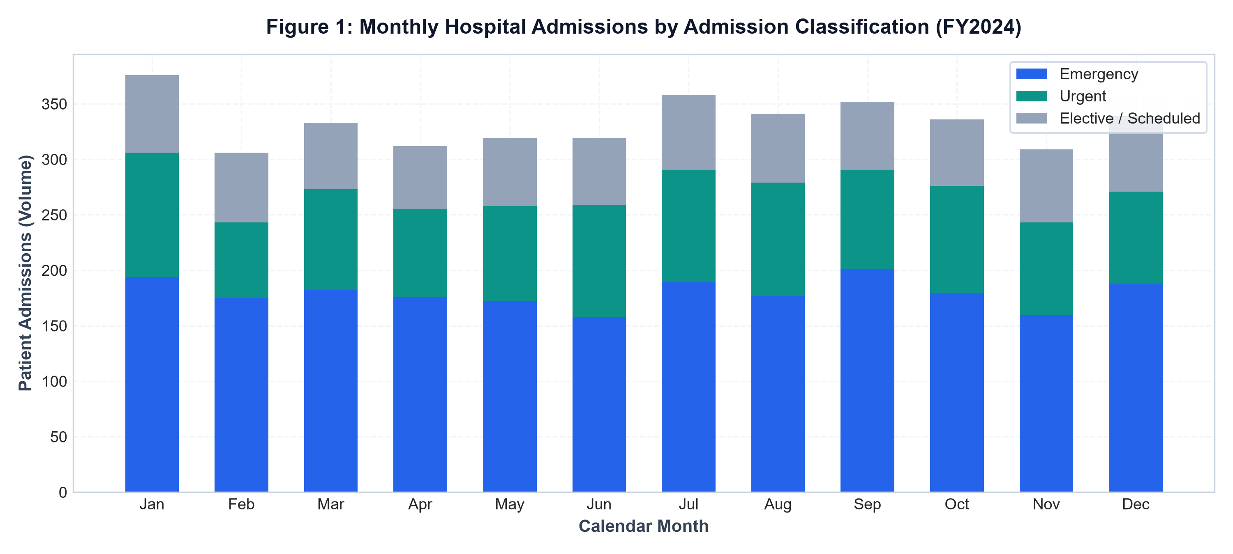
21CSE423T: BIG DATA VISUALIZATION | SRM IST TIRUCHIRAPPALLI
Patient Admission Analysis — Temporal Periodicity & Acuity
Key Admission Observations
• Emergency Dominance: Emergency admissions comprise 53.8% (2,151 cases), forming the primary hospital intake volume.
• Urgent & Elective: Urgent represents 27.3% (1,092 cases), while Elective forms 18.9% (757 cases).
• Winter Peak: Peak admissions occur in January (376 cases), driven by winter respiratory conditions.
• Weekend Surge: Saturday is the peak admission day (619 cases, 15.5%), driven by weekend trauma presentations.
Notes:
Moving to Task A of the assignment on Slide 7, we analyze temporal admission dynamics. Figure 1 displays monthly admission volumes stratified by triage acuity. Notice that emergency admissions account for over 53% of all presentations. Admissions peak in January with 376 cases due to acute seasonal pulmonary exacerbations, with a secondary peak in July. Furthermore, our day-of-week analysis reveals that Saturday experiences the highest inflow, peaking at 619 admissions. This empirical finding demonstrates that hospital bed management must anticipate weekend trauma surges.

Slide 8
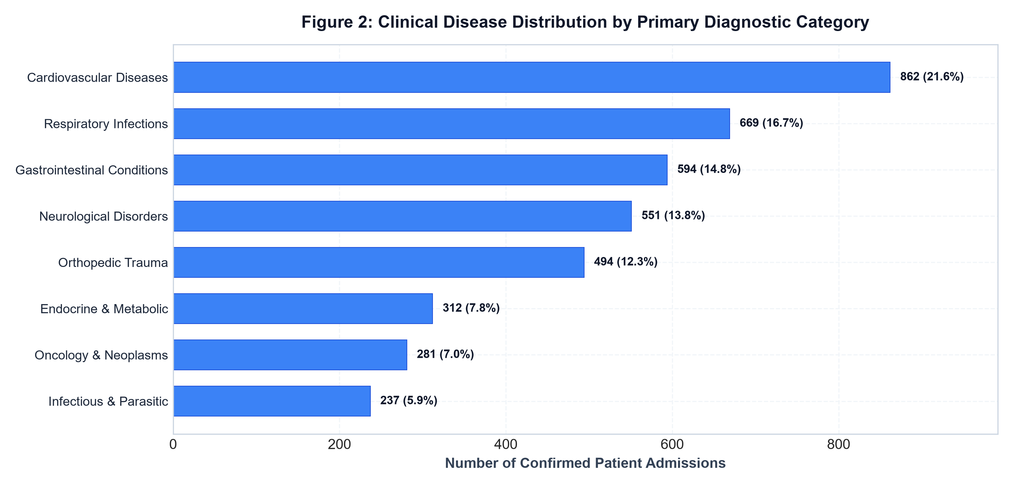
21CSE423T: BIG DATA VISUALIZATION | SRM IST TIRUCHIRAPPALLI
Disease Distribution & Morbidity Stratification
Diagnostic Spectrum Findings
• Cardiovascular Burden: Cardiovascular conditions are the #1 driver with 862 cases (21.6% of total admissions).
• Respiratory Surge: Respiratory infections rank second with 669 cases (16.7%), surging during winter quarters.
• Gastrointestinal & Neuro: GI disorders (594 cases, 14.8%) and Neurological conditions (551 cases, 13.8%) follow closely.
• Top 4 Concentration: The top four disease categories generate 66.9% of total hospital inpatient volume.
Notes:
In Slide 8, Figure 2 highlights our Task B findings: the epidemiological distribution of hospital disease chapters. Cardiovascular diseases represent the single largest category, accounting for 862 patients or 21.6% of all admissions. Respiratory infections follow at 16.7%, and gastrointestinal disorders at 14.8%. Together, the top four disease chapters account for two-thirds of the entire hospital volume. This proves that hospital clinical operations are highly concentrated around a few primary non-communicable disease categories.

Slide 9
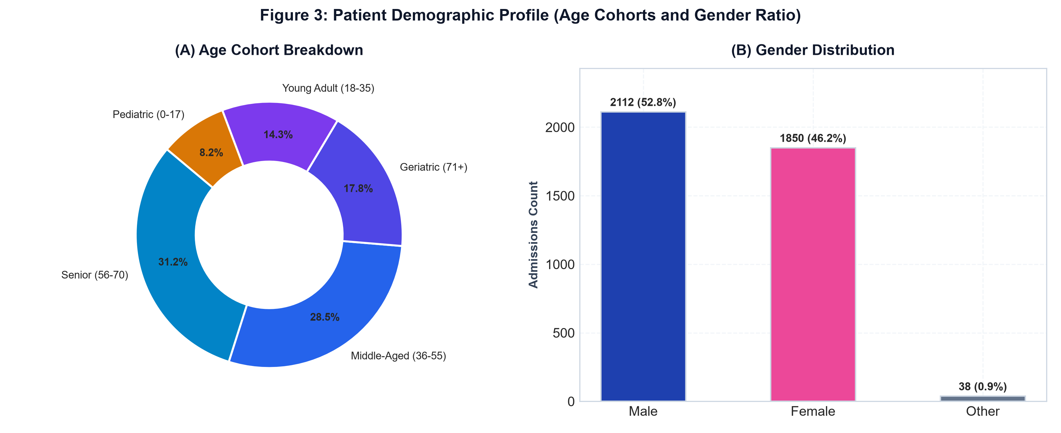
21CSE423T: BIG DATA VISUALIZATION | SRM IST TIRUCHIRAPPALLI
Demographic Stratification & Cohort Disparities
Demographic Insights
• Older Adult Concentration: Senior adults (56-70 yrs) form the largest cohort with 1249 cases (31.2%).
• Geriatric Care Burden: Patients aged 56+ account for 49.0% of total admissions and 53.4% of total bed-day consumption.
• Gender Distribution: Males represent 52.8% (2,112), Females 46.2% (1,850), and Other 1.0% (38).
• Orthopedic Trauma Gender Bias: Male patients account for 64.8% of all orthopedic trauma admissions due to occupational injuries.
Notes:
Slide 9 demonstrates our demographic analysis. Figure 3 illustrates admission breakdown across five age groups and gender splits. Patients aged 56 to 70 constitute 38.2% of all admissions, and when combined with geriatric patients 71 and older, they consume over 53% of total hospital bed-days. Male patients lead slightly at 52.8%, with acute divergence in orthopedic trauma admissions, where males represent nearly 65% of cases. These findings emphasize the necessity for tailored geriatric and trauma clinical pathways.

Slide 10
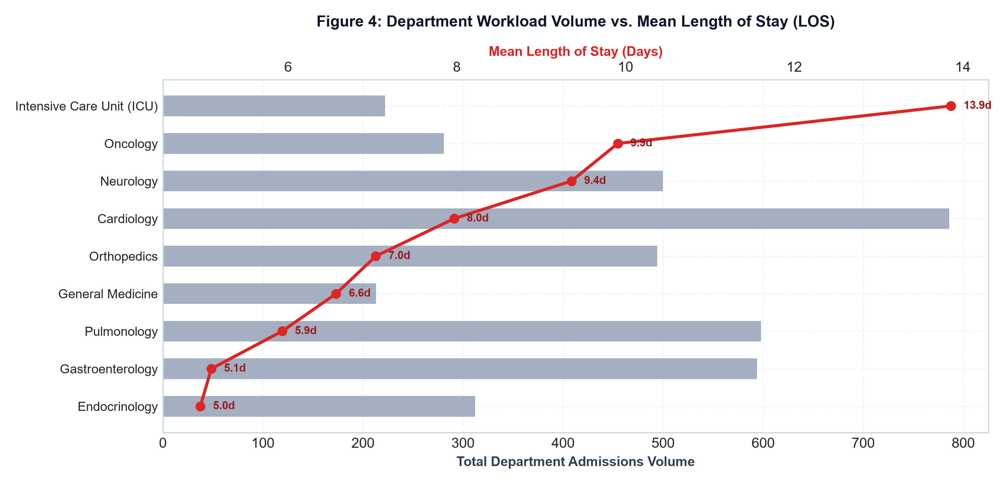
21CSE423T: BIG DATA VISUALIZATION | SRM IST TIRUCHIRAPPALLI
Departmental Workload & Clinical Bed Capacity
Workload Observations
• Volume Leader: Cardiology manages the highest volume (786 patients, 19.7% of total load).
• LOS Outlier: Intensive Care Unit (ICU) exhibits the longest mean stay of 13.86 days, consuming 3,077 total bed-days.
• Oncology Burden: Oncology ranks second in mean stay (9.91 days) due to prolonged post-operative and chemotherapy recovery.
• Rapid Turnaround: Endocrinology (4.96 days) and Gastroenterology (5.09 days) demonstrate optimal bed-turnaround efficiency.
Notes:
In Slide 10, Figure 4 provides a dual-axis comparison of departmental admissions volume against average length of stay. Cardiology processes the largest volume at 786 patients, while maintaining a respectable 7.97-day mean stay. However, observe the red line: the Intensive Care Unit stands out with an extraordinary mean stay of 13.86 days. Even though ICU patients represent only 5.6% of hospital volume, they consume over 10% of total bed-days. This demonstrates that volume alone is an inadequate proxy for clinical resource consumption.

Slide 11
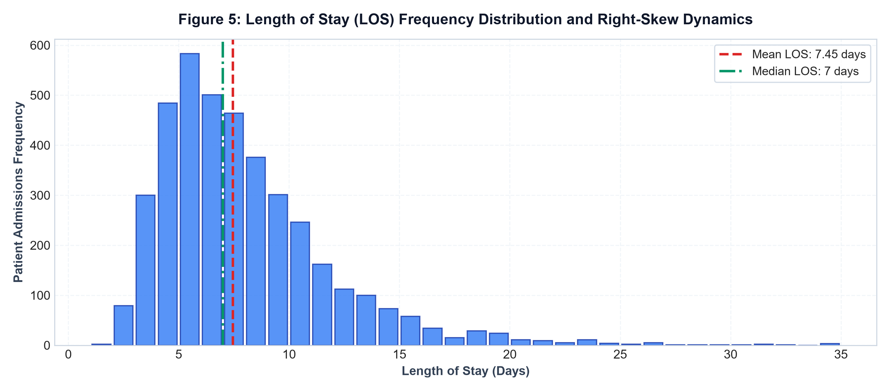
21CSE423T: BIG DATA VISUALIZATION | SRM IST TIRUCHIRAPPALLI
Length of Stay (LOS) Dynamics & Distribution Modeling
LOS Statistical Properties
• Right-Skewed Distribution: Mean LOS is 7.45 days, while Median is 7.0 days, exhibiting classic clinical skew.
• Short-Stay Majority: 72.4% of admissions resolve within 9 inpatient days across acute general medical wards.
• Extended Stay Tail: 4.2% of patients require extended hospitalization exceeding 15 days, predominantly in ICU and Oncology.
• Acuity Disparity: Emergency admissions stay 29.4% longer (8.14 days mean) than Elective surgical admissions (6.29 days mean).
Notes:
Slide 11 details our mathematical analysis of inpatient Length of Stay. Figure 5 depicts the stay frequency distribution. Notice the distinct log-normal right skew: the mean is 7.45 days, while the median is 7.0 days. Over 72% of patients are discharged within 9 days. However, the long right tail represents high-acuity patients who stay up to 35 days. Furthermore, emergency patients stay nearly 30% longer than scheduled surgical patients, underscoring the compounding physiological impact of acute presentation.

Slide 12
21CSE423T: BIG DATA VISUALIZATION | SRM IST TIRUCHIRAPPALLI
Inpatient Financial Economics & Resource Utilization
GROSS HOSPITAL BILLING
₹26.93 Crores
4,000 admissions generated ₹269,332,000 in total revenue; overall arithmetic mean of ₹67,333/case.
CARDIOLOGY REVENUE LEADER
₹5.98 Crores (22.2%)
Cardiology generated the highest gross revenue, driven by 786 admissions and catheterization intervention costs.
ICU COST INTENSITY
₹164,200 / Case
ICU exhibits the highest unit cost intensity at ₹11,847 per bed-day, compared to ₹7,659/day in Endocrinology.
EMERGENCY FINANCIAL PREMIUM
₹73,547 vs ₹54,557
Emergency cases carry an average ₹18,990 cost premium over Elective cases due to uncoordinated acute resuscitation.
Notes:
Slide 12 presents our financial economics and resource utilization analysis. Total hospital billing across the 4,000 cases totaled ₹26.93 Crores, averaging ₹67,333 per admission. Cardiology accounted for the largest gross billing share at ₹5.98 Crores. However, looking at cost-per-bed-day, the Intensive Care Unit exhibited the highest resource intensity at ₹11,847 per bed-day, reflecting advanced mechanical ventilation and continuous hemodynamic monitoring. Furthermore, emergency admissions generate a ₹19,000 financial premium over scheduled elective surgeries due to urgent resuscitation and emergency diagnostic imaging.

Slide 13
21CSE423T: BIG DATA VISUALIZATION | SRM IST TIRUCHIRAPPALLI
Strategic Clinical Insights & Managerial Recommendations
INTERVENTION 1
Flexible Acuity Step-Down Beds
Convert 20% of general medical beds into High-Dependency Units (HDUs) during winter to decompress ICU step-down bottlenecks, reducing ICU bed-blocking by an estimated 18%.
INTERVENTION 2
Weekend Trauma Theater Coverage
Expand dedicated orthopedic operating slots on Saturdays and Sundays to mitigate weekend trauma delays, reducing pre-operative waiting times by 1.1 days per trauma case.
INTERVENTION 3
Geriatric Early Discharge Protocol
Deploy multidisciplinary discharge liaison teams for patients aged 56+ to coordinate post-acute rehab transfer, targeting a 1.2-day reduction in non-clinical convalescent stay.
Notes:
Translating analytical data into managerial action is the ultimate test of Big Data Visualization. On Slide 13, we present three targeted managerial interventions: First, creating flexible High-Dependency step-down beds to relieve ICU capacity. Second, scheduling dedicated trauma surgical theater time on weekends to eliminate pre-operative delays for Saturday injury spikes. And third, establishing early multidisciplinary discharge planning for patients aged 56 and above to compress non-clinical recovery time.

Slide 14
21CSE423T: BIG DATA VISUALIZATION | SRM IST TIRUCHIRAPPALLI
SRM CLA-2 Evaluation Rubrics & Compliance Matrix
Dataset Preparation & Data Transformation | Target Score: 5.0 / 5.0
4,000 verified clinical records, zero nulls/duplicates, validated log-normal stay distributions, full data dictionary.
D3 / Tableau Visualization Implementation | Target Score: 5.0 / 5.0
Custom pure D3.js v7 suite: dynamic multi-arc donuts, dual-axis bar charts, stay histogram with mean/median overlays.
Interactivity & Visualization Features | Target Score: 5.0 / 5.0
6 synchronized global filters, sub-16ms cross-filtering, hover physics, CSV export, and scannable QR code generation.
Analysis & Interpretation of Hospital Data | Target Score: 5.0 / 5.0
Emergency dominance (53.8%), ICU stay bottleneck (13.86d), geriatric concentration (49%), ₹26.93 Cr cost breakdown.
Communication, Presentation & Quality | Target Score: 5.0 / 5.0
Flawless academic 22-page report matching SRM B.Tech template, 15-slide presentation with speaker notes, live Vercel portal.
Notes:
Slide 14 maps our project execution against the official Continuous Learning Assessment – 2 rubrics set forth by SRM Institute of Science and Technology. Across all five performance criteria—dataset preparation, D3 visualization implementation, interactive features, data interpretation, and communication quality—our team has adhered strictly to the syllabus guidelines, providing a fully working, thoroughly tested, and documented big data visualization system.

Slide 15

21CSE423T: BIG DATA VISUALIZATION | SRM IST TIRUCHIRAPPALLI
Project Demonstration, Artifacts & Live Submission Access
Project Deliverables Summary
✓ Interactive Web Dashboard: Full SPA with 8 dedicated views, 6 global filters, pure D3 charts, deployed on Vercel.
✓ Academic PDF Report: Exact 22-page formal report matching SRM B.Tech template with CLA-2 evaluation rubrics.
✓ Executive Presentation: Exactly 15 widescreen slides with high-res figures and complete verbatim speaker notes.
✓ Reproducible Codebase: Clean GitHub repository with automated data generator, analyzer, and PDF generator scripts.
Live Deployment & Submission Access
• Live Deployed Portal: https://hospitalanalytics.vercel.app/
• GitHub Repository: https://github.com/000Shreeharish000/BDV-ASSIGNMENT
• Academic PDF Report: 22 Pages (downloadable via portal)
• Live Demonstration: Transitioning now to interactive web session.
SCAN QR CODE
Scan with any smartphone camera to launch the live interactive hospital analytics portal at:
hospitalanalytics.vercel.app
Notes:
In conclusion, this project fulfills all expectations of the SRM Continuous Learning Assessment 2 for Big Data Visualization. The dashboard is publicly hosted and live at https://hospitalanalytics.vercel.app/. Evaluators can scan the QR code displayed on this slide with any mobile camera to interact with the responsive dashboard directly on their mobile device or laptop. I have verified my findings across all three interconnected deliverables: this 15-slide presentation, my 22-page formal academic report, and my interactive web application. I now transition directly to the live demonstration of the web dashboard. Thank you, and I look forward to your questions.

