Slide 1

CArds
Viva las codecaln

Slide 2
where to begin…
The Original MVP (that’s not the name of a rapper)
2 Players vs Computer
Deal cards to player
Compare hands
Assign/display winner
Update score
Option to play another round or start a new session

Slide 3
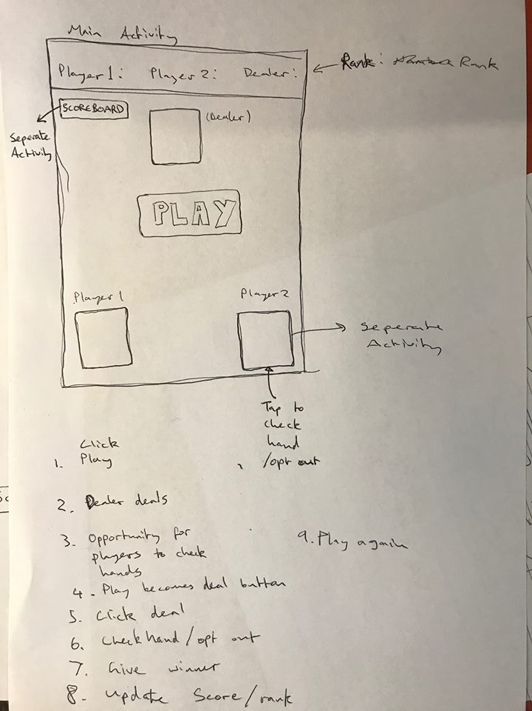
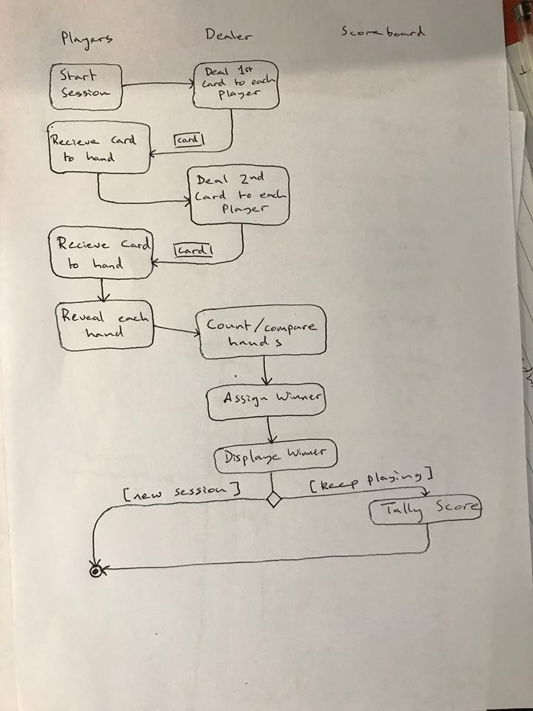
Planning…

Slide 4
where to begin…
Adapting the base code from Lab
Abstract super class for Dealer and Player – Person
Some methods and properties got moved up to Person (hand stuff)
Update logic to accommodate playing with two cards

Slide 5
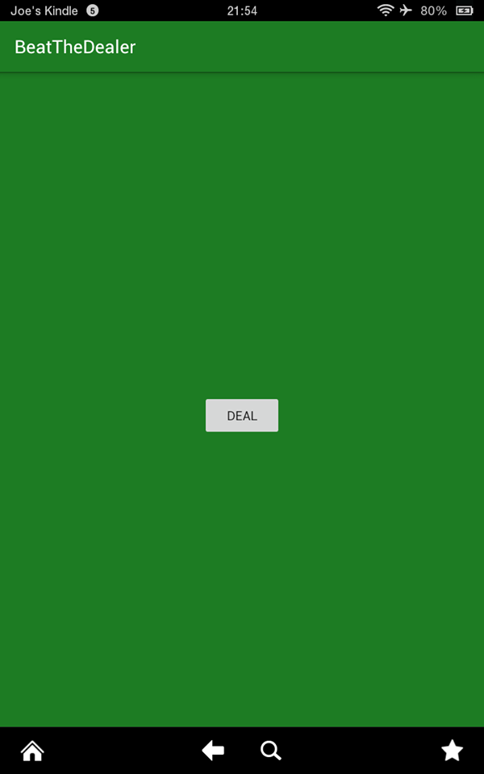
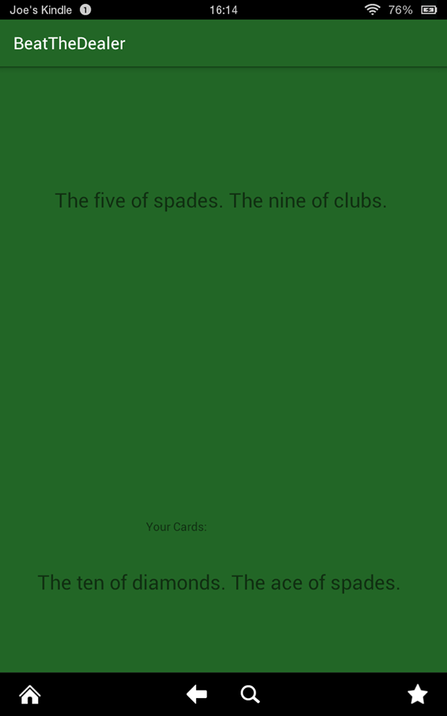
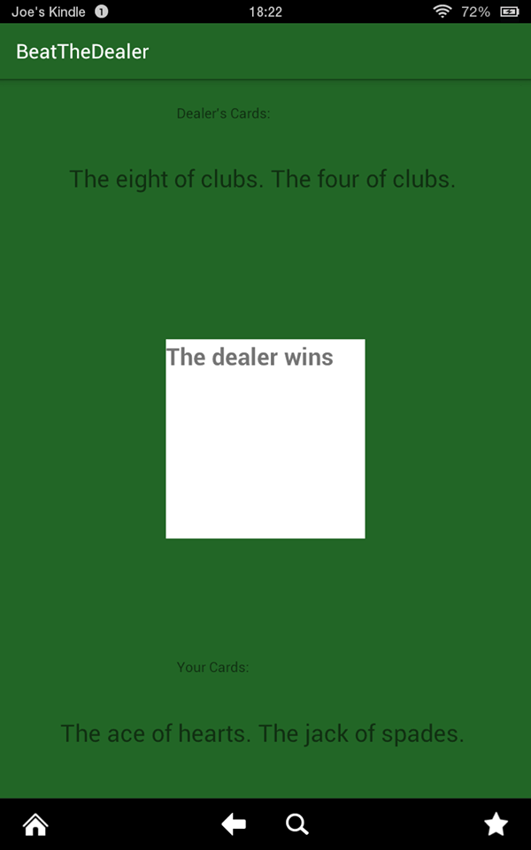
Android

Slide 6
Android
New rules:
Beat the dealer – 1P v C
Scoring system: 2pts Win, 1 pt Draw, -1pt Opt Out, -2pts Lose
One of Dealer’s cards viewable by Player

Slide 7
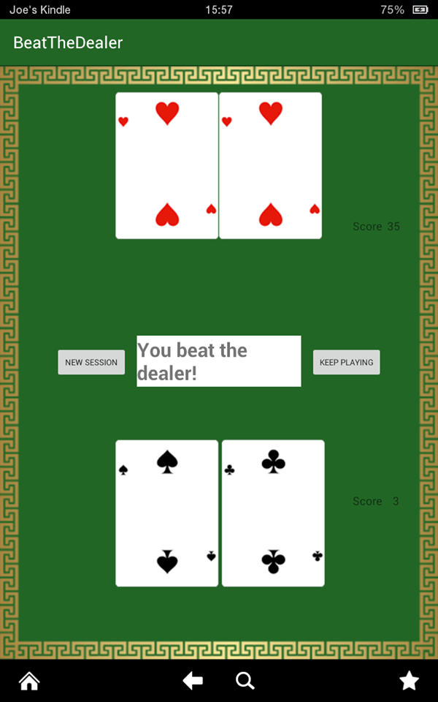
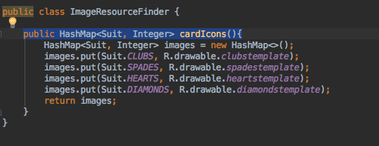

Android

Slide 8
BlackJack
Extending to a different game:
Game abstract super class – property for card limit, methods for adding players to the game and updating the scores.
Scoring system the same as Beat The Dealer (though not enforced by game)
Ace can be high or low

Slide 9
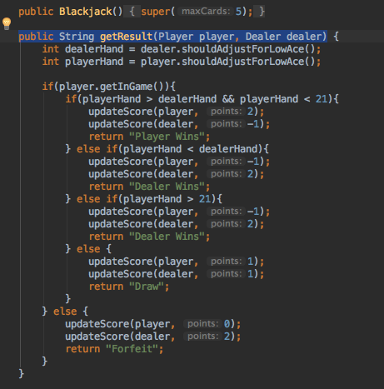
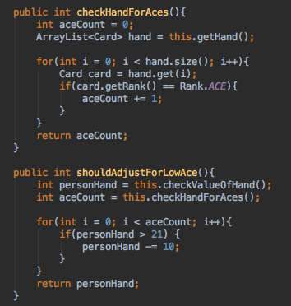
BlackJack

Slide 10
Extensions
Additional Games – code would need some further reorganisation/refactoring
Add a 2 player mode – would possibly work with current code but would potentially struggle in the Activities themselves
Database for leaderboard

