Slide 1
Thoracic Surgery
For Lung Cancer Patients
By: Seung Chi

Slide 2
Problem
Patients who receive thoracic surgery for lung cancer do so with the expectation that their lives will be prolonged for a sufficient amount of time afterwards.
The problem to solve is whether there is a way to determine postoperative 1 year survival of lung cancer patients utilizing the patient attributes in the data set.

Slide 3




Who benefits from answering this problem?
Patients
Families of Patients
Physicians
Hospitals
Healthcare Organizations

Slide 4


Data Set
Original from UCI Machine Learning Repository
Collected retrospectively at Wroclaw Thoracic Surgery Centre for patients who underwent major lung resections for primary lung cancer in the years 2007-2011
470 instances and no missing values
This report consists of 454 patient data.
Excluding outliers from FEV1 and Age columns

Slide 5
Descriptions of Attributes (1)
Attribute | Description
Diagnosis | ICD-10 codes for primary and secondary as well multiple tumors if any
FVC | Forced vital capacity
FEV1 | Volume that has been exhaled at the end of the first second of forced expiration
Performance | Performance status on Zubrod scale, Good (0) to Poor (2)
Pain | Pain before surgery (T = 1, F = 0)
Haemoptysis | Haemoptysis before surgery (T = 1, F = 0)
Dyspnoea | Dyspnoea before surgery (T = 1, F = 0)
Cough | Cough before surgery (T = 1, F = 0)
Weakness | Weakness before surgery (T = 1, F = 0)

Slide 6
Descriptions of Attributes (2)
Attribute | Description
Pain | Pain before surgery (T = 1, F = 0)
Tumor_Size | T in clinical TNM - size of the original tumor, 1 (smallest) to 4 (largest)
Diabetes_Mellitus | Type 2 diabetes mellitus (T = 1, F = 0)
MI_6mo | Myocardial Infarcation (Heart Attack) up to 6 months prior (T = 1, F = 0)
PAD | Peripheral arterial diseases (T = 1, F = 0)
Smoking | Smoking (T = 1, F = 0)
Asthma | Asthma (T = 1, F = 0)
Age | Age at surgery
Death_1yr | 1 year survival period - (T) value if died (T = 1, F = 0)

Slide 7
Difference between 1 year death and live patients
69 death out of 454; 15.20% death rate in 1 year post-op.
Attribute | Death in 1 year (Mean) | Live 1 year (Mean)
FVC | 3.195072 | 3.304597
FEV1 | 2.383188 | 2.540805
Performance | 0.913043 | 0.774026
Pain | 0.101449 | 0.051948
Haemoptysis | 0.202899 | 0.124675
Dyspnoea | 0.115942 | 0.044156
Cough | 0.797101 | 0.677922
Weakness | 0.246377 | 0.158442
Attribute | Death in 1 year (Mean) | Live 1 year (Mean)
Tumor_Size | 2.014493 | 1.683117
Diabetes_Mellitus | 0.144928 | 0.062338
MI_6mo | 0.000000 | 0.005195
PAD | 0.028986 | 0.015584
Smoking | 0.898551 | 0.815584
Asthma | 0.000000 | 0.005195

Slide 8
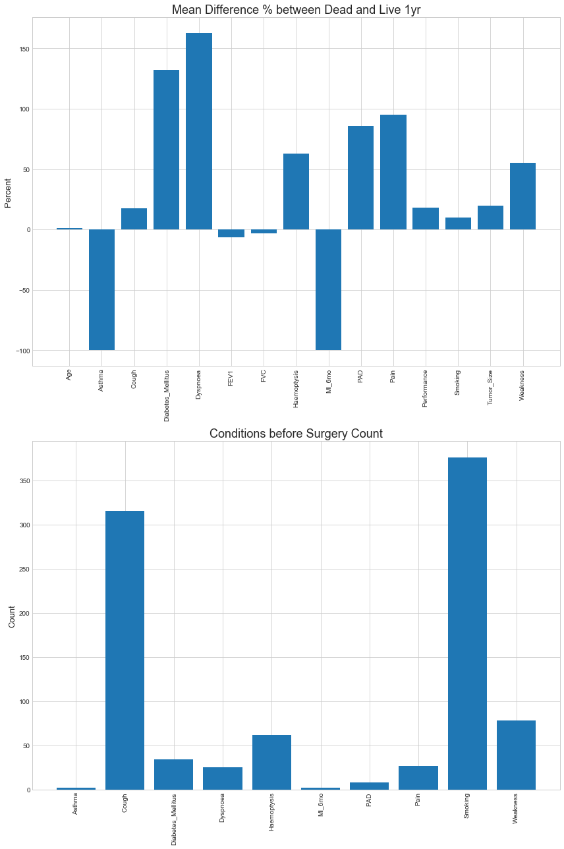
Mean Difference % of Dead and Live (1 yr)

Slide 9
Count of Symptoms or Conditions before Surgery

Slide 10
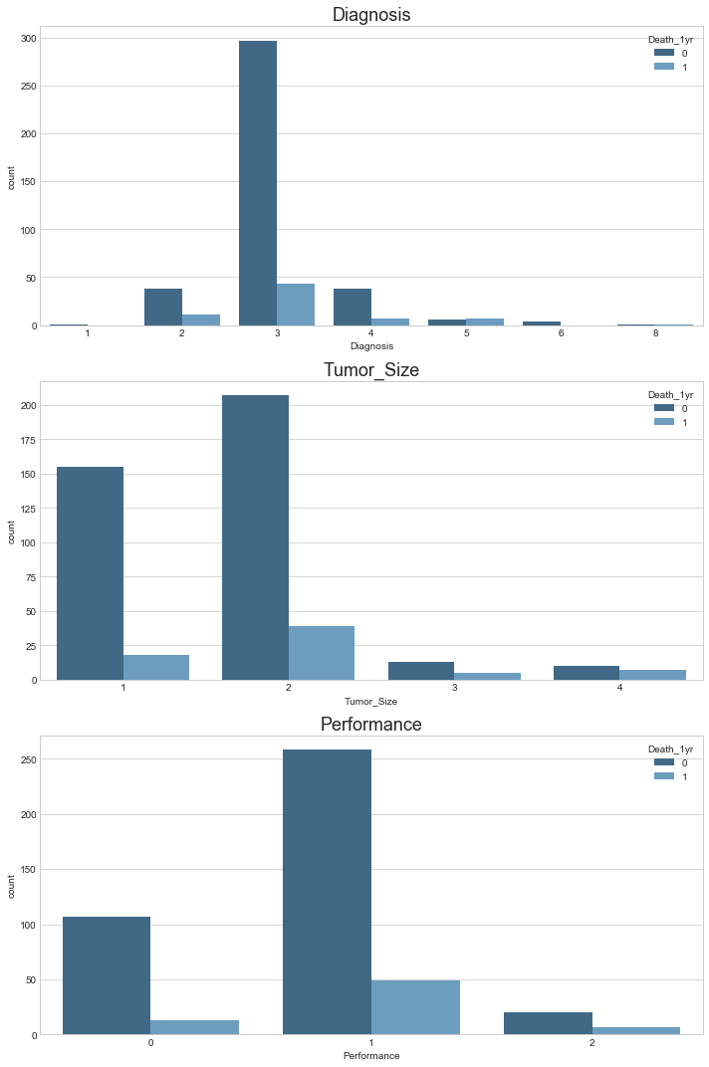
Categorical Data

Slide 11

Hypothesis Testing
Null Hypothesis: The 1 year death and live patients have the same mean, tested for each attribute.
Test Statistic: Mean difference between death and live patients
Significance level: 0.05

Slide 12
Results of Hypothesis Testing
Attribute | P value
FVC | 0.1706
FEV1 | 0.0588
Performance | 0.0300
Pain | 0.0964
Haemoptysis | 0.0623
Dyspnoea | 0.0242
Cough | 0.0320
Weakness | 0.0606
Tumor_Size | 0.0003
Diabetes_Mellitus | 0.0209
MI_6mo | 0.7264
PAD | 0.3498
Smoking | 0.0581
Asthma | 0.7178
Age | 0.2714

Slide 13

Mean difference % for Attributes of Significance
Performance = 17.96%
Dyspnoea = 162.57%
Cough = 17.58%
Tumor_Size = 19.69%
Diabetes_Mellitus = 132.49%

Slide 14
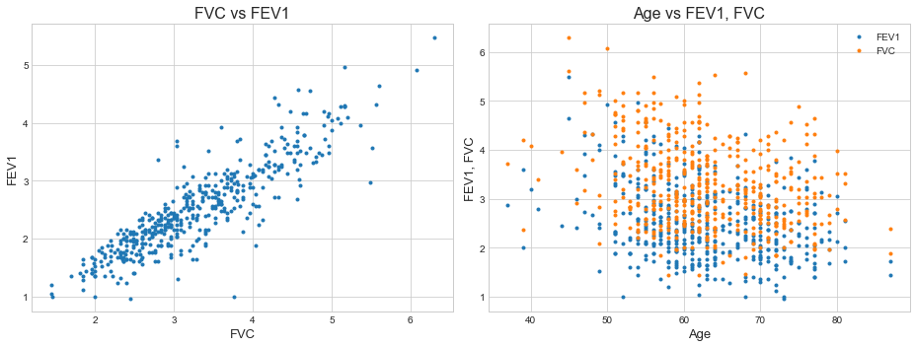
Correlations of Numerical (Age, FVC, FEV1) Data
Correlation Coefficients:
Age & FEV1
-0.2994
Age & FVC
-0.3096

Slide 15
Correlation of FVC & FEV1
Correlation Coefficient:
0.8875
FEV1/FVC Ratio:
Used in diagnosis of obstructive and restrictive lung disease

