Slide 1
Data Analysis
Insights & Pattern

Slide 2
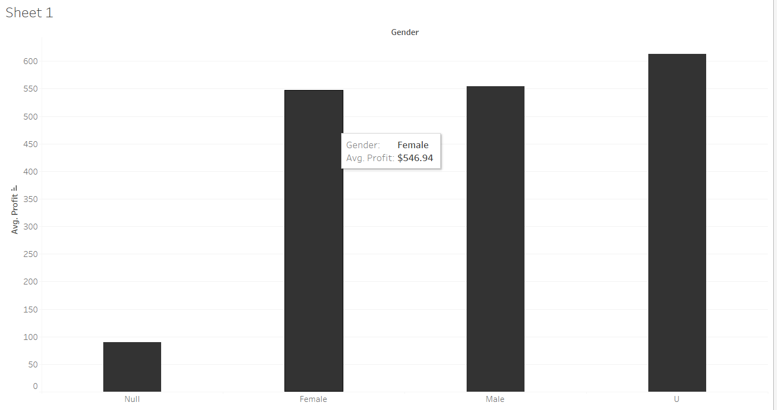
This is Gender Avg. profit Sheet with that we can see how much we get from each gender.

Slide 3
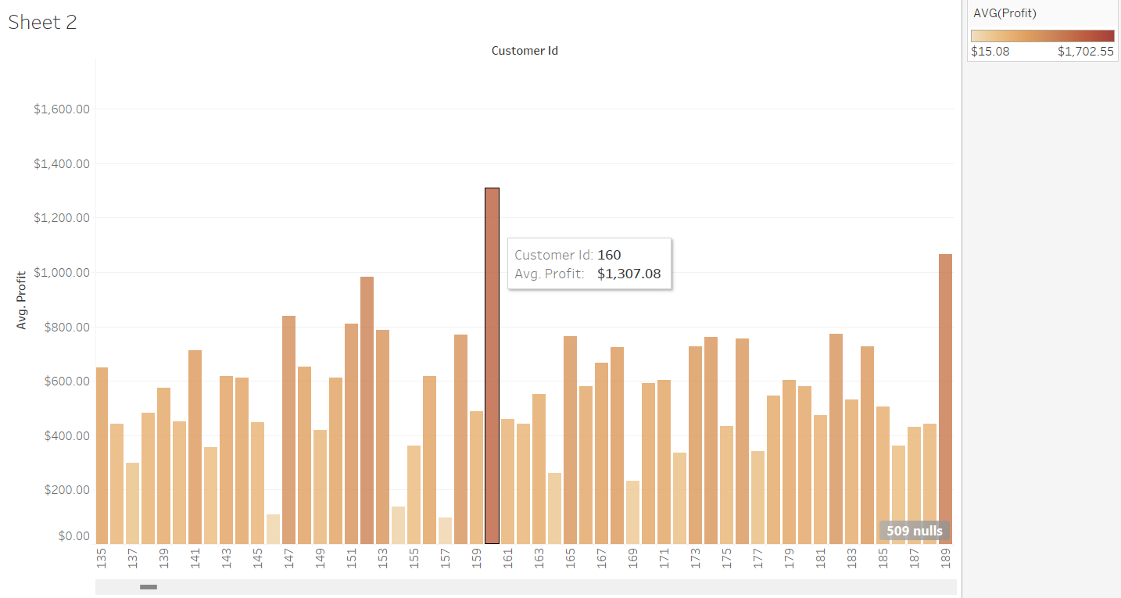
Now this is Customer ID Sheet as we can see , we get Avg. profit $1,307 from customer ID:160 So we have to maintain good relationship with him and provide customers like this
best quality service.

Slide 4
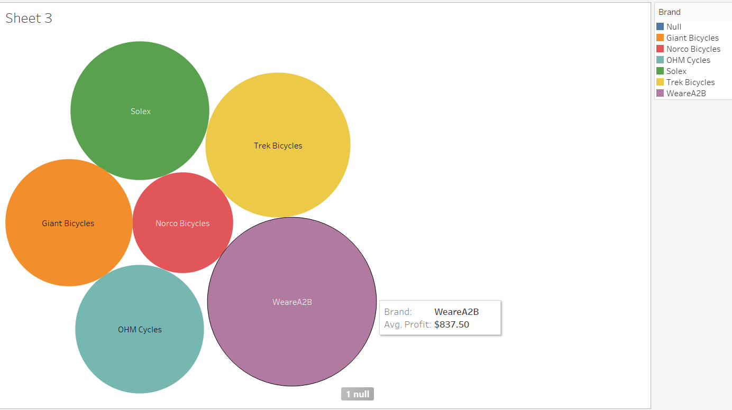
This is Brand Avg. profit Sheet from this we see WeareA2B is ahead of everyone with the Average profit of 837$ that means we have to focus on Nacro Bicycles
And come up with the better marketing strategy and good offers.

Slide 5
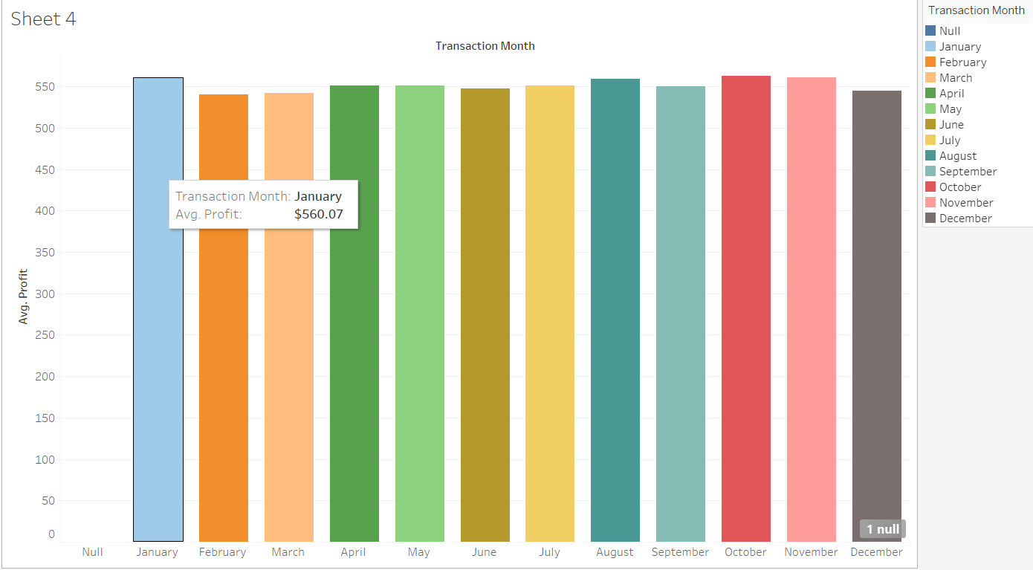
This is Transaction Month Sheet from this we now know each month’s Average profit
From January we get Avg. profit $560.07. We can see company’s performance is better in January , August, October, November and also try to do better in February and March.

Slide 6
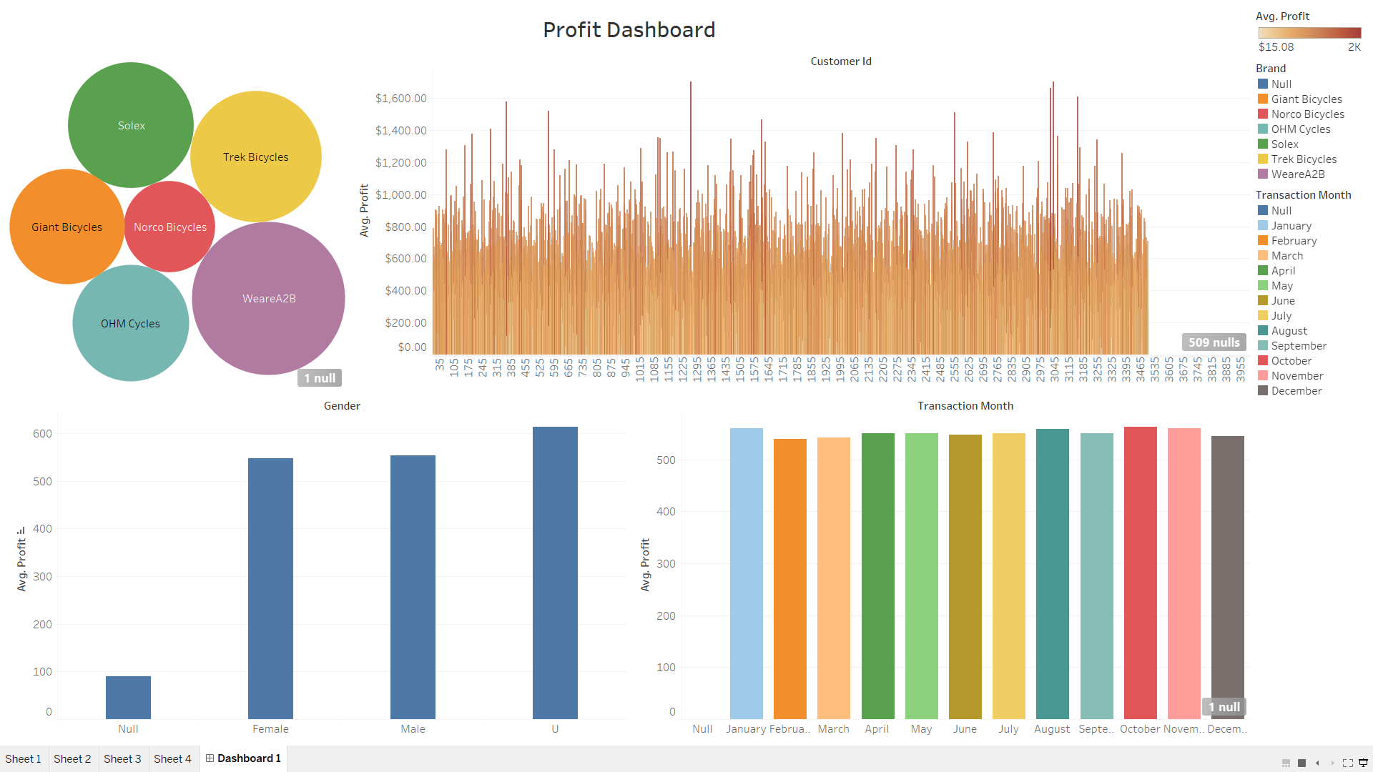
This is the final Profit Dashboard feel free to explore all in One.

