Slide 1
Dynamic calculator
THIS PROGRAM IS MAKE WITH HELP TO
Python program lang.

Slide 2
Introduction
IN THIS PROGRAM
TO APPLY MATHMATICAL ALGORITHM FUNCTION
THEY ARE RESULT PROVIDED ACCORDING TO USER
SIMPLE AND COMPLEX VALUES ARE CALCULATE
TO FAST WORKABLITY
CUSTOMIZATION TO CHANGE AND UPDATE FUNCTION

Slide 3
Benefits
FLEXIBILITY IN THIS PROGRAM
PAPERLESS TO WORK
EASY TO MANAGE AND HANDLE
ON TIME SHOW ACCURATE RESULT
REDUCING THE MAN POWER
NO COST AND NO MAINTANANCE IN PROGRAM

Slide 4

Live Test in program

Slide 5
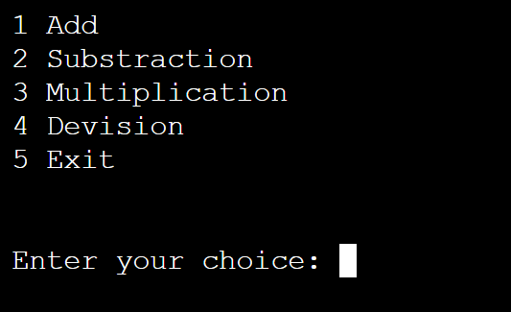
Interface 1

Slide 6
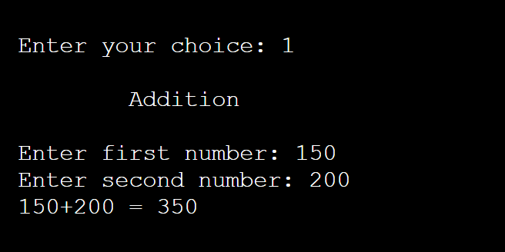
Interface 2

Slide 7
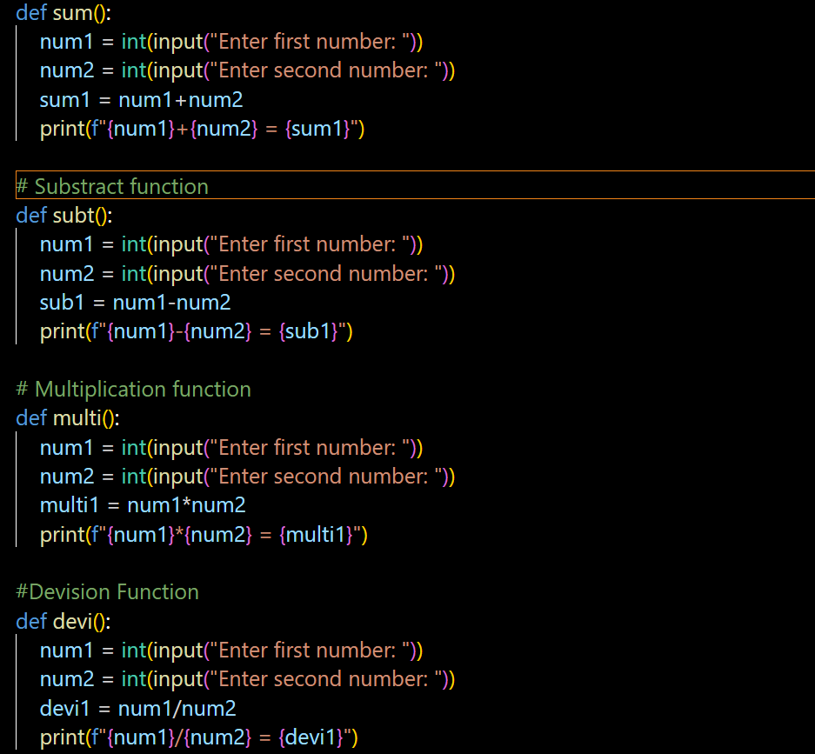
PYTHON CODE

Slide 8
WORKING PROSSES
TO SHOW THE INLIST DIFFERENT OPTION
WHICH ACTION TO PERFORM USER
ENTER YOUR CHOICE
TO ENTER THE SPECIFIC NUMBER ( FIRST , SECOND )
SHOW THE OUTPUT RESULT IN CONSOLE BAR

Slide 9
Why to use
Python
STRONG FOUNDATION
WIDE RANGE OF APPLICATION
EFFICIENCY SPEED
PORTABILITY

Slide 10
REQURED PYTHON PROG.
CODE EDITOR FOR VS CODE
PYTHON COMPILER

Slide 11


Slide 12


