Slide 1

Sentiment Analysis
of
Reviews

Slide 2
INFO 7390 Final Project
Team Members Name:
Mitesh Desai (002953596)
Sneha Swaroop (001572060)
Shiwani Deshmukh (002194015)

Slide 3
TABLE OF CONTENTS
01
02
03
PROBLEM STATEMENT & BACKGROUND
DATA VISUALIZATION & ALGORITHMS
OBTAINED RESULTS & CONCLUSION

Slide 4
PROBLEM STATEMENT
Evaluate the sentiment of a movie review that has been retrieved from the Internet Movie Database (IMDb) website
Employ different classification model to predict the number of positive and negative reviews in the IMDB Reviews Database depending on sentiments
Perform Sentiment Analysis from a set of movie reviews by doing analysis of words

Slide 5
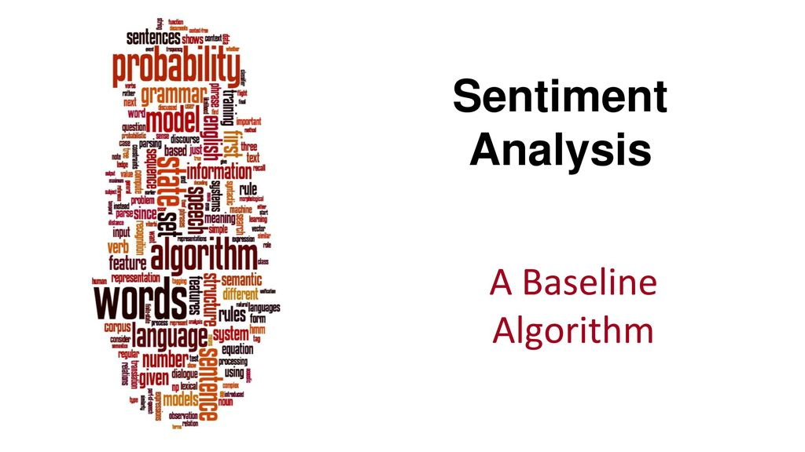
Sentiment Analysis is the process of computationally recognizing and categorising opinions contained in a piece of text, especially in order to discern whether the writer has a positive or negative attitude toward a certain topic.
IMDb is a database of information for all visual entertainments. It contains more than 50000 entries of reviews posted on the website coupled with a target variable that indicates whether a review has a positive sentiment or negative sentiment.
Our dataset - Keras IMDB dataset (https://storage.googleapis.com/tensorflow/tf-keras-datasets/imdb.npz )
Mercury is the closest planet to the Sun and the smallest one in the Solar System—it’s only a bit larger than the Moon. The planet’s name has nothing to do with the liquid metal

Slide 6
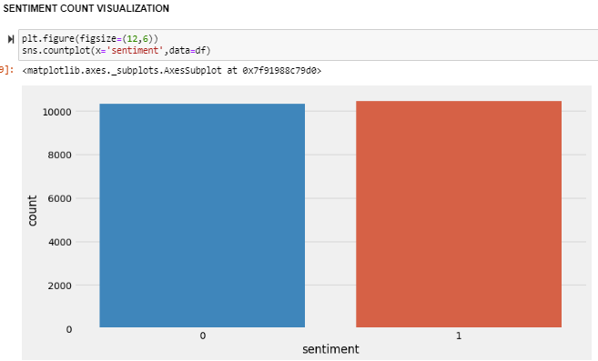
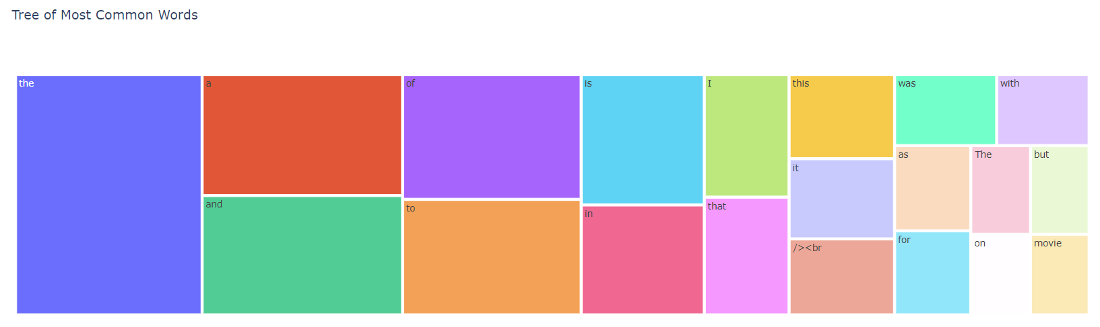
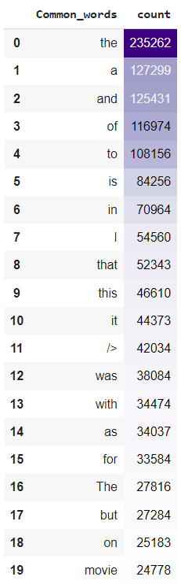
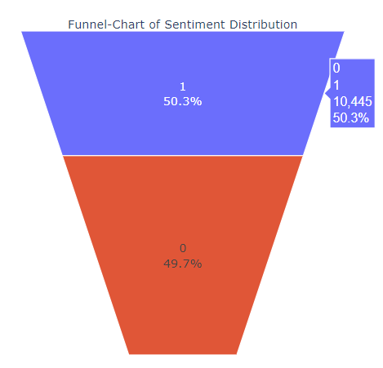
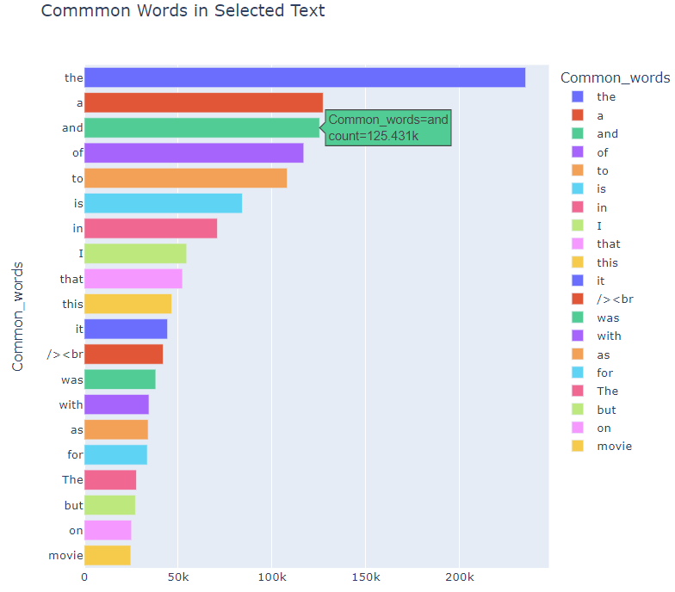
DATA VISUALIZATION

Slide 7
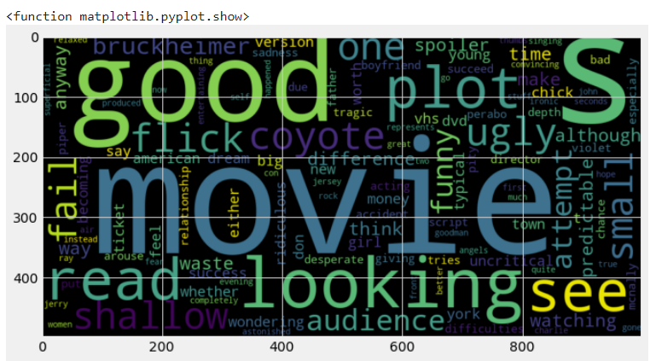
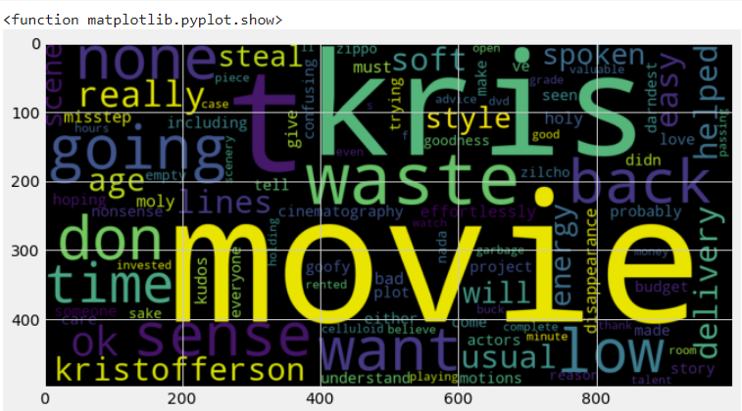
Positive WordCloud
Negative WordCloud
DATA VISUALIZATION
WordCloud is a visual representation of text data. Here, we have implemented WordCloud on the training dataset by splitting the train and test data and then normalizing the training set.

Slide 8
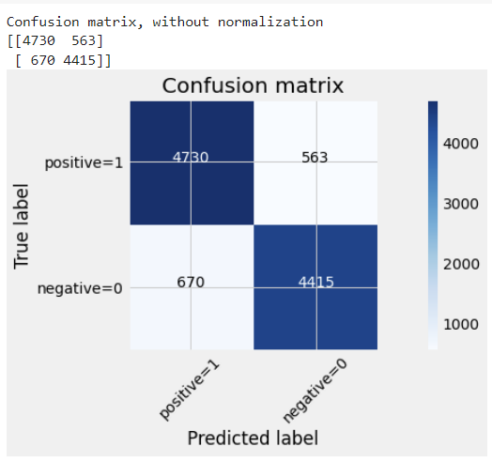
ALGORITHM & OBTAINED RESULTS
Using Logistic Regression Model
Logistic Regression model estimates the probability of a dependent variable as a function of independent variables. The dependent variable is the output that we are trying to predict, while the independent variables or features are the factors that we feel could influence the output.
The Accuracy for the implemented Logistic Regression Model for sentiment analysis is 0.88.
The Precision is 0.88, Recall is 0.86 and Error Rate is 0.11 which is the indication of a great model performance.
Confusion matrix and the efficiency metric indicate that the Logistic Regression model has performed well.

Slide 9
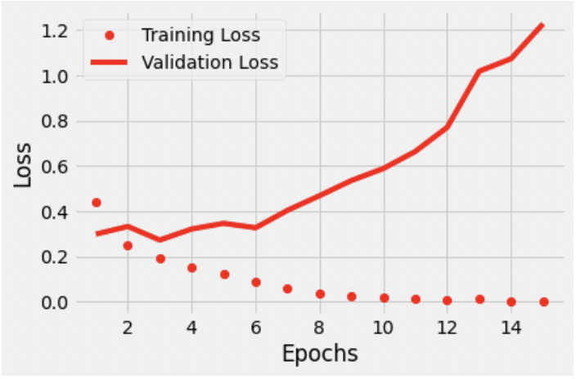
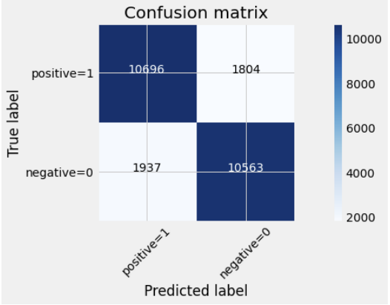
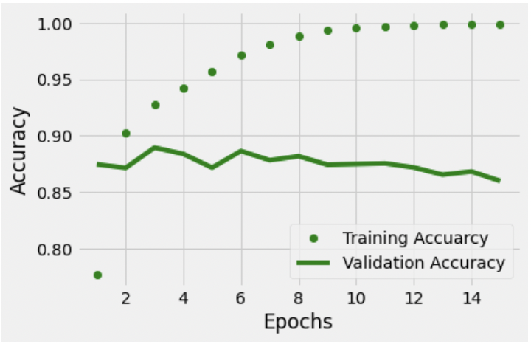
ALGORITHM & OBTAINED RESULTS
Using RNN Model
Recurrent Neural Network (RNN) works on the principle of saving the output of a particular layer and feeding this back to the input in order to predict the output of the layer.
RNNs can use their internal state (memory) to process variable length sequences of inputs.
The Accuracy for the implemented RNN for sentiment analysis is 0.85.
The Precision is 0.85, Recall is 0.84 and Error Rate is 0.14 which is the indication of a great model performance.
Confusion matrix and efficiency metric indicate that the RNN model has performed well.

Slide 10
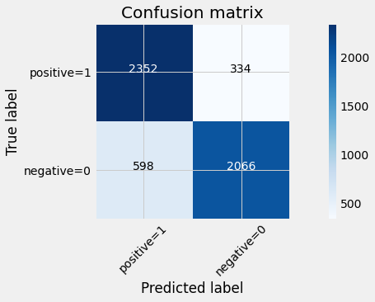
ALGORITHM & OBTAINED RESULTS
Using LSTM Model
Long Short-Term Memory (LSTM) networks is special kind of recurrent neural network that is capable of learning long term dependencies in data. This is achieved because the recurring module of the model has a combination of four layers interacting with each other.
The Accuracy for the implemented Long Short-Term Memory Model for sentiment analysis is 0.83.
Confusion matrix and efficiency metric indicate that the Recurrent Neural Network (RNN) model has performed well.

Slide 11

Thank You!
CONCLUSION
Sentiment Analysis for IMDb Reviews Database was successfully performed
We have implemented Logistic Regression, Recurrent neural networks (RNN), and Long Short-Term Memory (LSTM) models
We can observe that Logistic Regression, Recurrent neural networks (RNN) and LSTM are performing efficiently. The reasonable accuracy and efficiency of the models are achieved

