Slide 1
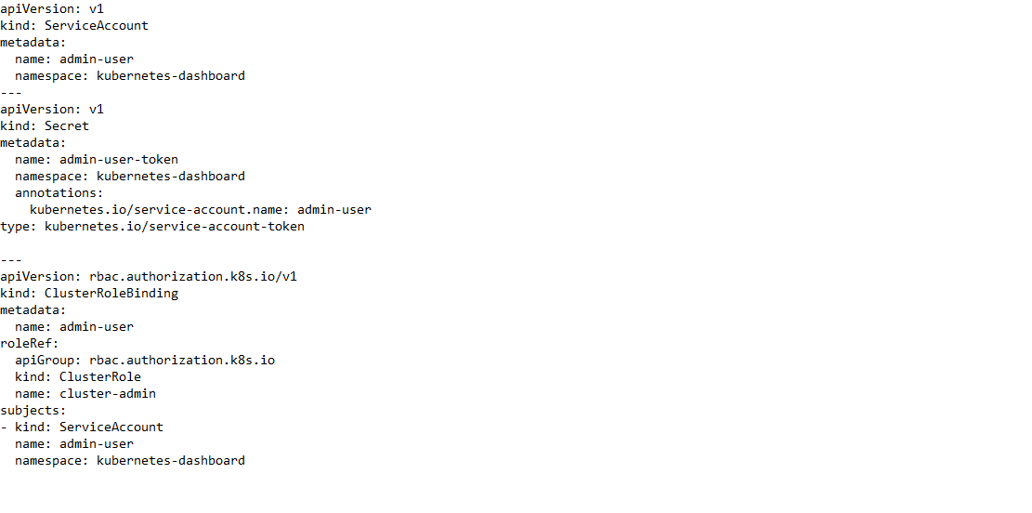
DRASHBOARD ADMINUSER

Slide 2
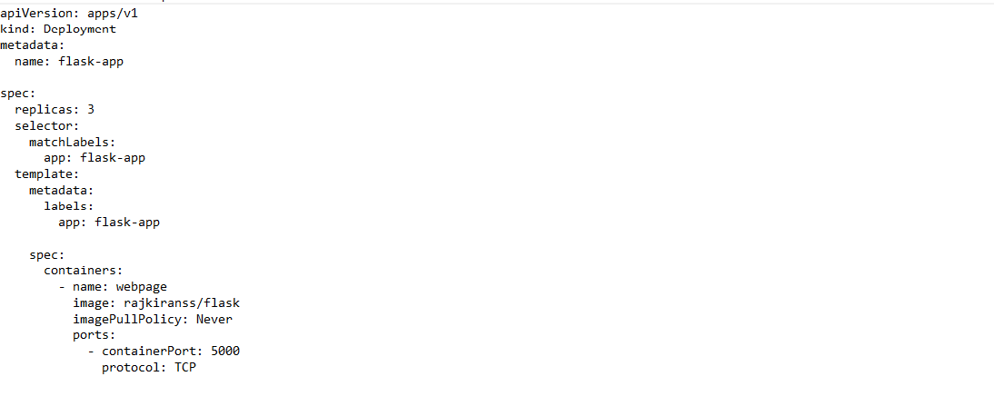
FLASK DEPLOYMENT

Slide 3
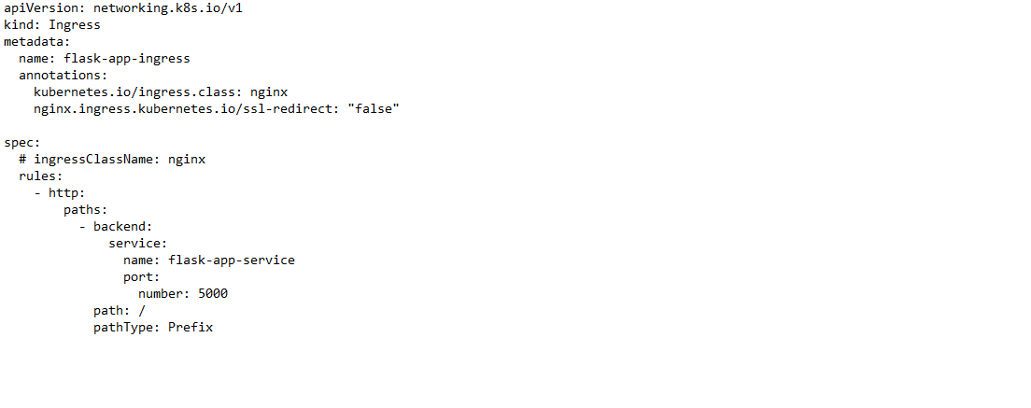
FLASK INGRESS

Slide 4
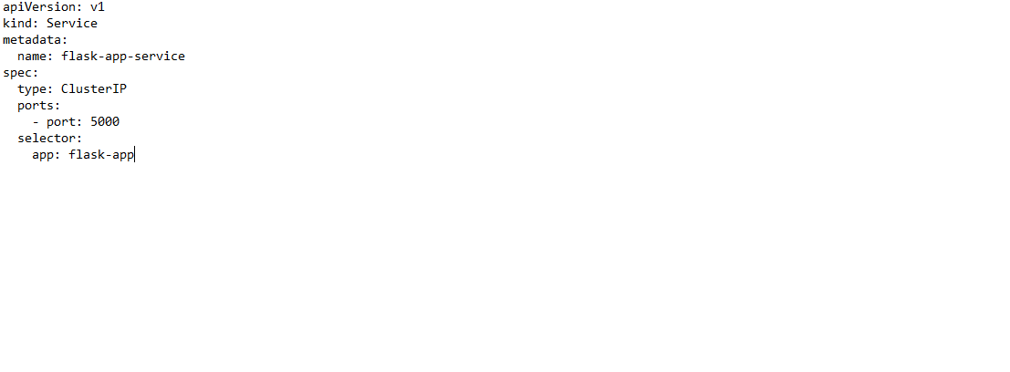
FLASK SERVICE

Slide 5
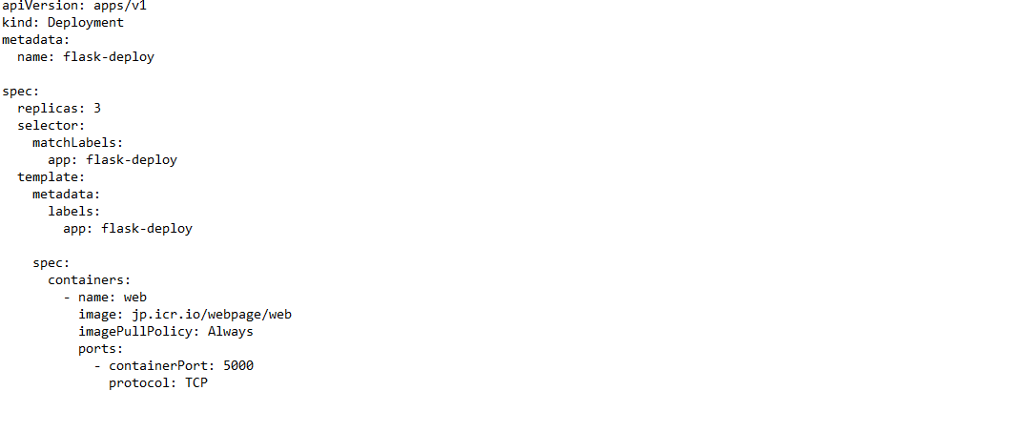
IBM DEPLOYMENT

