Slide 1
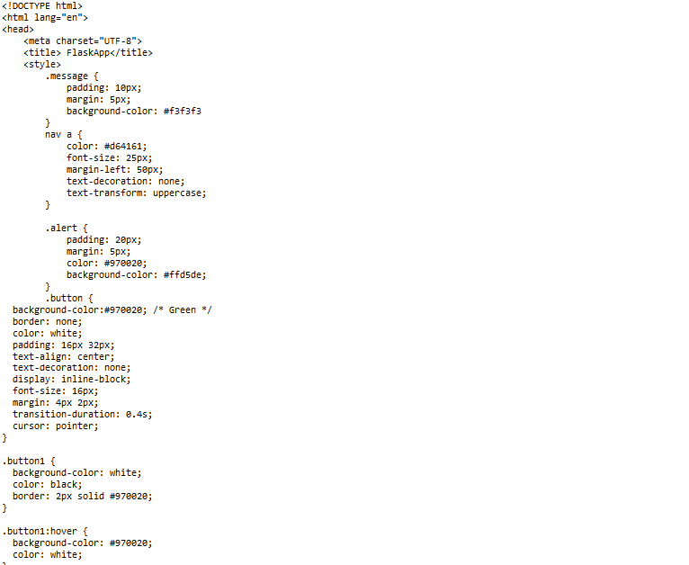
BASE

Slide 2
