Slide 1


Bgolearn
Package (Py)

Slide 2
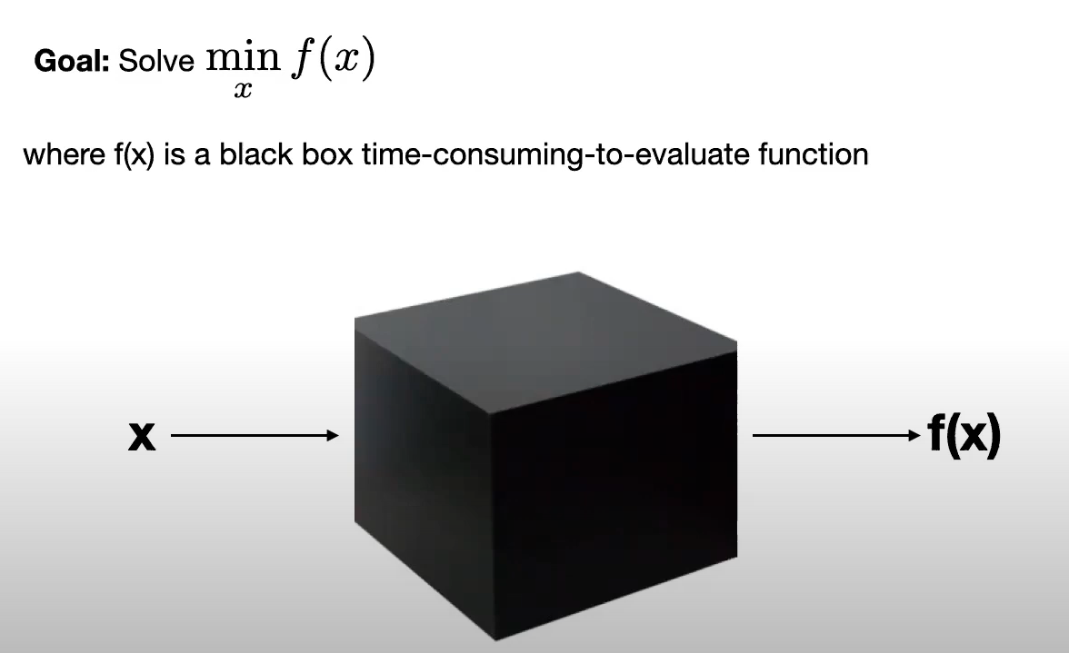
BayesOpt
Ref : Frazier, 2018, arXiv: 1807.02811v1

Slide 3

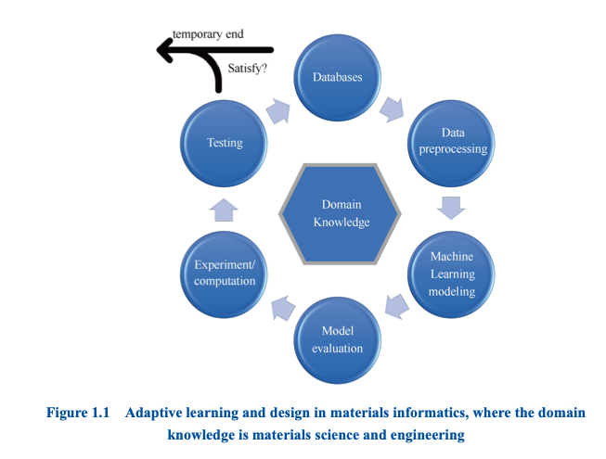
BayesOpt-loop
Ref : Zhang T-Y, 2022, An Introduction to Materials Informatics (I)

Slide 4
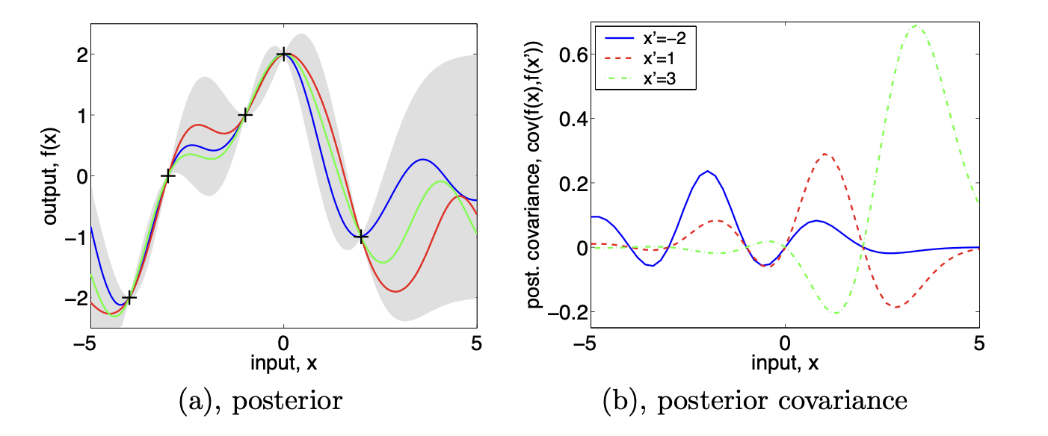
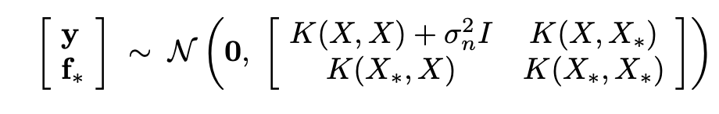
BayesOpt-molding
Gaussian process regression / Krigging model
Ref : Williams et al. 2006. Gaussian processes for machine learning.

Slide 5
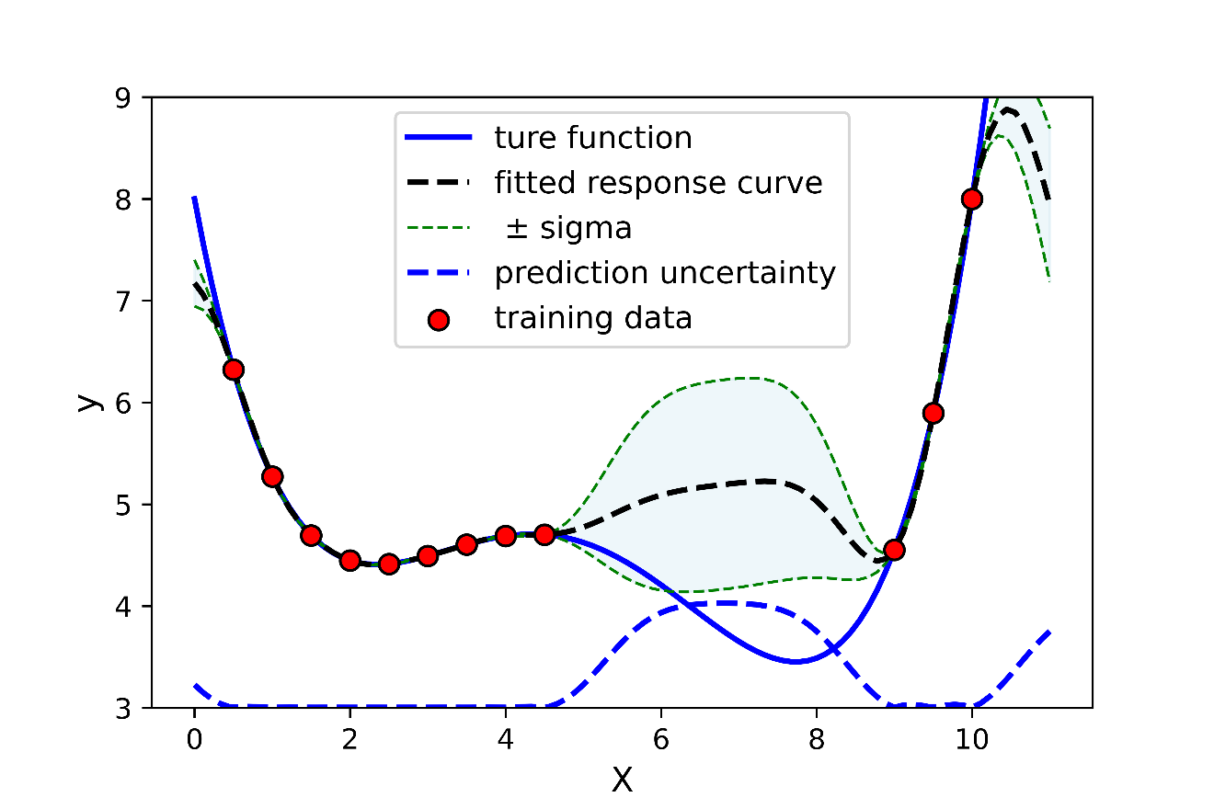
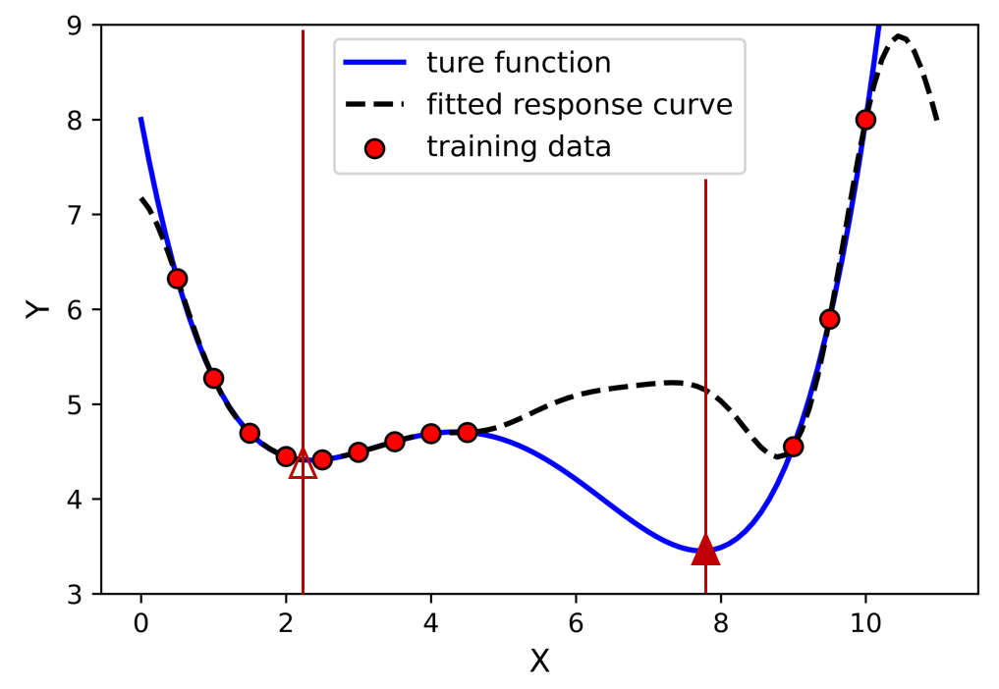
BayesOpt-utilityFus

Slide 6
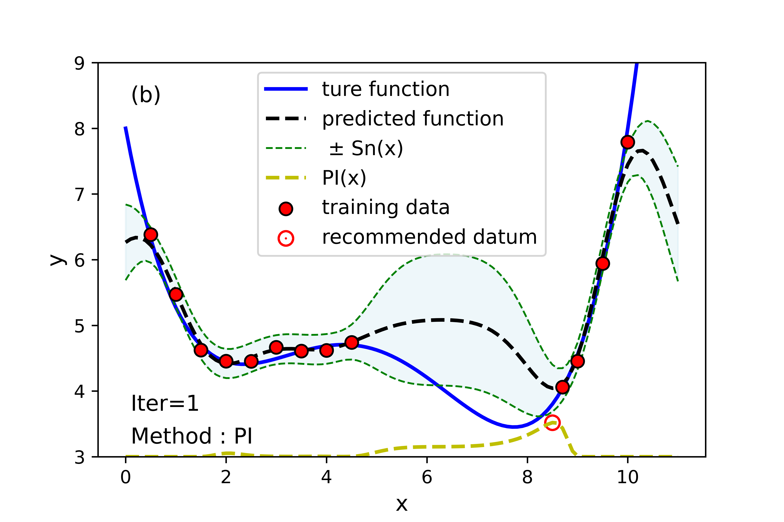
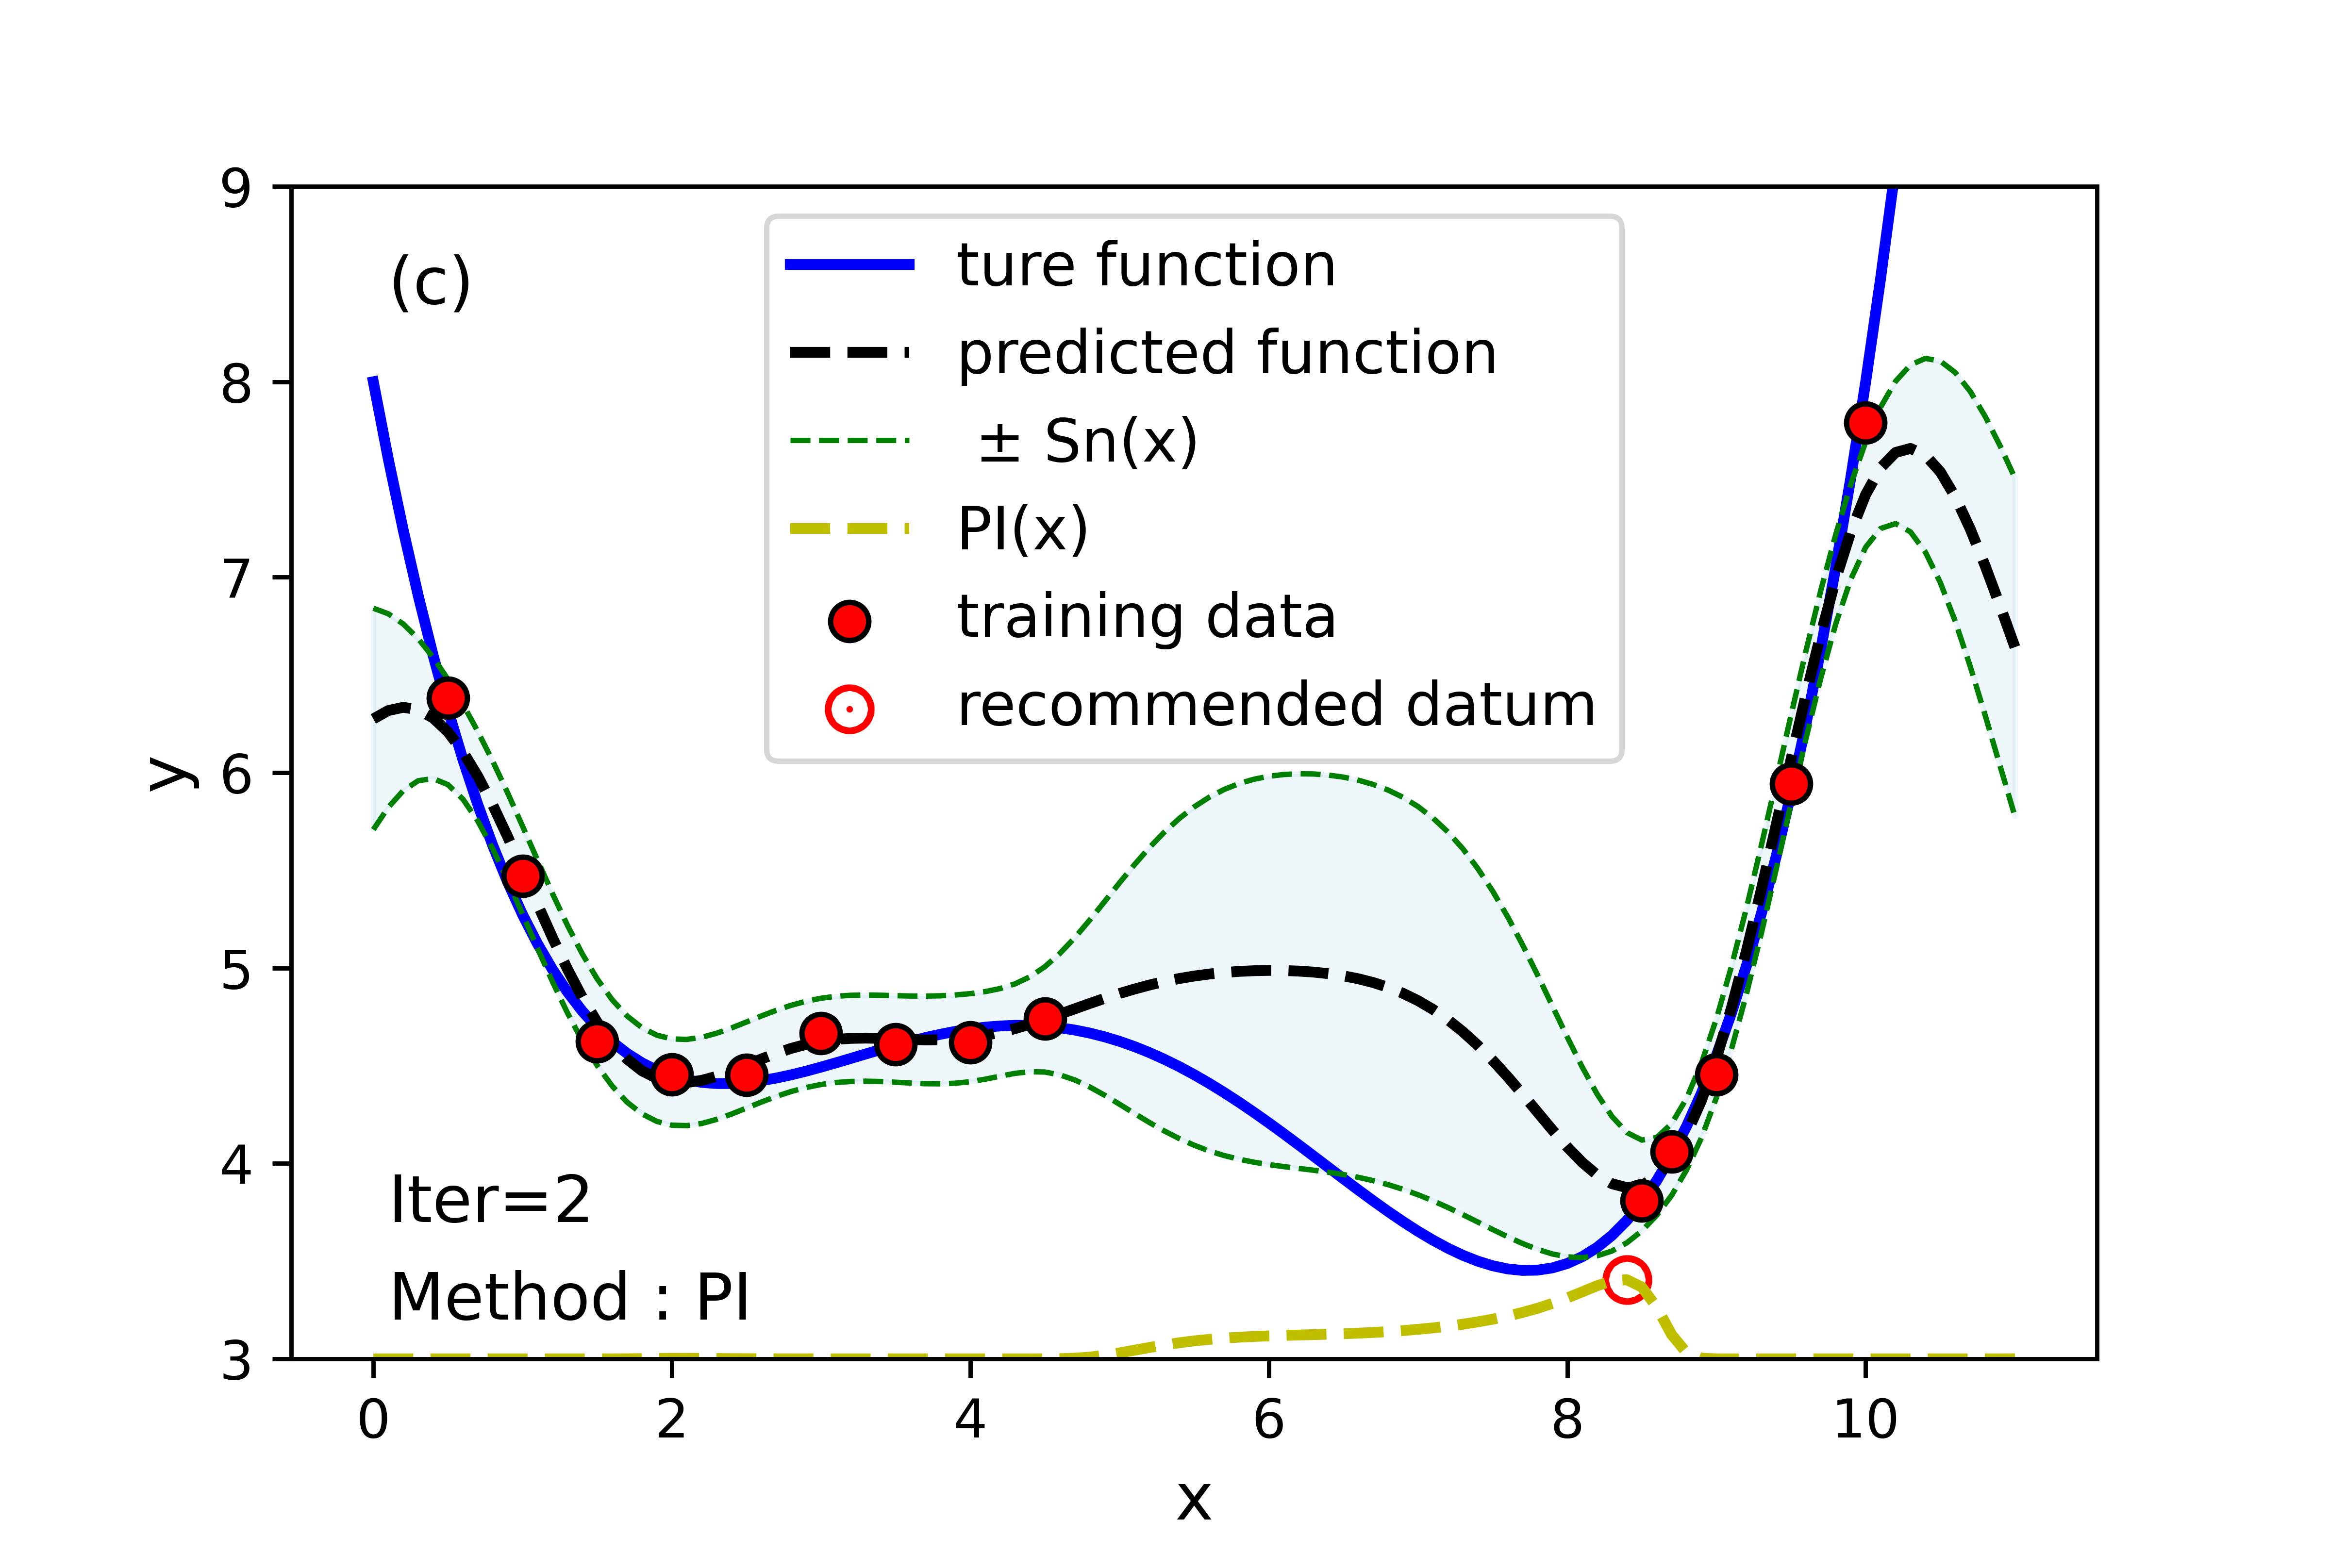
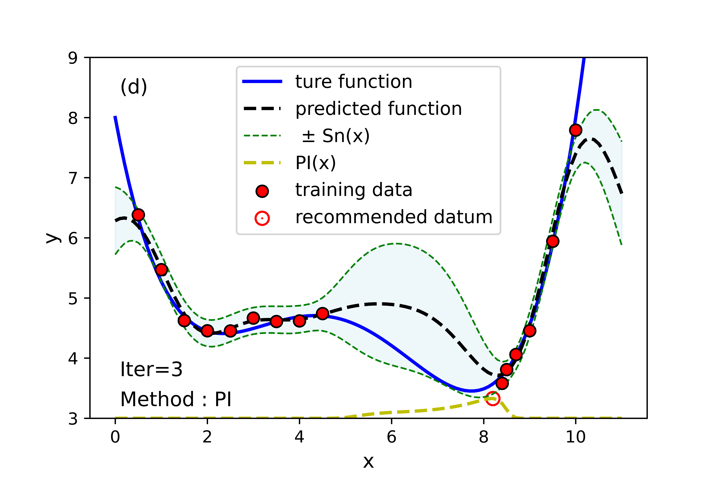
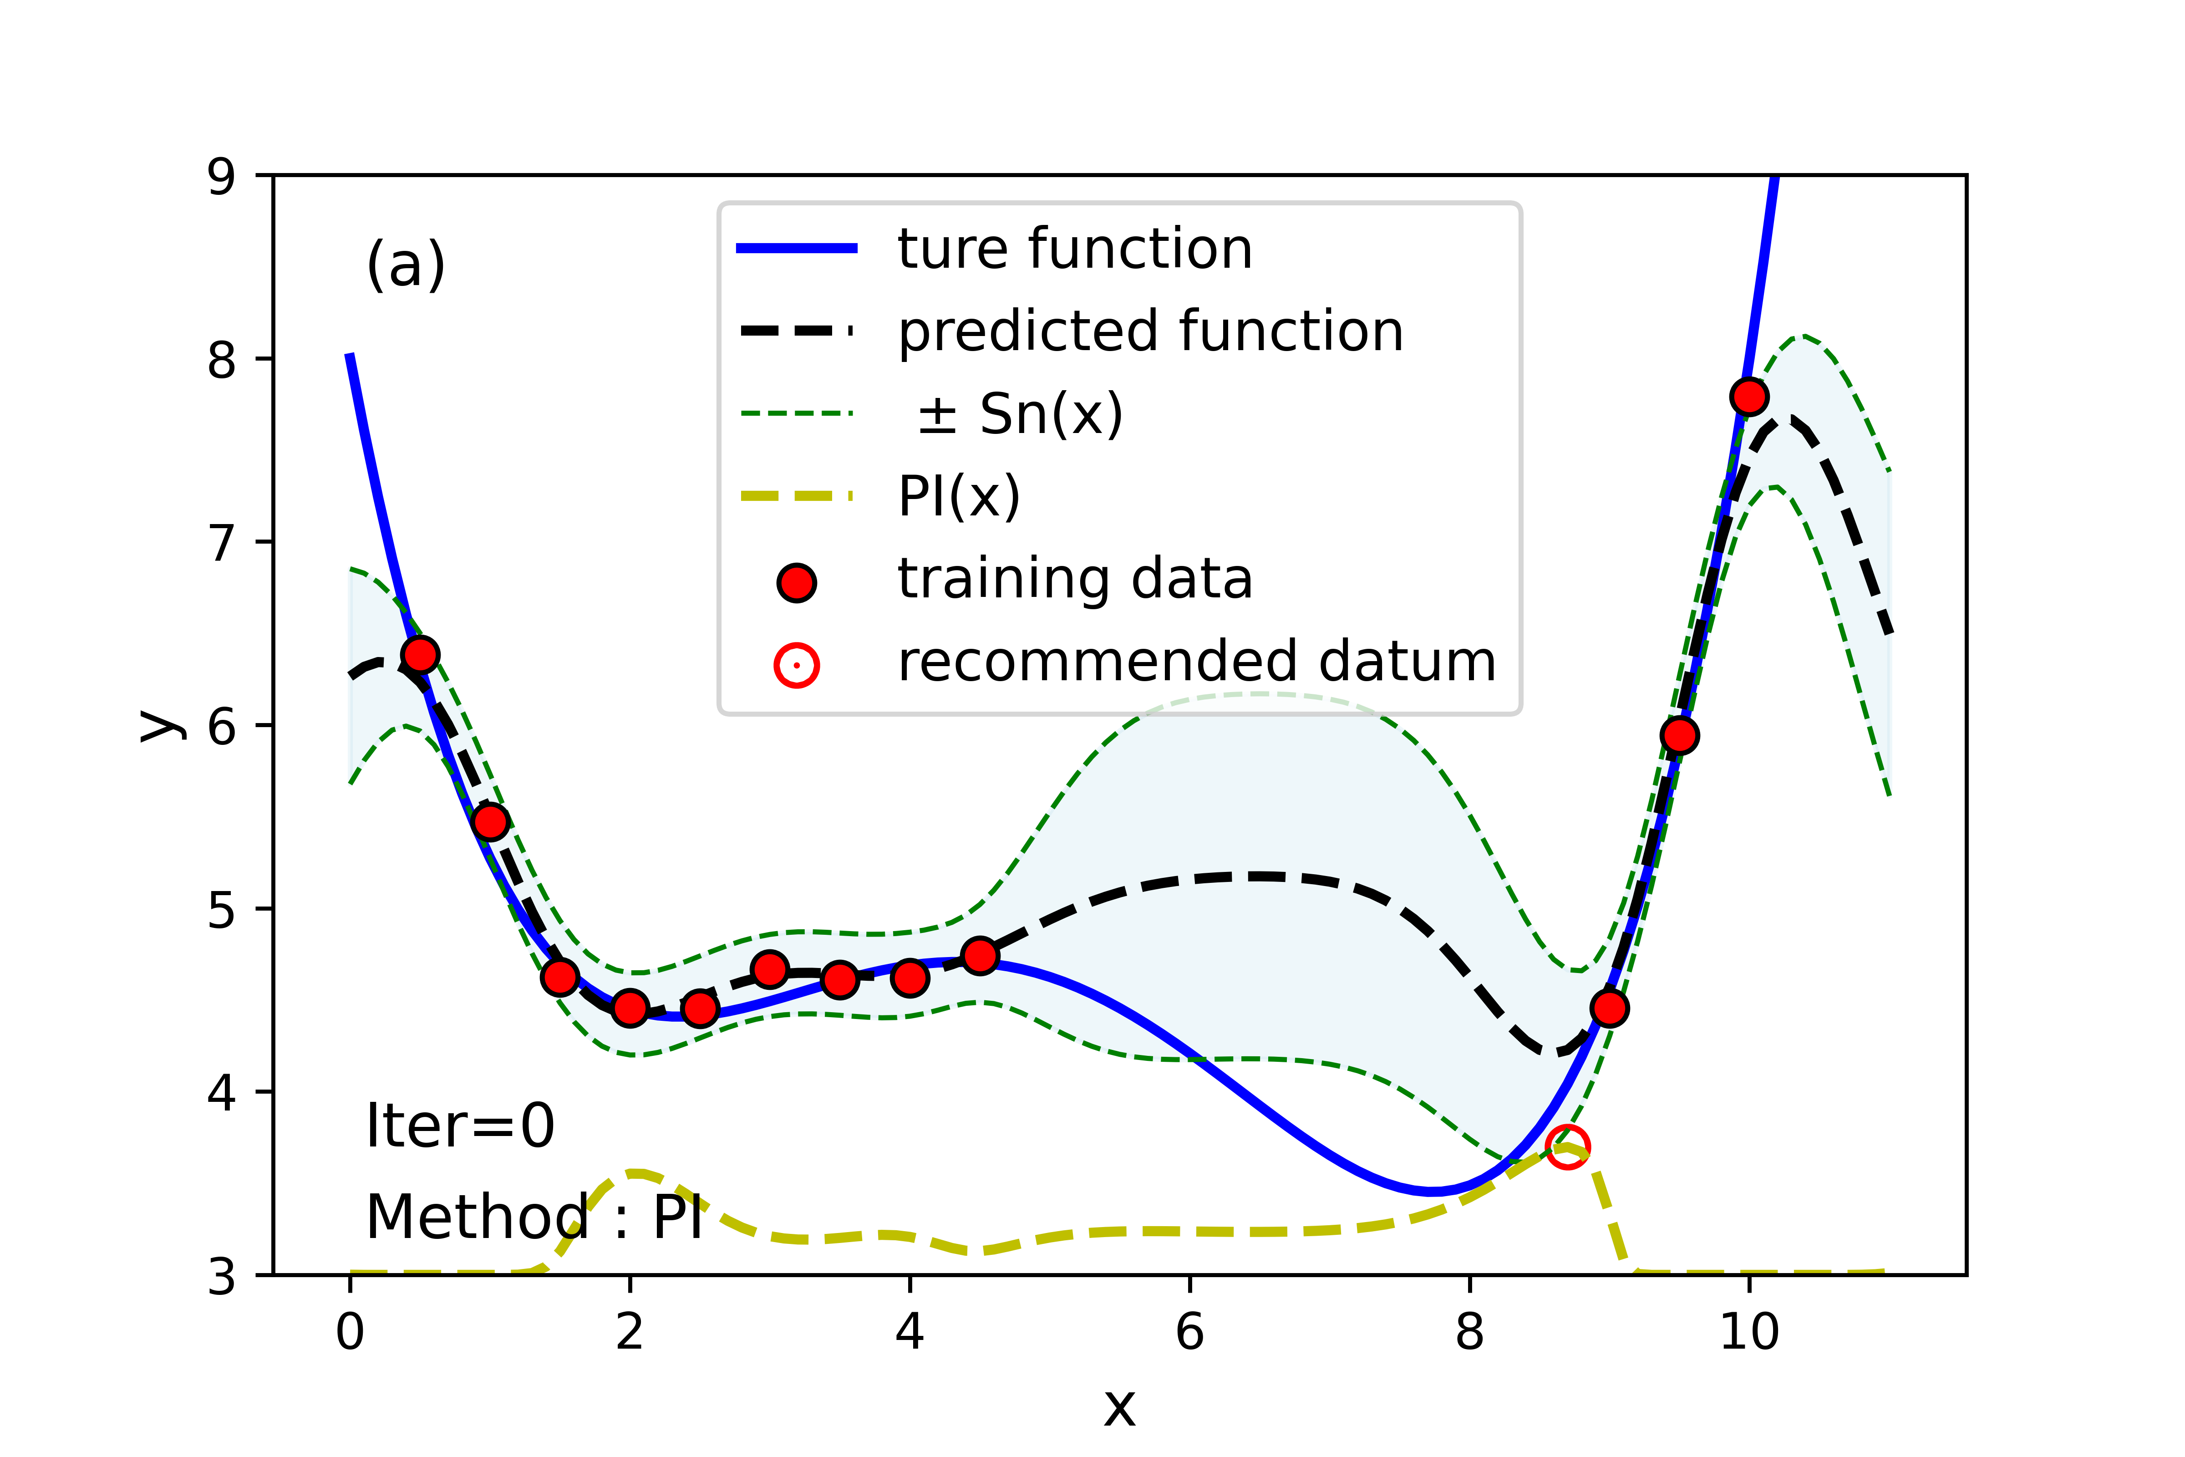
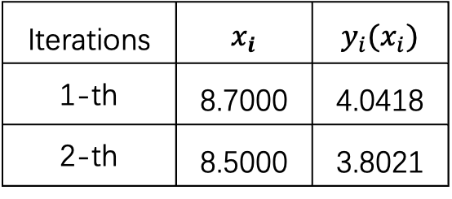
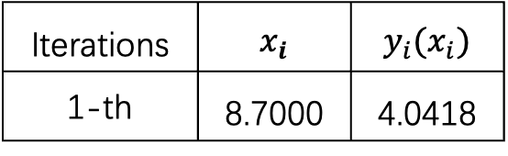
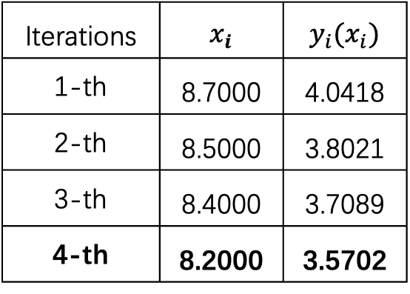
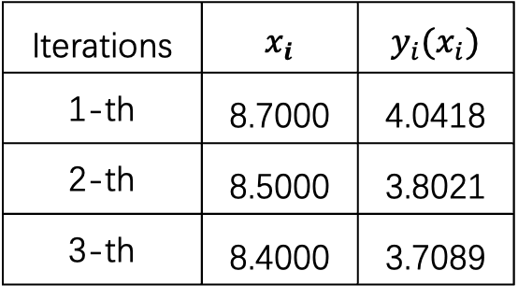
BayesOpt-utilityFus
Probability of Improvement
Iterations | $$x_{i}$$ | $$y_{i}(x_{i})$$
1-th | 8.7000 | 4.0418
2-th | 8.5000 | 3.8021
3-th | 8.4000 | 3.7089
4-th | 8.2000 | 3.5702
Iterations | $$x_{i}$$ | $$y_{i}(x_{i})$$
1-th | 8.7000 | 4.0418
Iterations | $$x_{i}$$ | $$y_{i}(x_{i})$$
1-th | 8.7000 | 4.0418
2-th | 8.5000 | 3.8021
Iterations | $$x_{i}$$ | $$y_{i}(x_{i})$$
1-th | 8.7000 | 4.0418
2-th | 8.5000 | 3.8021
3-th | 8.4000 | 3.7089
POI is worked but not the best one in this case!

Slide 7
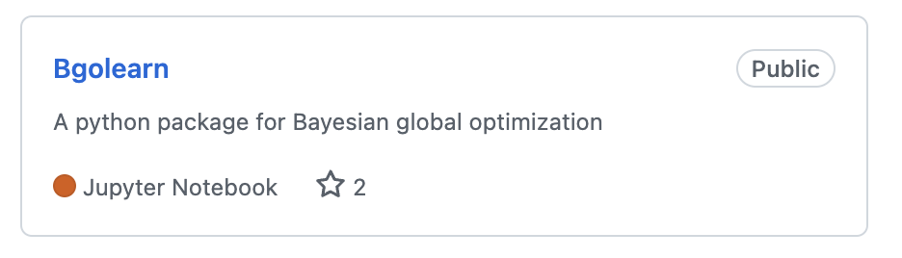
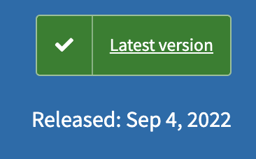
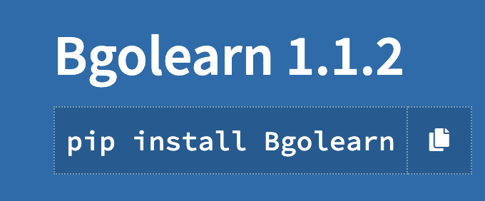
Bgolearn
1.Expected Improvement algorithm,
2.Expected improvement with “plugin”，3.Augmented Expected Improvement，4.Expected Quantile Improvement，5.Reinterpolation Expected Improvement， 6.Upper confidence bound，
7.Probability of Improvement，
8.Predictive Entropy Search，
9.Knowledge Gradient

Slide 8

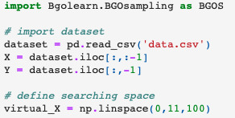
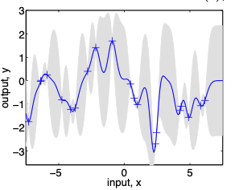
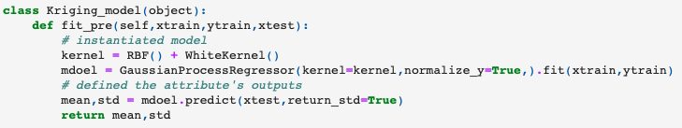
Bgolearn
Only three steps
step 1 ：
step 2 ：

Slide 9
Bgolearn
Only three steps
step 3 ：
Bgolearn = BGOS.Bgolearn()
My_BGO = Bgolearn.fit(
data_matrix = data_matrix,
Measured_response = Measured_response ,
virtual_samples = virtual_samples,
Kriging_model = Kriging_model,
opt_num = 1,
min_search = True
)
My_BGO. Knowledge_G()

Slide 10


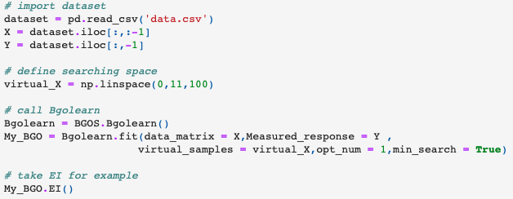
Bgolearn
But
I don’t even wanna definine a Kriggling model
It’s Okay, after Version V1.1.0 of Bgolearn
https://github.com/Bin-Cao/Bgolearn

Slide 11
THANKS

