Slide 1
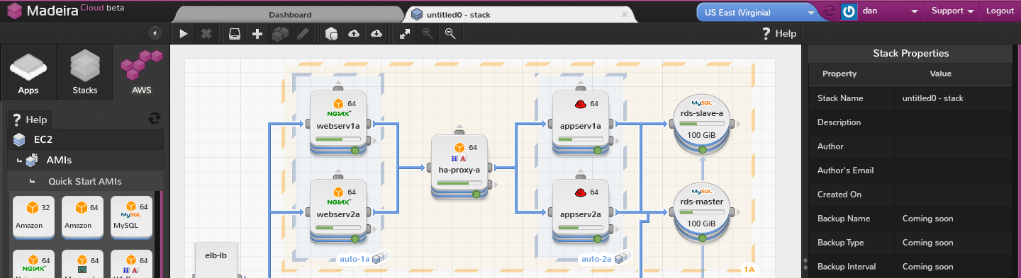
MadeiraCloud is a visual tool to simplify building, monitoring, and managing applications on IaaS.

Slide 2
Developers and system administrators suffer from a lack of visibility.
Infrastructure resources (server, storage, network)
Software configuration (OS, library, software, code)
Real-time and historical performance
Cloud application architecture is much more dynamic and as a consequence there is less visibility and more chaos.

Slide 3
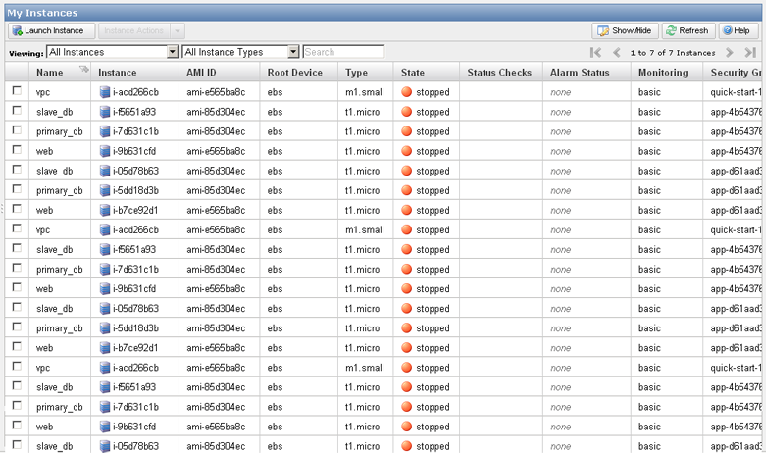
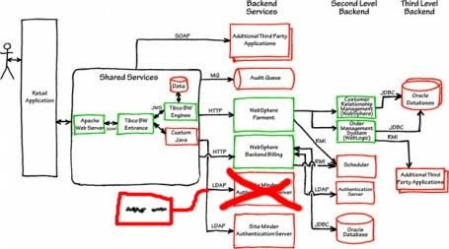

Slide 4
Currently, architectural designs are mocked up, corresponding to lists of IP addresses, server descriptions and their properties, which are maintained in different ways on different providers.
Static designs quickly become out of date and lists can become overwhelming when dealing with a large number of resources.

Slide 5
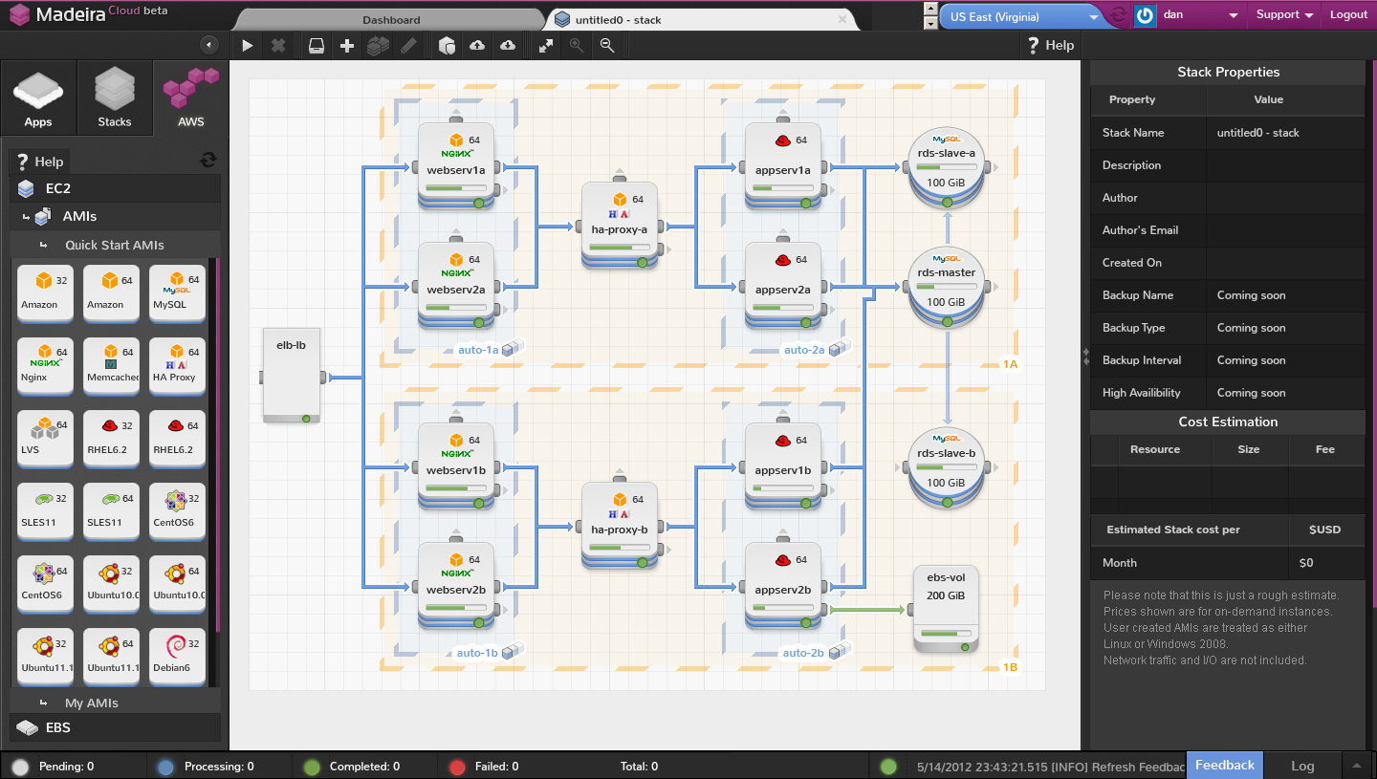

Slide 6
Now users can provision infrastructure as they designed it, by using our WYSIWYG GUI.
By simply dragging-and-dropping resources to a canvas, specify the required packages, and visually connecting the resources to set up network and software configurations.
Click “Run” and our back-end takes care of the rest, provisioning the resources exactly as designed.

Slide 7
But the design doesn't become a relic, the running application is still presented as a “living diagram”, allowing users to add/remove resources on the fly, change properties, update packages or deploy the latest code.
Easy to understand at a glance
Always up to date
Save time by quickly isolating issues

Slide 8
SaaS
Browser based
Monthly subscription
Manages IaaS account through APIs

Slide 9
Case Study
Our pain of managing cloud applications still continues as we host MadeiraCloud on AWS. Part of the AWS partnering process includes a technical review with their team so, like with a new employee or new team member working on an existing application, we had to bring them up to speed quickly on our architecture design. This was incredibly easy because we were already using a meta-MadeiraCloud to manage our production environment, so we had a live, up-to-date diagram on hand within seconds.

Slide 10
Target Market
Although in the future we can support any IaaS provider, at the moment we are dedicated to AWS.
We can add value to any AWS user, but our primary target segment:
Are companies of any size
Who operate more than 20 instances
With applications which make use of multiple AWS services
As the complexity of a cloud application increases, so does the need for our service. This means that any medium to high user of AWS is in our target market.

Slide 11




Competitors
From the product perspective, our closest competitor is a US based start-up called Transcend Computing and their StackStudio product.
There are a number of competitiors in the more general cloud application management space, including RightScale, Scalr, and Scalarium.
We also have to compete also with the AWS console itself.

Slide 12
Competitive Edge
Our visual approach is fundamentally different to existing cloud application management services like RightScale, Scalr, and Scalarium. Our IDE style is already well known to developers and we take a higher level, human approach so using our service is incredibly easy in comparison.
We have the first mover advantage against StackStudio and our product is already more mature. Transcend Computing's strategy is more towards being a UI for CloudFormation, whereas our ambitions go far beyond that, and are not limited by CF's features.

Slide 13
Development Roadmap
We use Build-Measure-Learn approach for our product roadmap, and so there is no definitive roadmap. Instead, we build an MVP to test whether a particular feature is well-received by our users.
Features we will be testing soon are:
More AWS Service support: VPC, ELB, AutoScaling
Chef/Puppet extension for distributed applications
Timeline for historical performance/load/failure playback
Sharing, collaboration and pre-built designs
Role-based user management and budgeting

Slide 14
Key Personnel
Zhao Peng (CTO & Founder)
Peng has 9 years of experience in cloud, utility and distributed computing. Back in 2003, he worked on combining Xen and grid computing to deliver IaaS. He recently initiated and led China Mobile’s Big Cloud IaaS project, A CMRI project to research the key technologies and prototype cloud services system development for China Mobile Cloud Computing Infrastructure, which he left to found found MadeiraCloud. He holds a MSc from University College Dublin, Ireland.
Daniel O'Prey (CEO & Founder)
After studying Business Management and Information Management at the University of Sheffield, UK. Daniel worked as an independent developer and designer in London and New York, heading the development of a cloud based SIM card management portal for a leading European MVNO and acting as an IT consultant to Telecoms SMBs.
Jimmy Xu (VP Engineering)
Jimmy Jimmy is the youngest ever winner of the Department of Railway’s highest prize, the ZhangTianYou Award. He is a top-notch coder and a true hacker. He holds a BS from Beijing Jiaotong University.

Slide 15
Board of Advisors
Reuven Cohen
I am an early innovator in the cloud computing space as the founder of Toronto based Enomaly in 2004 (Acquired by VirtuaStream in 2012). Enomaly was among the first to develop a self service infrastructure as a service (IaaS) platform (ECP) circa 2005. As well as SpotCloud (2011) the first commodity style cloud computing Spot Market.
Jonathan Siegel?

