Slide 1
Database preservation toolkit
State-of-the-art and future plans
EARK all staff meeting
Luis Faria lfaria@keep.pt
Innovation Director
KEEP SOLUTIONS
June 12-13, 2014

Slide 2
Database Preservation Toolkit
Developed within RODA project
Now stand-alone open-source project
http://keeps.github.io/db-preservation-toolkit/
Imports and exports between DBMS and DB formats
Supports preservation formats: DBML, SIARD

Slide 3
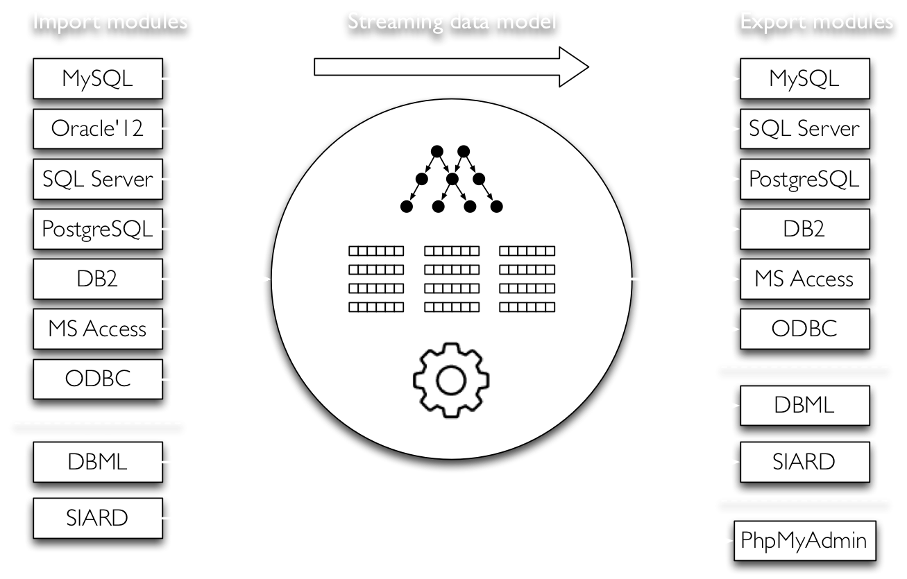
db-preservation-toolkit architecture

Slide 4
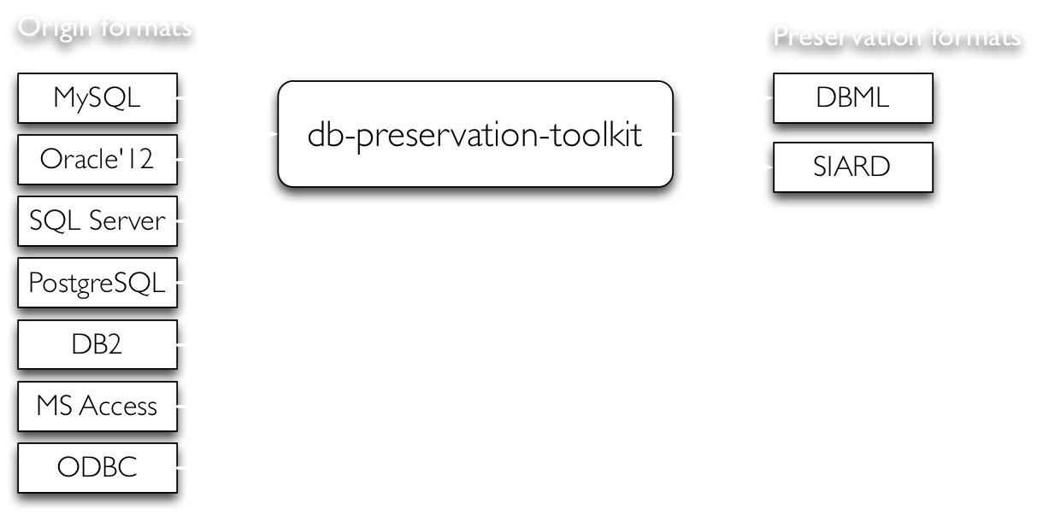
Pre-ingest / Production / SIP creation

Slide 5
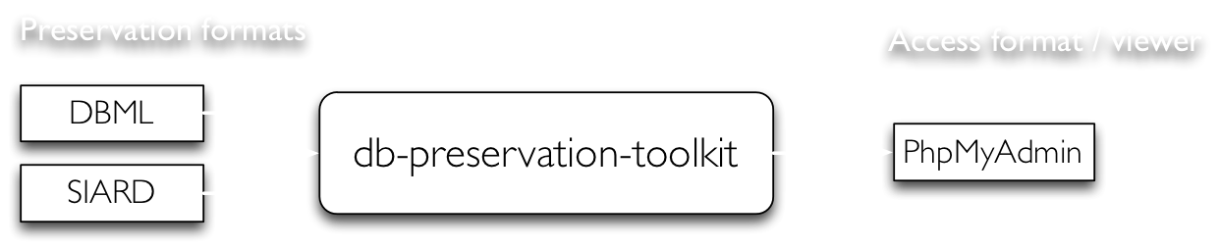
Access

Slide 6
Demonstration

Slide 7
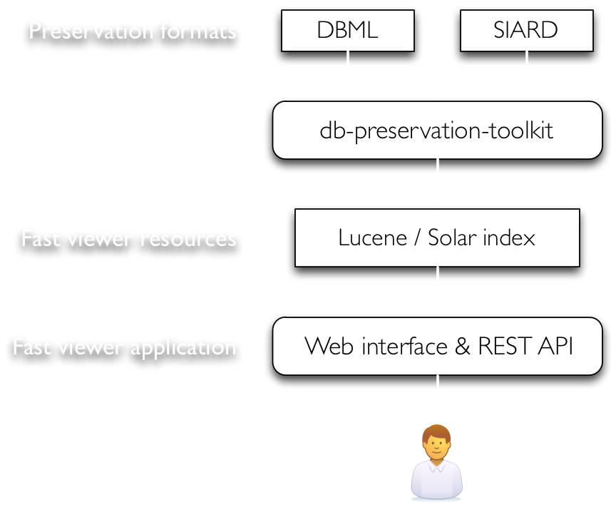
Future plan:
Fast database viewer

