Slide 1
AI JOB MATCHING PORTAL

Slide 2

OVERVIEW
The Job Portal with AI Matching is a web-based platform connecting companies and job seekers.

Slide 3

PROJECT MODULES

Slide 4
PROFILE MANAGEMENT
Companies post job openings.
Applicants upload resumes and specify preferences.

Slide 5
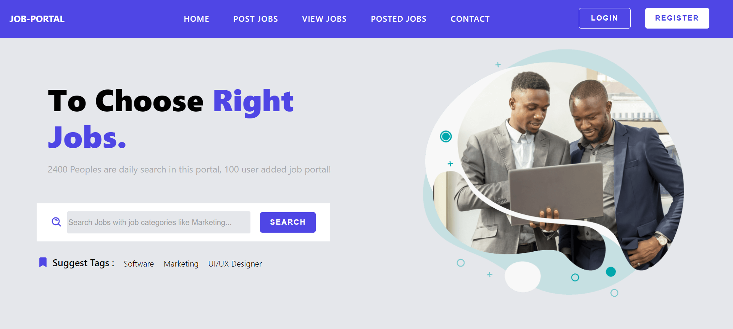

Slide 6
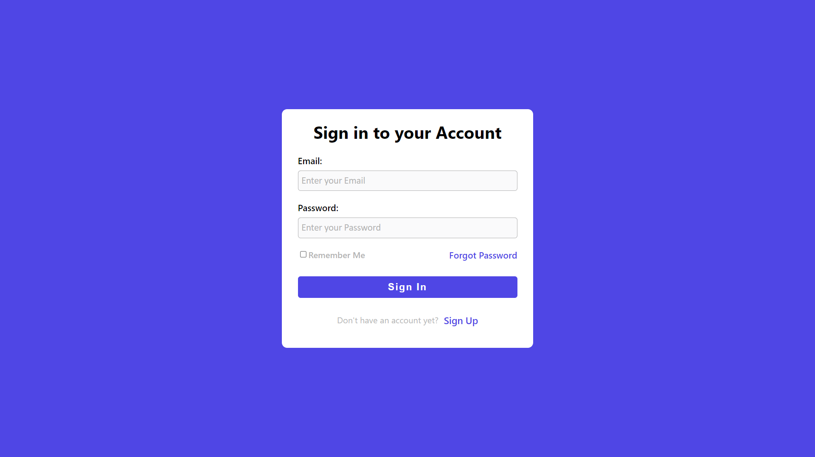
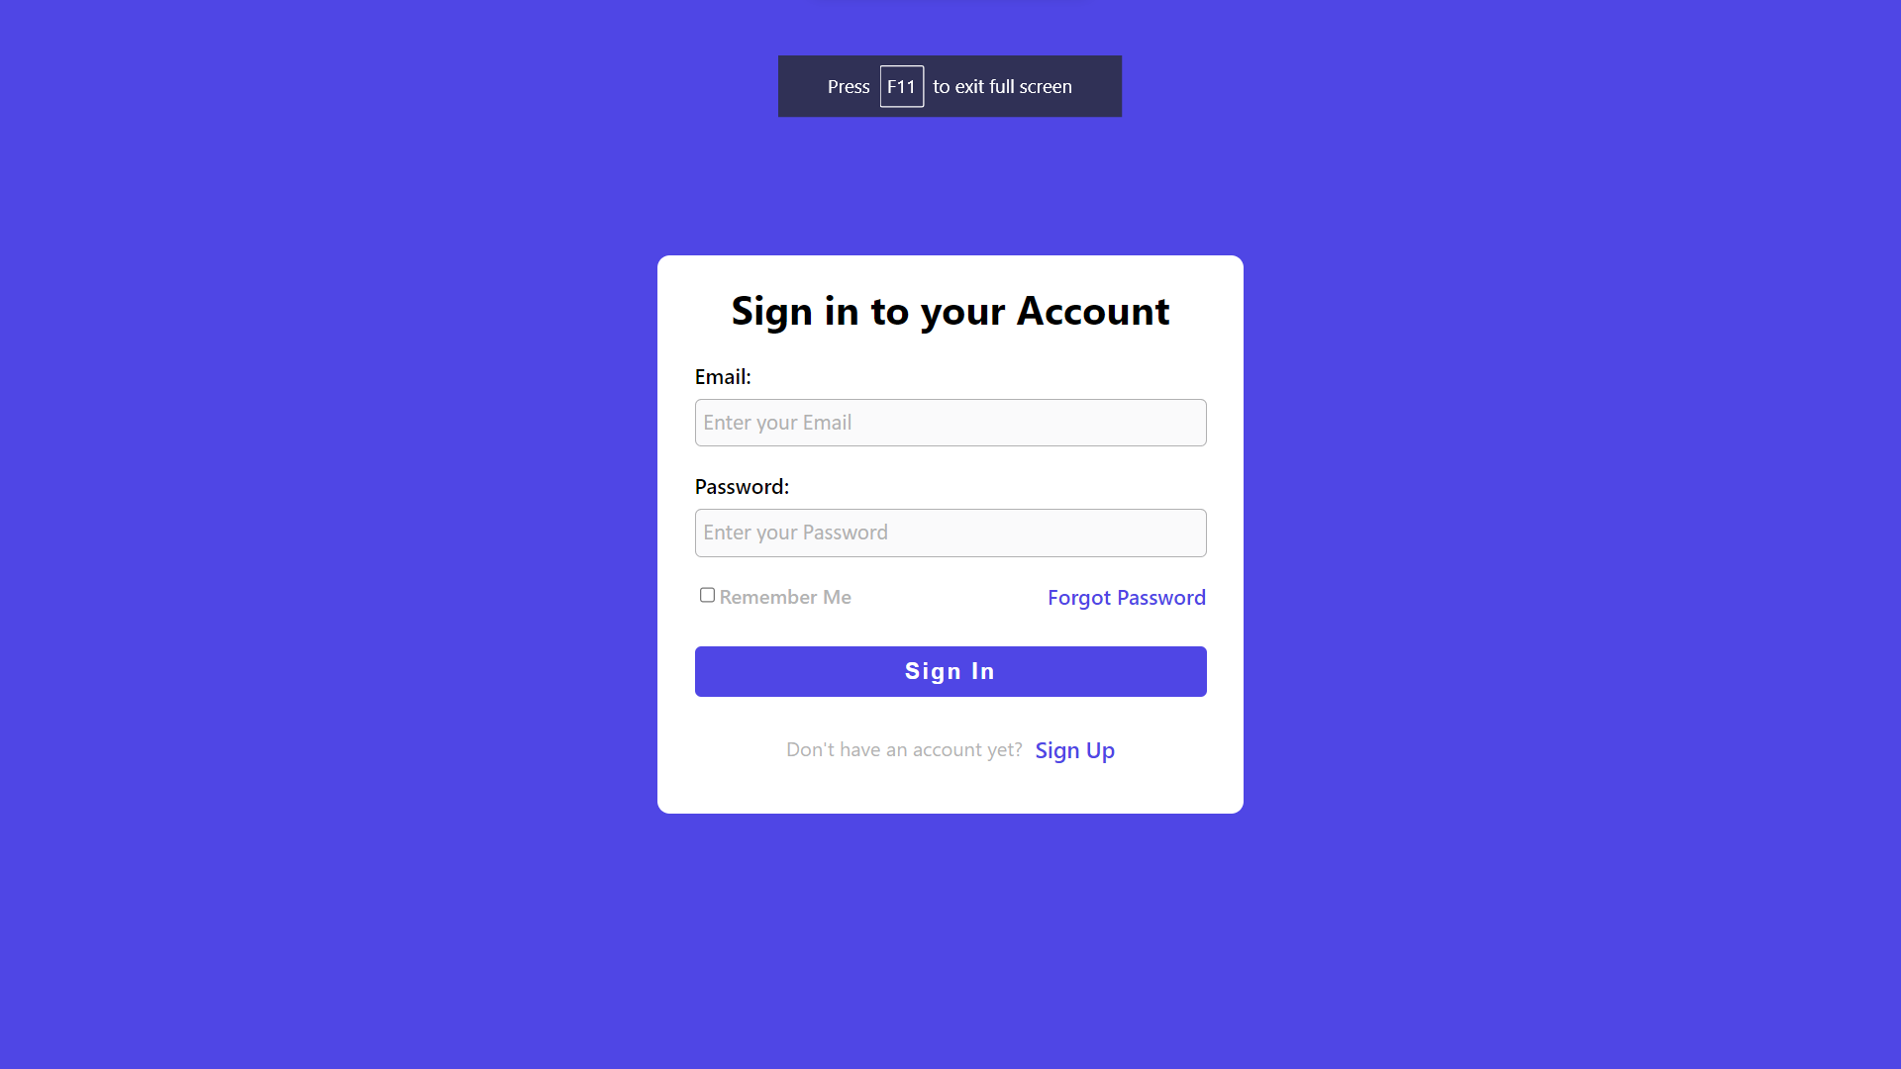

Slide 7
JOB POSTING
Companies share comprehensive job information.
Details include title, skills, experience, location, and deadline.

Slide 8
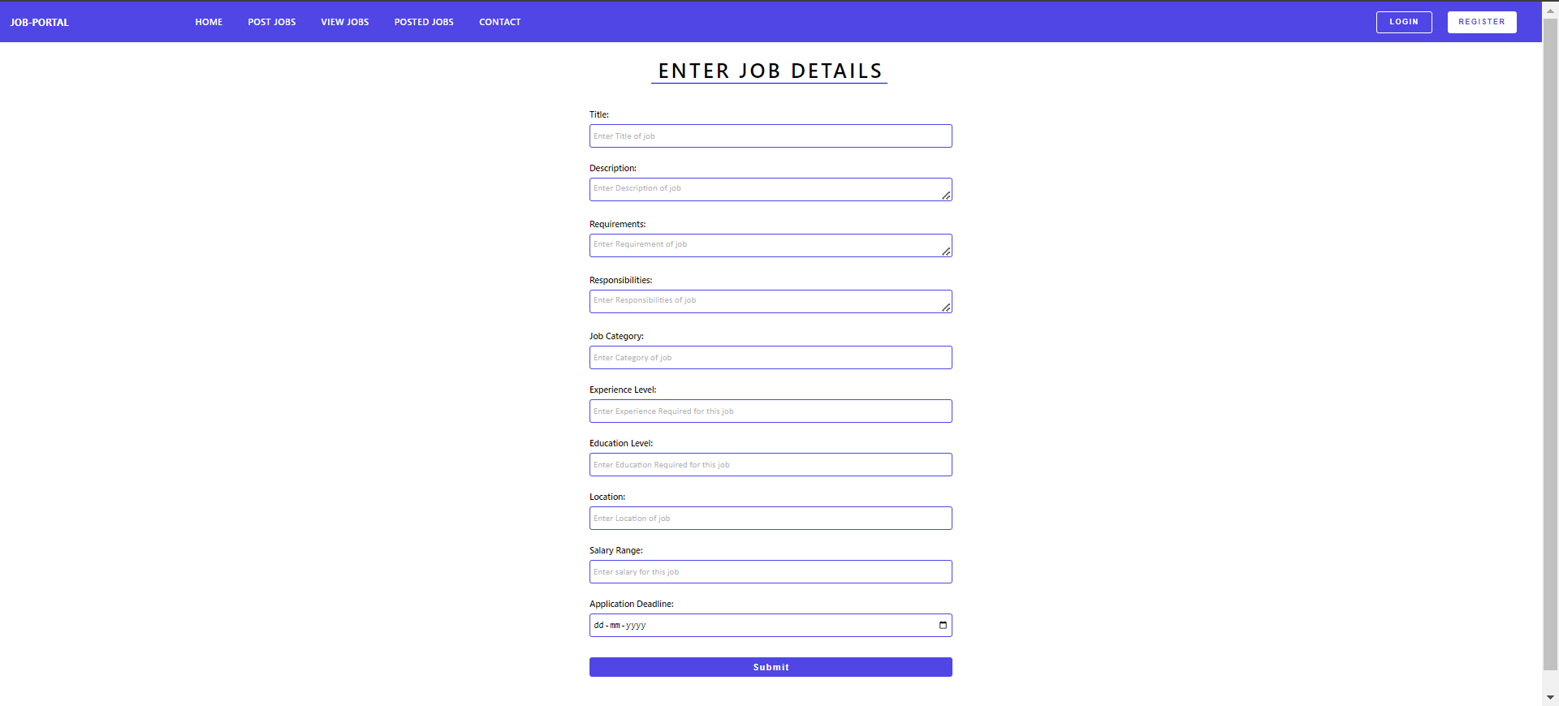

Slide 9
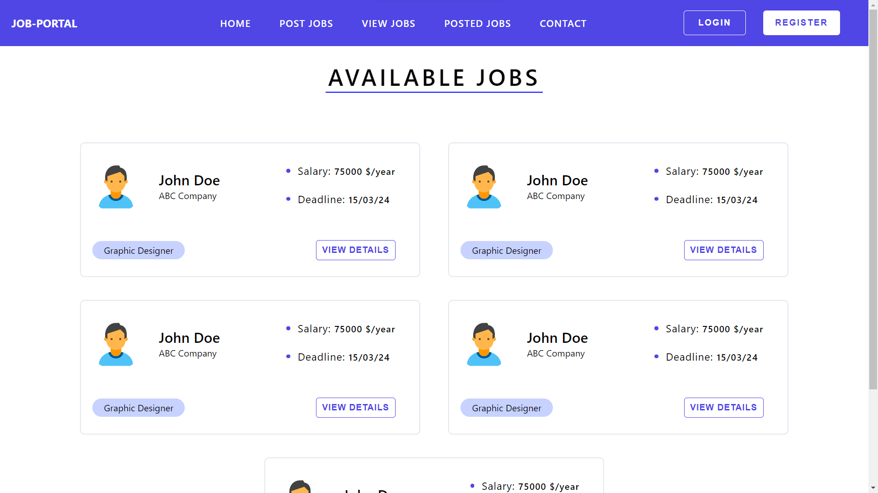
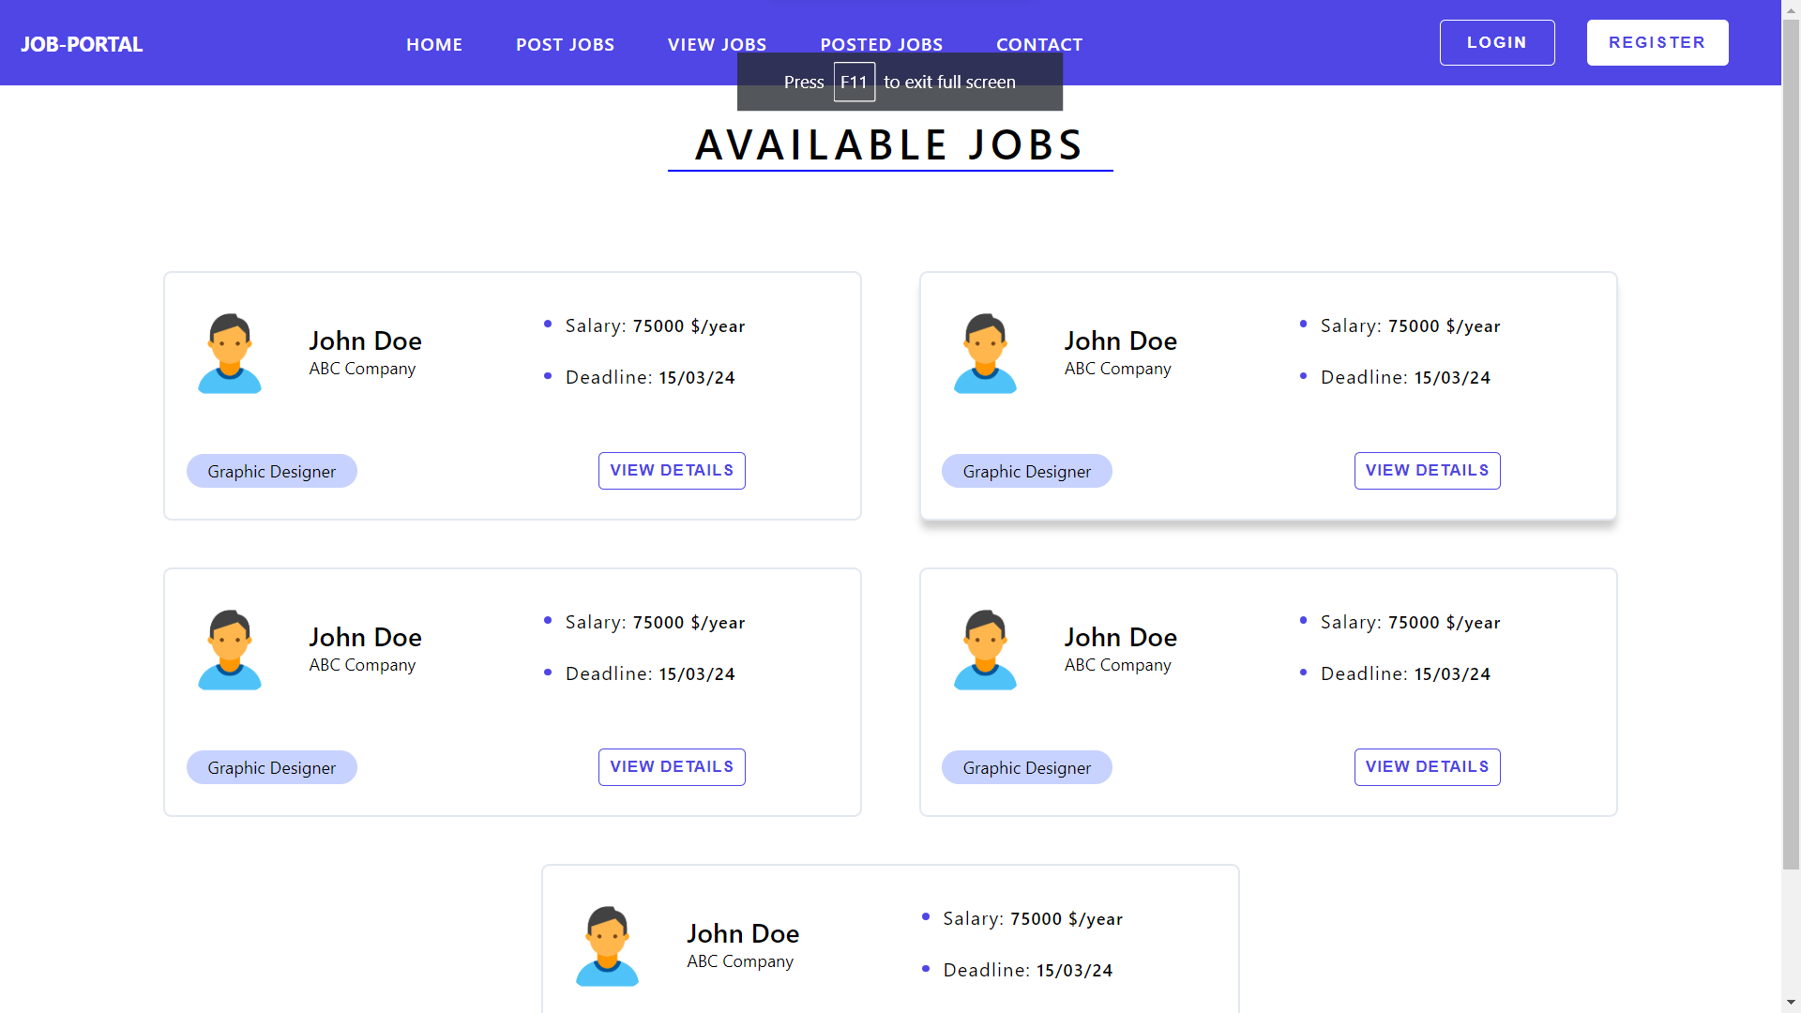
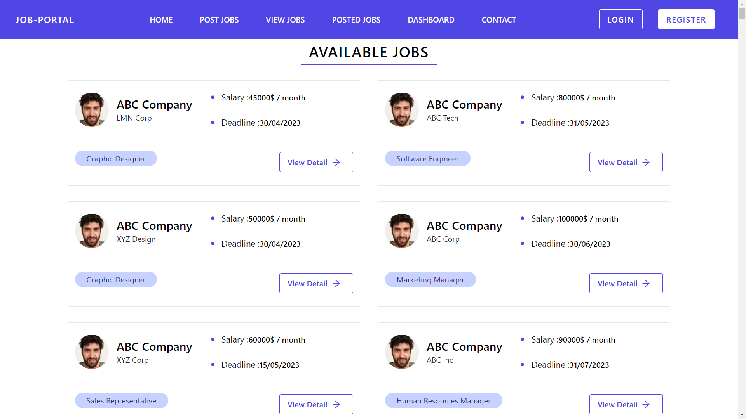

Slide 10
AI MATCHING ALGORITHM
Match job openings with applicants based on skills, experience, education, and location.

Slide 11

ADMIN PANEL
User management, job posting management, report generation, access controls.

Slide 12
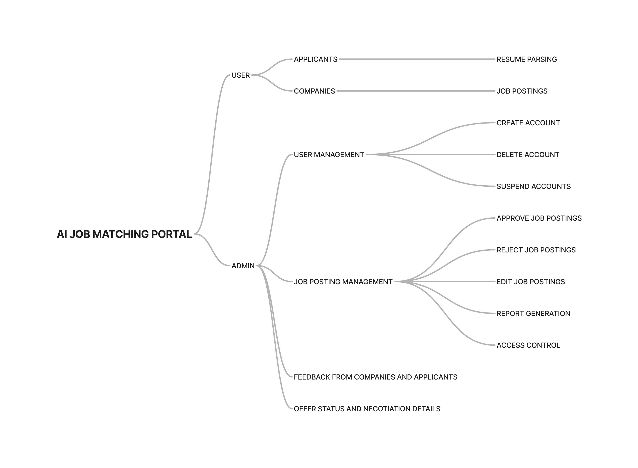

Slide 13
FEATURES​
Efficient Job Posting
Resume Parsing
AI-Based Matching
Mobile Compatibility
Application Tracking System (ATS)

Slide 14
TECHNOLOGIES
Node.js
Express.js
MongoDB
React.js
Python 3.10 (BERT as Pretrained Model)

Slide 15

CONCLUSION
Comprehensive job portal with AI matching for efficient job placement.

Slide 16
THANK YOU

