Slide 1
Computer Vision Final Project:
Frame Generation
徐志瑋 cw.hsu@mediatek.com

Slide 2
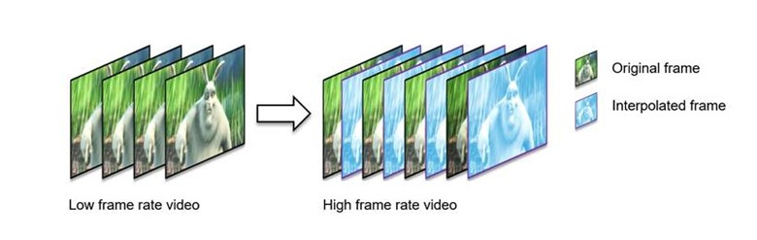
Frame Generation
Frame generation is a widely used technology in gaming and video processing to create and insert new frames between the existing frames.
  30 fps → 60 fps → 120 fps
Frame generation can also be applied to video compression.
  A to-be-compressed frame can be predicted by a generated frame.

Slide 3
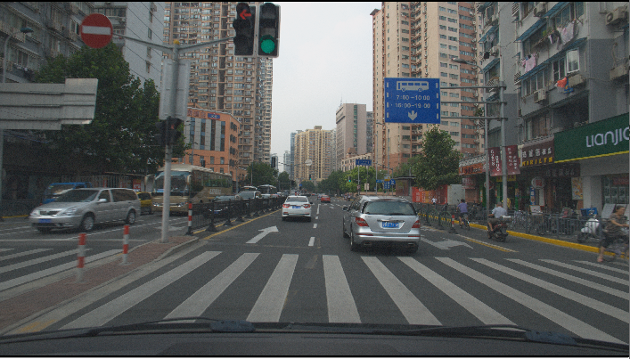
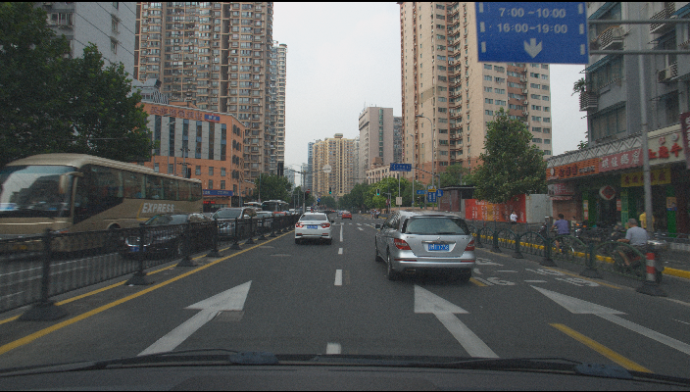
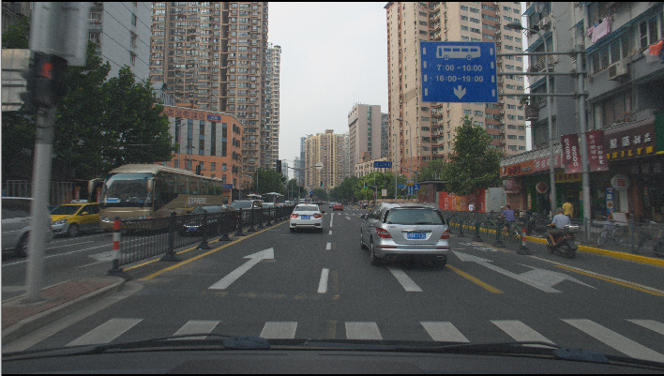
Project Goal
Given base layer (BL) frame of time index t, enhancement layer (EL) frame of t-1, and EL frame of t+1, please generate EL frame of t
  Given even frames of a 4K (3840x2160) video sequence
  Given odd frames of a Full High-Definition (FHD, 1920x1080) video sequence
  Generate odd frames of the 4K video sequence
t = 0
t = 1
t = 2
EL, 4K
BL, FHD

Slide 4
Project Goal
Given base layer (BL) frame of time index t, enhancement layer (EL) frame of t-1, and EL frame of t+1, please generate EL frame of t
  Given even frames of a 4K (3840x2160) video sequence
  Given odd frames of a Full High-Definition (FHD, 1920x1080) video sequence
  Generate odd frames of the 4K video sequence
t = 0
t = 1
t = 2
EL, 4K
BL, FHD

Slide 5
What You Need to Do
Download the data from TA
  Original 4K video sequences with odd frames
  Multi-layer bitstreams encoded by Versatile Video Coding (VVC/H.266), containing coded 4K layer and coded FHD layer
  VVC decoder
  Script for converting multi-layer bitstreams into even frames of 4K video sequences and odd frames of Full-HD video sequences
  PSNR and BD-rate calculating code

Slide 6
What You Need to Do
Convert multi-layer bitstreams into 4K/FHD video sequences as input
  For one original video sequence, there are 4 multi-layer bitstreams of different bitrates. Each bitstream will be decoded and converted into a 4K video sequence with even frames only and a FHD video sequence with odd frames only.
  The picture format is in 10-bit YUV420 progressive format.
    One luma/chroma sample is stored in two bytes. The value is stored in the least significant 10 bits of the two bytes.
Pic0_Y
3840x2160
Pic0_U
1920x1080
Pic0_V
1920x1080
Pic1_Y
3840x2160
Pic1_U
1920x1080
Pic0_V
1920x1080
…
Picture 0
Picture 1

Slide 7
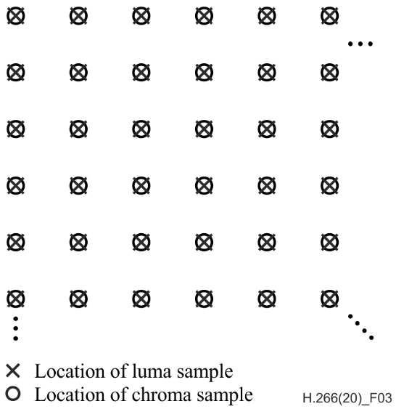
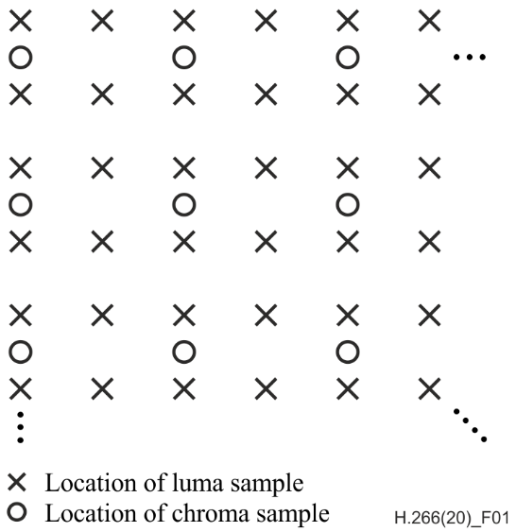
YUV420 Format
YUV444 format
  One luma sample with one U sample and one V sample
  Can be transformed to RGB444 directly
YUV420 format
  4 luma samples with one U sample and one V sample
  Need upsampling for chroma samples before transforming to RGB444

Slide 8
What You Need to Do
Generate 4K output video sequences with odd frames only
  You can use AI or non-AI methods
  Constraint: less than 200K MACs/pixel (3840x2160x200K MACs for a picture)
  Don’t need to output the last frame
Picture Count
1
2
3
4
596
597
598
599
0
Original
4K
…
FHD

Slide 9
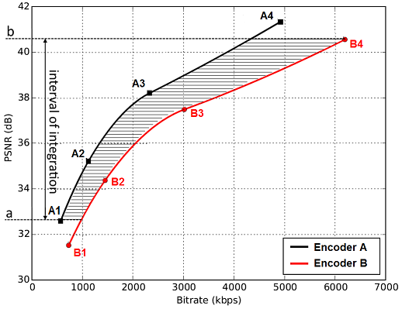

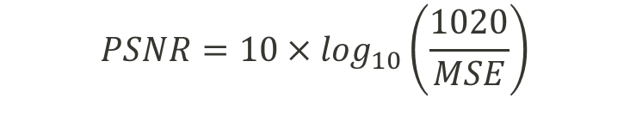
What You Need to Do
Calculate PSNR with original video sequences by using the provided code
Calculate BD-rate by using the provided code
  Need PSNR values of the 4 different bitrates
  Anchor: 4K video sequence upsampled from FHD video
  sequence by bicubic filter
  Negative value of BD-rate means better performance
$$PSNR=10×\log_{10}⁡\left(\frac{1020}{MSE}\right)$$
$$MSE=\frac{\sum{{\left(Ori −Pred\right)}^{2}}}{Total Samples}$$
https://medium.com/innovation-labs-blog/bjontegaard-delta-rate-metric-c8c82c1bc42c

Slide 10
Evaluation
We provided 4 video sequences for development and pre-evaluation.
Before the software deadline, please submit your source codes and report the BD-rates of the 4 video sequences.
We will provide 2 hidden video sequences after the software deadline.
Please report the BD-rates of the 4+2 video sequences.
  Please use the same source codes before and after the software deadline.

Slide 11
Evaluation - Score Criterion
Objective quality: (50%)
  BD-rate ranking (of 4+2 video sequences)
  In case of constraint violation
    Complexity > 200K MACs/pixel (-25%)
    Copy golden data directly (-50%)
Presentation: (50%) Top 10 teams
  Novelty and technical contribution (20%)
  Experiment completeness (25%)
  Presentation (5%)
Report: (50%) Other teams
  Novelty and technical contribution (25%)
  Experiment completeness (25%)
Points | # of teams
50% | 1
48% | 2
46% | 2
42% | The rest teams /4
38% | The rest teams /4
34% | The rest teams /4
30% | The rest teams /4
Notes:
Describe the algorithms you used. For example, how to generate the models, how to select the compensated blocks,, PSNR difference after applying post-processing.

Slide 12
Evaluation Server
To be announced by TA
Notes:
Describe the algorithms you used. For example, how to generate the models, how to select the compensated blocks,, PSNR difference after applying post-processing.

Slide 13
Project Output
The report of your final project
Generated video sequences
Description of your method
Source codes

Slide 14
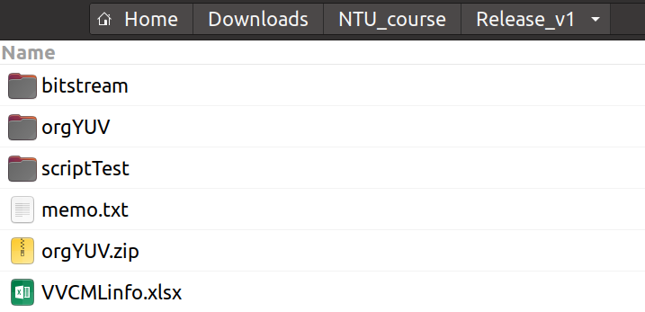
Initial final project directory
bitstream: compressed video files to be decoded
orgYUV: unzip orgYUV.zip. 4 uncompressed 4K videos with only odd frames
  For PSNR calculation
  View videos with YUView
    https://github.com/IENT/YUView
scriptTest
  Scripts for calculating BD-rate
memo.txt
  Best BD-rate you can get!
VVCMLinfo.xlsx
  Video information

Slide 15
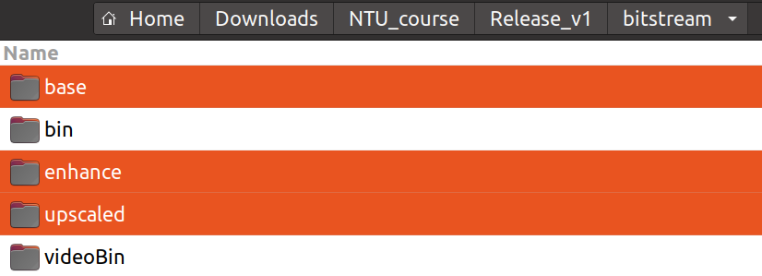
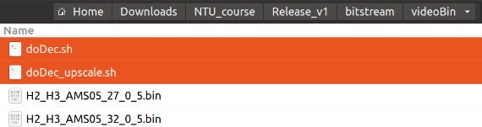
Decompress the bitstreams to get videos
Make sure you get storage space ~300GB and make sure “ffmpeg” is installed (“ffmpeg” command available in terminal)
Make sure there are 3 empty directories: “base/enhance/upscaled”
@Ubuntu (>=20.04), go to “bitstream/videoBin”, run two scripts:
  doDec.sh → get video in “base/enhance”
  doDec_upscale.sh → get video in
  “upscaled”

Slide 16
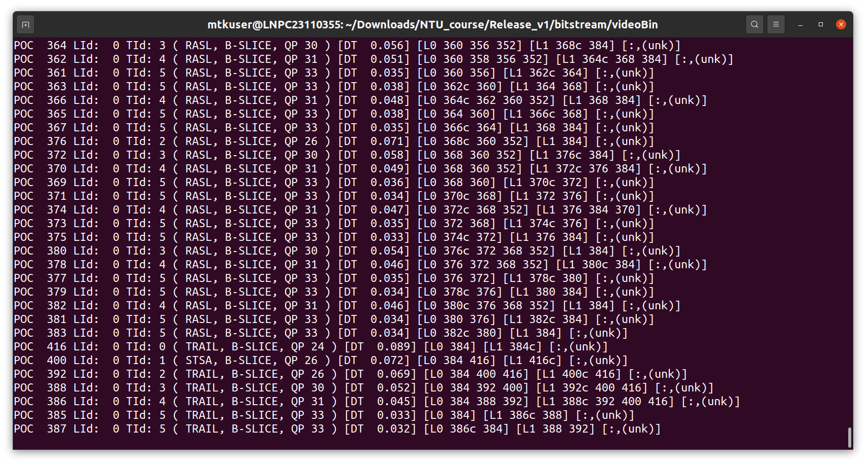
Video decoding in progress

Slide 17
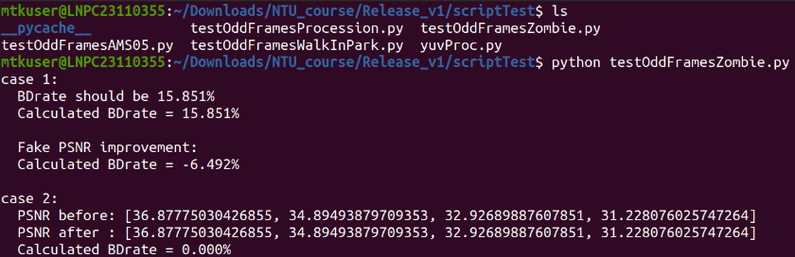
Measuring your performance
Go to “scriptTest”, there are 4 scripts for each video
  testOddFrameProcession.py, testOddFrameAMS05.py, testOddFrameZombie.py, testOddFrameWalkInPark.py
  For example, run “python testOddFrameZombie.py” to get the BD-rate
    BD-rate = 0.000% means no improvement comparing to just upscaling the video (as the videos in “upscaled”)
    More negative value of BD-rate means better performance (check last line of output to get BD-rate)

Slide 18
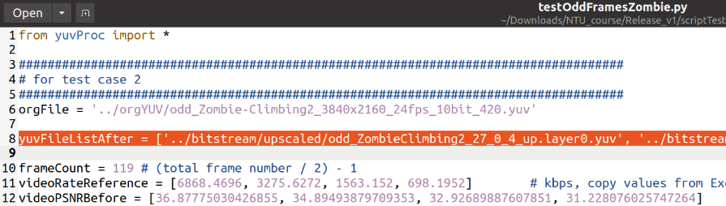
Put your own video files
Put your 4 files of odd frames of 4K resolution from high quality to low quality to be the list (“yuvFileListAfter”) in line 8 as the figure below and run the script to get BD-rate
Current exemplary video files in “yuvFileListAfter” are from “upscaled” where videos are upscaled by simple FIR filter
  Upscaled videos are served as baseline videos therefore the BD-rate is 0.000%

Slide 19
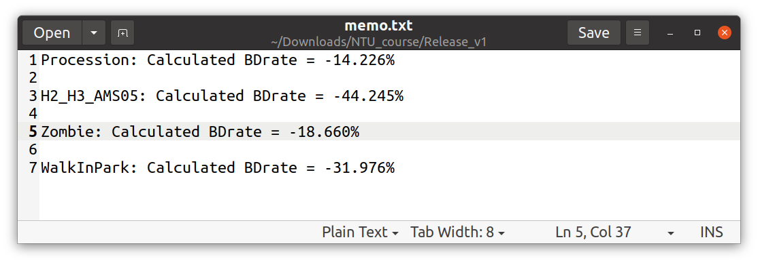

Best BD-rate you can get! Theoretically~~
Best BD-rate is evaluated by the decoded odd frames of 4K resolution (EL)
You should only use [1][2] as input
  [1] Videos in “base”, BL, odd frames of FHD (1080p)
  [2] Video in “enhance”, EL, even frames of 4K
  To generate odd frames of 4K resolution
Wish you a negative BD-rate! May the force be with you!

