Slide 1


STUDENT DETAILS
Name : Shivam M. Bhosle
SkillsBuild Email ID : shivambhosle270903@gmail.com
College Name : Bharati Vidyapeeth Deemed University Department of Engineering & Technology
College State : Navi Mumbai, Maharashtra
Internship Domain : Artificial Intelligence
Period : 12/06/2023 to 24/07/2023

Slide 2
AI MENTAL FITNESS TRACKER
Predict mental fitness rate of a person through various features
Mental health is just as important as physical health, and it is important to monitor our mental fitness just as we monitor our physical fitness. This project aims to develop an AI mental fitness tracker that can predict a person's mental fitness rate through various features.
The project will use a variety of machine learning techniques to train the AI model. The data for the model will be collected from a variety of sources, such as surveys, wearable devices, and social media.

Slide 3
AGENDA
1. | Overview
2. | Who are the End Users of this project?
3. | My Solution and its Value Proposition
4. | Modelling
5. | My Contribution
6. | Results
7. | Conclusion
8. | Links

Slide 4

OVERVIEW
The AI Mental Fitness Tracker is an innovative project that aims to predict the mental fitness rate of individuals using various features. Mental fitness plays a crucial role in our overall well-being and has a significant impact on our daily lives. However, monitoring and assessing one's mental fitness can be a complex and subjective task.
Features:
Data-Driven Insights
Machine Learning Algorithms
Predictive Models
Data Collection

Slide 5

Who are the End Users of this project?
The end users of the AI Mental Fitness Tracker project are doctors and other healthcare professionals who will use the tracker to help their patients improve their mental health. The tracker will provide doctors with a comprehensive overview of their patients' mental fitness, including location and various mental disorders. This information will help doctors to diagnose mental health problems and to develop personalized treatment plans.

Slide 6

MY SOLUTION AND ITS VALUE PROPOSITION
The AI Mental Fitness Tracker offers a unique and valuable solution to predict mental fitness levels. By leveraging advanced machine learning algorithms and incorporating various features, we provide accurate and objective assessments of mental well-being. Early detection of potential issues enables timely intervention, preventing the escalation of problems. Furthermore, our project contributes valuable data-driven insights to researchers. Overall, our solution enhances individual well-being and fosters a society that prioritizes mental fitness.

Slide 7
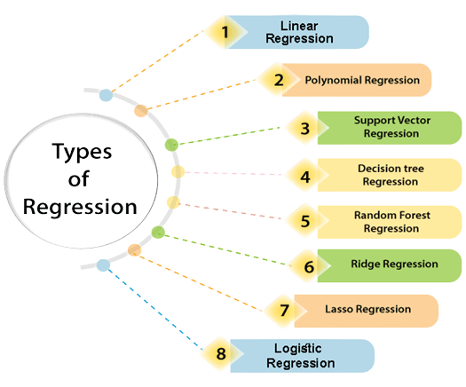
MODELLING
Linear Regression : Linear regression algorithm shows a linear relationship between a dependent (y) and one or more independent (y) variables.
Random Forest Regression : It builds multiple decision trees to make predictions. It is a more complex regressor, but it is also more accurate.
Decision Tree Regression : Decision Tree is a decision-making tool that uses a flowchart-like tree structure or is a model of decisions and all of their possible results, including outcomes, input costs, and utility.

Slide 8

MY CONTRIBUTION
I implemented three regression models: Linear Regression, Random Forest Regression, and Decision Tree Regression. Each of these models has its own strengths and limitations. By incorporating multiple regression models, I aimed to enhance the accuracy and reliability of the mental fitness predictions.
To select the best model for the project, I conducted rigorous testing and evaluation. I compared the performance of each model based on metrics such as mean squared error, R-squared value. After thorough analysis, I determined the most suitable regression model that demonstrated the highest predictive accuracy and stability for mental fitness rate estimation.
This customization allowed me to optimize the AI Mental Fitness Tracker by leveraging the strengths of different regression models and selecting the most robust and accurate one.

Slide 9
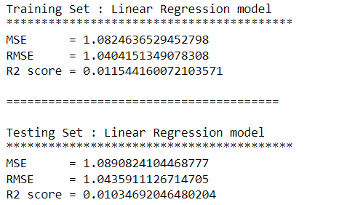
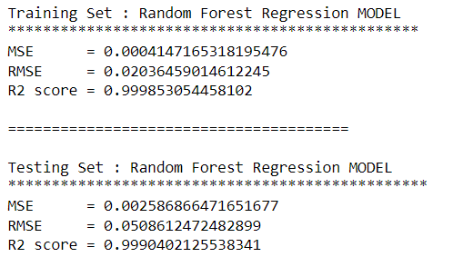
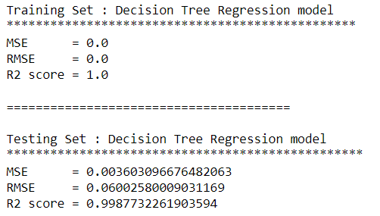
RESULTS
Linear Regression model
Random Forest Regression model
Decision Tree Regression model

Slide 10
CONCLUSION
The Linear Regression model's performance for both the training and testing sets is not particularly strong. The mean squared error (MSE) and root mean squared error (RMSE) indicate relatively high levels of error, while the R2 score suggests that only a small portion of the variance in the data is explained by the model.
The Random Forest Regression model shows excellent performance on both the training and testing sets. It achieves a high R2 score of around 0.999, indicating that it can explain a significant portion of the variance in the target variable. The mean squared error (MSE) and root mean squared error (RMSE) values are also low, suggesting good predictive accuracy. Overall, the model demonstrates strong performance in predicting the target variable.
The Decision Tree Regression model performed very well on both the training and testing sets. The MSE, RMSE, and R2 scores for the training set are all 0, which indicates that the model perfectly predicted the training data. The MSE and RMSE scores for the testing set are very small, and the R2 score is very close to 1, which indicates that the model also performed well on the testing data. Overall, the Decision Tree Regression model is a good choice for this regression task.
From the above 3 Models, RANDOM FOREST RERESSION MODEL & DECISION TREE REGRESSION MODEL will be a good choice for the given data files.

Slide 11
LINKS
Project Link : https://github.com/007-Shivam/AI_Mental_Health_Tracker
References :
https://www.javatpoint.com/artificial-intelligence-ai
https://www.javatpoint.com/machine-learning
https://www.geeksforgeeks.org/random-forest-regression-in-python/
https://www.geeksforgeeks.org/python-decision-tree-regression-using-sklearn/
https://www.javatpoint.com/linear-regression-in-machine-learning

