Slide 1
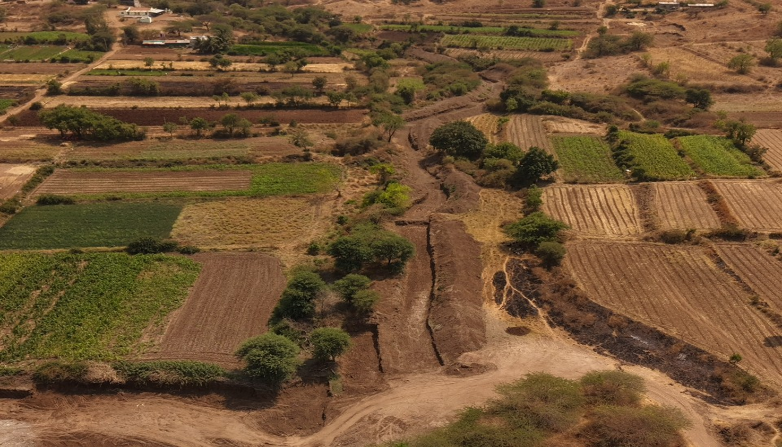
Integrated Watershed Management Project (IWMP)
Climate Resilience & Sustainable Livelihoods
SJSM · SATARA
PROJECT COMPLETION R E P O R T
LOCATION
Veloshi, Block – Phaltan, Dist. Satara
January 2026– March 2026
PERIOD
Shramjivi Janata Sahayyak Mandal

Slide 2
Table of Contents
CONTENTS
01
Executive Summary
3
02
Project Overview & Background
4
03
Objectives & Scope
4
04
Key Interventions & Approach
5
05
Key Achievements & Milestones
6
06
Outcomes & Impact
7
07
Challenges & Mitigation
8
08
Lessons Learned
8
09
Sustainability & Roadmap
8
10
Monitoring & Evaluation
9
11
Events & Campaigns
9
12
Case Studies & Success Stories
10
13
Community Feedback
10
14
Field Photography
11

Slide 3
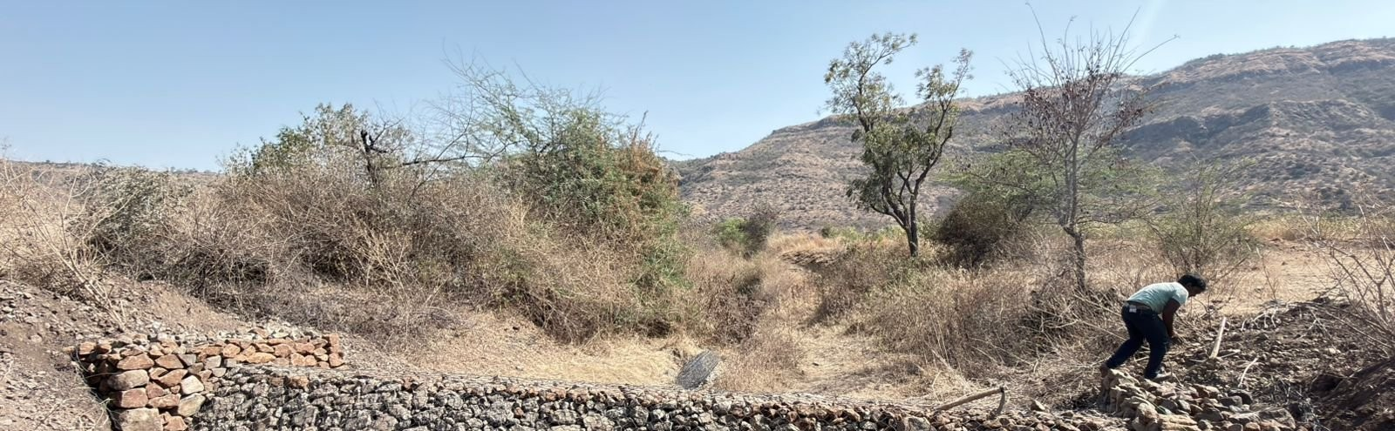
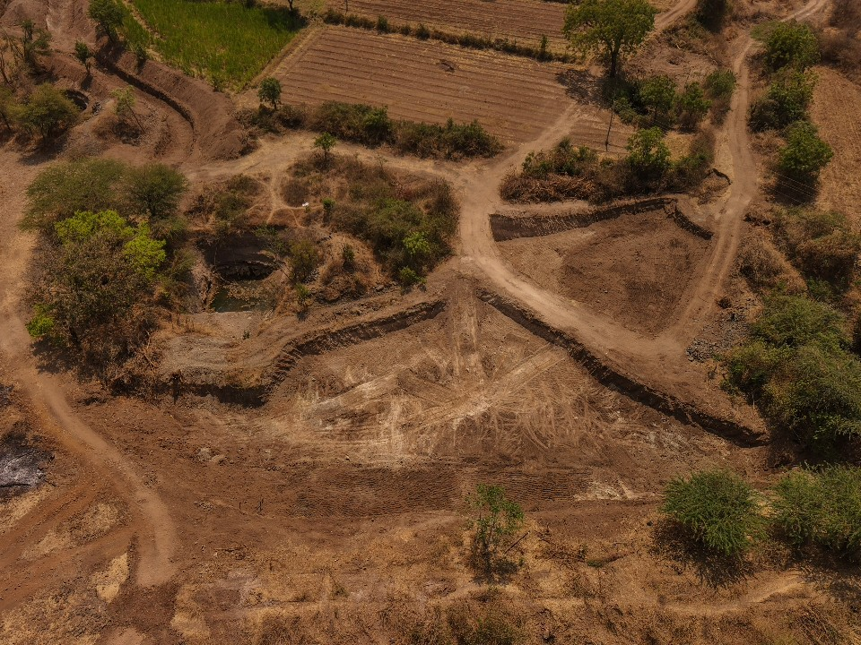
Executive Summary
01 · EXECUTIVE SUMMARY
98
Households
Direct Beneficiaries
18
Acres
Land Reclaimed
100%
Complete
All 6 Targets Met
38,000
m³
Total Earthwork
The project reached a final milestone during January–March 2026 with 100% execution of all proposed primary activities. All structural and earthwork interventions met their targets, providing immediate agricultural benefits — land reclamation and enhanced water storage — for the farming community of Veloshi.
Soil Conservation
1 Gabion + 15 Loose Boulder structures fully completed, protecting watershed integrity.
Land Reclamation
18 acres of barren land converted to fertile farmland using nutrient-rich desilted soil.
Water Management
38,000 m³ of Nala deepening and desilting achieved, improving drainage and storage.
Community Impact
98 farming families are directly & 72 indirectly benefiting from improved land and water access.

Slide 4
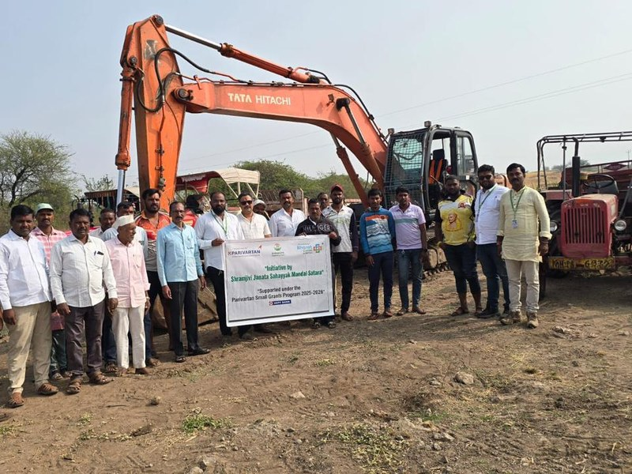
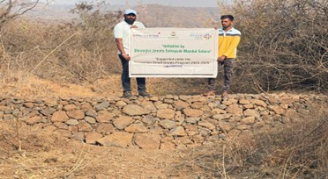
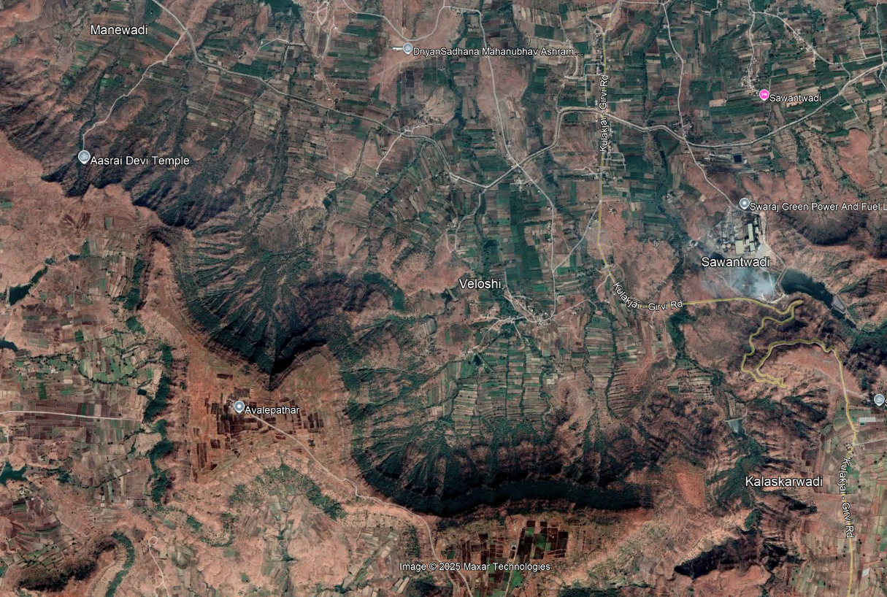
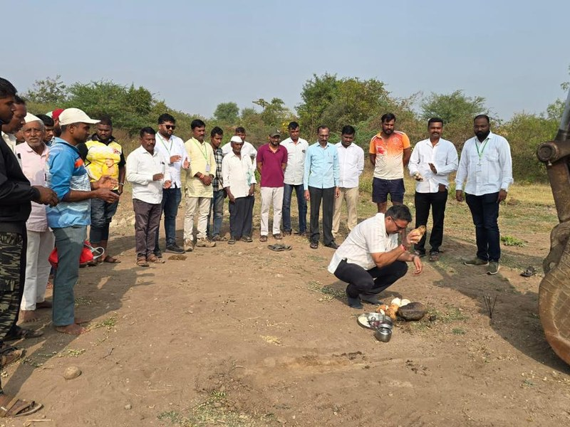
Project Overview & Background
02 · PROJECT OVERVIEW & BACKGROUND
LOCATION | PERIOD
Veloshi, Block Phaltan Dist. Satara Maharashtra | January – March 2026 (Final Reporting)
Background & Context
Shramjivi Janata Sahayyak Mandal (SJSM) is a registered NGO based in Satara, Maharashtra, committed to integrated watershed development and rural livelihood support. Supported by the Parivartan Small Grants Programme of HDFC Bank, this initiative restores the watershed in Veloshi village — a rain-fed agricultural community vulnerable to monsoon variability.
Project Scope Beneficiary Profile
Geographic focus on Veloshi, Satara watershed
98
Households
Gabion & Loose Boulder construction for soil conservation
Nala deepening/widening and ENB desilting
Land reclamation through desilted soil distribution
Farmer Exposure Visit for community knowledge transfer
directly benefiting from
soil distribution & land prep

Slide 5
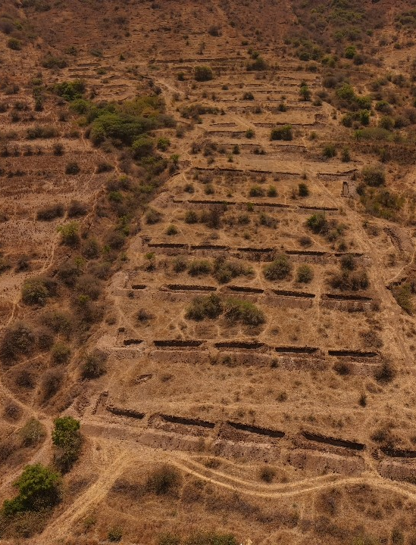






Key Interventions & Approach
04 · KEY INTERVENTIONS & APPROACH
01
Loose Boulder Structures
Target: 15 No. Achieved: 15 No.
Fifteen permeable check dams placed across seasonal streams to slow water flow, encourage infiltration, and reduce soil loss from sloped agricultural fields.
Gabion Structures
1 No. Achieved: 1 No.
02
Target:
Wire-mesh rock structures built to stabilise stream banks, reduce water velocity, and prevent downstream erosion — especially critical during monsoon floods.
03
04
Staggered Contour Trenches
Target: 4,500 m³ Achieved: 4,500 m³
Trenches dug across hill slopes capture rainwater for percolation, enhancing groundwater recharge and providing moisture to vegetation through dry periods.
Nala Deepening & Widening
Target: 19,000 m³ Achieved: 19,000 m³
Deepening and widening of seasonal streams to improve water carrying capacity, storage, and drainage — reducing flood risk and extending water availability.
05
Desilting of Water Bodies
06
Farmer Exposure Visit
Target: 1 Visit Achieved: 1 Visit
Structured field visit to Village Ghatdare demonstrated best practices in watershed management, building local capacity for ongoing maintenance and replication.
Target: 19,000 m³ Achieved: 19,000 m³
Existing water bodies were desilt ed to restore capacity. Nutrient-rich excavated soil was redistributed to reclaim 18 acres of barren agricultural land.

Slide 6
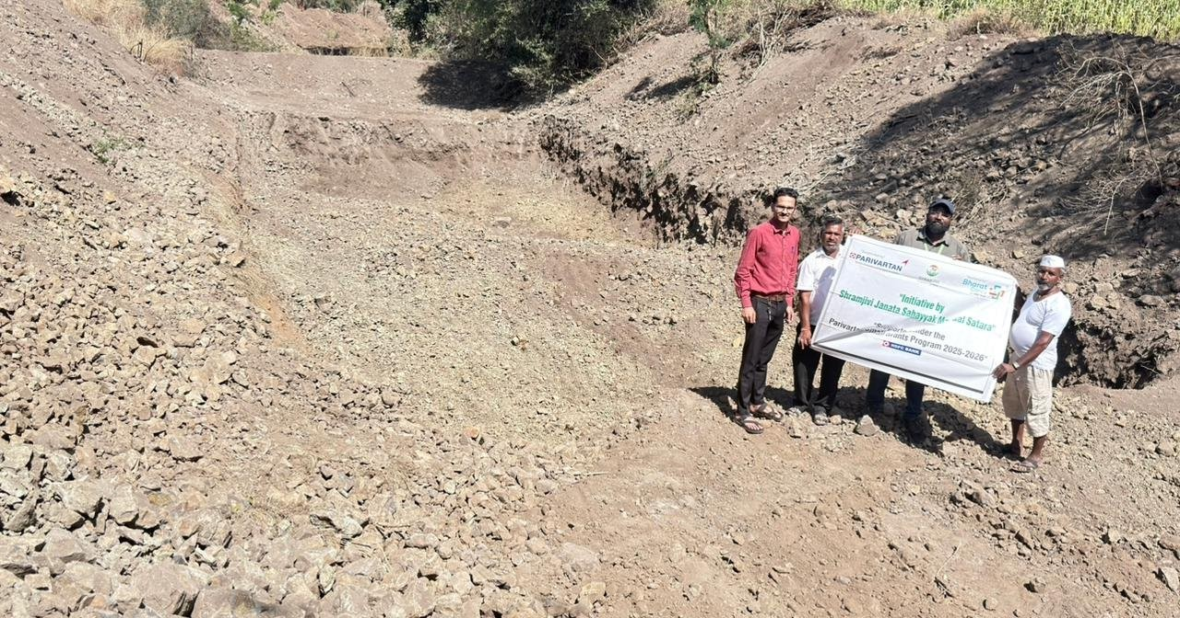
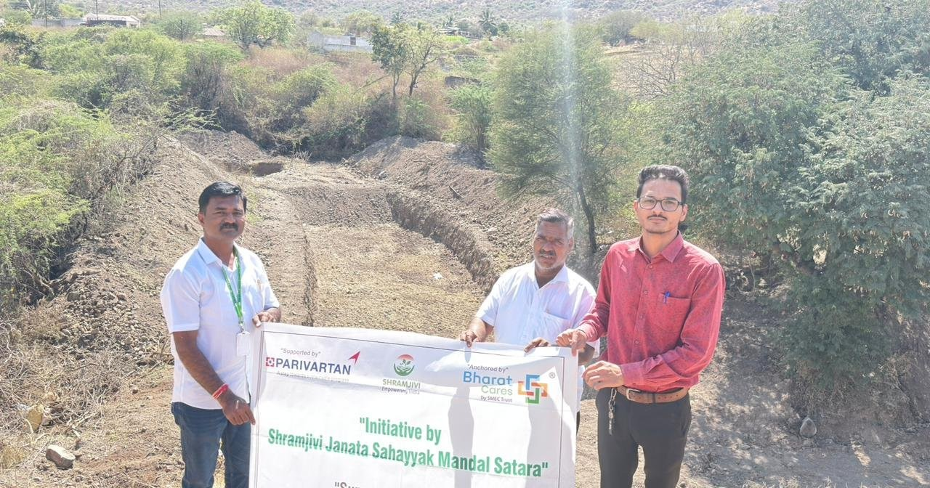
100% Targets Met
Every planned intervention completed on time — meeting or exceeding all targets.
05 · KEY ACHIEVEMENTS & MILESTONES
Activity / Intervention | Target | Achieved | Status
Gabion Structures | 1 No. | 1 No. | 100%
Loose Boulder Structures (LB) | 15 No. | 15 No. | 100%
Staggered Contour Trenches (SCT) | 4,500 m³ | 4,500 m³ | 100%
Desilting of Small ENB | 19,000 m³ | 19,000 m³ | 100%
Nala Deepening & Widening | 19,000 m³ | 19,000 m³ | 100%
Farmer Exposure Visit | 1 Visit | 1 Visit | 100%
,,
“Every watershed intervention fully delivered on time — a milestone reflecting the entire team’s dedication to climate-resilient development.”
16
Structures Built
38,000
m³ Earthwork
4,500
m³ SCT
18 acres
Reclaimed
Achievement Rate
100%
Gabion
100%
Loose Boulders
100%
SCT
100%
Desilting
100%
Nala Work
100%
Exposure Visit
Nala Deepening Work
Desilted Soil Distribution

Slide 7
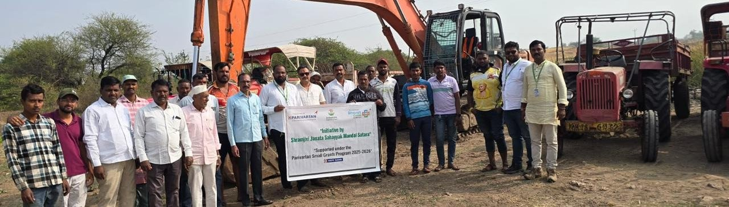
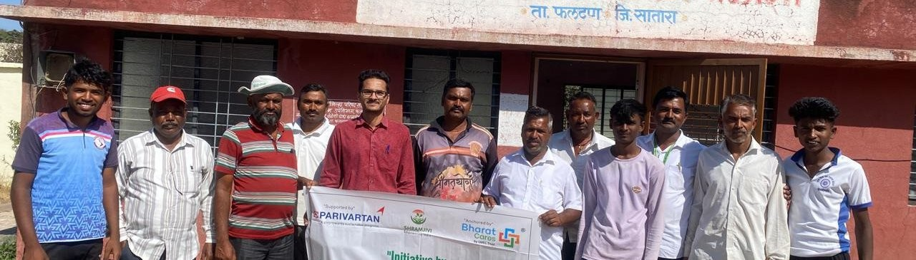
Transforming Land, Water & Lives
06 · OUTCOMES & IMPACT
18
Acres
Barren land converted to cultivable farmland
98
Households Direct beneficiaries from desilted soil
19,000
m³
Nala deepening & widening completed
19,000
m³
Desilting of existing water bodies
4,500
m³
Contour trenches constructed
Land Reclamation
Water Infrastructure
Through 19,000 m³ of desilting, nutrient-rich soil was distributed across 18 acres of barren land, directly expanding the cultivable area for 98 beneficiary families.
Combined Nala deepening and desilting (38,000 m³ total) has dramatically improved drainage and water storage across the Veloshi watershed, reducing flood risk and extending irrigation access.
Climate Resilience
Community Empowerment
Pre-monsoon completion of all Gabions, Loose Boulders, and SCT means the watershed now harvests and retains rainfall, reducing runoff and replenishing groundwater reserves.
The Farmer Exposure Visit equipped local stakeholders with hands-on watershed knowledge. Water User Group formation will ensure community-led maintenance of all completed infrastructure.
Events & Field Campaigns
Project INAUGURATION
On February 3, 2026, the project was inaugurated at Veloshi village in Phaltan block, with villagers and SJSM members in attendance.
Land Reclamation Drive
Veloshi, Block Phaltan, Satara
Awareness campaign on the benefits of using nutrient-rich desilted soil for farmland reclamation. All 98 beneficiary households were reached with guidance on land preparation and crop selection for newly converted 18-acre plots.

Slide 8
Challenges, Lessons & Future Roadmap
07–09 · CHALLENGES, LESSONS & ROADMAP
Challenge Encountered & Overcome
Finalising the last 1,500 m³ of Nala deepening within the reporting deadline required intensive daily monitoring and field execution by site supervisors. Through sustained effort, 100% of the targeted 19,000 m³ was ultimately achieved.
What Worked
What Could Improve
Recommendations
Integration of desilting with land reclamation converted 18 acres of barren land. Pre-monsoon structural completion ensured immediate water harvesting before rains arrived.
A single Farmer Exposure Visit limits deep knowledge transfer. More frequent community engagement sessions would enhance adoption of watershed management techniques.
Future projects should soil-test desilted material before distribution to optimise crop selection. Form Water User Groups for long-term maintenance of all completed structures.
Sustainability & Future Roadmap
Sr. No. | Component | Description | Key Focus Area
01 | Capacity Building | Conducted training for all 28 beneficiary Households on sustainable agriculture and soil management for newly reclaimed land. | Farmer training & soil sustainability
02 | Community Ownership | Established water user groups from local farming communities to ensure long-term maintenance of watershed structures. | Local governance & maintenance
03 | Scale & Continuity | Expanded the nala deepening model to adjacent watersheds in Phaltan Block, replicating 19,000 m³ earthwork approach. | Model replication & expansion

Slide 9
Monitoring & Evaluation
10 · MONITORING, EVALUATION & COMPLIANCE
Mechanism | Frequency | Responsible | Key Finding
Field Visits | Regular | Mr. Suresh Kadam (PM) | Verified SCT & desilting completion
Weekly Updates | Weekly | Site Supervisors | Tracked Nala widening to 19,000 m³
Dashboards | Monthly | Project Mgmt. Unit | Progress vs all 6 targets visualised
Progress Rpts | Monthly | Reporting Team | Feb–Mar 2026 achievements compiled
Audit | End-of-Project | Financial Auditor | Aligned with Parivartan SGP guidelines

Slide 10
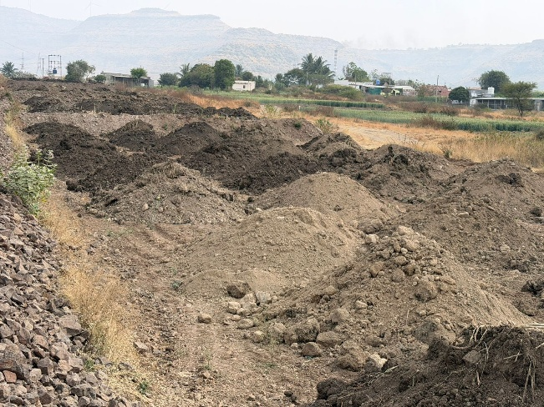
Success Stories & Community Voices
12–13 · SUCCESS STORIES & COMMUNITY VOICES
Transforming Barren Land
into Productive Farmland
In Veloshi village, what was once infertile rocky land now sustains crops for 39 farming families. Through 19,000 m³ of strategic desilting, the project restored water bodies and unlocked 18 acres of agricultural potential. Nutrient-rich sediment, carefully redistributed, has transformed the soil profile of barren plots, giving each family a direct stake in the watershed’s recovery.
Land Reclamation Water Conservation 98 Beneficiaries Satara
“
The structural and earthwork
interventions have successfully met their primary targets, resulting in
“
18 acres of previously barren land
have been transformed into cultivable agricultural land — a life-changing
“
All proposed activities — Gabions, SCT,
and Nala work — were fully executed on time. A remarkable achievement in
immediate agricultural benefits for
our community.
outcome for our families.
watershed management.
Chandrakant Jadhav
Sunil Mane
Benefited Farmer, Veloshi
Ram Kolekar
Head Operations SJSM.
Sarpanch, Veloshi

Slide 11
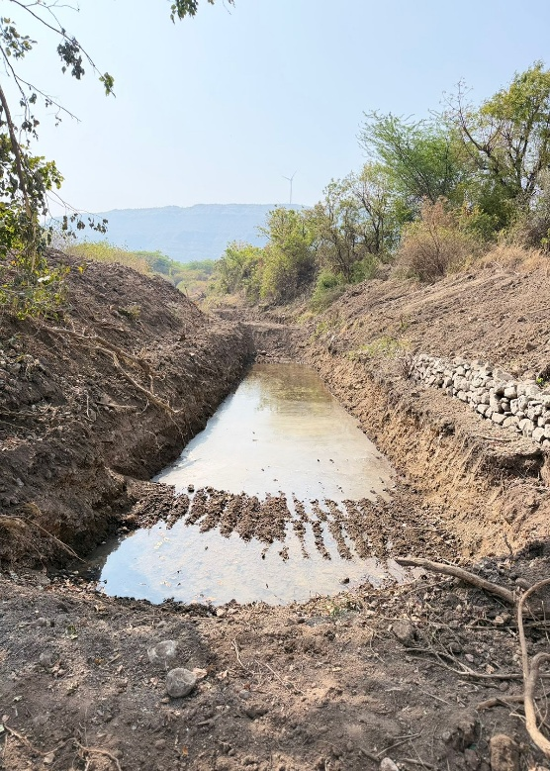
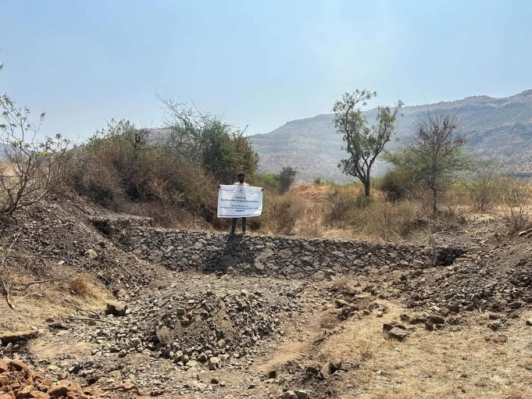
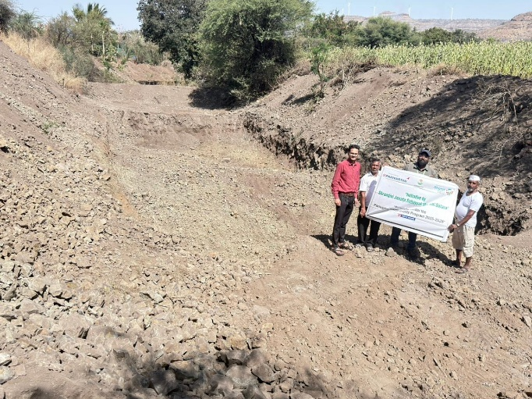
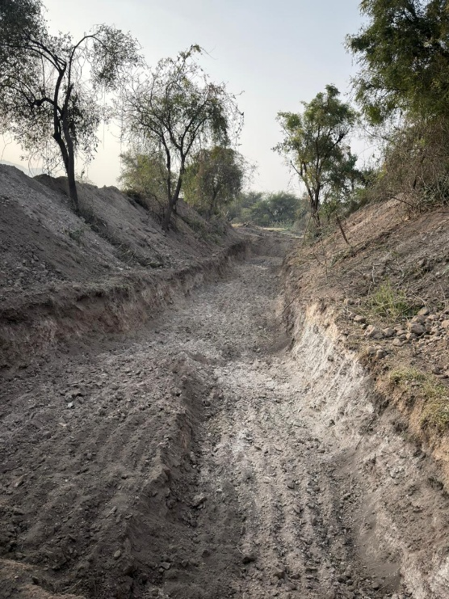
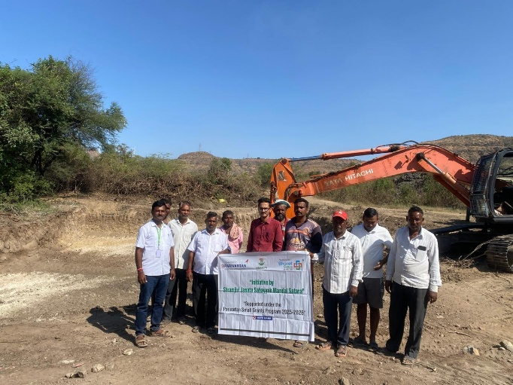

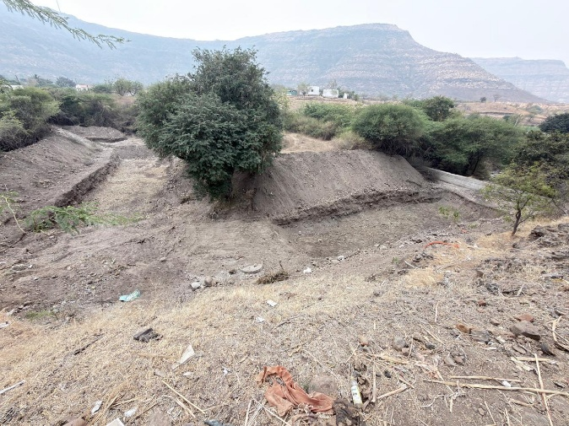
Project in Action
14 · FIELD PHOTOGRAPHY

Slide 12
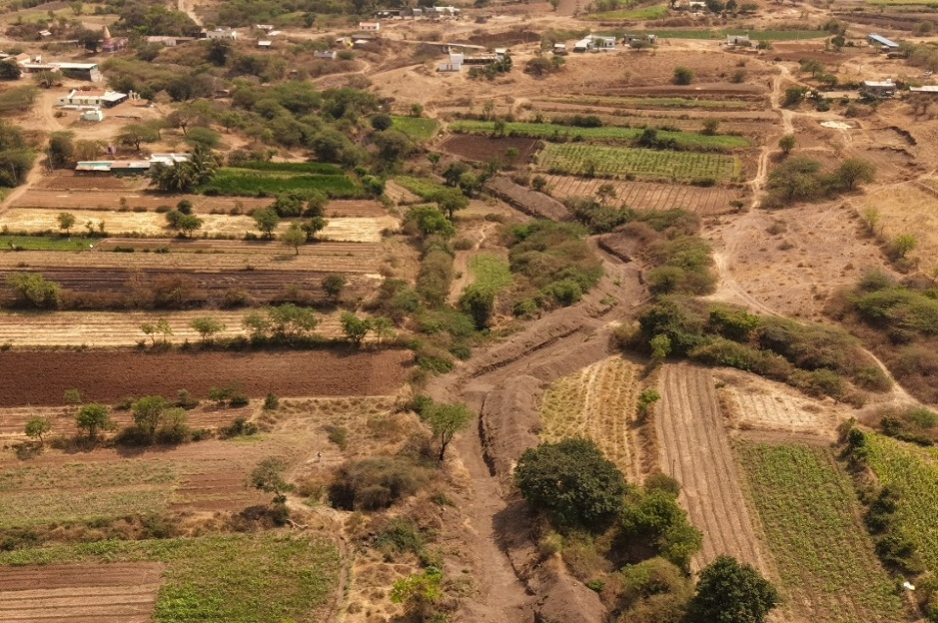
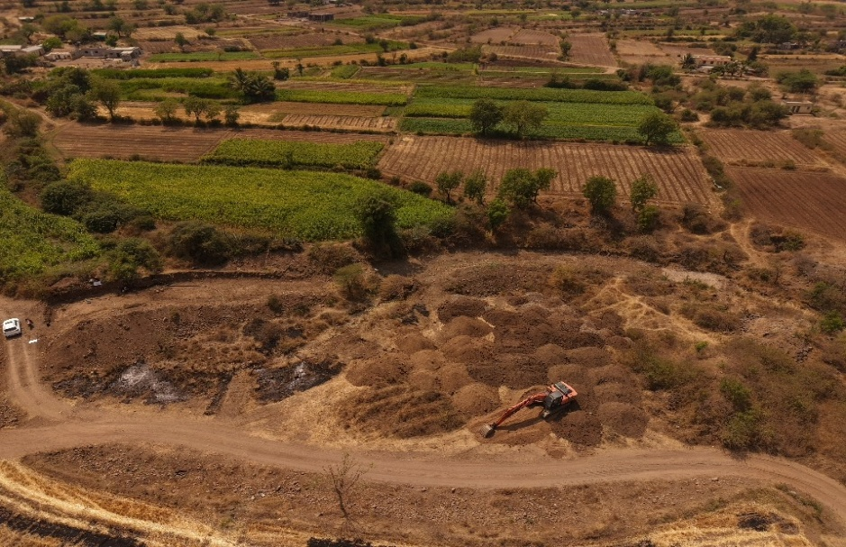
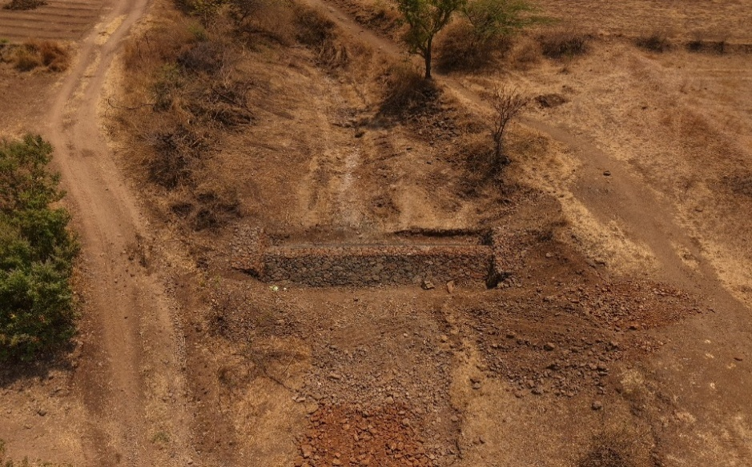
DroNe Photographs
14 · FIELD PHOTOGRAPHY

Slide 13
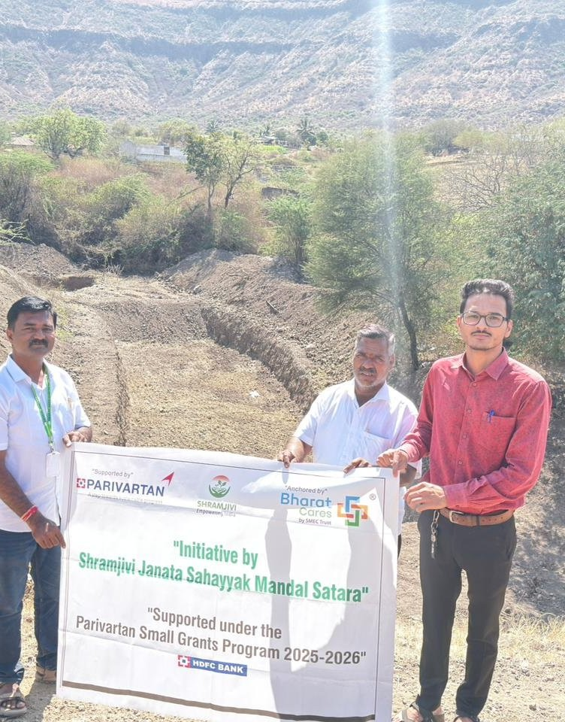
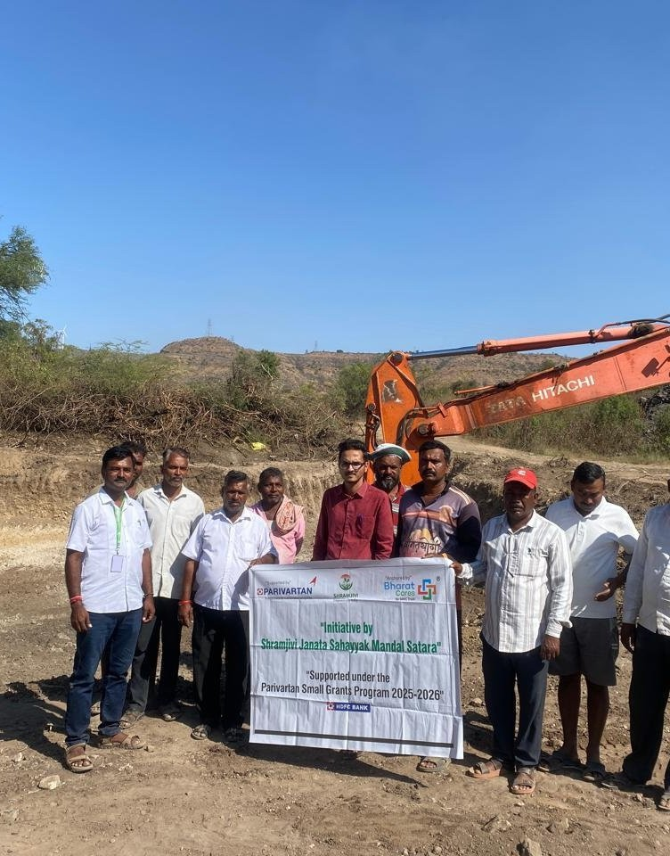
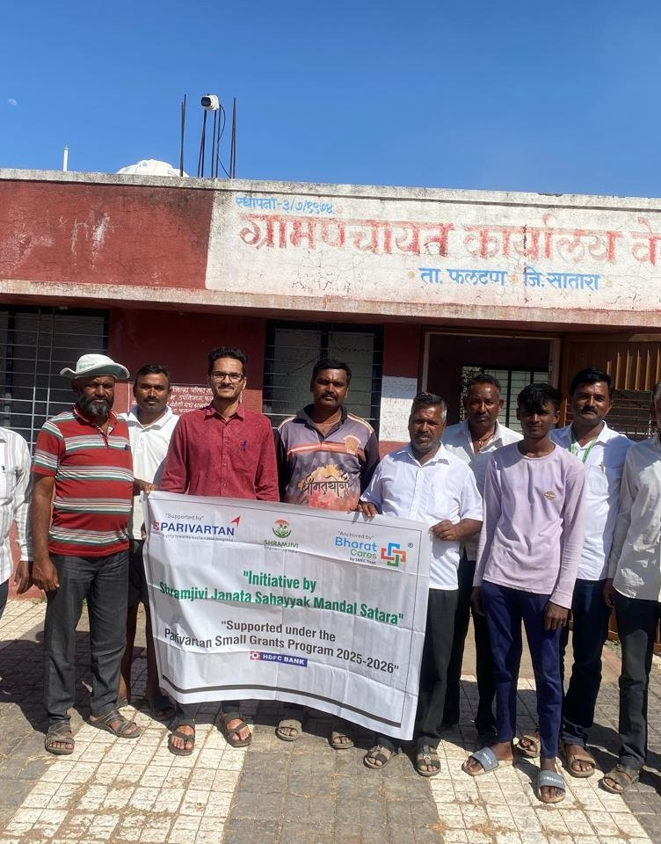
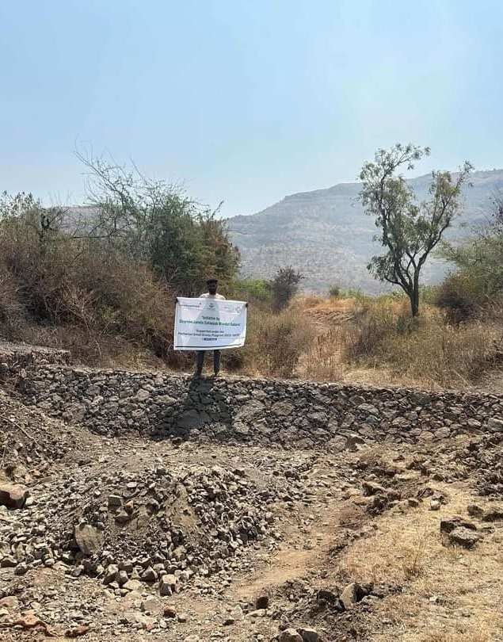
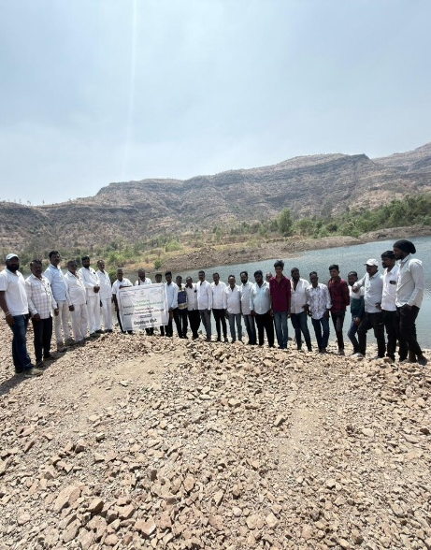
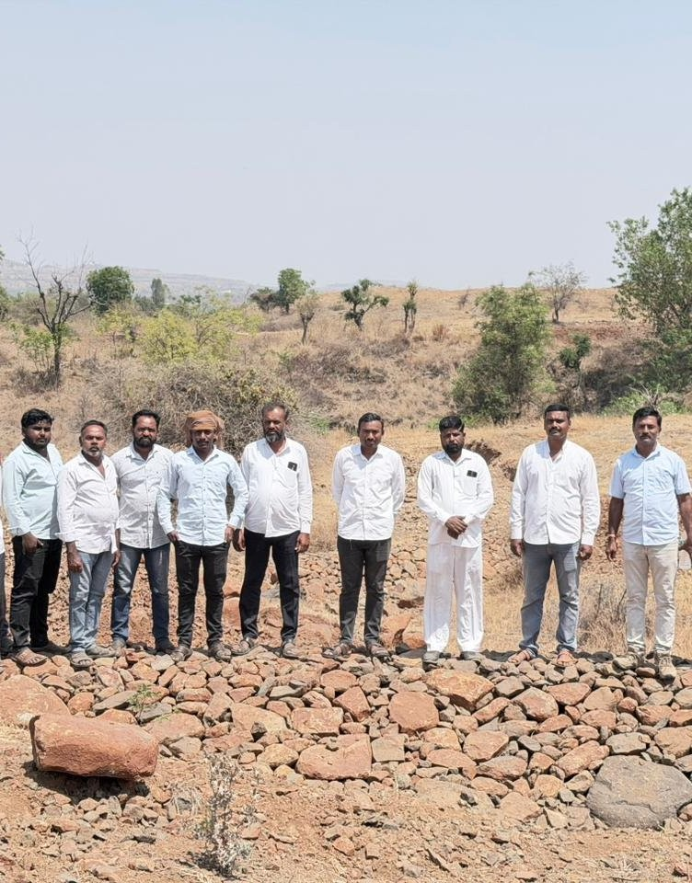
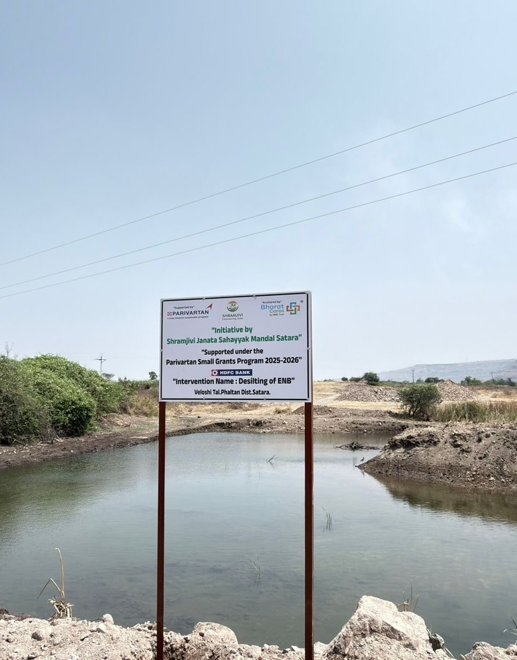
Earthwork, Land & Community
14 · FIELD PHOTOGRAPHY — EARTHWORK & COMMUNITY
Desilted Soil Distribution
Land Levelling
Reclaimed Agricultural Land
Gabion Structure
Exposure Visit to Ghatdare, Khandala Block
Structure Signage Board

Slide 14
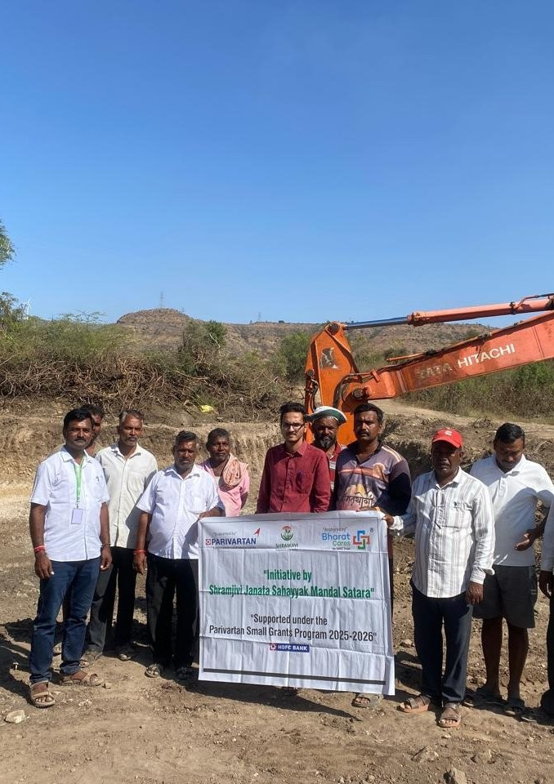


Thank You
Shramjivi Janata Sahayyak Mandal (SJSM), Satara
Integrated Watershed Management for Climate Resilience & Sustainable Livelihoods
Project Completion Report2025–26 | Submitted: 30 March 2026
Veloshi, Block – Phaltan, Dist. Satara, Maharashtra
Reporting Period: January – March 2026 (Final)
Supported under the Parivartan Small Grants Programme 2025-2026
Growing Communities · Conserving Water · Building Resilience

