Slide 1
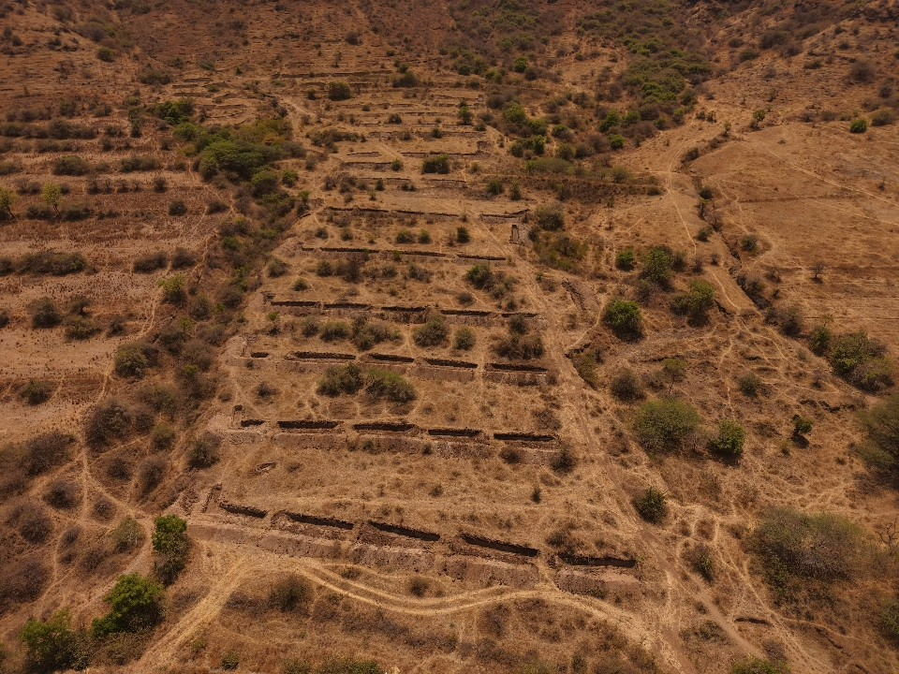


ANNUAL REPORT
2025
-26
Integrated Watershed Management
for Climate Resilience & Sustainable Livelihoods
Shramjivi Janata Sahayyak Mandal (SJSM), Satara
📍 Veloshi, Phaltan, Satara
📅 Feb – Mar 2026
👤 Mr. Suresh Kadam
Supported By Parivartan Small Grants Programme — HDFC Bank

Slide 2
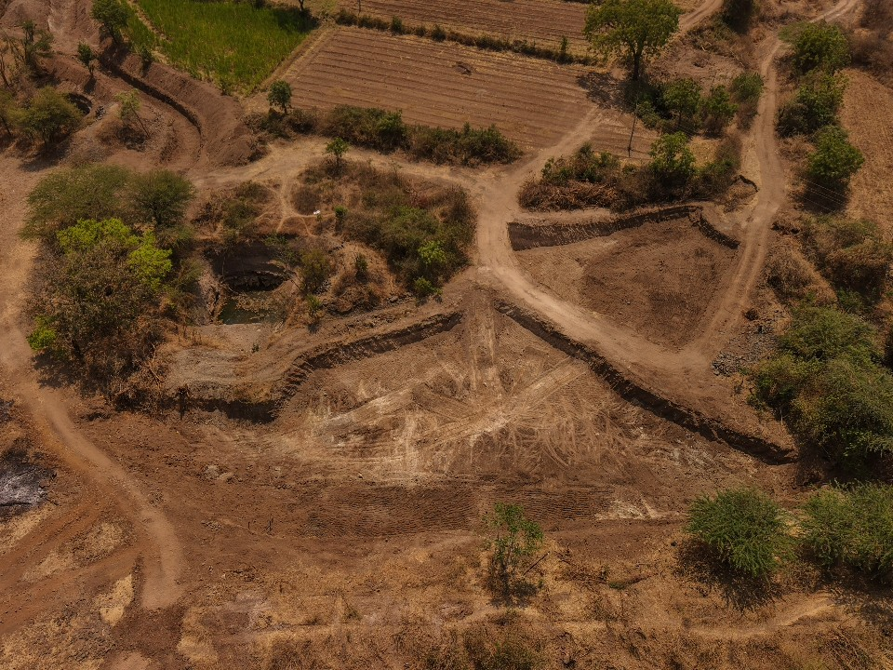
EXECUTIVE SUMMARY
Project at a Glance
The project achieved 100% completion of all primary activities during February–March 2026.
All structural and earthwork interventions met their targets, delivering immediate agricultural and water infrastructure benefits to the farming community of Veloshi, Satara.
39
18
15
100%
FARMERS
ACRES
STRUCTURES
ACHIEVED
Direct Beneficiaries
Barren Land Reclaimed
Loose Boulders Built
All Targets Met

Slide 3
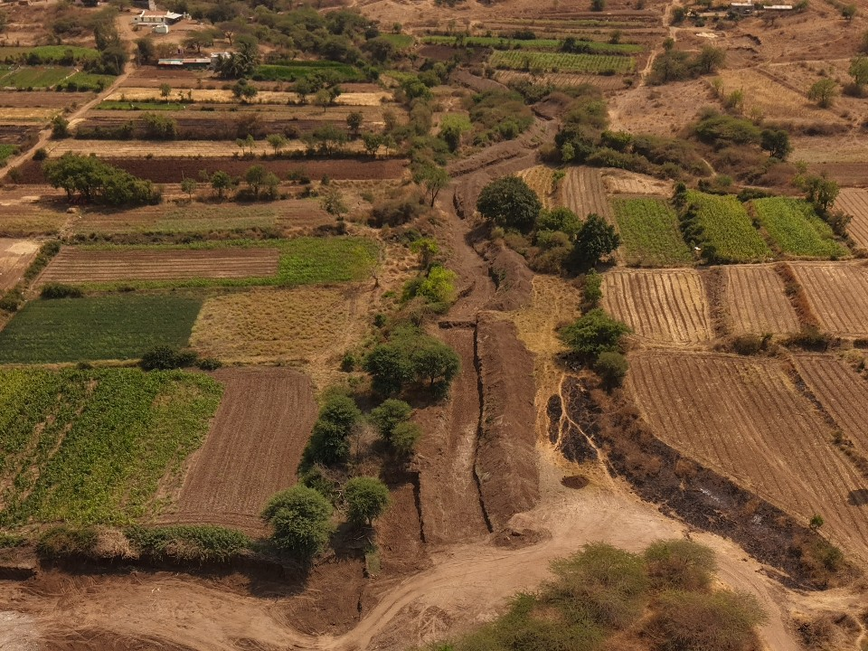
PROJECT OVERVIEW
PROJECT
About
This Project
Integrated Watershed Management for
Climate Resilience & Sustainable Livelihoods
ORGANISATION
Shramjivi Janata Sahayyak Mandal (SJSM), Satara
Veloshi · Phaltan · Satara
2025 — 2026
LOCATION
Veloshi, Block – Phaltan, District Satara, Maharashtra
PERIOD
January – March 2026 | Reporting: Feb – Mar 2026
FUNDER
Parivartan Small Grants Programme — HDFC Bank
CONTACT
Mr. Suresh Kadam (Project Manager)
Mr. Ram Kolekar (Head Operations)

Slide 4
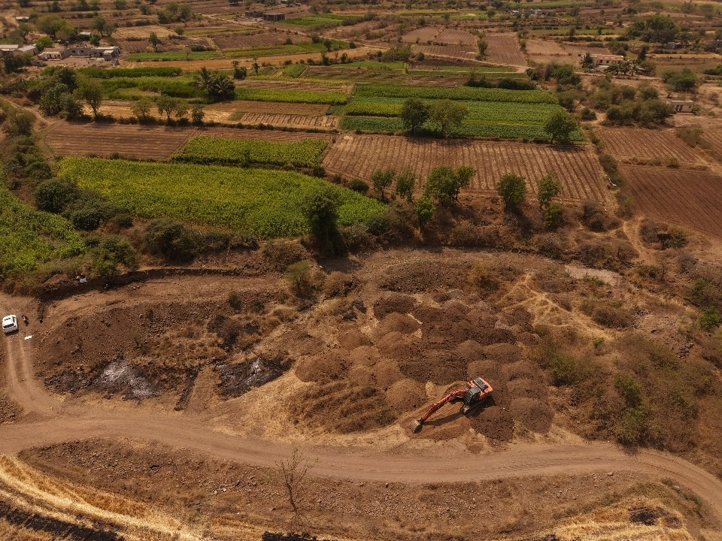
KEY INTERVENTIONS
Our Approach & Method
🪨
Soil Conservation
💧
Water Management
Gabion & Loose Boulder structures to manage surface runoff and prevent erosion before monsoon season.
Deepening & widening of Nalas, desilting of water bodies to improve drainage and storage capacity.
🌾
🌱
👩‍🌾
Land Reclamation
Climate Resilience
Community Empowerment
Nutrient-rich desilted soil redistributed to convert barren land into fertile agricultural plots.
Staggered Contour Trenches (SCT) to enhance groundwater recharge and reduce monsoon runoff.
Farmer Exposure Visit to demonstrate techniques and build long-term community capacity.

Slide 5
Key Achievements & Milestones
#
Activity / Intervention
Target
Achieved
Status
1
Gabion Structures
1 No.
1 No.
✅ Complete
2
Loose Boulder Structures (LB)
15 No.
15 No.
✅ Complete
3
Staggered Contour Trenches (SCT)
4,500 m³
4,500 m³
✅ Complete
4
Desilting of Small ENB
19,000 m³
19,000 m³
✅ Complete
5
Nala Deepening & Widening
19,000 m³
19,000 m³
✅ Complete
6
Farmer Exposure Visit
1 Visit
1 Visit
✅ Complete
Achievement Rate
100%
100%
100%
100%
100%
100%
Gabion
Loose Boulders
SCT
Desilting
Nala Work
Exposure Visit

Slide 6
OUTCOMES & IMPACT
Transforming Land.
Empowering Farmers.
39
18
19K
4,500
100%
Farmers
Acres
m³
m³
Targets
received nutrient-rich
desilted soil directly
of barren land transformed
into cultivable farmland
of Nala deepening &
widening completed
Staggered Contour
Trenches excavated
all 6 project activities
fully achieved

Slide 7
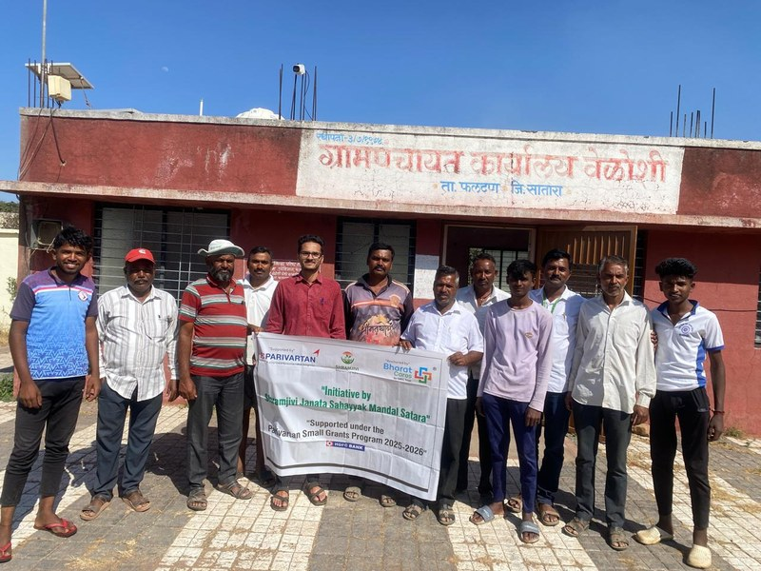
✦ SUCCESS STORY ✦
Community Impact
Transforming
Barren Land
into Life
Through the integrated use of 19,000 m³ of desilted soil from Nala deepening and ENB desilting works, the project successfully converted 18 acres of previously barren, unproductive land into fertile, cultivable agricultural plots — directly transforming the livelihoods of 39 farming families in the Veloshi area of Satara district.
“
The earthwork interventions have successfully met primary targets, resulting in immediate agricultural benefits for our farming community.
— Local Farming Community, Satara Watershed Region
S
Soil Recipient Group
18
39
18 acres of barren land transformed into cultivable fields via desilted soil application.
Acres Reclaimed
Families Benefited
W
Watershed Stakeholders
All primary activities — Gabions, SCT, Nala widening — fully executed on schedule.

Slide 8
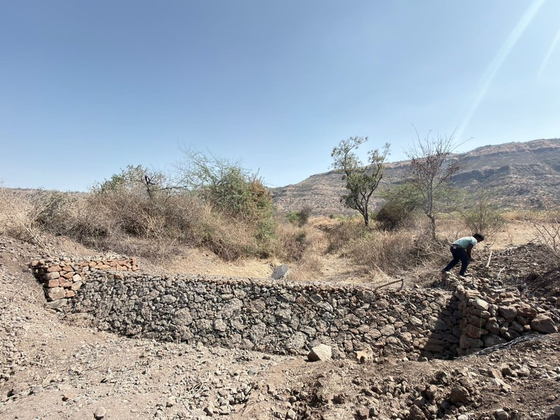
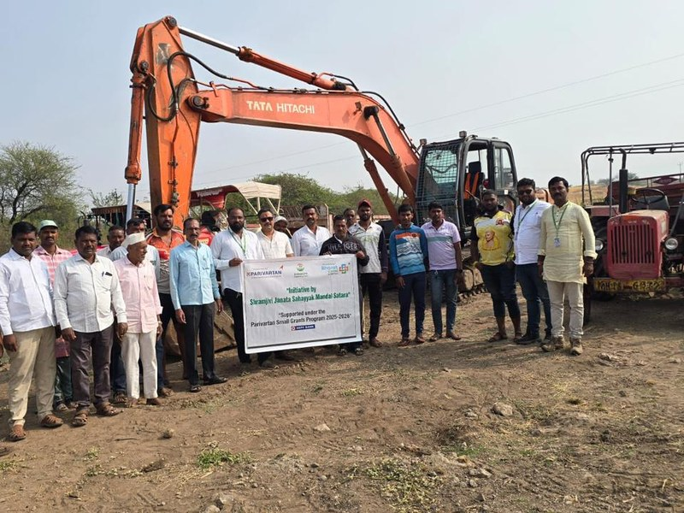
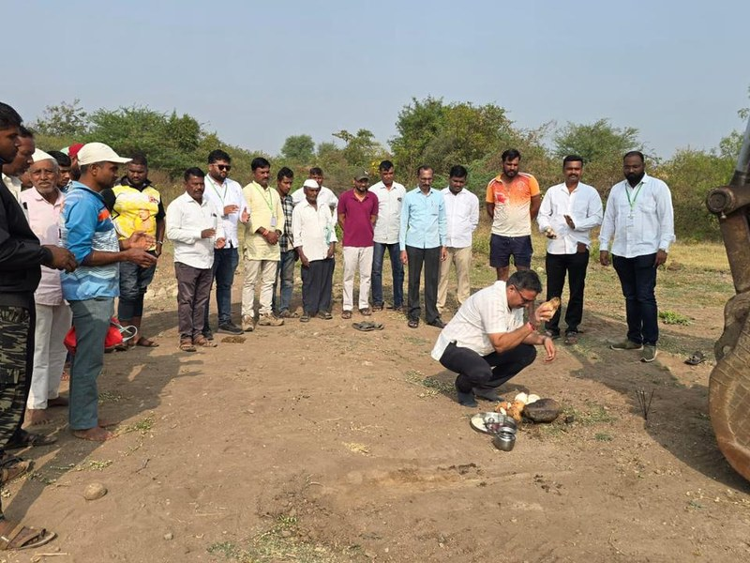
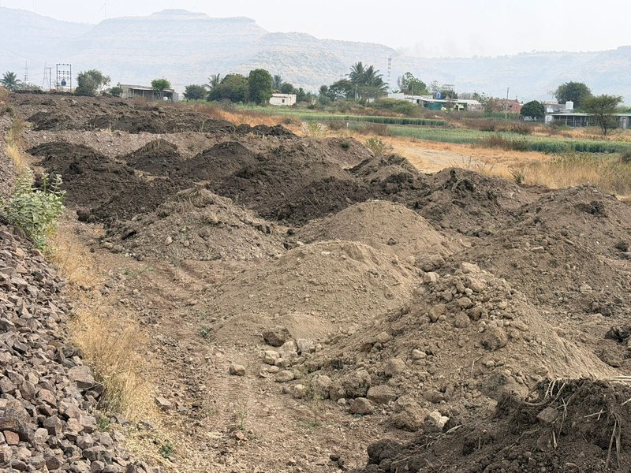
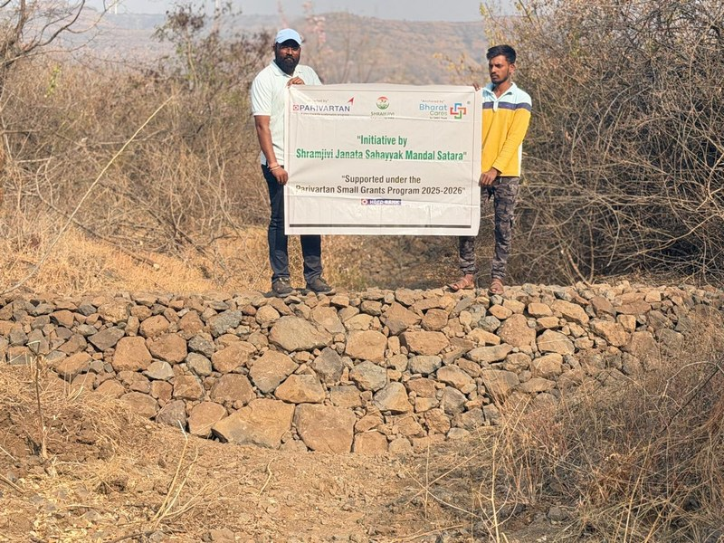
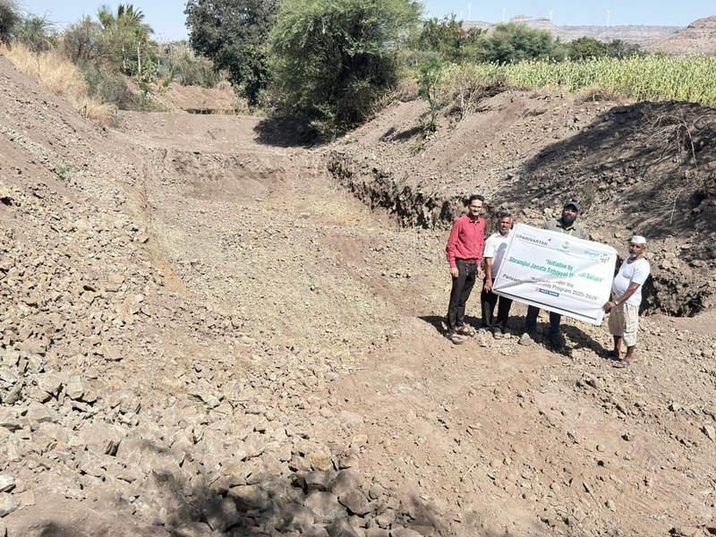
PHOTO GALLERY · PART 1
Field Documentation
Soil Conservation & Water Infrastructure
Gabion Structure — Soil & Water Conservation
Watershed Site Overview
Site Preparation
Nala Deepening Work
Excavation Progress
Earthwork — Ground Level

Slide 9
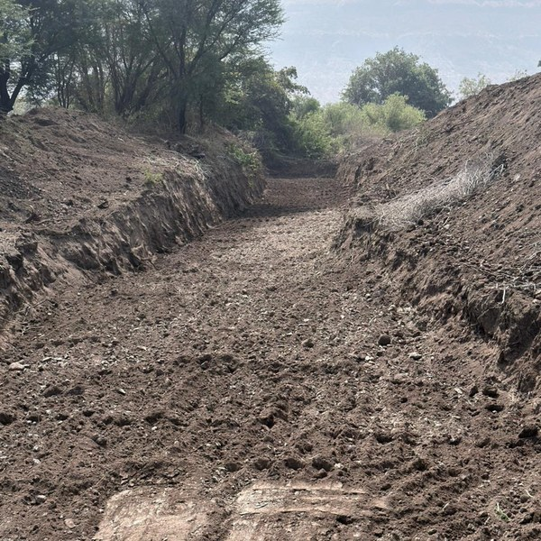
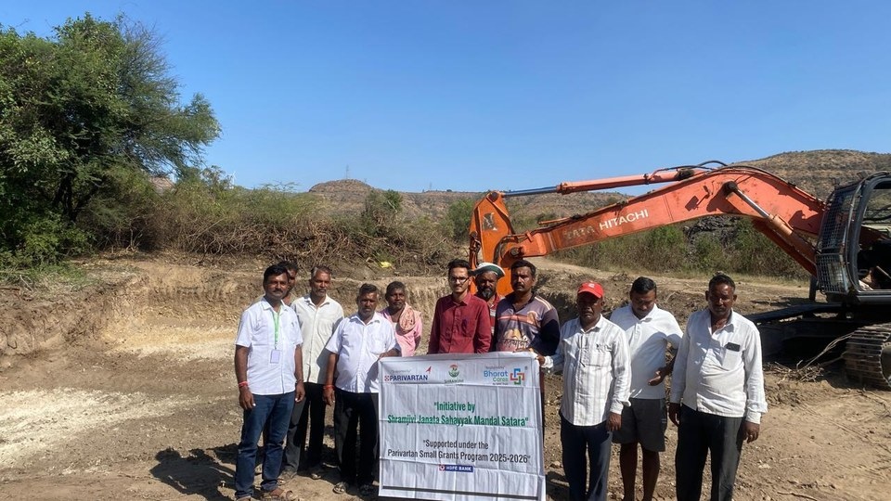
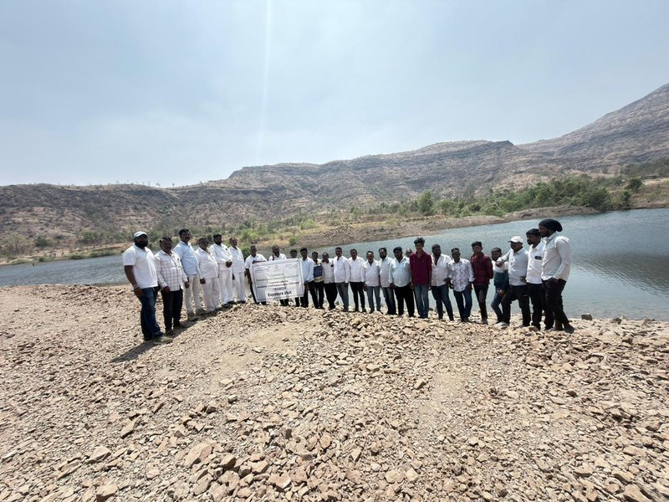
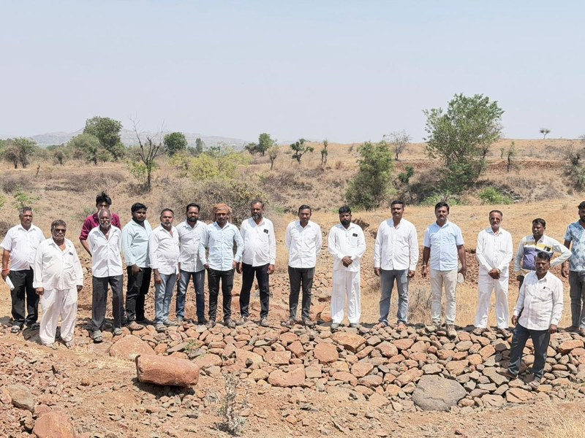
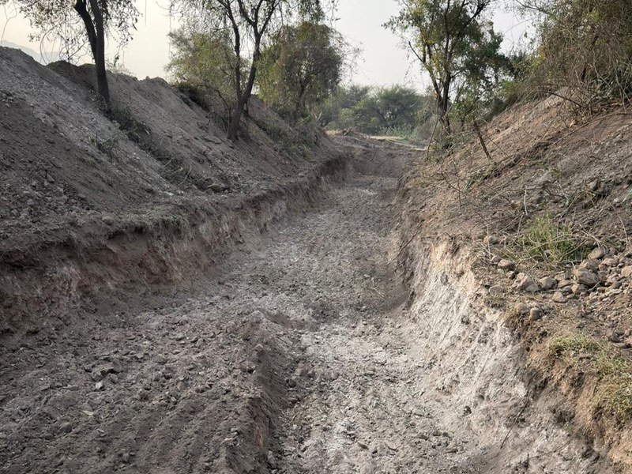
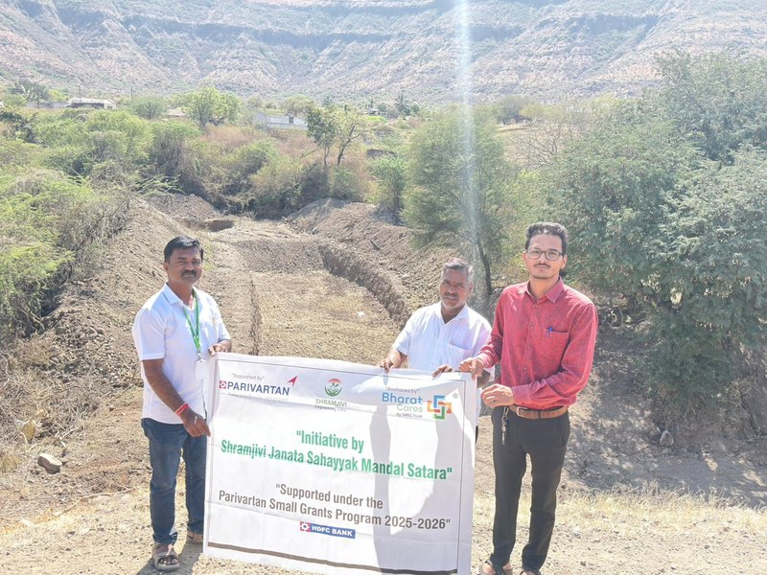
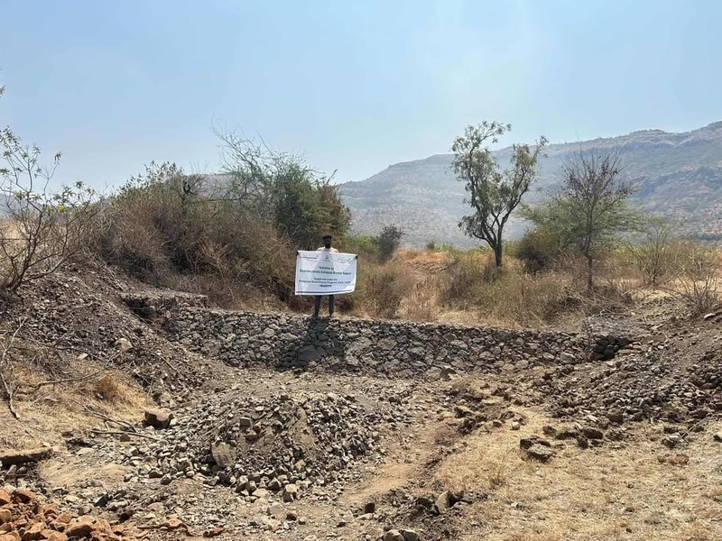
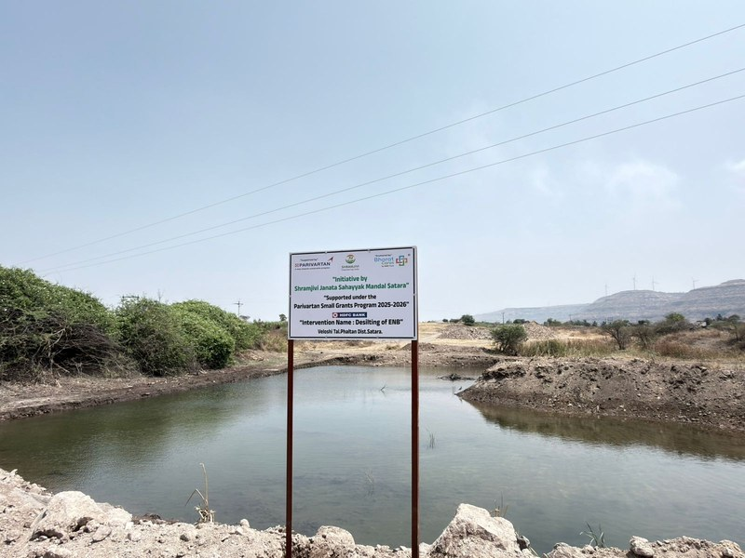
PHOTO GALLERY · PART 2
Field Documentation
Land Reclamation & Community Engagement
Watershed Infrastructure
Community Field Work
Reclaimed Land Preparation
Water Storage Site
Desilted Soil Collection
Land Levelling
Farmer Visit
Completed Site

Slide 10
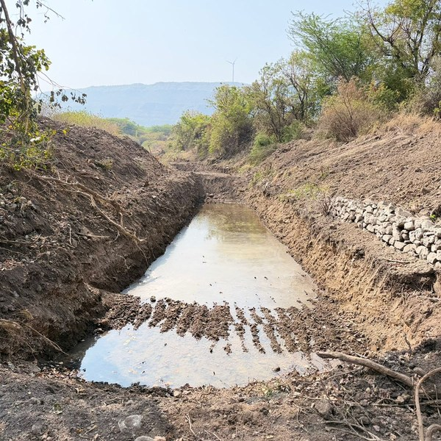
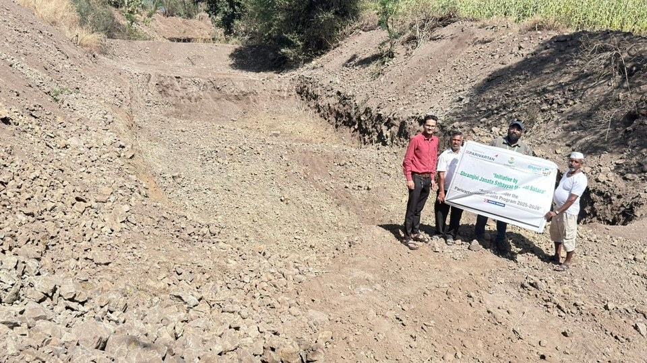
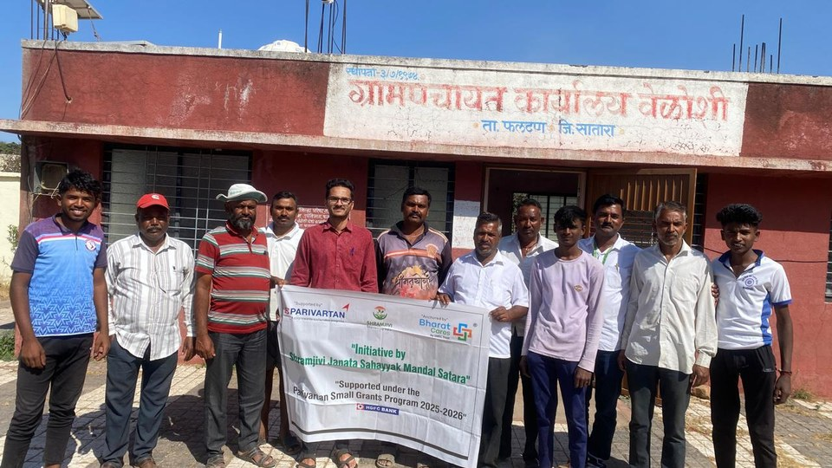
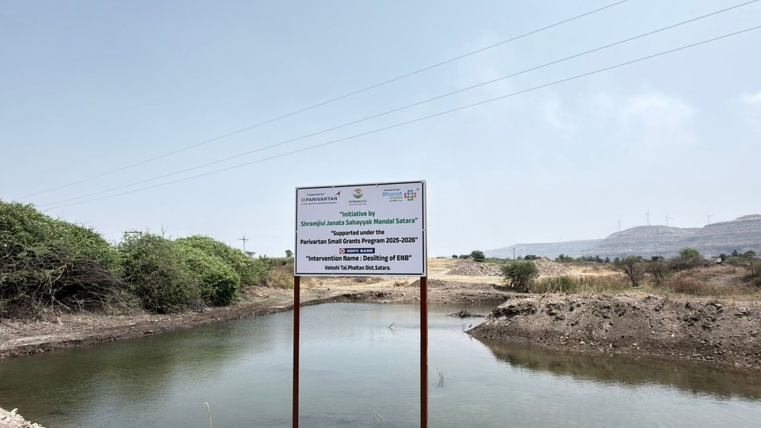
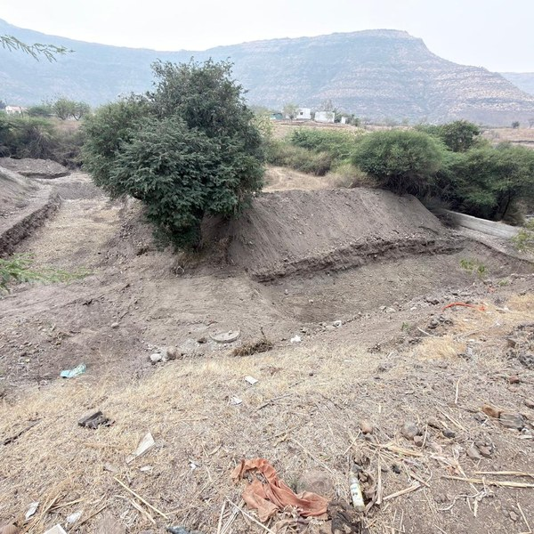
PHOTO GALLERY · PART 3
On The Ground
Structures, Earthwork & Community Participation
SCT Construction
Earthwork Progress
Agricultural Land
Final Site View
Boulder Structure

Slide 11
Monitoring, Evaluation & Challenges
Mechanism
Frequency
Responsible
Findings/Notes
Field Visits
Regular
Mr. Suresh Kadam
Verified SCT and desilting completion
Weekly Updates
Weekly
Site Supervisors
Tracked Nala widening to 19,000 m³ target
Progress Reports
Monthly
Reporting Team
Final achievements compiled Feb–Mar 2026
Internal Audit
End of Project
Financial Auditor
Aligned with Parivartan SGP guidelines
Challenge & Resolution
Lessons Learned
⚠ Challenge
✅
Desilting + land reclamation integration proved highly effective — 18 acres converted.
Finalising the last 1,500 m³ of Nala deepening & widening within the reporting deadline required intensive field execution and daily monitoring.
✅
Structural works before monsoon ensured immediate water harvesting benefits.
💡
More frequent exposure visits recommended for deeper knowledge transfer.
✅ Outcome: 100% of the 19,000 m³ target achieved — deadline met.
💡
Soil testing of desilted material before distribution could optimise crop selection.

Slide 12
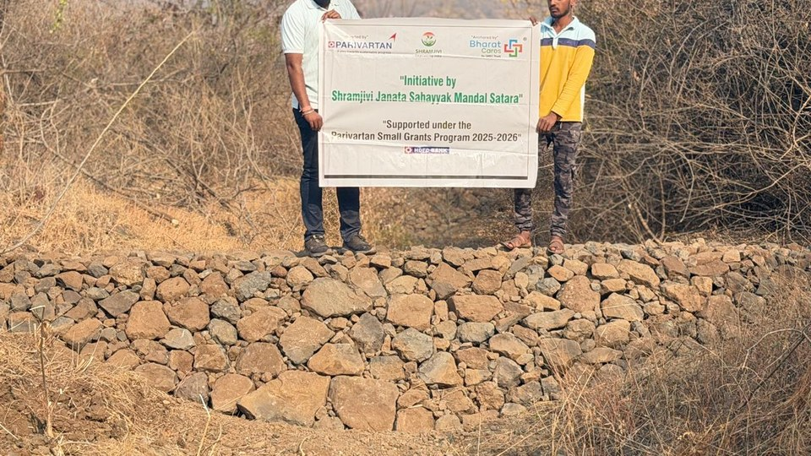
SUSTAINABILITY & ROADMAP
Looking Forward
🎓
🤝
📈
Capacity
Building
Community
Ownership
Scale &
Continuity
Conduct follow-up training for 39 farmers on sustainable agricultural practices using the 18 acres of reclaimed land.
Form Water User Groups to take long-term responsibility for maintenance of Gabion and Loose Boulder structures.
Explore scaling the Nala deepening model to adjacent watersheds, building on 19,000 m³ success.

Slide 13

Thank You
Shramjivi Janata Sahayyak Mandal (SJSM)
Integrated Watershed Management for Climate Resilience & Sustainable Livelihoods
📍 Veloshi, Block – Phaltan, Dist. Satara, Maharashtra
📅 Reporting Period: February – March 2026
🏦 Supported by Parivartan SGP — HDFC Bank
Annual Report | 2025 – 26 | SJSM Satara

