Slide 1
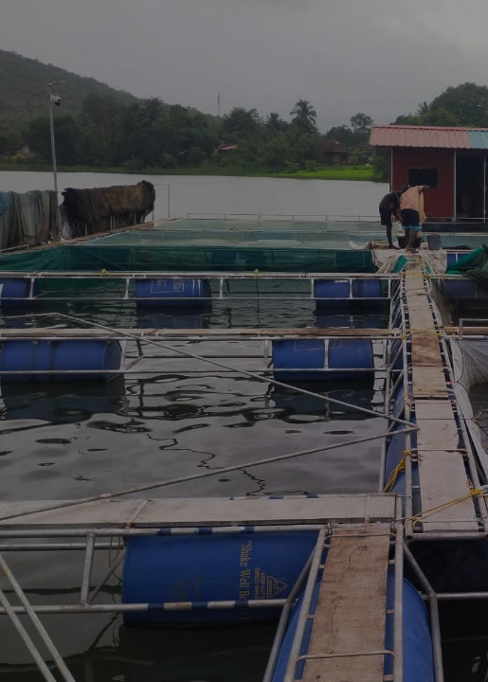


PROJECT COMPLETION REPORT · MAY 2023 – APRIL 2026
Inland Fishery Based
Livelihood Improvement
Intervention
for Tribal Community of Poladpur block, Raigad
FUNDED BY
IMPLEMENTED BY
Atlas Copco (India) Pvt. Ltd.
Shramjivi Janata Sahayyak Mandal (SJSM)
Corporate Social Responsibility Initiative
Satara, Maharashtra

Slide 2
Table of Contents
SJSM · Atlas Copco CSR · 2023–2026
Table of
Contents
Cover Page
1
Project overview & partnership details
About SJSM & Project Background
3
Organisation profile and project context
Project Objectives
3
Goals and intended outcomes
Project Completion Report
May 2023 – April 2026
Major Interventions - Overview
5
Nine fishery livelihood support activities
Fishery Operations in Detail
6
Hatchery, fingerling stocking, brood stock
Training & Capacity Building
7
126 programmes · 800+ participants
Capacity Building Achievements
8
Training data and key outcomes
Photo Gallery - Field Activities
9
Glimpses of interventions on ground
Major Achievements Summary
10
10 milestones with data
Fisheries Impact & Income Generated
11
270 beneficiaries · ₹1.89 Crore
Poladpur Block - Deep Dive
12
Interventions, reach & outcomes
Mahad Block - Deep Dive
13
Interventions, reach & outcomes
Government Scheme Access - Poladpur
14
485 beneficiaries · ₹3.05 Crore
Government Scheme Access - Mahad
15
235 beneficiaries · ₹1.78 Crore
Social Welfare & Media Coverage
16
Scheme linkages & newspaper coverage
Success Story 1 - Ranjana Pawar
17
From daily struggle to sustainable income
Success Story 2 - Gadital Cooperative
18
Preserving the catch, securing the future
Success Story 3 - Cage Culture
19
Innovating fisheries at Aambavade Dam
Cumulative Impact Summary
20
All outcomes across both blocks
Way Forward & Recommendations
21
Next steps and replication strategy
Conclusion
22
Closing statement and partnership acknowledgement
Project Completion Report · Inland Fishery Based Livelihood Improvement · Poladpur & Mahad, Raigad
2

Slide 3

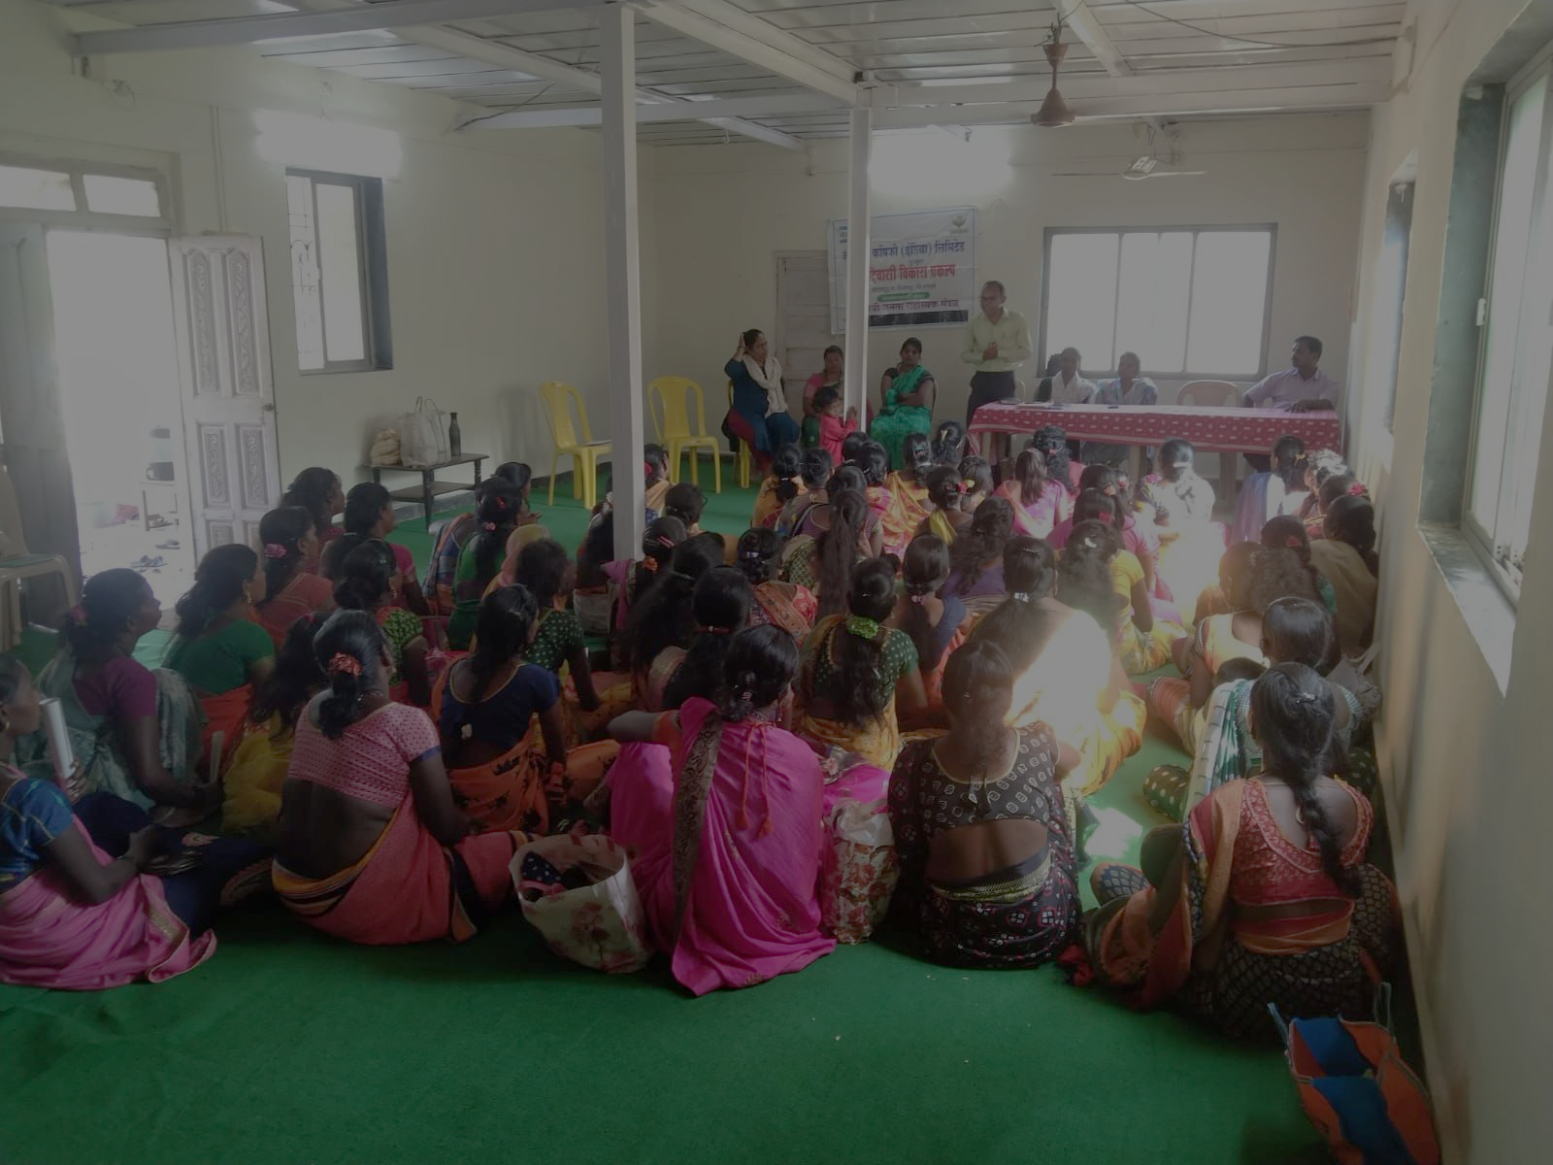




Background & About the Project
SJSM · Atlas Copco CSR · 2023–2026
About Shramjivi Janata Sahayyak Mandal (SJSM)
Development NGO established 1980 · Satara, Maharashtra
BACKGROUND
SJSM is a development NGO based in Satara, Maharashtra, established in 1980 by youth from nomadic tribal communities near the Koyna Dam. It has expanded to 500+ villages across Satara, Sangli, and Raigad - promoting self-reliant, community-led development.
The Katkari tribal communities of Poladpur Taluka primarily depend on inland fisheries and wage labour. Limited access to modern fishing equipment, poor post-harvest infrastructure, and declining fish productivity restricted income opportunities for fishing families.
About the Project
SJSM has promoted 60 cooperatives with 27,500+ tribal families across sectors including fisheries, dairy, food processing, SHGs, herbal cultivation, and Ayurvedic medicine. Its micro-credit cooperative has 2,525 households with an annual turnover of ₹100 million.
The project aimed to enhance the socio-economic condition of tribal fishing communities through sustainable fisheries development, capacity building, institutional strengthening, and livelihood support interventions. Implemented across 15 tribal hamlets of Poladpur Taluka (and Mahad Block), the project focused on improving fish production, strengthening cooperatives and SHGs, promoting scientific fishery practices, and increasing access to government entitlements over three years.
After the Konkan floods of 2005, SJSM initiated tribal rehabilitation and inland fisheries programs for Katkari communities, forming the Konkan Lokadhikar Manch to strengthen tribal rights and advocacy.
15
800+
368 HH
3 Years
₹6.72 Cr
Tribal Hamlets
Covered
Direct
Beneficiaries
Baseline
Surveyed
Project
Duration
Total Project
Impact
Project Objectives
1
Strengthen the traditional inland fishery-based livelihood of the Katkari tribal community.
2
Develop and implement scientific fishery management models, including stocking density and culture-based capture fisheries.
3
Strengthen local fish fingerling production units to ensure sustainable fish seed availability.
4
Increase fish production per unit area, enhancing income of local tribal fishermen.
5
Improve financial management skills and cooperative governance among fisherfolk.
Project Completion Report · Inland Fishery Based Livelihood Improvement · Poladpur & Mahad, Raigad
3

Slide 4
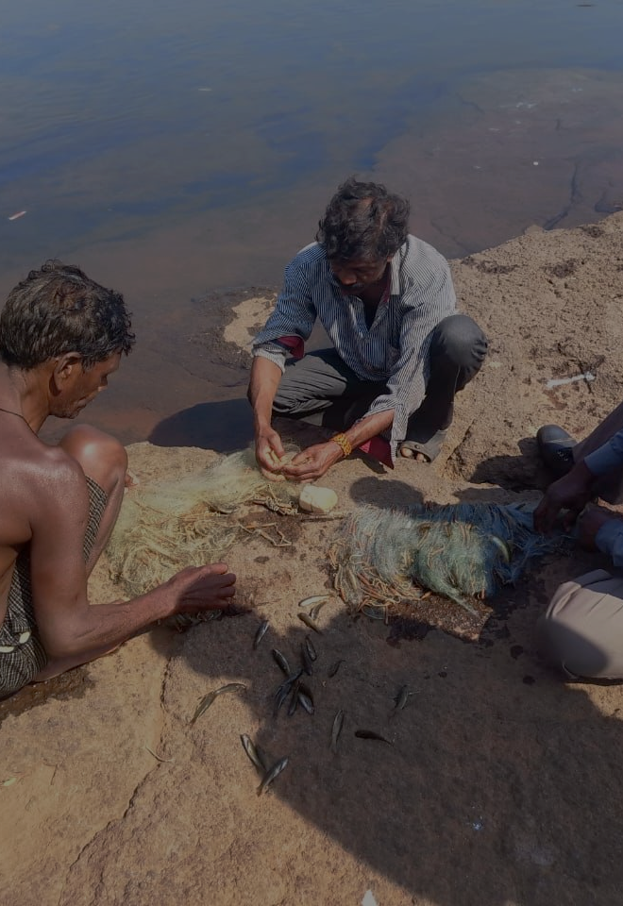
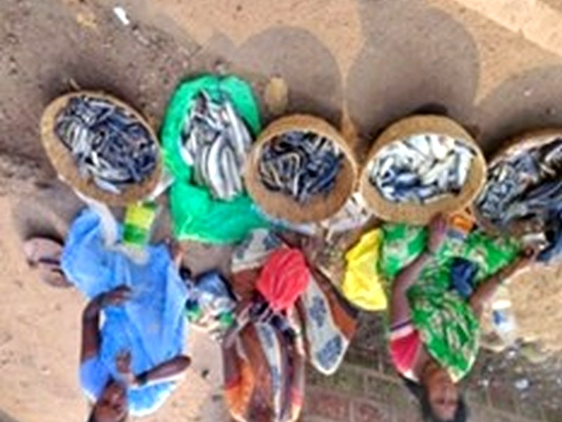
CHAPTER 01
Major Interventions
& Fishery Livelihood Support
Nine targeted interventions delivered to 270+ tribal fishermen across 15 hamlets in Poladpur Taluka - encompassing fishing equipment, cage culture, hatchery support, fingerling stocking, and market linkages.
4

Slide 5
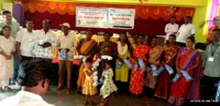
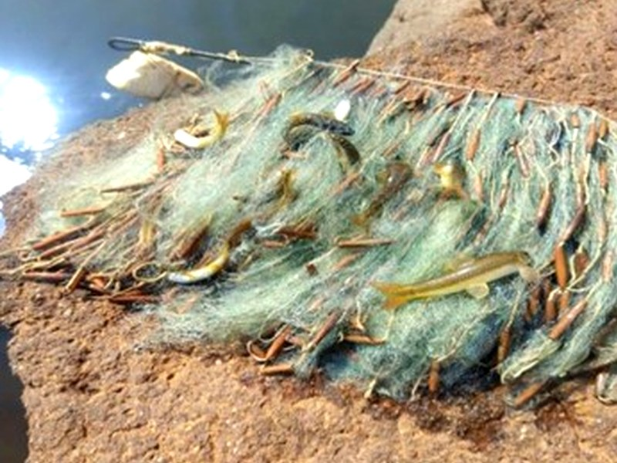
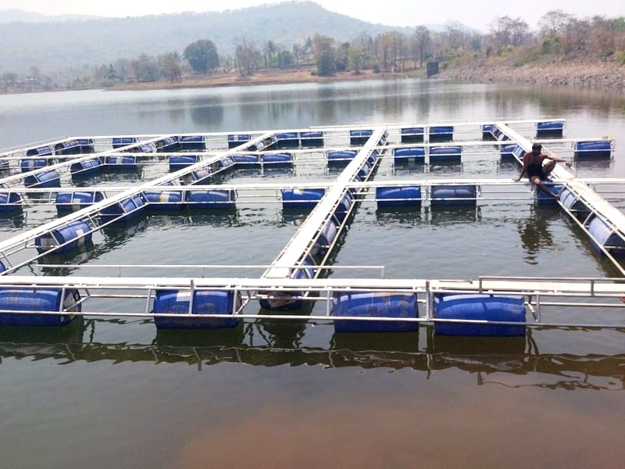


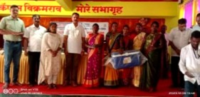
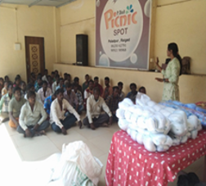
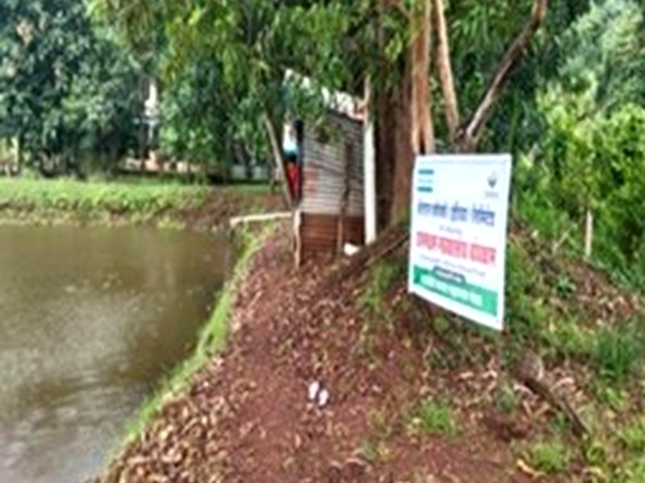



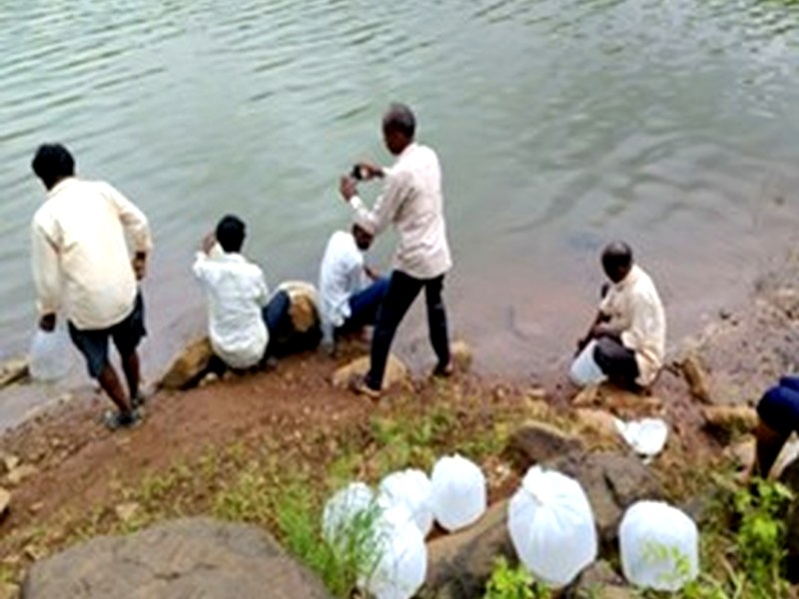
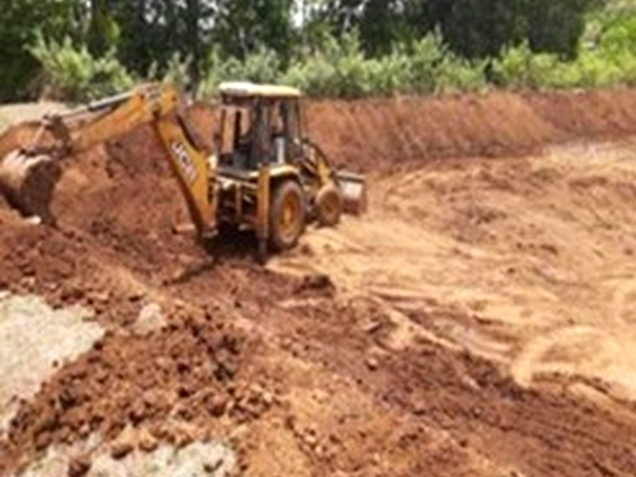
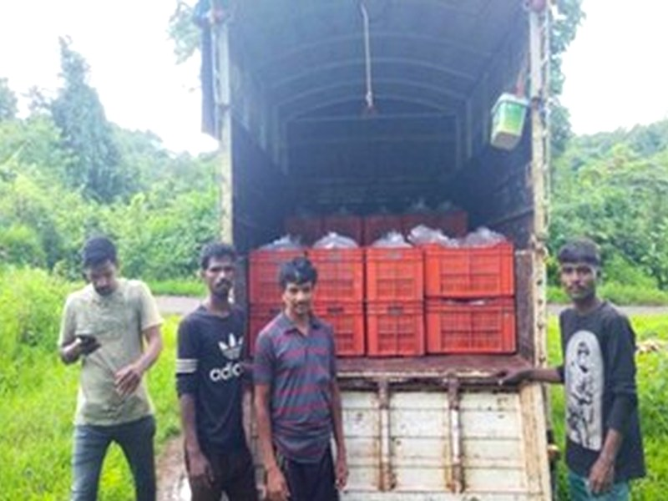

Major Interventions - Fishery Livelihood Support
SJSM · Atlas Copco CSR · 2023–2026
A. Fishery Livelihood Support Interventions
Nine activities covering equipment, aquaculture, seed production, and market access
1
2
3
Distribution of Fishing Nets
River & Dam Fishing Nets
Cage Culture Unit at Aambavade Dam
Fishing nets distributed to fishermen & cooperative members. Training on proper usage and maintenance provided. Improved efficiency, increased catch potential, and promoted sustainable fishing practices.
River and dam fishing nets provided to eligible fishermen, enabling expanded operations and access to new fishing areas. Reduced operational costs and improved fishing productivity.
One cage culture unit established at Ambavade Reservoir. Training on cage management, fish feeding, and health monitoring. Fingerlings stocked; regular monitoring ensured healthy growth.
4
5
6
Distribution of Ice Boxes
Supply of Marketing Accessories
Nurturing of Brood Stock
Ice boxes distributed to fishing families to improve storage and transportation. Training on hygienic handling conducted. Reduced post-harvest losses and enabled better market prices.
Marketing kits - knives, weighing scales, and plastic containers - provided to fishermen. Enhanced fish handling, storage, and marketing. Improved product quality and customer confidence.
Quality brood stock of Catla, Rohu, Mrigal, and Cyprinus species procured under scientific management. Regular feeding and health monitoring ensured successful breeding cycles.
7
8
9
Stocking of Fingerlings in Reservoirs
Construction of Brood Stock Pond
Hatchery Rearing Support
21.5 lakh fingerlings scientifically stocked in five reservoirs over three years. Good survival and growth rates confirmed by monitoring, improving fish production and biodiversity.
Nutritious feed supplied to brood stock to improve growth, health, and reproductive performance. Training on feeding schedules and nutrition management enhanced breeding efficiency.
Comprehensive hatchery support through nets, haps, feed, medicines, and equipment. Improved hatchery management and larval rearing resulted in higher survival rates and increased seed production.
Project Completion Report · Inland Fishery Based Livelihood Improvement · Poladpur & Mahad, Raigad
5

Slide 6
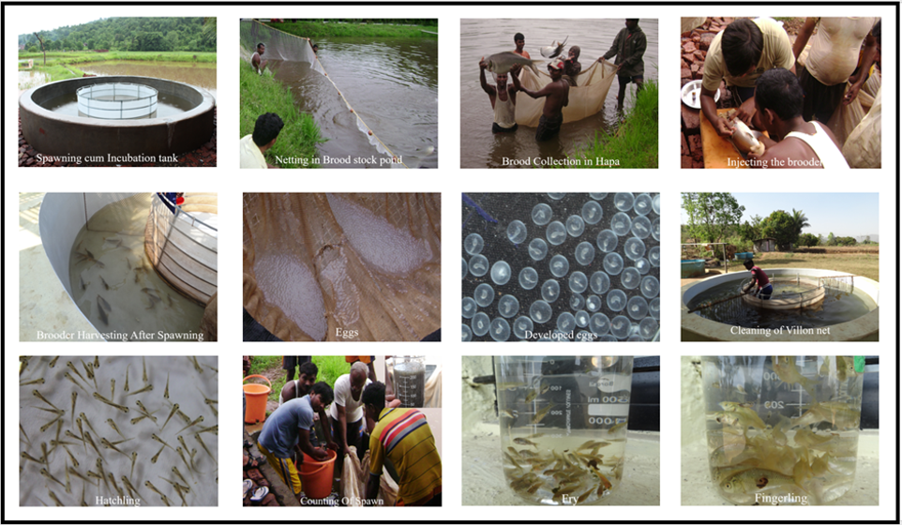
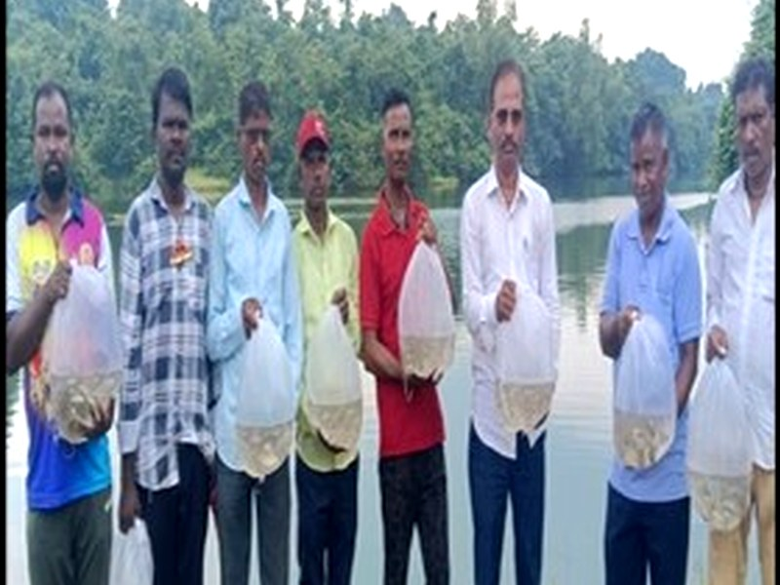
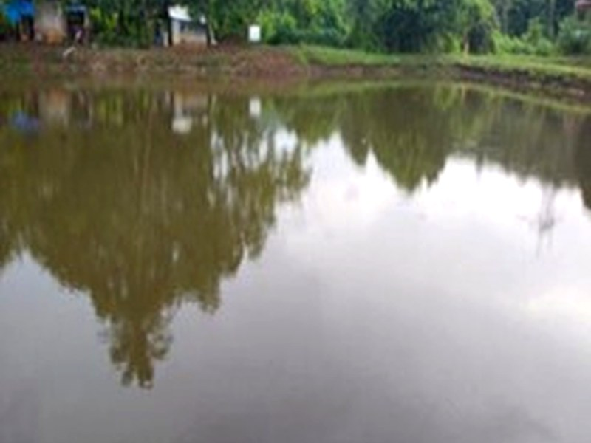
Fishery Operations - Hatchery, Stocking & Brood Stock
SJSM · Atlas Copco CSR · 2023–2026
Fishery Production Operations in Detail
Hatchery unit, fish seed stocking, brood stock management, and pond construction
Fish Production Unit - Hatchery Process (Spawning · Breeding · Larval Rearing · Fingerling Production)
A total of 21.5 lakh fingerlings were scientifically stocked in 5 reservoirs covering 242 hectares during the project period (2023–2026), contributing to improved fish population and biodiversity.
Fish Seed Stocking in Reservoir
Construction of Fish Brood Stock Pond
Brood Stock & Hatchery Support - Key Details
Species
Catla, Rohu, Mrigal, Cyprinus (Indian major carps)
Brood Stock
1,000 kg quality brood stock procured and maintained
Feeding
12 months of nutritious feed supplied; training on schedules provided
Hatchery Input
Nets, haps, feed, medicines, and essential equipment provided
Breeding
Induced breeding, larval rearing, and health monitoring ensured high survival
Stocking
21.5 lakh fingerlings stocked in 5 reservoirs (242 ha) over 3 years
Project Completion Report · Inland Fishery Based Livelihood Improvement · Poladpur & Mahad, Raigad
6

Slide 7
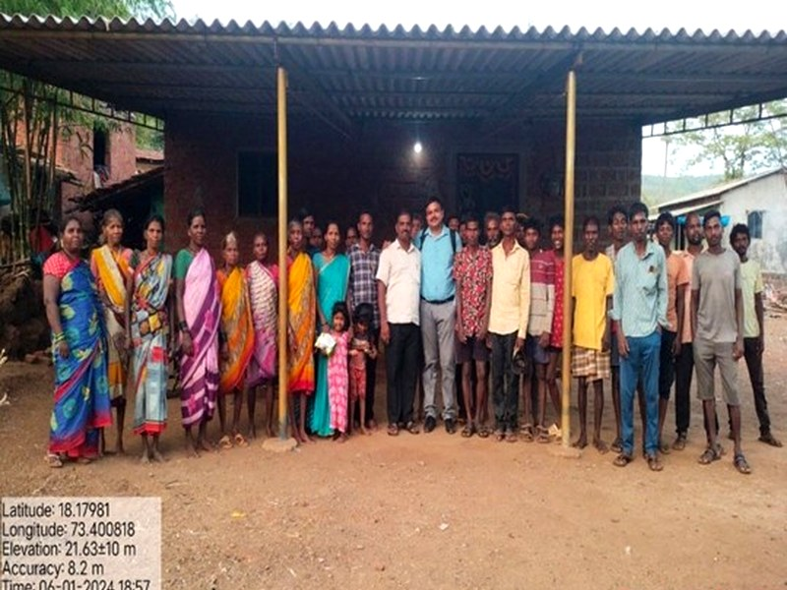
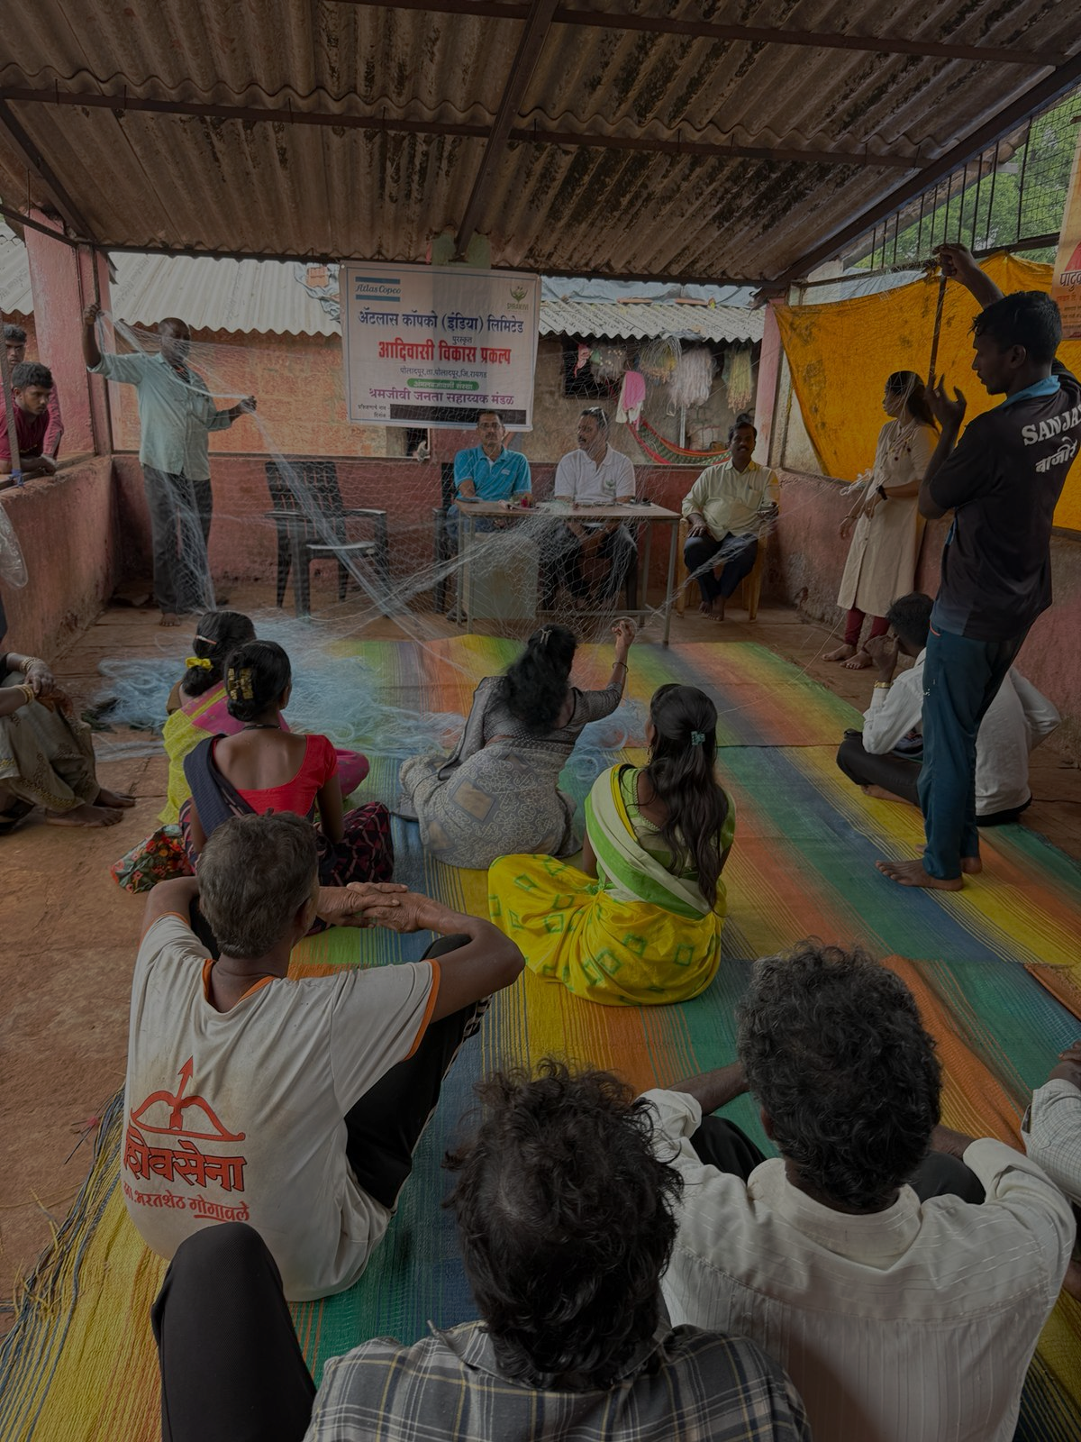
CHAPTER 02
Training &
Capacity Building
126 training and awareness programmes conducted, reaching 800+ participants across 15 tribal hamlets. From cooperative governance to tribal rights, every community group was systematically empowered.
7

Slide 8



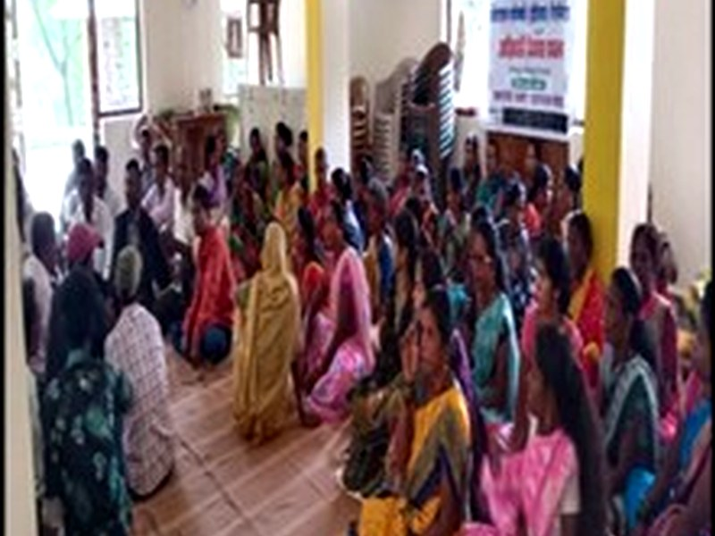
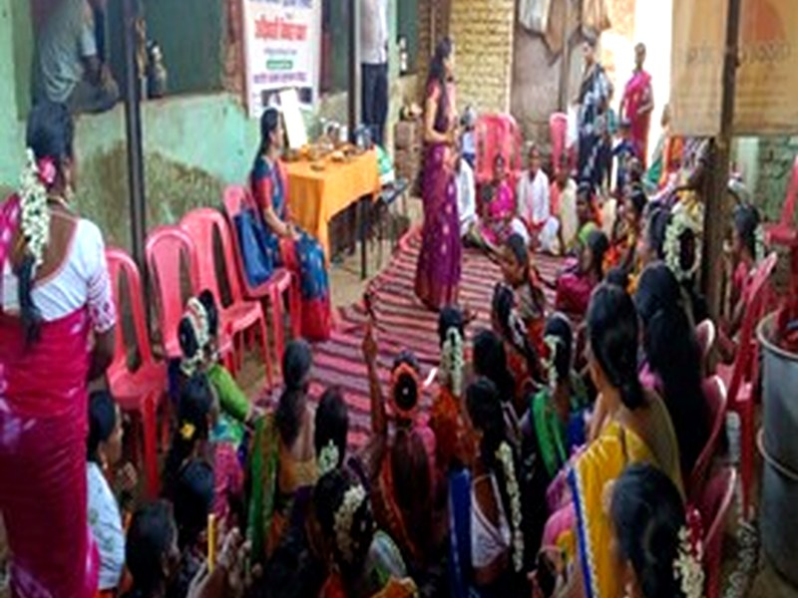
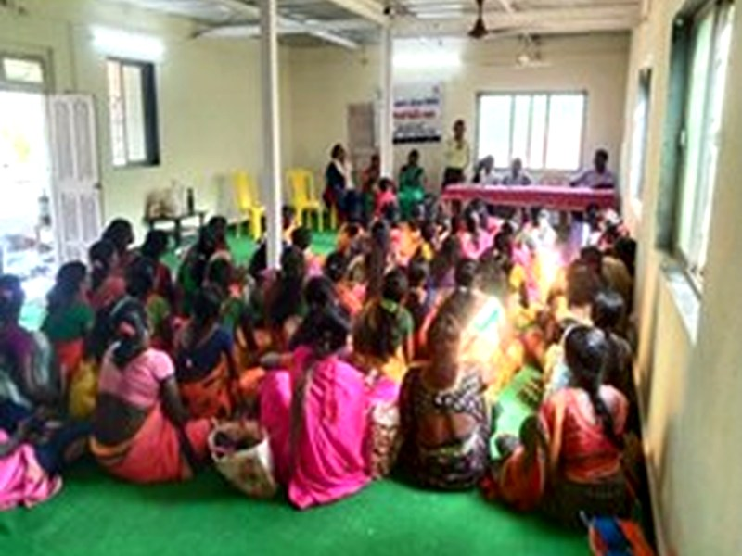
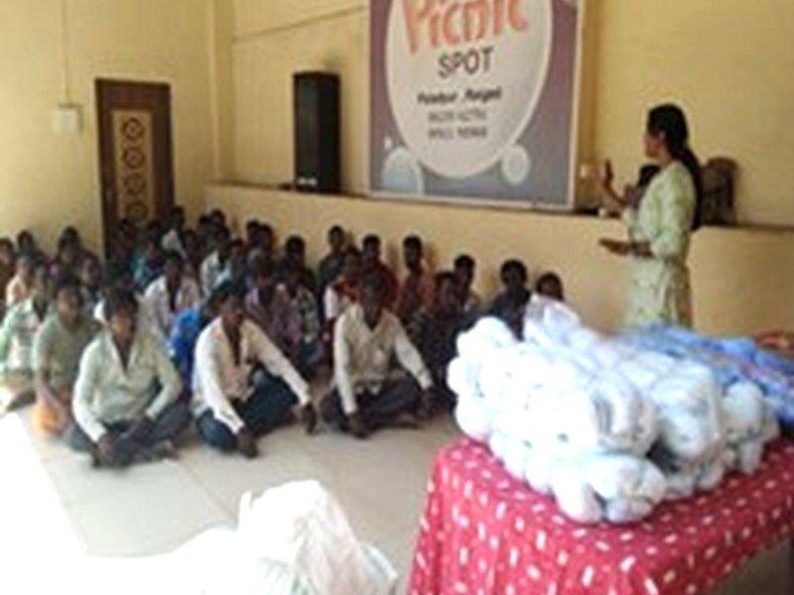
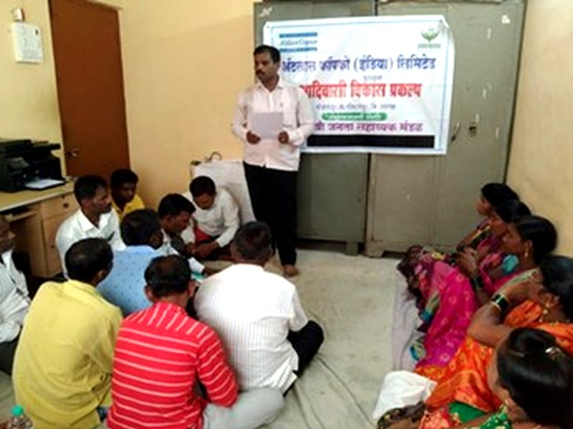
Training & Capacity Building
SJSM · Atlas Copco CSR · 2023–2026
Training & Capacity Building Programmes
Systematic strengthening of fishermen, SHGs, cooperatives, and community leaders
126
800+
15
SHGs
300+
343
Training
Programmes
Participants
Reached
Strengthened
Fishermen
Sensitized
Katkari Members
Reached
#
Programme
Reach & Scale
Key Outcomes
1
Awareness on Sustainable Fishing Practices
45 camps · 300+ fishermen & Community Members 15 Tribal hamlets
Eco-friendly practices, compliance with seasonal bans, aquatic ecosystem conservation awareness.
2
Fishing Cooperative Member Training
12 programmes · 16 cooperative members trained
Enhanced governance, financial management, leadership, and adoption of modern fishing techniques.
3
Micro-Credit Cooperative Member Training
12 programmes · 20 cooperative members trained
Improved financial literacy, bookkeeping, credit management, and entrepreneurship skills.
4
SHG Capacity Building
6 programmes · 89 participants · 15 SHGs strengthened (4 new + 4 revived)
Enhanced credit access, government scheme linkages, and women's economic empowerment.
5
River Fishing Beneficiary Training
6 programmes · 32 fishermen from 42 tribal wadis
Improved fishing techniques, fish preservation, post-harvest management, river conservation.
6
Fishing Cooperative EC Members
18 sessions · 11 EC members trained
Strengthened governance, financial oversight, fisheries management, and leadership.
7
Micro-Credit Cooperative & Village Leaders
18 sessions · 15 EC + 20 village leaders
Improved decision-making, governance, financial management, and community mobilization.
8
Katkari Adivasi Aadhaar Sanghatna (KAAS)
9 programmes · 32 KAAS + 343 community members
Tribal rights awareness, government welfare schemes, social entitlements, community leadership.
Project Completion Report · Inland Fishery Based Livelihood Improvement · Poladpur & Mahad, Raigad
8

Slide 9




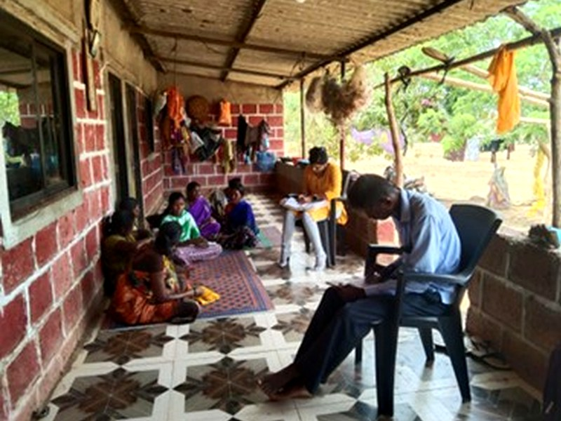
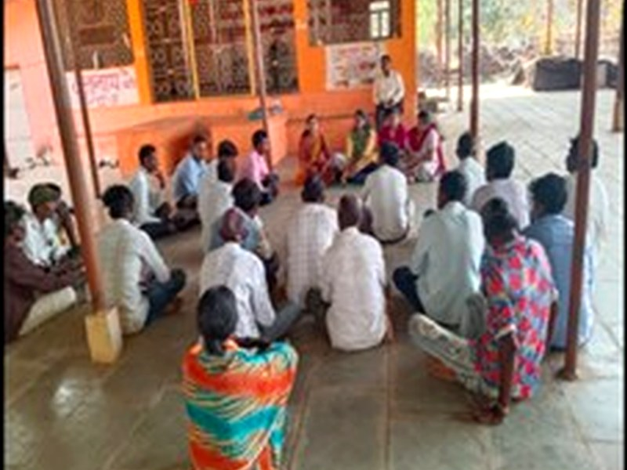
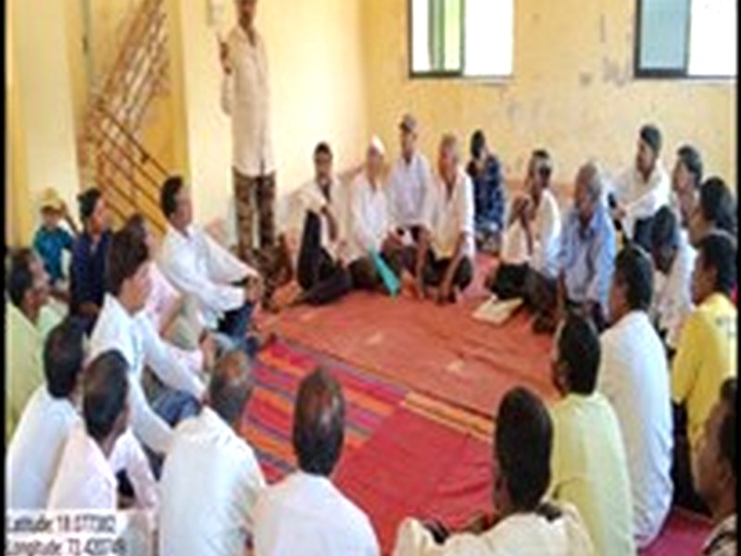
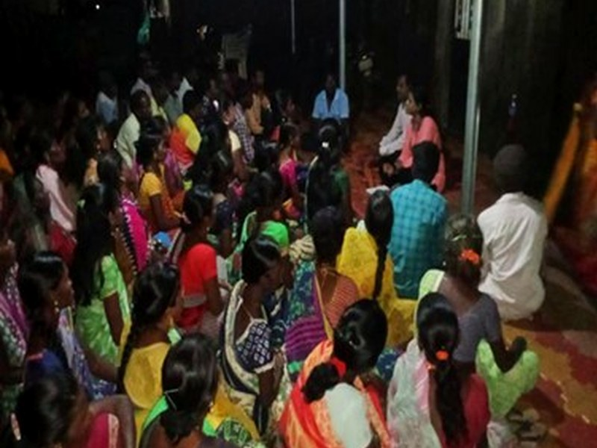
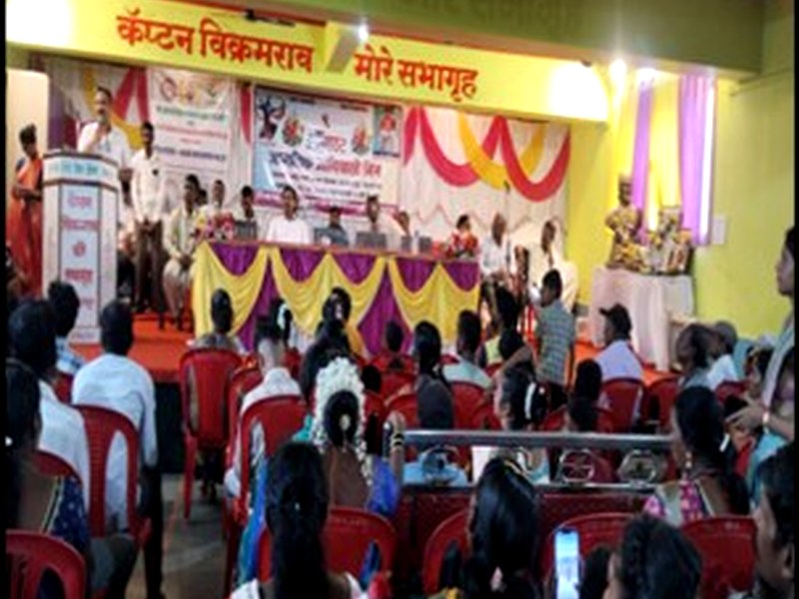
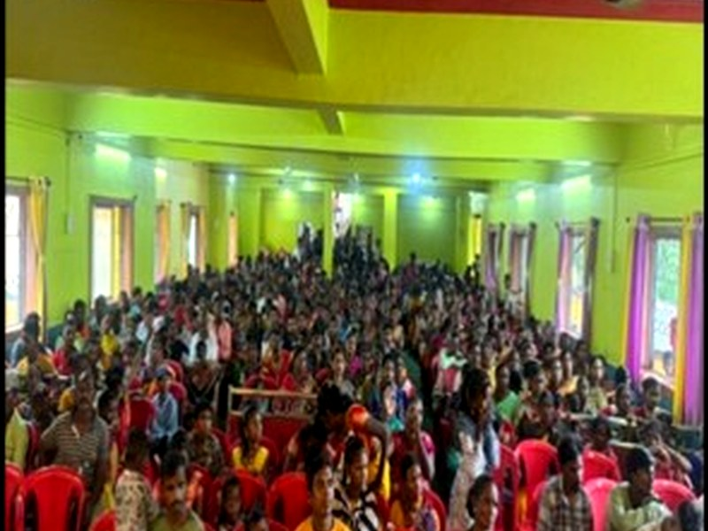
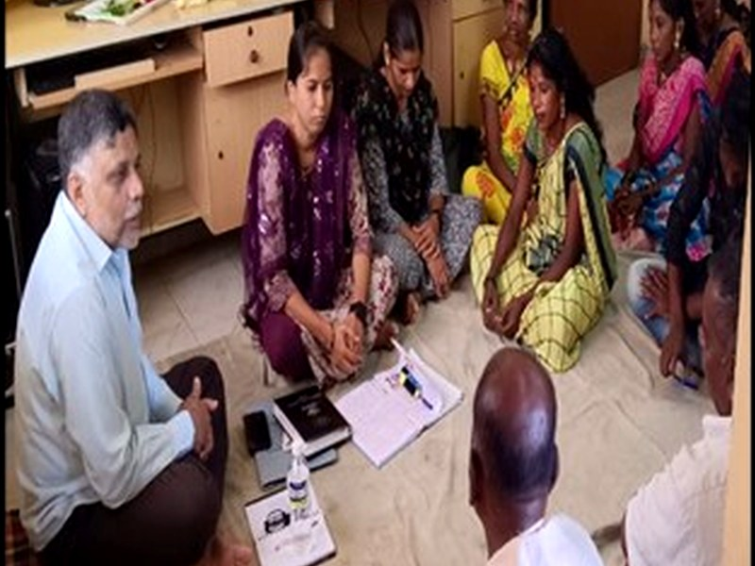
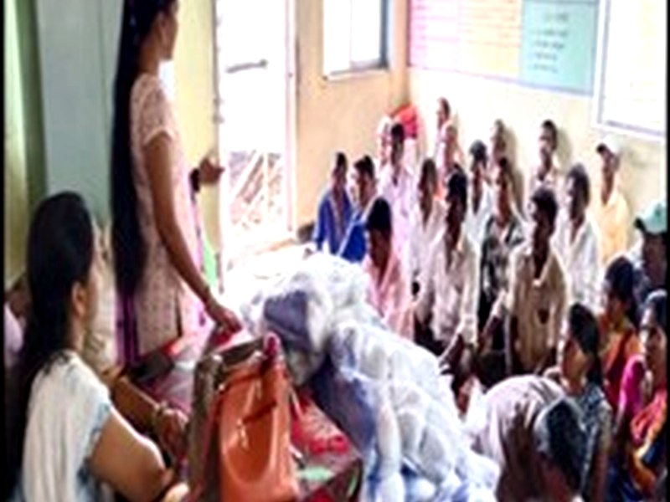
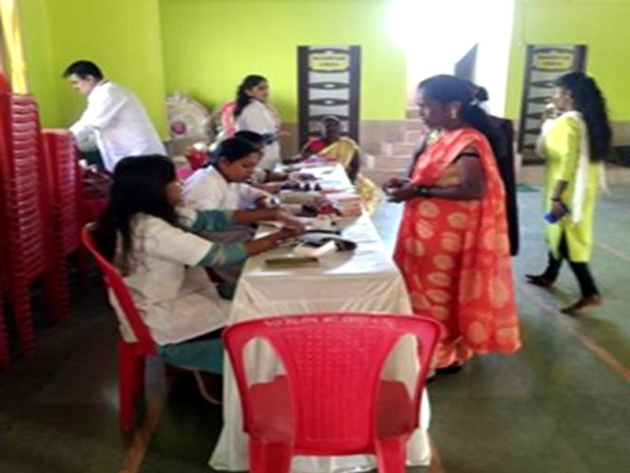
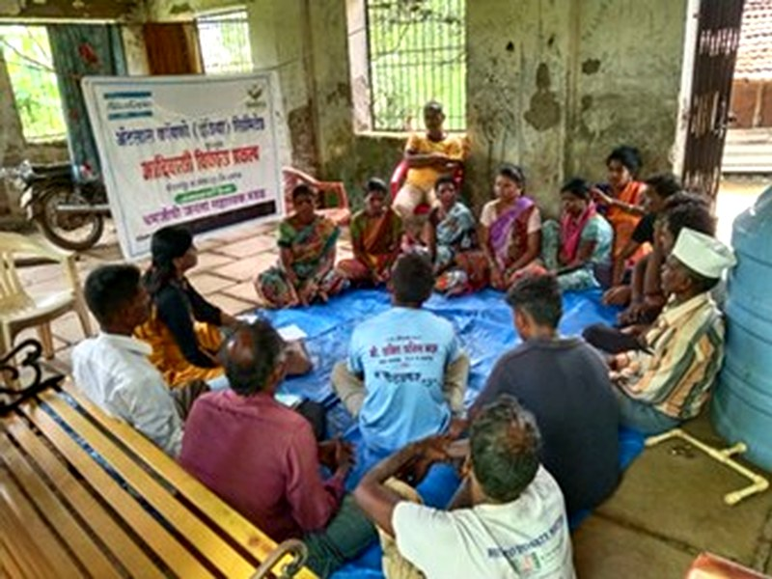
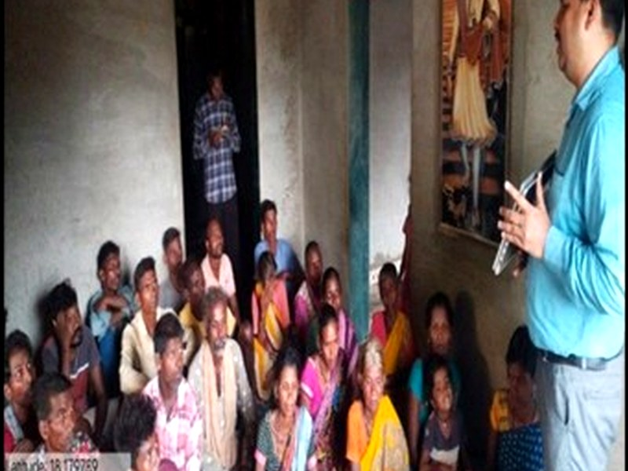
Capacity Building Achievements & Field Photos
SJSM · Atlas Copco CSR · 2023–2026
Key Capacity Building Achievements at a Glance
126 training and awareness programmes conducted during the project period across all activity areas.
Over 800 participants reached through awareness camps, training programmes, and community meetings.
15 SHGs strengthened, including 4 newly formed SHGs and 4 revived inactive groups across tribal hamlets.
16 fishing cooperative members, 20 micro-credit cooperative members, 11 fisheries cooperative EC members trained.
15 micro-credit EC members, 20 village leaders, 32 river fishing beneficiaries, and 32 KAAS members directly trained.
300+ fishermen sensitized on sustainable fishing practices, seasonal restrictions, and resource conservation.
343 Katkari community members engaged through KAAS strengthening and rights-based awareness initiatives.
Glimpses of Training Activities
Baseline survey, awareness camps, SHG meetings, and capacity building sessions
Baseline Survey
Awareness Camp
Community Meeting
Training Session
SHG Capacity Building
Women's Meeting
Expert Training
Fisheries Training
Health Check-up Camp
Expert Capacity Building
Community Leader Training
Project Completion Report · Inland Fishery Based Livelihood Improvement · Poladpur & Mahad, Raigad
9

Slide 10
Major Achievements Summary
SJSM · Atlas Copco CSR · 2023–2026
Major Achievement of Project - Summary Table
Ten key milestones achieved during May 2023 to April 2026
#
Activity
Major Milestone
Key Outcome
1
Baseline Survey
368 HH surveyed across 15 wadis
Household profiles created, documentation gaps identified, and support for accessing government schemes.
2
Dam Fishing Nets
83 fishermen supported
Increased fish catch, improved fishing efficiency, and enhanced income generation.
3
River Fishing Nets
213 fishermen supported
Expanded fishing coverage, reduced operational costs, and improved livelihoods.
4
Cage Culture Units
4 cage culture units installed
Promoted aquaculture, ensured year-round fish production, and created a sustainable income source.
5
Ice Boxes
25 SHG members supported
Reduced post-harvest losses, improved fish quality, and increased market value.
6
Marketing Accessory Kits
25 kits distributed
Improved fish handling, hygiene, weighing accuracy, and marketing efficiency.
7
Brood Stock Procurement
1,000 kg brood stock procured
Strengthened fish breeding, seed production, and long-term fish stock sustainability.
8
Fingerling Stocking
21.5 lakh in 5 reservoirs (242 ha) over 3 years
Enhanced fish population, improved biodiversity, and increased fisher incomes.
9
Brood Stock Feed
Feed provided for 12 months
Improved fish growth, breeding performance, and hatchery productivity.
10
Hatchery Rearing Support
Nets, haps, feed, medicines, equipment provided
Increased fish seed production, reduced mortality, and strengthened hatchery operations.
Overall: These fishery livelihood interventions significantly strengthened tribal fishing communities - improving fish production, reducing post-harvest losses, and contributing to greater income and economic resilience.
Project Completion Report · Inland Fishery Based Livelihood Improvement · Poladpur & Mahad, Raigad
10

Slide 11

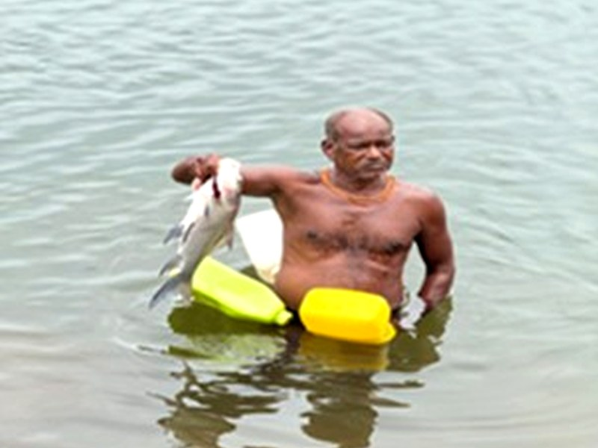
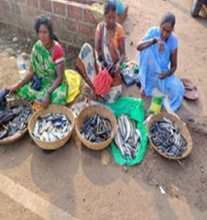
Impact on Fisheries-Based Livelihoods
SJSM · Atlas Copco CSR · 2023–2026
Impact on Fisheries-Based Livelihoods
During the three-year project period (2023–2026), a total of 270 fishermen directly benefited from fisheries-based livelihood interventions. Together, they harvested 1,20,552 kg of fish, generating a cumulative income of ₹1.89 Crore.
270
1,20,552 kg
₹1.89 Crore
Direct
Beneficiaries
Total Fish
Production
Total Income
Generated
Fisheries Income Generated During the Project
Category-wise breakdown of fish production and income earned
Category
Beneficiaries
Fish Production
Avg. Rate
Income Generated
River Fishing Beneficiaries
198
68,406 kg
₹155/kg
₹1,06,02,930
Dam Fishing Beneficiaries
72
52,146 kg
₹160/kg
₹83,43,360
TOTAL
270
1,20,552 kg
-
₹1,89,46,290
Key Impact Achieved
270 tribal fishermen secured sustainable livelihood opportunities through project interventions.
1.20 lakh kg of fish production achieved during the project period across 5 reservoirs.
Total income of ₹1.89 Crore generated - ₹1.06 Cr from river fishing + ₹83.4 L from dam fishing.
Improved fishing equipment, stocking, and training enhanced productivity and catch efficiency.
Increased fish availability strengthened local markets and improved household food security.
Project contributed to greater economic resilience and improved living standards among tribal families.
Fisherman in Active Fishing - River Catch
Fish Catch at Market - Post-Harvest
11
Project Completion Report · Inland Fishery Based Livelihood Improvement · Poladpur & Mahad, Raigad

Slide 12
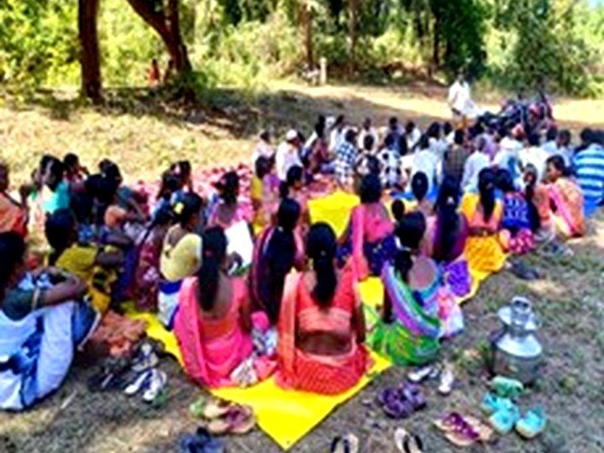
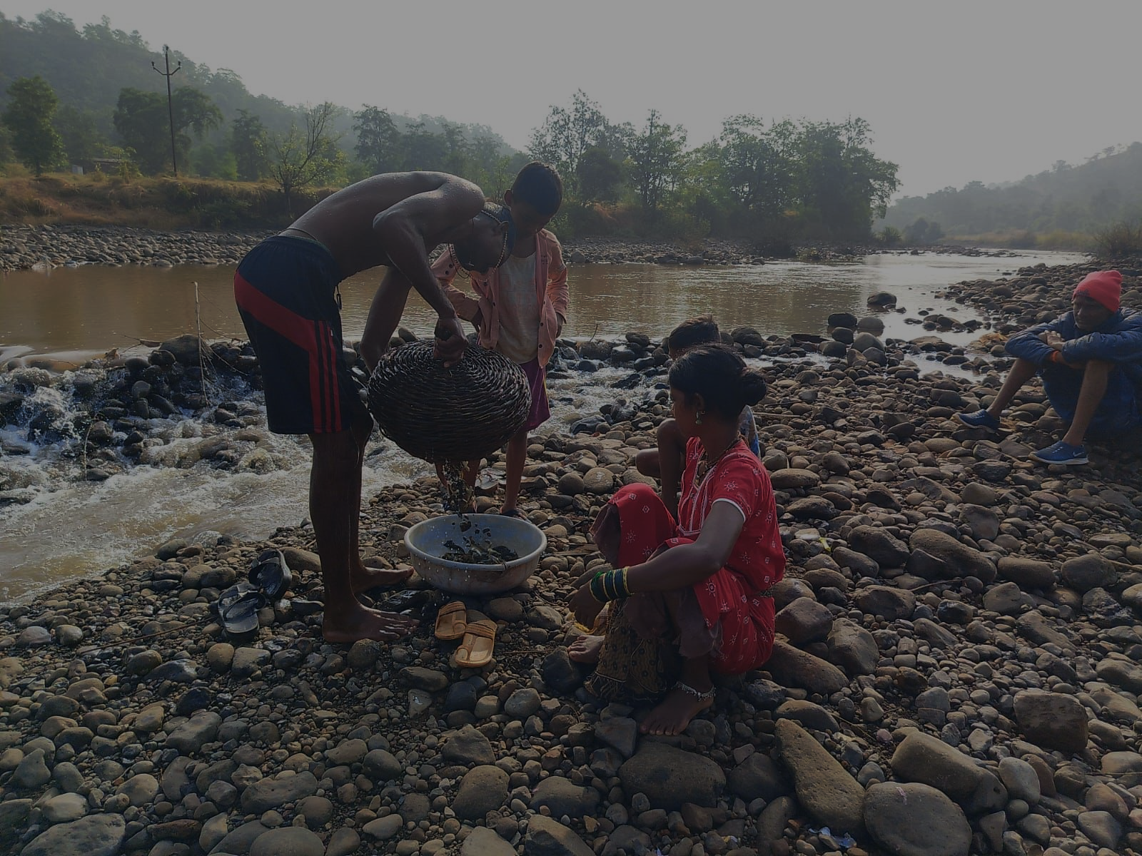
CHAPTER 03
Poladpur Block
Deep Dive
Comprehensive coverage of interventions, capacity building, government scheme access, and community transformation specifically in Poladpur block - the primary project area.
12

Slide 13
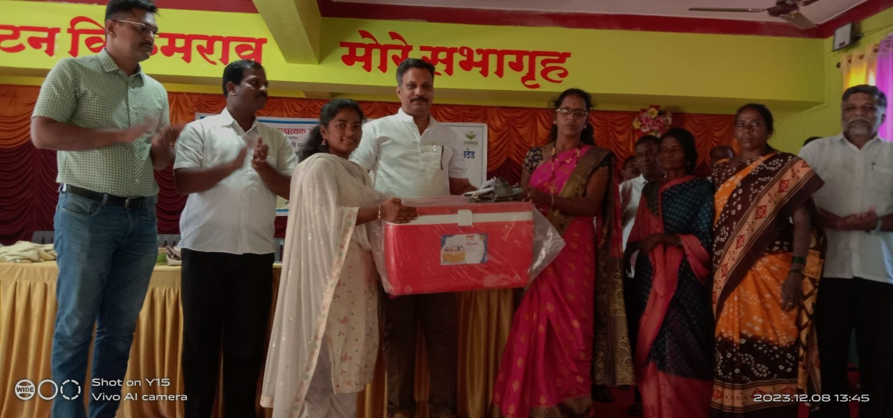
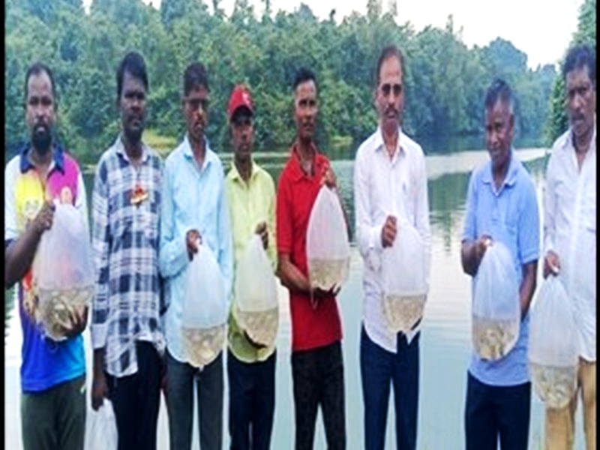
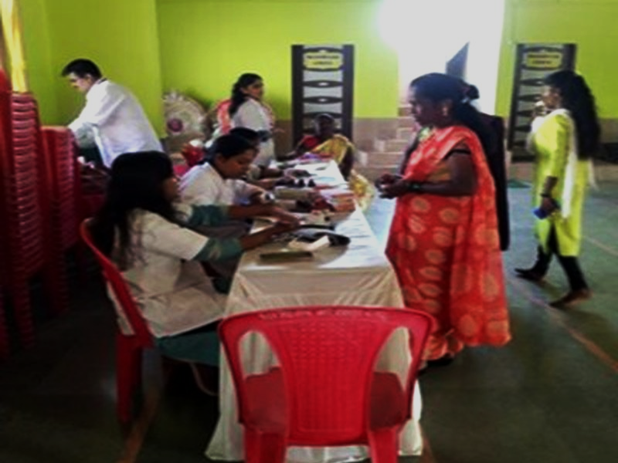

Poladpur Block - Interventions & Outcomes
SJSM · Atlas Copco CSR · 2023–2026
Poladpur Block - Project Footprint & Outcomes
Primary project block · 15 tribal hamlets · Raigad district, Maharashtra
15
213
83
485
₹3.05 Cr
Hamlets
Covered
River Net
Beneficiaries
Dam Net
Beneficiaries
Govt. Scheme
Beneficiaries
Scheme
Benefits
Interventions in Poladpur Block
1
Fishing Net Distribution
Dam nets for 83 fishermen; river nets for 213 fishermen from 15 tribal wadis. Training on proper usage and sustainable practices.
Net Distribution Event
2
Fingerling Stocking
21.5 lakh fingerlings stocked across 5 reservoirs (242 ha) - Poladpur being the primary area. Good survival rates documented.
3
Ice Boxes & Marketing
Fish Stocking Activity
25 ice boxes to SHG members; 25 marketing kits distributed. Post-harvest losses reduced significantly.
4
Health Camp
Health check-up camps conducted for tribal fishing families - benefiting community wellbeing.
Health Camp
Government Scheme Access - Poladpur Block: 485 beneficiaries · ₹3.05 Crore in benefits · Includes PMAY housing (116 families), Shabari Awas Yojana (18 families), 257 caste certificates, MSRLM revolving funds.
Distribution of Fishing Equipment - Poladpur
Fingerling Transportation for Stocking
Project Completion Report · Inland Fishery Based Livelihood Improvement · Poladpur & Mahad, Raigad
13

Slide 14
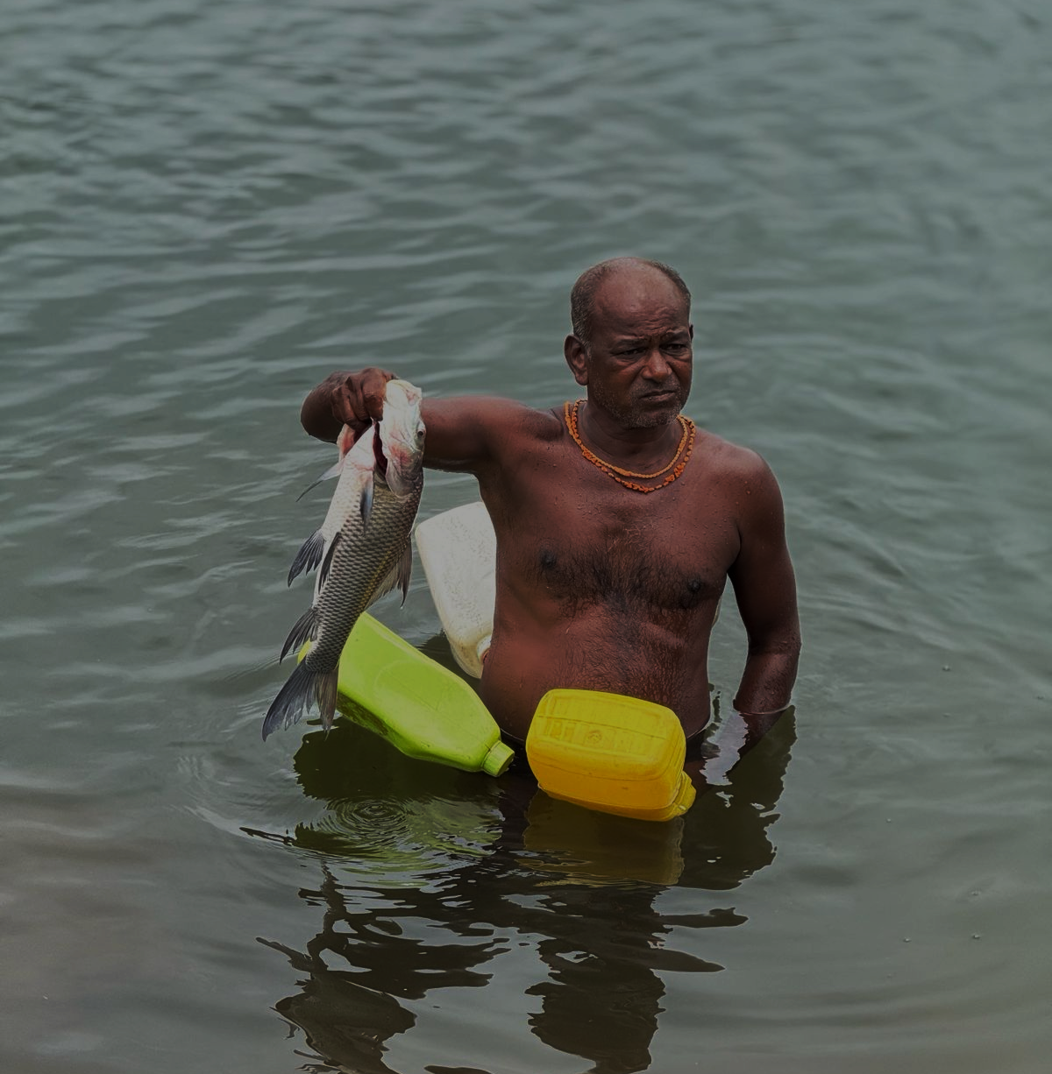
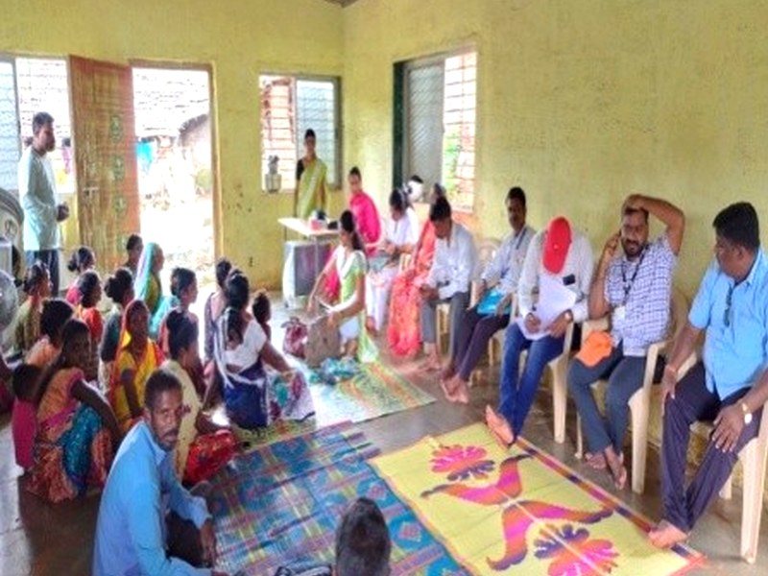
CHAPTER 04
Mahad Block
Deep Dive
Community interventions, capacity building, and government scheme access in Mahad Block - the Next project area extending the project's reach to additional tribal communities.
14

Slide 15
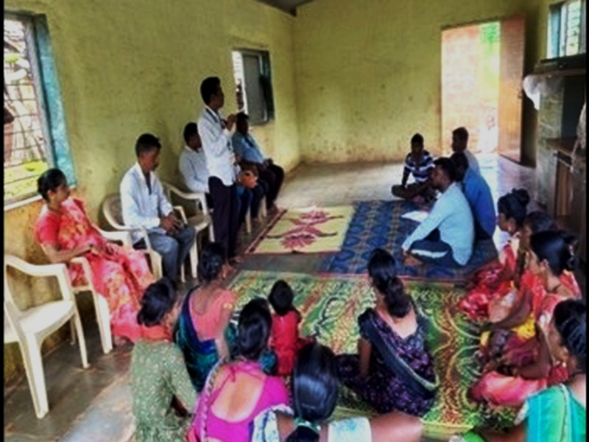
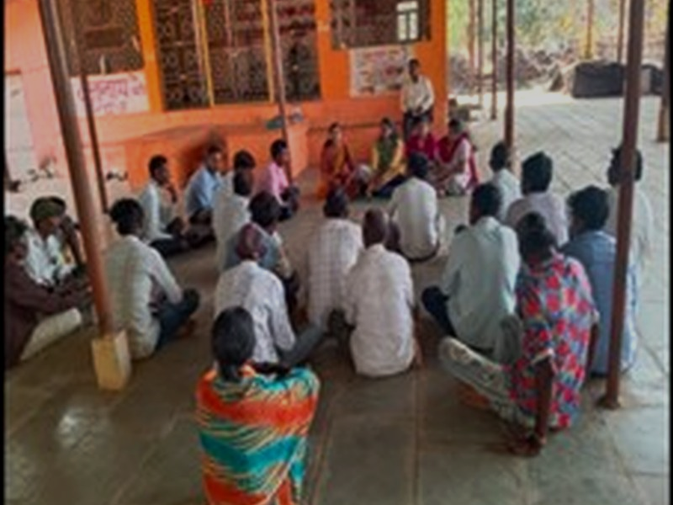

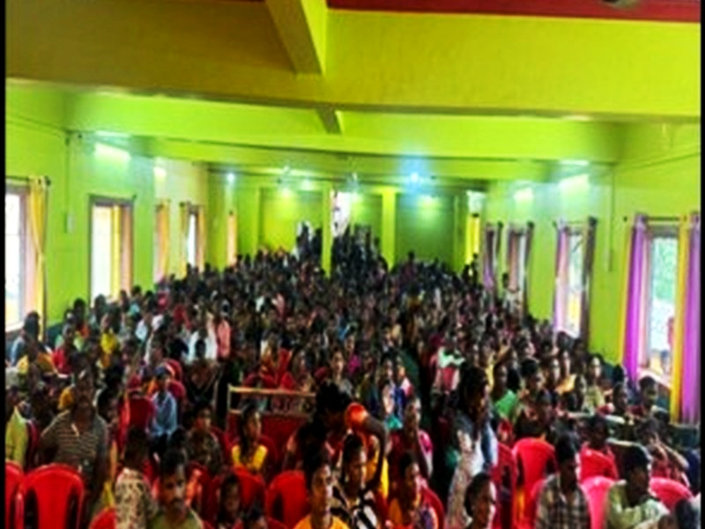
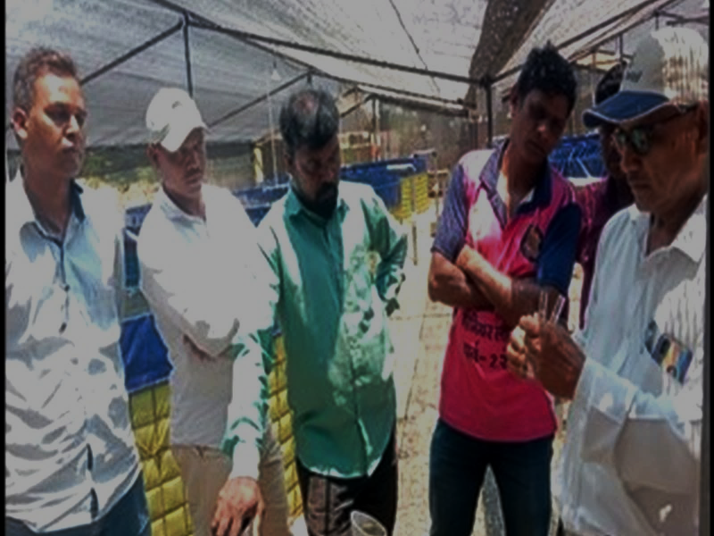
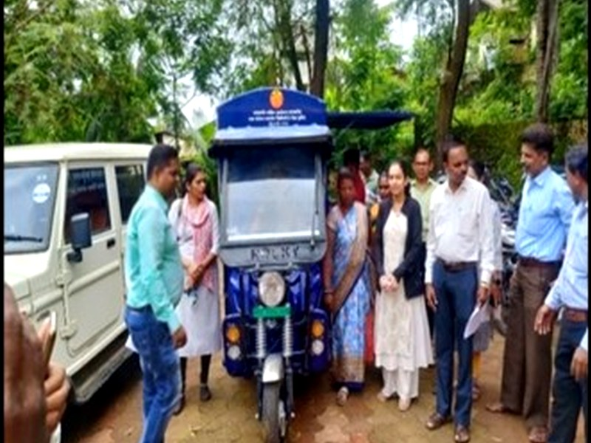
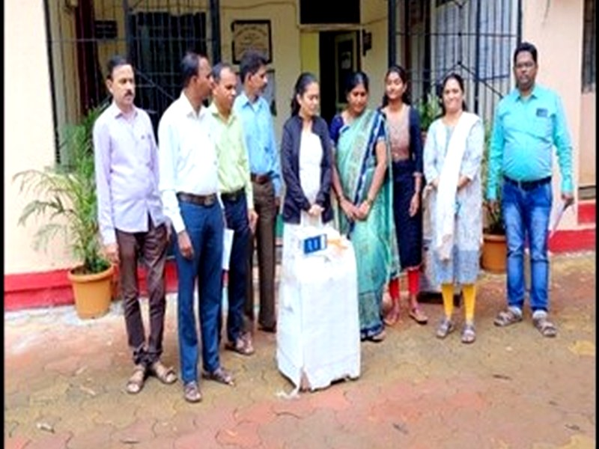
Mahad Block - Interventions & Outcomes
SJSM · Atlas Copco CSR · 2023–2026
Mahad Block - Project Footprint & Outcomes
Next project block · Raigad district, Maharashtra
235
₹1.78 Cr
62
22
300+
Govt. Scheme
Beneficiaries
Scheme
Benefits
PMAY Housing
Families
Shabari Awas
Families
Fishermen
Sensitized
Interventions & Activities in Mahad Block
The Mahad Block was covered as the Next project area, extending the reach of the fisheries livelihood intervention to additional tribal communities. Key activities included awareness campaigns, training for fishermen and SHG members, capacity building of village leaders, and facilitation of access to government welfare schemes.
Through continuous awareness campaigns and handholding support by SJSM, 235 beneficiaries from Mahad Block accessed government welfare schemes worth ₹1.78 Crore during the project period.
Community Gathering - Mahad
Government Scheme Access - Mahad Block
PMAY Housing
62 families received housing support under Pradhan Mantri Awas Yojana
Awareness Camp - Mahad Block
Shabari Awas Yojana
22 families benefited from this tribal housing scheme
Caste Certificates
Beneficiaries supported to obtain caste certificates and ration cards
Poultry Units
SHG Meeting in Mahad Block
Poultry units provided to beneficiaries for income diversification
Ujjwala Gas
Ujjwala LPG Gas Connections extended to eligible beneficiaries
Community Infrastructure
Support for community infrastructure and sanitation improvement
Capacity Building - Mahad
Mahad Block Impact: 235 beneficiaries accessed government schemes worth ₹1.78 Crore - including housing, livelihood assets, LPG connections, and caste certificates.
E-Rickshaw Distribution - Govt. Scheme
15
Solar Panel Distribution - Mahad
Project Completion Report · Inland Fishery Based Livelihood Improvement · Poladpur & Mahad, Raigad

Slide 16




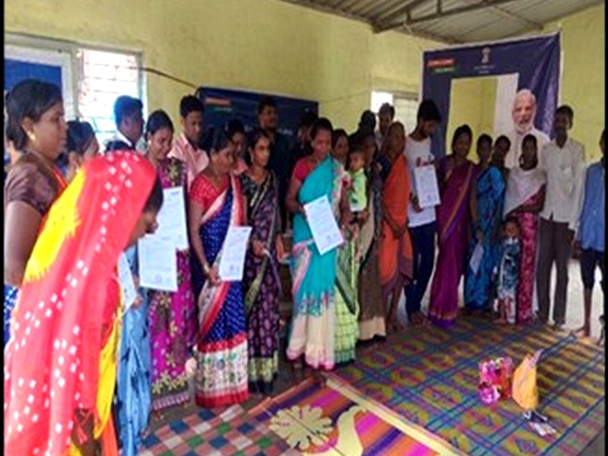



Government Scheme Access - Poladpur Block
SJSM · Atlas Copco CSR · 2023–2026
Government Scheme Access & Social Entitlements - Poladpur Block
485 beneficiaries · Schemes worth ₹3.05 Crore · 2023–2026
One of the most significant outcomes of the project was the increased awareness among tribal communities regarding their rights, government welfare schemes, and the importance of possessing essential documents. Through continuous awareness campaigns, training programmes, community meetings, and handholding support provided by SJSM, beneficiaries were able to access a range of government welfare schemes and social security benefits.
116
18
PMAY Housing Support
Shabari Awas Yojana
116 families from tribal hamlets received housing support under Pradhan Mantri Awas Yojana (PMAY). This transformative intervention provided concrete homes to families previously living in kutcha structures.
18 families benefited from Shabari Awas Yojana - a state-level tribal housing scheme. Combined with PMAY, this scheme provided comprehensive housing coverage to eligible tribal families.
257
40
Caste Certificates
MSRLM Revolving Fund
257 beneficiaries obtained caste certificates, enabling access to various tribal welfare schemes, educational benefits, job reservations, and government entitlements previously inaccessible without documentation.
40 women members from 4 Self-Help Groups received revolving fund support through Maharashtra State Rural Livelihoods Mission (MSRLM), enhancing financial inclusion and entrepreneurship.
485
Total Scheme Beneficiaries
Beneficiaries also accessed Ujjwala Gas Connections, Ayushman Bharat Cards, and electricity connections - collectively improving quality of life across 15 tribal hamlets in Poladpur ₹3.05 Crore
Equipment Distribution
educational material support
Solar Power Scheme
community infrastructure schemes
Project Completion Report · Inland Fishery Based Livelihood Improvement · Poladpur & Mahad, Raigad
16

Slide 17

Government Scheme Access - Mahad Block & Social Welfare
SJSM · Atlas Copco CSR · 2023–2026
Mahad Block Scheme Access & Social Welfare Infrastructure Support
235 beneficiaries · ₹1.78 Crore · Plus social welfare linkages across both blocks
Government Scheme Distribution - Community Empowerment Event
Scheme
Beneficiaries / Units
Value / Benefit
Impact
PMAY - Pradhan Mantri Awas Yojana
62 families
Housing grant
Permanent concrete homes for tribal families
Shabari Awas Yojana
22 families
State housing grant
Tribal housing scheme; complementary to PMAY
Caste Certificates
Multiple beneficiaries
Documentation
Access to reservations, schemes, and entitlements
Ration Cards
Multiple beneficiaries
Food security
Access to PDS and subsidized food provisions
Poultry Units
Multiple beneficiaries
Livelihood asset
Income diversification beyond fishing activities
Ujjwala LPG Connections
Multiple beneficiaries
Clean cooking fuel
Reduced indoor smoke; women's health improvement
Community Infrastructure
9 hamlets
Satranji + furniture support
Physical assets for community meeting spaces
Educational Materials
9 hamlets
Furniture + supplies
Support for schools and educational infrastructure
Solar Power Scheme
5 hamlets
Solar installations
Renewable energy access for tribal hamlets
Additional Social Welfare Infrastructure Linkages
E-rickshaw units provided for livelihood transportation
Sugarcane juice extraction machines for income generation
Open gym equipment installed in tribal hamlets
Community business infrastructure support extended
Solar power scheme covered 5 hamlets across both blocks
Project Completion Report · Inland Fishery Based Livelihood Improvement · Poladpur & Mahad, Raigad
17

Slide 18



Media Coverage & Social Recognition
SJSM · Atlas Copco CSR · 2023–2026
Media Coverage - Project in the News
Project activities gained significant media attention in local and regional newspapers
The project's community activities, government scheme distributions, and tribal empowerment initiatives received coverage in local Marathi newspapers, reflecting the public significance and community recognition of SJSM's work in Poladpur and Mahad blocks.
Marathi Newspaper Coverage - Poladpur Tribal Fisheries Project
'Prahar' Newspaper - Project Activities Coverage
Pudhari Newspaper - SJSM Tribal Empowerment Coverage
Media coverage in 'Pudhari ', 'Prahar', and local Marathi newspapers highlighted the transformative impact of fisheries interventions and government scheme access for Katkari tribal communities.
Project Completion Report · Inland Fishery Based Livelihood Improvement · Poladpur & Mahad, Raigad
18

Slide 19

CHAPTER 05
Success Stories
Community Voices
Three documented stories of transformation - a tribal fisherwoman, a 172-member cooperative, and a cage culture pioneer - demonstrating the human impact behind the numbers.
19

Slide 20



Success Story 1 - Ranjana Pawar
SJSM · Atlas Copco CSR · 2023–2026
SUCCESS STORY 1
"From Daily Struggles to Sustainable Success"
Ranjana Pawar · Fisherwoman & Cooperative Member · Poladpur Taluka
BACKGROUND
Ranjana Pawar has been engaged in fishing activities along with her family for many years as a member of the local fishing cooperative. Fishing served as the primary income source for her household. However, limited access to quality fishing equipment, inadequate post-harvest facilities, and fluctuating fish catch resulted in irregular earnings and financial uncertainty.
CHALLENGES
PROJECT INTERVENTION
Like many fisher families in the region, Ranjana faced difficulties maintaining stable income due to traditional fishing methods, post-harvest losses, and limited market opportunities. The lack of proper storage facilities often affected fish quality and reduced the selling price of her catch, compounding financial stress on the household.
Under the Fisheries Livelihood Development Project by Atlas Copco India and SJSM, Ranjana received support through various livelihood enhancement initiatives. She participated in training on sustainable fishing practices, fish handling, marketing, and resource conservation. Improved fishing equipment and post-harvest support were facilitated.
CHANGE ACHIEVED: More regular earnings, reduced post-harvest losses, ability to sell fish at improved prices. Enhanced financial security and reduced dependence on seasonal wage labour. Ranjana is now a confident, active cooperative member.
The training and support provided through the project helped me improve my fishing activities and earn a more stable income. Today, I feel more confident about supporting my family through fishing.
- Ranjana Pawar, Fisherwoman and Cooperative Member, Poladpur
Project Completion Report · Inland Fishery Based Livelihood Improvement · Poladpur & Mahad, Raigad
20

Slide 21


Success Story 2 - Gadital Fishing Cooperative
SJSM · Atlas Copco CSR · 2023–2026
SUCCESS STORY 2
“Preserving the Catch, Securing the Future”
Adiwasi Machhimar V.K. Sahakari Sanstha, Gadital - 172 Members · near Bajire Dam, Poladpur
Society Profile
Society Name:
Adiwasi Machhimar V.K. Sahakari Sanstha, Marya Gadital
Members:
172 active members
Chairman:
Mr. Kashinath Tukaram Pawar
Secretary:
Mr. Pandurang Sitaram Waghe
Location:
Gadital village, near Bajire Dam
Activity:
Inland fishing as primary livelihood
Ice Box Distribution Event - Adiwasi Machhimar V.K. Sahakari Sanstha, Gadital
THE CHALLENGE
PROJECT INTERVENTION
IMPACT OF CHANGE
Members of the cooperative regularly ventured into Bajire Dam reservoir to catch fish. However, due to the perishable nature of fish and the absence of cold storage facilities, unsold fish often spoiled within a day, resulting in financial losses. Fishermen were forced to sell at whatever price local traders offered.
Under the project, Atlas Copco India and SJSM provided ice boxes to members of the fishing community. Training was conducted on hygienic fish handling, storage practices, and effective use of ice boxes to improve fish preservation and reduce post-harvest losses.
Fish can now be stored safely for longer periods, reducing spoilage. Fishermen gained flexibility to sell in nearby and distant markets, securing better prices. Dependence on local middlemen reduced, bargaining power strengthened, and income stability increased for all 172 members.
Earlier, we had to sell fish immediately, often at whatever price was offered. With the ice boxes provided through the project, we can preserve our fish, access better markets, and earn better incomes. Our hard work now brings better returns.
- Member, Adiwasi Machhimar V.K. Sahakari Sanstha, Gadital
Project Completion Report · Inland Fishery Based Livelihood Improvement · Poladpur & Mahad, Raigad
21

Slide 22




Success Story 3 - Cage Culture Innovation
SJSM · Atlas Copco CSR · 2023–2026
SUCCESS STORY 3
"Innovating Fisheries, Securing Futures"
Cage Culture Initiative · Aambavade Dam · Adiwasi Machhimar V.K. Sahakari Sanstha
Background
The fishing community around Aambavade Dam depends primarily on fisheries for its livelihood. Declining fish availability, seasonal fluctuations, and limited access to modern aquaculture practices resulted in unstable incomes. Traditional fishing methods were insufficient due to declining fish stocks and seasonal uncertainties.
Project Intervention
Atlas Copco India provided CSR support and SJSM facilitated the establishment of a Cage Culture Unit at Aambavade Dam. Activities included: installation of fish cages, stocking of commercially valuable fish species, and technical training on cage management, feeding practices, water quality monitoring, and fish health management.
Cage Culture System at Aambavade Dam - Full View
Change Achieved
Established a functional cage culture unit at Aambavade Dam
Enhanced fish production through scientific aquaculture practices
Improved technical knowledge and skills of cooperative members
Cage Frame Installation Process - Community Participation
Created a sustainable income source beyond traditional fishing
Promoted efficient and responsible use of reservoir resources
Cage culture has opened a new avenue of income for our cooperative. With the training and support received through the project, we are now confident about adopting modern fish farming practices and building a better future for our families.
Strengthened long-term economic resilience of fishing households
- Member, Adiwasi Machhimar V.K. Sahakari Sanstha, Aambavade
Cage Frame
Cage System
Operational Cage
The Cage Culture Initiative demonstrated how innovative fisheries interventions can transform traditional livelihoods into sustainable income-generating opportunities for tribal communities.
Project Completion Report · Inland Fishery Based Livelihood Improvement · Poladpur & Mahad, Raigad
22

Slide 23



Cumulative Impact Summary - 2023–2026
SJSM · Atlas Copco CSR · 2023–2026
Cumulative Project Impact - May 2023 to April 2026
Comprehensive outcomes across fisheries, government schemes, training, and community development
21.5 Lakh
₹1.89 Cr
₹4.83 Cr
Fingerlings Stocked
(5 reservoirs, 242 ha)
Fisheries Income
Generated
Govt. Scheme
Benefits
720
126
800+
Govt. Scheme
Beneficiaries
Training
Programmes
Participants
Reached
Block-wise Impact Comparison
Indicator
Poladpur Block
Mahad Block
TOTAL
Govt. Scheme Beneficiaries
485
235
720
Govt. Scheme Benefits
₹3.05 Crore
₹1.78 Crore
₹4.83 Crore
PMAY Housing Families
116 families
62 families
178 families
Shabari Awas Families
18 families
22 families
40 families
Caste Certificates
257 beneficiaries
Multiple
257+
Fisheries Livelihood Impact
Category
Beneficiaries
Fish Production
Market Rate
Income Generated
River Fishing
198
68,406 kg
₹155/kg
₹1,06,02,930
23
Project Completion Report · Inland Fishery Based Livelihood Improvement · Poladpur & Mahad, Raigad
Dam Fishing
72
52,146 kg
₹160/kg
₹83,43,360
TOTAL
270
1,20,552 kg
-
₹1,89,46,290
Project Completion Report · Inland Fishery Based Livelihood Improvement · Poladpur & Mahad, Raigad
23

Slide 24





Way Forward & Recommendations
SJSM · Atlas Copco CSR · 2023–2026
Way Forward & Recommendations
In conclusion, the project has successfully boosted fishery-based livelihoods, enhancing income and community resilience. To ensure year-round self-reliance, additional support is needed to diversify livelihoods through small-scale enterprises and animal husbandry.
Extend Project Support
Replicate the Fishery Model
Provide two additional year of funding to diversify livelihoods through small-scale enterprises and animal husbandry, ensuring year-round income stability for Katkari tribal families in both blocks.
Scale the successful fishery model to adjacent Mahad and Mangaon blocks, empowering additional tribal communities toward sustainable, self-sufficient futures based on proven intervention strategies.
Strengthen Institutions
State Partnership Linkages
Continue capacity building of fishing cooperatives, SHGs, and community organizations to ensure long-term self-management, governance, and financial sustainability beyond the project period.
Explore formal linkages with Maharashtra state fisheries departments, NABARD, and government programmes for continued technical support, policy integration, and resource mobilization.
By expanding proven interventions to Mahad and Mangaon blocks, we can empower more tribal communities toward sustainable and self-sufficient futures - building on the demonstrated success of this three-year model.
Project Completion Report · Inland Fishery Based Livelihood Improvement · Poladpur & Mahad, Raigad
24

Slide 25


CONCLUSION
Three Years of
Transformative Impact
The Inland Fishery Based Livelihood Improvement Intervention, implemented by Shramjivi Janata Sahayyak Mandal (SJSM) with CSR support from Atlas Copco (India) Pvt. Ltd., has achieved significant milestones in improving the livelihoods, institutional capacities, and socio-economic conditions of Katkari tribal fishing communities in Poladpur Taluka and Mahad Block, Raigad district.
Over three years (May 2023 – April 2026), the project has demonstrated that targeted investments in fisheries development - combining livelihood support, scientific fisheries management, capacity building, and institutional strengthening - can create lasting impact for marginalized tribal communities.
Together, we have demonstrated that sustainable development is achievable when communities, NGOs, and the private sector work in partnership toward a shared vision of inclusive growth. This project stands as a testament to what collective action and genuine partnership can achieve.
IMPLEMENTED BY
FUNDED BY
Shramjivi Janata Sahayyak Mandal
(SJSM), Satara
Atlas Copco (India) Pvt. Ltd.
Corporate Social Responsibility Initiative
Established 1980 · Maharashtra
Project Period: May 2023 – April 2026
· For Corporate Presentation Only · © 2026 SJSM & Atlas Copco (India) Pvt. Ltd.

