Slide 1
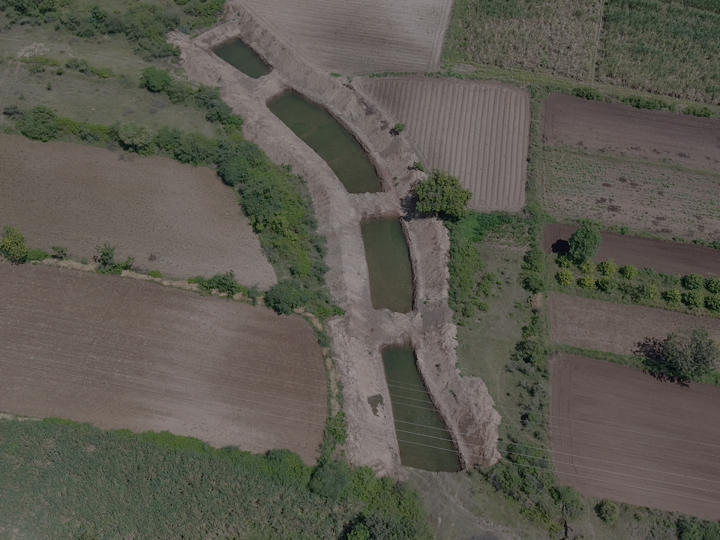


TE Integrated Watershed
Management Project
(IWMP)
SJSM · SATARA
ANNUAL REPORT FY 2025–26
LOCATION
Ghatdare, Khandala, Dist. Satara
TE Connectivity
CSR Partner:

Slide 2
TE IWMP – Annual Report 2025-26
TE Connectivity × SJSM Satara | Ghatdare Watershed
CONTENTS
Table of Contents
01
Executive Summary
3
02
Background & Need
4
03
Project Objectives & Scope
4
04
Water Conservation Structures – Progress & Achievement
5
05
Achievement vs Target — Visual
5
06
Annual Water Storage Created by Structure
5
07
Outcomes & Measured Impact
6
08
Groundwater Monitoring — June 2025 to April 2026
6
09
Field Documentation –Nala Deepening & Earthwork
7
10
Field Documentation -Aerial View
8 -9
11
Field Documentation -Launch & Community
10
12
Water Purification Unit -Safe Drinking Water
11
13
Media Coverage Newspaper Reports
12
14
Alignment with UN Sustainable Development Goals
13

Slide 3
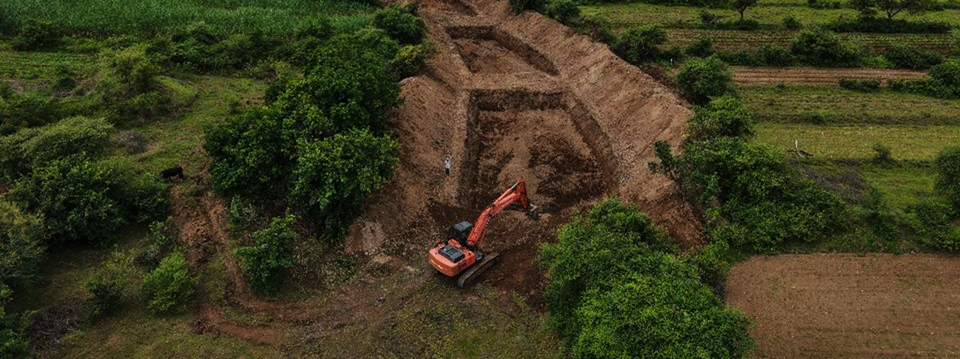
TE IWMP – Annual Report 2025-26
TE Connectivity × SJSM Satara | Ghatdare Watershed
Executive Summary
The TE Integrated Watershed Management Project (IWMP) at Ghatdare village, Khandala, Satara — implemented by Shramjivi Janata Sahayyak Mandal (SJSM) under the CSR initiative of TE Connectivity — has completed its first full year (FY 2025-26) with near-100% achievement across all primary targets. The project has delivered tangible outcomes: a 2.5–3.2 metre rise in groundwater levels, 136.43 TCM of additional annual water storage, and successful community mobilisation of all 225 households across 647 hectares.
225 Households Community Reached | 647 Hectares Total Project Area | 136.43 TCM/Year Water Storage Created | 3+metres Max Rise Groundwater Recharge
Project Overview
Project Title | TE Integrated Watershed Management Project (IWMP), Village – Ghatdare
CSR Partner | TE Connectivity
Implementing Partner | Shramjivi Janata Sahayyak Mandal (SJSM), Satara
Location | Ghatdare, Taluka – Khandala, District Satara, Maharashtra
Project Launch | 1 April 2025
Reporting Period | April 2025 – March 2026 (FY 2025-26)
Head Operations | Mr. Ram Kolekar
Total Area | 647 Hectares
Households | 225 Households | Gram Panchayat Ghatdare–Bhoslewadi

Slide 4
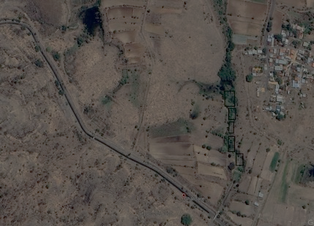
TE IWMP – Annual Report 2025-26
TE Connectivity × SJSM Satara | Ghatdare Watershed
Background & Need
Ghatdare Village — Google Earth Satellite View (Pre-intervention)
Ghatdare village has historically faced acute water scarcity, declining groundwater levels, and severe soil erosion that reduced agricultural productivity and increased drought vulnerability.
TE Connectivity, in partnership with SJSM and Gram Panchayat Ghatdare–Bhoslewadi, launched this integrated watershed programme to:
Restore the natural water balance
Control soil erosion through ridge-to-valley treatment
Bring 647 Ha of farmland under assured irrigation
Provide safe drinking water to 225 households
Build climate resilience and improve crop productivity
Project Objectives
Groundwater Recharge Increase groundwater recharge and create decentralized water storage through Nala deepening and Contour Trenches.
Soil Conservation
Control soil erosion through comprehensive ridge-to-valley treatment using Gabion, Loose Boulder, and SCT structures.
Bring 250 hectares of farmland under assured irrigation, progressing toward 647 Ha total area target.
Install and commission a Water Purification Unit to provide clean drinking water to all 225 households.
Build climate resilience through community mobilisation, Gram Sabha approvals, and local ownership of infrastructure.
Irrigation Expansion
Safe Drinking Water
Community Governance

Slide 5
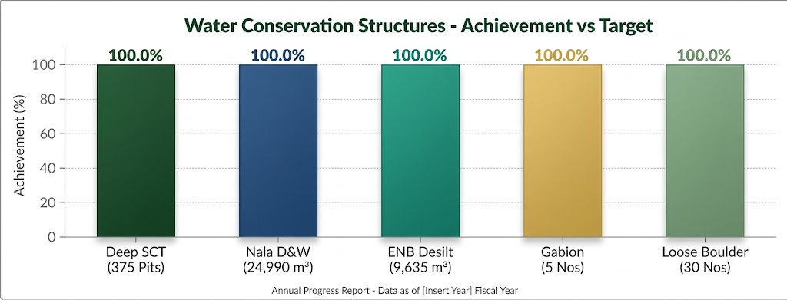
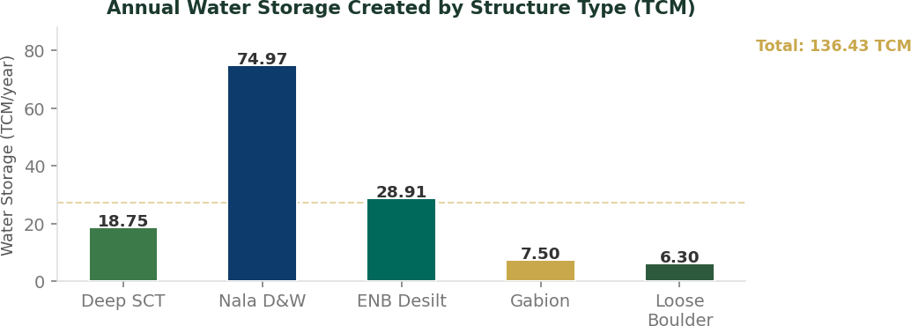
TE IWMP – Annual Report 2025-26
TE Connectivity × SJSM Satara | Ghatdare Watershed
Water Conservation Structures – Progress & Achievement
Sr. | Activity / Intervention | Plan (Target) | Actual (Achieved) | Water Storage (TCM/year)
2a | Deep SCT – Staggered Contour Trenches | 375 Pits | 375 Pits | 18.75
2b | Nala Deepening & Widening | 25,000 m³ | 24,990 m³ | 74.97
2c | Desilting of Existing Water Bodies (ENB) | 9,635 m³ | 9,635 m³ | 28.91
2d | Gabion Structures | 5 Nos | 5 Nos | 7.50
2e | Loose Boulder Structures (LBS) | 30 Nos | 30 Nos | 6.30
 | TOTAL ANNUAL WATER STORAGE | – | – | 136.43 TCM
Achievement vs Target — Visual
Annual Water Storage Created by Structure

Slide 6
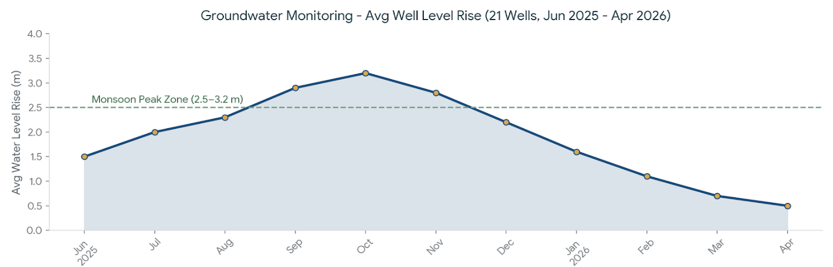
TE IWMP – Annual Report 2025-26
TE Connectivity × SJSM Satara | Ghatdare Watershed
Outcomes & Measurable Impact
Groundwater Recharge | 2.5 – 3.2 metre average post-monsoon rise observed across 21 monitoring wells in Ghatdare. Peak recharge recorded July–October 2025. Highest recharge zones adjacent to Nala Deepening and ENB desilting sites.
Water Storage Created | Total additional annual water storage of 136.43 TCM created — providing groundwater recharge and reliable irrigation buffer across the entire 647 Ha watershed area.
Irrigation Potential | Significant improvement in irrigation potential with 100 Ha directly under assured irrigation; progressive expansion toward the 647 Ha long-term target as treatment zones mature.
Soil Erosion Control | Erosion stabilised across treated ridge-to-valley zones. Gully plugging effective — 5 Gabion and 30 Loose Boulder structures successfully installed and functional.
Water Purification Unit | Unit planned and procurement initiated. Once commissioned, will provide treated safe drinking water to all 225 households in Ghatdare village.
Community Governance | Majority Gram Sabha approval secured. All 225 households engaged via community sessions and local committees formed for long-term maintenance of watershed structures.
Groundwater Monitoring — June 2025 to April 2026
Parameter | Detail
Monitoring Points | 21 observation wells across Ghatdare village
Average Well Depth | 8 – 9 metres
Post-monsoon Rise | Average 2.5 – 3.2 m (July–October 2025)
Seasonal Low | February–March 2026 (dry season)
GPS Coverage | Lat 18.0157–18.0186 | Long 74.0693–74.0712
Highest Recharge Zones | Adjacent to Nala Deepening & ENB desilting sites

Slide 7
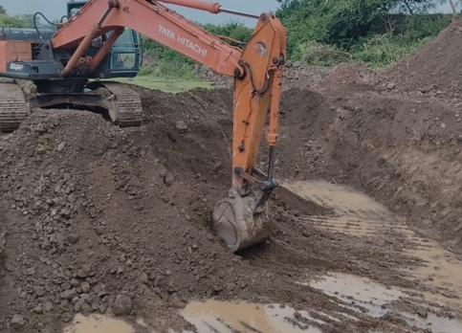
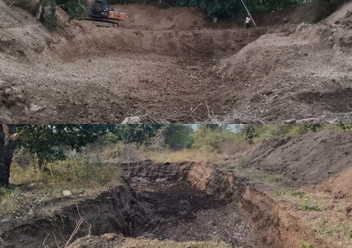
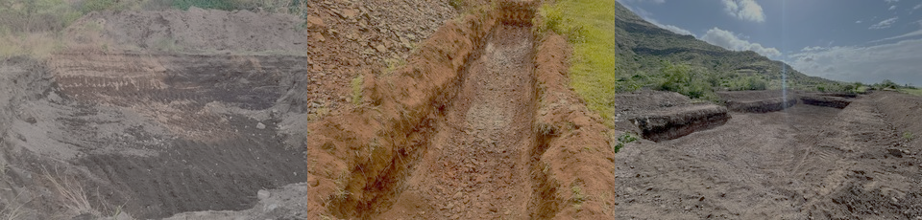
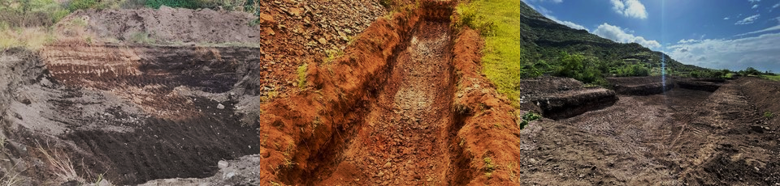
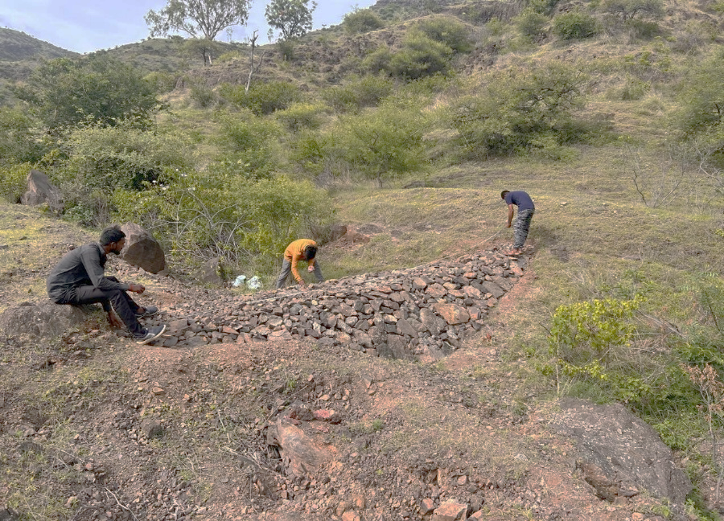
TE IWMP – Annual Report 2025-26
TE Connectivity × SJSM Satara | Ghatdare Watershed
Field Documentation –
Nala Deepening & Earthwork
Field photographs of Nala deepening and widening operations at Ghatdare using Tata Hitachi excavators — core earthwork activity achieving 24,990 m³ against the 25,000 m³ target.
Tata Hitachi Excavator — Active Nala Deepening (24,990 m³)
Completed Nala Section — Soil Excavation Site
Nala Widening — Field View
DesiltingTreatment
Gabion Measurement

Slide 8
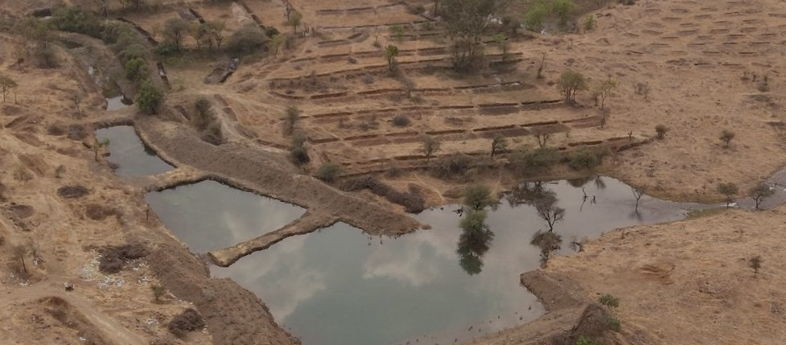
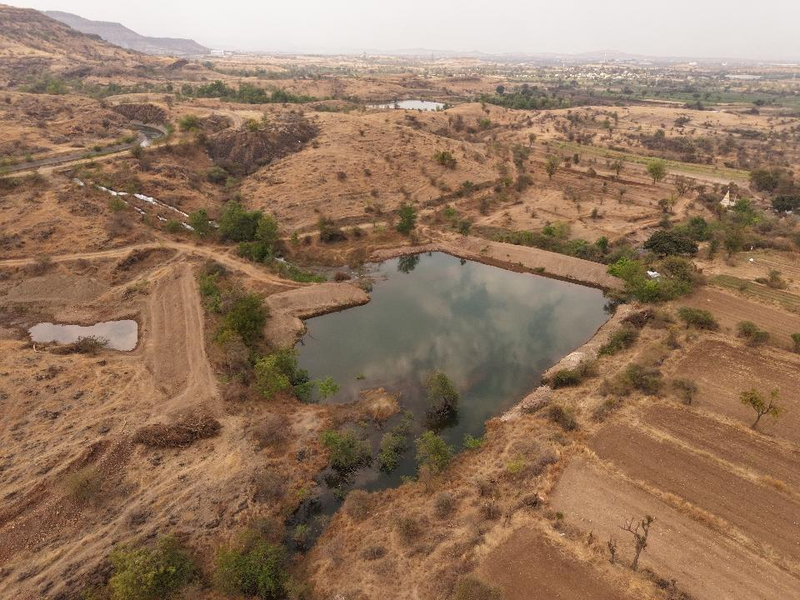
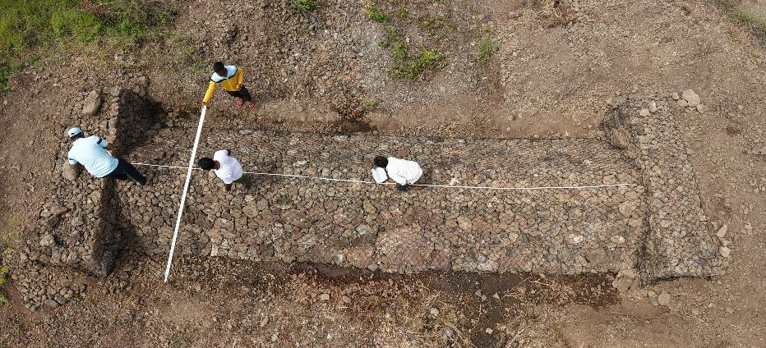
TE IWMP – Annual Report 2025-26
TE Connectivity × SJSM Satara | Ghatdare Watershed
Field Documentation —-
Aerial View
Aerial View — Completed Nala Deepening with Water Ponds, Ghatdare (Drone Photo)

Slide 9
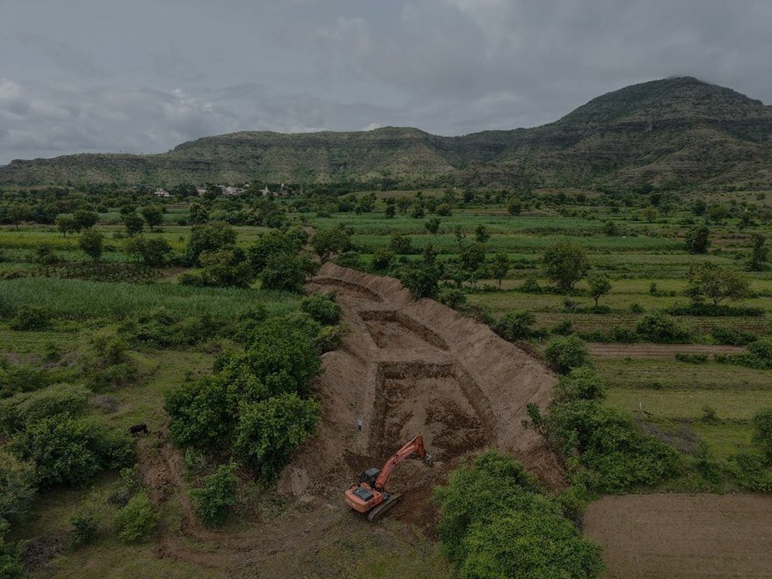
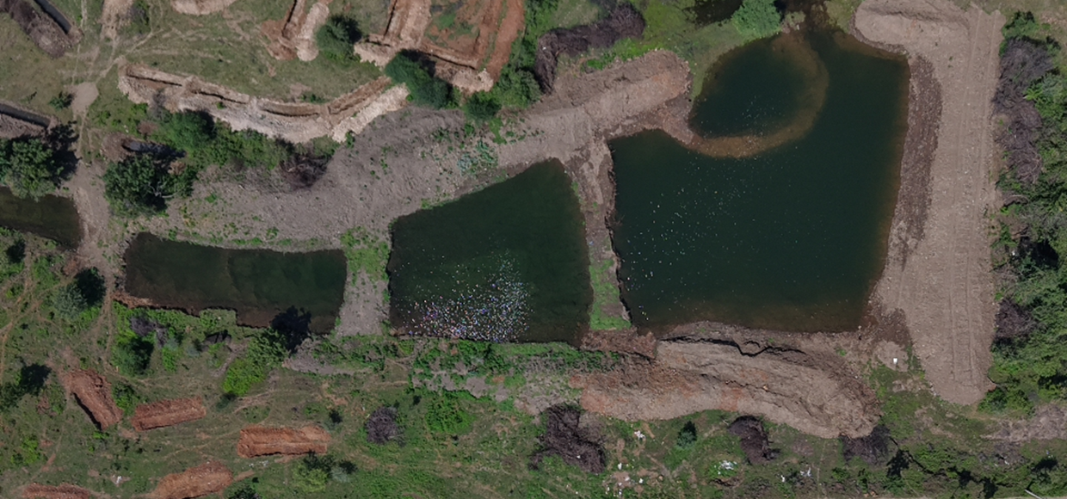
TE IWMP – Annual Report 2025-26
TE Connectivity × SJSM Satara | Ghatdare Watershed
Field Documentation —-
Aerial View

Slide 10
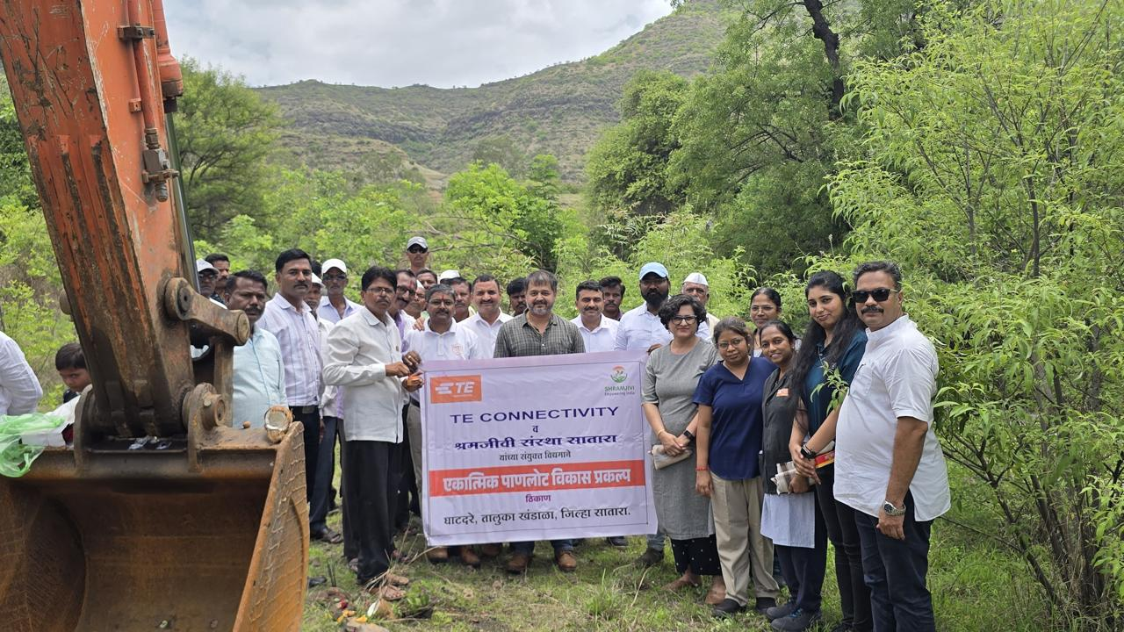
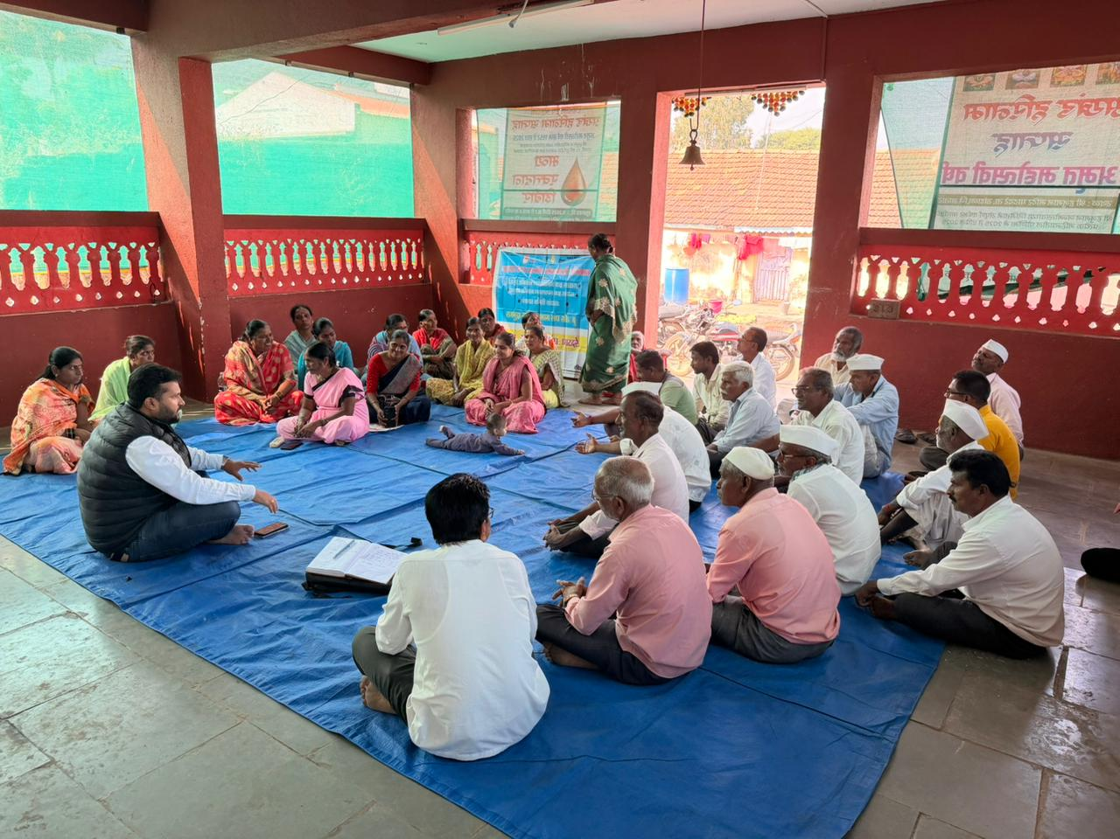
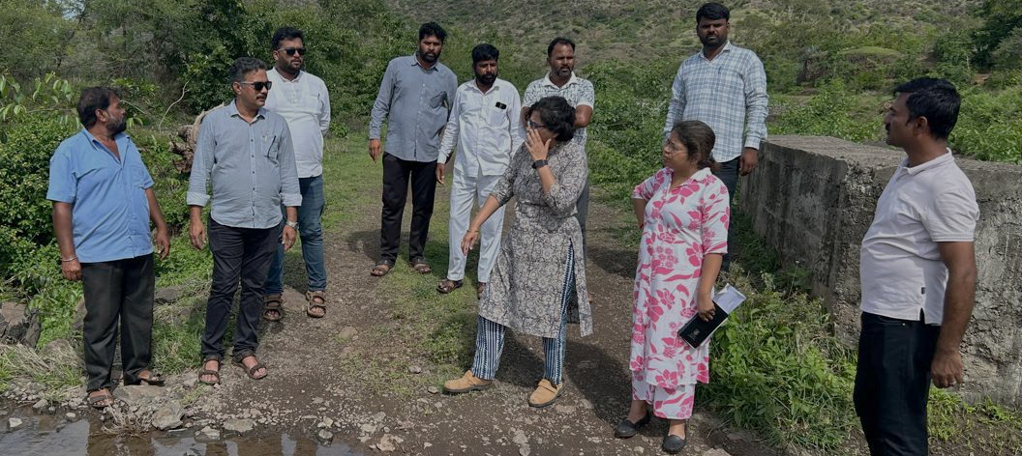
TE IWMP – Annual Report 2025-26
TE Connectivity × SJSM Satara | Ghatdare Watershed
Field Documentation -
Launch & community
TE Connectivity × SJSM Project Launch — Ghatdare Site
Gram Sabha — Farmer Community Meeting
Field Visits

Slide 11
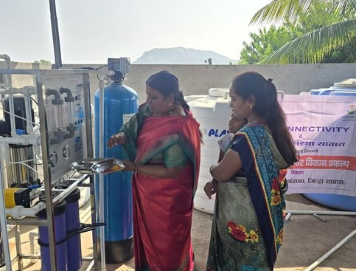
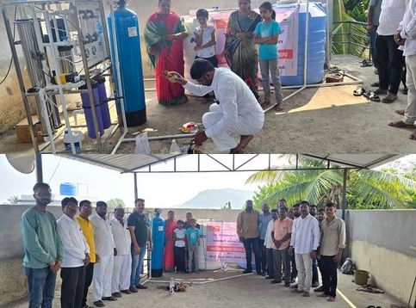
TE IWMP – Annual Report 2025-26
TE Connectivity × SJSM Satara | Ghatdare Watershed
Water Purification Unit -
Safe Drinking Water
The Water Purification Unit — a key deliverable of the TE IWMP — was procured and installed to provide safe, treated drinking water to all 225 households of Ghatdare village. The unit was inaugurated and received enthusiastically by the community, particularly women and SHG members who led the commissioning process.
Water Purification Plant — Inauguration by Community Inauguration and Handover session
Water Purification Unit — Key Facts
Capacity: Community-scale RO purification
System Beneficiaries: All 225 households, Ghatdare village
Technology: Reverse Osmosis with multi-stage filtration
Status: Installed and commissioned — community operations underway.
Impact: Provides clean, safe drinking water, reducing waterborne disease risk

Slide 12
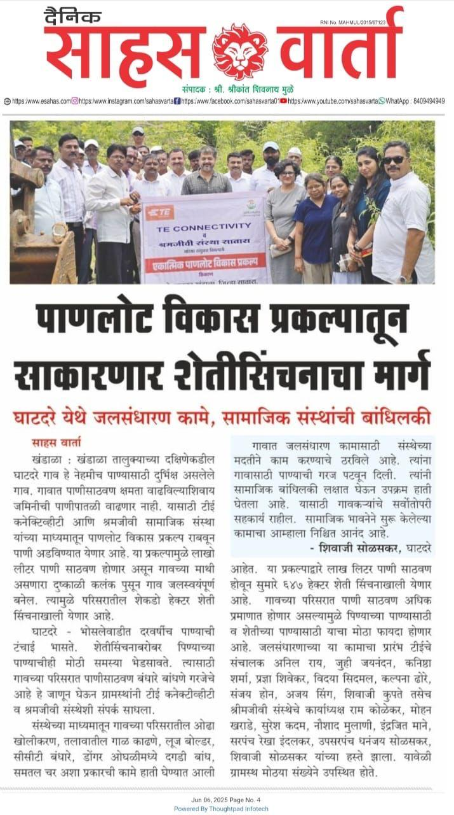
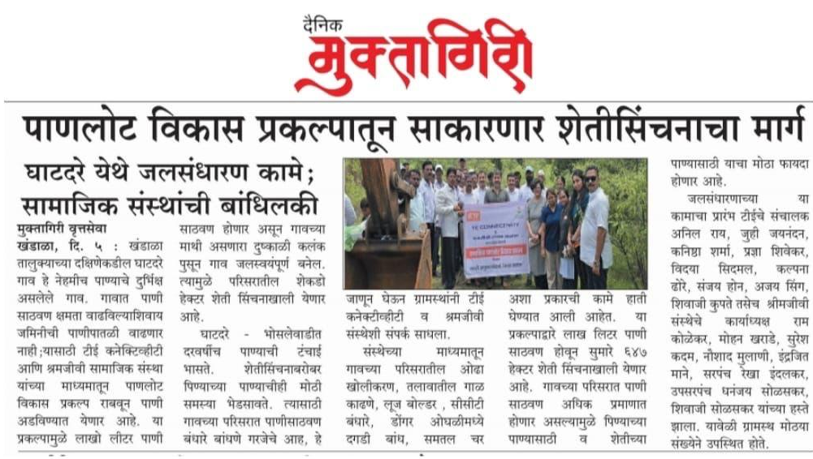
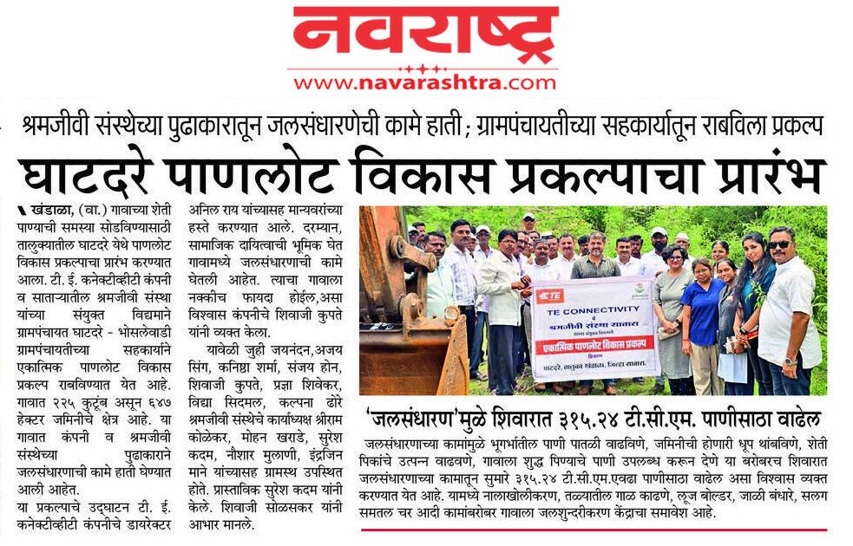
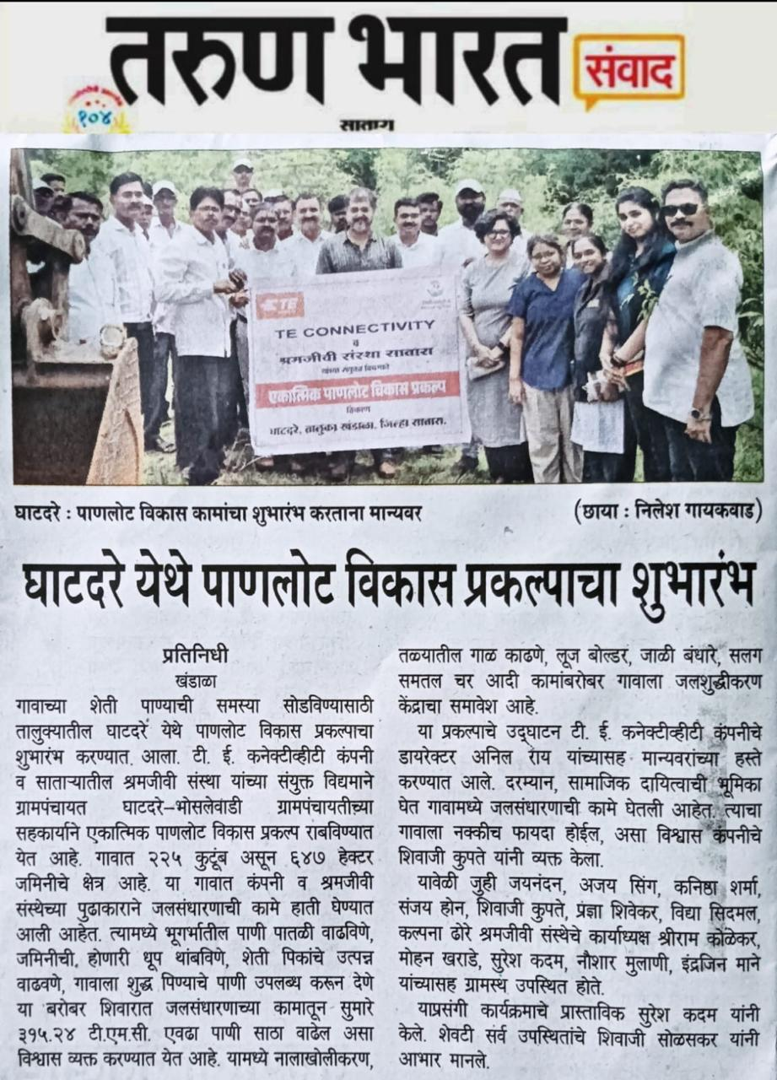
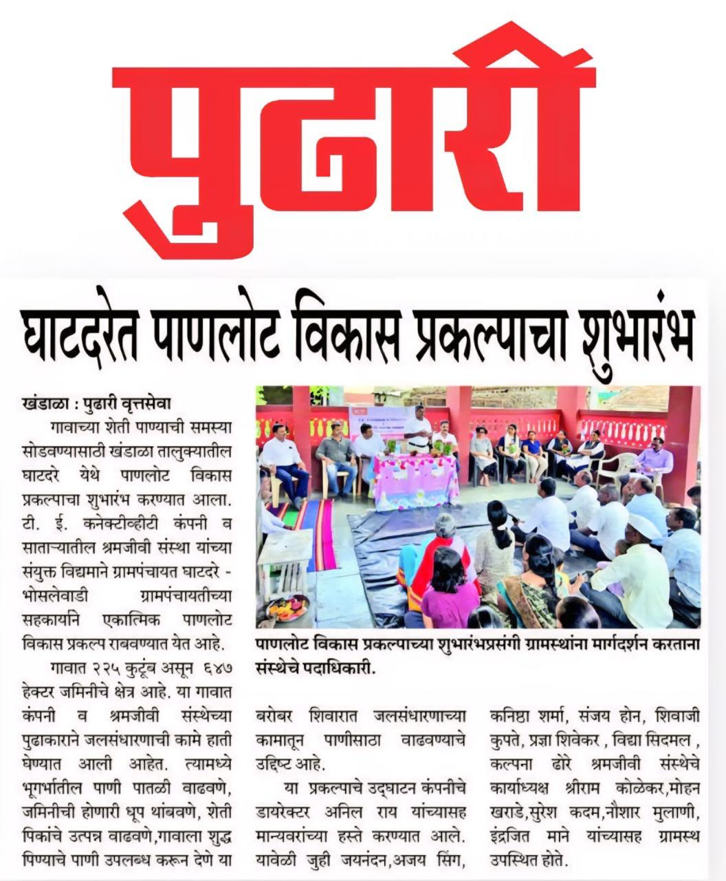
TE IWMP – Annual Report 2025-26
TE Connectivity × SJSM Satara | Ghatdare Watershed
Media Coverage Newspaper Reports
The TE Integrated Watershed Management Project attracted significant regional media attention and coverage in 5 major Marathi newspapers — Pudhari (district-wide circulation), Tarun Bharat, Sahas Varta, Dainik Muktagiri, Navrastra— reaching thousands of readers across Satara and Khandala Taluka, building public awareness of watershed conservation and CSR impact.

Slide 13






TE IWMP – Annual Report 2025-26
TE Connectivity × SJSM Satara | Ghatdare Watershed
Alignment with UN Sustainable Development Goals
The TE IWMP directly contributes to six UN Sustainable Development Goals, demonstrating how integrated watershed management creates multi-dimensional social, environmental, and governance impact.
 | SDG 2 Zero Hunger
Improves groundwater recharge and Expands assured irrigation across 647 Builds resilience through soil water purification to ensure Ha to boost agricultural productivity conservation, water harvesting, and safe drinking water for 225 and food security for farm families. sustainable land management households. practices.
Controls soil erosion, restores degraded land, and promotes sustainable ecosystem use across the watershed.
Multi-stakeholder collaboration: TE
Connectivity (CSR), SJSM (NGO)
Gram Panchayat (governance). ,
Conclusion & Way Forward
The TE Integrated Watershed Development Project – Ghatdare delivered measurable outputs (structures, desilting, monitoring, community mobilisation) and achieved early outcomes (substantial groundwater recharge of 2.5–3.2 m, 136.43 TCM additional water storage, improved irrigation potential, and strengthened community governance) in FY 2025-26.
Next Steps: Completing community-led maintenance systems, scaling irrigation interventions to reach the full 647 Ha target, measuring crop yield changes, and commissioning the Water Purification Unit will consolidate these gains and demonstrate long-term impact aligned with SDGs 2, 6, 13, 15, and 17.
TE Integrated Watershed Management Project (IWMP) — Ghatdare CSR Partner: TE Connectivity | Implementing Partner: SJSM, Satara
Head Operations : Mr. Ram Kolekar | Location: Ghatdare, Khandala, Satara Annual Report FY 2025-26 | Report prepared: April 202
6

